Slide 1

Roulettech Project
Record Management System
By Himakar Ananthasetty

Slide 2
Record Management System
Title: Technical Stack Overview
Content: Frontend:
React JS, Material UI components for Icons and Forms.
AWS S3: Storage for static assets like images, CSS, and JavaScript files.
Backend:
Django, Python
AWS EC2: Virtual servers used to host the Django application.

Slide 3
Record Management System
Database: Django SQLite
Additional Tools
GitHub: Source code repository and version control.
Amazon Web Services for deployment

Slide 4
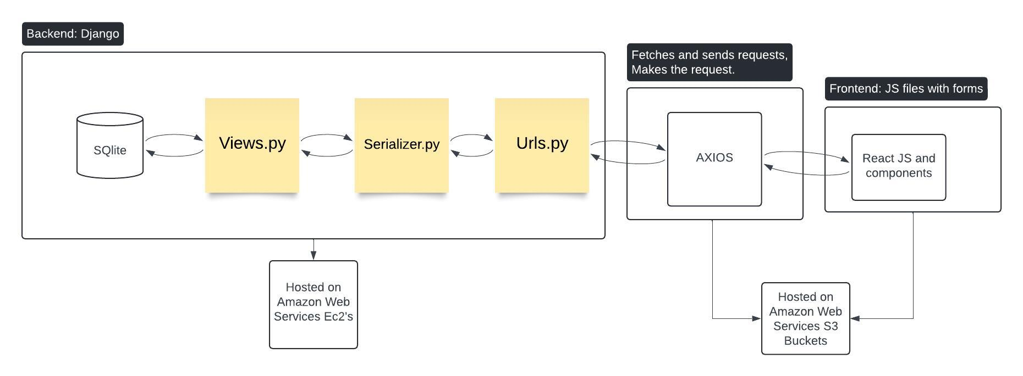
Architecture Diagram:

Slide 5
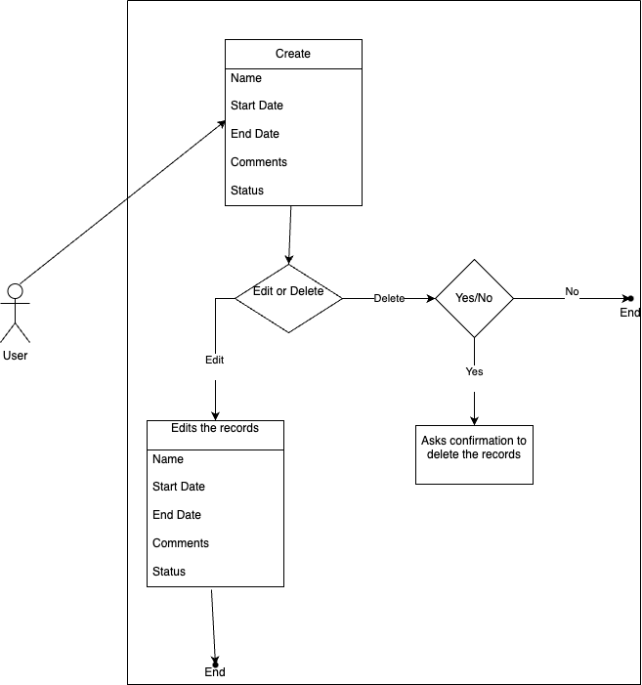
Architecture: Use Case Diagram

Slide 6
Record Management System: Home Page
Title: Home Page
Description: Displays records with options to edit and delete. Features:
Edit: Modify a record by ID.
Delete: Opens a confirmation page for record deletion.

Slide 7
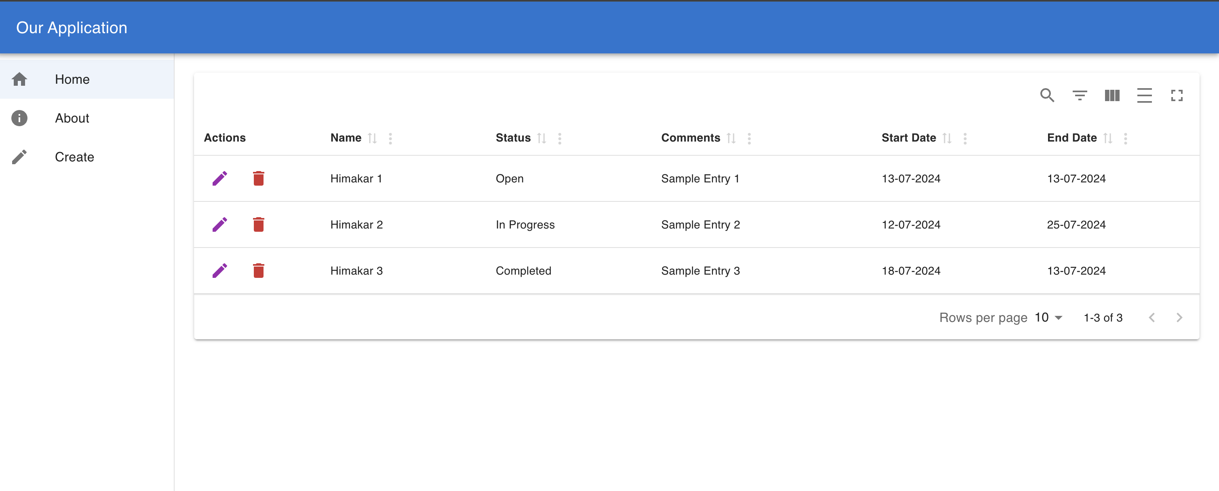
Record Management System: Home Page

Slide 8
Record Management System: Edit Page
Title: Edit Page
Description: Allows users to update details of a specific record.
After Editing: Changes are reflected on the Home page.

Slide 9
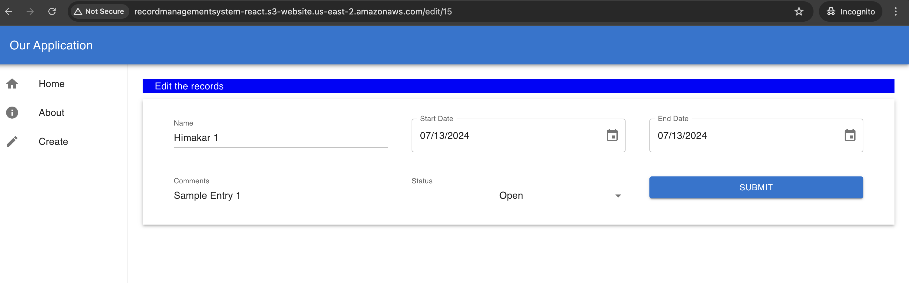
Record Management System: Edit Page

Slide 10
Record Management System: Delete Page
Title: Delete Page
Description: Appears when a user chooses to delete a record, with a confirmation step.
After Editing: Record is removed from the Home page.

Slide 11
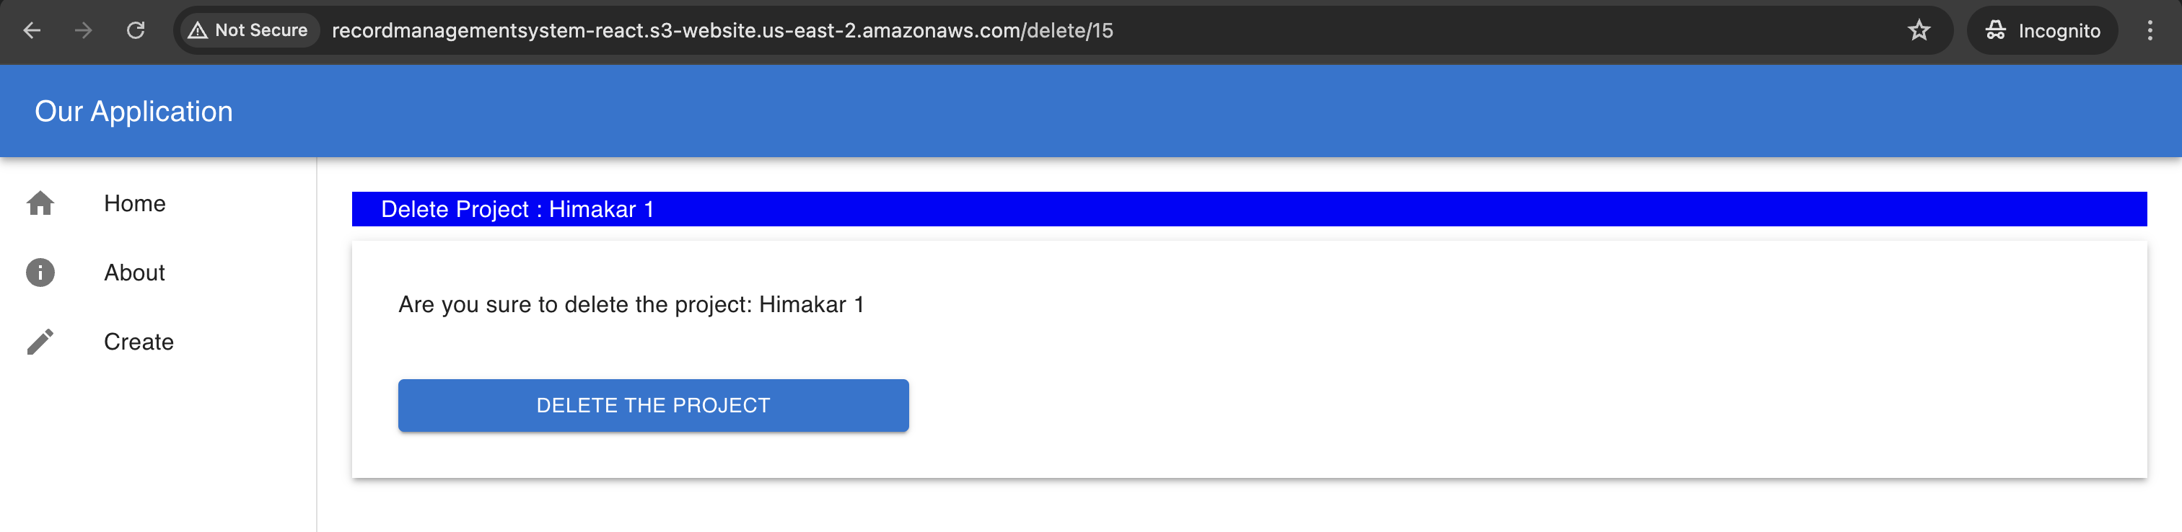
Record Management System: Delete Page

Slide 12
Record Management System: About Page
Title: About Page
Description: Provides project details, tech stack, and purpose.

Slide 13
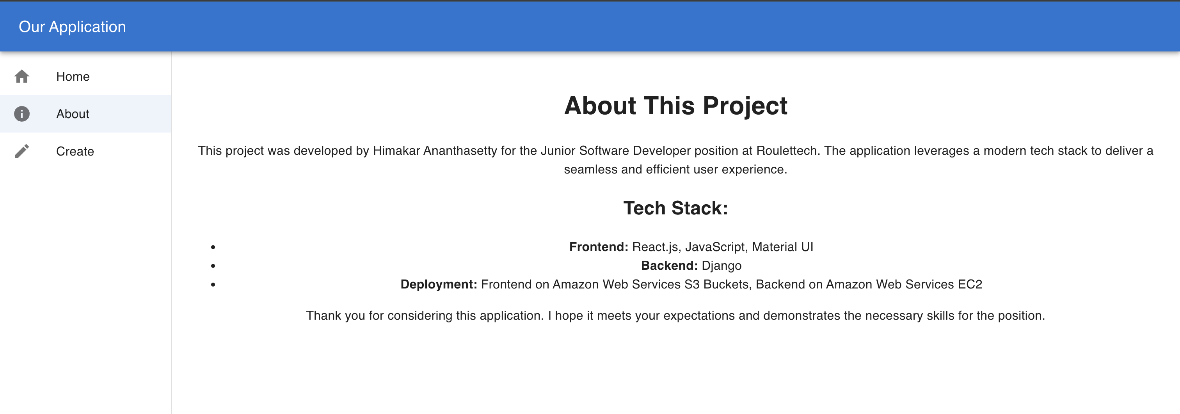
Record Management System: About Page

Slide 14
Record Management System: Create Page
Title: Create Page
Description: Features a form to create a new entry with fields for Name, Start Date, End Date, Comments, and Status.

Slide 15
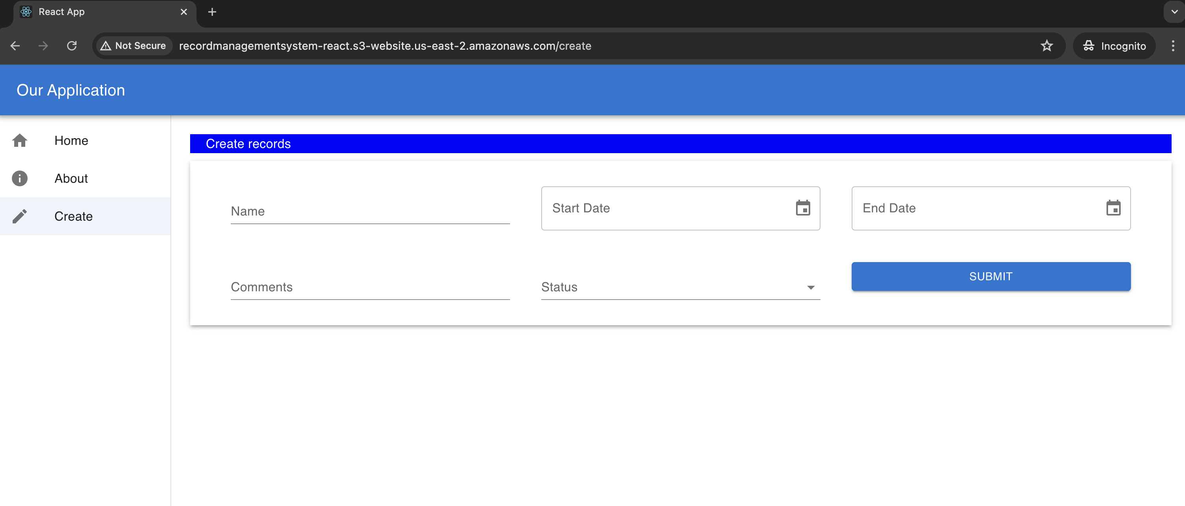
Record Management System: Create Page

Slide 16
Deployment Process to AWS
Frontend Deployment:
Step 1: Build React application using npm run build.
Step 2: Upload the build output to S3 bucket configured for static website hosting.
Step 3: Configure S3 bucket policy in permissions and Enabling Static website hosting.

Slide 17
Deployment Process to AWS
Backend Deployment:
Step 1: Connect to EC2 - SSH into EC2 Instance
Step 2: Clone the Repository
git clone https://github.com/himakarananthasetty/RecordManagementSystem_Django_React
cd RecordManagementSystem_Django_React
Step 3: Install Necessary Packages
Step 4: Set Up a Virtual Environment
Create and Activate Virtual Environment

Slide 18
Deployment Process to AWS
Backend Deployment:
Step 6: Make Migrations
Apply Database Migrations
Code:
python manage.py makemigrations
python manage.py migrate
Step 7: Run the Django Server
Start Django Development Server
Code: python manage.py runserver 0.0.0.0:8000

Slide 19
Website Hosted Link
Title: Website Hosted Link
FrontEnd Link: http://recordmanagementsystem-react.s3-website.us-east-2.amazonaws.com/
BackEnd Link: http://3.17.144.153/8000

Slide 20
Bonus
Frontend Deployment with AWS CloudFront
Content Delivery Network via AWS CloudFront
Access Link:
https://d38gztwwel0vi9.cloudfront.net

Slide 21
Features Summary
Title: Features Summary
Home: Displays records with options to edit and delete.
Edit: Updates record details.
Delete: Confirms record deletion.
About: Details on project, technical stack, and purpose.
Create: Adds new records through a form.

