Slide 1
Assignment 1 solution

Slide 2
ASSIGNMENT - 1
Read…
https://en.wikiversity.org/wiki/Introduction_to_Computers/Networks
What do you understand by physical and logical topology of a network ?
Explain which physical and logical topologies do these below networks belong to …..
Twisted pair Ethernet
IBM’s Token Ring

Slide 3
Q- 2
Two basic categories of network topologies exist, physical topologies and logical topologies.
The cabling layout used to link devices is the physical topology of the network. This refers to the layout of cabling, the locations of nodes, and the interconnections between the nodes and the cabling.[1] The physical topology of a network is determined by the capabilities of the network access devices and media, the level of control or fault tolerance desired, and the cost associated with cabling or telecommunications circuits.
In contrast, logical topology is the way that the signals act on the network media, or the way that the data passes through the network from one device to the next without regard to the physical interconnection of the devices. A network's logical topology is not necessarily the same as its physical topology. For example, the original twisted pair Ethernet using repeater hubs was a logical bus topology carried on a physical star topology. Token ring is a logical ring topology, but is wired as a physical star from the media access unit. Logical topologies are often closely associated with media access control methods and protocols. Some networks are able to dynamically change their logical topology through configuration changes to their routers and switches.

Slide 4
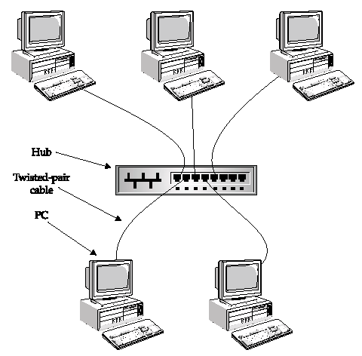
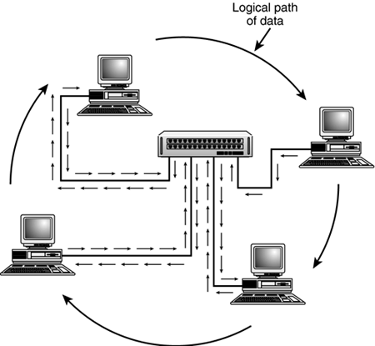
Q- 3
A twisted pair Ethernet is a logical bus topology in a physical star topology layout.
While IBM's token ring is a logical ring topology, it is physically
set up in star topology.

