Slide 1
NETWORKING TODAY

Slide 2
Lan technologies
Ethernet
Fast Ethernet
Gigabit Ethernet
10 Gigabit Ethernet
Asynchronous Transfer Mode (ATM)
Power over Ethernet (PoE)

Slide 3
Lan technologies
Name | IEEE Standard | Data Rate | Media Type | Maximum Distance
Ethernet | 802.3 | 10 Mbps | 10Base-T | 100 meters
Fast Ethernet/ 100Base-T | 802.3u | 100 Mbps | 100Base-TX 100Base-FX | 100 meters 2000 meters
Gigabit Ethernet/ GigE | 802.3z | 1000 Mbps | 1000Base-T 1000Base-SX 1000Base-LX | 100 meters 275/550 meters 550/5000 meters
10 Gigabit Ethernet | IEEE 802.3ae | 10 Gbps | 10GBase-SR 10GBase-LX4 10GBase-LR/ER 10GBase-SW/LW/EW | 300 meters 300m MMF/ 10km SMF 10km/40km 300m/10km/40km

Slide 4
Networking protocols
TCP/IP (for UNIX, Windows NT, Windows 95 and other platforms)
IPX (for Novell NetWare)
DECnet (for networking Digital Equipment Corp. computers)
AppleTalk (for Macintosh computers)
NetBIOS/NetBEUI (for LAN Manager and Windows NT networks).

Slide 5

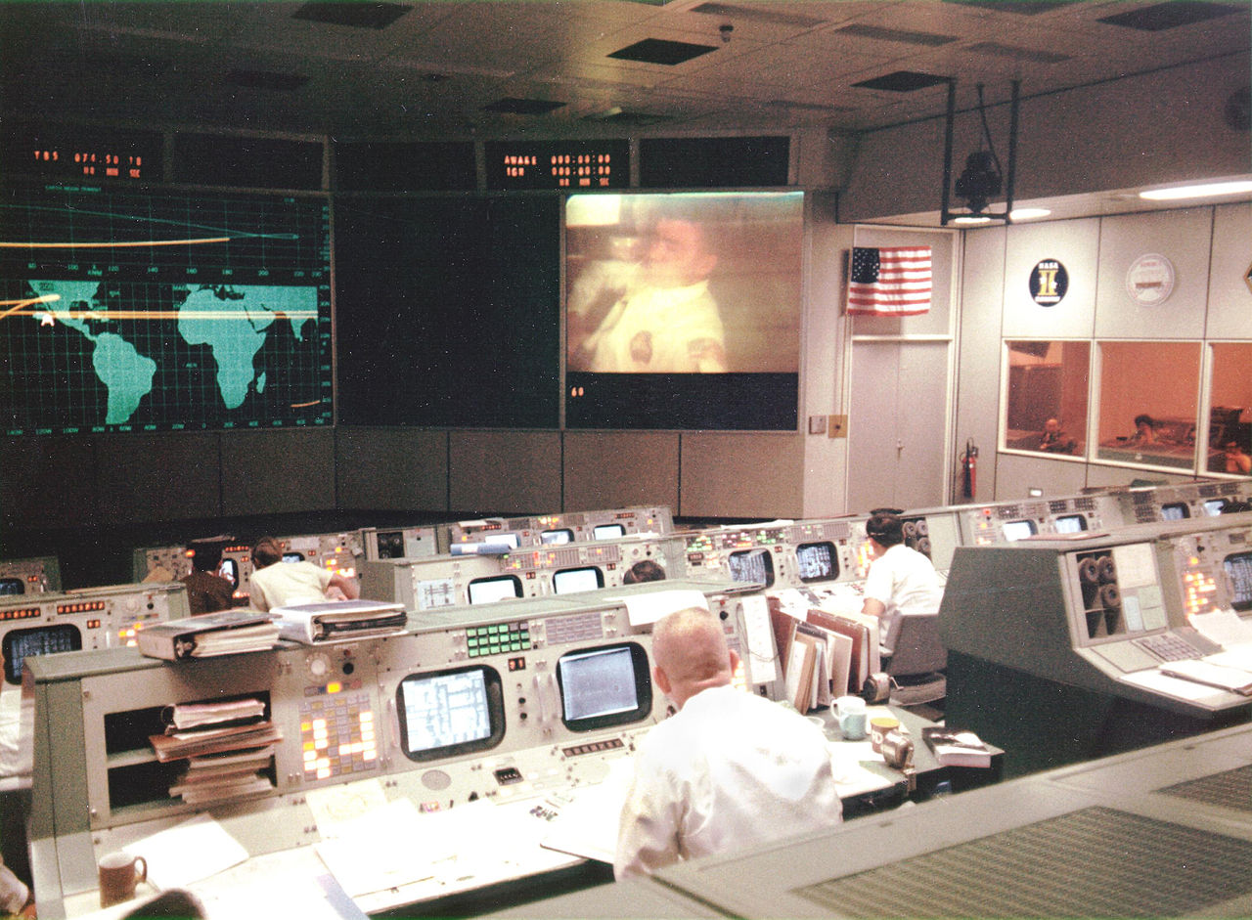
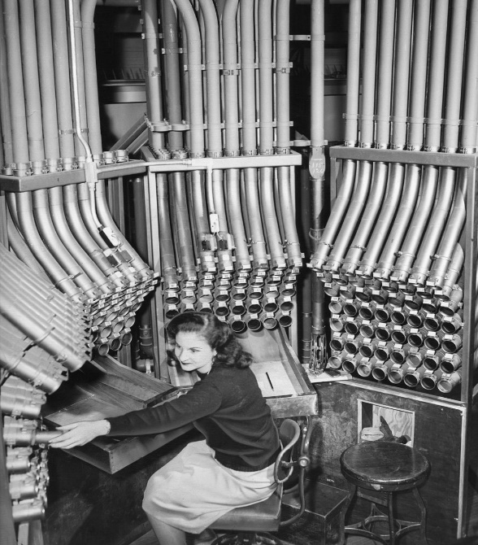
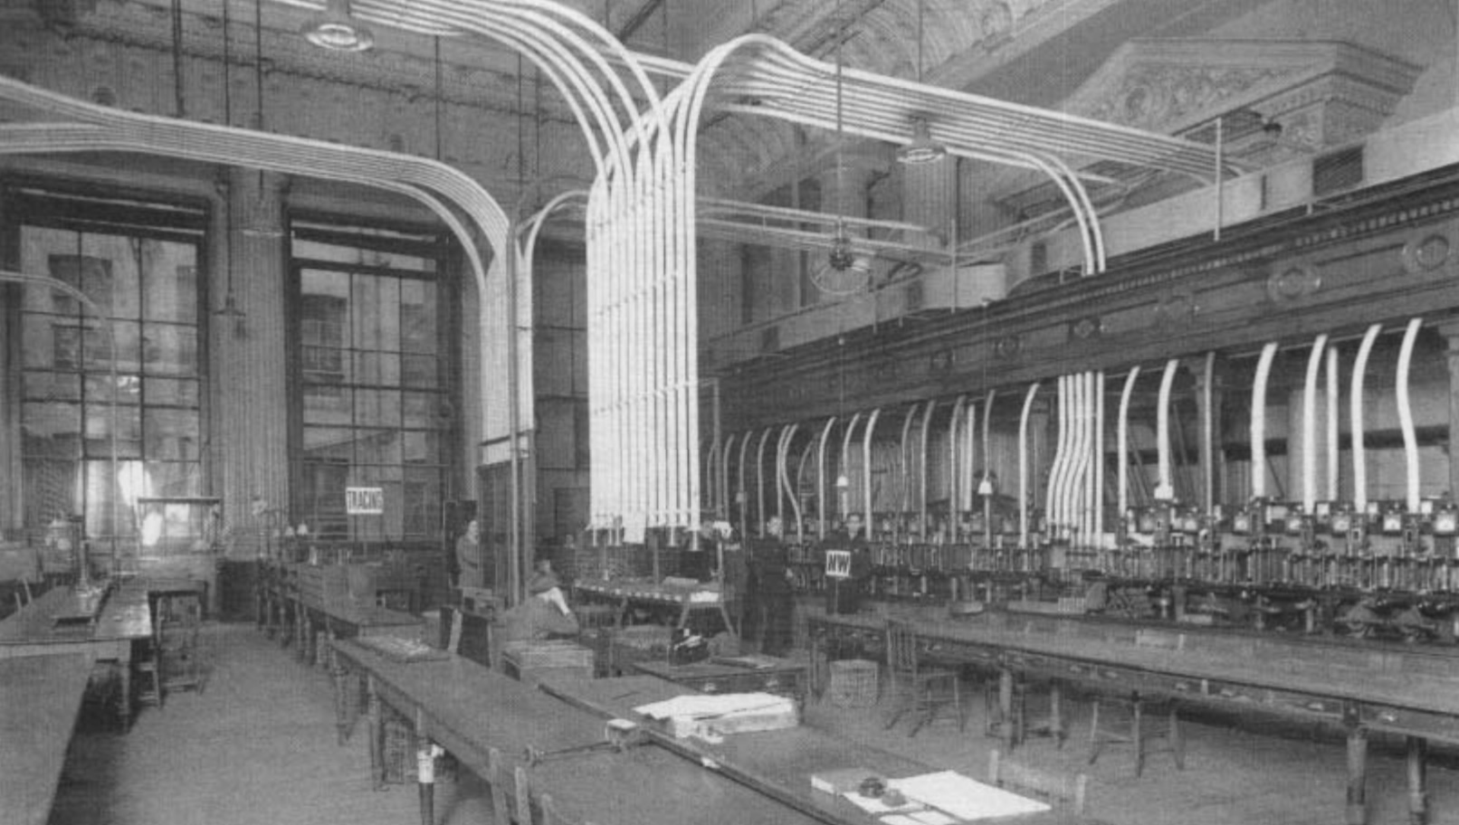
Pneumatic tubes system

Slide 6
Ethernet vis-à-vis tcp/ip
Imagine one of those pneumatic tube message systems. Ethernet is the tube used to send the message, IP is an envelope in the tube, and TCP/UDP is a letter in the envelope.
Someone (an application) writes a letter and stuffs it in an envelope. Another person (a NIC) looks at the address on the envelope, puts it in a tube, caps it off, stuffs it in the right door to bring it closer to its destination, then pushes the button.
The tube gets carried to another door, where someone (a router) opens the tube, reads the address, puts it back in the tube, and sends it through another door.
Eventually it arrives at its destination, where the NIC on the other side picks it up and gives it to the application.
This is, of course, a vast oversimplification of what actually happens, but it is a fairly decent base on which to start.

Slide 7
Ethernet vis-à-vis tcp/ip
LAN - ETHERNET
WAN / MAN / CAN / INTERNET - ETHERNET + TCP/IP

Slide 8
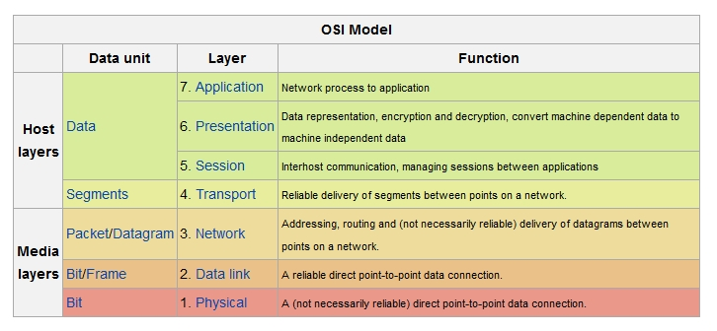
The Open System Interconnection Model

Slide 9
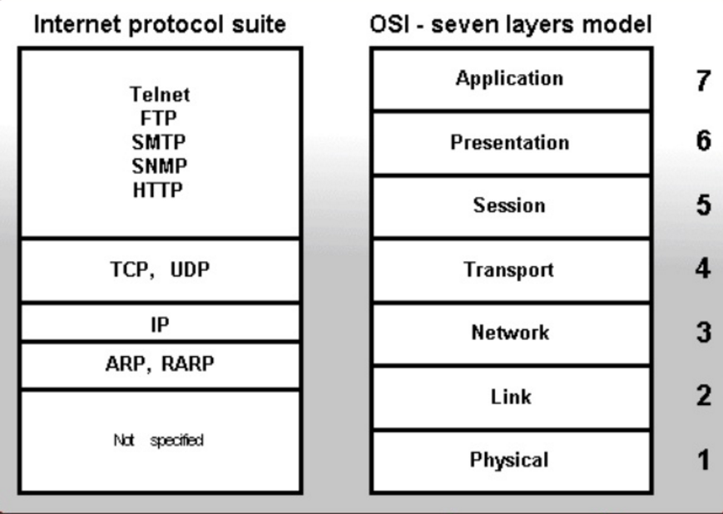
osi vs tcp/ip

Slide 10
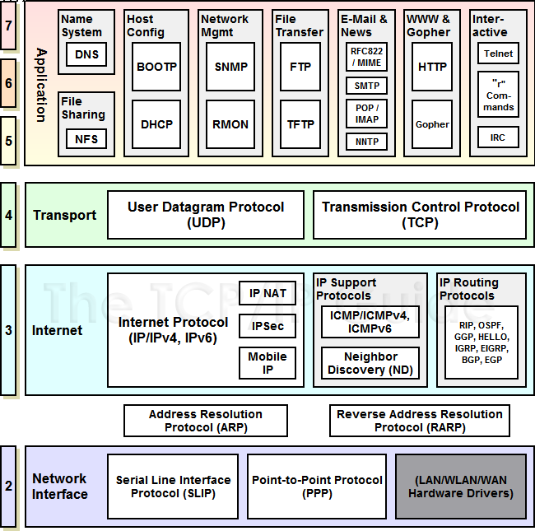
internet protocols

Slide 11
arp / rarp
ARP operates at Layer 2 in the OSI model.
ARP works on modern Ethernet and Wi-Fi networks as follows: Network adapters are produced with a physical address embedded in the hardware called the Media Access Control (MAC) address. Manufacturers take care to ensure these 6-byte (48-bit) addresses are unique, as IP relies on these unique identifiers for message delivery.
When any device wishes to send data to another target device, it must first determine the MAC address of that target given its IP address These IP-to-MAC address mappings are derived from an ARP cache maintained on each device.
If the given IP address does not appear in a device's cache, that device cannot direct messages to that target until it obtains a new mapping. To do this, the initiating device first sends an ARP request broadcast message on the local subnet. The host with the given IP address sends an ARP reply in response to the broadcast, allowing the initiating device to update its cache and proceed to deliver messages directly to the target.
A network protocol called RARP (Reverse ARP) was also developed in the 1980s to complement ARP. As its name implies, RARP performed the opposite function of ARP, converting from physical network addresses to the IP addresses assigned to those devices. RARP was made obsolete by DHCP and is no longer used.
A separate protocol called Inverse ARP also supports the reverse address mapping function. Inverse ARP is not used on Ethernet or Wi-Fi networks either although it can sometimes be found on other types.

