Slide 1
oVERVIEW
ENTERPRISE NETWORK

Slide 2
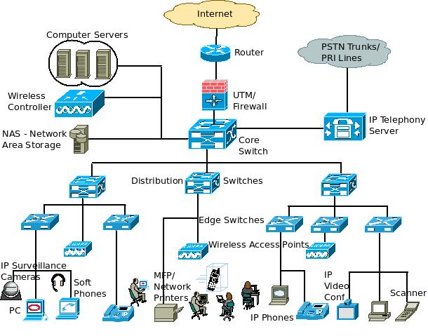
An example enterprise network

Slide 3
Enterprise network
Enterprise networks contain hundreds of sites and support thousands of users worldwide.
A well managed network allows users to work reliably. Network documentation is crucial for maintaining the required 99.999 percent uptime.
All Internet traffic flows through the enterprise edge, making security considerations necessary.
Routers and switches provide connectivity, security, and redundancy while controlling broadcasts and failure domains.

