Slide 1

INTRODUCTION
NAME-HIMANSHU KUMAR JHA
ROLL NO. -227042
DISCIPLINE-BTECH CSE(AIML)
SEMESTER-1st SEM
MENTOR TEACHER- MR. GARVIT VERMA .

Slide 2

Index
Introduction to project
Objective
navbar
About homepage
ADVERTISING PRODUCTS
ADDING LINK TO IMAGE
Application of software tools
REFERENCES
CONCLUSION

Slide 3
Introduction to project
This project is a website made by using HTML & CSS. The theme of this website is affiliate marketing. Affiliate marketing is the online marketing of any products and when anybody buys the product redirected by that link the website owner gets some credit amount . Every big company has an Affiliate marketing program in which anyone can enroll and then the company gives them the product link using which the host will get money.

Slide 4
Objective
This website is affiliate marketing this website makes easy for any individual to search their product they want to buy .This website is affiliated with many e-commerse companies , hence making esay otherwise its becomes very complicated for an individual to roam around various websites to buy a single product.

Slide 5

NAVBAR

Slide 6

ABOUT HOMEPAGE

Slide 7
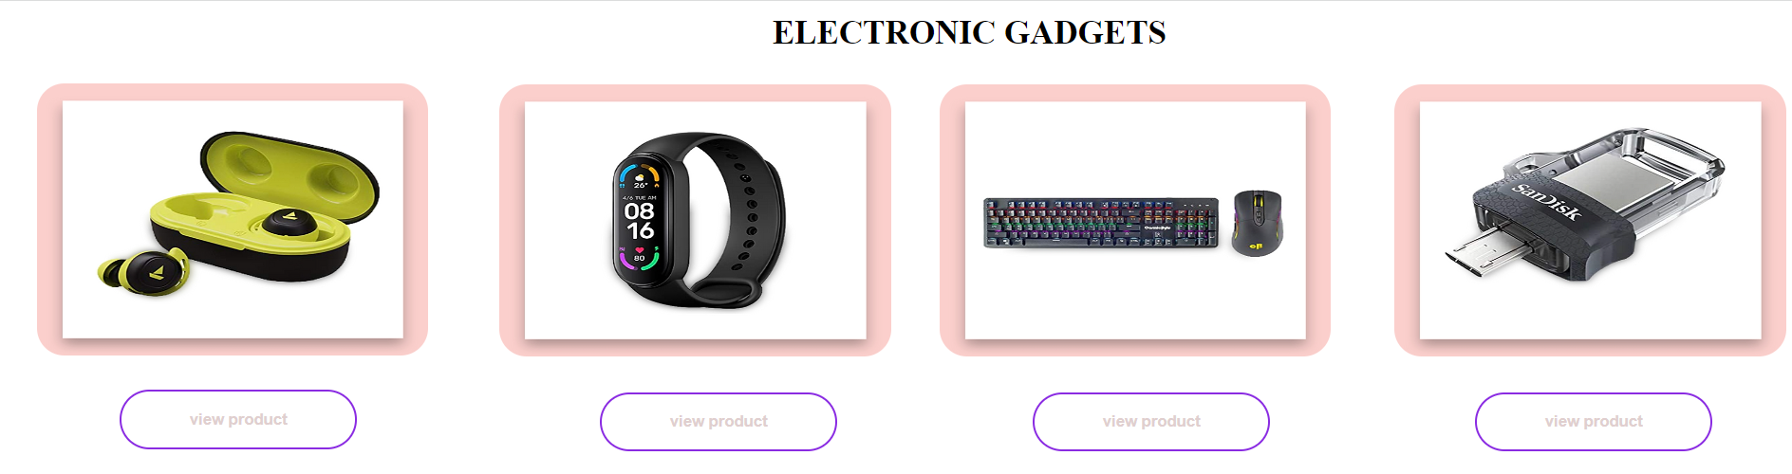
Putting the advertisement on webpage with image

Slide 8
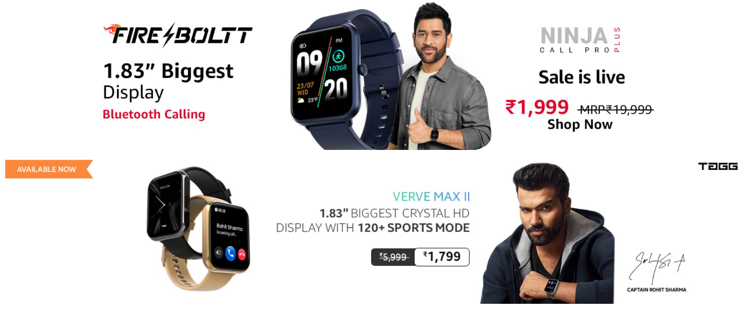
ADDING LINK TO IMAGE

Slide 9
Application of software tools
1.V.S code
2.Google chrome
3.Github

Slide 10
REFERENCES
1.GOOGLE
2.YOUTUBE
3.MR. GARVIT VARMA SIR
4.W3 SCHOOL
5.UDEMY

Slide 11
Conclusion
-This website makes easy to compare prices from different website products .
-Its is very easy to buy products from our website.
-By affiliation we can earn some revenue

Slide 12
Thank You
Himanshu_227042@saitm.com

