Slide 1
DATA 606 Hakim - Project
Jawaid Hakim

Slide 2
Overview
Researchers randomly generated realistic resumes to send to job postings in Boston and Chicago. They then randomly assigned a first name to the resume that would communicate the race and gender of the application.
First names for the study were selected so that the names would predominantly be recognized as belonging to black or white individuals.
All other factors being equal does the perceived race of applicants have a meaningful impact on the callback rate?

Slide 3
Data - OpenIntro.
Each case represents a randomly generated resumes There are 4870 cases.
This was an experiment conducted over several months during 2001 and 2002 in Boston and Chicago.
The categorical response variable is the received_callback
The categorical explanatory (predictor) variable is the race

Slide 4
Summary Statistics
Of all applicants who received a callback, 60% were perceived to be White and 40% were perceived to be Black
## # A tibble: 2 × 3 ## race n p ## <fct> <int> <dbl> ## 1 white 235 0.599 ## 2 black 157 0.401

Slide 5
Compute sample proportion
sample_props <- df |> rep_sample_n(size = 500, reps = 1000, replace = TRUE) |> count(received_callback_cat) |> mutate(p_hat = n /sum(n)) |> filter(received_callback_cat == 'Yes')

Slide 6
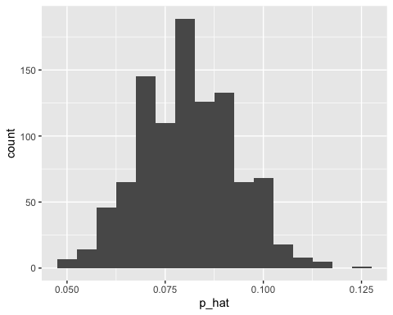
Plot sample proportion
Sample Proportion

Slide 7
Hypothesis
$H_{0}$: there is no difference in callback proportion between candidates who are perceived to be white and those perceived to be black $H_{A}$: candidates who are white are more likely to receive callback
95% Confidence Interval for the sample proportion:
## # A tibble: 1 × 2 ## lower_ci upper_ci ## <dbl> <dbl> ## 1 0.0731 0.0881

Slide 8
Chi-square Testing framework
Assumptions for using Chi-square:
Both variables are categorical
Observations are independent
Individuals can only belong to one cell in the contingency table. That is, cells in the table are mutually exclusive – an individual cannot belong to more than one cell
There must be at least 5 frequencies in each cell
Our dataset satisfies all above assumptions.

Slide 9
Compute Chi-square
## Response: received_callback_cat (factor) ## Explanatory: race (factor) ## Null Hypothesis: independence ## # A tibble: 1 × 1 ## stat ## <dbl> ## 1 16.4

Slide 10
Compute null distribution
The null distribution is what we would expect to see if the response and explanatory variables were truly independent.
null_dist_sim <- df |> specify(received_callback_cat ~ race, success = 'Yes') |> hypothesize(null = 'independence') |> generate(reps = 500, type = 'permute') |> calculate(stat = 'Chisq', c('white', 'black'))

Slide 11
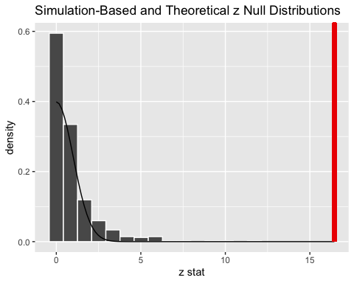
Plot null distribution

Slide 12
Plot of null distribution shows that the observed test statistic would be unlikely if there was no association between $race$ and $callback_rate$. So we reject $H_{0}$ in favor $H_{A}$.

Slide 13
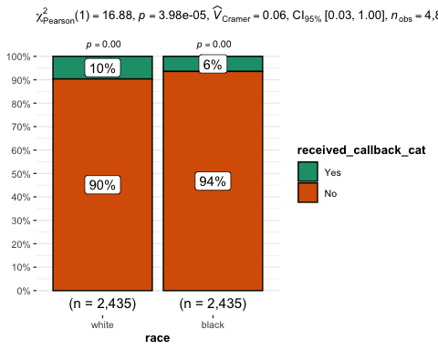
Plot
## You can cite this package as: ## Patil, I. (2021). Visualizations with statistical details: The 'ggstatsplot' approach. ## Journal of Open Source Software, 6(61), 3167, doi:10.21105/joss.03167

Slide 14
Limitations
This analysis looked at just $race$ as the explanatory variable. However, the dataset contains other variables (see below) that may have an impact on the $callback_rate$. A multiple regression model could be used to identify combinations of explanatory variables.
Gender
Resume Quality
Computer Skills
Years of Experience

