Slide 1
DATA 606 Hakim - Project
Jawaid Hakim

Slide 2
Introduction
Researchers randomly generated realistic resumes to send to job postings in Boston and Chicago.
They then randomly assigned a first name to the resume that would communicate the race and gender of the applicant.
First names for the study were selected so that the names would predominantly be recognized as belonging to black or white individuals.
Research Question: Does the perceived race of applicants have a meaningful impact on the callback rate?

Slide 3
Data - OpenIntro.
Each of the 4870 cases represents a randomly generated resume
This was an experiment conducted over several months during 2001 and 2002 in Boston and Chicago
Categorical response variable is $received_callback$
Categorical explanatory variable is $race$

Slide 4
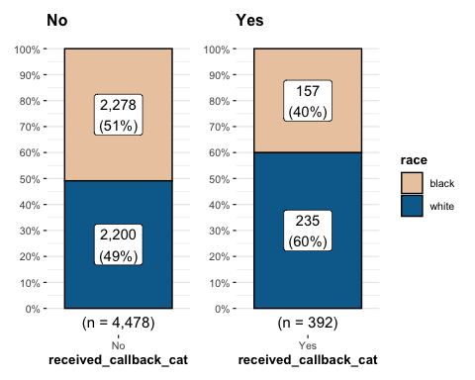
Callback Proportions

Slide 5
Calculate sample proportion
sample_props <- df |> rep_sample_n(size = 500, reps = 1000, replace = TRUE) |> count(received_callback_cat) |> mutate(p_hat = n /sum(n)) |> filter(received_callback_cat == "Yes")

Slide 6
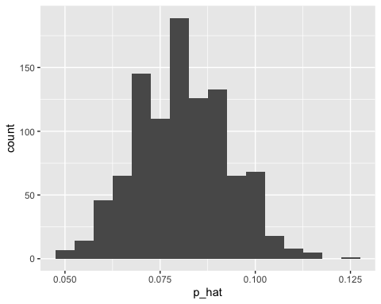
Sample proportion
Sample Proportion

Slide 7
Confidence Interval
95% Confidence Interval for the sample proportion:
## # A tibble: 1 × 2 ## lower_ci upper_ci ## <dbl> <dbl> ## 1 0.0731 0.0881

Slide 8
Independence hypothesis test
$H_{0}$: there is no difference in callback proportion between candidates who are perceived to be white and those perceived to be black
$H_{A}$: candidates who are white are more likely to receive callback

Slide 9
Chi-square Testing framework
Assumptions for using Chi-square:
Both variables are categorical
Observations are independent
Individuals can only belong to one cell in the contingency table. That is, cells in the table are mutually exclusive – an individual cannot belong to more than one cell
There must be at least 5 frequencies in each cell
Our dataset satisfies all above assumptions.

Slide 10
Compute Chi-square
## Response: received_callback_cat (factor) ## Explanatory: race (factor) ## Null Hypothesis: independence ## # A tibble: 1 × 1 ## stat ## <dbl> ## 1 16.4

Slide 11
Simulated null distribution
The null distribution is what we would expect to see if the response and explanatory variables were truly independent.
sim_null_dist <- df |> specify(received_callback_cat ~ race, success = 'Yes') |> hypothesize(null = 'independence') |> generate(reps = 500, type = 'permute') |> calculate(stat = 'Chisq', c('white', 'black'))

Slide 12
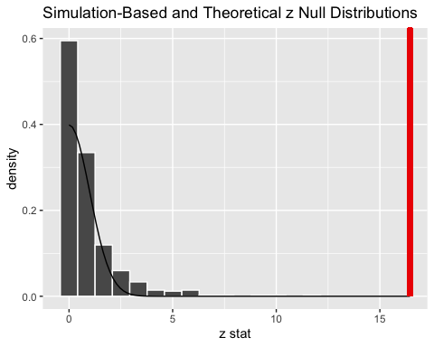
Null distribution plot with observed stat and confidence internal

Slide 13
Plot of the null distribution shows the observed test statistic would be unlikely if there was no association between $race$ and $callback_rate$. So we reject $H_{0}$ in favor $H_{A}$.

Slide 14
Other Variables
This study looked at $race$ as the explanatory variable. However, the dataset contains other variables (see below) that may be relevant. A multiple regression model could be used to identify combinations of explanatory variables.
Gender
Resume Quality
Computer Skills
Volunteer
Honors
…

Slide 15
Generalized linear model
Estimate Std. Error z value Pr(>|z|) (Intercept) -1.9350 0.1545 -12.525 < 2e-16 *** genderm -0.1785 0.1337 -1.335 0.1818 resume_quality.L 0.2243 0.1178 1.904 0.0569 . computer_skillsTRUE -0.3433 0.1386 -2.478 0.0132 * volunteerTRUE -0.1305 0.1637 -0.797 0.4253 honorsTRUE 0.7819 0.1819 4.299 1.72e-05 *** raceblack -0.4298 0.1078 -3.988 6.65e-05 ***

Slide 16
Limitations
This study was originally conducted in 2001 and 2002 in Chicago and Boston. Over the last 20 years there has been increasing awareness of bias in hiring practices. The data needs to be refreshed and more cities should be included in the study to eliminate potential regional biases.

Slide 17
Conclusion
Many biases have been identified in the job market over the years. As a result, HR professionals recommend not including age, religion, nationality, sexual orientation, etc. in job applications.
This study identified the applicant’s first name as a potential source of bias (!), which should raise red flags for HR professionals, job applicants, and hiring managers.
One hopes such studies will lead to even greater awareness regarding subtle biases in hiring practices and the need for training and due diligence that is necessary to overcome such biases.

