Slide 1
DATA 606 Hakim - Project
Jawaid Hakim

Slide 2
Introduction
Data comes from a study that sought to understand the influence of race (and gender) on job application callback rates
Researchers monitored job postings in Boston and Chicago during 2001 and 2002
Randomly generated resumes to send to job postings
Randomly assigned a name to the resume that would communicate the race and gender of the applicant
First names for the study were selected that would predominantly be recognized as belonging to black or white individuals
Research Question: Does the perceived race of applicants have a meaningful impact on the callback rate?

Slide 3
Data
OpenIntro - Which resume attributes drive job callbacks?
This was an experiment conducted over several months during 2001 and 2002 in Boston and Chicago
Each of the cases (4870) represents a randomly generated resume
Categorical response variable is $received_callback$
Categorical explanatory variable is $race$

Slide 4
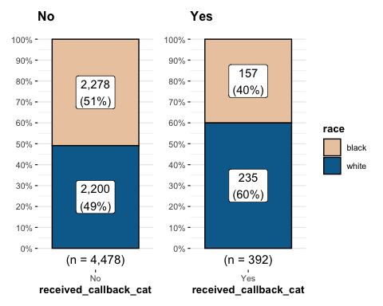
Callback Proportions - Group by Callback Rate

Slide 5
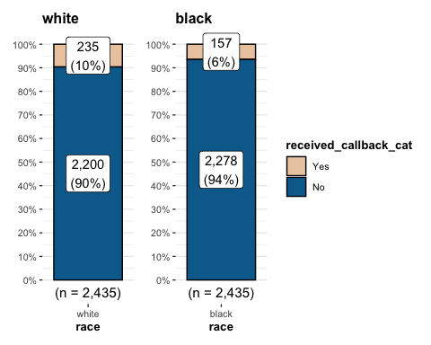
Callback Proportions - Group by Race

Slide 6
Calculate sample proportion
sample_props <- df |> rep_sample_n(size = 500, reps = 1000, replace = TRUE) |> count(received_callback_cat) |> mutate(p_hat = n /sum(n)) |> filter(received_callback_cat == "Yes")

Slide 7
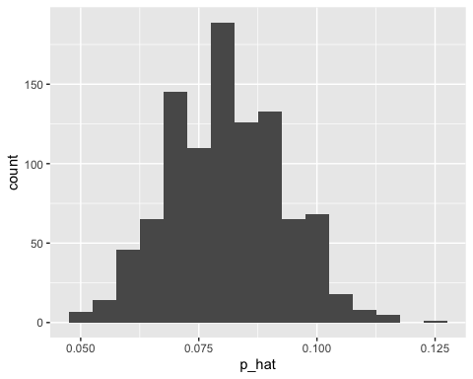
Sample proportion
Sample Prop - Received Callback

Slide 8
Sample Proportion - 95% Confidence Interval
ci <- df |> specify(response = received_callback_cat, success = 'Yes') |> generate(reps = 1000, type = 'bootstrap') |> calculate(stat = 'prop') |> get_ci(level = 0.95) print(ci)
## # A tibble: 1 × 2 ## lower_ci upper_ci ## <dbl> <dbl> ## 1 0.0731 0.0881

Slide 9
Independence hypothesis test
$H_{0}$: assumes there is no association between callback rate and the perceived race of the candidate
$H_{A}$: assumes there is an association between the callback rate and perceived race of the candidate

Slide 10
Chi-square Testing framework
Assumptions for using Chi-square:
Both variables are categorical
Observations are independent
Individuals can only belong to one cell in the contingency table. That is, cells in the table are mutually exclusive – an individual cannot belong to more than one cell
There must be at least 5 frequencies in each cell
Our dataset satisfies all above assumptions.

Slide 11
Observed Chi-square
obs_indep_stat <- df |> specify(received_callback_cat ~ race, success = 'Yes') |> hypothesize(null = 'independence') |> calculate(stat = 'Chisq', c('white', 'black'))
## X-squared ## 16.44903

Slide 12
Simulated null distribution
The null distribution is what we would expect to see if the response and explanatory variables were truly independent.
sim_null_dist <- df |> specify(received_callback_cat ~ race, success = 'Yes') |> hypothesize(null = 'independence') |> generate(reps = 500, type = 'permute') |> calculate(stat = 'Chisq', c('white', 'black'))

Slide 13
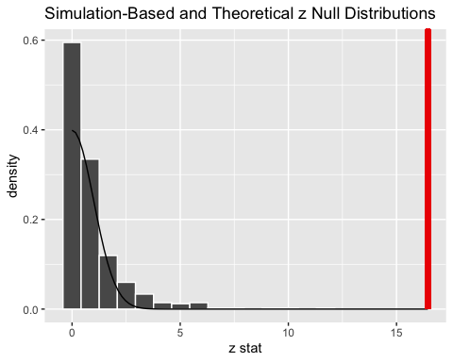
Null distribution plot with observed stat

Slide 14
Plot of the null distribution shows the observed test statistic would be unlikely if there was no association between $race$ and $callback_rate$. Consequently, we reject $H_{0}$ in favor $H_{A}$.

Slide 15
Other Variables
This study looked at $race$ as the explanatory variable. However, the dataset contains other variables (see below) that may be relevant. A multiple regression model could be used to identify combinations of explanatory variables.
Gender
Resume Quality
Computer Skills
Volunteer
…

Slide 16
Generalized linear model
Estimate Std. Error z value Pr(>|z|) (Intercept) -1.8120 0.1499 -12.091 < 2e-16 *** genderm -0.1919 0.1334 -1.439 0.150 resume_quality.L 0.3022 0.1157 2.612 0.009 ** computer_skillsTRUE -0.3787 0.1378 -2.748 0.006 ** volunteerTRUE -0.2168 0.1617 -1.340 0.180 raceblack -0.4307 0.1075 -4.006 6.18e-05 ***

Slide 17
Limitations
This study was originally conducted in 2001 and 2002 in Chicago and Boston. Over the last 20 years there has been increasing awareness of bias in hiring practices. The data needs to be refreshed and more cities should be included in the study to eliminate potential regional biases.

Slide 18
Conclusion
Many biases have been identified in the job market over the years. As a result, HR professionals recommend not including age, religion, nationality, sexual orientation, etc. in job applications.
This study identified the applicant’s first name as a potential source of bias (!), which should raise red flags for HR professionals, job applicants, and hiring managers.
One hopes such studies will lead to greater awareness regarding subtle biases in hiring practices and the need for training and due diligence to overcome such biases.

