Slide 1

SRM Institute of Science and Technology
College of Engineering & Technology | School of Computing Department of Computing Technologies
18CSC305J Artificial Intelligence – Mini Project
Product Recommendation System
Team Members
HIMAL PANDEY [RA2111003011922] MEGHANA RAJ [RA2111003011921] ASHI GUPTA [RA2111003011925]

Slide 2
Abstract
The cold start problem in recommender systems, affecting new users or items lacking interaction data, manifests as user and item cold start scenarios. To alleviate this challenge:
Rank-based recommendations: New users receive popular item recommendations, bypassing the need for past behavior data.
Content-based filtering: New items are recommended based on their attributes or metadata, catering to users with similar preferences.
Hybrid approaches: Combining collaborative and content-based filtering offers a comprehensive solution, leveraging user similarity and item attributes for accurate recommendations.
Collaborative filtering tackles user cold start by recommending items liked by similar users. Content-based filtering addresses item cold start by suggesting similar items based on attributes.

Slide 3
Introduction
The "Product Recommendation System" project introduces an innovative solution powered by AI and ML algorithms to deliver personalized product recommendations tailored to individual preferences. By analyzing extensive customer data, including purchase history and demographics, the system uncovers patterns to generate accurate suggestions. With a user- friendly interface and continuous optimization, businesses can increase engagement and drive conversions, fostering long-term customer loyalty and success in today's competitive market.
Overall, the "Product Recommendation System" empowers businesses to deliver targeted product suggestions, increase customer engagement, and drive conversion rates, ultimately fostering long-term customer loyalty and business success in today's dynamic marketplace. write the same content in smaller paragraph for introduction ofproduct recommendation system.

Slide 4
Challenges/Motivation
Data Complexity: Dealing with diverse product catalogs, customer preferences, and fluctuating market trends poses a significant challenge. Developing a solution capable of efficiently handling this complexity is a key motivator.
Scalability: Ensuring the recommendation system can handle a large volume of products and users while maintaining performance and responsiveness. Creating a scalable solution to accommodate the growing demands of the market motivates the development process.
Algorithmic Complexity: Implementing recommendation algorithms that accurately capture user preferences and behavior. Addressing the complexity of algorithm design and optimization to improve recommendation accuracy and relevance is a challenging yet motivating aspect.
User Engagement: Encouraging user interaction with the recommendation system and ensuring that recommended products align with user interests. Enhancing user engagement and satisfaction through personalized recommendations is a driving factor.
Data Quality and Privacy: Ensuring the quality, relevance, and privacy of the data used for training the recommendation model. Improving data quality and adhering to privacy regulations to enhance the reliability and trustworthiness of the recommendation system.

Slide 5
Problem Statement
Recommender systems face a significant hurdle known as the cold start problem, impacting their ability to provide accurate recommendations for new users or items lacking interaction data. This problem presents two main scenarios: user cold start and item cold start. User cold start occurs when a new user signs up, and the system lacks data on their preferences, while item cold start arises with the introduction of new items, lacking user interaction history. Addressing this challenge is vital for enhancing user engagement and improving recommendation accuracy.
To tackle the cold start problem, innovative strategies are necessary. Rank-based recommendations can introduce new users to popular items, while content-based filtering can suggest new items based on their attributes. Additionally, hybrid approaches, combining collaborative and content-based filtering, offer a comprehensive solution. By effectively addressing the cold start problem, recommender systems can enhance user experience and drive business success in diverse domains.

Slide 6
Literature Survey
The "Recommender Systems Handbook" by Ricci et al. introduces a pioneering approach to sentiment analysis by summarizing customer reviews. They propose a technique combining supervised machine learning and lexicon-based sentiment analysis, showing its effectiveness in extracting sentiment information from reviews.
"Introduction to Information Retrieval" by Manning et al. offers insights into content-based and collaborative filtering methods used in recommendation systems, laying a theoretical foundation for understanding recommendation algorithms.
"Hands-On Recommendation Systems with Python" by Banik provides practical experience in building recommendation systems using Python. It covers collaborative filtering, content-based filtering, and hybrid approaches with tutorials and real-world examples.
"A Survey of Recommender Systems in E-Commerce Contexts" by Jamali and Ester gives an overview of recommender systems in e-commerce, discussing their applications, challenges, and future directions in enhancing user experience and driving business success online.

Slide 7
Existing System / Work
Existing works in product recommendation systems include:
"Recommender Systems Handbook" by Ricci et al., pioneering sentiment analysis from customer reviews.
"Introduction to Information Retrieval" by Manning et al., offering insights into recommendation techniques.
"Mining of Massive Datasets" by Leskovec et al., covering data mining techniques for recommendation systems.
"Hands-On Recommendation Systems with Python" by Banik, providing practical guidance in building recommendation systems.
"A Survey of Recommender Systems in E-Commerce Contexts" by Jamali and Ester, exploring the role of recommender systems in online retail.

Slide 8
Proposed System / Work
The proposed system for product recommendation aims to leverage advanced machine learning algorithms to deliver personalized recommendations tailored to individual preferences. By analyzing diverse data sources such as purchase history, browsing behavior, and demographic information, the system will uncover patterns and correlations to generate accurate and relevant suggestions. Additionally, the system will employ innovative techniques such as collaborative filtering and content-based filtering to enhance recommendation accuracy and coverage. The user interface will provide a seamless experience, allowing users to explore recommendations, provide feedback, and refine preferences over time. Continuous monitoring and optimization of the recommendation algorithms will ensure adaptability to evolving customer needs and market trends, ultimately empowering businesses to increase customer engagement and drive conversion rates.

Slide 9
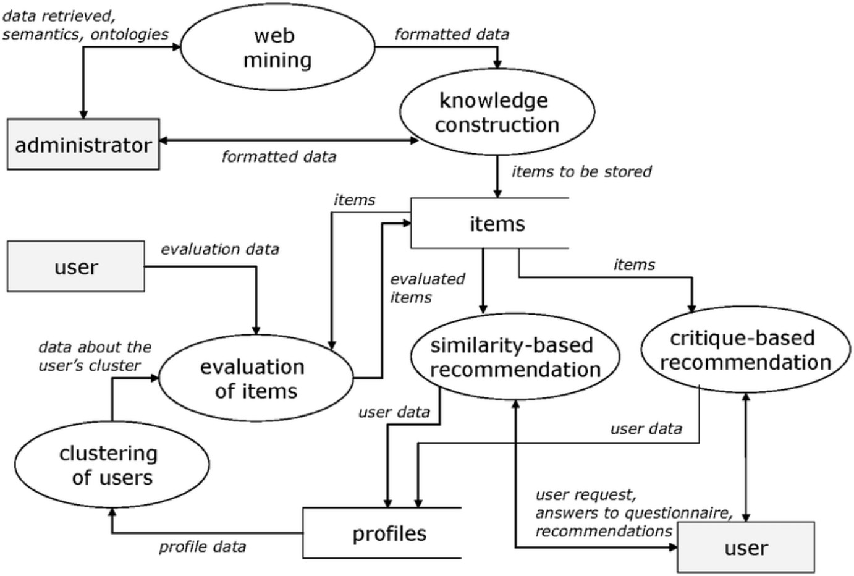
Architecture / Data Flow Diagram

Slide 10
Prototype / Application Developed
Our product recommendation system prototype is designed to enhance the shopping experience for users and boost sales for e-commerce businesses. Here's an overview of the application:
Rank Based Product Recommendation:
Objective: Recommend top products with the highest number of ratings to target new customers and address the cold start problem.
Approach: Calculate the average rating and total number of ratings for each product. Sort products by average rating and recommend top products with a specified minimum number of interactions.
Similarity-based Collaborative Filtering:
Objective: Provide personalized recommendations to users based on interactions of similar users.
Approach: Convert user IDs to integers for convenience. Find similar users using cosine similarity and recommend products based on interactions of similar users.

Slide 11
Prototype / Application Developed
Model-based Collaborative Filtering:
Objective: Provide personalized recommendations based on user behavior and preferences, addressing challenges of sparsity and scalability.
Approach: Use compressed sparse row (CSR) matrix for memory efficiency. Perform singular value decomposition (SVD) to reduce dimensionality. Calculate predicted ratings and recommend top products based on user's ratings and predicted ratings.
Evaluation of the Model:
Calculate average actual ratings and predicted ratings to assess model performance. Compute the Root Mean Squared Error (RMSE) to measure the accuracy of the SVD model.
Overall, our application offers a comprehensive solution for product recommendation, leveraging machine learning algorithms to deliver personalized and relevant suggestions to users while addressing the challenges of the cold start problem and sparsity in data.

Slide 12
Application Developed Workflow
Workflow for Product Recommendation System Application:
Data Collection and Preprocessing:
Gather data from various sources including user interactions, product attributes, and historical transactions.
Preprocess the data to clean inconsistencies, handle missing values, and format it for analysis.
Exploratory Data Analysis (EDA):
Conduct exploratory data analysis to gain insights into the characteristics of the dataset.
Identify patterns, trends, and correlations between different features that can inform recommendation strategies.
Feature Engineering:
Extract relevant features from the dataset that can be used to build recommendation models. Create user profiles based on past interactions, preferences, and demographic information.
Encode product attributes and metadata to capture item characteristics.

Slide 13
Application Developed Workflow
Model Selection and Training:
Choose appropriate recommendation algorithms based on the nature of the data and the problem domain. Split the dataset into training and testing sets for model evaluation.
Train recommendation models using supervised or unsupervised learning techniques such as collaborative filtering, content-based filtering, or hybrid methods.
Model Evaluation:
Evaluate the performance of recommendation models using metrics such as accuracy, precision, recall, and F1-score.
Validate the models using cross-validation techniques to ensure robustness and generalization.
Deployment:
Deploy the trained recommendation models into a production environment where they can be integrated with the application.
Implement APIs or endpoints to serve real-time recommendations to users based on their interactions.

Slide 14
Conclusion
In summary, the product recommendation system stands as a crucial asset in modern e- commerce, revolutionizing the way users discover and engage with products. By leveraging cutting-edge machine learning techniques such as collaborative filtering and content-based filtering, this system offers personalized recommendations tailored to individual preferences, effectively addressing challenges like the cold start problem. Through rigorous evaluation and continuous refinement, it not only enhances user experience but also drives business growth by increasing sales and fostering customer loyalty. As technology advances, the evolution of recommendation algorithms ensures that these systems remain at the forefront of enhancing the digital shopping experience, ultimately reshaping the landscape of online commerce for years to come.

Slide 15
References
Koren, Y., Bell, R., & Volinsky, C. (2009). Matrix factorization techniques for recommender systems. Computer, 42(8), 30-37.
Linden, G., Smith, B., & York, J. (2003). Amazon.com recommendations: item-to-item collaborative filtering. IEEE Internet Computing, 7(1), 76-80.
Breese, J. S., Heckerman, D., & Kadie, C. (1998). Empirical analysis of predictive algorithms for collaborative filtering. Proceedings of the Fourteenth Conference on Uncertainty in Artificial Intelligence, 43-52.
Adomavicius, G., & Tuzhilin, A. (2005). Toward the next generation of recommender systems: a survey of the state-of-the-art and possible extensions. IEEE Transactions on Knowledge and Data Engineering, 17(6), 734-749.
Sarwar, B., Karypis, G., Konstan, J., & Riedl, J. (2001). Item-based collaborative filtering recommendation algorithms. Proceedings of the 10th International Conference on World Wide Web, 285-295.
Ricci, F., Rokach, L., & Shapira, B. (2015). Recommender Systems Handbook. Springer.
Zhang, Y., Koren, Y., & Volinsky, C. (2012). Collaborative filtering for implicit feedback datasets. Proceedings of the IEEE International Conference on Data Mining, 263-272.

Slide 16
Thank You

