Slide 1
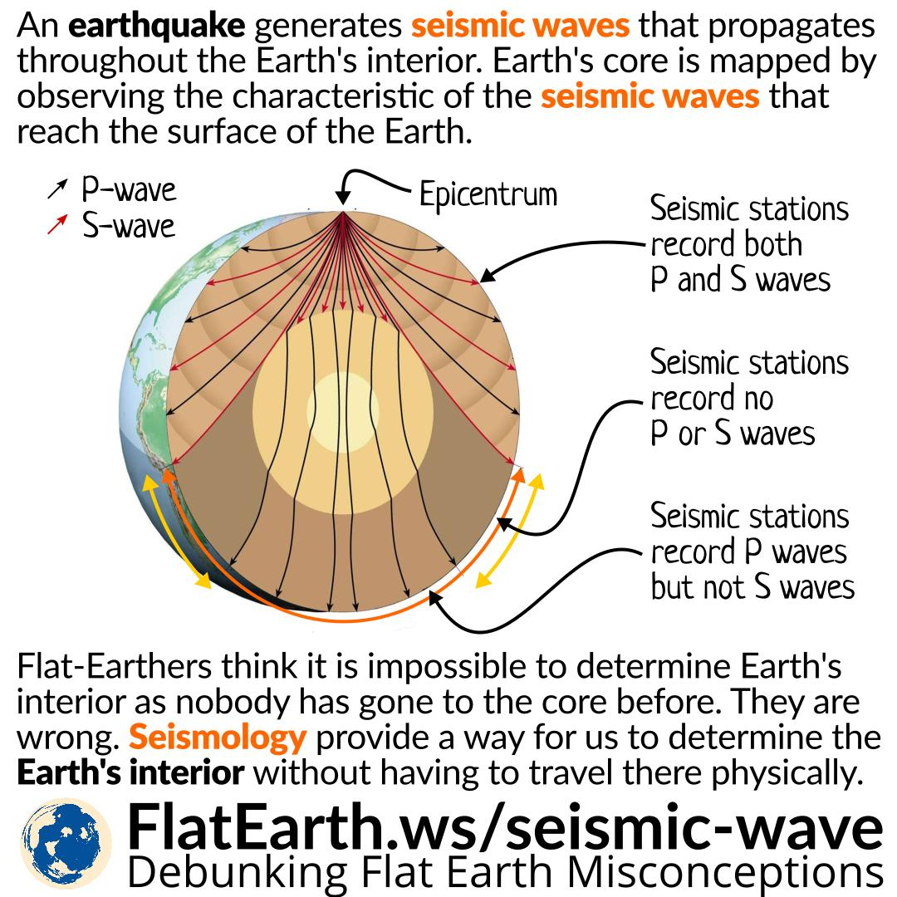
“TYPES OF SEISMIC WAVES”
PRESENTED BY : AAYUSHA KHADKA
& SNEHA DANGI…..

Slide 2
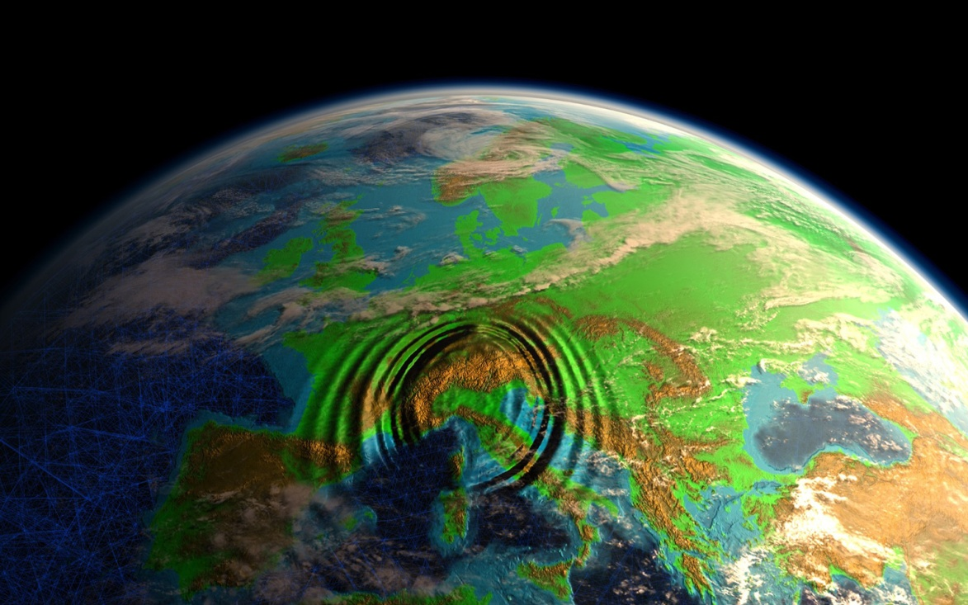
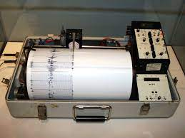
What is seismic wave? How is it measured? What are it types ? Who measures seismology ?
A wave of energy that is generated by an earthquake or other earth vibration and that travels within the earth or along its surface.
It is measured through seismogram.
Body waves , Primary waves, Secondary waves, Surface ways, Rayleigh & Love waves.
A seismologist measures seismic waves…..

Slide 3
Difference Between Primary & Secondary Waves….
In P or compressional waves, the vibration of the rock is in the direction of propagation. P waves travel fastest and are the first to arrive from the earthquake.
The P wave will be the first wiggle that is bigger than the background signals). Because P waves are the fastest seismic waves, they will usually be the first ones that your seismograph records.
P waves can travel through liquid and solids and gases
In S or shear waves, rock oscillates perpendicular to the direction of wave propagation.
The next set of seismic waves on your seismogram will be the S waves. These are usually bigger than the P waves.
While S waves only travel through solids.

Slide 4
Rayleigh & Love Waves….
Rayleigh waves are a type of surface wave that travel near the surface of solids .
Rayleigh waves include both longitudinal and transverse motions that decrease exponentially in amplitude as distance from the surface increases.
Rayleigh Waves—surface waves that move in an elliptical motion, producing both a vertical and horizontal component of motion in the direction of wave propagation.
Love waves (also known as waves are surface seismic waves that cause horizontal shifting of the Earth during an earthquake.
Love waves are transverse and restricted to horizontal movement - they are recorded only on seismometers that measure the horizontal ground motion.
Important characteristic of Love waves is that the amplitude of ground vibration caused by a Love wave decreases with depth - they're surface waves.

Slide 5
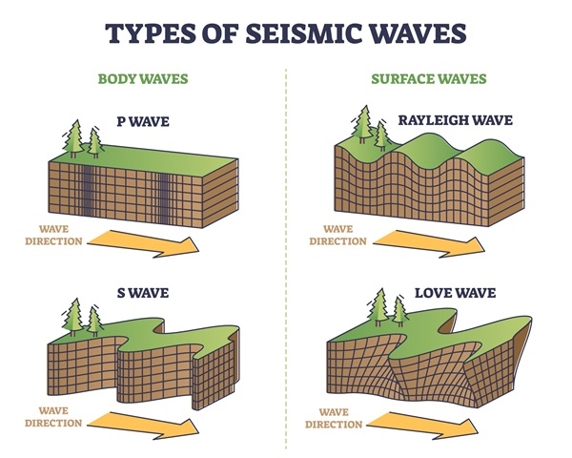
What does earthquakes and marsquakes teach us about planets?

Slide 6
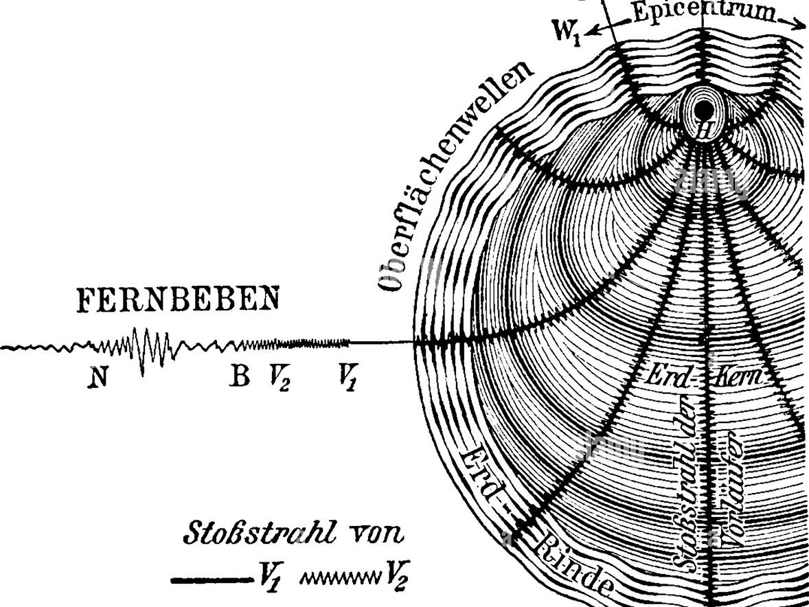
RAYLEIGH
WAVES

Slide 7
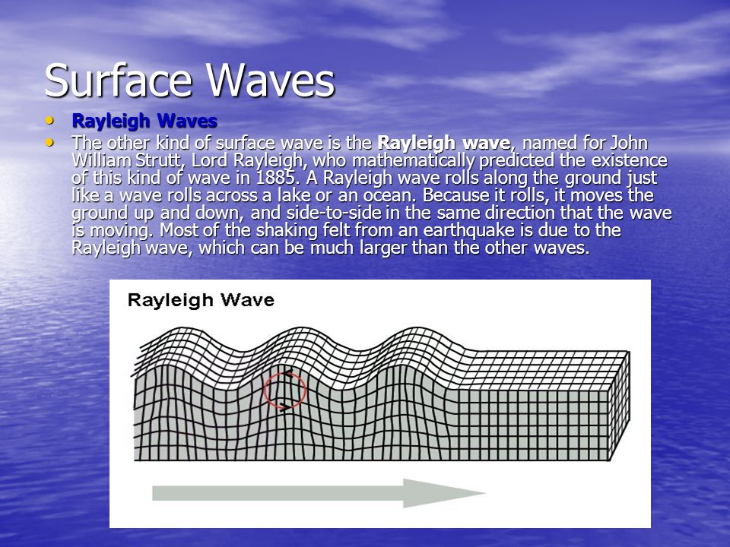
RAYLEIGH
WAVES

Slide 8
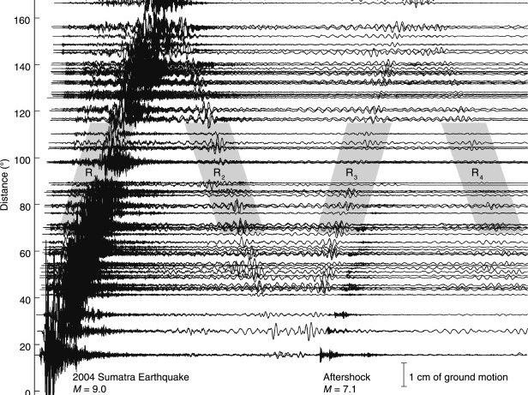
LOVE WAVES

Slide 9
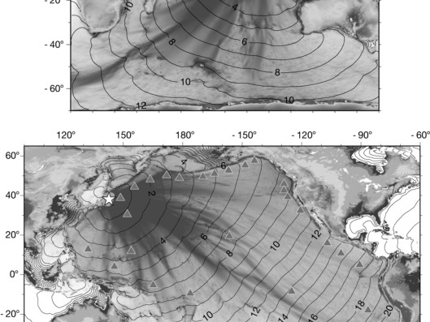
DEPTH PICTURE OF
LOVE WAVES

Slide 10
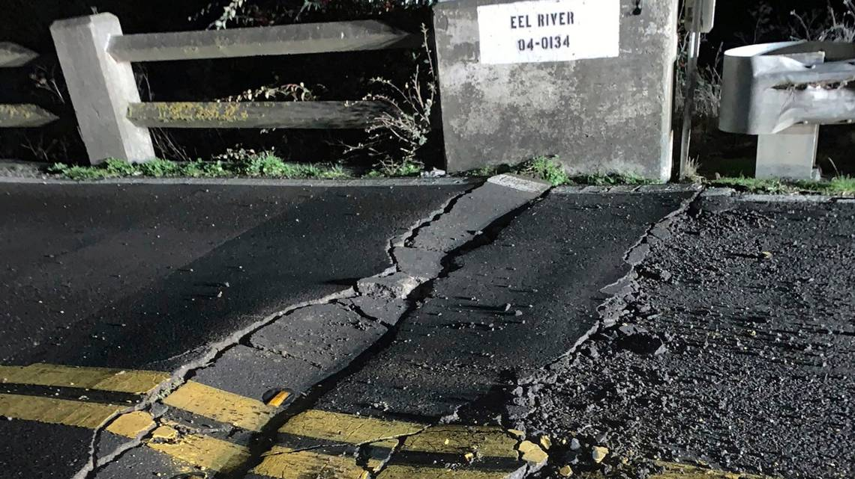
Animation shows deadly Northern California earthquake’s shockwave roll across the US
This image posted by Caltrans District 1 shows a road closure on California State Route 211 at Fernbridge , a 1,320-foot-long (402.3 m) concrete arch bridge that spans the Eel River near Fortuna, Calif., in Humboldt County. The bridge is closed while they conduct a safety inspection checking for possible seismic damage. Officials say a strong earthquake in Northern California has cut off power to thousands and damaged roads and homes.

Slide 11
Tonga volcano eruption continues to astonish
Scientists have described a massive "magma hammer" they say slammed the underside of the Tonga volcano which erupted so spectacularly in January.
An analysis of seismic waves has revealed four individual events that are interpreted to be thrusts of molten rock beneath the underwater mountain.
Occurring within a five-minute period, each of these blows is calculated to have had a force of a billion tonnes.
It's a further revelation about the behaviour of Hunga-Tonga Hunga-Ha'apai.
The seamount produced the biggest atmospheric explosion ever recorded by modern instrumentation - far bigger even than any nuclear bomb test conducted after WWII.
It displaced some 10 cubic km of rock, ash and sediment, much of it exiting through the volcano's mouth, or caldera, to shoot straight up into the sky, like a "shotgun blast" as one geologist called it.
Tonga volcanic eruption reshaped Pacific seafloor
Robot boat to map Tonga volcano aftermath
Immense crater hole created in Tonga volcano https://www.bbc.co.uk/news/correspondents/jonathanamos

Slide 12
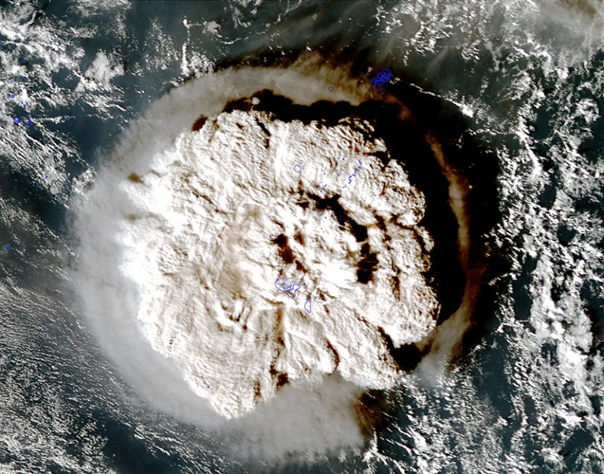
Tonga volcano eruption continues to astonish
https://www.bbc.co.uk/news/correspondents/jonathanamos

Slide 13


