Slide 1
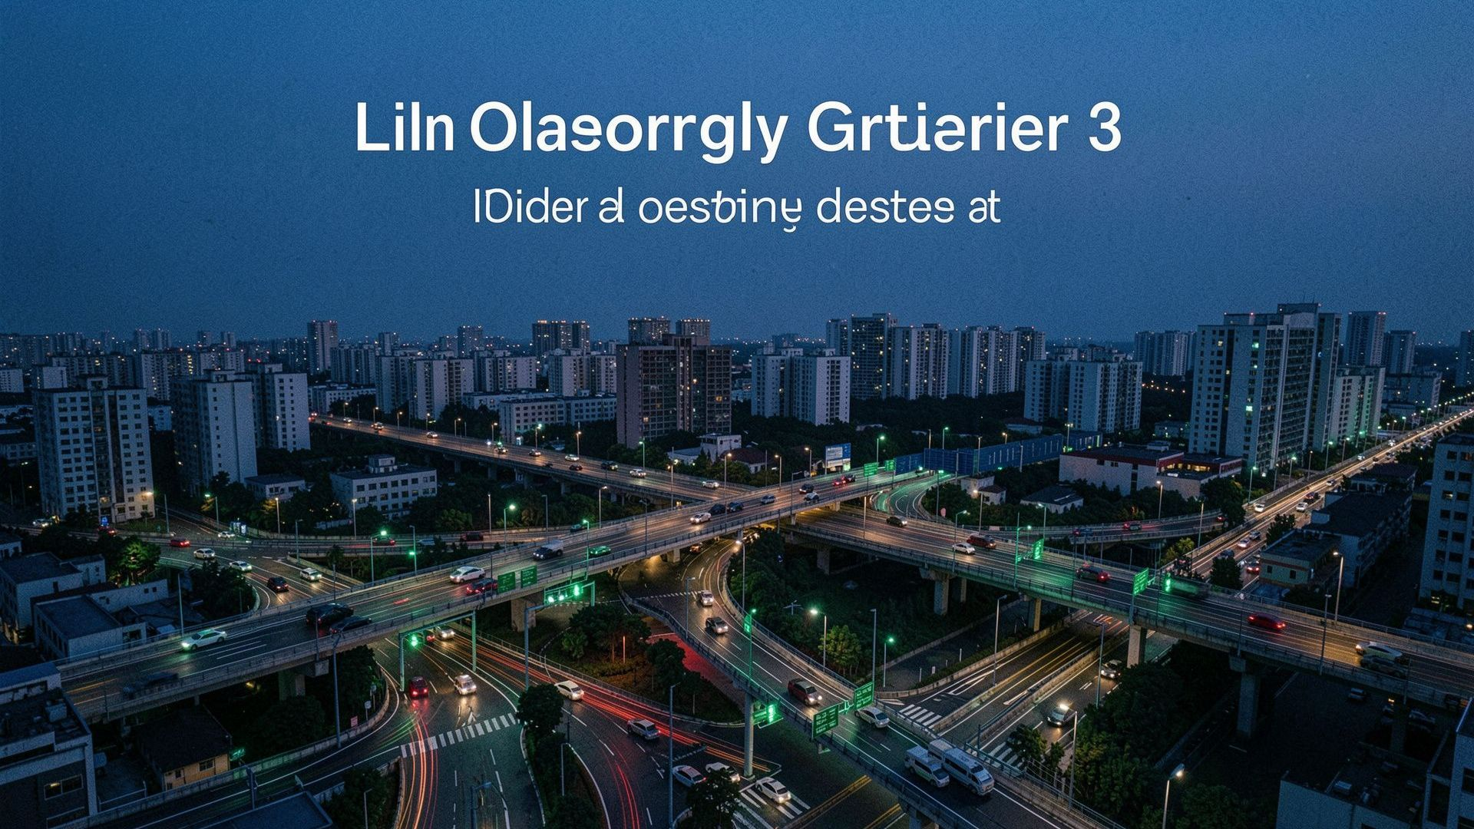
BUILD WITH AI · CODE FOR COMMUNITIES — SECOND EDITION
CIVICPULSE
BRICS
TRACK: OPEN INNOVATION
Team: [Team Name] · Members: [Names + Roles]
CITIZENS → AI → SECTOR HEALTH MATRIX & TELEMETRY → POLICYMAKERS
Scalable AI-Driven Infrastructure Prioritization for Digital Public Goods
“From Citizen Voices to Actionable Infrastructure Intelligence.”

Slide 2
Fragmented citizen voices delay action
TODAY
• Voice, text, and messaging feedback is scattered across multiple channels.
• Reports arrive in different languages and regional dialects.
• Unstructured reports are difficult to analyze and deduplicate at scale.
• Critical infrastructure hotspots stay hard to detect before catastrophic failure.
1. Citizen Reports
2. Data Silos
3. Limited Visibility
4. Delayed Prioritization
CORE GAP
Citizen feedback exists.
Actionable intelligence doesn’t.

Slide 3
THE SOLUTION
From feedback to action
CivicPulse BRICS turns citizen reports into geospatially prioritized infrastructure intelligence.
REPORT
Voice / Text / Custom Location & Auto-GPS
UNDERSTAND
AI Transcription + Multilingual Translation
CLUSTER
Geospatial Proximity Hotspots (10km DBSCAN)
PRIORITIZE
Multi-Factor ML Priority Index (0–100 Scorer)
ACT
AI Project Directives, Budgets & Policy Review
Don’t just collect complaints. Identify emerging infrastructure needs.

Slide 4
THE PLATFORM
One platform. Five capabilities.
01 Citizen Portal
Voice + Text + Custom Location
Interactive GPS detection & BRICS country selector
02 Multilingual AI
Transcription + Translation
Automatic dialect synthesis & hazard classification
03 Geo-Intelligence
10km Proximity Clustering
DBSCAN grouping of isolated infrastructure requests
04 Priority Engine
Volume + Outage Duration + Sector Deficit + Disruption Intensity
Calculates unified 0–100 ML severity ranking across sectors
05 Policy Command Center
Sector Health Matrix + Autonomous Radar + AI Directives
Interactive radial dials, live threat sweep radar & policy review briefs

Slide 5
TECHNICAL CORE
The CivicPulse intelligence pipeline
01
VOICE /
TEXT
02
MULTILINGUAL
NLU
03
0–100 ML
SEVERITY
04
10KM
DBSCAN
05
PRIORITY
INDEX
06
AI POLICY
BRIEF
Transcribe · Translate · Categorize · 0–100 Multi-Factor Severity Scorer · Geospatial Clustering · Sector Health Deficit
TECHNICAL CORE
Multilingual Transformer NLU + Scikit-Learn DBSCAN + Haversine Matrix + Zero-Setup SQLite / PostgreSQL

Slide 6
DECISION SURFACE
From data to decision
SECTOR MATRIX & RADAR
Real-time radial gauges for Water, Roads, Power, Sanitation & autonomous threat radar sweep.
LIVE FEED & TELEMETRY
Anonymized, AI-translated citizen requests with live institutional status tickers.
AI POLICY DIRECTIVES
Autonomous project solutions with actionable budgets, timelines, and policy review citations.
1
50 Citizen Reports
2
1 Geographic Hotspot
3
1 Priority Project
4
Policy Action

Slide 7
SYSTEM DESIGN
Simple, scalable architecture
INPUT
Citizen Portal · Voice | Text | Custom Location | BRICS Nation Selector
API
FastAPI (Async Python 3.11 Backend) + Next.js 14 App Router
AI
Multilingual NLU Engine · Dialect Synthesis & Project Solutions
DATA
SQLite (Zero-Setup Engine) / PostgreSQL + PostGIS
INTELLIGENCE
Scikit-Learn DBSCAN (10km Proximity) + 0–100 ML Severity Scorer
OUTPUT
Policymaker Command Center · Sector Health Matrix & Autonomous Radar
Supporting technologies: Tailwind CSS · Lucide Icons · HTML5 Canvas Radar · Interactive SVG Dials · REST APIs

Slide 8
PRODUCTION-READY BY DESIGN
Built for real-world civic systems
PRIVACY
PII sanitization & anonymization before persistence
SECURITY
JWT + HTTP-only cookies & input schema validation
ACCESS CONTROL
RBAC: SuperAdmin | Policymaker | Analyst | Citizen
SCALABILITY
Local ward → Regional → National → BRICS-scale
SUCCESS METRICS
Processing Time · Cluster Quality · Multi-Factor ML Accuracy · PII Removal Effectiveness

Slide 9
THE END-TO-END PROMISE
One report → one actionable decision
1. Citizen Voice & Text Report
2. AI Multilingual Audio Synthesis
3. Automatic Translation & Hazard Tagging
4. PII Sanitization & Anonymization
5. Geospatial Clustering (10km DBSCAN)
6. 0–100 Multi-Factor ML Severity Scoring
7. AI Project Recommendation with Budget
8. Sector Health Matrix & Policy Action
REAL-WORLD EXAMPLE
“Pipeline rupture reported in Ward 4”
→ Hotspot detected (10km DBSCAN)
→ ML Severity 88/100 (Critical Hazard)
→ Project Brief auto-drafted with $85,000 budget & 4-day timeline
CIVICPULSE BRICS
“Turning Citizen Voices into Actionable Infrastructure Intelligence.”
Build with AI: Code for Communities — Second Edition
Multilingual AI · Geospatial Intelligence · Digital Public Goods

