Slide 1

Secure Key Management System
Presented by: Himanshu Bankar, DIV-II (17)
Guide: Prof. Yogini Pethe Co-Guide: Prof. S Upadhye
Evaluator: Dr. S Uparkar
College: Shri Ramdeobaba College of Engineering and Management Department: MCA

Slide 2

Introduction
Problem Statement: The challenge of managing and securing passwords remains significant. Weak storage practices and password reuse frequently lead to data breaches, exposing sensitive information.
Project Overview: This project introduces a secure platform designed to empower users with the ability to generate, securely store, and efficiently manage their passwords. Key features include two-factor authentication (2FA) for enhanced security and robust encryption to protect stored credentials.
Objective: The primary objective is to develop a highly secure and user-friendly password manager that guarantees the safe storage and retrieval of sensitive credentials, providing users with peace of mind.

Slide 3
Literature Review
Existing Solutions:
Conventional password managers like LastPass and Bitwarden.
Password storage integrated within browsers such as Google Chrome and Firefox.
Identified Shortcomings:
Cloud-based managers are susceptible to security breaches.
Absence of supplementary authentication protocols prior to accessing stored passwords.
Inadequate password generation methodologies.

Slide 4

Methodology
Approach:
User authentication using OTP-based 2FA
Secure storage using AES encryption
Password strength analyzer and generator
Tools & Technologies:
Frontend: React.js, Tailwind CSS, ShadCN
Backend: Express.js, MongoDB
Security: JWT, Bcrypt, AES Encryption

Slide 5
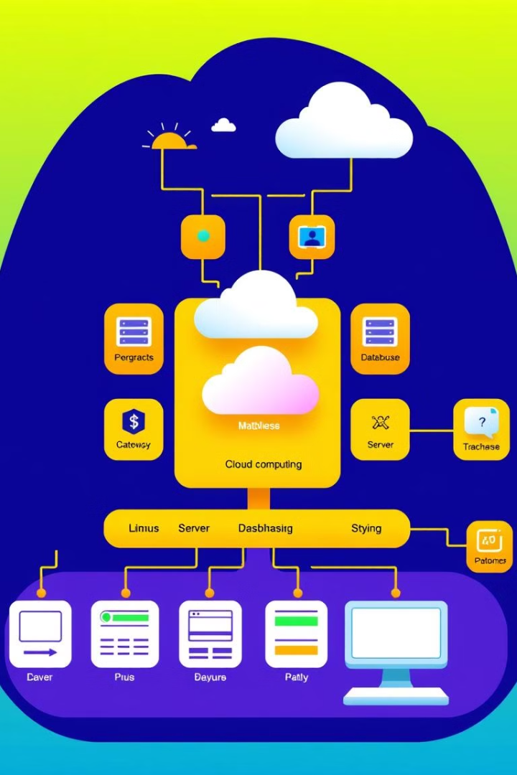
System Architecture
User Flow:
User registers with email verification
Logs in with password + OTP (2FA)
Can generate & save passwords securely
Stored passwords are encrypted & only decrypted after 2FA

Slide 6

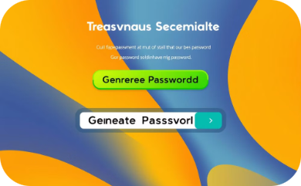


Implementation
Key Features Visualized:
Login & Registration
Password Generator
Secure Password Storage
Two-Factor Authentication (2FA)
Secure login page with OTP verification for registered users.
Generates strong, secure passwords with strength suggestions.
Passwords stored securely with robust encryption.
Enhanced security with two-factor authentication.

Slide 7
Security Features
AES Encryption: Protects your passwords with advanced encryption standard (AES) for maximum safety.
2FA Authentication: Adds an extra layer of security, requiring a second verification method for login.
Password Strength Analyzer: Analyzes password strength in real-time, preventing the use of weak, easily compromised passwords.
Zero-Knowledge Storage: Ensures that your passwords are encrypted and inaccessible, even to administrators, guaranteeing complete privacy.

Slide 8
Demo & Working
User Interaction Flow:
Sign Up: Verify email with OTP.
Login: Enter password and OTP for secure access.
Generate & Save Passwords: Utilize encrypted storage for enhanced security.
View Passwords: Access granted only after successful 2FA verification.

Slide 9
Conclusion & Future Scope
Conclusion:
Created a secure and intuitive key management system.
Implemented robust encryption and multi-factor authentication.
Future Enhancements:
Integrate biometric authentication options.
Enable secure cloud integration with end-to-end encryption.
Incorporate support for enterprise-grade security policies.

Slide 10
References
Research papers on password security
OWASP guidelines on secure authentication
Documentation for AES encryption, MongoDB security

