Slide 1
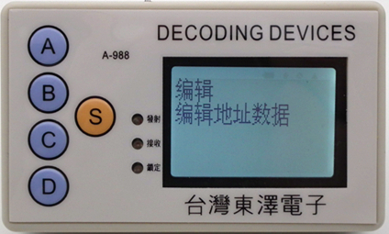
MINI PROJECT
INTERNSHIP
NAME- HIMANI CHAUHAN
Section - ECE – 2
1802731068

Slide 2
VHSIC-HDL
VHDL stands for very high-speed integrated circuit hardware description language. It is a programming language used to model a digital system by dataflow, behavioral and structural style of modeling. This language was first introduced in 1981 for the department of Defence (DoD) under the VHSIC program.

Slide 3
DESCRIBING DESIGN
In VHDL an entity is used to describe a hardware module. An entity can be described using:
Entity declaration
Architecture
Configuration
Package declaration
Package body

Slide 4
ENTITY DECLARATION
It defines the names, input, output signals and modes of a hardware module.
SYNTAX: entity entity _ name is
port( a,b,c: in std_logic;
d: out std_logic);
end entity_name;
An entity should start with “entity” keyword and end with “end” keyword. The direction will be input , output or inout type

Slide 5
ARCHITECTURE
Architecture can be described using dataflow , structural or mixed modeling.
SYNTAX :- architecture architecture_ name of entity namearchitecture_ declarative part;
begin
statements;
end architecture name;
Here, we should specify the entity name for which we are writing the architecture body. The architecture statements should be inside the ‘begin’ and ‘end’ keyword. Architecture declarative part may contain variables, constants, or component declaration.

Slide 6
BEHAVIORAL MODELING
In this modeling style, the behavior of an entity as set of statements is executed sequentially in the specified order. Only statements placed inside a PROCESS, FUNCTION, or PROCEDURE are sequential.
PROCESSES, FUNCTIONS, and PROCEDURES are the only sections of code that are executed sequentially.
One important aspect of behavior code is that it is not limited to sequential logic. Indeed, with it, we can build sequential circuits as well as combinational circuit.

Slide 7
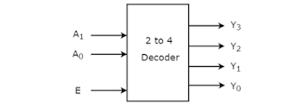
What is decoder?
A decoder is an electronic circuit with multiple input and multiple output signals, which converts every unique combination of input states to a specific combination of output states. It is a combinational logic circuit that converts binary information from the n coded inputs to a maximum of 2^{n} unique outputs.

Slide 8
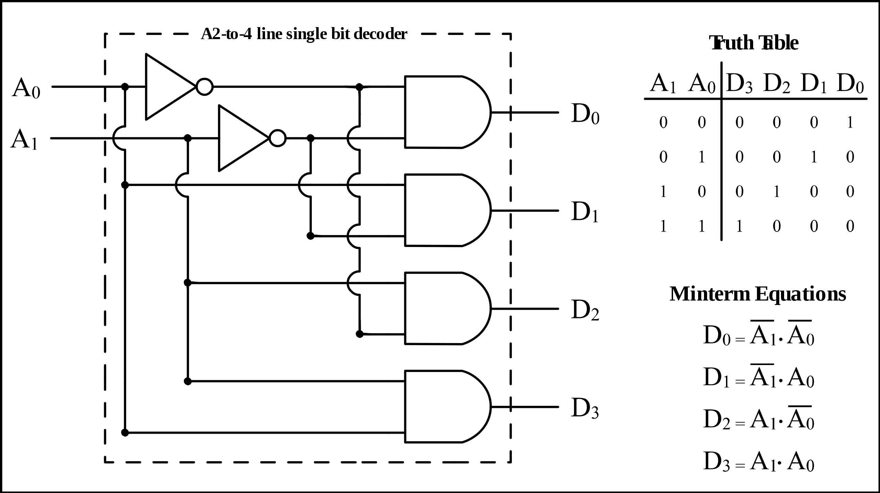

Slide 9
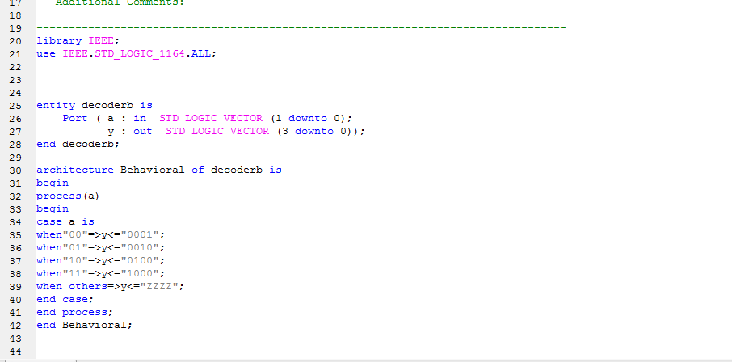
VHDL CODE FOR 2x4 DECODER

Slide 10
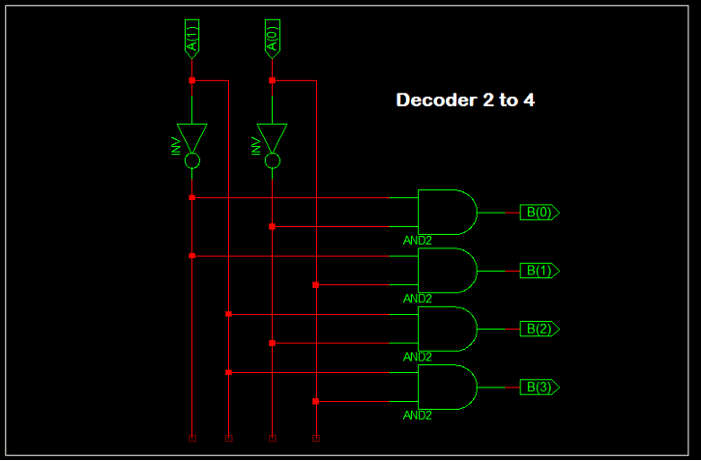
logic diagram

Slide 11
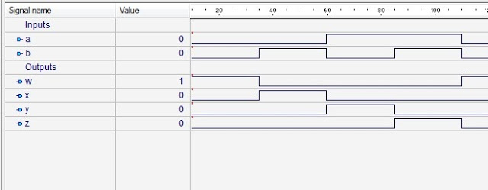
WAVEFORM

Slide 12
APPLICATIONS OF DECODER
The Decoders were used in analog to digital conversion in analog decoders.
Used in electronic circuits to convert instructions into CPU control signals.
They mainly used in logical circuits, data transfer.
Used for data distribution i.e. demultiplexing.

Slide 13
THANK YOU

