Slide 1
History of BlockChain..
By: Himani Chauhan

Slide 2
The underlying technology behind crytocurrencies is the BlockChain. It allows every client in the network to reach consensus without ever having to trust each other.

Slide 3
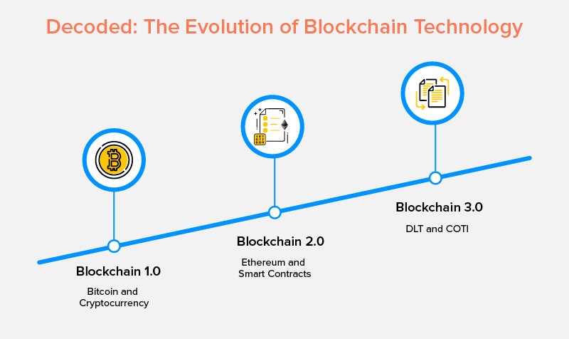

Slide 4
The Early Days..
Blockchain started its journey back in 1991. But the developers and researchers failed to implement the blockchain practically. It was described by Stuart Haber and W. Scott Stornetta in 1991.

Slide 5
The Early Days..
Blockchain started its journey back in 1991. But the developers and researchers failed to implement the blockchain practically. It was described by Stuart Haber and W. Scott Stornetta in 1991.
They aim to design a system where document timestamps could not be tampered with. But they were failed to implement the system.

Slide 6
1ST GENERATION BLOCKCHAIN
In 2008, Satoshi Nakamoto releases the white paper of bitcoin. Bitcoin is a blockchain based peer to peer payment system. Gradually, the bitcoin started its way to market.

Slide 7
1ST GENERATION BLOCKCHAIN
In 2008, Satoshi Nakamoto releases the white paper of bitcoin. Bitcoin is a blockchain based peer to peer payment system. Gradually, the bitcoin started its way to market.
Due to inflation in bitcoin price, it was not suitable for payment in daily routine. As time passes the new innovation were develop using blockchain technology. The blockchain of bitcoin is not scalable as the transaction speed was very low as 7 TPS.

Slide 8
1ST GENERATION BLOCKCHAIN
In 2008, Satoshi Nakamoto releases the white paper of bitcoin. Bitcoin is a blockchain based peer to peer payment system. Gradually, the bitcoin started its way to market.
Due to inflation in bitcoin price, it was not suitable for payment in daily routine. As time passes the new innovation were develop using blockchain technology. The blockchain of bitcoin is not scalable as the transaction speed was very low as 7 TPS.
Bitcoin blockchain was failed to provide the users with efficiency. Furthermore, bitcoin was just a payment system. There was a need for a blockchain that solves the real world problems.

Slide 9
2nd Generation BlockChain
In 2013, Vitalik Buterin introduce the concept of smart contracts using blockchain technology. The project Ethereum gain global popularity as it was providing the platform for developing decentralized applications.

Slide 10
2nd Generation BlockChain
In 2013, Vitalik Buterin introduce the concept of smart contracts using blockchain technology. The projects Ethereum gain global popularity as it was providing the platform for developing decentralized applications.
Ethereum is an open source, public, blockchain-based distributed computing platform and operating system featuring smart contract functionality.

Slide 11
2nd Generation BlockChain
In 2013, Vitalik Buterin introduce the concept of smart contracts using blockchain technology. The projects Ethereum gain global popularity as it was providing the platform for developing decentralized applications.
Ethereum is an open source, public, blockchain-based distributed computing platform and operating system featuring smart contract functionality.
Ethereum provides the facility to the developer to develop the decentralized application using standard ERC20 token.

Slide 12
2nd Generation BlockChain
In 2013, Vitalik Buterin introduce the concept of smart contracts using blockchain technology. The projects Ethereum gain global popularity as it was providing the platform for developing decentralized applications.
Ethereum is an open source, public, blockchain-based distributed computing platform and operating system featuring smart contract functionality.
Ethereum provides the facility to the developer to develop the decentralized application using standard ERC20 token.
Ethereum blockchain is not up to the mark. It has failed to provide the problem to the scalability issue

Slide 13
3rd Generation blockChain
We are entering into 3rd generation blockchain where the more scalability and interoperability are the goals to achieve.

Slide 14
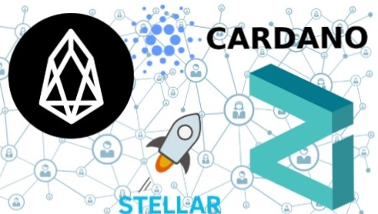
3rd Generation blockChain
We are entering into 3rd generation blockchain where the more scalability and interoperability are the goals to achieve.
Some of the leading projects in 3rd generation blockchain are Zilliqa, AION, Cardano, EOS, etc. These projects are using new concepts to make the blockchain more scalable.

Slide 15
3rd Generation blockChain
We are entering into 3rd generation blockchain where the more scalability and interoperability are the goals to achieve.
Some of the leading projects in 3rd generation blockchain are Zilliqa, AION, Cardano, EOS, etc. These projects are using new concepts to make the blockchain more scalable.
The blockchain is a technology with the potential of solving the real world problem in every aspect of life. It’s not only limited to the financial transaction. There are numerous blockchain applications available in the market that are aiming to solve the real world problems.

Slide 16
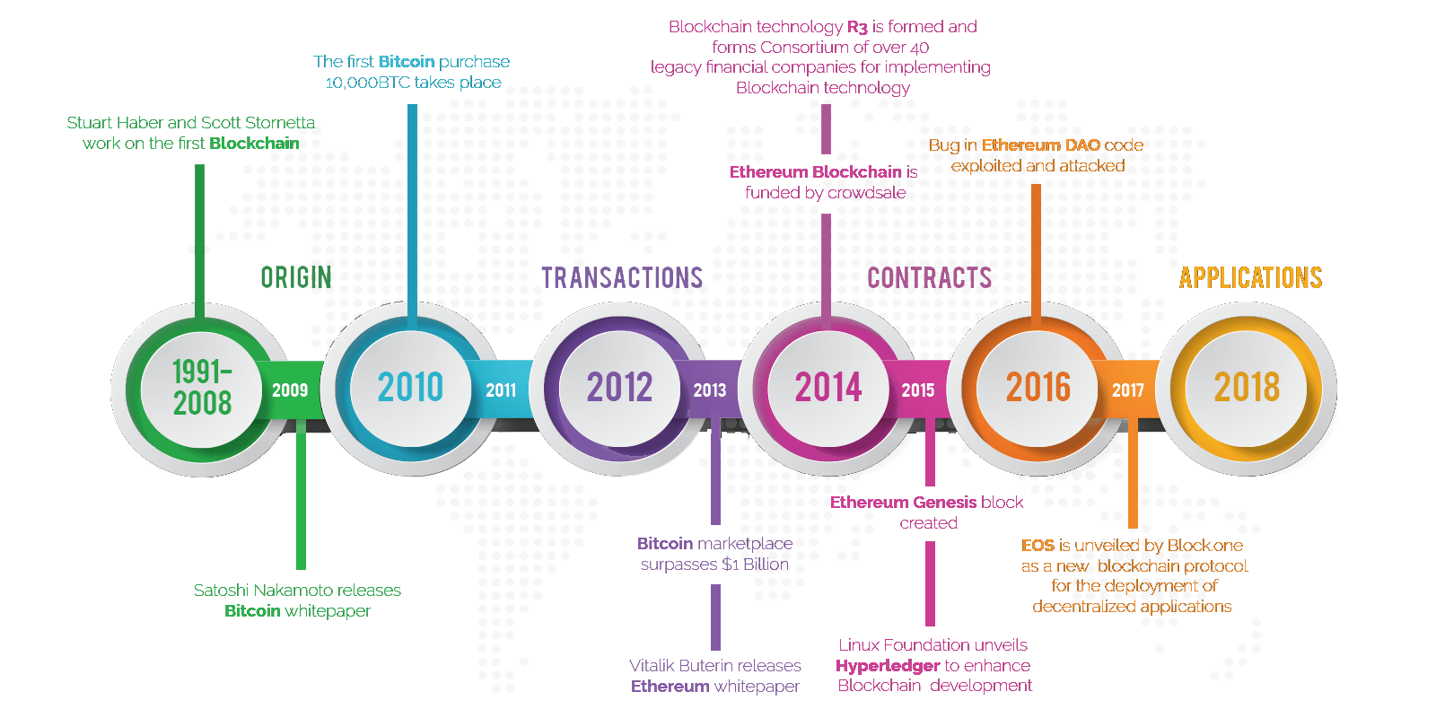
Timeline Of blockchain

Slide 17
Thank You..

