Slide 1
History of BlockChain..
By: Himani Chauhan

Slide 2
The underlying technology behind crytocurrencies is the BlockChain. It allows every client in the network to reach consensus without ever having to trust each other.

Slide 3


Slide 4
The Early Days..
The idea behind blockchain technology was described as early as 1991 when research scientists Stuart Haber and W. Scott Stornetta introduced a computationally practical solution for time- stamping digital documents so that they could not be backdated or tampered with.
The system used a cryptographically secured chain of blocks to store the time-stamped documents and in 1992 Merkle trees were incorporated to the design, making it more efficient by allowing several documents to be collected into one block. However, this technology went unused and the patent lapsed in 2004, four years before the inception of Bitcoin.

Slide 5
Reusable Proof Of Work..
In 2004, computer scientist and cryptographic activist Hal Finney (Harold Thomas Finney II) introduced a system called RPoW, Reusable Proof Of Work. The system worked by receiving a non-exchangeable or a non-fungible Hashcash based proof of work token and in return created an RSA-signed token that could then be transferred from person to person.
RPoW solved the double spending problem by keeping the ownership of tokens registered on a trusted server that was designed to allow users throughout the world to verify its correctness and integrity in real time.
RPoW can be considered as an early prototype and a significant early step in the history of cryptocurrencies.

Slide 6
Bitcoin Network..
In late 2008 a white paper introducing a decentralized peer-to-peer electronic cash system - called Bitcoin - was posted to a cryptography mailing list by a person or group using the pseudonym Satoshi Nakamoto.
Bitcoins are “mined” for a reward using the proof-of-work mechanism by individual miners and then verified by the decentralized nodes in the network.
On the 3rd of January 2009, Bitcoin came to existence when the first bitcoin block was mined by Satoshi Nakamoto, which had a reward of 50 bitcoins. The first recipient of Bitcoin was Hal Finney, he received 10 bitcoins from Satoshi Nakamoto in the world's first bitcoin transaction on 12 January 2009.

Slide 7
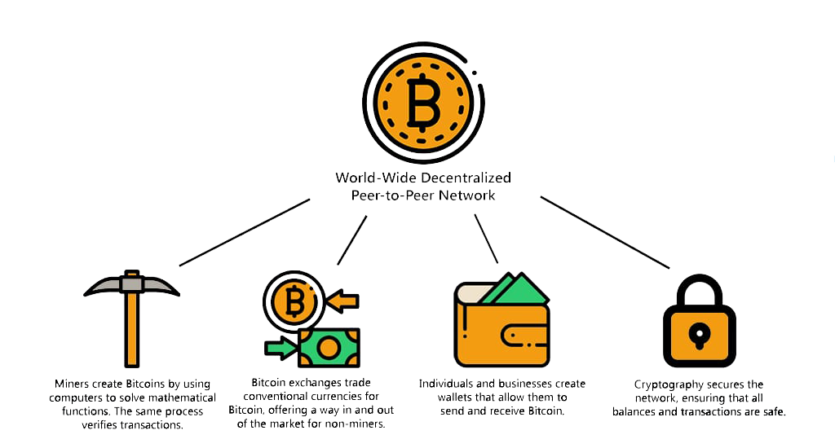

Slide 8
Ethereum..
In 2013, Vitalik Buterin, a programmer and a co-founder of the Bitcoin Magazine stated that Bitcoin needed a scripting language for building decentralized applications. Vitalik started the development of a new blockchain-based distributed computing platform, Ethereum, that featured a scripting functionality, called smart contracts.
The cryptocurrency of Ethereum is called Ether, it can be transferred between accounts and is used to pay the fees for the computational power used when executing smart contracts.
Today blockchain technology is gaining a lot of mainstream attention and is already used in a variety of applications, not limited to cryptocurrencies.

Slide 9
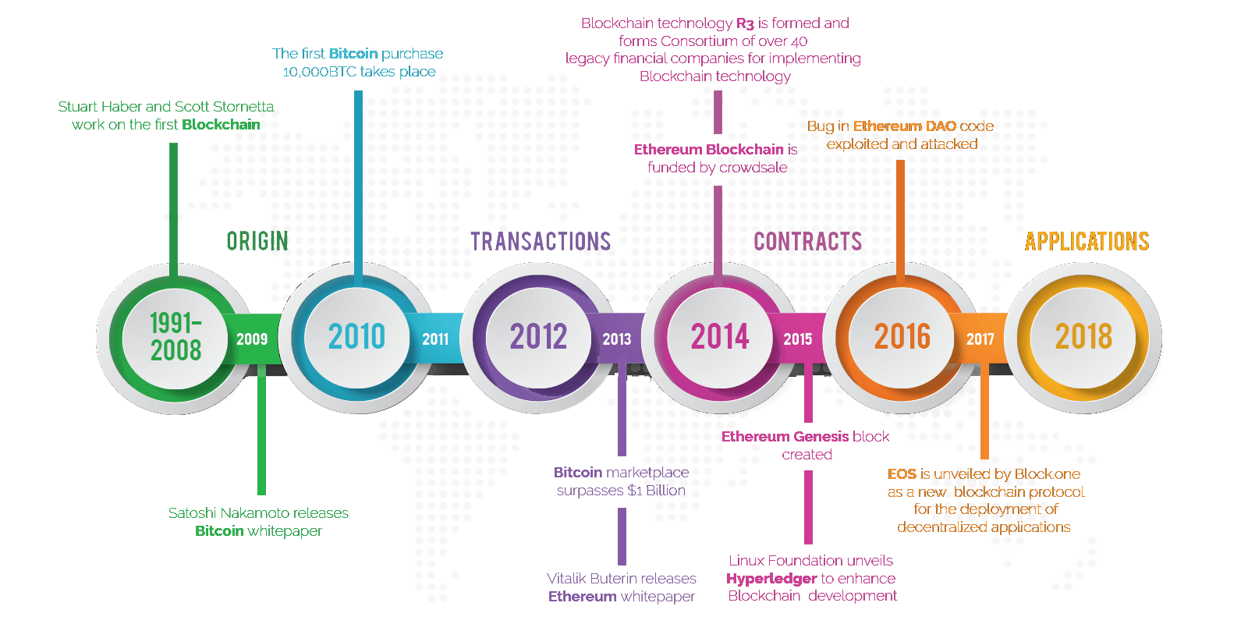

Slide 10
Thank You..

