Slide 1
Multiplexer and de-multiplexer
Prepared by:- LAKSHYA SHARMA (1802731083)

Slide 2
Multiplexer and De-Multiplexer
A multiplexer is a circuit that accept many input but give only one output
A de-multiplexer function exactly in the reverse of a multiplexer, that is a de-multiplexer accepts only one input and gives many outputs
Generally multiplexer and de-multiplexer are used together

Slide 3
Multiplexer
Multiplexer means many into one. A multiplexer is a circuit used to select and route any one of the SEVERAL input signals to a SINGLE signal output.
An simple example of a non electronic circuit of a multiplexer is a single pole multi position switch.

Slide 4
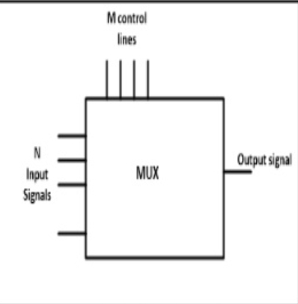
Uses of Multiplexers
Multi-position switches are widely used in many
electronicss circuits.
However circuits that operate at high speed require
The multiplexer to be automaticallyselected.
A mechanical switch cannot perform this task
satisfactorily.Therefore, multiplexer used to perform
high speed switching are constructed of electronic components.

Slide 5
Types of multiplexer
Multiplexer handle two type of data that is analog and digital. For analog application, multiplexer are built of relays and transistor switches. For digital application, they are built from standard logic gates.
The multiplexer used for digital applications, also called digital multiplexer, is a circuit with many input but only one output. By applying control signals, we can steer any input to the output. Few types of multiplexer are 2-to-1, 4-to-1, 8-to-1, 16-to-1 multiplexer.

Slide 6
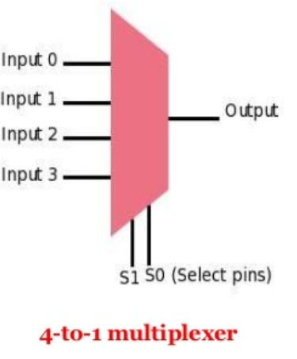
4-to-1 multiplexer
The 4-to-1 multiplexer has 4input bit, 2 control bits, and 1output bit. The four input bitstare l0,l1,l2 and l3
only one of this is transmitted to the output y.
The output depends on the value of S0 and S1 which is the control input
The control input determines which of the input data bit is transmitted to the output

Slide 7
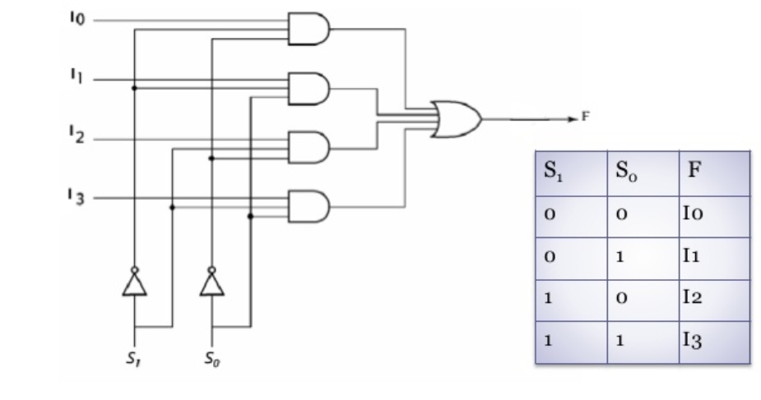
4-to-1 multiplexer

Slide 8
Library IEEE; use IEEE.STD_LOGIC_1164.all; entity mux_4to1 is port( A,B,C,D : in STD_LOGIC; S0,S1: in STD_LOGIC; Z: out STD_LOGIC ); end mux_4to1; architecture bhv of mux_4to1

Slide 9
Begin process (A,B,C,D,S0,S1) is begin if (S0 =‘0’ and S1 = ‘0’) then Z <= A; elsif (S0 =‘1’ and S1 = ‘0’) then Z <= B; elsif (S0 =‘0’ and S1 = ‘1’) then Z <= C; else Z <= D; end if; end process; end bhv;

Slide 10
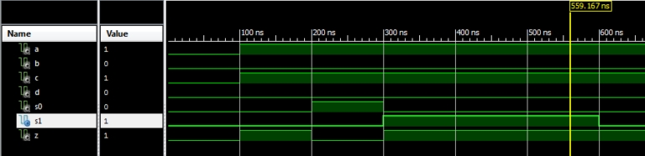
Simulation waveform

Slide 11
Applications of multiplexer
Multiplexer are used in various fields where multiple data need to be transmitted using a single line.
Following are some of the applications of multiplexers
Communication system
Telephone network
Computer memory

Slide 12
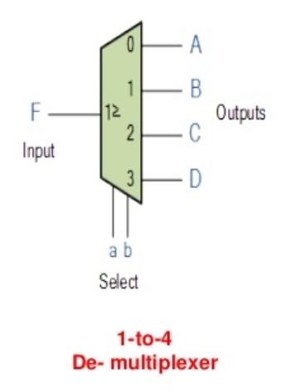
De-multiplexer
De-multiplexer means one to many. A de-multiplexer is a circuit with one input and many output
By applying control signal,we can steer any input to the output. Few types of demultiplexer are 1-to 2. 1-to-4.1-to-8 and 1-to 16 demultiplexer.

Slide 13
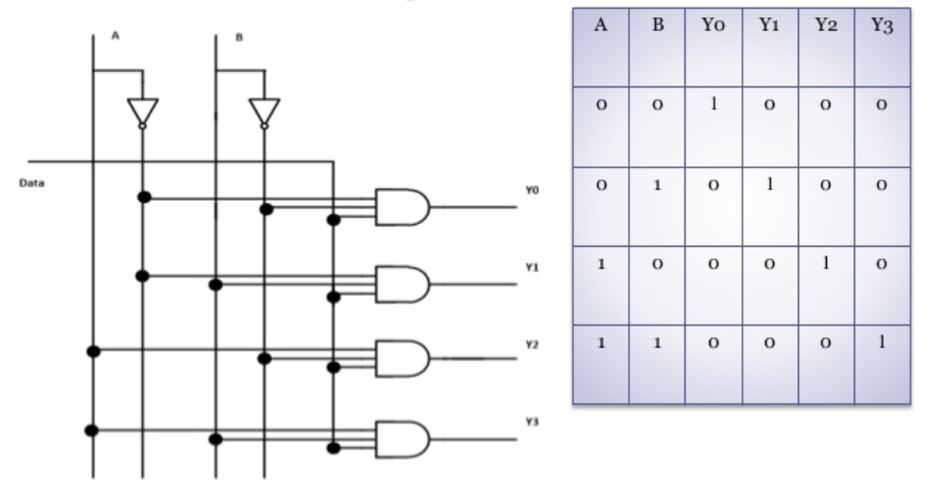
1-to-4 de-multiplexer

Slide 14
APPLICATIONS OF DE-MULTIPLEXER
DE-MULTIPLEXER is used to connect a single source to multiple destinations. The main application area of de-mux is communication system where mux is used.
Communication systems
ALU
Serial to parallel converter

Slide 15
THANKYOU

