Slide 1
DSO 510 Final Project
Benjamin Zhao, Lisa Xiao, En-Ning Chiang,
Mridula Singhal, Himani Desai, Suwara Thianrungrot

Slide 2
Do Twitter Mentions impact Stock Prices?
David Wallach's Stockerbot
API tracked tweets from 7/6/2018-7/18/2018 for stock mentions
Tracked from sources such as MarketWatch, WSJ, Yahoo Finance, the Federal Reserve, Ben Bernanke, StockTwits

Slide 3
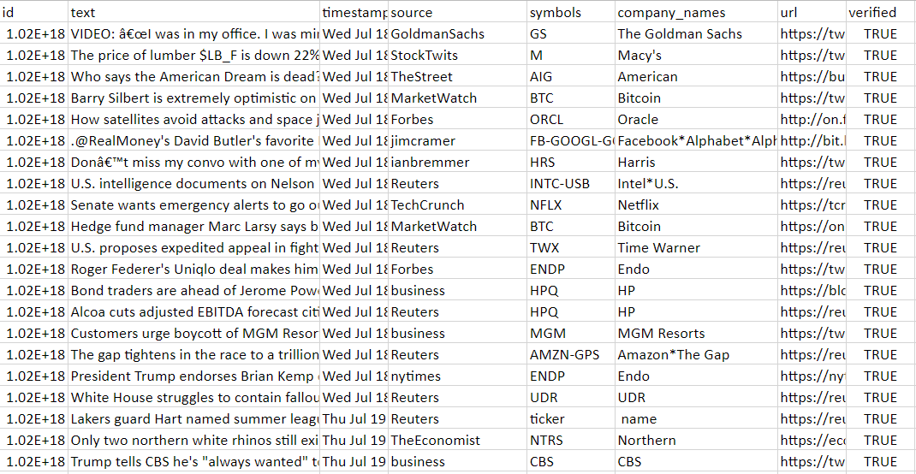

Slide 4
Do Twitter Mentions Impact Stock Prices?
Collected stock data for mentioned stocks over same period
Tracked day-to-day stock change
Compared number of twitter mentions to stock performance and mention by source type to stock performance

Slide 5
Key Facts
396 Stocks
24753 Tweets
Prominent representation by major stocks such as Apple, FB, Google, Amazon, Netflix, etc.
Sources include Yahoo Finance, Federal Reserve, Jim Cramer, Goldman Sachs, Morgan Stanley, Mark Cuban, Ben Bernanke, Forbe, The Economist, etc.

Slide 6
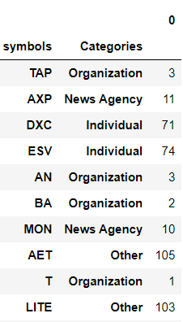
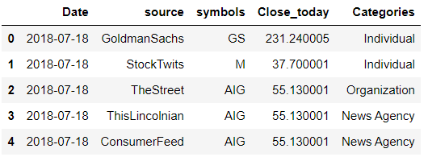
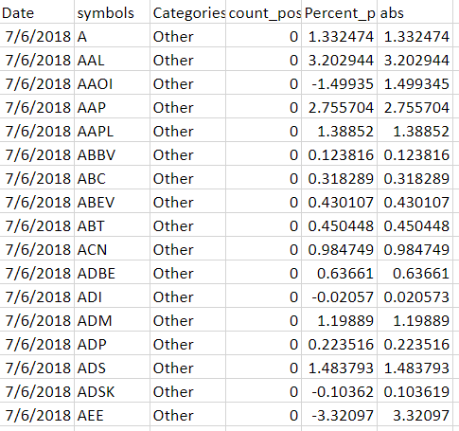
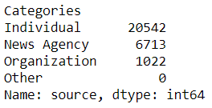

Slide 7
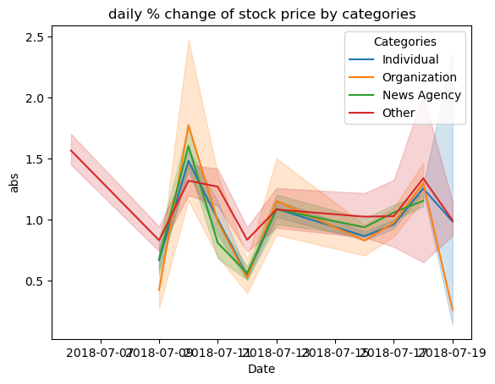

Slide 8
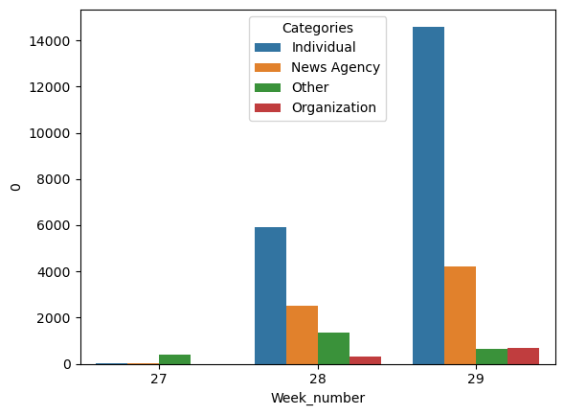

Slide 9
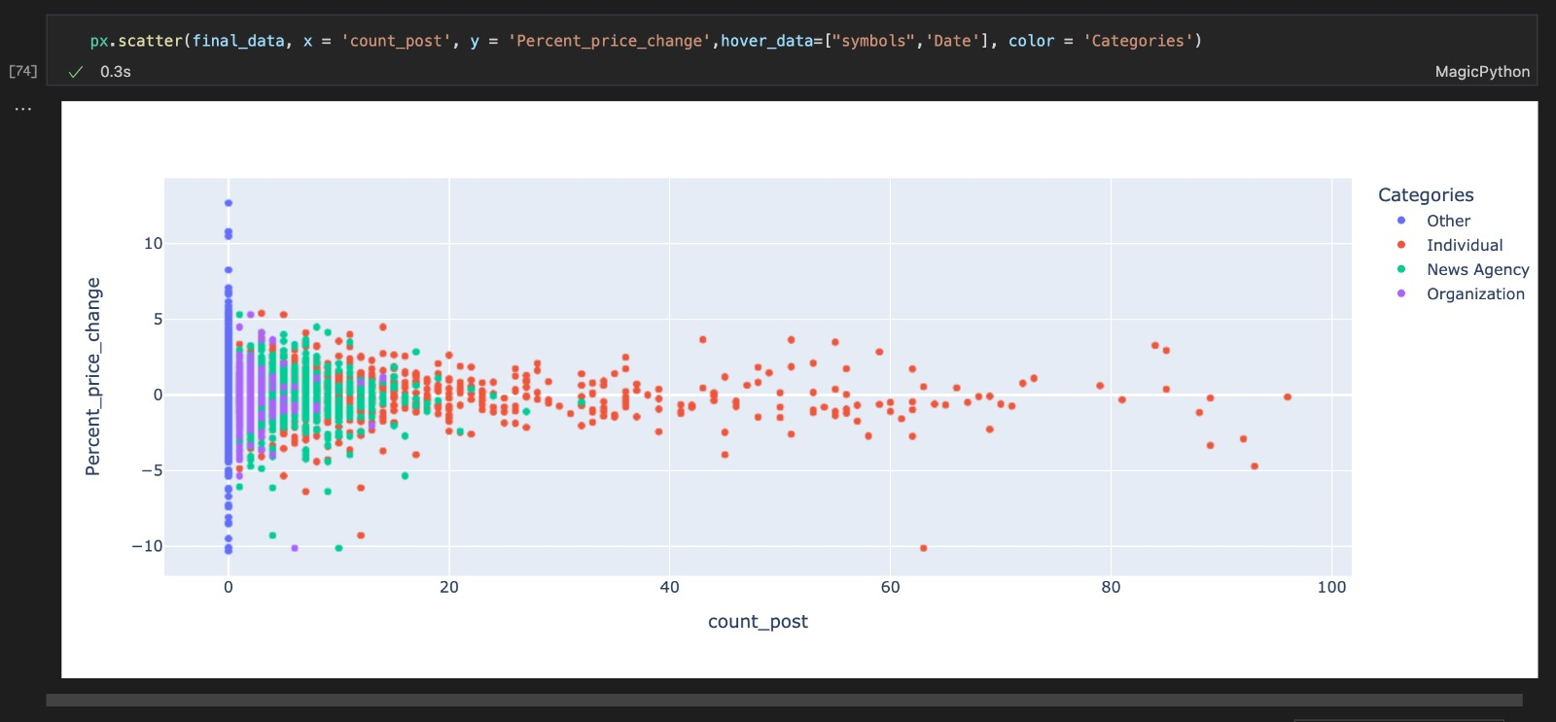

Slide 10
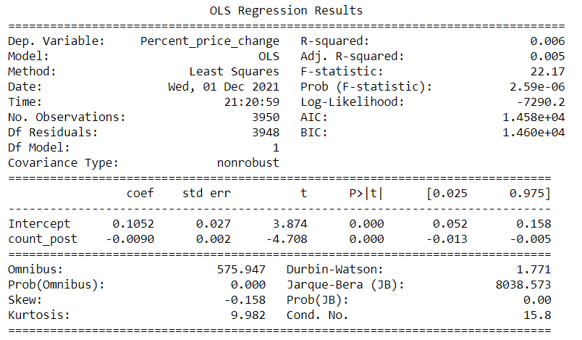

Slide 11
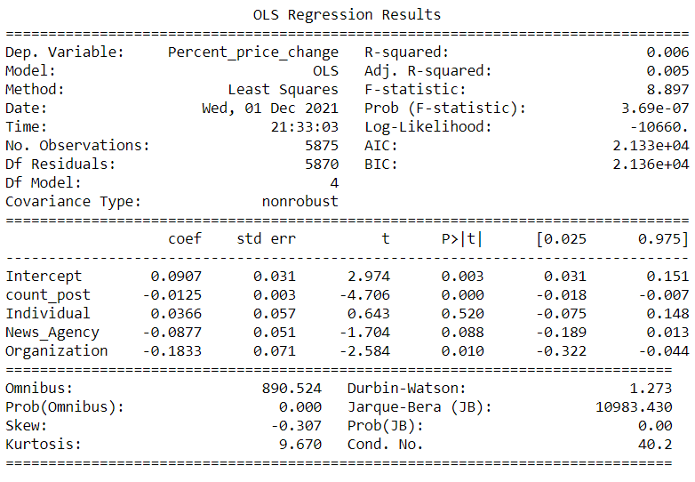

Slide 12
