Slide 1

FACTORS DRIVING THE CREDIT CARD TOTAL SPEND

Slide 2
BUSINESS PROBLEM
Here, the problem is to find the drivers of the Total spend of Credit Card( Primary Card +
Secondary Card)
2. Given the factors, predict credit limit for the new applicants Data.
The data is given for 5000 customers and there are 130 features which are contributing in
determining the Credit Card spend.
Out of the 130 features only few are responsible to determine the spend behaviour of the
customers.
The main objective is to determine if the problem can be solved as the linear problem such
that the independent variables(Y) can be represented as a linear combination of dependent
variables (X)

Slide 3
DEPENDENT AND INDEPENDENT VARIABLES
The dependent variable(Y) in the given data is the combination of cardspent (Primary Card) and card2spent(Secondary Card which is Total_spent.
The independent variables (X) in the given data are mainly the (variables)features such as:
region
agecat
edcat
jobcat
union
empcat
inccat and so on……….

Slide 4
ELIMINATION OF FEATURES
The features can be eliminated based on business importance like:
Cust_id, birthmonth is eliminated.
The features having redundant behavior like having categorical as well as continuous behaviour are eliminated like: employ, address, commute, income..
The features having high percentage of missing values (>25%) are eliminated which are: lntollmon, lntollten, lnequipmon, lnequipten, lncardmon, lncardten, lnwiremon, lnwireten.
Finally 50+ variables are selected using Recursive Feature Elimination.
In the final model 25-30 variables have been taken for regression analysis.

Slide 5
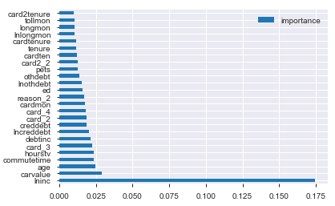
FEATURE IMPORTANCE

Slide 6
KEY DRIVERS
The key drivers of the model are:
card2_2
card2_3
hourstv
card2_4
card2_5
card2benefit_3
card_2
card_3
card_4
card_5
cardfee
cardtenurecat_3
lninc
cardmon
commutebike
default
gender
owndvd
reason_2
reason_9
ed
region_5
telecommute

Slide 7
REASONS OF FAILURE OF THIS MODEL
This is because most of the independent variables have weak/negative correlation with the dependent variable.
Model is not complex and has noise.
The variables are not explaining the dependent variable completely.

Slide 8
SOLUTIONS TO IMPROVE MODEL
Increase the size or number of parameters in the ML model.
Increase the complexity or type of the model.
Increasing the training time until cost function in ML is minimised.
Using modeling techniques like Random Forest, XGBoost can boost the accuracy.

