Slide 1
■ CS270 / TEAM PROJECT
■ A PERCEPTION-TO-MOTION PLATFORM
Vision-Guided Remote
Robotic Arm Platform
Hand tracking, remote control, and physical interaction through a LEGO robotic arm.
Presenters Team 1
Course CS270

Slide 2
■ 01 / PROJECT OVERVIEW
02 / 12
A camera-controlled arm that interprets
human movement.
The arm's value is the general control platform, not any single trick.
A gesture game can be one audience-facing interaction. The same tracking and motion layers also support grasping, pointing, hand-following, scripted social gestures, and manual remote commands.
A camera observes the user. Computer vision extracts hand and target state. Control logic chooses an intent. The robotic arm executes a calibrated motion.
Interactive
Responsive
Understandable
Vision-Guided Robotic Arm

Slide 3
■ 02 / PROJECT OVERVIEW
03 / 12
The technical center is hand-motion
detection and classification,
with low delay.
Camera choice — evaluated, not assumed
Hand recognition — broader scope
A Pi camera fits a compact embedded build once mounting is stable.
Instead of a few static signs, we track hand landmarks, palm position, finger openness, thumb orientation, pointing direction, and recent motion history. New intents can be mapped to new robot actions without rebuilding the hardware.
Vision-Guided Robotic Arm

Slide 4
■ 03 / SYSTEM GOALS
04 / 12
Five goals shape every
implementation decision.
G·01
Vision-based interaction
Read hand position, finger state, pointing direction, and motion from a live camera feed.
G·02
Remote robotic control
Gesture, keyboard, or web-interface commands all trigger the same robot motion layer.
G·03
Physical object interaction
Calibrated open, close, reach, hold, release, and reset actions for basic pick-and-place.
Expressive behavior
Short greeting, acknowledgment, pointing, and response sequences to make the demo memorable.
G·04
Safe fallback
When input is unclear: pause, return to neutral, or switch to manual rather than send unsafe motion.
G·05
Vision-Guided Robotic Arm

Slide 5
■ 04 / TECHNICAL FRAMEWORK
05 / 12
A four-stage pipeline from pixels to motion.
Each stage has a narrow contract with the next. That keeps the system debuggable and lets us swap perception, intent, or actuation independently.
STAGE 01
STAGE 02
STAGE 03
STAGE 04
Camera
Input
Intent &
Control
Perception
Actuation
External webcam during development. Pi camera for compact build. Final choice based on FOV, lighting, and mounting.
OpenCV + MediaPipe Hands. Outputs palm center, landmarks, per-finger open/closed, motion direction.
Finite-state controller picks intent: follow, grasp, point, greet, respond. Stable across frames before firing.
LEGO SPIKE arm with calibrated poses. Composes neutral, open, closed, point, reach, reset into behaviors.
Vision-Guided Robotic Arm

Slide 6
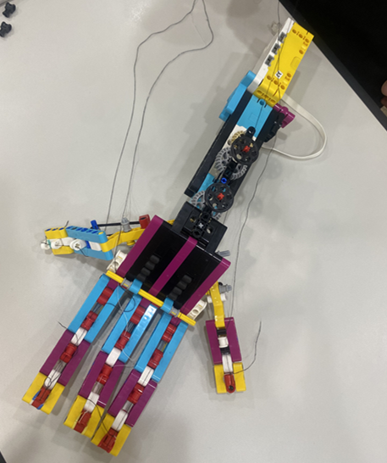
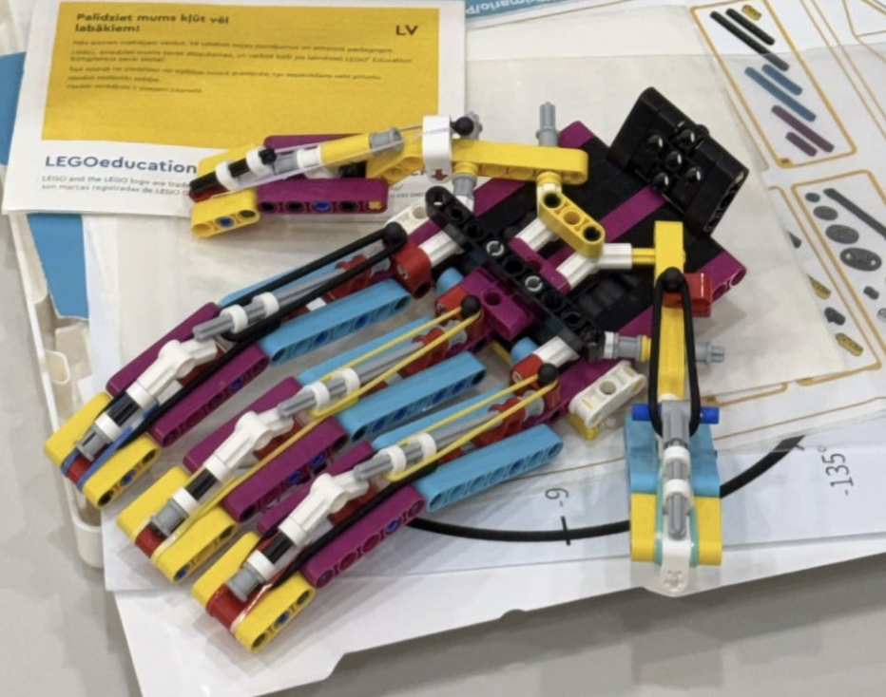
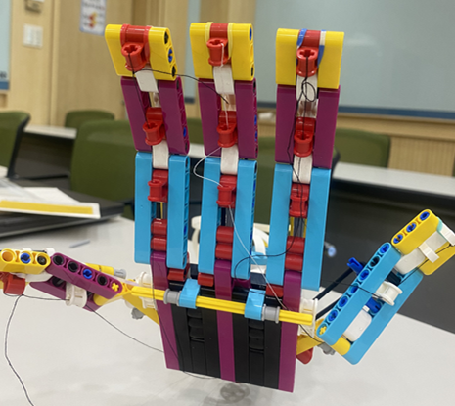
■ 05 / OUR ROBOT ARM SO FAR
07 / 12
● STAGE 02 OF 04
Vision-Guided Robotic Arm
21 landmarks — MediaPipe Hands output

Slide 7
■ 06 / INTENT & CONTROL LAYER
08 / 12
● STAGE 03 OF 04
INTENT VOCABULARY
Visual state → robot intent.
Follow the hand
Open gripper
Close gripper
Select target
Point at direction
Greeting sequence
Response sequence
Game interaction
A finite-state controller mediates between perception and motors so the arm doesn't lurch on every small visual change. The same intent layer also accepts keyboard and web commands one path, two front-ends.
WHY A REMOTE PATH MATTERS
If live tracking gets unstable mid-demo, the same motion primitives are still reachable through keyboard or web commands while the live camera overlay shows perception is running. The presentation never goes silent.
Vision-Guided Robotic Arm

Slide 8
■ 07 / ACTUATION LAYER
09 / 12
● STAGE 04 OF 04
SAVED POSES
Calibrated poses, composable behavior.
Neutral
Open
Closed
Pointing
Reach
Reset
SAFETY STATES
A LEGO SPIKE arm with saved motor positions. Complex behaviors are built as sequences of simple primitives every high-level action decomposes into known, repeatable commands.
Ambiguous command, lost tracking, or end of sequence → return to neutral or wait. Motor limits and pose ranges are checked during calibration to avoid self-collision and excess strain on the LEGO mechanism.
Vision-Guided Robotic Arm

Slide 9
■ 08 / IMPLEMENTATION PLAN
10 / 12
Five phases, each with a deliverable we can demo.
PHASE 01
PHASE 02
PHASE 03
PHASE 04
PHASE 05
Mechanical baseline
Camera & tracking baseline
Gesture-to-intent mapping
Motion primitives
Integrated demo
Stable LEGO arm. Gripper assembly. Neutral pose, open/close pose, reset behavior.
Live video feed with hand landmarks, palm position, and basic object tracking.
Reliable mapping for open, closed, pinch/select, point, wave, follow, stop, plus game mode.
Reusable actions: move, open, close, point, hold, release, wave, return to neutral.
Live perception overlay, robot response, remote override, prerecorded backup video.
Vision-Guided Robotic Arm

Slide 10
■ 09 / RISKS & MITIGATION
11 / 12
Where it could go wrong
and how we can catch it.
Risk
Mitigation
Lighting and camera placement
Calibrate the camera setup in the demo room and use a stable mount.
Ambiguous hand input
Use a confidence gate and neutral fallback rather than forcing a classification.
Mechanical inconsistency
Calibrate poses and use repeatable primitives instead of one-off commands.
Robot delay / communication
Measure the full perception-to-motion loop; keep a manual command path ready.
Live-demo failure
Prepare a build/demo video and a live CV overlay so the project stays understandable.
Vision-Guided Robotic Arm

Slide 11
■ 10 / EXPECTED OUTCOME
12 / 12
A SUCCESSFUL DEMO SHOWS
A working arm platform that reads a person's hand intent from video and converts it into visible physical action.
Live hand tracking
A visible command state
Calibrated arm movement
Several distinct interaction behaviors
Presented as a general remote robotic arm system with a fun demonstration layer on top.
Vision-Guided Robotic Arm

