Slide 1
Design and Simulation of a Robotic Arm using Computer Programming
Presented by: Devarsh Randeria(11840420)
Himani Madaan(11840550)
Sanjay Kumar Purty(11840990)

Slide 2
ROBOTIC ARM
A robotic arm is a type of mechanical arm, usually programmable, with similar functions to a human arm.
There are two types of motion provided by the joints of robotic arm i.e, translational and rotational.
Applications of a pick and place robot:
Assembly
Packaging
Bin picking
Inspection

Slide 3
DESIGN
The robotic arm is assumed to be a shaft and the design is done accordingly.
The weights of the individual links are considered to be negligible.
Consider a payload of mass m kg that needs to be lifted by a pick and place robot.
Let L be the total length of the robotic arm link.
So, L=L1+L2 where L1 and L2 are lengths of link 1 and 2 respectively where L1/L2=1.5.
Let d be the diameter of the robotic arm whose dimension is considered to be 5mm.
Robotic arm is made up from Aluminium 6061.
The yield strength of Al 6061 is considered to be 150 MPa and a factor of Safety(FOS) of 3 is considered.

Slide 4
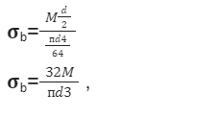
DESIGN
Now when the shaft is subjected to pure bending moment, the bending stress is given by,
Yield tensile strength of aluminium(also considering FOS) should be greater than the bending stress generated, thus,

Slide 5
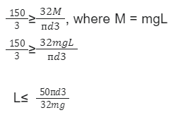
DESIGN
Here the mass value will be taken from the user and accordingly the total length of the arm and the individual length of the links will be calculated.

Slide 6
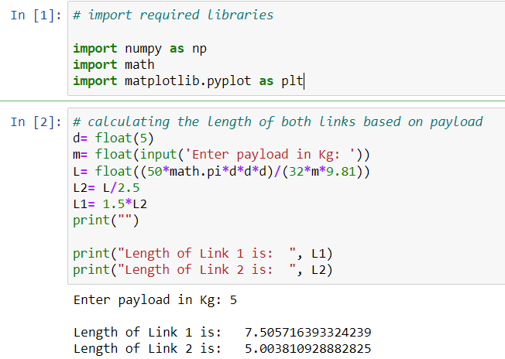
CODING

Slide 7
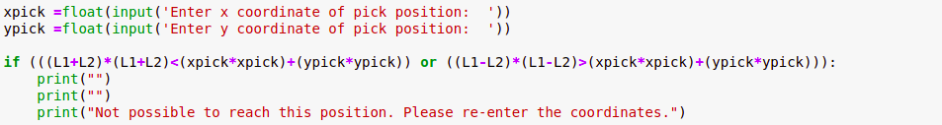
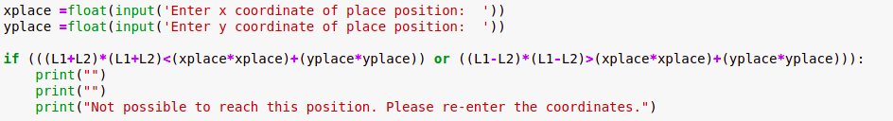
Pick and Place position

Slide 8
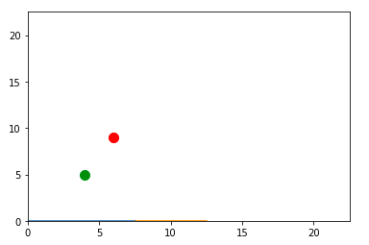
Ploting the pick and place position

Slide 9
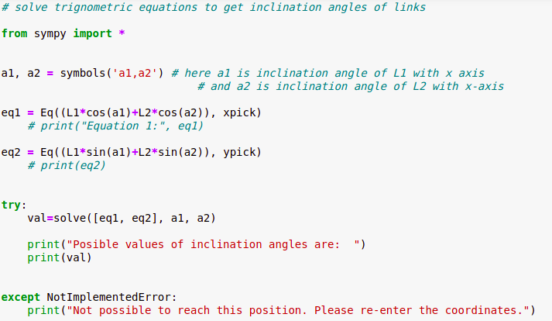
Finding possible angles of pick and place position

Slide 10
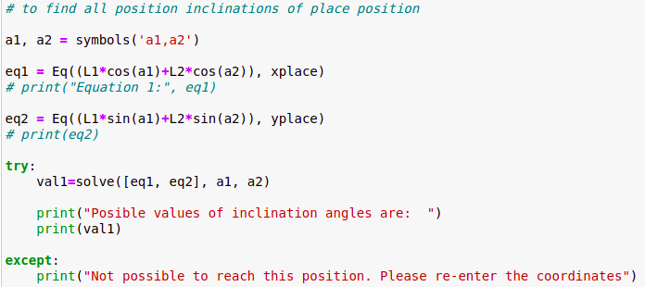

Slide 11
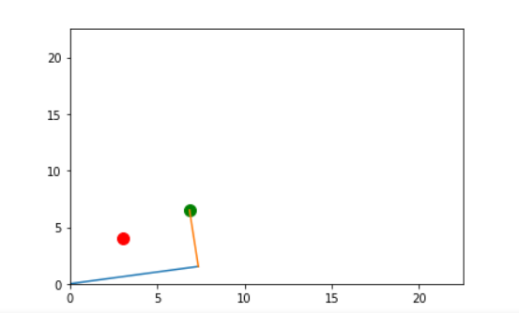
Finding Optimal Solution:
Based on area swept by the links to attain that particular angle (from current position).
Angle pair with minimum swept area will be considered.

Slide 12
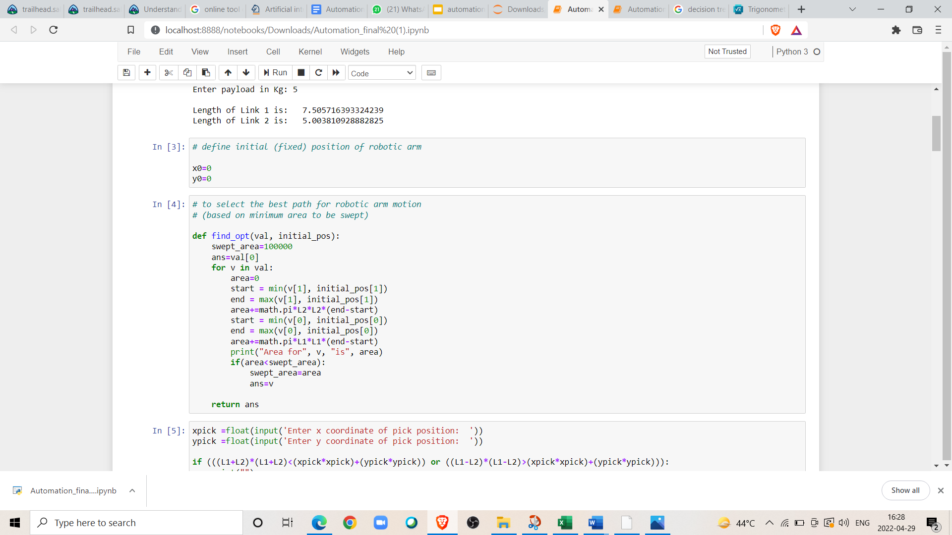
Function Definition:

Slide 13
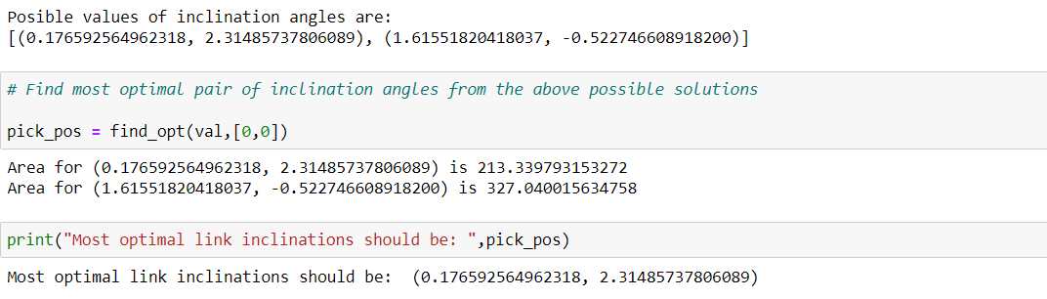
Function Call:

Slide 14
Movement of Links
Movement 1: Moving link 1 from 0 inclination angle to pick position, keeping L2 fixed at 0 inclination angle.
Movement 2: Moving link 2 from 0 inclination angle to pick position, keeping L1 fixed at prev position.
Movement 3: Moving link 1 from pick position to place position, keeping L2 fixed at prev inclination angle.
Movement 4: Moving link 2 from pick position to place position, keeping L1 fixed at prev final inclination.

Slide 15
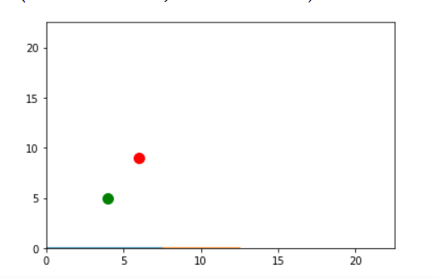
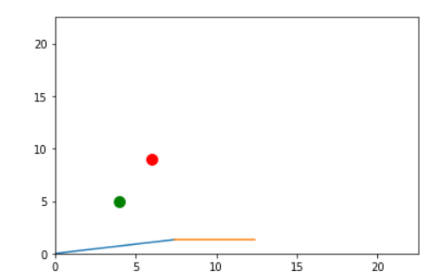
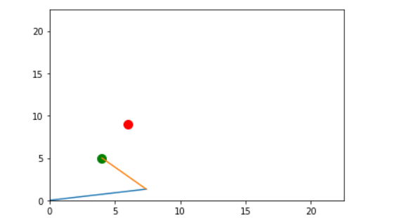
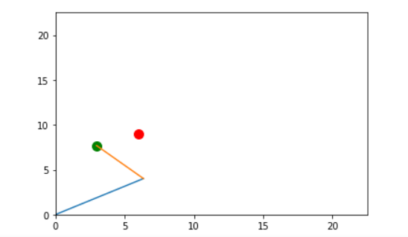
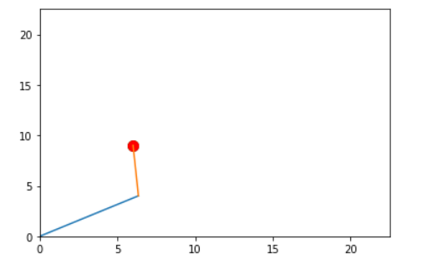

Slide 16
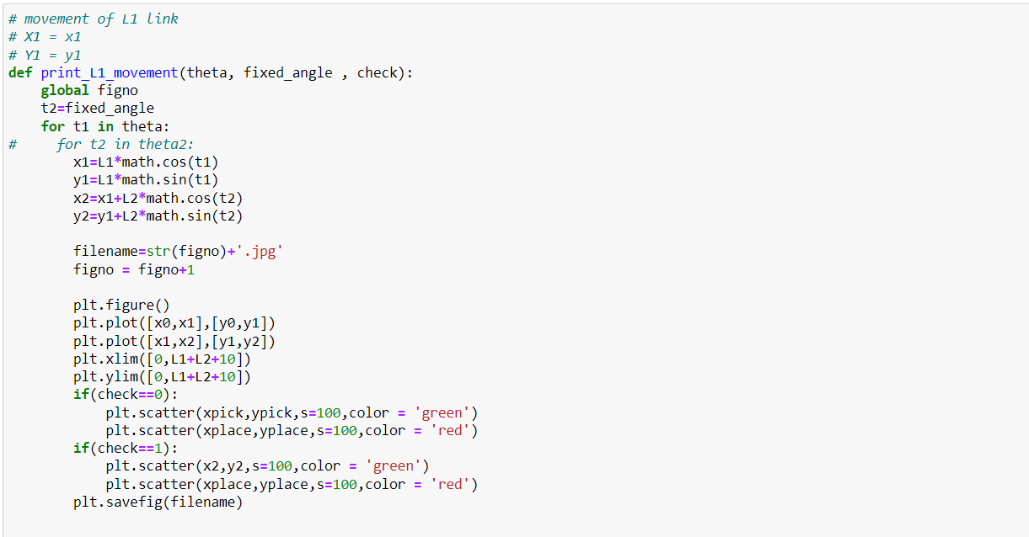
Function Definition:

Slide 17
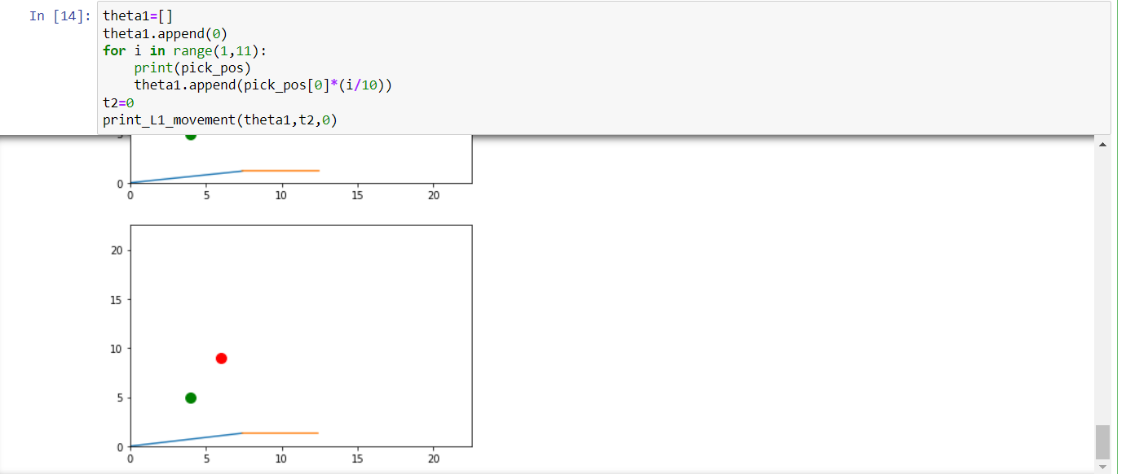
Function call:

Slide 18
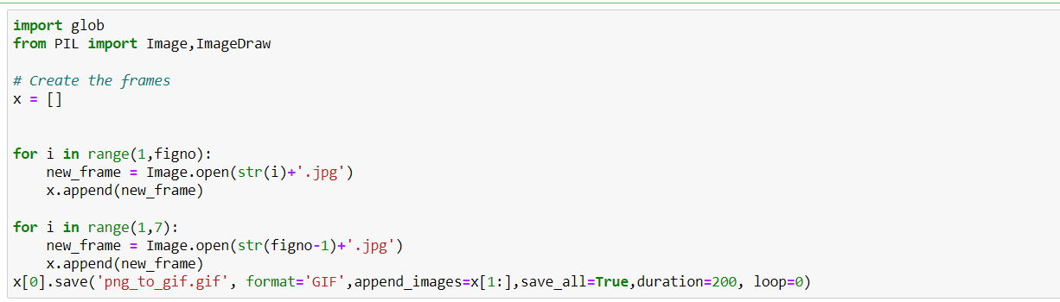
Converting Frames to GIF:

Slide 19
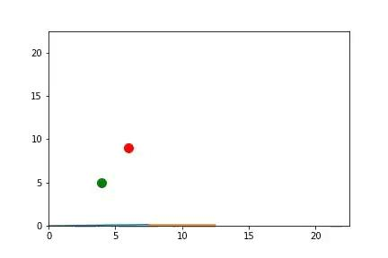
Resulting Simulation:

Slide 20
Future Work:
Using ML for object detection:
The simulation done above does not identify a object, it only performs a pick and place operation. Object identification can be added to the robotic arm using machine learning i.e, it only picks a specified colour object from a range of colours in a given plane and then picks it and drops it to the required location.
Here the major problem is that because of large number of objects some object might interrupt the path which robot may choose to travel because of which path optimization needs to be performed using inverse kinematics method which is currently beyond the scope of this paper.

Slide 21
Resources:
Term Paper Link: https://drive.google.com/file/d/1OahhG0NxmjSq7T84h_o3rhcxu8roA2We/view?usp=sharing
Python Code Link: https://drive.google.com/file/d/1hMMUGNlNVgi2FVtHHVqPDRASyTXIw1Ww/view?usp=sharing
Sample Simulation Link: https://drive.google.com/file/d/1DOG2YclE1kHE-RIaaZbFTiIJu8zRMDNn/view?usp=sharing

Slide 22
Thank you…!

