Slide 1
Calendar Service
PREPARED by: Himani Patel

Slide 2
Tools & Technology
Terms | Technology
Client | Jersey Client
Web Service | REST API, Java
Testing Framework | Junit
Server | Tomcat 7.0
Project | Java Maven Project
Development Tool | Eclipse

Slide 3
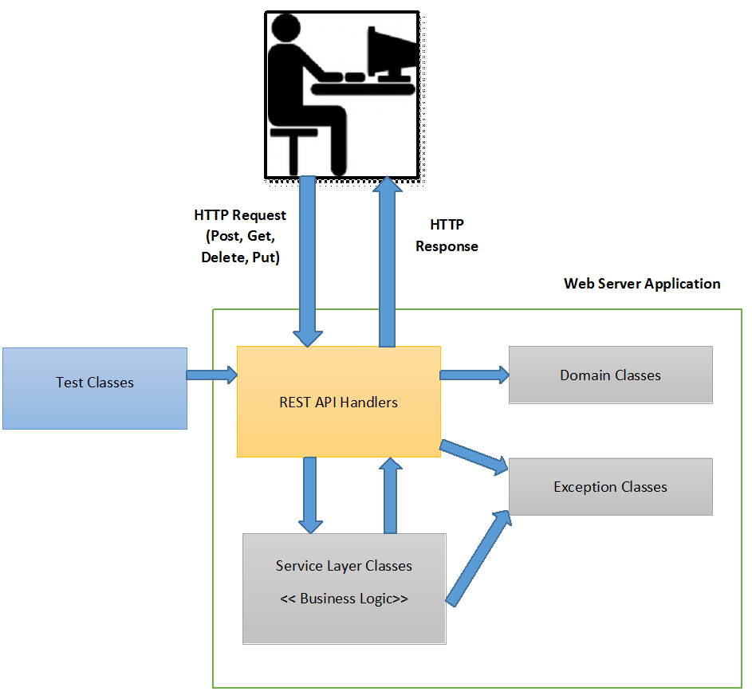
High Level System Architecture

Slide 4
Functionality
Schedule Meeting
Check for room availability for given time slot
Check for host/attendees availability for give time slot
Get meeting by meeting id
Cancel meeting
Update meeting by changing room or add/remove attendees
Get room details by name
Get person details by email id
View room calendar for given date (also for work hours)
View person calendar for given date (also for work hours)

Slide 5
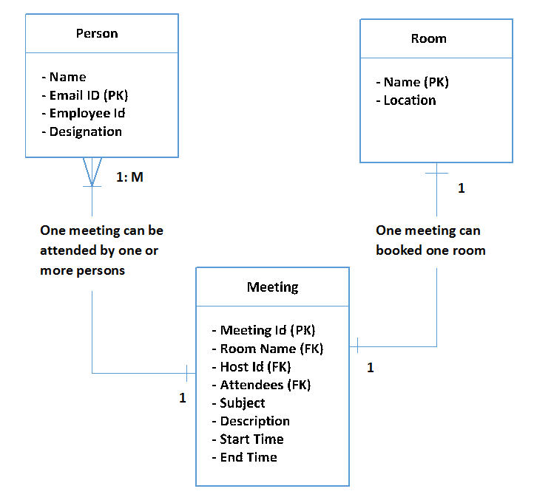
Entity Relationship Diagram

Slide 6
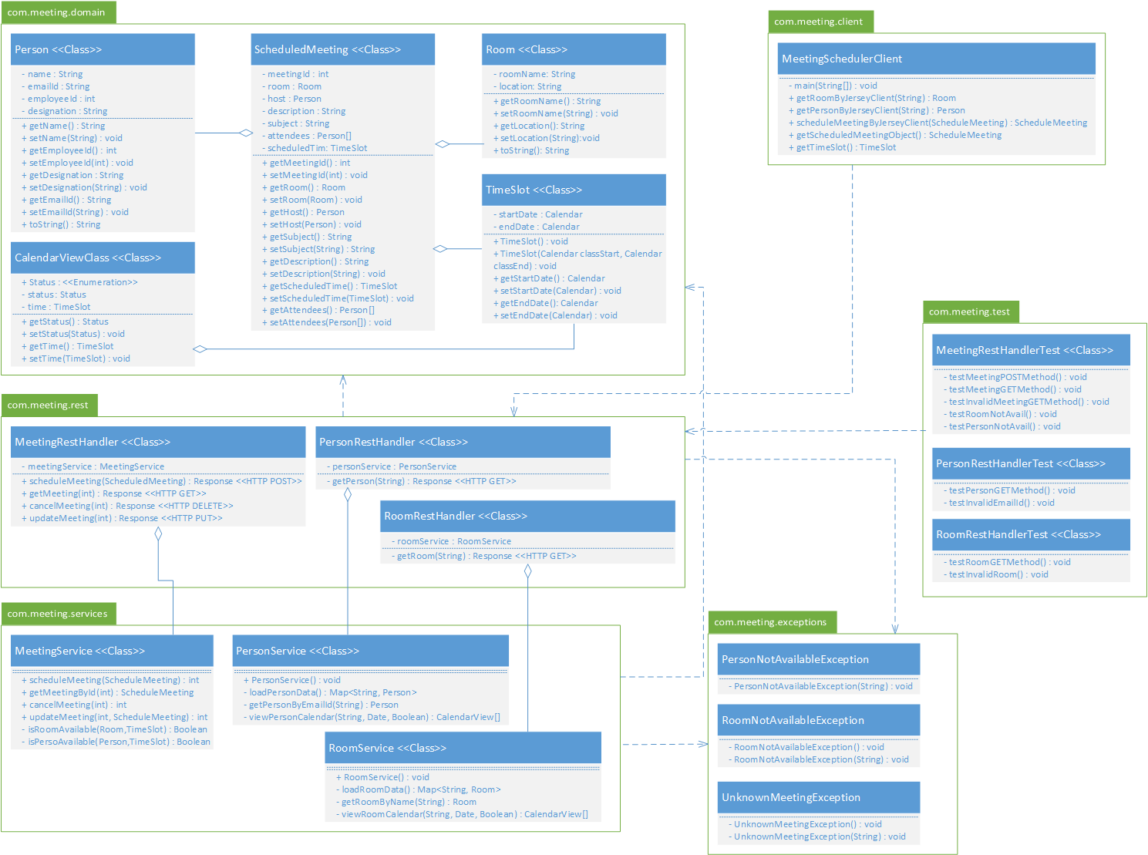
Class Diagram

Slide 7
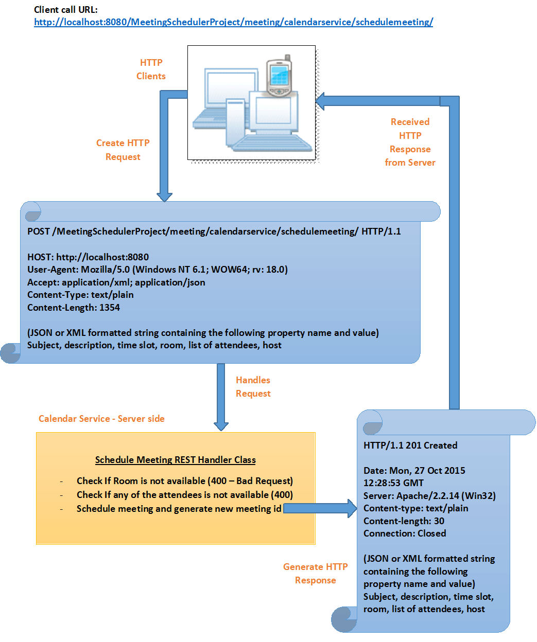
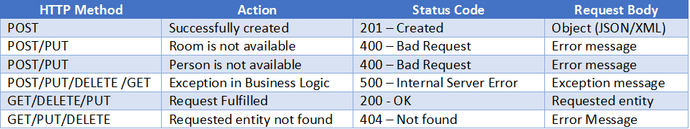
Schedule Meeting - API
HTTP Status Codes used in Calendar Service

Slide 8
Thank You!

