Slide 1


BUSINESS DECISION INTELLIGENCE
Dr Himani

Slide 2
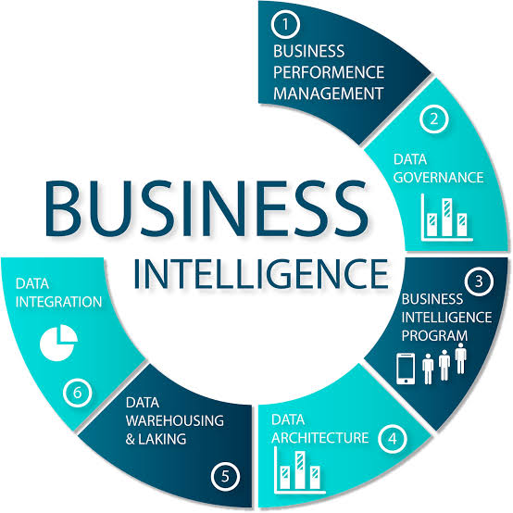
Business intelligence
According to Wikipedia “ consists of strategies, methodologies, and technologies used by enterprises for data analysis and management of business information to inform business strategies and business operations”
According to Solomon Negash and Paul Gray, business intelligence (BI) can be defined as systems that combine:
Data gathering
Data storage
Knowledge management
with analysis to evaluate complex corporate and competitive information for presentation to planners and decision makers, with the objective of improving the timeliness and the quality of the input to the decision process.

Slide 3
Business Intelligence
Business intelligence refers to a collection of mathematical models and analysis methods that utilize data to produce valuable information and insight for making important decisions.
Main Components of Business Intelligence System:
1.Data Source
2.Data Mart / Data Warehouse
3.Data Exploration
4.Data Mining
5.Optimization
6.Decisions

