Slide 1
Car Price Prediction

Slide 2
Business Problem
With the change in market due to Covid 19 impact, Car market is facing problems with their previous car price valuation machine learning models. Here we will develop new machine learning models from new data to evaluate car price.

Slide 3
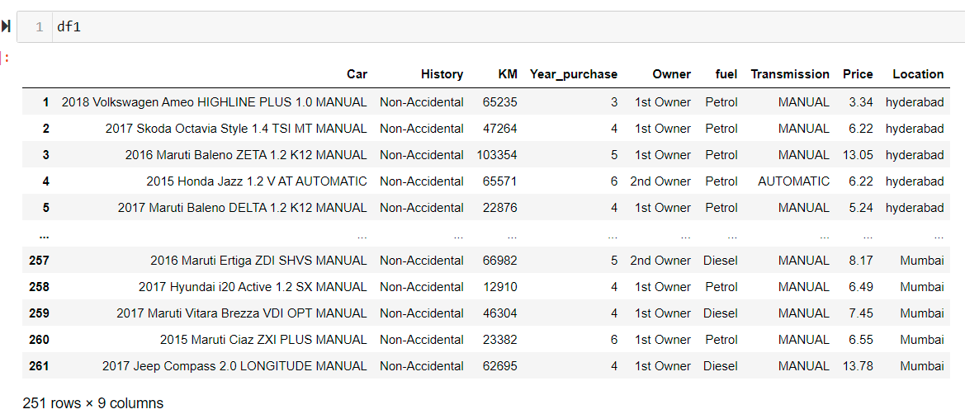
Data Set

Slide 4
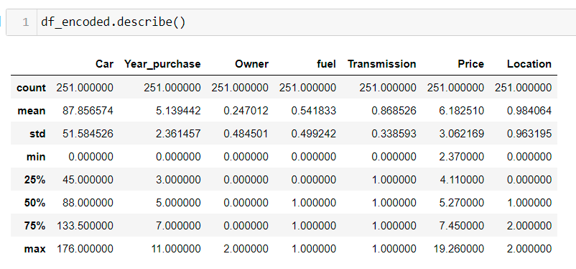
Statistical Description

Slide 5
Data Preprocessing
The required steps were taken, the NAN values were replaced.
Unwanted columns were dropped
The data set was treated for further preparation

Slide 6
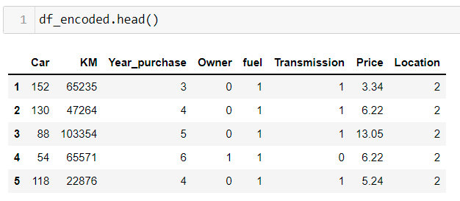
Cleaned data for further analysis

Slide 7
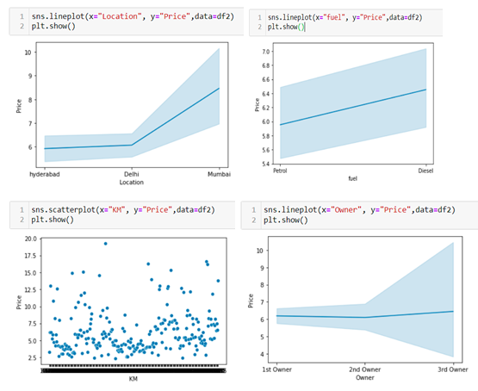
Visualization

Slide 8
Observation
The vehicles in the Mumbai as more resale values.
Diesel vehicle has more expensive.
Distance covered did not give a better picture and prices are spread, and majorly constant.
The number of owner doesnot make much cange in the price of the vehicle.

Slide 9
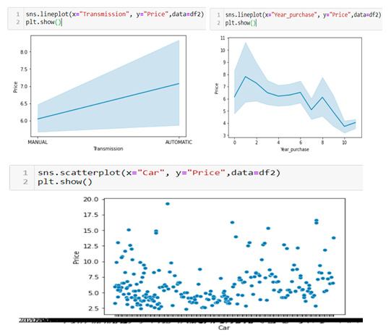
Visualization

Slide 10
Observation
Further the automatic vehicles are more in expensive, while the older the car is lesser is the price.
Also the car models are uniformly distributed, with some exceptions.

Slide 11
Key Metrics Used
Mean Squared Error
Root Mean Squared Error
Mean Absolute Error

Slide 12
Models Used
LinearRegression
SVR
RandomForestRegressor
GradientBoostingRegressor

Slide 13
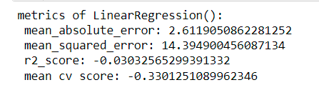
Final Observation
Selecting Linear Regression Model as it has low RMSE and better R2.

Slide 14
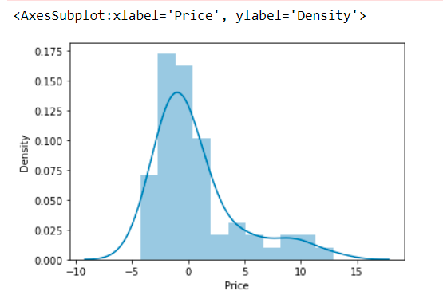
Distribution plot: test data

Slide 15
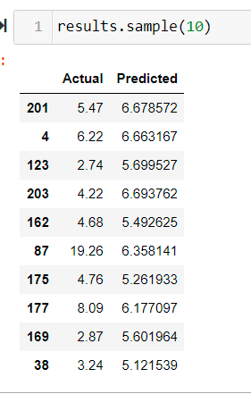
Result Sample: Actual vs Predicted

Slide 16
Thank You
Himani Uniyal

