Slide 1
Crime Rate Detection and Probability in various areas of India

Slide 2
Why did we choose this idea?
In a report, it has been claimed that crimes in India saw a ‘marginal increase’ in the first 45 days of this year (2018) as compared to the corresponding period of the previous year.
It is worth mentioning here that, in 2016, according to the NCRB data, the total crimes were recorded to be 2.97 million while the crime rate was found to be 379 crimes per lakh population.
Not much technology in India has been dedicated to solve crimes or make people aware about them. Various helpline numbers have been encouraged to use but none of them really helps to alert people.

Slide 3
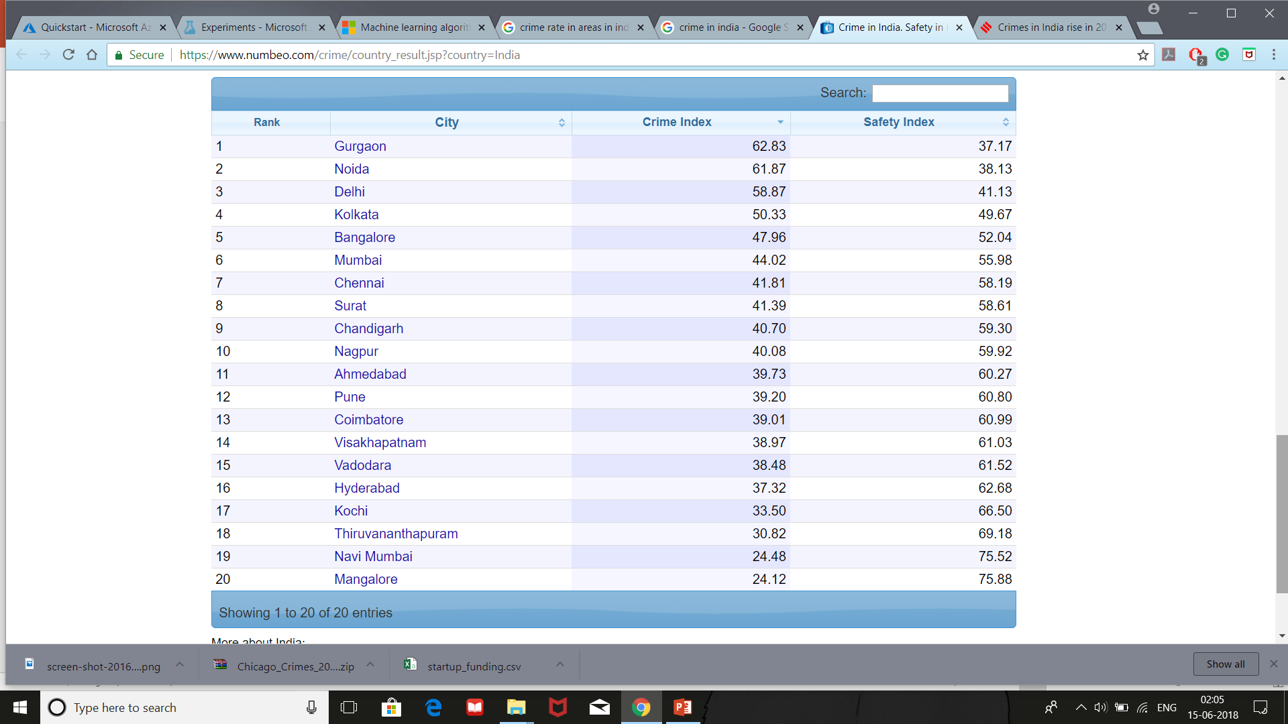

Slide 4
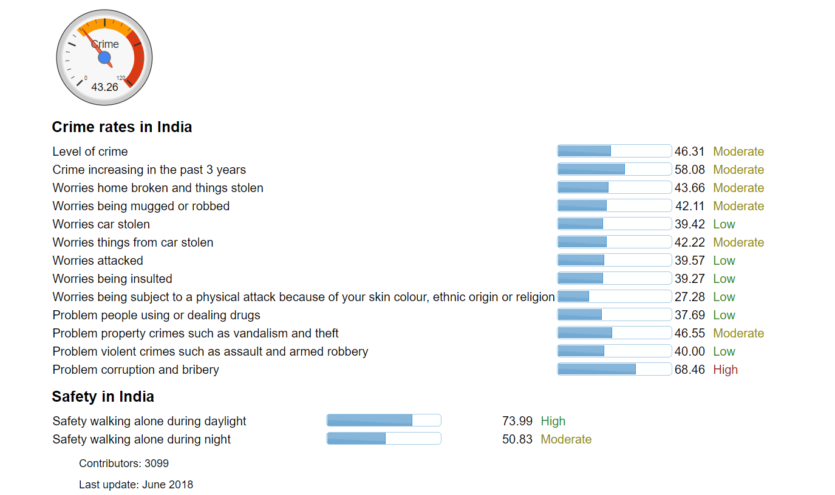

Slide 5
Scope
This project basically predicts the probability of a crime taking place at a particular place based on the dataset given to it.
It can also tell about the kind of crimes that took place for example, if it was a theft or a murder.
It assesses the number and type of crime taken place over the year at that place and gives the required result.

Slide 6
Limitations
The dataset that we provided is of Chicago from the year 2012 to 2017.
To know about the exact probability of some crime, we need to enter the exact coordinates of the place.

Slide 7
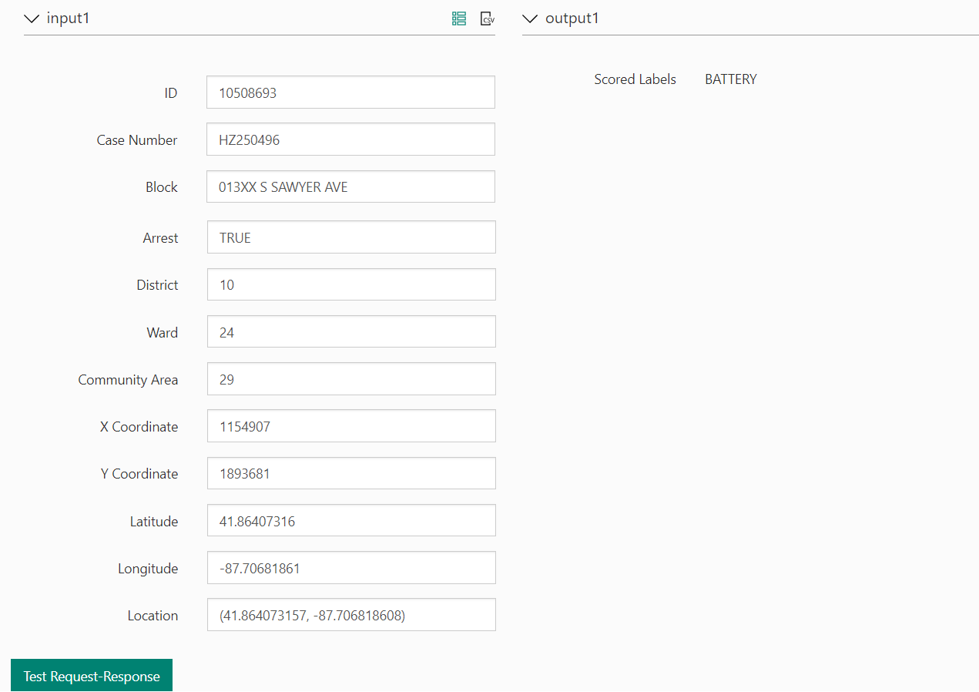

Slide 8
India is listed as one of the ten most dangerous places for women travellers
Why it's so dangerous: "India is a Trip by Skyscanner favorite destination for solo female travelers and one of the most complex, with wide variations across regions," says Pond. But the country continues to experience terrorist activities that may impact U.S. citizens, according to the State Department. "Past attacks have targeted public places, including some frequented by Westerners, such as luxury and other hotels, trains, train stations, markets, cinemas, mosques and restaurants in large urban areas," advises the State Department. "Attacks have taken place during the busy evening hours in markets and other crowded places, but could occur at any time."
Trip by Skyscanner's advice for how to stay safe:
If you go, go with eyes wide open. Even with a companion,
sexual assault remains a serious and ongoing problem.
Wear long, loose clothing that covers your shoulders. Lots of female travelers we know even buy and wear Indian clothing upon arrival.
Be prepared for staring; you’ll likely experience a lot of it.
Start and end your days early to avoid being out at night.
If taking the train, purchase the highest-class train tickets in advance and take women-only transportation options in cities like Delhi.
Never walk alone on city streets at night. In smaller towns, try to have a male companion. Even then, this may not be enough of a precaution.
Regions like Kerala and cities like Rishikesh (known for its regular influx of yoga students) are comparatively safe, as are Gujarat, Punjab and Calcutta. Family-run guesthouses can be lovely places to stay.
Take a small doorstop with you in case you’re staying in accommodations that make you uneasy (Pond had an unexpected late overnight in Bangalore once and says she felt anything but relaxed). These can slow an intruder down for a few seconds, long enough to yell for help or find an escape route.

Slide 9
The sun, sand and rocking nightlife of the famed beaches of Goa hide a dark underbelly: The iconic holiday destination has claimed the lives of roughly 20 foreigners every year in the last decade or so.
The rape and murder of 28-year-old Irish woman Danielle McLaughlin in Canacona in March this year was only the latest in a long list of crimes against foreigners in the coastal state.
According to an RTI reply accessed by a local activist in support of relatives of several of the deceased, a shocking 245 foreigners have died in Goa in the last 12 years.
What should worry the state that receives more than 5 lakh tourists every year is that more and more foreigners are raising their voice over safety and security issues. In at least half a dozen cases where the relatives managed to get the courts to order re-investigation, the “natural” deaths turned out to be pre-meditated murders.

Slide 10
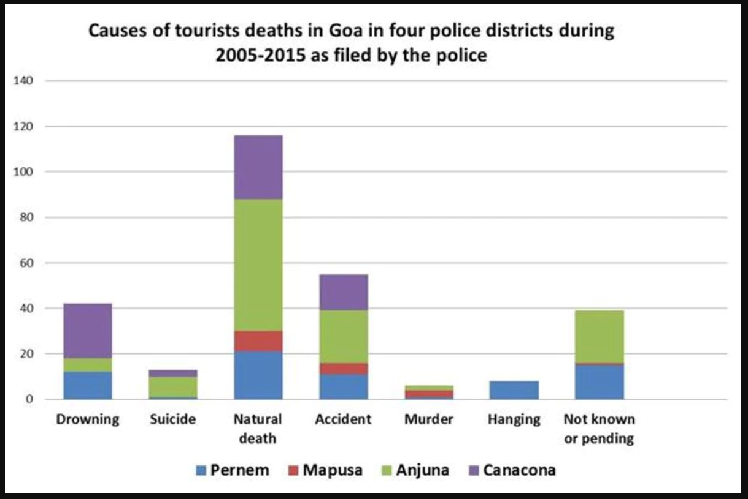

Slide 11
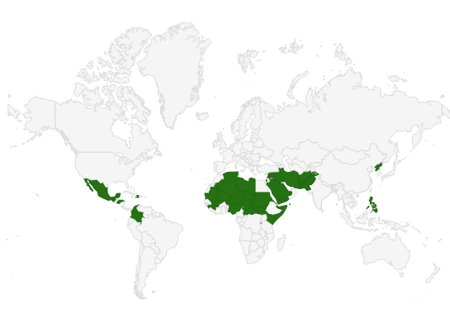
The U.S. State Department also puts out travel warnings when there's a long-term, protracted condition that makes a country too dangerous for Americans to visit. Here is a map of all of the travel warnings that are in effect since September of last year. It likely doesn't come as a shock to anyone who reads foreign news, consisting largely of hotspots in North Africa, the Middle East, and a few outlying Asian countries such as North Korea:

Slide 12
Generally, the level of crimes is moderate and India is relatively safe for tourists. The most common types of crime are theft, armed robbery and rapes. Agree on all fares and payments in advance and being told that you can pay “as you like” is a bad sign. While travelling in the transport and in general never accept any food or drinks as they might be spiked. In order to make your trip safe. SafeAround has compiled information from numerous sources make sure you have a safe trip to India and be aware of all potential dangers. India is the 106th safest country in the world, based on the safest and most dangerous countries ranking. Is India a Safe or Dangerous country?
India is a relatively safe country, though there are some hazards each newcomer should be aware of. Terrorism is a threat, the probability of attacks is high, constant vigilance is recommended. Demonstrations and strikes might cause inconveniences and unrest. It can be escalated rapidly and turn violent. Monitor local media in order to be aware of any strikes in advance. Swimming in India: Seemingly to be safe, Indian water might hide dangerous strong undertows. During monsoon season, you should exercise extra caution while swimming in open water along the Indian coastline. Every year, several people in the Bay of Bengal, Mumbai, Goa, and Puru drown. There have been reports of crocodile attacks in salt water on the Andaman Islands. Train travel: Travel by train in India is generally safe. Nevertheless, accidents and on-board fires are sometimes caused by aging infrastructure, poorly maintained equipment, overcrowding, and operator errors. Instable areas Jammu & Kashmir: Due to the high probability of terrorist attacks and frequent civil unrest, travelling to these areas with the exception of visits to Ladakh region and its capital Len is not recommended. Since the 90s, as many as 70.000 people have been killed in the Kashmir conflict. India-Pakistan border Travelling is not recommended within 10th km zone of the border between Pakistan and India. Military presence is high, due to the disputed area: Karakoram mountain range. North-eastern states Civil unrest and often bombings of public transport, make the area dangerous, thus travelling is strongly unadvised to these areas. States: Assam, Mizoram, Nagaland, Tripura, Manipur are especially under concern. Restricted/Protected areas: Certain areas need special advance permission. Areas requiring a permit include: The state of Arunachal Pradesh Portions of the state of Sikkim Portions of the state of Himachal Pradesh near the Chinese border Portions of the state of Uttarakhand (Uttaranchal) near the Chinese border Portions of the state of Rajasthan near the Pakistani border Portions of the state of Jammu & Kashmir near the Line of Control with Pakistan and certain portions of Ladakh The Andaman & Nicobar Islands The Union Territory of the Laccadives Islands (Lakshadweep) Portions of the state of Manipur Portions of the state of Mizoram Portions of the state of Nagaland Crime: Petty crime is on the rise. It is common, particularly on public transport. Travelling by train, lock your sleeping compartments. Violent crime against foreigners is uncommon. Be cautious displaying valuables or cash in order to reduce chances of being robbed. ATM scams are on the rise. Use a credit card for payments only at reputable establishments, otherwise, there is a high chance, that your credit card credentials might be stolen. Sexual assaults: India notoriously known for a high rate of sexual assaults, though many of them are committed against locals, foreigners must be cautious as well. Travelling alone for women is not recommended. Sexual harassment might occur anywhere: marketplaces, train stations, buses and public streets. Delhi has the highest rate of sexual harassment. Female tourists should be accompanied, avoid isolated areas at any time of day.

Slide 13
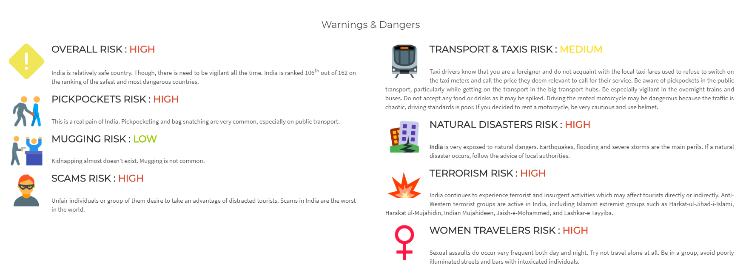

Slide 14
Competition
My cab is driving through a middle-class neighborhood of Rio de Janeiro at dusk. As we start snaking up a winding road, the street gets bumpier and there’s less lighting. As we near an intersection, a red pop-up appears on the driver’s Waze app: “Area with risk of crime.” There’s a voice alert too.
The crime warning feature, which appears in 25 areas in Rio, was launched in early August by Waze just in time for the rush of an estimated half million Olympic tourists.
Rio’s chronic crime had been on the decline for a few years, but homicides in the state surged by 17% and street robberies by 34% in the first six months of 2016, as the country’s economic crisis bit harder.
Waze isn’t the only one. Last week the Igarapé Institute, a Rio think tank, rolled out CrimeRadar, an app that shows crime rates in the city in different neighborhoods and even at different times of day.
Such warnings, however, raise a thorny ethical dilemma: Can you warn people about risky areas without stigmatizing those neighborhoods, potentially hurting businesses and denting property values?
It’s a question that’s set to become more pressing everywhere, as “open data” programs make cities and their structural inequalities more transparent. But it’s an especially tricky one in Rio, already deeply polarized between haves and have-nots.
Waze officials say the idea for a crime alert has been gestating for a few years, because of demand from its users. Waze has 65 million users worldwide, and Brazil is one of its biggest markets. To identify areas of risk, Waze tapped into data it got from Disque-Denúncia, a public safety call center inspired by Crimestoppers-style programs in the US. It also relied on the knowledge of its community of volunteer map editors in Rio, and a score of Brazilian employees.

Slide 15
CrimeRadar, which is based on government data on 14 million crime incidents, shows a map of the city with blue and green signaling lower-crime areas, and orange and red for higher-crime ones. To reduce the risk of stigma, says Robert Muggah, research director at Igarapé, the app provides data in blocks of 250 by 250 meters (820 by 820 feet) instead of at a more granular level. And, he notes, it shows that crime isn’t limited to poor neighborhoods; some middle and upper-income areas of Rio are among the riskiest. Nonetheless, CrimeRadar makes no attempt to obscure the information, which means it has even more potential than WAZE to stigmatize neighborhoods. Only time will tell whether it does—or indeed whether it makes people safer.
The bSafe app ensures the safety and security of women. It allows contacts follow you through a live GPS trail and also set a timed alarm which goes off if you haven’t ‘checked in’. Moreover, it will also make your phone ring with a fake call and also notifies the emergency contacts with the location, video and even siren

