Slide 1


Impact of RAN Virtualization on Fronthaul Latency Budget: An Experimental Evaluation
F. Giannone^{1,} H. Gupta², K. Kondepu¹, D. Manicone¹,
A. Franklin², P. Castoldi¹, L. Valcarenghi¹
¹Scuola Superiore Sant’Anna, Pisa, Italy
²Indian Institute of Technology Hyderabad, India
WS-21: International Workshop on 5G Test-Beds & Trials – Learnings from implementing 5G (5G-Testbed 2017)
Globecom 2017, 4-8 December 2017 – Singapore, Singapore

Slide 2
Summary
Virtualized New Radio Access Network (RAN)
Virtual Network Function (VNF) performance evaluation
Implementation of EPC and RAN functions in ARNO-5G testbed
Experimental Results
Conclusions

Slide 3
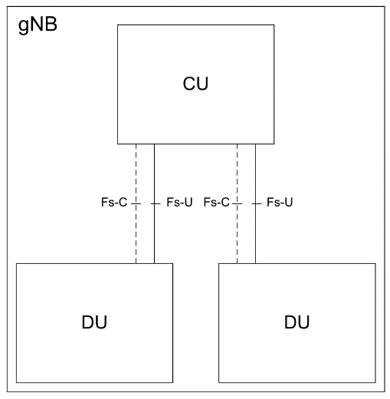
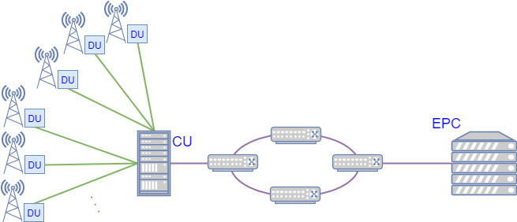
Virtualized New RAN
gNB functional split
  Distributed Unit (DU)
  Central Unit (CU)
RAN split
  Fronthaul
  Backhaul
Micro-cloud/fog node
Fronthaul
Cloud node
Backhaul
gNB

Slide 4
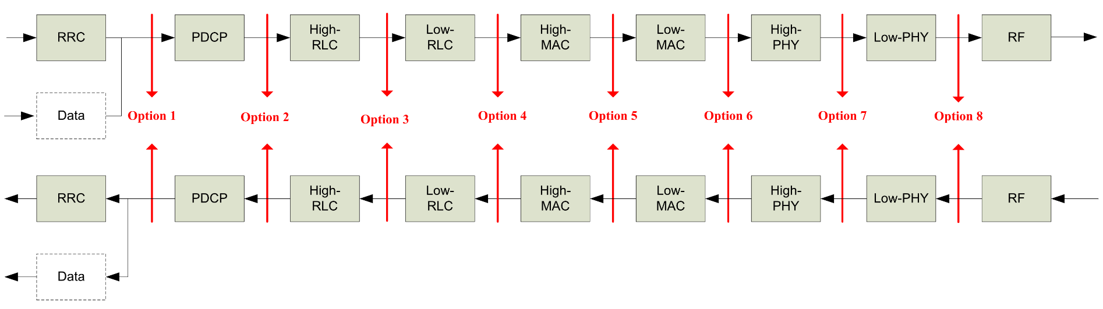
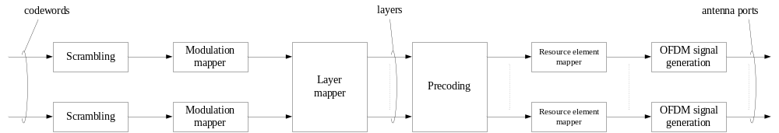
gNB Functional Splits (3GPP TR 38.801)
Option 7-1
Option 8

Slide 5
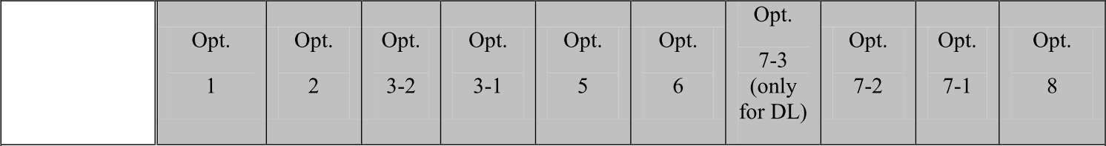
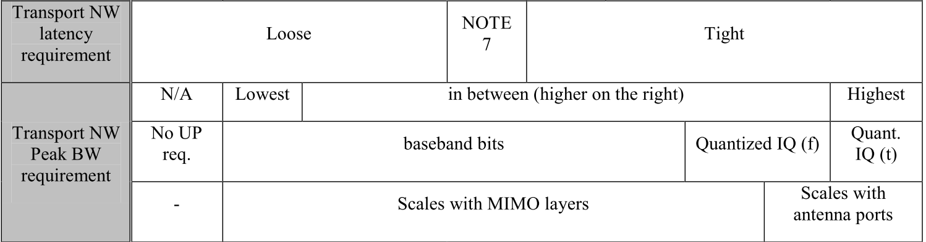


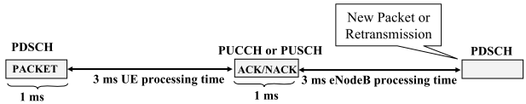
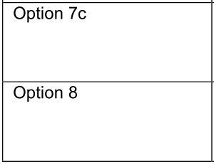
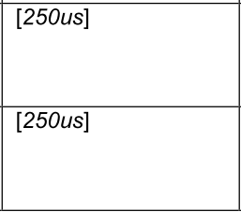
Fronthaul requirements (TR 38.801)
Not yet clarified
due to 4ms
HARQ process
Source: LTE for UMTS: Evolution to LTE-Advanced, 2nd Edition, Harri Holma, Antti Toskala
ISBN: 978-0-470-66000-3

Slide 6
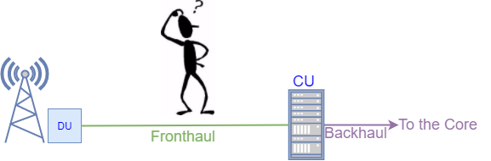
Study objective
Are the extra levels of abstraction impacting the fronthaul latency constraints?
Does the jitter impact the fronthaul link performance?

Slide 7
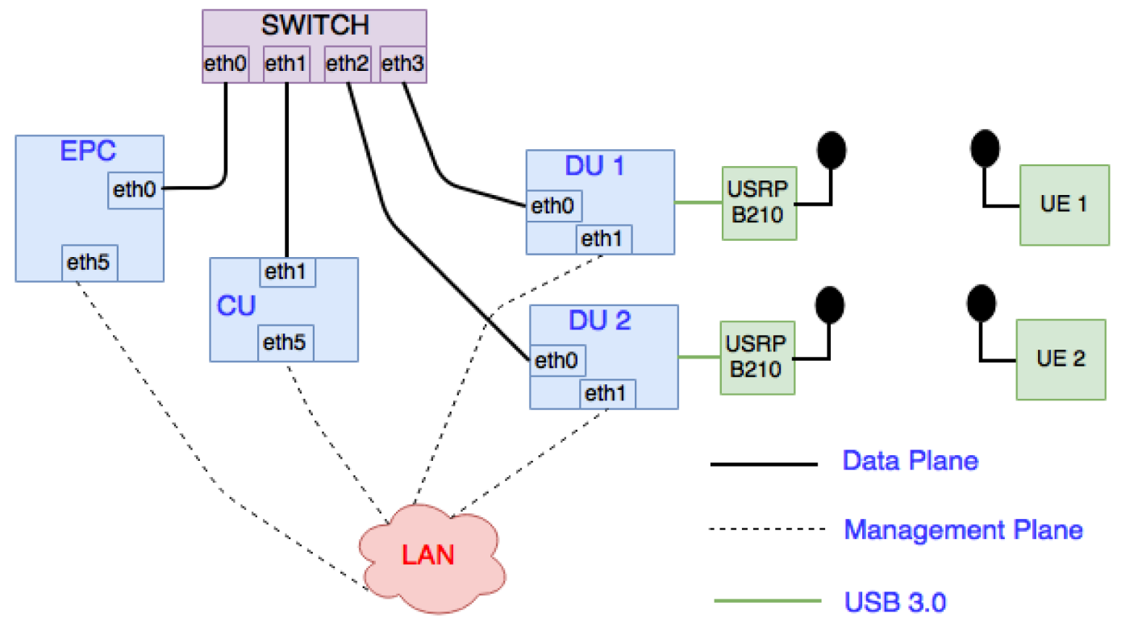
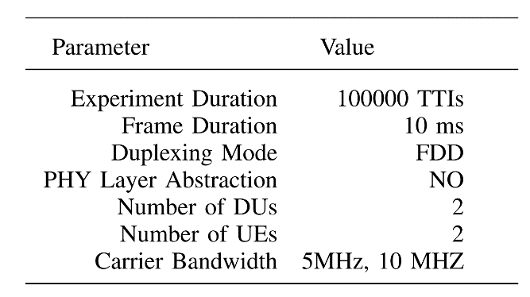
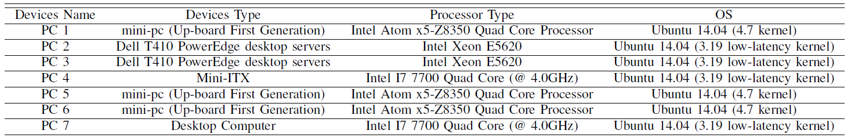
Functional element placement in the ARNO-5G testbed
arnotestbed.santannapisa.it
Cisco
Catalyst 2960G
LTE
Huawei E3372
PC4
PC5
PC1
PC2
PC6
PC7
Intel i7 4790 (@ 3.60 GHz)

Slide 8
Mobile Network Software – OpenAirInterface
For the Core and RAN implementation the OpenAir interface software is used.
Core Implementation
openair-cn Implements the EPC 3GPP specs Contains the implemention of: Home Subscriver Server (HSS) Mobile Management Entity (MME) Serving Gateway (S-GW) PDN Gateway (PDN-GW)
RAN Implementation
openairinterface5g
Implementation of Rel 10 LTE of: Evolved NodeB (eNB); User Equipment (UE). Implemented functional splits options: IF4p5 → Option 7-1 (intra-PHY split) IF5 → Option 8 (PHY-RF split)
 | Option 7-1
 | Uplink Direction | Downlink Direction
DU | FFT, CP removal and PRACH filtering | IFFT, CP addition and PRACH filtering
CU | Rest of PHY functions and the higher layers | Rest of PHY functions and the higher layers

Slide 9
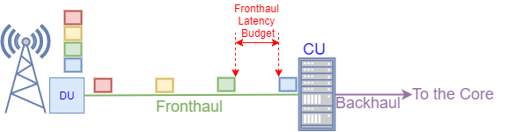
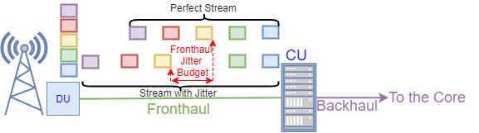
Performance Evaluation Parameters
Allowable latency budget: allowable one-way fronthaul latency between DU and CU
Allowable jitter budget: allowable one-way fronthaul jitter between DU and CU

Slide 10
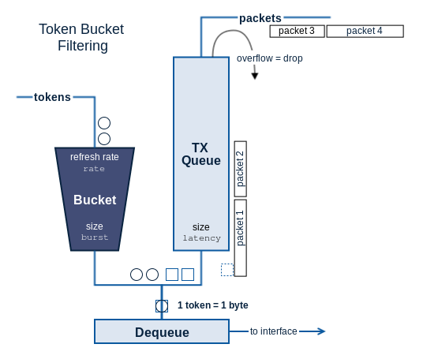
Emulations of Latency and Jitter on the fronthaul
The linux utility traffic control ¨tc-netem¨ is used
A delay d0 is applied to the DU Ethernet interface towards the CU.
A delay d1 is applied to the CU Ethernet interface towards the DU.
Evaluation of the frontahul latency budget:
  d0 and d1 are increased with steps of 10 µs until DU, CU and UE disconect.
Evalution of the fronthaul jitter budget:
  A jitter following a normal distribution is added to the latency values d0 and d1 with standard deviation increased of steps of 5µs.
Source: https://www.excentis.com/blog/use-linux-traffic-control-impairment-node-test-environment-part-2

Slide 11
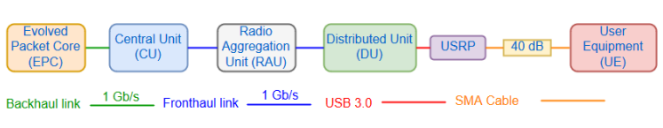
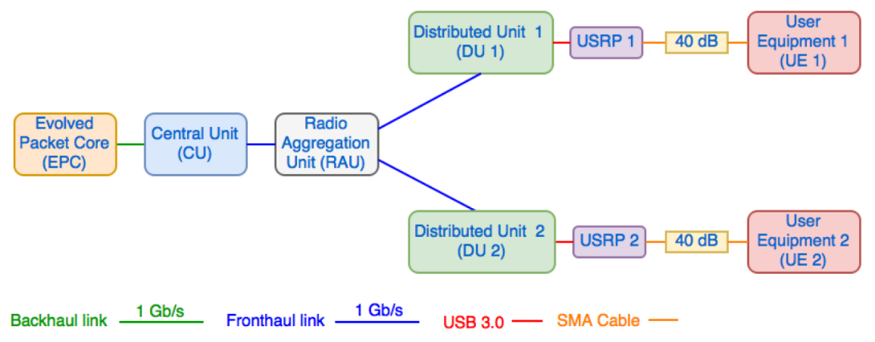
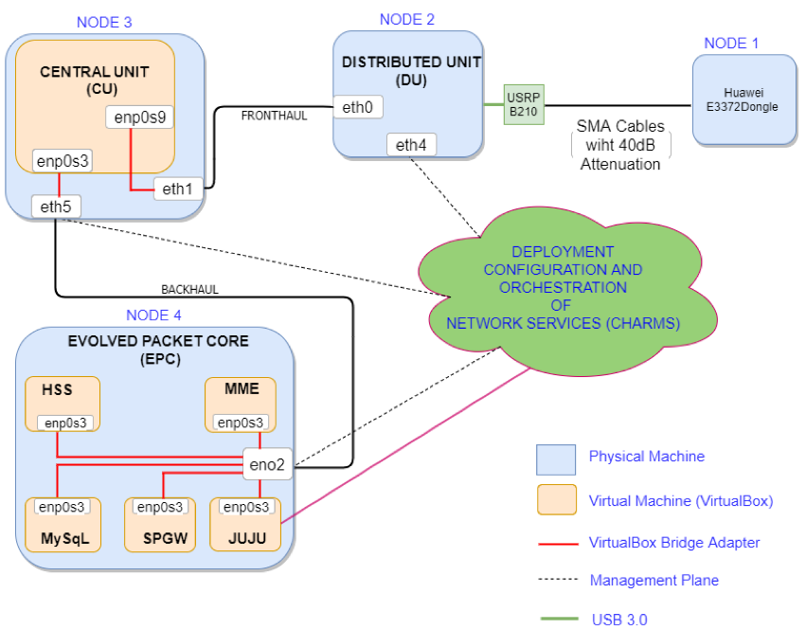
Considered scenarios
Scenario 1:
  All functional elements deployed in bare metal
Scenario 2:
  Two DUs in bare metal connected to two instances of CU running in the same bare metal
Scenario 3:
  CU and EPC virtualized through VirtualBox
  DU in bare metal
  All functional elements based on juju charms and managed through Juju.

Slide 12
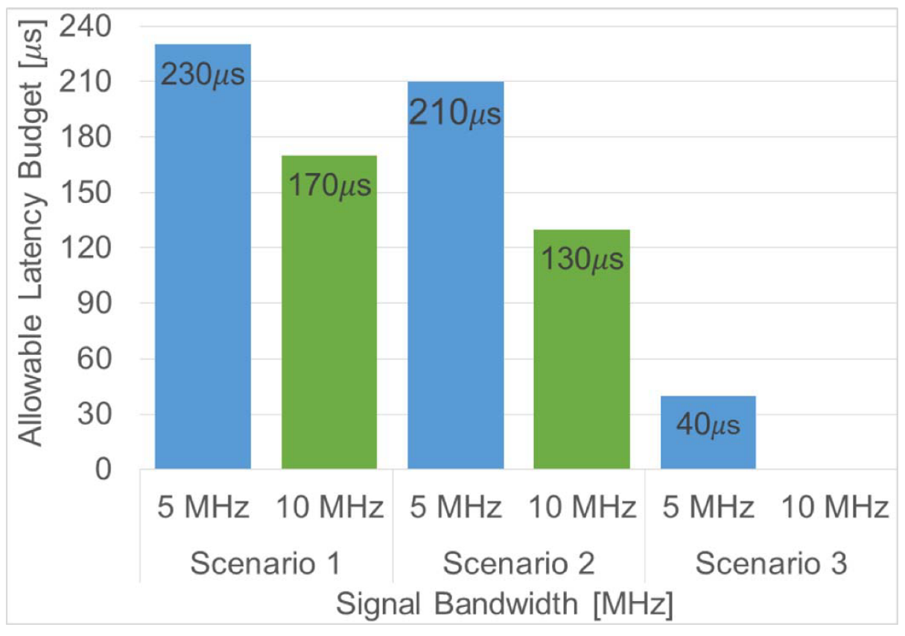
Allowable Latency Budget
Allowable latency budget always below 250 μs
Allowable latency budget decreases if the signal bandwidth and if the number of DUs connected to the same CU increases due to heavier processing
Allowable latency budget is much lower if mobile network functions are virtualized

Slide 13
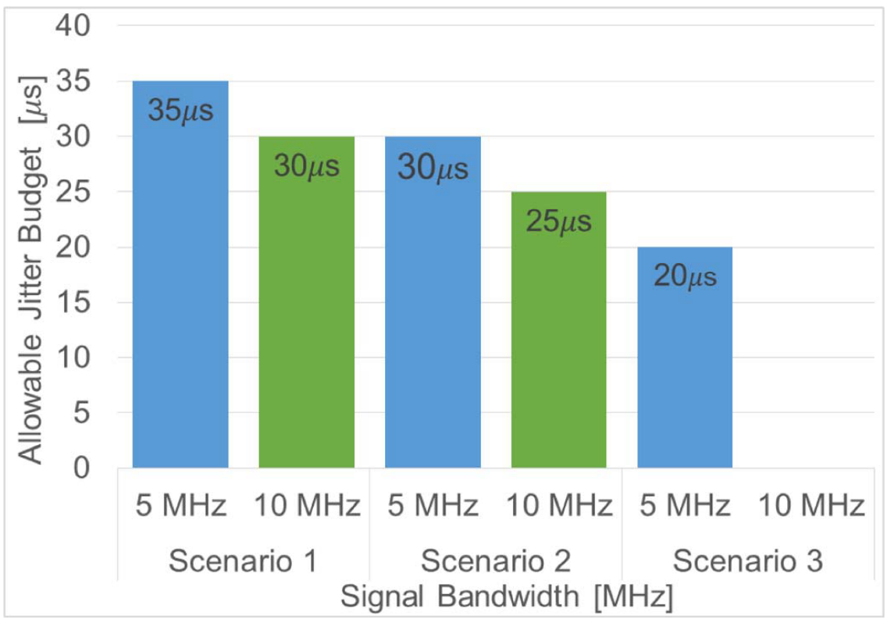
Impact of Allowable Jitter Budget on Allowable Latency Budget
The Jitter is applied to a latency value close to the fronthaul allowable latency budget
The fixed latency value is choosen according to the scenario
220 μs
160 μs
200 μs
120 μs
30 μs
Jitter negatively impacts latency budget

Slide 14
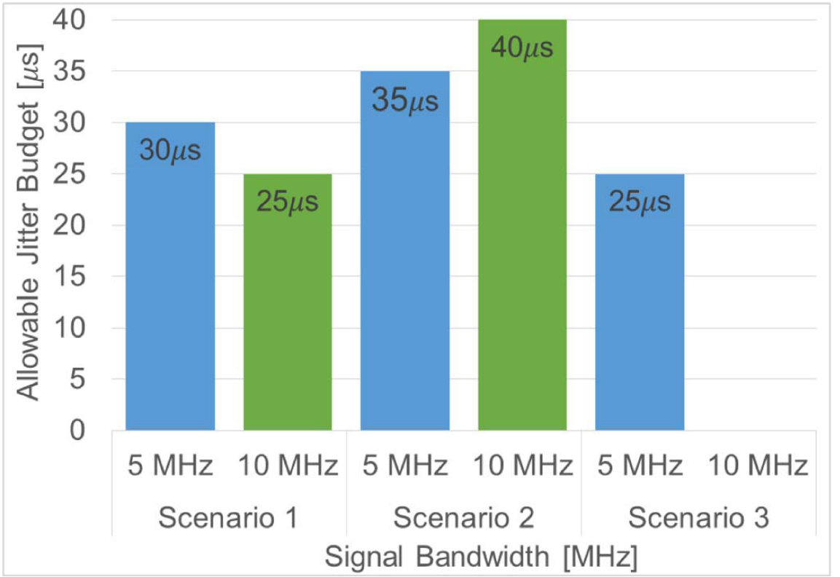
Allowable Jitter Budget
The Jitter is applied to a latency value far to the fronthaul allowable latency budget
The fixed latency value is choosen according to the scenario
50 μs
100 μs
100 μs
50 μs
20 μs
Jitter negatively impacts fronthaul because there are periods in which not enough samples (i.e., modulation symbols) can be delivered to the PHY layer

Slide 15
Conclusions
Experimental evaluation of the impact of virtualizing eNB functions on the fronthaul latency and jitter budget
Functional split Option 7-1 (i.e. intra-PHY) and Option 8 (PHY-RF) are applied
No virtualization
Virtualization based on Virtualbox
The fronthaul latency bandwidth reduction depends on the considered signal bandwidth (i.e. 5 MHz, 10 MHz) and on the number of functions running in the same device
Virtualization decreases the allowable latency budget
A jitter of at most 40 us can be tolerated

Slide 16

thank you!
email: luca.valcarenghi@santannapisa.it
This work has been partially funded by the EU H2020 5G-
Transformer Project (grant no. 761536)

Slide 17
Backup Slides

Slide 18
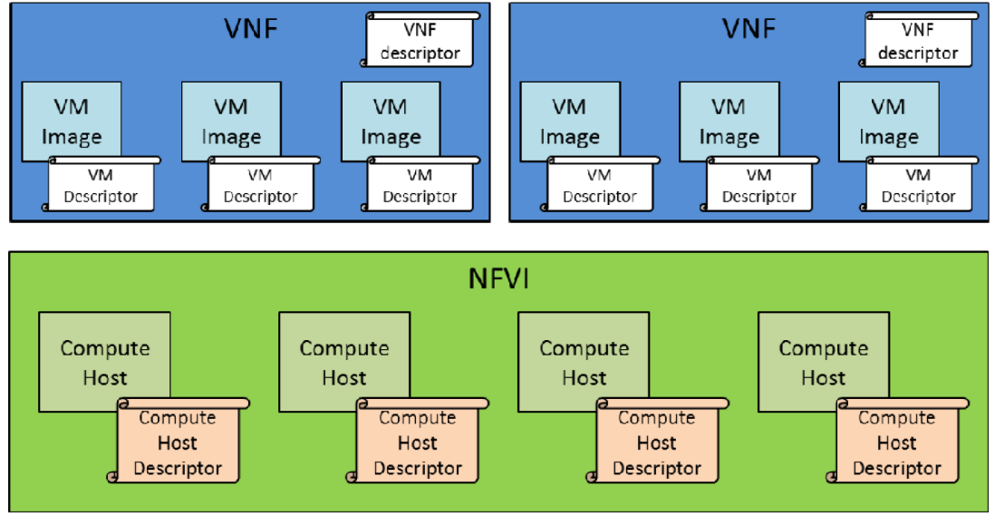
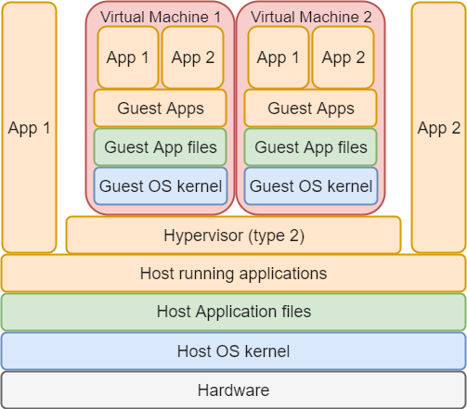
gNB Virtualization
ETSI (ETSI GS NFV-PER 001 V1.1.1 (2014-06)) descriptors:
  Virtual Network Function (VNF)
  Virtual Machine (VM)
  Compute Host
What virtualization implies:
  applications running in the guest host have “to cross” several layers of abstraction.
  Extra levels of abstraction reduce workload performance.
Different virtualization types:
  Hypervisor-based virtualizations:
    allow to fully emulate a CPU architecture and OS;
  Container-based virtualizations:
    utilizes kernel features to create an isolated environment of the process using the host hardware.

Slide 19
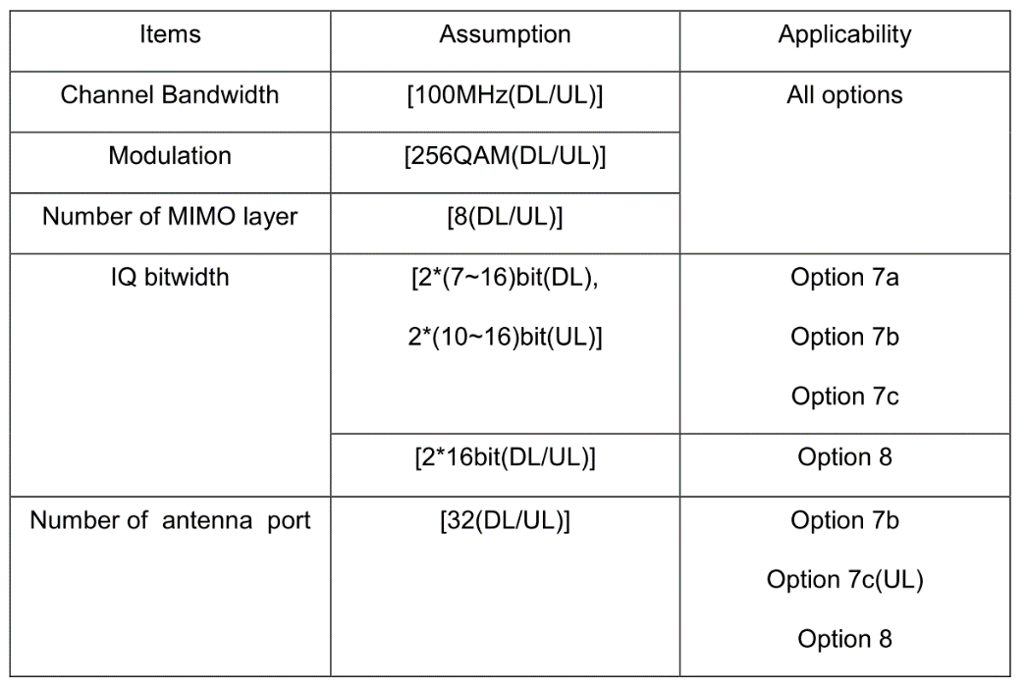
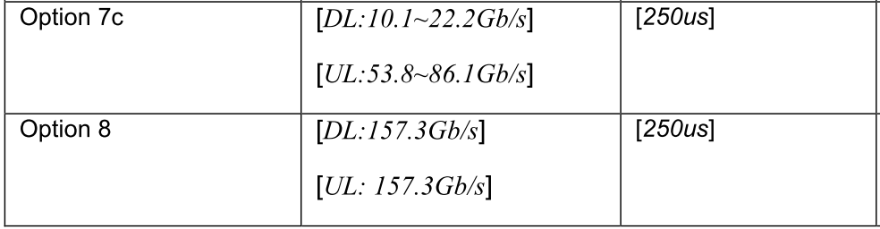
Fronthaul requirements (TR 38.801)
Not yet clarified
ASSUMPTIONS
To be reviewed
due to 4ms
HARQ process
Source: LTE for UMTS: Evolution to LTE-Advanced, 2nd Edition
Harri Holma, Antti Toskala
ISBN: 978-0-470-66000-3

Slide 20
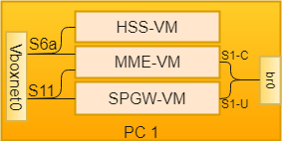
Virtualized EPC and CU Network configuration
HSS-VM:
  1 Virtual Interfaces in host-only networking (s6a interface);
MME-VM:
  1 Virtual Interfaces in host-only networking mode (S6a interface);
  1 Virtual Interfaces in bridge networking mode (S1-C interface);
SPGW-VM:
  1 Virtual Interfaces in host-only networking mode (S11 interface);
  1 Virtual Interfaces in bridge networking mode (S1-U interface)
CU-VM:
  1 Virtual Interfaces in bridge networking mode (S1-U and S1-C interfaces);
  1 Virtual Interfaces in bridge networking mode (fronthaul link).

