Slide 1

How much is Fronthaul Latency Budget Impacted by RAN Virtualisation ?
H. Gupta², D. Manicone¹,
F. Giannone¹, K. Kondepu¹, A. Franklin²,
P. Castoldi¹, L. Valcarenghi¹
¹Scuola Superiore Sant’Anna, Pisa, Italy
²Indian Institute of Technology Hyderabad, India
IEEE Conference on Network Function Virtualization and Software Defined Networks (NFV-SDN)
6-8 November 2017 – Berlin, Germany

Slide 2
Summary
A Virtualized New Radio Acces Network
Problem Description
Investigated questions
The Federated ARNO-5G Testbed
Mobile Network Software - OpenAirInterface
Performance Evalution Parameters
Emulations of Latency and Jitter on the fronthaul
Evaluation Scenario
Considered Virtualisation Methods
Experimental Results
Conclusions

Slide 3
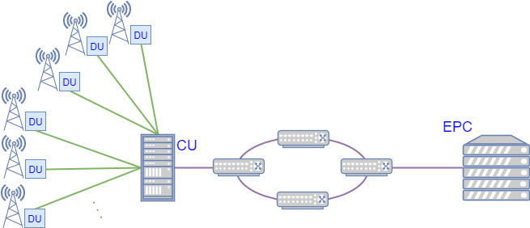
A New Virtualized Radio Access Network
A New Radio Access Network (New RAN) has been proposed to increase the performance with limited deployment costs
Micro-cloud/fog node
Fronthaul
Cloud node
Backhaul
eNodeB functional split
  Distributed Unit (DU)
  Central Unit (CU)
RAN split
  Fronthaul
  Backhaul

Slide 4
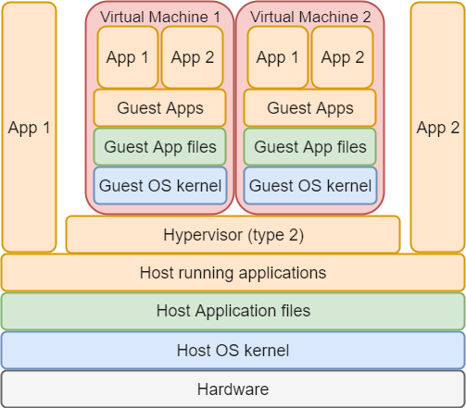
Problem description
Different functional splits → different latency constraints (TR38.801):
  Option 7a functional split max. allowed one-way latency → 250 [µs]
What virtualization implies:
  applications running in the guest host have “to cross” several layers of abstraction.
  Extra levels of abstraction reduce workload performance.
Different virtualization types:
  Hypervisor-based virtualizations:
    allow to fully emulate a CPU architecture and OS;
  Container-based virtualizations:
    utilizes kernel features to create an isolated environment of the process using the host hardware.

Slide 5
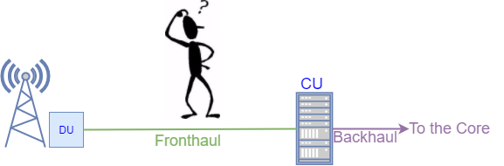
Investigated questions in this paper
Are the extra levels of abstraction impacting the fronthaul latency constraints?
Does the jitter impact the fronthaul link performance?

Slide 6
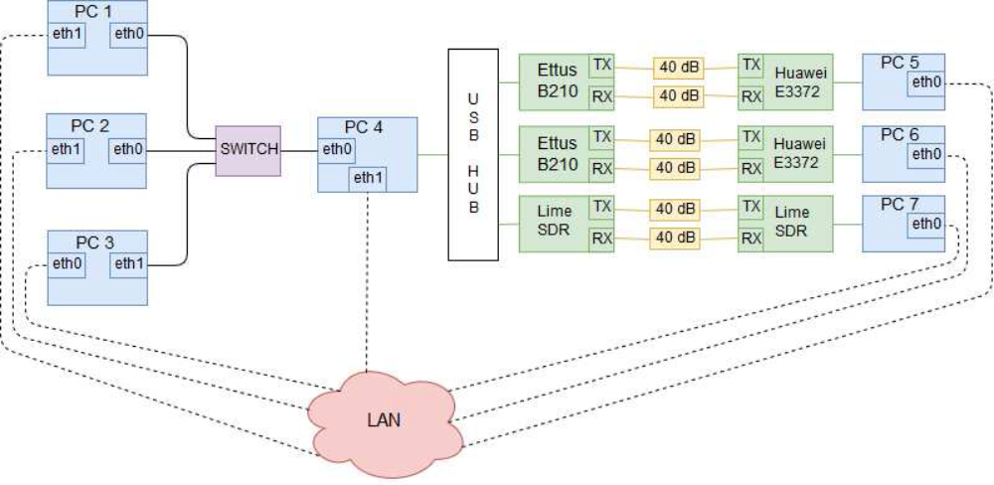



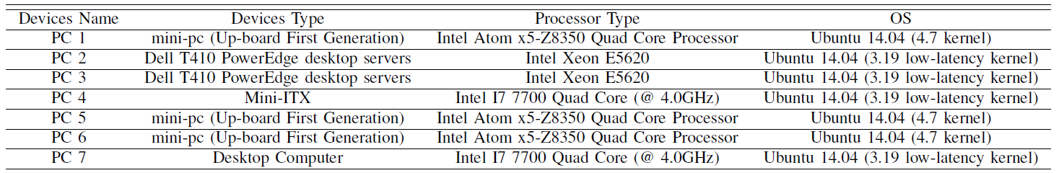
The Federated ARNO-5G Testbed
In the ARNO-5G Testbed different virtualisation methods are considered in order to virtualize the EPC and the CU.
Management Plane

Slide 7
Mobile Network Software – OpenAirInterface
For the Core and RAN implementation the OpenAir interface softwae are used.
Core Implementation
openair-cn Implements the EPC 3GPP specs Contains the implemention of: Home Subscriver Server (HSS) Mobile Management Entity (MME) Serving Gateway (S-GW) PDN Gateway (PDN-GW)
RAN Implementation
openairinterface5g
Implementation of Rel 10 LTE of: Evolved NodeB (eNB); User Equipment (UE). Implemented functional splits options: IF4p5 → Option 7-1 (intra-PHY split) IF5 → Option 8 (PHY-RF split)
 | Option 7-1
 | Uplink Direction | Downlink Direction
DU | FFT, CP removal and PRACH filtering | IFFT, CP addition and PRACH filtering
CU | Rest of PHY functions and the higher layers | Rest of PHY functions and the higher layers

Slide 8
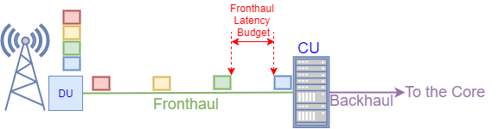
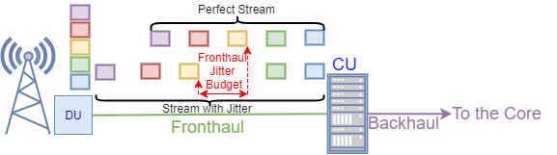
Performance Evaluation Parameters
When virtualised EPC and CU are considered a experimental evalution in Option 7-1 functional split scenario of the following parameters are performed:
  Allowable Latency budget supported by the fronthaul;
  Allowable Jitter budget supported by the fronthaul;
The fronthaul latency budget is defined as the one-way latency requirement:
The fronthaul jitter budget is defined as the maximum supported latency variation:

Slide 9
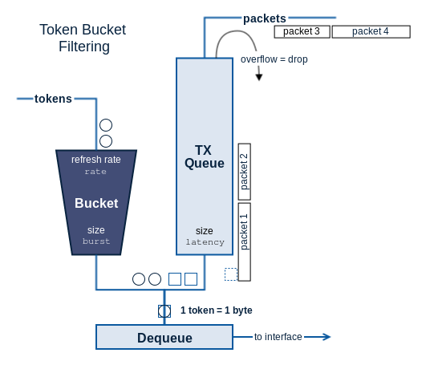
Emulations of Latency and Jitter on the fronthaul
The linux utility traffic control «tc-netem» is used
A delay d0 is applied to the DU Ethernet interface towards the CU.
A delay d1 is applied to the CU Ethernet interface towards the DU.
Evaluation of the frontahul latency budget:
  d0 and d1 are encreased with steps of 10 µs until DU, CU and UE disconect.
Evalution of the fronthaul jitter budget:
  A jitter following a normal distribution is added to the latency values d0 and d1 with steps of 10 µs.
Source: https://www.excentis.com/blog/use-linux-traffic-control-impairment-node-test-environment-part-2

Slide 10
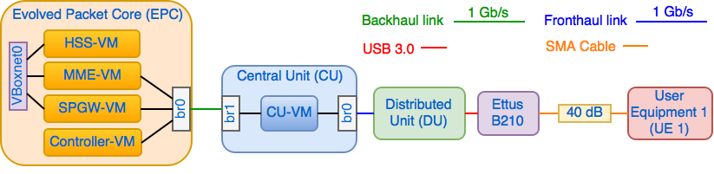
Evaluation Scenario
The virtualized EPC:
  The Mobile Management Entity (MME) is deployed in a VM (MME-VM);
  The Home Subscriber Server (HSS) is deployed in a VM (HSS-VM);
  The Serving Gateway (S-GW) and the PDN-Gateway (P-GW) are deployed in a VM (SPGW-VM).
The virtualized Central Unit (CU) is deployed in a VM (CU-VM).
The Distributed Unit (DU) runs directly in the physical machine.
The User Equipment (UE) is deployed by means of a Huawei E3372 dongle attached to a PC. The UE is connected to the RAN through SMA cables with 40 dB of attenuation

Slide 11
Considered Virtualisation Methods
Hypervisor-based virtualization and Container-based virtualization are analyzed.
Considered Hypervisor-based virtualization methods:
  VirtualBox;
  Kernel-Based Virtual Machine (KVM);
Considered Container-based virtualization method:
  Docker Container.
Using VirtualBox and KVM virtualisation methods:
  The HSS-VM, MME-VM and SPGW-VM are created with the following characteristics:
    Ubuntu 16.04 (4.8 generic kernel);
    1 core virtual CPU and 1 GB of RAM.
  The CU-VM is created with the following characteristics:
    Ubuntu 14.04 (3.19 low-latency kernel);
    8 core virtual CPU and 16 GB of RAM.
Using the Docker Container virtualisation methods:
  A Container is created in a physical machine for the deployment of the EPC and the elements belonging to it (i.e. MME, HSS, SPGW);
  A Container is created in a second physical machine for the deployment of the CU.

Slide 12
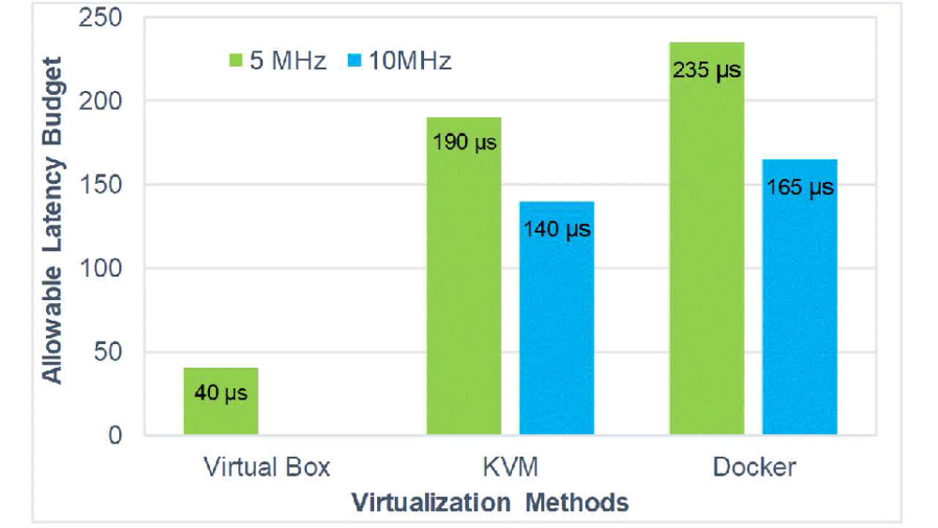
Experimental Results – Allowable Latency Budget
Using Virtual Box the fronthaul allowable latency budget is very low.
Using KVM and Docker Container the fronthaul allowable latency is close to the 3GPP constraints.

Slide 13
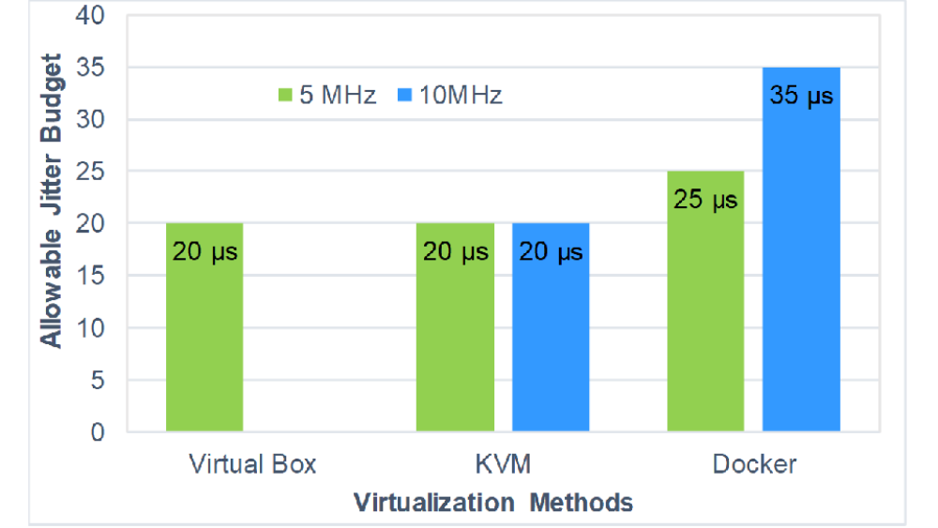
Experimental Results – Allowable Jitter Budget (1)
The Jitter is applied to a latency value close to the fronthaul allowable latency budget.
The fixed latency value is choosen according to the Virtualization Methods and the signal bandwidth
Latency = 150 µs
Latency = 220 µs
Latency = 170 µs
Latency = 20 µs
Latency = 120 µs

Slide 14
Experimental Results – Allowable Jitter Budget (1)
The Jitter is applied to a latency value far to the fronthaul allowable latency budget.
The fixed latency value is choosen according to the Virtualization Methods and the signal bandwidth
Latency = 100 µs
Latency = 150 µs
Latency = 100 µs
Latency = 20 µs
Latency = 80 µs

Slide 15
Conclusions
Experimental evaluation of the impact of virtualizing eNB functions on the fronthaul latency and jitter budget are performed.
Functional split Option 7-1 (i.e. intra-PHY) are applied.
Different Virtualisation methods are considered:
  VirtualBox;
  KVM;
  Docker Container.
The lighter virtualisation methods (e.g. Docker Container) impact the fronthaul latency budget less than heavier virtualisation methods (i.e. VirtualBox).
The fronthaul latency bandwidth reduction depends on the considered signal bandwidth (i.e. 5 MHz, 10 MHz).
The performed experimental evaluation showed that a jitter of at most 40 us can be tolerated.

Slide 16
thank you!
email: francesco.giannone@santannapisa.it
This work has been partially funded by the H2020-ICT-2014-1 Wishful project (grant no. 645274).

Slide 17
Backup Slides

Slide 18
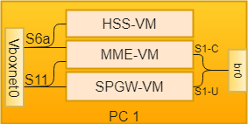
Virtualized EPC and CU Network configuration
HSS-VM:
  1 Virtual Interfaces in host-only networking (s6a interface);
MME-VM:
  1 Virtual Interfaces in host-only networking mode (S6a interface);
  1 Virtual Interfaces in bridge networking mode (S1-C interface);
SPGW-VM:
  1 Virtual Interfaces in host-only networking mode (S11 interface);
  1 Virtual Interfaces in bridge networking mode (S1-U interface)
CU-VM:
  1 Virtual Interfaces in bridge networking mode (S1-U and S1-C interfaces);
  1 Virtual Interfaces in bridge networking mode (fronthaul link).

Slide 19
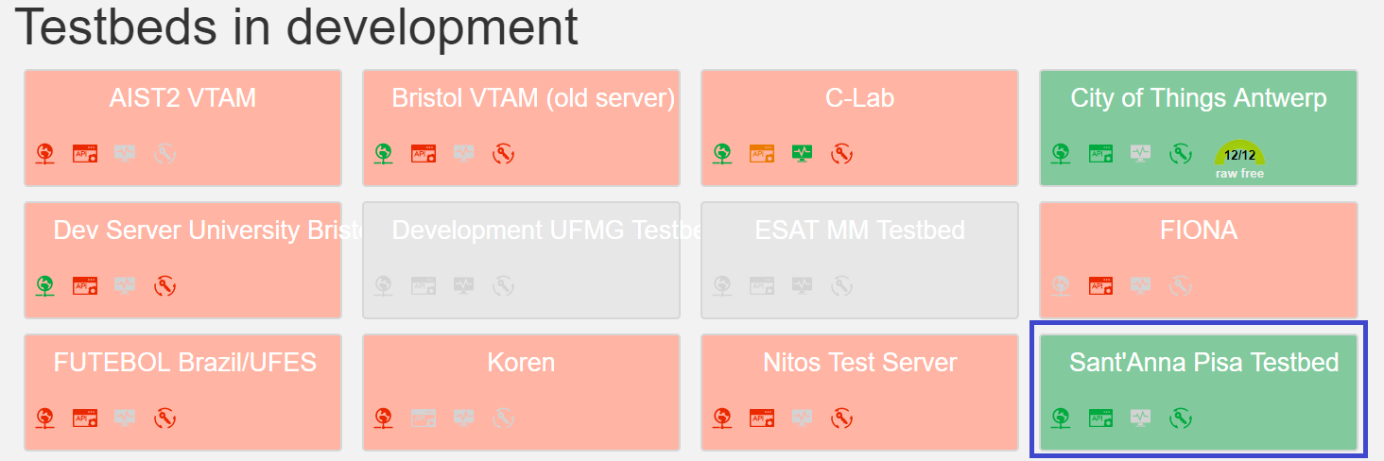
Federation of the ARNO-5G Testbed
ARNO-5G Testbed:
  Is federated in Fed4FIRE federation;
  Accepts only trusted users from iMinds.
Therefore, experimenters can:
  Acces and reserve resources from multiple testbeds via jFed;
  Configure experimentes interconnecting such resources.

Slide 20
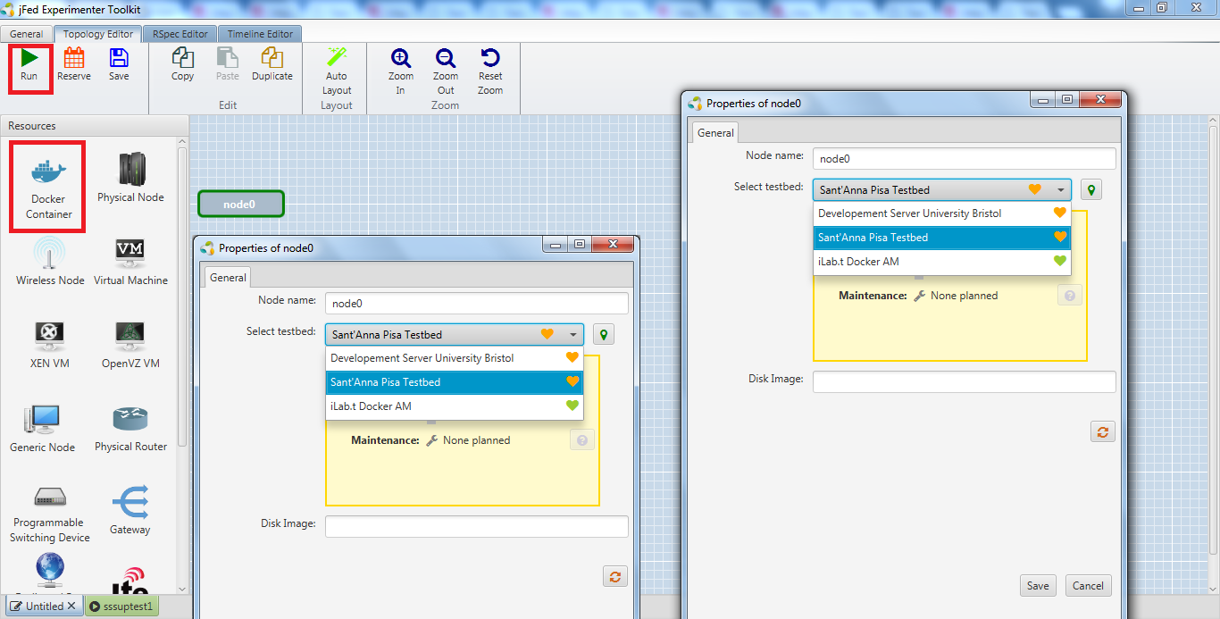
Reserve Resources in ARNO-5G Testbed
Through jFed tool an experimenter can:
  Select the ARNO-5G Testbed, namely «Sant’Anna Pisa Testbed»;
  Provide his slice name
In this way a Docker Container in ARNO-5G Testbed is created;
The ARNO-5G devices are now accessible;
Each OAI component of ARNO-5G Testbed are reachable.
  Through SSH based on the specific container.
More details on how to reserve the components of ARNO-5G Testbed can be found in the ARNO-5G Testbed web page.

