Slide 1
GoStop
Project Overview
AUTOMATION
TESTING PROJECT
Application Under Test
GoStop.com — Online Travel & Hostel Booking Platform
Selenium 4.41
Cucumber 7.33
TestNG 7.1 2
End-to-End Selenium + Cucumber BDD Framework for Travel Booking
Java · Maven · Log4j · Allure Reports · Page Object Model
Developed by: Himank Patidar

Slide 2




Project Goals & Technology Stack
🎯 Objectives
Automate the end-to-end booking ﬂow on GoStop.com
🛠 Technology Stack
Test Automation
Selenium Java 4.41 .0
Validate destination selection, room & experience booking
BDD Framework
Cucumber 7.33.0
Verify guest detail entry and payment initiation
Test Runner
TestNG 7.12.0
Enable regression testing with reusable step deﬁnitions
Build Tool
Apache Maven
Integrate Allure reporting for rich test results
Logging
Log4j 2.25.3
Reporting
Allure 2.32.0

Slide 3







Project Architecture — Page Object Model (POM)
src/main/java
base/ · pageObject/
src/test/java
stepDeﬁnitions/ · hooks/ · cucumberOptions/
Base.java
ThreadLocal WebDriver, Properties loader
HomePage.java
Destination, Location & Date selectors
RoomAndExperiencePage.java
Room type, Paragliding, Proceed button
GuestPage.java
First/Last name, Mobile, Email, Pay button
ScenerioHook.java
@Before setup ChromeDriver · @After screenshot + quit
src/test/resources
features/ (A_SelectThePlace, B_validateRoom, C_ValidateGuestDetail)
src/main/resources
selenium-server-4. 44. 0. jar · log4j2. xml

Slide 4



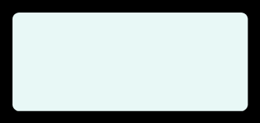



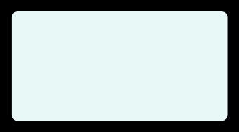
Cucumber BDD — Test Scenarios
@SelectPlace · Feature A — Select Place & Date
User navigates to the GoStop home page
Clicks 'Destinations' and selects McLeod Ganj
Selects 'McLeodganj, Bhagsu' as the speciﬁc property
Applies check-in (Jun 30) and check-out (Jul 25) dates via URL
@ValidateRoomAndExperience · Feature B — Room &
@ValidateGuest · Feature C — Guest Details & Payment
Builds on Feature B (room + experience selected)
Fills guest: Jay Pandya, +91 987654321 0, jay098@gmail.com
Clicks 'Proceed to Pay' to initiate checkout
Veriﬁes available rooms are displayed
⚡ All 3 features share step deﬁnitions via reusable Gherkin syntax. Tags enable selective test execution.
Experience
Builds on Feature A (destination + dates selected)
Selects room type: 'Bed + Breakfast' Adds an experience: 'Paragliding' Clicks 'Proceed to unlock offers'

Slide 5







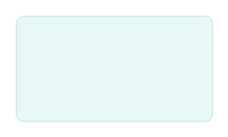
Test Execution Flow
1
Maven
Sureﬁre
2
TestNG
Runner
3
Cucumber
Engine
4
ScenerioHook
@Before
5
Step
Executes
6
@After
TearDown
Triggers testng.xml on mvn cucumberOptions/TestRun test ner.java orchestrates suites
Parses .feature ﬁles, matches step defs
Launches ChromeDriver,
sets implicit wait
POM actions via Selenium WebDriver
Screenshot (Allure) + driver.quit()
WebDriverWait
JavascriptExecutor
ThreadLocal<WebDriver>
ExpectedConditions used for dynamic element waits (20s timeout)
Scroll & JS-based interactions for complex UI elements
Thread-safe driver management in Base class for parallel execution

Slide 6

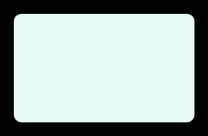
Key Features & Design Decisions
📄
Feature Files
🔗
Shared Step Defs
🌐
URL-based Date
3 independent . feature ﬁles with Gherkin syntax covering Place, Room & Guest ﬂows. Tags enable targeted runs.
Given/When/Then steps are shared and reused across features, avoiding duplication — DRY principle.
Date selection bypasses fragile calendar UI by appending ?checkin=&checkout= query params directly.
📸
Allure Reports
🔒
Thread-Safe Driver
📋
Externalised Conﬁg
Screenshots auto-attached to passing scenarios in @After hook via Allure API for visual test history.
ThreadLocal<WebDriver> in Base class enables parallel test execution without driver collisions.
data. properties ﬁle holds URL, frameworkUrl & browser — easy environment switching without code change.

Slide 7
Summary & Conclusion
GoStop Automation Testing Project
3
Feature Files
3
Page Objects
3
Step Deﬁnitions
6
Libraries Used
Robust BDD framework with clean separation of concerns using POM
Resilient date handling via URL parameters avoids ﬂaky calendar interactions Reusable hooks with Allure integration ensure maintainable test reporting ThreadLocal WebDriver design supports future parallel execution scale-out
Built with Selenium · Cucumber · TestNG · Maven · Allure · Log4j

Slide 8
Summary & Conclusion
GoStop Automation Testing Project
3
Feature Files
3
Page Objects
3
Step Deﬁnitions
6
Libraries Used
Robust BDD framework with clean separation of concerns using POM
Resilient date handling via URL parameters avoids ﬂaky calendar interactions Reusable hooks with Allure integration ensure maintainable test reporting ThreadLocal WebDriver design supports future parallel execution scale-out
Built with Selenium · Cucumber · TestNG · Maven · Allure · Log4j

Slide 9
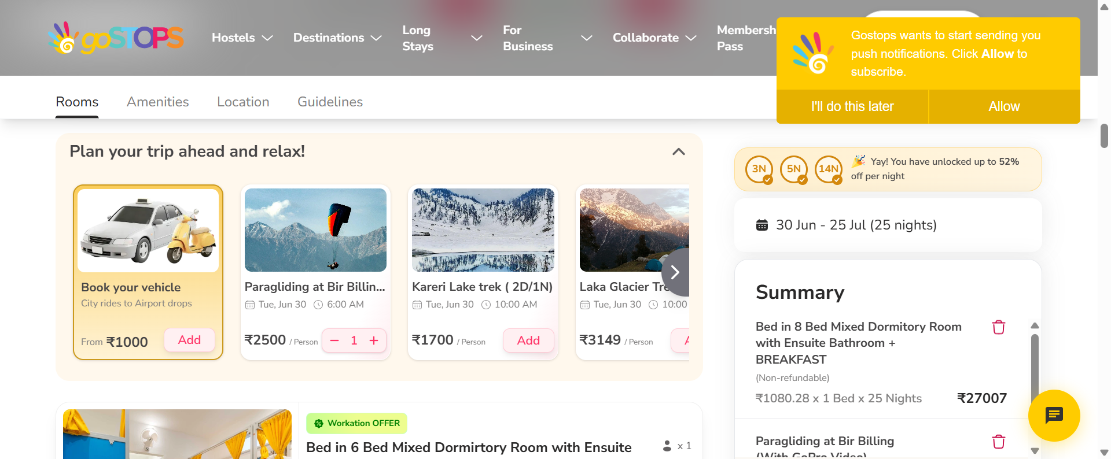
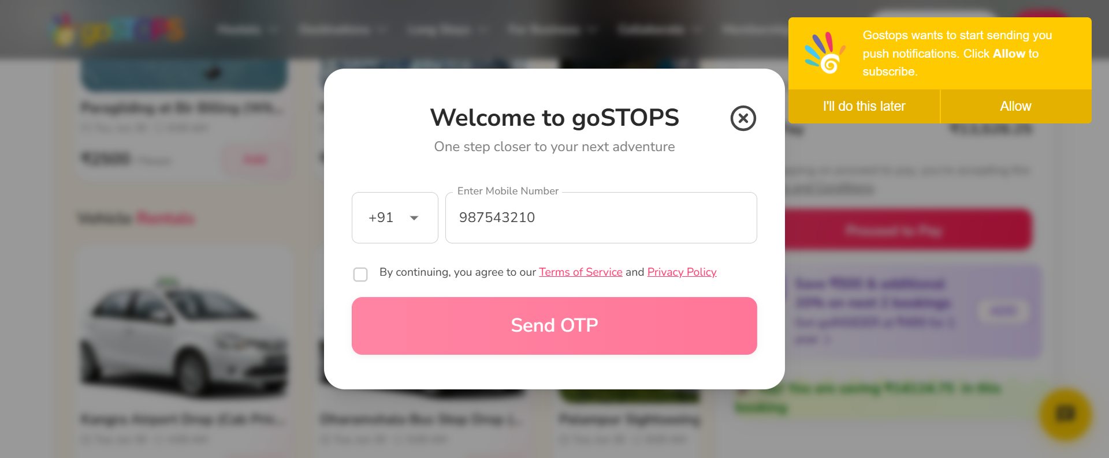
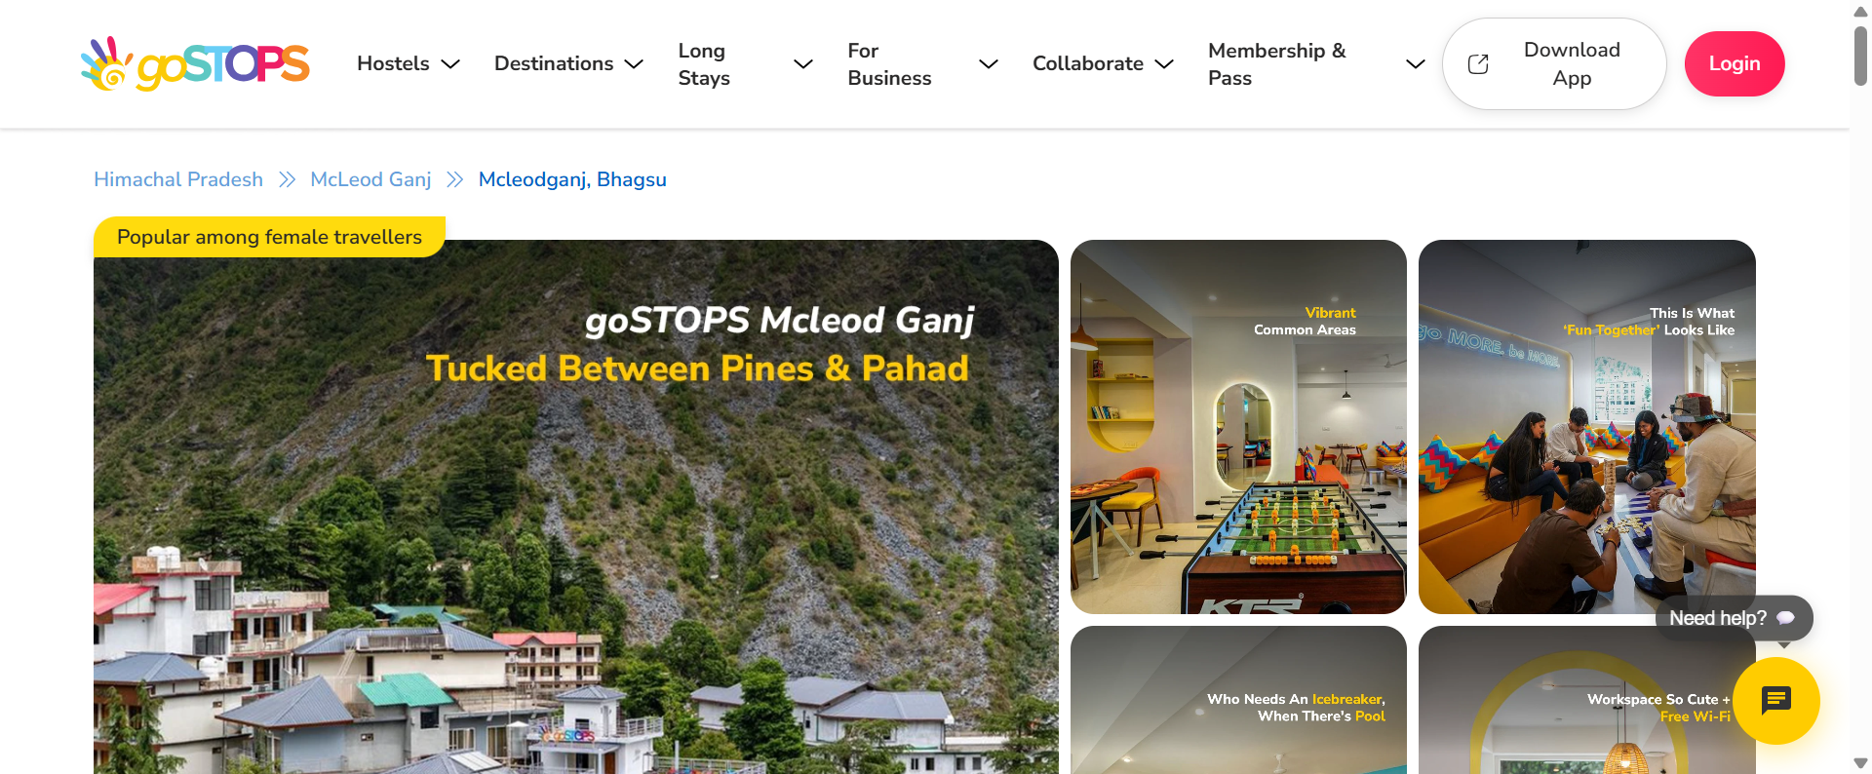
Al l u r e S c r e e n s h o t
Built with Selenium · Cucumber · TestNG · Maven · Allure · Log4j

