Slide 1
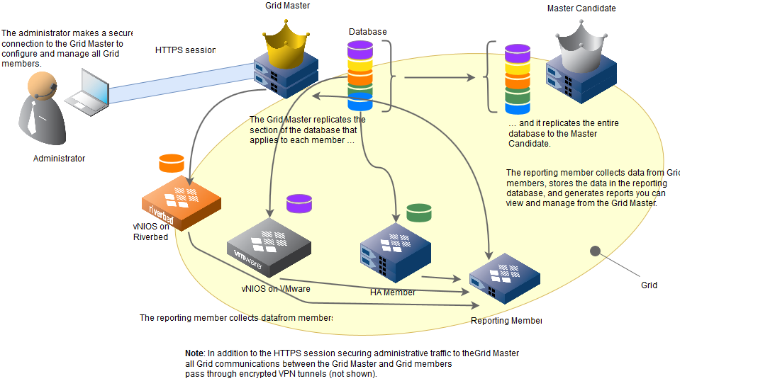
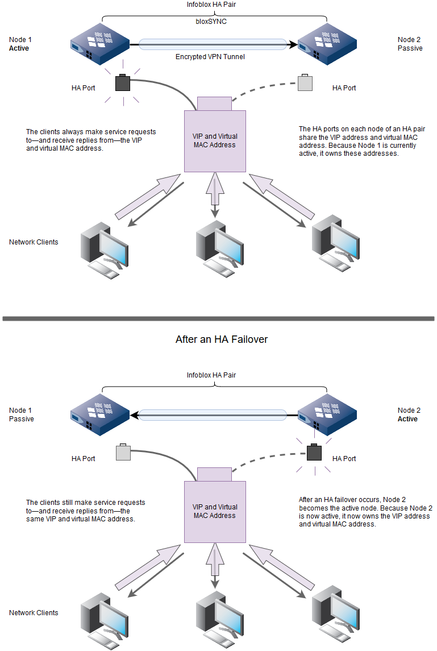
INFOBLOX DDI ADVANCED OPERATIONS
Architecture, coexistence patterns, DNS and DHCP logging, IPAM analytics, Grid and HA mechanics, and day-two operational troubleshooting
Screenshots are from public Infoblox documentation, community material, or public product pages. Case studies are composite scenarios built from recurring operational patterns rather than named customers.
Advanced Infoblox lecture deck
1
Notes:
Open by setting expectations: this is not a product overview. It is an operations-heavy walk-through designed for engineers who already know the UI. Call out that case studies are composite patterns, not named customers. [Sources] - Infoblox NIOS documentation: About Infoblox Grids - Infoblox NIOS documentation: About HA Pairs - Infoblox NIOS documentation: Managing Licenses / Managing Certificates

Slide 2
SESSION MAP
How to use this deck in a two-hour advanced class
The pacing below gives the lecturer natural pause points for questions, live demos, or whiteboarding.
1. Architecture and coexistence Slides 3-8. Review the Grid model, migration versus carveout patterns, and how to integrate legacy DNS/DHCP platforms without creating two competing sources of truth.
2. Service logs and operational evidence Slides 9-22. Revisit only the DNS and DHCP concepts that matter during incidents, then connect query logs, lease history, IPAM audit events, and Splunk searches into one workflow.
3. Grid and HA mechanics Slides 23-28. Explain what the appliances are doing underneath the UI: member synchronization, VRRP, HA ports, the encrypted VPN tunnel, takeover, and virtual MAC movement.
4. Routine operations and failure playbooks Slides 29-36. Cover licenses, certificates, monitoring, and the three playbooks operators need most often: HA pair faults, DHCP failover association faults, and DNS resolution faults.
Session map
2
Notes:
Encourage the audience to listen for three recurring themes: authority, synchronization, and evidence. Most advanced Infoblox incidents reduce to one of those themes. [Sources] - Deck structure authored for this lecture; operational themes derived from public Infoblox documentation across Grid, DNS, DHCP, HA, and audit topics.

Slide 3
ARCHITECTURE
Infoblox DDI is a distributed operating model, not just three services in one UI
Start here because every later troubleshooting step depends on understanding where configuration lives, where service state lives, and how those two move through the Grid.
One object model across DNS, DHCP, and IPAM Infoblox stores records, ranges, networks, leases, and many policy objects in one shared model. That is why a host or fixed-address change can simultaneously affect DNS naming, DHCP behavior, and address inventory. The operational benefit is consistency; the operational risk is that a bad change can propagate farther than engineers expect.
Grid Master, members, reporting, and candidate roles The Grid Master is the control point for configuration and policy. Members run the actual services. Reporting members collect data for reporting and analytics, while a Grid Master Candidate keeps a full copy of the Grid database for disaster recovery rather than day-to-day change administration.
Why failures feel different at each layer A Grid Master issue usually stops controlled change but does not immediately stop DNS or DHCP already running on synchronized members. A member issue is service-local. A reporting issue hurts visibility more than availability. That distinction helps you respond without overcorrecting during an outage.
Architecture
3
Notes:
Walk the audience through the diagram clockwise: administrator to Grid Master, member-specific database slices, full database on the candidate, and reporting data flow. Emphasize that changes can be blocked while services still answer traffic. [Sources] - Infoblox NIOS documentation: About Infoblox Grids - Infoblox NIOS documentation: Grid and partitioned database replication / reporting member behavior

Slide 4
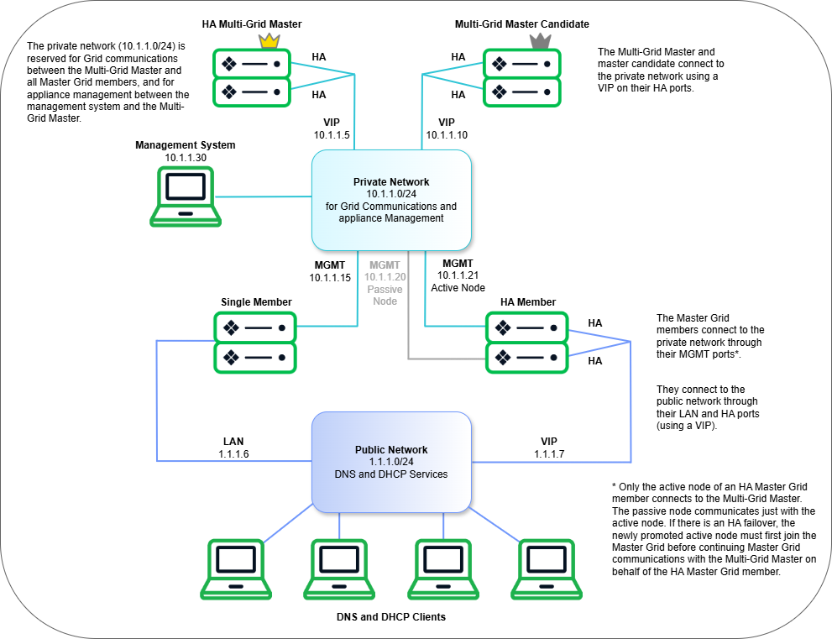
ARCHITECTURE
Grid anatomy: keep control traffic separate from service traffic whenever you can
This is the mental model behind troubleshooting member sync, service reachability, and seemingly random restart requirements.
Grid communications are management traffic Infoblox documentation recommends using the MGMT path for Grid communications and appliance management where possible. That separates database synchronization, admin access, and maintenance from the LAN interfaces that answer DNS and DHCP for clients.
Members cache only what they need to serve A member does not need the entire Grid database to continue serving requests. It keeps the service-specific slice it needs. That is why a member can continue answering even if the Grid Master is unavailable for a period, provided the member is already synchronized and healthy.
What to check first in operations Look at member status, service status, replication state, pending restart indicators, and time synchronization. Many incidents that appear to be DNS data errors or DHCP scope errors turn out to be stale config on a member that has not restarted or synchronized as expected.
Architecture
4
Notes:
This slide is where you explain why a management outage and a service outage are not the same thing. Call out that operators often test only DNS resolution and miss that the member is unsynchronized or carrying a pending restart. [Sources] - Infoblox NIOS documentation: Grid Communications - Infoblox NIOS documentation: About Infoblox Grids

Slide 5
COEXISTENCE
Three ways two DDI environments commonly coexist during transformation
Use this comparison to explain why migration, carveout, and long-term coexistence require different success criteria and rollback plans.
Migration to a single target
Carveout / separation
Long-term coexistence with legacy
Goal: retire the legacy environment and make Infoblox authoritative.
Success looks like: all zones, scopes, options, and operational ownership move to the Grid; old servers are left only for rollback or historical validation.
Typical tactics: inventory discovery, TTL reduction, data import or AXFR, staged cutover, validation from multiple client paths, and rapid rollback windows.
Goal: split one environment into two sustainable operating models.
Success looks like: each business unit or program has clear ownership of forward zones, reverse zones, networks, DHCP scopes, and Extensible Attributes; shared services are delegated or forwarded explicitly.
Typical tactics: carve by network container and zone boundary, shorten leases before move day, update relay targets, and clean inherited options before export.
Goal: manage legacy servers without forcing immediate cutover.
Success looks like: one system remains the source of truth for each object class, while conditional forwarders, secondary zones, or Microsoft integration provide visibility and controlled management.
Typical risks: duplicate ownership, mismatched DNS views, stale reservations, and conflicting change windows between teams.
Coexistence
5
Notes:
Drive home that the word coexistence hides three very different programs. Migration optimizes for speed and validation. Carveout optimizes for boundary clarity. Long-term coexistence optimizes for ownership discipline. [Sources] - Infoblox NIOS documentation: Configuration Example – Configuring a Grid - Infoblox NIOS documentation: Configuring Microsoft Windows Servers - Infoblox blog: Transform Microsoft IPAM: Supporting Windows Server 2022

Slide 6
MIGRATION
Composite case: consolidating BIND and Windows DDI into Infoblox
This scenario combines patterns seen in real migrations: fragmented ownership, stale TTL strategy, and incomplete validation of DHCP option inheritance.
Environment The estate includes a BIND authoritative pair for core zones, two Windows DHCP servers for campus scopes, and spreadsheets used as pseudo-IPAM. The biggest non-technical problem is that ownership is split between network and server teams, so no one has a complete inventory of zones, reservations, or option inheritance.
Recommended migration sequence 1) Discovery and ownership mapping. 2) Lower TTLs early enough to matter. 3) Import or transfer data and clean it. 4) Validate forward, reverse, reservations, and DDNS behavior from representative clients. 5) Cut over relays and NS records. 6) Keep a rollback window while caches expire.
Approach The team first freezes discretionary changes, lowers TTLs for high-risk zones, exports and validates zone data, inventories DHCP scopes and options, and decides which legacy objects will be imported versus rebuilt cleanly in Infoblox. Parallel validation is performed from multiple network segments before the nameserver and relay cutovers.
Failure patterns to avoid The most common migration mistakes are importing stale records as if they were current truth, forgetting reverse zones and DDNS ownership, and assuming a scope-level option in Windows maps one-to-one with the intended inherited behavior in Infoblox. Those mistakes create partial success that looks fine in the UI but fails in production.
Lesson Successful migration is mostly about proving authority and inheritance, not just copying objects. If you do not know which system truly owns a record or scope before cutover, you do not yet have a migration plan.
Migration
6
Notes:
Tell the class this is a composite case, then ask them which hidden dependency usually surprises teams most: reverse zones, DDNS ownership, or DHCP option inheritance. Use that discussion to reinforce inventory discipline. [Sources] - Composite case built from recurring patterns in Infoblox NIOS migration documentation and public Infoblox community field guidance; not a named customer. - Infoblox NIOS documentation: Configuration Example – Configuring a Grid

Slide 7
CARVEOUT
Composite case: carving a business unit out of a shared DDI environment
Carveout is harder than migration because both environments must remain correct afterward, not just during the cutover weekend.
Environment A business unit is being separated from a larger enterprise. It needs independent DNS, DHCP, and IPAM, but still depends on shared identity, security tooling, and a handful of shared application namespaces. Existing networks and reverse zones were designed for the enterprise as one administrative boundary, not two.
Carveout control points Use four control points: authoritative zone boundary, reverse delegation boundary, network container ownership, and DHCP relay target ownership. If any of those four remain ambiguous, the two environments will continue stepping on each other after separation.
Design choices that matter The cleanest carveout uses network containers and delegated subzones that mirror new ownership. Shared names should be delegated or conditionally forwarded, not cloned casually. DHCP cutover is safer when lease timers are shortened in advance and relay targets are updated only after the recipient environment truly owns the corresponding networks.
What breaks most often Operators frequently forget inherited options and Extensible Attributes, causing the receiving environment to lose operational metadata even when raw subnets arrive intact. Another common failure is orphaned DDNS records: the old environment stops leasing, but still appears authoritative for a reverse zone or host naming convention.
Lesson Migration is about consolidation; carveout is about durable boundaries. Make the new operational ownership model visible in zone delegation, network containers, and Extensible Attributes before you call the cutover complete.
Carveout
7
Notes:
Use this slide to explain why carveout programs fail even when exports/imports are technically successful: the teams never translated organizational boundaries into DDI object boundaries. [Sources] - Composite case built from recurring carveout patterns discussed in Infoblox field guidance and general DDI operating practices; not a named customer.

Slide 8
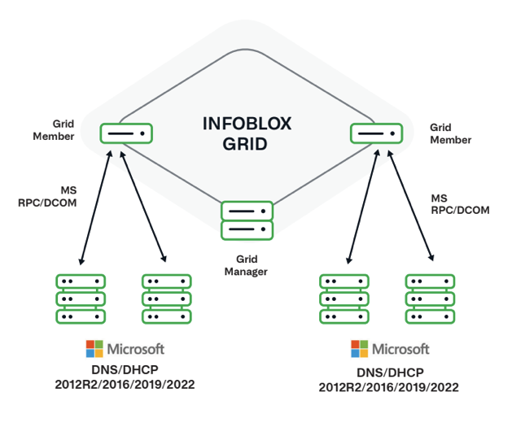
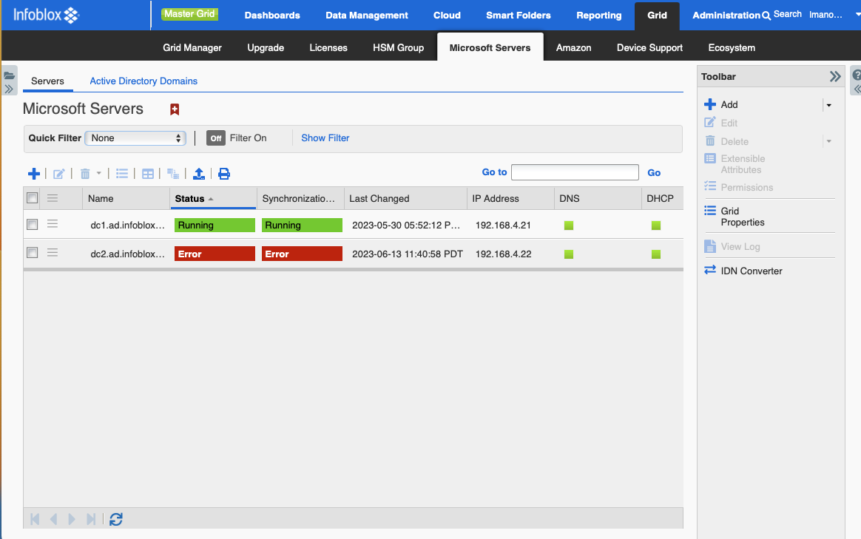
LEGACY INTEGRATION
Legacy server integration: reduce cutover risk without creating two masters
This is the bridge pattern between coexistence and full migration. It is useful, but only when ownership remains explicit.
Microsoft DNS and DHCP integration Infoblox can centrally manage Microsoft DNS and DHCP servers using the Microsoft management capability rather than forcing immediate replacement. The value is centralized visibility, synchronized data, reporting, and RBAC while the legacy Microsoft estate continues running where it already is.
BIND and other legacy patterns For non-Microsoft DNS, the first bridge is usually conditional forwarding, secondary zones, or a carefully bounded authoritative split. That lets you prove query flow and delegation correctness before you decide whether to rebuild or import full data sets into Infoblox.
Do not tolerate dual ownership The bridge model fails when both sides are allowed to be edited as if each were authoritative. Decide which system owns the object, where the audit trail lives, and which change window is binding. Otherwise your troubleshooting time will be spent reconciling administrative drift rather than service issues.
Licensing reminder Managing Microsoft servers requires the appropriate Microsoft management license. During rollout, verify the license is present before troubleshooting what appears to be a discovery or synchronization fault.
Legacy integration
8
Notes:
Explain that integration is a control pattern, not necessarily a permanent architecture. Good engineers use it to stage migration safely; bad engineers use it to avoid making an ownership decision. [Sources] - Infoblox NIOS documentation: About Managing Microsoft Windows Servers - Infoblox NIOS documentation: Configuring Microsoft Windows Servers - Infoblox blog: Transform Microsoft IPAM: Supporting Windows Server 2022

Slide 9
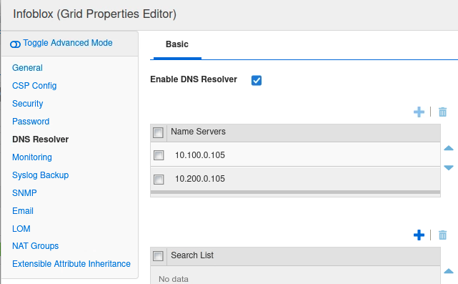
DNS
DNS recap for operators: only the concepts you need when incidents happen
This is not a theory lesson. The point is to sharpen the mental model used when you inspect query logs, views, and resolver behavior on Infoblox.
Authoritative versus recursive is the first branch in any investigation If the member is authoritative for the answer, the problem space is record data, zone delegation, views, ACLs, DNSSEC, or service restart state. If the member is recursive, the problem space shifts to cache, forwarders, root-hint reachability, response handling, and upstream authority behavior.
Views, ACLs, and policy create intentionally different truths One Infoblox member can legitimately return different answers to different clients because of DNS views and recursion controls. That is powerful, but it is also why engineers can misdiagnose a view-order or client-match problem as "random DNS" when the appliance is actually being consistent with its policy logic.
TTL is an operational timer, not a record decoration TTL controls rollback speed, cache persistence, and the time a bad answer can remain visible after you have already fixed the source data. Negative caching matters too: an NXDOMAIN can persist after the record is added if the original negative TTL was long enough.
Operator shortcut Before changing a record, prove: who answered, from which view, and whether the answer came from cache or authoritative data. That single discipline avoids many self-inflicted outages.
DNS
9
Notes:
Emphasize that advanced DNS troubleshooting becomes easier if you refuse to use the phrase "DNS is broken". Force the class to say whether recursion, authority, view selection, or upstream dependency is failing. [Sources] - Infoblox NIOS documentation: DNS resolver configuration topics - Infoblox NIOS documentation: DNS query logging and DNS views topics

Slide 10
DNS
DNS query path and failure domains
The lecturer can use this slide as a whiteboard replacement: follow the request from client to answer and show where each class of evidence is collected.
Client Symptoms appear here first: browser timeout, app delay, intermittent lookup, or stale cached answer.
Infoblox member Decides view match, cache use, recursion, local authority, query logging, and whether to forward or iterate.
Forwarder / root Only relevant if recursion leaves the member. Problems here show up as timeout, SERVFAIL, or long latency.
Authoritative server Owns the final record set. Delegation errors, stale zone data, or DNSSEC issues often live here.
Response path Caches, negative caches, and MTU/firewall issues can make a fixed record still look broken to the client.
Proof points at the member Use query logs, dig or nslookup from the member itself, view and ACL inspection, and packet capture only if logs cannot explain the path. If a member can resolve or answer correctly from its own perspective, shift the investigation outward to the client path or upstream dependencies.
Proof points for authoritative problems Check which zone is authoritative, whether the correct member or view loaded the zone, whether a restart is pending, whether delegation and glue are correct, and whether negative caching is still in effect on resolvers that queried before the fix.
What not to do Do not change multiple layers at once. If you adjust the record, the view, and the forwarder path together, you destroy the evidence chain that would have told you which layer was truly wrong.
DNS query path
10
Notes:
Treat this as the class control slide for DNS investigations. Point at each box and ask what evidence you can collect there. That turns general DNS knowledge into a concrete Infoblox workflow. [Sources] - Infoblox NIOS documentation: DNS query logging topics - General DNS operational model consistent with RFC-based recursive/authoritative resolution behavior.

Slide 11
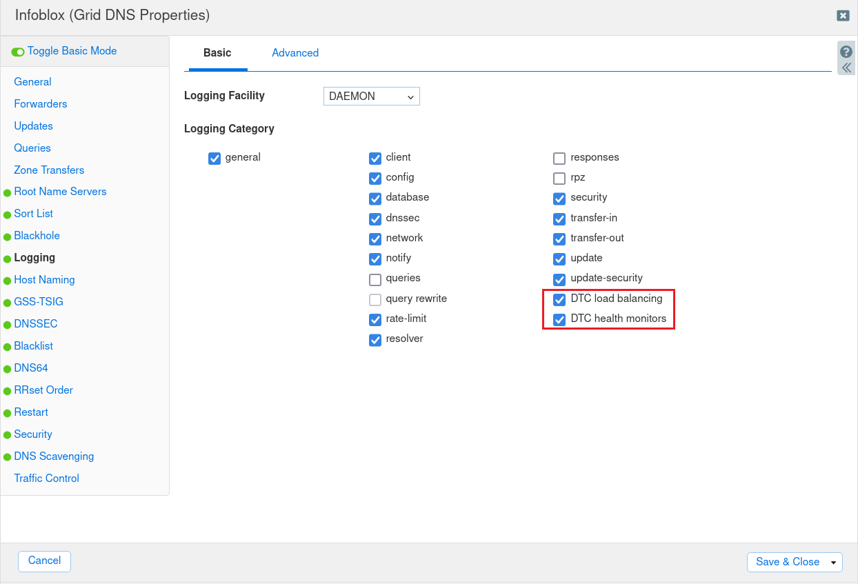
DNS LOGGING
DNS query logging: enable only what helps answer the question you actually have
Verbose logging is powerful and expensive. Advanced operators know when to turn categories on, how long to leave them on, and where to export them for analysis.
Where query logging is configured Infoblox allows DNS logging to be enabled at the Grid level or at the member level. That matters because broad logging during a major incident can create noise and overhead across many members when only one view, site, or resolver path actually needs inspection.
Category selection is the real tuning knob The categories determine whether you see client events, resolver behavior, query and response details, security actions, transfer activity, and more. Query and response categories tell you what happened; resolver, network, and security categories often explain why it happened.
Volume strategy for advanced environments For short diagnostic windows, syslog query logging is often sufficient. For high-rate environments or deeper packet-like visibility, dnstap is more efficient. Either way, define the start and end of your capture window so the team does not normalize excessive logging as the default operating mode.
Practical rule If you cannot explain why a logging category is enabled, it should probably be off until a specific incident or use case justifies it.
DNS logging
11
Notes:
Use the screenshot to point out that logging choices are about category selection, not just an on/off switch. Mention dnstap as the better option when syslog-style query logging becomes too heavy. [Sources] - Infoblox NIOS documentation: DNS Query Logging - Infoblox NIOS documentation: Setting DNS Logging Categories - Infoblox NIOS documentation: dnstap logging support in NIOS

Slide 12
DNS TROUBLESHOOTING
A practical DNS troubleshooting matrix for Infoblox operators
Teach this matrix as a decision tree: classify the symptom first, then gather the shortest proof that narrows the failure domain before you change anything.
Symptom / question
Likely domain
First proof point
Typical Infoblox action
NXDOMAIN or record not found
Wrong zone, wrong view, missing record, stale negative cache, or delegation gap.
Query the member directly from the affected client path; compare authoritative answer, view match, and cache behavior.
Verify zone authority and view order, add or correct the record only after proving the member and client are using the same view; account for negative TTL before declaring the fix ineffective.
SERVFAIL
Upstream recursion problem, DNSSEC validation issue, broken forwarder path, or malformed authority response.
Test recursion from the member, inspect resolver and security categories, and compare behavior with an upstream dig +trace.
Check forwarders, root-hint reachability, DNSSEC state, and upstream authoritative health before editing local data.
Timeout or very slow response
Network path issue, MTU/firewall problem, unreachable forwarder, or overloaded resolver path.
Measure latency from client and member, check whether the member logs the request, and test reachability to forwarders or authoritative servers.
Fix pathing or upstream dependency first; do not change records to solve a transport problem.
Wrong answer or intermittent answer
Wrong view order, stale cache, split-horizon policy, secondary zone lag, or inconsistent upstream authority.
Compare answers by client subnet and by querying the member directly with explicit server selection.
Inspect views, ACLs, cache TTL, secondary transfer state, and pending restart flags before assuming record data is corrupt.
DNS troubleshooting
12
Notes:
Encourage students to memorize the symptom categories rather than specific commands. The classification process is what scales across environments and versions. [Sources] - Infoblox NIOS documentation: DNS query logging topics - Infoblox reporting documentation: DNS traffic dashboards and NXDOMAIN/SERVFAIL reports

Slide 13
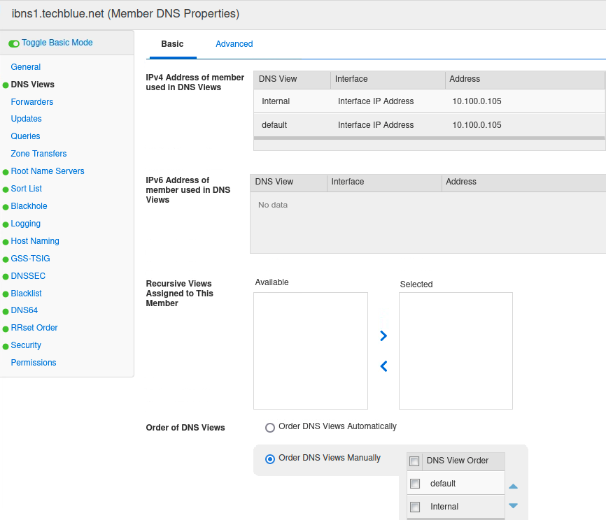
DNS CASE STUDY
Composite DNS case: internal clients received the external answer because the view order was wrong
This case is common in mature environments because the data is correct in both views; only the matching logic is wrong.
Symptom Internal users begin resolving a partner or application name to the public address even though an internal view exists. A quick spot-check from an administrator machine may still work, which misleads the team into thinking the problem is caching or random recursion behavior.
Finding The member participates in multiple DNS views. Manual ordering placed the default view ahead of the internal view, so affected clients matched the default view first. Because both views contained plausible data, the failure looked like a data error instead of a policy-selection error.
Fix Correct the view order or client-match logic, then retest from representative clients. Validate both forward and reverse behavior where relevant, and keep TTL/negative-cache expectations in mind so the team does not mistake propagation delay for a failed fix.
Why this case matters Advanced environments often have both internal and default views for legitimate reasons. That means engineers must prove which view answered, not simply whether the record exists somewhere in the Grid.
Lesson When a record looks correct but clients still receive the wrong answer, suspect the selection logic before you assume the data is wrong. View order and client matching are policy bugs that often masquerade as data bugs.
DNS case study
13
Notes:
Ask the audience how they would prove view selection from both the member and the client path. That discussion usually surfaces ACLs, recursion policy, and cache state naturally. [Sources] - Infoblox NIOS documentation: DNS views and recursive view assignment topics - Public Infoblox screenshot demonstrating manual DNS view ordering on a member.

Slide 14
DHCP
DHCP workflow deep dive: more than the DORA acronym
Advanced operators need to know what changes between initial acquisition, renew, rebind, relay-based delivery, and DDNS update behavior.
1. Discover Client broadcasts because it does not yet know the server. Relay devices may insert GIADDR or Option 82 to anchor the request to the correct network context.
2. Offer The server offers an address and options based on network match, reservation logic, policy, and available lease state.
3. Request The client explicitly requests the offered lease. During renewals, the request may be unicast to the original server instead of broadcast.
4. Acknowledge The server commits the lease and may trigger DDNS updates depending on your update policy and naming workflow.
Relay and network identity matter more than most teams realize Infoblox decides which network object should serve the request using GIADDR, interface context, and policy. If the relay target or subnet identity is wrong, the scope can look healthy in the UI while the client receives nothing because the request no longer maps to any valid network.
Renew and rebind behavior explains many “intermittent” issues A client with an old lease may keep renewing successfully even while new clients fail. That creates the illusion that DHCP is partially healthy when only the renewal path is healthy. Always separate initial acquisition failures from renew or rebind failures in your troubleshooting notes.
DDNS is part of the operational workflow, not an afterthought If host naming, reverse records, or lease ownership rules are wrong, the address assignment may succeed while application resolution still fails. That is why DHCP and DNS troubleshooting frequently need to be performed together, especially during migration and carveout events.
DHCP
14
Notes:
Use the lower right card to bridge DHCP into DNS. That is a good moment to remind the class that many app teams experience a DHCP problem as a DNS problem because the IP assignment worked but DDNS did not. [Sources] - Infoblox NIOS documentation: IPv4 DHCP protocol overview - Infoblox NIOS documentation: DHCP relay and Option 82 topics

Slide 15
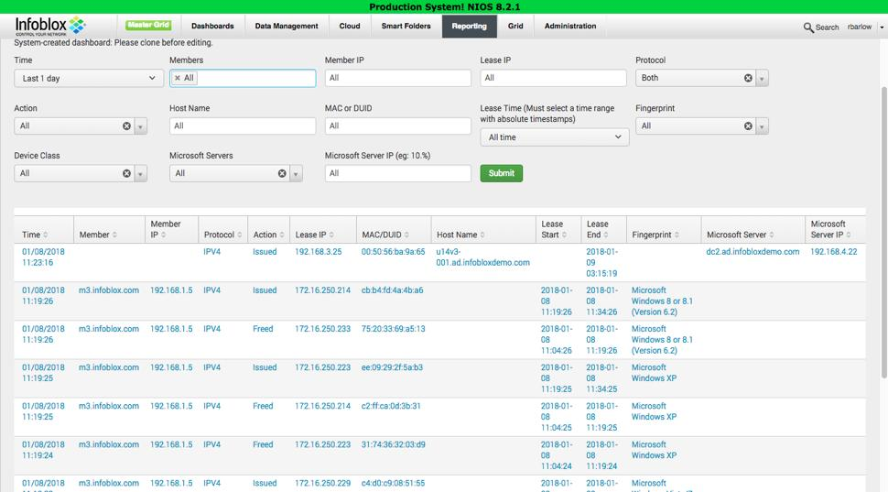
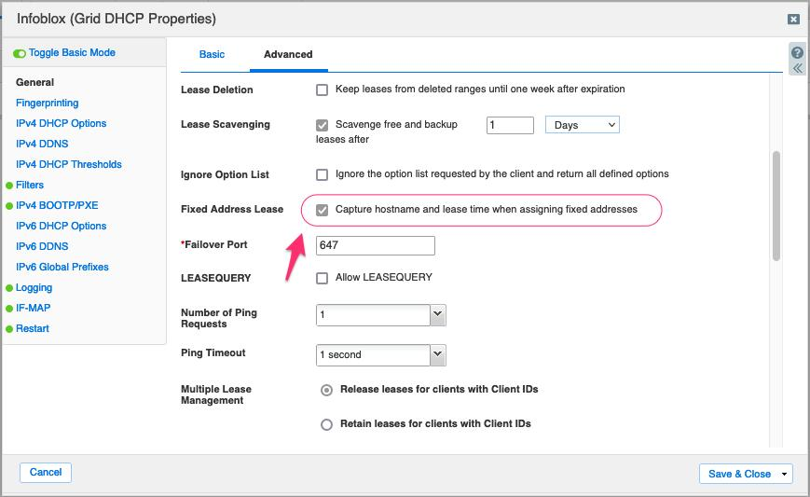
DHCP LOGS
DHCP lease logs and lease history: what they tell you and what they do not
Lease history is one of the most valuable troubleshooting and forensic tools in NIOS, but only if you enabled the right logging before the incident.
Lease history is not magic; it depends on logging strategy Infoblox can track lease history, including lease issue, release, renewal, and related attributes such as MAC or DUID, hostname, member, and timestamps. But you only get that history if logging has been enabled at the appropriate scope before the event you are investigating.
What the history is best at proving Lease history is excellent for answering “who had this address,” “which member assigned it,” “when did the client move,” and “was the lease dynamic or fixed.” It is much less useful if the real issue is that the request never matched a network in the first place, because in that case no lease was ever created.
Settings that improve the audit trail Options such as capturing hostname and lease time for fixed addresses improve the usefulness of logs for reserved devices that otherwise look static and uninteresting. In advanced environments, those devices are often the most operationally critical.
Operational caution Lease-history style reporting can be more expensive than many teams expect. Enable it intentionally, keep it sized for real troubleshooting value, and export the data you truly need to long-term analytics.
DHCP logs
15
Notes:
Walk students through the two screenshots together: one proves why lease history is useful, the other shows that the data quality depends on earlier configuration decisions. [Sources] - Infoblox NIOS documentation: Managing Leases - Infoblox reporting documentation: DHCP Lease History report / dashboard behavior - Public Infoblox screenshot of Grid DHCP Properties (Advanced).

Slide 16
DHCP TROUBLESHOOTING
A disciplined DHCP troubleshooting workflow
Classify the failure before you touch a scope: no address, wrong address or options, or conflict/churn. Each path has different proof points.
No address assigned
Wrong address or wrong options
Address conflict or excessive churn
Symptoms: APIPA or no lease at all.
Start with relay or subnet identity: did the request reach Infoblox, and did it map to a valid network on the correct member or failover pair?
Then check utilization, disabled scope state, access controls, and whether the request is being dropped as an unknown network segment or policy mismatch.
Symptoms: client gets an address, but from the wrong scope or with the wrong gateway, DNS, or boot options.
Check network match, reservations, option inheritance, failover peer ownership, and whether a fixed address or host object overrides the inherited values the engineer expected to be active.
Symptoms: duplicate IP, frequent reassignments, unstable clients, or seemingly random movement.
Check for static assignments outside IPAM, shortened timers, bad client IDs, duplicate MACs, or relay changes that moved clients between scopes. Lease history is the proof path here, not guesswork.
One rule that saves time Always validate GIADDR or relay context before changing a DHCP range. A large fraction of “DHCP server” incidents are actually network-identity incidents.
DHCP troubleshooting
16
Notes:
Use this slide to show why DHCP troubleshooting benefits from strict symptom classification just like DNS troubleshooting does. Without classification, teams jump straight to ranges and options and lose time. [Sources] - Infoblox NIOS documentation: DHCP protocol and relay topics - Infoblox NIOS documentation: Managing Leases

Slide 17
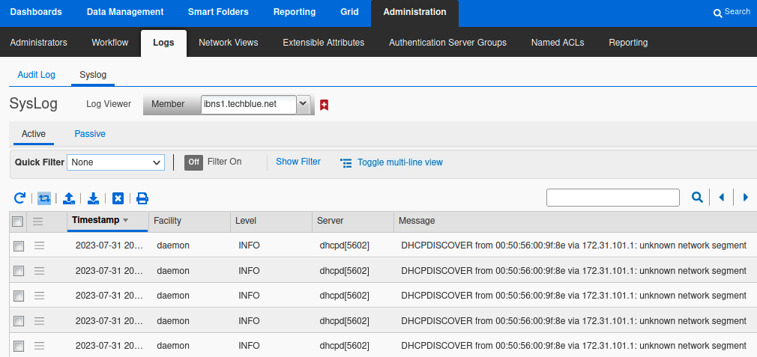
DHCP CASE STUDY
Composite DHCP case: “unknown network segment” after a new VLAN was cut over
This case is especially common during campus refreshes, cloud extension, and carveout events where relay paths change faster than DDI object ownership.
Symptom New clients on a recently introduced VLAN do not receive addresses, but existing devices on nearby subnets continue operating normally. Engineers quickly assume a scope-exhaustion problem because the DHCP server is reachable and older clients elsewhere are still healthy.
Evidence The syslog view shows DISCOVER messages being logged as coming from an unknown network segment. Lease history remains empty for the affected subnet because no lease was ever committed. Packet captures confirm the requests arrive, but the network identity in the relay context does not match any valid served network.
Root cause and fix The relay target was updated before the matching Infoblox network and failover assignment were complete. The fix is to create or correctly assign the network object, validate relay context and member ownership, and then retest with a fresh client request rather than relying on old renewals.
Why this case fools teams Because the server is up and logs are present, operators often conclude that DHCP itself is healthy. In reality the server is healthy but the request has no valid network context, so the workflow fails before lease logic can even begin.
Lesson If the appliance says “unknown network segment,” do not start by resizing scopes. Start by proving the request-to-network mapping: relay path, subnet identity, member assignment, and failover association.
DHCP case study
17
Notes:
Read the log message aloud. It is one of those beautifully direct clues that teams ignore because they are already mentally committed to a scope-exhaustion theory. [Sources] - Infoblox community / public lab screenshot showing DHCPDISCOVER unknown network segment troubleshooting - Infoblox NIOS documentation: DHCP relay and network matching topics

Slide 18
DHCP FAILOVER
DHCP failover associations: the normal behaviors that people misread as faults
Teach this slide before the troubleshooting playbook so the class knows which behaviors are by design and which ones truly indicate a broken association.
Design rules
Normal behaviors that surprise operators
True red flags
Both peers in the association should be assigned to the relevant network, time must be synchronized, and the team should understand the selected MCLT and partner-down behavior. Document who owns maintenance actions because uncoordinated peer changes are a major source of association drift.
Initial lease durations can look unexpectedly short in a failover design; temporary imbalance between peers can also be normal during certain transitions. Engineers new to failover often read those patterns as evidence of corruption when the protocol is actually doing exactly what it should.
Deadlock or conflict states, one peer serving a network the other does not own, repeated communication failures, or manual recovery actions performed without capturing evidence first are real risk indicators. Those conditions deserve structured recovery rather than improvisation.
Recovery posture Before resetting or recovering a DHCP failover relationship, collect status from both peers, verify network assignment symmetry, confirm time sync and communication state, and only then use recovery workflows such as deadlock recovery if they are truly warranted.
DHCP failover
18
Notes:
Explain that students should not panic when they see short initial lease timers or temporary peer imbalance. Save the panic for deadlock, conflict, or asymmetric network ownership. [Sources] - Infoblox NIOS documentation: Configuring DHCP failover associations - Infoblox NIOS documentation: Recovering DHCP failover associations / deadlock recovery - Infoblox public guidance: short initial lease in DHCP failover is expected behavior

Slide 19
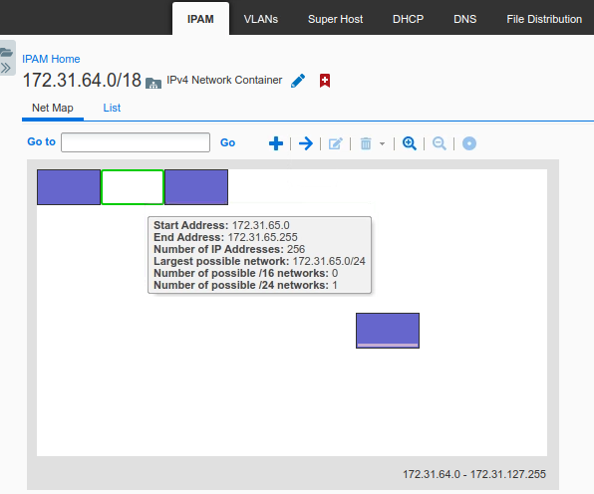
IPAM
IPAM hierarchy: design the object tree so operations and carveouts are easy later
IPAM is where many advanced Infoblox environments either become auditable and scalable or descend into manual exceptions and naming debt.
Hierarchy that mirrors authority Use network containers for major allocation boundaries such as region, program, or business unit; use networks for actual routed subnets; use ranges for service pools; and use host, fixed-address, or reservation objects for endpoint-specific logic. The hierarchy should reflect operational authority, not just address math.
Inheritance is a strength when it is intentional Options, views, and metadata inherited through the hierarchy reduce repetitive configuration and simplify audits. But hidden inheritance becomes a trap during migration or carveout because engineers export visible objects and forget the policies those objects inherit from above.
Extensible Attributes are operational metadata, not decoration Attributes such as site, VLAN, country, region, owner, or service tier turn IPAM into an operational query system. They make carveout exports, compliance checks, and Splunk enrichment significantly more useful than raw network objects alone.
Design rule If a future operator cannot tell who owns a subnet by looking at the container path and Extensible Attributes, the hierarchy is probably too implicit.
IPAM
19
Notes:
Use the image to make the hierarchy tangible, then stress that the real value is not the map itself but the operational meaning of the hierarchy and metadata. [Sources] - Infoblox NIOS documentation: IPAM object model / network containers, networks, and ranges - Infoblox NIOS documentation: About Extensible Attributes

Slide 20
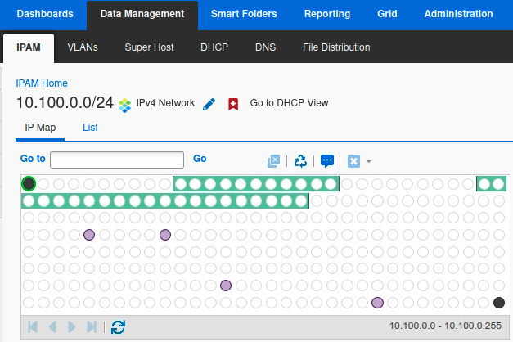
IPAM AUDIT
IPAM event log and audit analysis: prove who changed what, when, and where
This slide is the bridge between IPAM and monitoring. It explains why many “network incidents” are actually change-analysis incidents.
What the audit log captures Infoblox audit mechanisms record actions such as admin login and logout, service restarts, appliance reboot, and add, modify, or delete operations on objects. For advanced environments, WAPI events and structured audit data are equally important because automation-driven changes can be harder to spot in raw syslog alone.
How to analyze an IPAM change Look for the object path, admin identity, member, timestamp, and old versus new values. Then line that change up with service logs and user impact. If an address pool moved, an attribute changed, or a network was reassigned minutes before clients failed, you already have a strong hypothesis without guessing.
The audit trail is the operational story During migration and carveout, the audit trail tells you whether the system was changed correctly as much as whether the service is currently answering. In advanced environments, accurate chronology is often more valuable than a static screenshot of “current state.”
SIEM hint When exporting to Splunk, preserve admin, object type, object name, action, member, and message fields. Without those fields the audit data becomes far less useful for root-cause analysis.
IPAM audit
20
Notes:
Explain that IPAM is not only inventory. In many outages the decisive evidence is the audit sequence that shows an object change immediately before the symptom window. [Sources] - Infoblox NIOS documentation: Using Audit Log / Viewing Audit Log / About Audit Log Events - Infoblox NIOS documentation: Audit Log WAPI Events

Slide 21
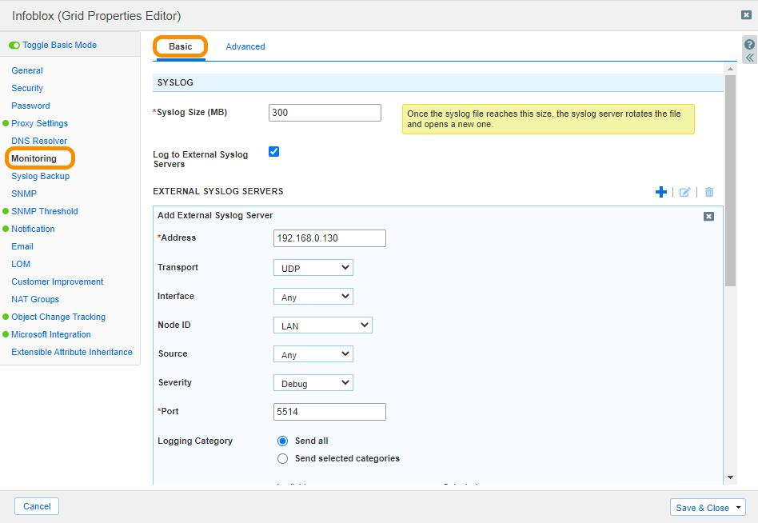
SPLUNK INTEGRATION
Sending Infoblox telemetry to Splunk: choose the path that matches the question
Advanced teams rarely need only one ingestion method. Use raw syslog for broad service visibility and structured reporting/API access for richer audit analytics.
Infoblox members / Grid DNS, DHCP, IPAM, HA, and audit data originate here. Decide which events need immediate alerting versus long-term analysis.
External syslog or reporting path Syslog is the fastest path for service logs. Reporting-server and audit APIs provide richer structured access to audit and DDI data.
Splunk indexes and knowledge objects Normalize DNS, DHCP, IPAM, and audit fields early. Searches and dashboards survive upgrades better when event classes share a stable field model.
What to send over syslog Send DNS query and response categories when investigating resolution issues; DHCP lease or server events when investigating address delivery; Grid, HA, and service events for platform operations; and audit events for change visibility. Do not send everything at maximum verbosity forever. Tune by use case.
Structured audit option NIOS reporting and API access can expose audit-log and DDI data in a more structured form than raw syslog alone. That is useful when you want precise object-change analysis in Splunk instead of only textual events.
Splunk integration
21
Notes:
Explain the ingestion choice as question-driven. If the team wants rapid operational breadcrumbs, syslog is fine. If they want rich object-change analytics, reporting/API access becomes more attractive. [Sources] - Infoblox NIOS documentation: Accessing Audit Log Information from Reporting Server via the Splunk API - Infoblox NIOS documentation: External syslog configuration / monitoring topics

Slide 22
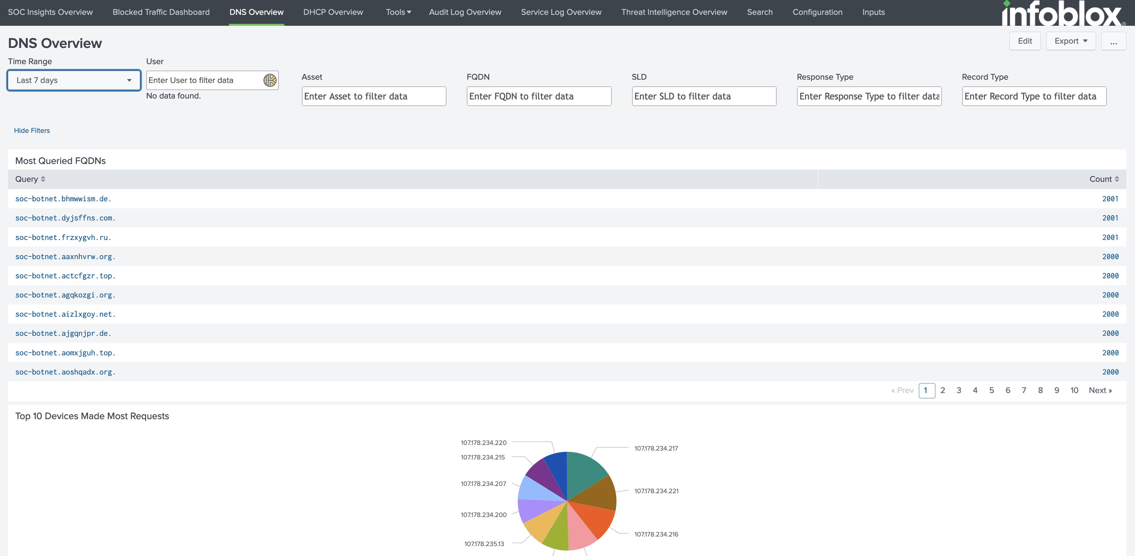
SPLUNK USE CASES
High-value Splunk searches for DNS, DHCP, and IPAM operations
The example SPL below is illustrative; field names vary by app, add-on, and event normalization strategy.
Why Splunk is useful here Splunk becomes the cross-domain view: DNS symptoms, DHCP churn, IPAM change events, and platform operations can be searched on the same timeline. That is what turns DDI from isolated tools into an operational evidence chain.
Example 1: DNS anomalies
index=infoblox response_code=NXDOMAIN
| stats count by src_ip, query
| sort -count
Example 2: DHCP churn
index=infoblox event_type=dhcp
| timechart span=15m count by member
Example 3: IPAM / audit trail
index=infoblox event_type=audit action IN (add,modify,delete)
| table _time user object_type object_name message member
Search design tip Build searches that pivot on object, client, or member identity. Those pivots survive real incidents better than dashboard-only views.
Splunk searches
22
Notes:
Tell the audience that the exact sourcetype and field names depend on their app and parsing strategy. The important part is the logic of the pivots: src_ip, query, member, object_name, and action. [Sources] - Splunkbase: Infoblox App for Splunk - Infoblox NIOS documentation: DNS query/response log message mapping to SIEM fields - Infoblox NIOS documentation: Accessing Audit Log Information from Reporting Server via the Splunk API

Slide 23
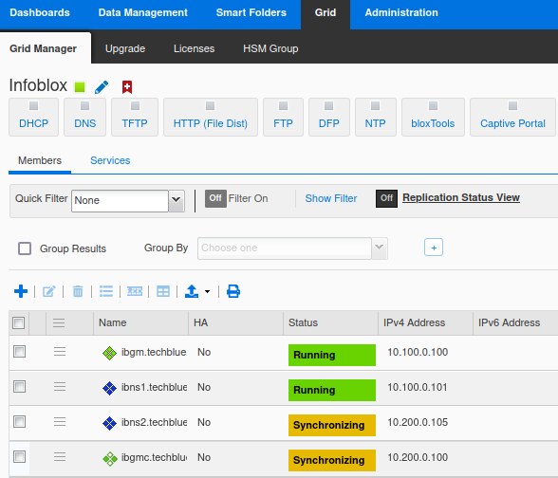
GRID OPERATIONS
Grid architecture recap: read status before you change anything
Most advanced operations start by proving the state of the Grid rather than jumping directly into service-level edits.
Grid Master governs change, members govern traffic A synchronized Grid means the configuration story is coherent. A healthy member means the service story is coherent. You need both, but they are not the same condition. Teams under pressure often confuse them and then take recovery actions appropriate for the wrong layer.
Read the UI status indicators critically States such as Running, Synchronizing, Offline, or HA Broken are not cosmetic. They tell you whether the appliance has the right data, whether the service is active, and whether a failover partner or Grid peer is behaving normally. These indicators should be part of every incident screenshot and change record.
Pending restart explains many “saved but not active” surprises In advanced environments, operators often forget that configuration may be saved but not active on the member until the relevant service restart occurs. That is especially important during DNS and DHCP changes where the UI and live traffic can briefly tell different stories.
Operator habit Before changing config during an incident, take a status snapshot: member state, service state, sync state, and whether any restarts are pending. It becomes your baseline when the situation evolves.
Grid operations
23
Notes:
Use this slide to teach the audience to start incidents with a Grid status snapshot. That is often more valuable than the first screen full of logs. [Sources] - Infoblox NIOS documentation: About Infoblox Grids - Public Infoblox Grid Manager screenshot used for instructional purposes.

Slide 24
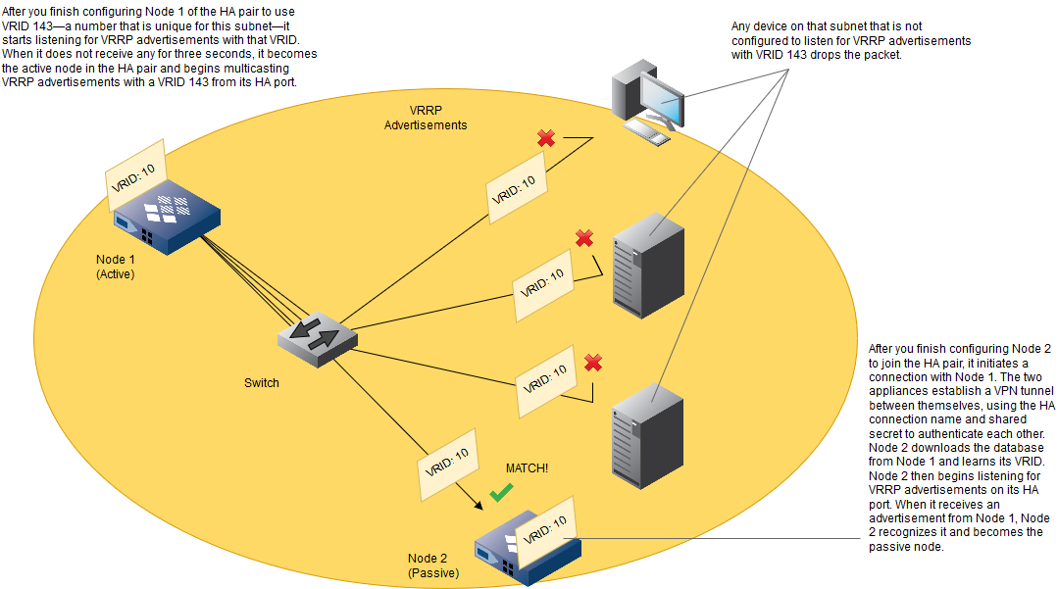
HA
HA pair architecture and VRRP: what the passive node is really doing
The passive node is not idle in the simplistic sense. It is learning state, listening for VRRP, and standing by to assume the VIP and virtual MAC.
HA in Infoblox is active and passive, not active and active Client traffic is served by the active node through the VIP. The passive node does not answer service traffic under normal conditions, but it continuously participates in the HA relationship so that takeover can happen quickly when the active node fails or when an operator initiates a controlled role swap.
Planning fundamentals: IP addressing and VRID Infoblox planning guidance calls for five IPv4 addresses on the same subnet for the pair, including the VIP and node-specific addresses. The HA pair also needs a unique VRID on that subnet so each node can recognize the correct VRRP advertisements for its own partnership.
Why same-subnet design is non-negotiable When teams violate the intended HA network design, the failure does not necessarily look like a clean HA error. It shows up as intermittent reachability, broken takeover, or a pair that appears half-healthy because control and client-facing traffic are learning different network truths.
Operator takeaway When HA behaves strangely, verify VRID, subnet design, and peer identity before blaming services. HA problems often begin as L2/L3 design problems.
HA
24
Notes:
Use the screenshot to explain that the passive node does not become passive by magic; it becomes passive by hearing the correct advertisements and establishing the correct HA relationship. [Sources] - Infoblox NIOS documentation: About HA Pairs - Infoblox NIOS documentation: Planning for an HA Pair - Infoblox NIOS documentation: VRRP Advertisements

Slide 25
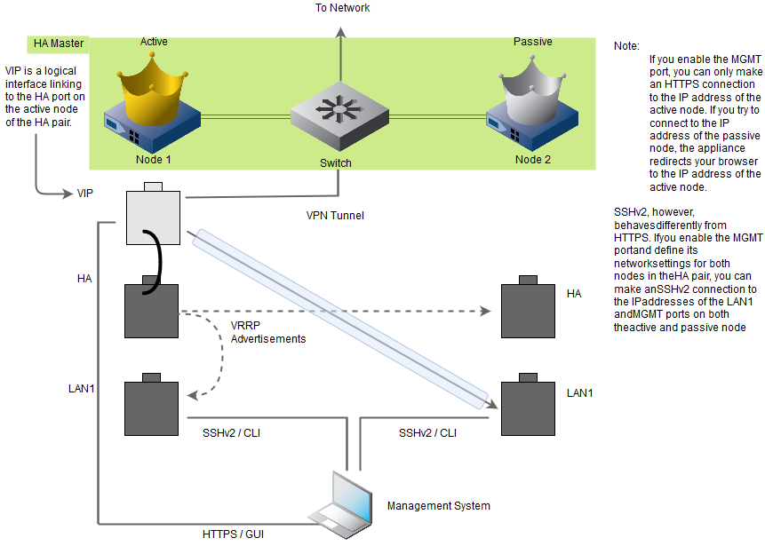
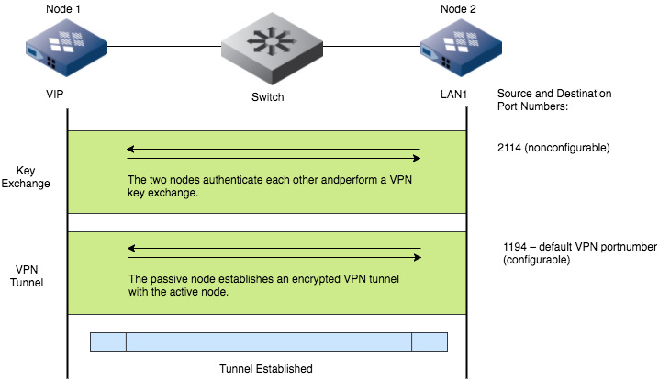
HA NETWORK DESIGN
Network interface design in HA: HA ports, LAN ports, management access, and the encrypted tunnel
This is where you explain why a pair can be reachable for one protocol but still be unhealthy for HA purposes.
Each interface role carries a different kind of truth The HA port is about pair relationship and VIP movement. LAN interfaces carry client-facing service traffic. Management access can behave differently depending on whether MGMT is enabled and whether the session is HTTPS or SSH. If you treat all interfaces as equivalent, troubleshooting becomes guesswork.
The nodes build an encrypted relationship, not just a shared VIP Infoblox HA uses authenticated key exchange and an encrypted VPN-style tunnel between peers. The documented control-plane ports matter operationally because firewalls, ACLs, or intermediate filtering can break synchronization even while basic reachability tests still appear healthy.
What to verify when sync is unstable Verify port reachability, same-subnet assumptions, cable or switch health, interface roles, and whether the team changed the VPN port or related Grid properties. An HA pair with a healthy LAN path but broken control path is one of the most deceptive failure modes in DDI operations.
Field reminder If you changed firewall policy near a pair and HA became unstable, test the documented HA communication ports before you restart anything.
HA network design
25
Notes:
This is the slide to connect interface design with security controls. Many environments harden the network around the appliances and accidentally break HA ports or the VPN tunnel. [Sources] - Infoblox NIOS documentation: Planning for an HA Pair - Infoblox NIOS documentation: Creating a Grid Master / HA key exchange and VPN tunnel details - Infoblox NIOS documentation: Changing Grid Properties (VPN port considerations)

Slide 26
HA FAILOVER
What really happens during HA failover: VIP ownership, virtual MAC movement, and client impact
A good HA lecture should explain both the appliance mechanics and the network-learning mechanics. You need both to understand post-failover symptoms.
Clients continue targeting the same service identity The whole point of the HA pair is that clients continue using the VIP and service identity rather than learning a new destination. On failover, the active role changes, but the client-facing service address does not. That allows continuity, but only if the network learns that the ownership has moved.
The virtual MAC is as important as the VIP The pair shares a virtual MAC in addition to the VIP. After failover, the new active node owns both. If adjacent switches or hosts do not refresh ARP and CAM state quickly enough, traffic may continue heading toward the old active path and the pair will look broken even though the HA role change succeeded.
What “minimal interruption” really means In-flight transactions can still be interrupted briefly during role change, especially if clients or applications are sensitive to even short DNS or DHCP delays. The correct expectation is brief interruption with fast recovery, not the total absence of any observable blip in every client workflow.
Validation sequence After failover, test from the appliance, from a nearby client, and from the switch perspective. Check HA state, ARP tables, and CAM learning before you conclude the new active node is unhealthy.
HA failover
26
Notes:
Make sure the class understands why HA and switching are inseparable here. The appliance can fail over correctly and still appear unavailable if the surrounding network has not relearned the virtual MAC. [Sources] - Infoblox NIOS documentation: About HA Pairs / VIP and virtual MAC behavior - Infoblox NIOS documentation: Planning for an HA Pair

Slide 27
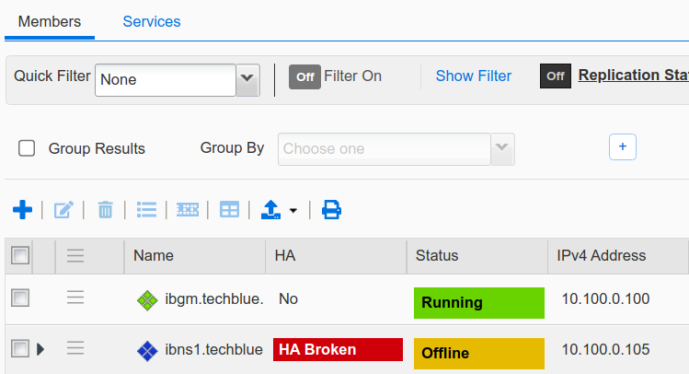
TAKEOVER
HA in Grid members, manual takeover, and Grid Master Candidate promotion are not the same event
Advanced operators distinguish local pair failover from Grid control-plane disaster recovery. The wrong procedure on the wrong problem can enlarge the outage.
Member takeover is a service-continuity action When a member HA pair changes active node, the member identity remains conceptually the same from the Grid perspective. Services follow the VIP. The main question is whether the pair remained healthy and whether clients learned the new path quickly enough.
Grid Master Candidate promotion is control-plane disaster recovery Promoting a Grid Master Candidate is a different class of event. It is about recovering the Grid database and change control when the Grid Master is lost. Document the promote-master procedure, test it in advance, and ensure the documented communication ports are open between candidate and members.
Use staged restarts when recovering the Grid Infoblox guidance notes that staggered member restarts can reduce avoidable DNS interruption during candidate promotion. That is a crucial teaching point: recovery should preserve service stability, not simply restore administrative control as fast as possible at any cost.
Decision test Ask: is this a pair continuity problem, or is it a Grid control-plane problem? If DNS and DHCP are still serving but the Grid Master is lost, do not treat it like a service failover event.
Takeover
27
Notes:
This is a critical distinction slide. Explain the promote-master workflow conceptually, then emphasize that teams should rehearse it rather than learning it during a real control-plane failure. [Sources] - Infoblox NIOS documentation: Promoting a Grid Master Candidate - Infoblox NIOS CLI documentation: set promote_master - Infoblox NIOS documentation: Grid Master Candidate promote test / staggered member restart guidance

Slide 28
MAC AND SWITCHING
MAC address communication: why a healthy failover can still look unhealthy on the network
This slide is deliberately network-centric because many Infoblox HA incidents are diagnosed too narrowly as appliance problems.
Old active node Before failover, the switch learned the virtual MAC on this path.
VIP + virtual MAC The client-facing service identity does not change; ownership moves.
New active node After failover, this node owns the same VIP and virtual MAC.
Gratuitous ARP / switch relearn The network must update where it believes the virtual MAC lives.
Common post-failover symptom DNS queries or DHCP requests succeed from one test point but fail from another because some devices or switches still point traffic toward the old active path. Operators then assume the new active node is unhealthy when the real problem is stale L2/L3 learning.
Troubleshooting sequence 1) Confirm pair state. 2) Inspect switch CAM and nearby host ARP. 3) Test from a directly adjacent client. 4) Capture on the relevant LAN or HA interface only if the path still disagrees with the appliance state.
Edge case worth teaching Public Infoblox guidance notes that certain suspend or unsuspend scenarios can pin the VRRP MAC to one appliance and make HA look broken. That is rare, but it is a good reminder to include network learning in every HA diagnosis.
MAC communication
28
Notes:
This slide often resonates with network engineers. Emphasize that a perfect appliance failover can still fail operationally if the surrounding network does not relearn the virtual MAC promptly. [Sources] - Infoblox NIOS documentation: About HA Pairs / VIP and virtual MAC behavior - Infoblox public education / knowledge note: VRRP MAC can remain fixed after suspend/unsuspend in certain scenarios

Slide 29
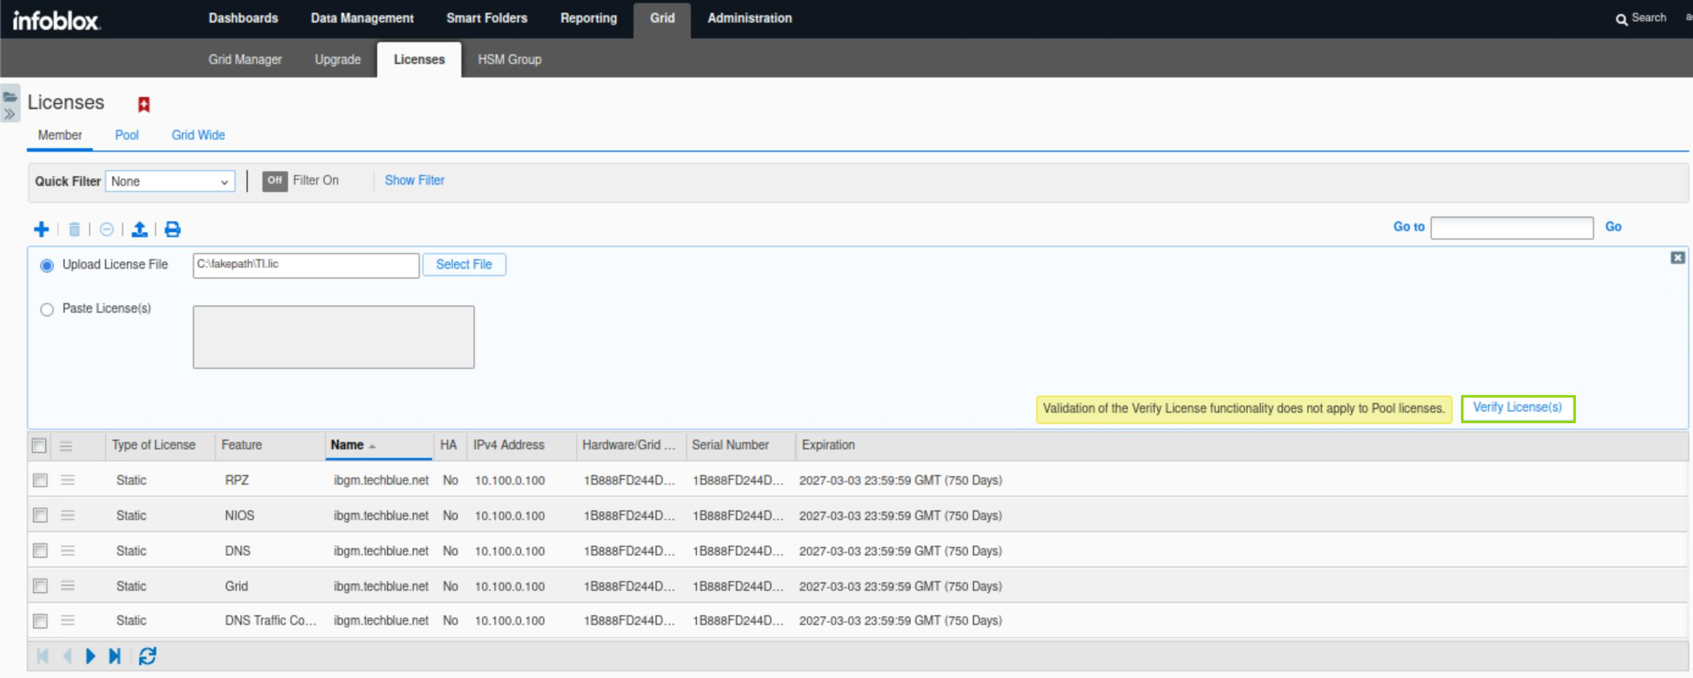
LICENSING
License model: static member licenses, pool licenses, grid-wide licenses, and operational order of operations
Advanced operators treat licensing as part of platform design and change control, not as paperwork handled only during procurement.
Static versus pool versus grid-wide Member or static licenses are tied to a specific appliance identity. Pool licenses float and can be allocated more flexibly. Grid-wide licenses are associated with the Grid Master UID and enable capabilities across the environment. Understanding which category a feature falls into matters when you move roles or recover systems.
Install in the right order The usual safe sequence is to apply the base NIOS license first, wait for any required restart, and then apply additional feature licenses such as DNS, DHCP, Grid, RPZ, Microsoft management, or reporting-related features. If you reverse the order, the platform can behave in ways that look like partial failure rather than simple missing entitlement.
Design implication for HA and migration Licenses need to match the service roles your appliances may assume, not just the roles they have today. If a passive HA node or replacement member lacks the necessary feature entitlement, failover or recovery may technically occur but the expected services will not be available afterward.
Operational rule Record license type, feature, appliance, expiry date, and Grid Master UID in your operational documentation. That turns emergency recovery from guesswork into a checklist.
Licensing
29
Notes:
Use this slide to make licensing concrete: it affects service placement, DR, and HA readiness. It is not only an administrative afterthought. [Sources] - Infoblox NIOS documentation: License Types - Infoblox NIOS documentation: Managing Licenses - Infoblox NIOS documentation: Grid-wide licenses generated from Grid Master UID

Slide 30
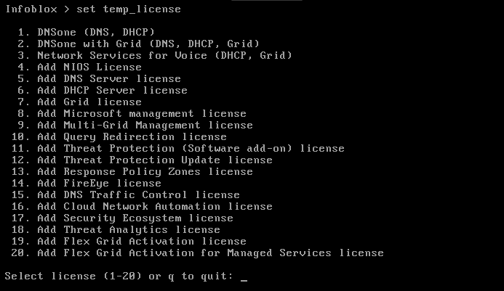
LICENSING
License failure scenarios and monitoring: temporary licenses, expiry, and mismatched HA pairs
This is one of the most under-taught Infoblox topics because licensing problems often masquerade as service or membership problems.
Temporary licenses are operationally dangerous when forgotten Temporary licenses are useful in labs, emergency recovery, or staged deployments, but public Infoblox guidance notes that expiry can stop services and even evict a member from the Grid. In production that can look like a spontaneous appliance or membership failure when the real issue is entitlement expiry.
Mismatched license coverage creates asymmetric recovery risk An HA pair may look fine while the active node owns the required features, but recovery fails when the peer takes over without equivalent entitlement. The same risk exists during migration when services are moved to a new member whose hardware and network are ready but whose feature license set is incomplete.
What to monitor proactively Track days to expiry, mismatched features between active and passive peers, and any use of temporary licensing outside explicitly approved windows. In Splunk or reporting, those are easy high-value alerts because they prevent avoidable outages rather than merely describing them afterward.
Runbook item Keep the recovery path for licensing with the DR runbook: Grid Master UID, appliance IDs, feature inventory, and who can obtain replacement or corrected licenses quickly.
Licensing
30
Notes:
This is a good place to remind the class that not every “member eviction” or service loss is a software bug. Sometimes the platform is faithfully enforcing license state. [Sources] - Infoblox NIOS documentation: NIOS Licenses and License Expiry - Infoblox NIOS documentation: Managing Licenses

Slide 31
CERTIFICATES
Certificate management on the Grid Master and members: a reliable lifecycle
Walk through the lifecycle in order so the audience does not reduce certificates to “upload a file and hope the browser likes it.”
1. Generate or request Create a CSR or choose the approved certificate source. Ensure CN and SAN values match how admins actually access the Grid Master or member.
2. Obtain full chain Collect the server certificate and any required intermediate or CA certificates in the required format, typically PEM.
3. Upload and replace Upload the HTTPS certificate to the Grid Master or member. Be ready for the session to end because replacing the certificate can log administrators out.
4. Verify and monitor Reconnect using the intended FQDN, validate trust, confirm member communication, and record expiry for proactive renewal.
Scope matters Think in layers: the Grid Master web interface certificate, member certificates, and CA trust stores are related but not identical concerns. A browser trust error is not the same operational event as a member trust or synchronization issue, even if both are certificate-adjacent.
Why naming discipline matters If admins reach the Grid by short name one day and by FQDN the next, certificate validation will seem inconsistent. Use stable administrative access names and document them so renewal events do not introduce avoidable confusion.
Monitoring rule Track certificate expiry the same way you track license expiry: centrally, with lead time, and with explicit ownership. The right time to discover a missing intermediate certificate is not during an emergency browser login to the Grid Master.
Certificates
31
Notes:
Remind students that replacing a cert can log them out. That tiny operational detail causes surprising stress during change windows if it is not expected. [Sources] - Infoblox NIOS documentation: Managing Certificates / Uploading HTTPS Certificates - Infoblox NIOS documentation: Managing CA Certificates / PEM requirements

Slide 32
CERTIFICATES
Composite certificate case: the cert was “replaced successfully,” but admins still saw trust warnings and sync concerns
This scenario is common enough that every advanced Infoblox class should cover it.
What the team observed • The Grid Master certificate was replaced during a maintenance window and the upload itself appeared to succeed.
• Some admins could reconnect only after bypassing a browser warning, while others reported that the certificate still looked invalid.
• Around the same time, a few member communication or admin-login anomalies appeared, which tempted the team to blame a broader software issue.
What the root cause analysis found • The server certificate had been uploaded without the full intermediate chain, so some clients could not build trust even though the leaf certificate was present.
• The access URL used by administrators was inconsistent with the certificate naming.
• Time synchronization drift made troubleshooting noisier because certificate validity checks and log timelines did not line up cleanly.
• Recovery required importing the correct CA chain, validating the intended FQDN, correcting time/NTP where needed, and then re-verifying member and admin behavior.
Monitoring cues Watch for expiring certificates, failed admin logins after certificate changes, NTP drift, and recent certificate-upload audit events. Those signals together often explain certificate incidents faster than browser screenshots alone.
Certificates
32
Notes:
Tell students that certificates fail in clusters: trust chain, naming, and time. If they test only one of those three, they may leave the incident half-resolved. [Sources] - Composite case built from common certificate-management failure patterns in appliance administration. - Infoblox NIOS documentation: Managing Certificates / CA certificates

Slide 33
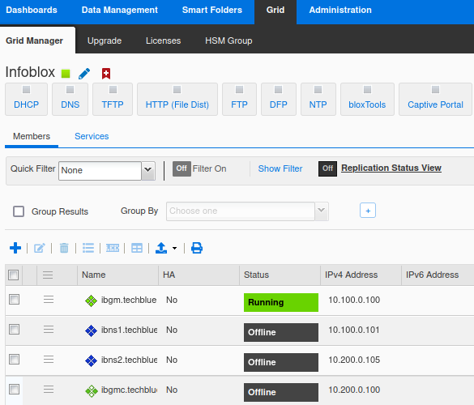
HA TROUBLESHOOTING
HA pair troubleshooting playbook
This slide is intentionally procedural. The class should leave with a repeatable order of operations rather than a collection of vague tips.
Step 1: establish actual pair state Use Grid Manager or CLI to determine whether the pair is healthy, HA Broken, offline, or simply serving from the expected active node. Do not rely on a client symptom alone to infer pair state; a client path problem can mimic a pair problem.
Step 2: validate the network assumptions behind HA Check HA cabling, same-subnet design, VRID, firewall policy, the HA tunnel, and the LAN path that carries the VIP. Then confirm that the switch and nearby hosts have relearned the virtual MAC and ARP state if failover occurred.
Step 3: decide whether to hold steady or intervene If the pair is stable on one node, aggressive intervention can enlarge the outage. Sometimes the safest response is to keep the current active node, collect evidence, and repair the passive side later. Reserve manual takeover or rejoin actions for situations where you understand the failure domain.
Evidence to save before escalation Status screenshots, recent HA events, switch ARP/CAM output, interface checks, and timing of any recent network policy changes. Those pieces make vendor escalation dramatically faster if needed.
HA troubleshooting
33
Notes:
Stress that “keep the pair stable and collect data” is sometimes the most mature response. Engineers under pressure often induce a second failure by forcing unnecessary role changes. [Sources] - Infoblox NIOS documentation: About HA Pairs - Infoblox NIOS documentation: Planning for an HA Pair - Infoblox public guidance on VRRP/MAC-related anomalies

Slide 34
DHCP FAILOVER TROUBLESHOOTING
DHCP failover association troubleshooting playbook
Use this playbook after you have already classified the symptom and proven that DHCP failover is actually involved.
State and communication checks
Data and ownership checks
Recovery decision
Review the association state on both peers, verify the peers can communicate, confirm clocks are aligned, and determine whether the pair is in a normal transient condition or a real fault such as deadlock or persistent partner-down. Capture the state before you touch recovery controls.
Verify that both peers are actually assigned to the relevant networks and that option inheritance, reservations, and scope ownership are symmetric where expected. One-sided network assignment is a classic reason a failover pair appears broken when the underlying issue is simple object placement.
Use deadlock recovery or deeper reset actions only after collecting evidence and ruling out basic ownership and timing issues. If the incident involves a recent migration, VLAN change, or relay move, re-check network mapping before concluding the association itself is corrupt.
Collect before you reset Save association state from both peers, supporting logs or support bundles, evidence of relay and network assignment, and any recent change records touching VLANs, ranges, or lease timers. Recovery without evidence solves the moment and damages future troubleshooting.
DHCP failover troubleshooting
34
Notes:
This is the slide where you coach discipline. Most bad DHCP failover recoveries happen because engineers skip straight to reset or partner-down actions without capturing state first. [Sources] - Infoblox NIOS documentation: Configuring and Recovering DHCP Failover Associations - Infoblox public community guidance: data to collect for DHCP failover troubleshooting

Slide 35
DNS TROUBLESHOOTING
DNS resolution troubleshooting playbook
By this point in the lecture the audience has seen the symptom matrix, the logging model, and a view-order case. This slide condenses that into an operational sequence.
1. Classify and localize
2. Prove the selection logic
3. Change only after the proof chain is clear
Decide whether the symptom is NXDOMAIN, SERVFAIL, timeout, or wrong answer. Then prove whether the member is acting authoritatively or recursively for that name and client path. Without that split, every later step is less efficient.
Determine which view answered, whether ACLs and client matching are correct, and whether cache state is masking a recent fix. Compare client-path queries with server-directed queries so you know whether the disagreement is in the member logic or beyond it.
If the issue is authoritative data, correct the zone or record and verify restart state. If the issue is recursion, correct forwarders, root-hint pathing, or upstream authority issues. If the issue is policy, fix view order or ACLs. Avoid multi-layer “shotgun” changes that destroy evidence.
Three commands and artifacts that solve most cases 1) A query from the affected client path. 2) A query directed at the member itself. 3) The corresponding Infoblox log or audit evidence. When those three disagree, the disagreement usually tells you exactly which layer is wrong.
DNS troubleshooting
35
Notes:
Close the troubleshooting sequence by reminding students that changing multiple layers at once is the enemy of learning. If they keep a proof chain, they will solve incidents faster and teach others better. [Sources] - Infoblox NIOS documentation: DNS query logging and troubleshooting-related reporting topics - Infoblox NIOS documentation: DNS views and resolver configuration topics

Slide 36
CLOSE
Operational checklist to carry back into production
Use this closing slide as the handoff from lecture to practice. It is designed to become a field checklist, not just a summary.
Before a migration, carveout, or major change • Prove authority and ownership: which system owns each zone, scope, reservation, and IPAM object.
• Lower TTLs or lease timers early enough to matter.
• Capture a Grid status baseline, including sync state and pending restarts.
• Validate logging paths before the change window so evidence exists if the cutover goes wrong.
• Confirm license and certificate readiness on the appliances that may become active or authoritative during recovery.
Day-two monitoring and troubleshooting discipline • Treat DNS, DHCP, IPAM, Grid, and HA as one evidence chain, not five unrelated tools.
• Start every incident by classifying the symptom and identifying the failure domain.
• Save screenshots, logs, and status before changing the system.
• Keep Splunk searches and dashboards aligned to pivots that matter operationally: client, member, object, and action.
• Rehearse takeover, candidate promotion, and certificate or license renewal before you need them under pressure.
Close
36
Notes:
End by challenging the audience to turn one of the lecture playbooks into a runbook within a week. That is the fastest way to convert training into operational improvement. [Sources] - Lecture synthesis based on the Infoblox public documentation and public product material cited throughout the deck.

