Slide 1
Income Classification Using Machine Learning
CAPSTONE PROJECT
Presented By:
Himanshu J. Shastrakar
K. K. Wagh Institute of Engineering Education and Research
Department of Information Technology

Slide 2
OUTLINE
Problem Statement
System Development Approach
Algorithm & Deployment (Step by Step Procedure)
Result
Conclusion
Future Scope
References

Slide 3
Problem Statement
In today’s world, predicting an individual's income level based on demographic factors can be useful for marketing, recruitment, and economic research. This project aims to classify individuals as earning either >50K or <=50K per year based on features such as age, workclass, education, occupation, and hours-per-week. The dataset used is the UCI Adult Income dataset containing 48,842 rows and 15 features. The objective is to build a robust machine learning model that can generalize well on unseen data. Key focus areas include data preprocessing, exploratory data analysis (EDA), and model evaluation.

Slide 4
System Approach
System Requirements:
Python 3.x
Jupyter Notebook / Google Colab
Libraries Used:
pandas, numpy – for data manipulation
matplotlib, seaborn – for visualization
scikit-learn – for preprocessing, model training & evaluation
Dataset Summary:
Source: UCI Machine Learning Repository
Features include: age, education, occupation, capital-gain, hours-per-week, etc.
Target: income (binary classification: >50K or <=50K)

Slide 5
Algorithm & Deployment
Data Preparation:
Imported libraries and loaded adult.csv
Cleaned data (handled nulls/whitespace, encoded categoricals)
EDA Highlights:
Explored age, education vs income, occupation, capital gain/loss
Modeling:
Split: 80% train / 20% test
Models: Logistic Regression, Decision Tree, Random Forest
Metrics: Accuracy, Confusion Matrix, Classification Report

Slide 6
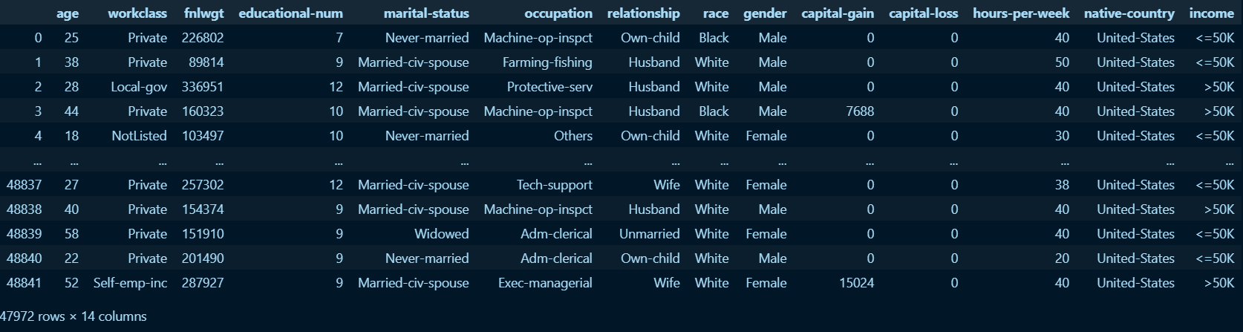
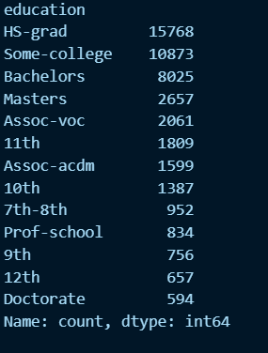
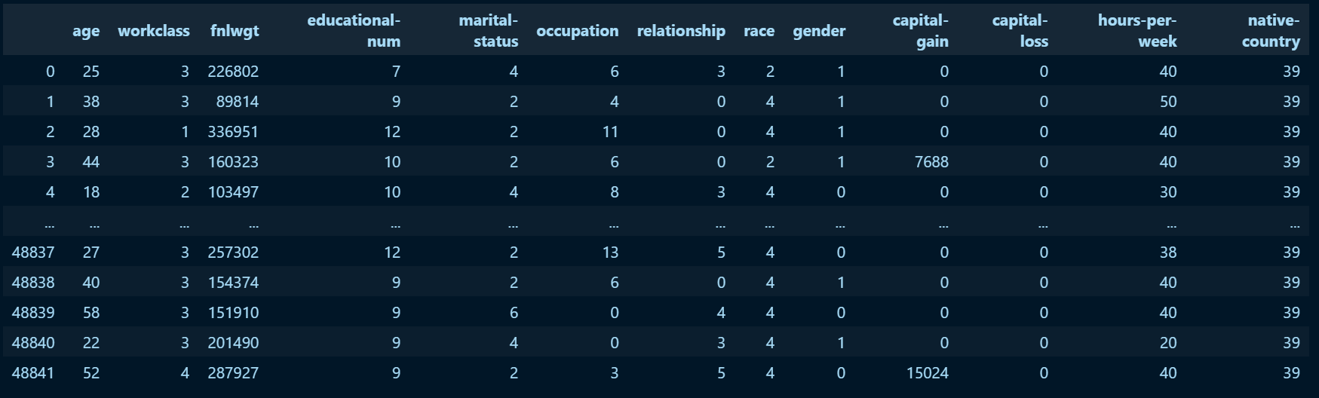
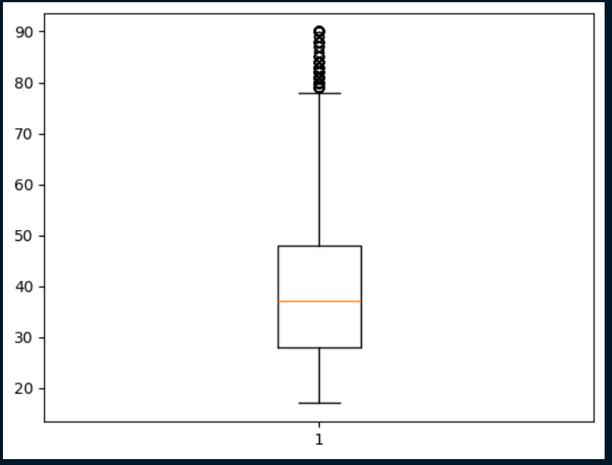
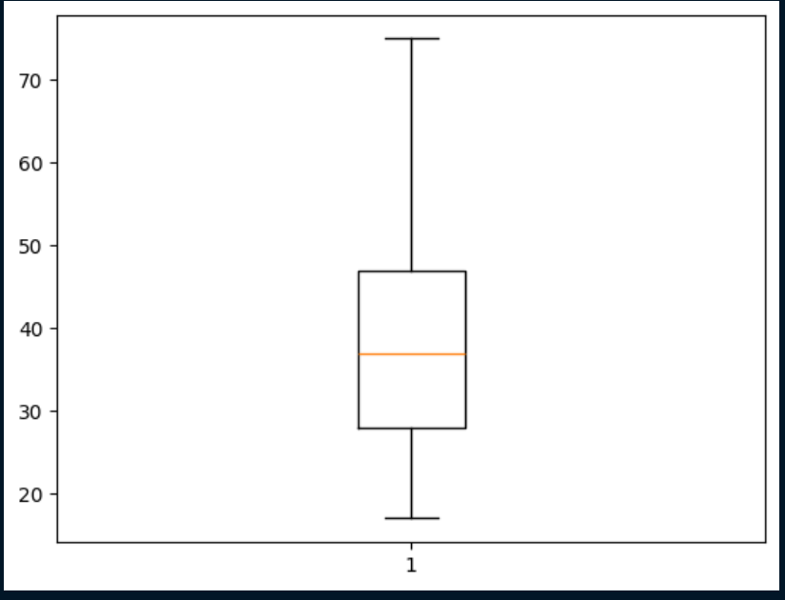
Result

Slide 7
Conclusion
The Random Forest model achieved the highest accuracy (~85% depending on tuning). Strong predictors included education, occupation, hours-per-week, and capital-gain. The model effectively distinguished income classes using demographic features. Challenges included class imbalance and encoding high-cardinality categorical variables. The project achieved its goal of building a reliable income classification pipeline using ML.

Slide 8
Future scope(Optional)
Use advanced algorithms like XGBoost or Neural Networks
Implement cross-validation and hyperparameter tuning
Integrate with a web application (Flask/Django)
Use explainable AI techniques (SHAP values) for interpretation

Slide 9
References
UCI Dataset: https://archive.ics.uci.edu/ml/datasets/adult
scikit-learn documentation
pandas & seaborn docs
Relevant ML tutorials or articles

Slide 10
THANK YOU

