Slide 1








HMS
:
Team Details:
Himanshu kumar
Gaurav Anand
Hritik singh
Himanshu
(2210991661)
(2210991570)
(2210991673)
(2210991663)
Faculty Coordinator:
Ms. Manisha Thakur
Chitkara University Institute of Engineering and Technology, Chitkara University, Punjab

Slide 2
Table of Contents
Introduction
Problem Statement
Technical Details
Key Features
Project Highlights
Conclusion
References/Links used

Slide 3
Introduction
Hospital Management System (HMS)
HMS is an all-in-one digital platform designed to streamline hospital operations and enhance patient care. Our system bridges the gap between doctors and patients through an intuitive, secure, and feature-rich environment, offering:
Seamless authentication with role-based access (patients, doctors, admins)
Appointment booking, medical history tracking, and real-time updates
Interactive dashboards and user-friendly interface across devices
Efficient management of patient records, schedules, and consultations
This platform simplifies healthcare delivery, enabling doctors to focus on treatment while empowering patients with easy access to medical services.

Slide 4
Problem Statement
Time-Consuming Appointment Process:
Patients struggle with long queues and manual appointment booking, which wastes time and causes unnecessary delays in treatment.
Limited Doctor–Patient Communication:
There is no centralized system for real-time interaction or follow-ups between doctors and patients, affecting the quality and continuity of care.
Inefficient Hospital Operations:
Without automation, administrative tasks such as scheduling, record-keeping, and reporting become time-consuming and error-prone.
Lack of Secure Data Access:
Patients and doctors lack a secure way to access health records remotely, making it difficult to manage or review medical history during emergencies.

Slide 5
Technical Details
Frontend: React.js, Typescript, Redux Toolkit, Tailwind CSS
Backend: Node.js with Express.js framework
Database: MySQL with Sequelize ORM
Authentication: JWT for secure user authentication
File Handling: Multer for product image uploads
API Architecture: RESTful design with comprehensive endpoints
Development: Concurrent workflow with mock data capabilities

Slide 6
Used Modules..
Frontend:
React.js - Component-based UI library for building interactive interfaces
Redux Toolkit - State management for storing application data and user state
Tailwind CSS - Utility-first styling framework for responsive design
React Router - Client-side navigation and route management

Slide 7
Used Modules..
Backend:
Node.js - JavaScript runtime for server-side operations
Express.js - Web framework for REST API development and request handling
Sequelize ORM - Database abstraction layer for MySQL interactions
MySQL - Relational database for storing products, users, and orders

Slide 8
Used Modules..
Security & Utilities:
JWT - Token-based authentication for user sessions
Bcrypt - Password encryption for secure credential storage
Axios - HTTP client for API communication
Validator.js - Input validation for data integrity

Slide 9
Key Features
Secure Experience:
Protected user accounts with role-based access
Confidential handling of patient medical data and prescriptions
Doctor Tools:
Efficient patient record management
Appointment scheduling and prescription upload functionality
Patient Benefits:
View medical history, prescriptions, and reports at one place Book, reschedule, or cancel appointments with ease

Slide 10
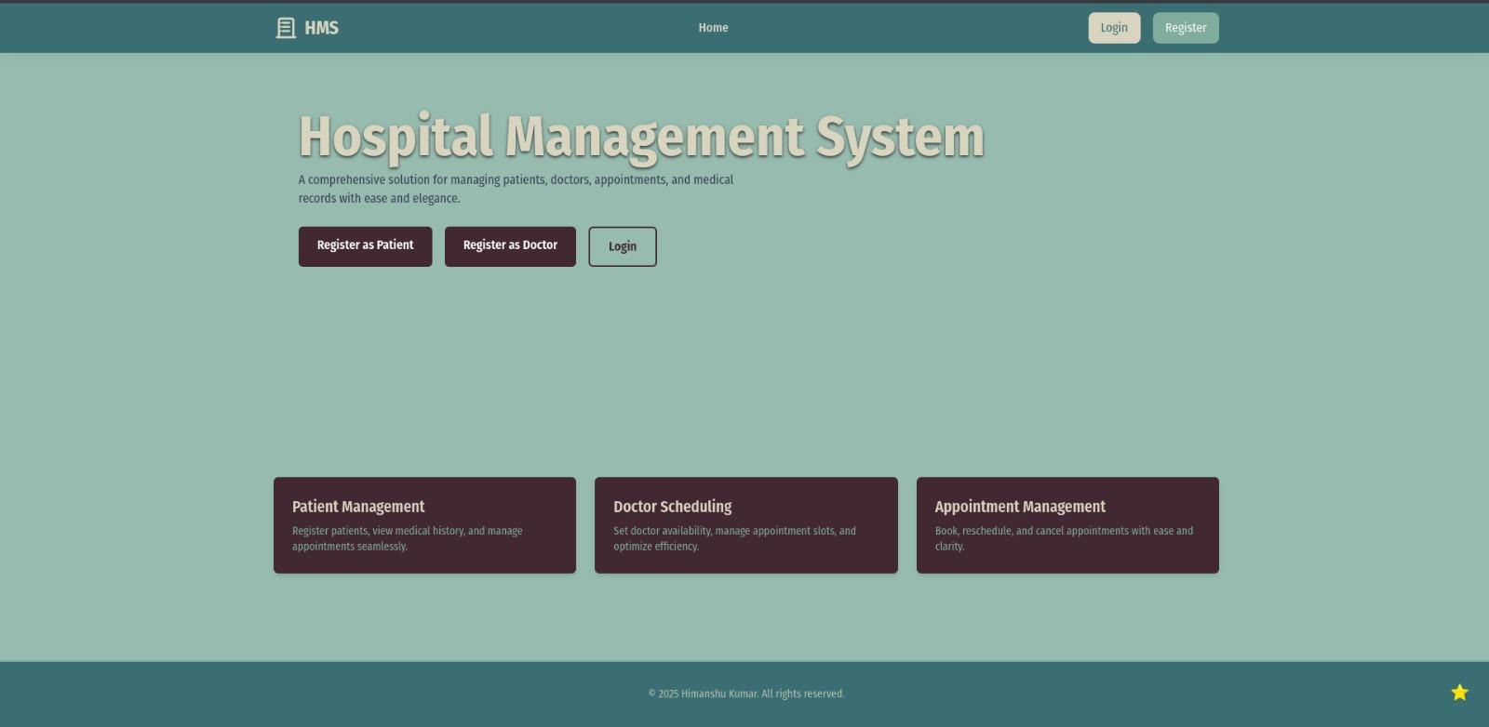
HomePage…..

Slide 11
Dashboard…..
Conclusion
Hospital Management System (HMS) successfully connects doctors and patients through a centralized, digital healthcare platform. We've addressed the inefficiencies in traditional hospital management by integrating appointments, patient records, and medical communication into one secure and user- friendly system. Our solution makes accessing healthcare services easier for patients while enabling doctors to manage consultations, records, and treatments more efficiently.

Slide 12
References/Links used
React Documentation
Redux Toolkit
•
•
•
•
•
Tailwind CSS
Express.js
Sequelize ORM
JWT Authentication
MySQl

