Slide 1
Jarvis AI Desktop Voice Assistant
Submitted By :- HIMANSHI(2210990403)
Chitkara University Institute of Engineering and Technology,
Chitkara University, Punjab

Slide 2
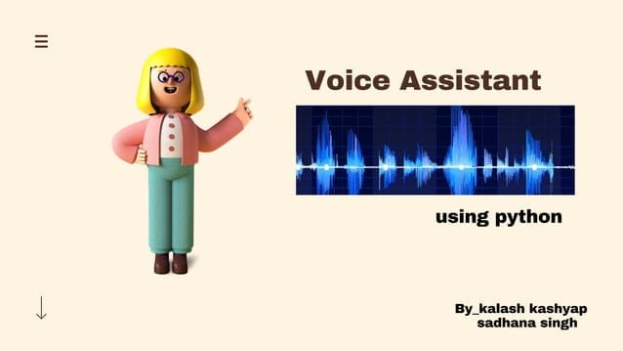

Slide 3
INDEX
Introduction
What is Jarvis doing?
How it works?
Flow Diagram
Virtual Library Requirements
Code Snippets

Slide 4
Introduction
This technology is based on Artificial Intelligence. This
software program use device’s Microphone to receive
voice requests and processing on it and send response
Via speaker. This software program is developed using
python language and its modules.

Slide 5
What is Jarvis doing?
It can send emails on your behalf.
It can do Wikipedia searches for you.
It is capable of opening websites like Google,Youtube, etc., in a web browser.
It is capable of opening your code editor or IDE with a single voice command.
It will greet you.
It can tell yot the present time.

Slide 6
How it works?
User ask the assistant to perform the task.
2. The natural language audio signal is converted into
digital data that can be analyzed by the software.
3. For this reason it must have reliable internet
connection.
.

Slide 7
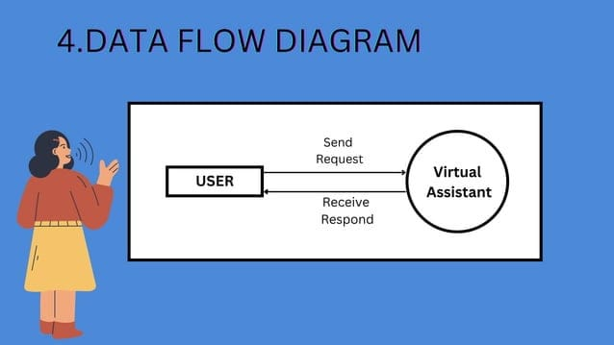
FLOW DIAGRAM

Slide 8
Virtual Library Requirement
1.Speech Recognition
$pip install Speech Recognition
2.Pyttsx3
$pip install pyttx3
3.Wikipedia
$pip install Wikipedia
4.PyAudio
$pip install PyAudio
5.Date Time

Slide 9
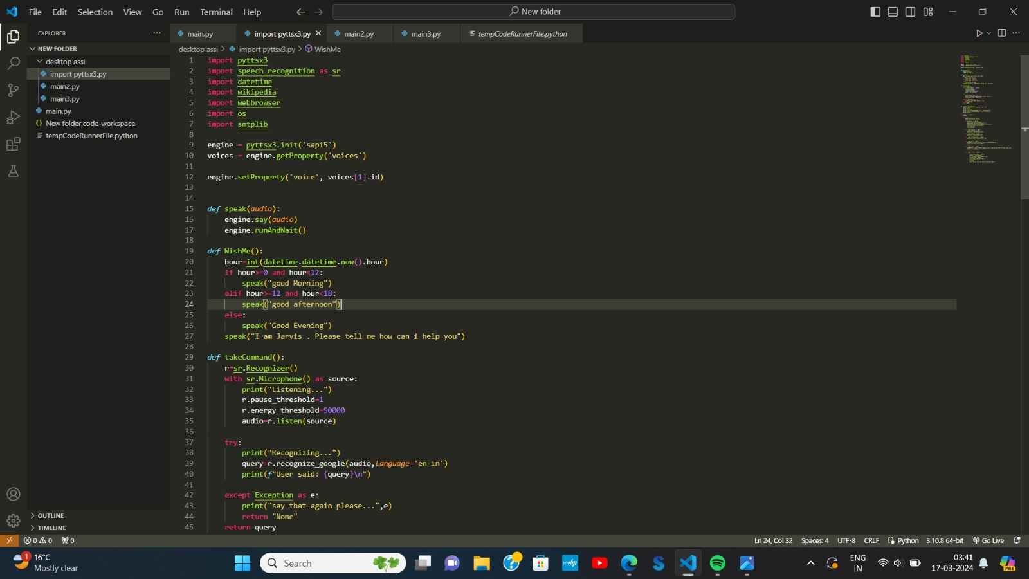
Code Snippets

Slide 10
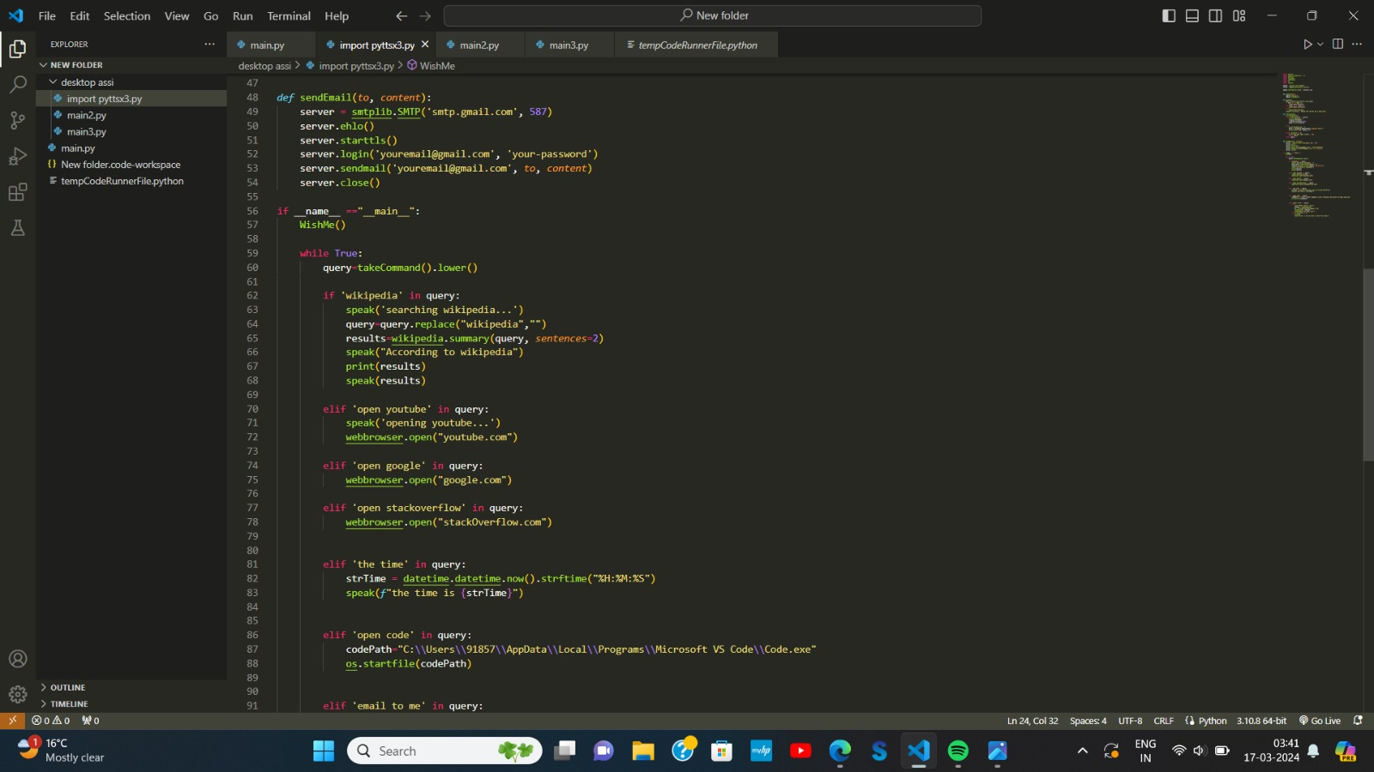

Slide 11
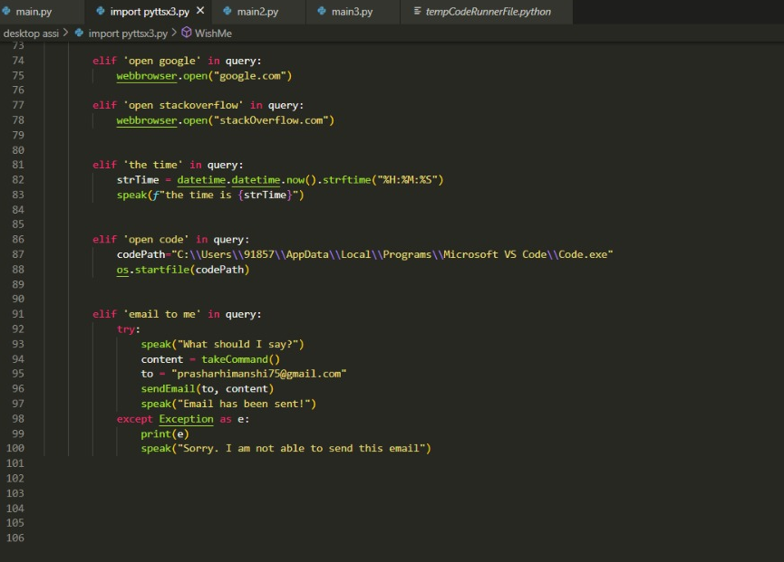

Slide 12


