Slide 1
Capstone Project - The Battle of the Neighborhoods Applied data science capstone Project
By
HIMANSHI SHARMA

Slide 2
Presentation Outline
Introduction: BUSINESS PROBLEM
Background
Problem description
Target audience
Success Criteria
DATA
Methodology
Analysis
conclusion

Slide 3
INTRODUCTION : BUSINESS PROBLEM
In this project we will try to find an location for a restaurant.Since there are lots of restaurants in Toronto we will try to detect locations that are not already crowded with restaurants. We are also particularly interested in areas with no Indian restaurants in vicinity. We would also prefer locations as close to city center as possible, assuming that first two conditions are met.

Slide 4
Background
There is a resturant contractor in one of the boroughs of Toronto (Scarborough). This contractor looking for the places such as Different types of Restaurants, Bakery, Breakfast Spot, Brewery and Café with fresh and high-quality. The contractor wants to build a restaurant for the Italian food lovers inside the borough, so that they will support more customers and also bring better "Quality of Service" to the there customers.

Slide 5
Problem Description
Since there are lots of restaurants in Toronto we will try to detect locations that are not already crowded with restaurants. We are also particularly interested in areas with no Indian restaurants in vicinity. We would also prefer locations as close to city center as possible, assuming that first two conditions are met.
We will use our data science powers to generate a few most promissing neighborhoods based on this criteria. Advantages of each area will then be clearly expressed so that best possible final location can be chosen by stakeholders. this report will be targeted to stakeholders interested in opening an Italian restaurant in Toronto.

Slide 6
Target Audience
Target audience for this project will be all the stakeholders who want establish restaurants or café in Toronto neighborhood and want a less populated area so that the competition to other stakeholders will be less in comparison to others.

Slide 7
Success criteria
The success criteria of this project will be a recommendation of area for new restaurant opening for the Italian food lovers on the basis of clusters in the nearby area.

Slide 8
DATA
The dataframe will consist of three columns: PostalCode, Borough, and Neighborhood. Only process the cells that have an assigned borough. number of existing restaurants in the neighborhood (any type of restaurant) number of and distance to Italian restaurants in the neighborhood, if any distance of neighborhood from city center We decided to use regularly spaced grid of locations, centered around city center, to define our neighborhoods.
Following data sources will be needed to extract/generate the required information:
centers of candidate areas will be generated algorithmically and approximate addresses of centers of those areas will be obtained using Google Maps API reverse geocoding number of restaurants and their type and location in every neighborhood will be obtained using Foursquare API coordinate of Delhi center will be obtained using Google Maps API geocoding of well known toronto location.

Slide 9
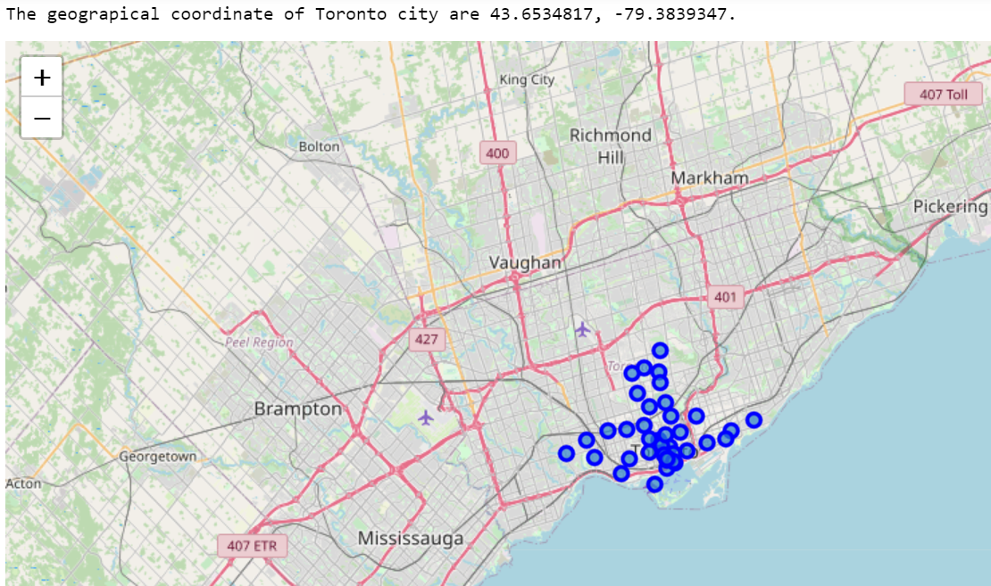
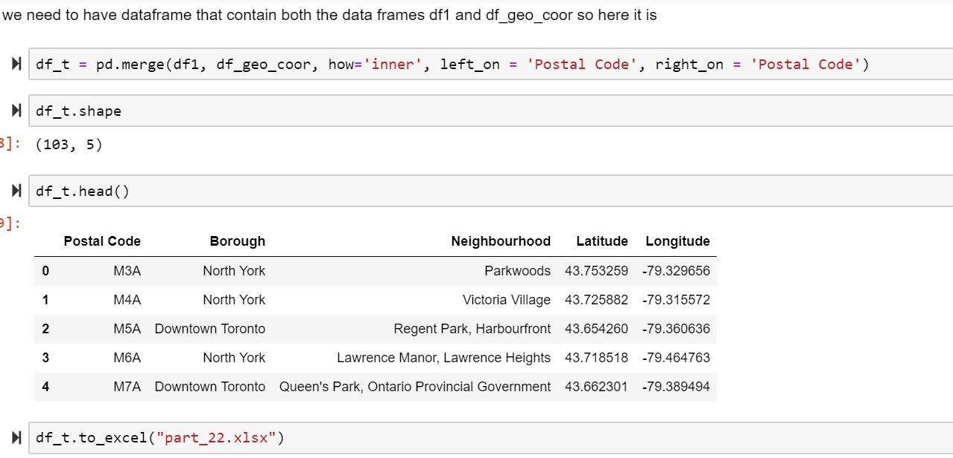
METHODOLOGY
Part 1: Identifying Postal Codes (and then Neighborhoods)

Slide 10
Part 2: Connecting to Foursquare and Retrieving Locational Data for Each Venue in Every Neighborhood After finding the list of neighborhoods, we then connect to the Foursquare API to gather information about venues inside each and every neighborhood. For each neighborhood, we have chosen the radius to be 1000 meter. It means that we have asked Foursquare to find venues that are at most 1000 meter far from the center of the neighborhood.
Part 3: Processing the Retrieved Data and Creating a DataFrome for All the Venues inside the Scarborough
When the data is completely gathered, we will perform processing on that raw data to find our desirable features for each venue. Our main feature is the category of that venue. After this stage, the column "Venue's Category" wil be One-hot encoded and different venues will have different feature-columns. After On-hot encoding we will integrate all restaurant columns to one column "Total Restaurants" and all food joint columns to "Total Joints" column.

Slide 11
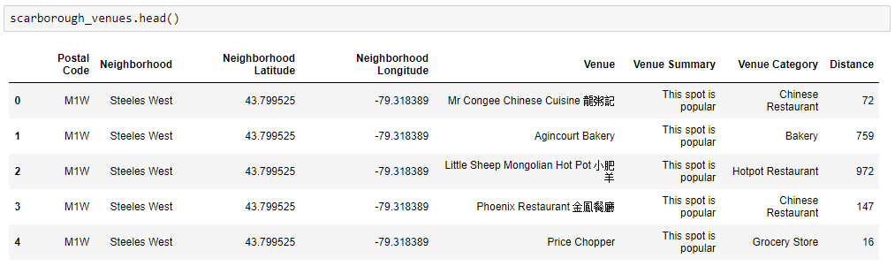
Part 3: Processing the Retrieved Data and Creating a DataFrome for All the Venues

Slide 12
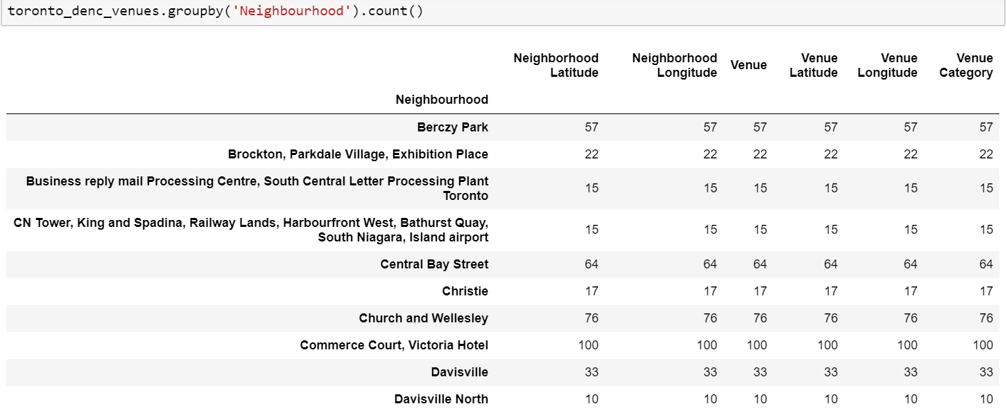
ANAYLSIS Now, the dataset is fully ready to be used for machine learning (and statistical analysis) purposes.

Slide 13
Part 4: Applying one of Machine Learning Techniques (K-Means Clustering)
Now, we focus on the centers of clusters and compare them for their "Total Restaurants" and their "Total Joints". The group which its center has the highest "Total Sum" will be our best recommendation to the contractor. {Note: Total Sum = Total Restaurants + Total Joints.} This algorithm although is pretty straightforward yet is strongly powerful. Run k-means to cluster the neighborhoods in Toronto into 5 clusters and then we will plot the map with the five different colour clusters, here this dark blue cluster is cluster 0 ,orange cluster is cluster 1 then red colour cluster is cluster 2, sky blue colour cluster is cluster 3 and light green cluster is cluster 4.

Slide 14
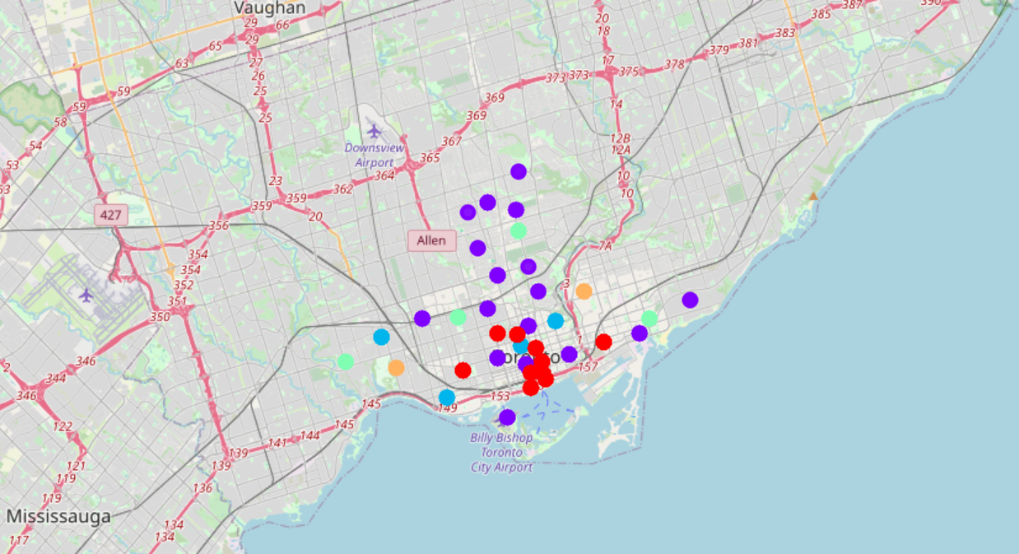

Slide 15
OBSERVATIONS
Most of Italian restaurants are in Cluster 0 and lowest in Cluster 4 and cluster 2 areas. Also, there are good opportunities to open restrurant in parkside drive and bayview avenue bloor street areas as the competition seems to be low. Looking at nearby venues, it seems Cluster 4 might be a good location as there are not a lot of italian restaurants in these areas. Therefore, this project recommends the entrepreneur to open an authentic Burmese restaurant in these locations with little to no competition. Nonetheless, if the food is authentic, affordable and good taste, I am confident that it will have great following everywhere.

Slide 16
Thank You!!!!
A

