Slide 1
SISTEC INNOVATION HACKATHON (SIH)
🕉️ GhatNetra AI (घाट-नेत्र)
AI-Powered River Ghat Crowd Management & Decision Support System
Problem Statement By: Madhya Pradesh State Tourism Development Corporation Limited (MPSTDC)
Government of Madhya Pradesh | Theme: AI & Intelligent Systems
SAGAR INSTITUTE OF SCIENCE AND TECHNOLOGY (SISTec), BHOPAL
Team Innovation Submission • Working AI Computer Vision & Decision Support Prototype
Focus: Ujjain Ram Ghat (Shipra River) • Omkareshwar • Maheshwar • Sethani Ghat

Slide 2
SISTEC INNOVATION HACKATHON (SIH) | MPSTDC
The Real-World Challenge: River Ghat Crowd Congestion
🚨 Mass Pilgrimage Hazards
• Religious mass gatherings (Simhastha Kumbh Mela, Mahakal Sawari, Narmada Jayanti) bring 5-10 lakh pilgrims to river ghats.
• Ancient narrow alleys and steep stone steps create sudden choking points.
• Dangerous stampede and drowning risks during holy dips (Snan).
❌ Manual Limitations
• Police rely on manual eye observation, making response reactive instead of proactive.
• No scientific data on how many pilgrims should be admitted per gate per minute.
• Zero automated warning when ghat capacity crosses critical safety limits.
• Lack of evacuation clearance time calculation during emergencies.
🎯 MPSTDC Scope Mandate
• Continuous crowd occupancy estimation via computer vision.
• Automated recommendations for Gate OPEN/CLOSE and entry rates.
• Dynamic alternate route crowd diversion.
• Physics-based safe evacuation time calculation.
• Pre-event crowd movement simulation for proactive planning.

Slide 3
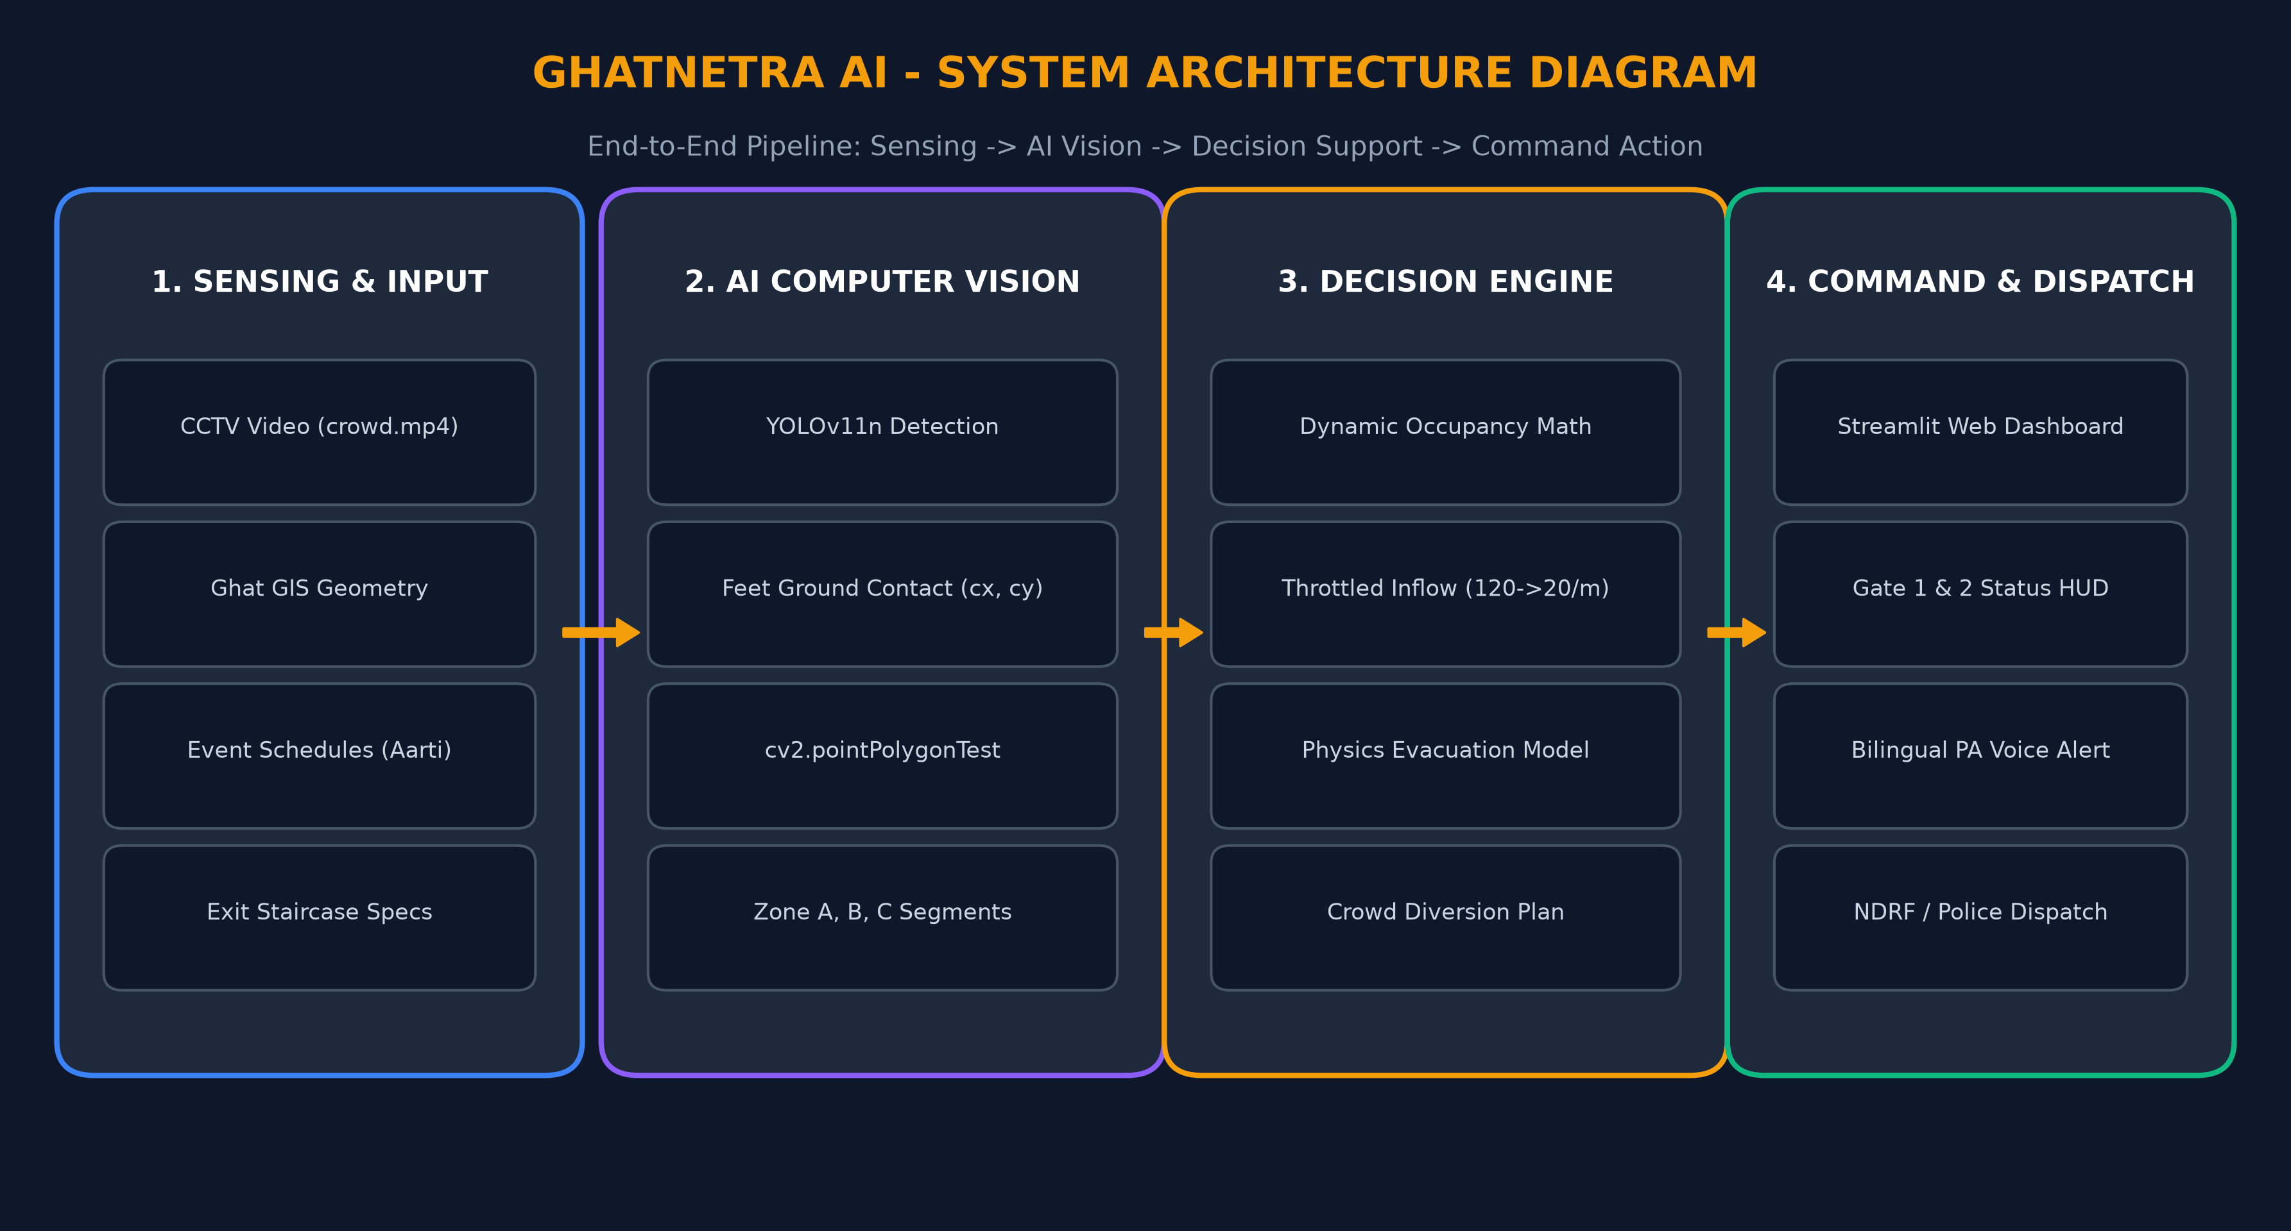
SISTEC INNOVATION HACKATHON (SIH) | MPSTDC
System Architecture: End-to-End Operational Pipeline

Slide 4
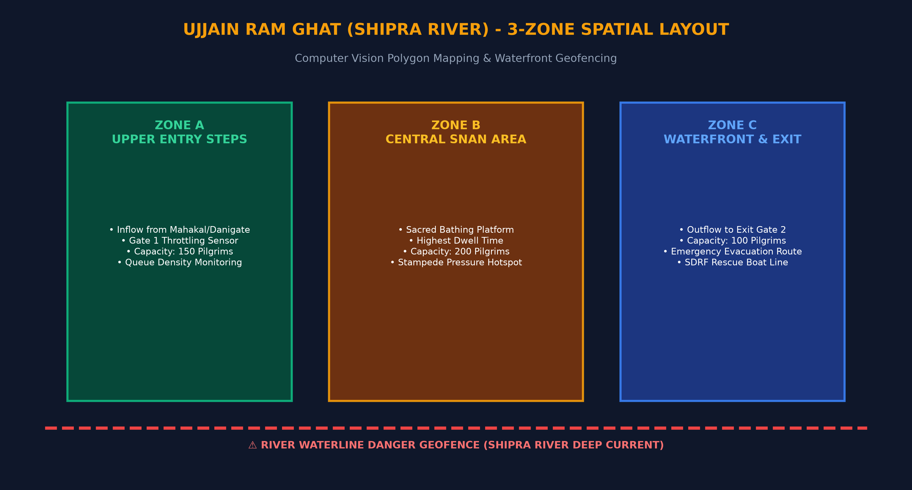
SISTEC INNOVATION HACKATHON (SIH) | MPSTDC
Spatial Ghat Segmentation: 3-Zone Geometry & Geofencing

Slide 5
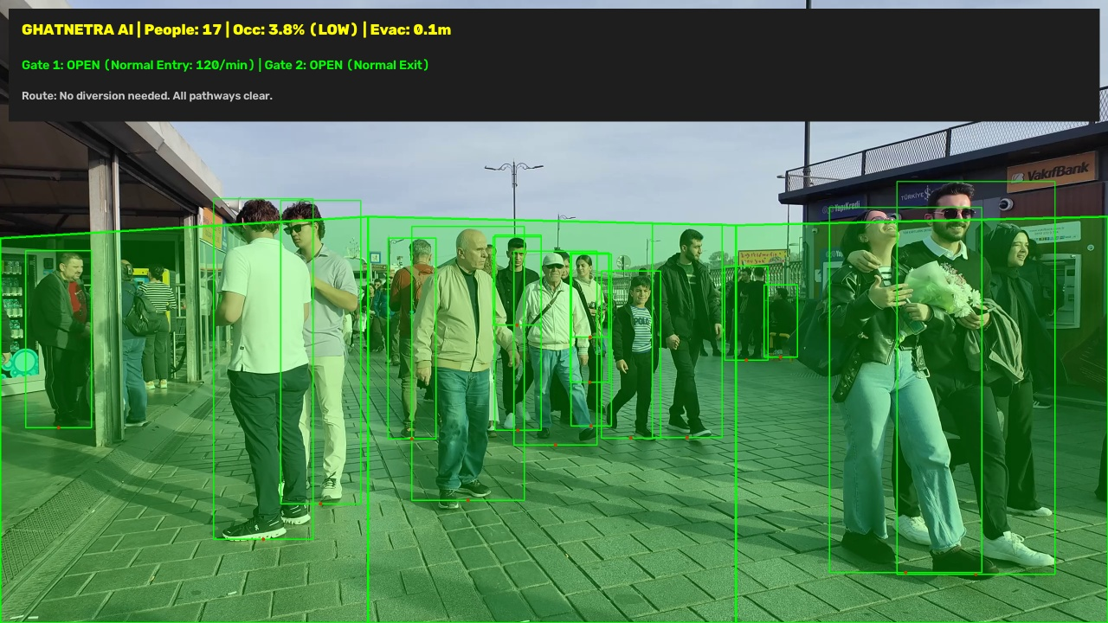
SISTEC INNOVATION HACKATHON (SIH) | MPSTDC
Live Prototype Verification: YOLOv11 & Heads-Up Command Bar
🔍 Visual Analytics Highlights
• Green Bounding Boxes: Ultralytics YOLOv11 nano detects pilgrims in real time at 30+ FPS.
• Red Ground Contact Dots: Exact feet coordinates (cx, y2) mapped to stone steps.
• Translucent Zone Overlays: Dynamic green/yellow/red color mapping via cv2.pointPolygonTest.
• Live Command Center HUD: Displays live headcount, occupancy %, Gate 1/2 status, and alternate diversion route.

Slide 6
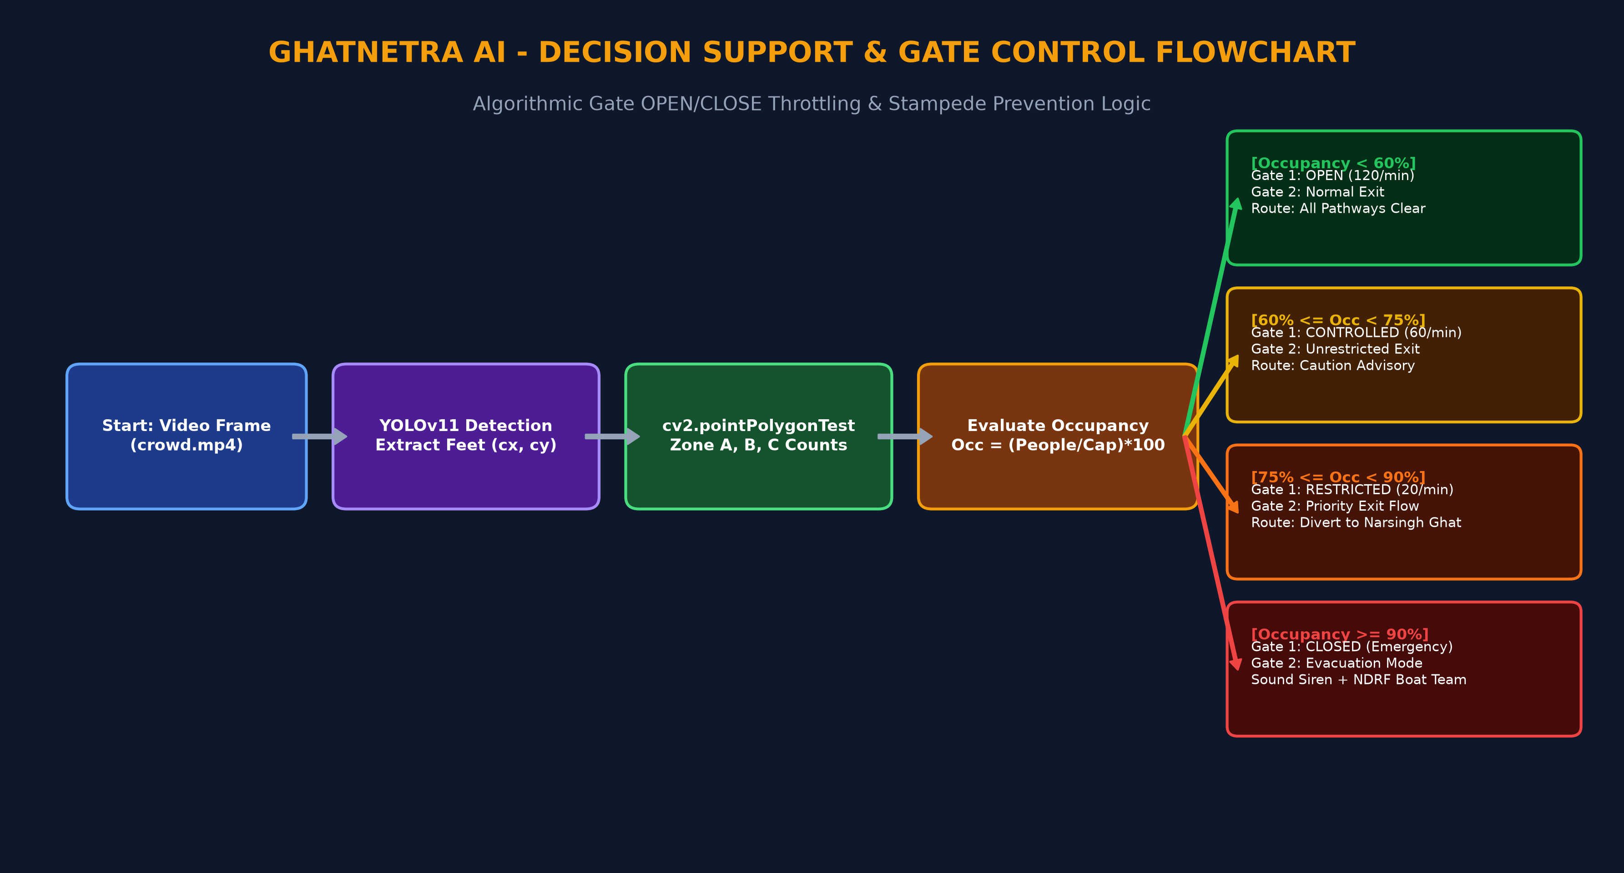
SISTEC INNOVATION HACKATHON (SIH) | MPSTDC
AI Decision Engine: Dynamic Gate Control & Evacuation Physics

Slide 7
SISTEC INNOVATION HACKATHON (SIH) | MPSTDC
Pre-Event 'What-If' Simulation Sandbox (For Judges & Police)
🎛️ Interactive Parameters
• Officials select major festival scenarios (Simhastha Shahi Snan, Mahakal Sawari).
• Adjust crowd sliders from 30 to 500+ simulated pilgrims.
• Vary exit staircase width (1.5m to 10m) and walking speed to test bottleneck risks.
⚡ Real-Time Decision Logic
• Gate 1 transitions: 🟢 OPEN (120/min) -> 🟡 CONTROLLED (60/min) -> 🔴 CLOSED (Emergency).
• Continuous evacuation clearance time countdown ($T = N / (W imes V imes 60)$).
• Dynamic diversion trigger to Narsingh Ghat before panic starts.
🔊 Multilingual Smart PA
• Automated bilingual voice broadcast in Hindi and English.
• Example: 'कृपया ध्यान दें! राम घाट पर क्षमता पूर्ण हो चुकी है। कृपया नरसिंह घाट की ओर प्रस्थान करें।'
• Clear acoustic guidance eliminates rumor-driven stampedes.

Slide 8
SISTEC INNOVATION HACKATHON (SIH) | MPSTDC
Complete 22-Feature Alignment With MPSTDC Scope
👁️ Vision & Zones (1-8)
• 1. YOLOv11 Person Detection
• 2. Real-Time Head Counting
• 3. Multi-Zone Ghat Decomposition
• 4. Zone-Wise People Count
• 5. Calibrated Zone Capacities
• 6. Dynamic Occupancy Math
• 7. Status: Low/Mod/High/Critical
• 8. Automated Operator Visual Alerts
🚪 Flow & Forecasting (9-16)
• 9. Entry/Exit Flow Management
• 10. Simulated Gate OPEN/CLOSE
• 11. Automated Entry Restriction
• 12. Dynamic Gate Re-Opening
• 13. Movement Vectors & Speed
• 14. 2D Gaussian Density Heatmaps
• 15. Observed Inflow Trend Graphs
• 16. 60-Minute Predictive Rush Forecast
🛡️ Safety & Command (17-22)
• 17. AI Security Deployment Directives
• 18. Dynamic Crowd Diversion Routes
• 19. AI Lost Child / Person Match Demo
• 20. Ujjain Riverfront GIS Map
• 21. Streamlit Web Command Center
• 22. Weather & River Discharge Data

Slide 9
SISTEC INNOVATION HACKATHON (SIH) | MPSTDC
Technology Stack & Ground Deployment Strategy
💻 Technology Core
• Python 3.12 (High performance & cross-platform).
• Ultralytics YOLOv11 nano (Fast inference on standard CPU/GPU).
• OpenCV (cv2) for polygon testing, HUD drawing, and heatmap blending.
• Streamlit with custom CSS for intuitive web command center.
⚙️ Edge Hardware & Offline
• Runs on local edge computers (NVIDIA Jetson / Local Ghat Control Room Server).
• 100% Offline Operational Capability: Works even during cellular network congestion.
• Drop-In CCTV Integration: Video path swaps directly with live RTSP IP camera feed.
🔒 Privacy & Safety Impact
• Zero Facial Storage: General pilgrim faces are processed in-memory without recording.
• Dial 112 & SDRF Integration: One-click dispatch of quick response motorized rescue boats.
• Zero-Stampede Mission across all major MP riverfronts.

Slide 10
SISTEC INNOVATION HACKATHON (SIH) 2026
Thank You, Respected Evaluators! 🙏
GhatNetra AI (घाट-नेत्र)
AI-Powered River Ghat Crowd Management & Decision Support System
Designed for MPSTDC, Government of Madhya Pradesh
READY FOR LIVE DEMONSTRATION:
1. Standalone OpenCV HUD Pipeline (`zone_detection.py`)
2. Interactive Web Command Center (`streamlit run app.py`)
3. Pre-Event 'What-If' Simulation Sandbox

