Slide 1
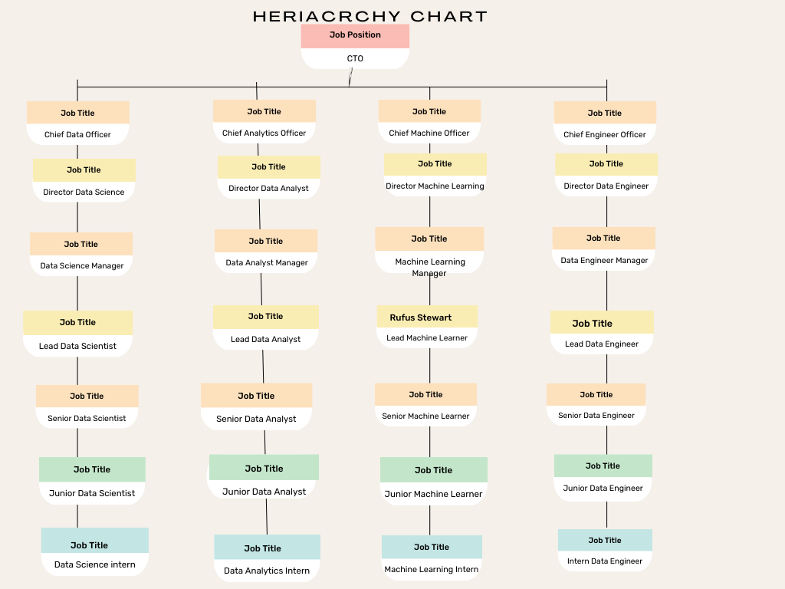

Slide 2
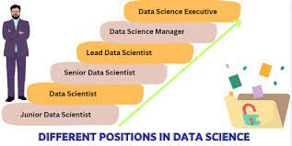
Chief Technology Officer (CTO)
|
Chief Data Officer (CDO) / Chief Analytics Officer (CAO)
|
Director of Data Science / Director of Machine Learning
|
Data Science Manager / Machine Learning Manager
|
Lead Data Scientist / Lead Machine Learning Engineer
|
Senior Data Scientist / Senior Machine Learning Engineer
|
Data Scientist / Machine Learning Engineer
Senior Data Analyst
|
Data Analyst
Junior Data Scientist / Junior Machine Learning Engineer
|
Junior Data Analyst / Data Science Intern
|
Intern

