Slide 1

Geometric Aware Differential
Privacy for Face Templates
Securing Biometric Systems with the GeoDP Framework
Novel Framework
Introducing GeoDP—a geometry-aware approach to deep face template protection with formal mathematical privacy guarantees.
Core Goal
Balancing rigorous differential privacy guarantees with high biometric utility across real-world recognition benchmarks.
Tata Consultancy Services

Slide 2

The Vulnerability of Deep Face Embeddings
  Face recognition is everywhere, but the mathematical face data (embeddings) it uses carries serious security risks.
Irrevocable by Nature
If a password is hacked, you can reset it. If your face data is stolen, it is compromised forever.
Multi-Vector Attack Surface
Attackers can track users across different systems (Linkage), steal their visual identity (Reconstruction), or expose their presence in a private database (MIA).
Why Existing DP Falls Short
Image-level DP degrades discriminative quality. Isotropic embedding-level DP ignores the anisotropic geometry of deep face spaces — yielding a suboptimal privacy-utility trade-off.
Tata Consultancy Services

Slide 3

Introducing the GeoDP Framework
GeoDP is a geometry-aware differential privacy framework that operates directly in the embedding space, exploiting the statistical
structure of face representations to intelligently allocate noise.
Operates in Embedding Space
Adaptive Noise Allocation
Pareto Optimization
Protects the 512 embeddings directly, bypassing the quality degradation of image-level perturbation.
Exploits the anisotropic geometry of
deep face embeddings to allocate differential privacy noise where it matters most.
Uses multi-objective Pareto optimization to select the best operating parameters balancing privacy and utility.
Tata Consultancy Services

Slide 4
Operational Architecture and Threat Landscape
System Architecture
Threat Model — Defends Against
Template Reconstruction
Cross-Database Linkage
Matching identities across disparate biometric systems.
Client
Captures face and generates a 512-dimensional ArcFace embedding
for transmission.
Recovering face images from stored embeddings.
Server
Membership Inference
Stores protected templates. Operates under an honest-but-curious
Determining whether an individual's data was used in training.
white-box adversary model.
Tata Consultancy Services

Slide 5

GeoDP: Two-Phase Execution Model
Phase 1: Offline Geometry Learning | Phase 2: Online Template Protection
Execution: Estimated once during system initialization. | Execution: Executed locally per enrollment or authentication.
Subspace Learning: Applies PCA and LDA to a representative population. | Projection: Projects the input 512-d ArcFace embedding onto the learned 128-d discriminative subspace.
Feature Mapping: Generates a Fisher projection matrix to map high-dimensional embeddings into a compact 128-d discriminative subspace. | Adaptive Covariance: Allocates noise based on discriminative importance using the learned eigenvalues:
Eigenvalue Decay: Scores each facial feature based on how important it is for recognizing the person. | Hybrid Perturbation: Adds full privacy noise to key features, but limits noise on weaker features to protect system accuracy.
System Output: Saves the learned mathematical models to be used for future authentications. | Normalization: Applies L2 normalization to ensure the protected template remains compatible with standard cosine-similarity matchers.

Slide 6




Offline Geometry Learning
Face Dataset
ArcFace Encoder
  Learn the intrinsic geometry of face embeddings only once using a representative face dataset.
  ArcFace feature:
  Projection:
  where:
​ = Fisher Projection Matrix
z = 128-d discriminative embedding
  Fisher Eigenvalues:
512-D Embeddings
PCA
LDA
128-D Fisher Space
Projection Matrix + Eigenvalue Spectrum

Slide 7
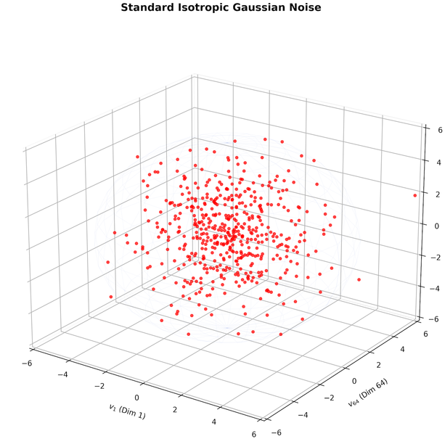

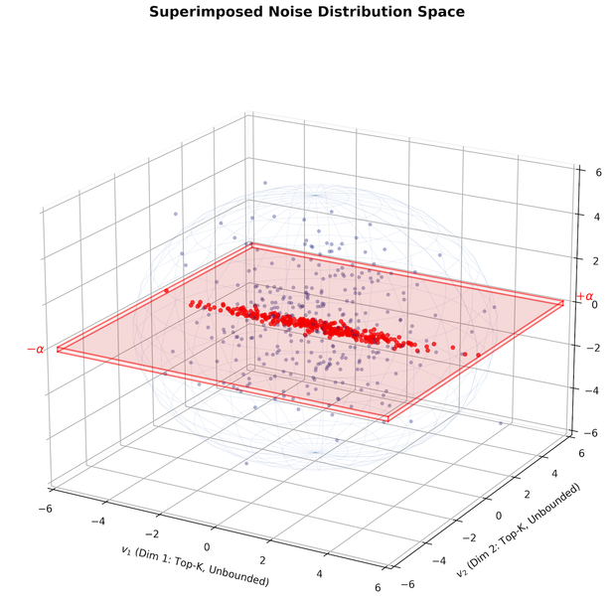
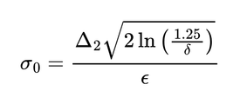

Geometry-Aware Covariance
Traditional Differential Privacy :
  Adds identical Gaussian noise to every dimension
  Ignores feature importance
  Unnecessary accuracy loss
Proposed GeoDP :
  Noise depends on Fisher eigenvalues
  Base Noise :
  Adaptive Noise :

Slide 8

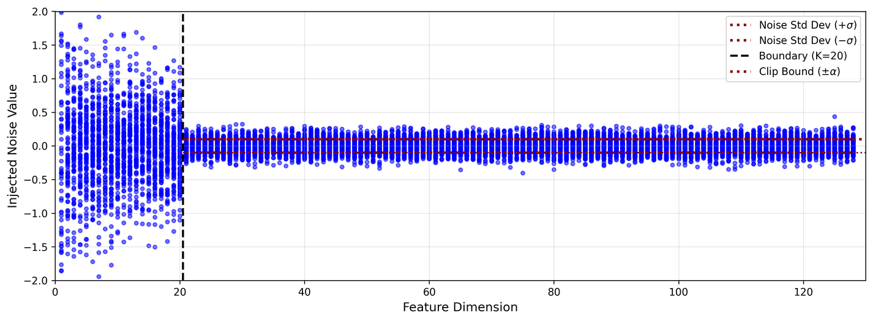
Adaptive Hybrid Perturbation
PERTURBATION STRATEGY
Full Gaussian (Top K Dims, i ≤ k) :
2
Unbounded noise ni ∼N(0 , σ i) provides rigorous (
ϵ,
δ
)-DP
Eigenvalue-proportional σi ensures privacy budget is concentrated where discrimination power is highest.
guarantee on the most identity-revealing dimensions.
Clipped Gaussian (Residual Dims, i > k) :
Bounded perturbation n̂i = clip(ni
distortion in low-energy dimensions.
α α
) limits catastrophic
Clipping threshold α trades tail privacy for template utility in near-zero eigenvalue directions.
,− ,

Slide 9
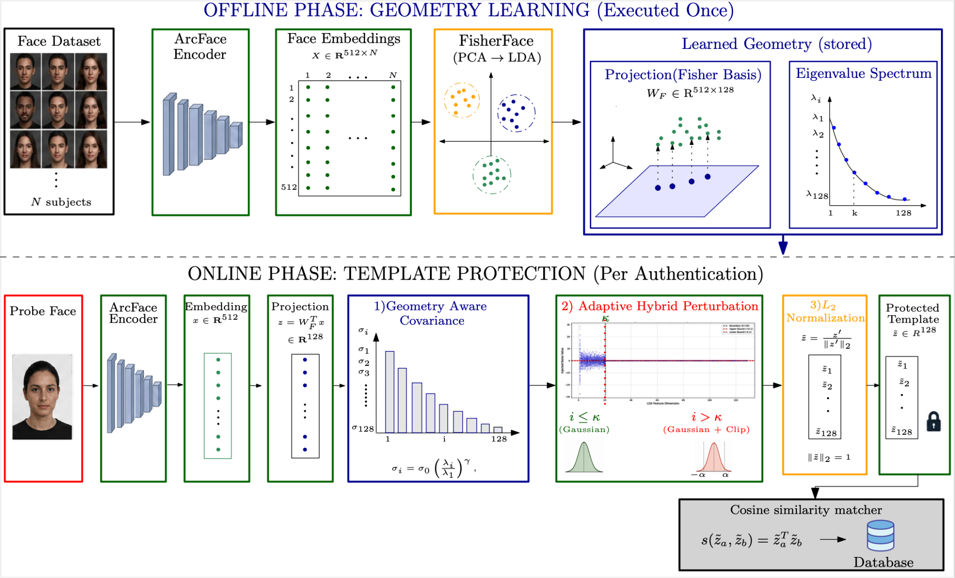

Slide 10
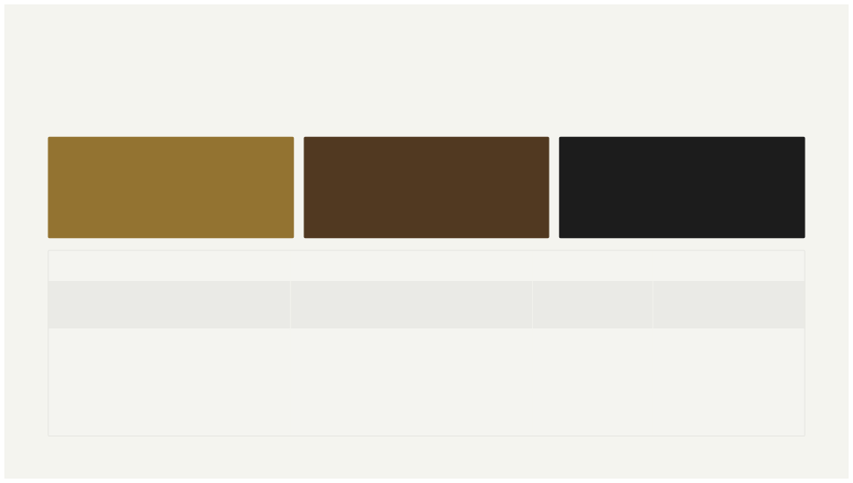
Rigorous Multi-Dataset Evaluation
GeoDP is evaluated under a comprehensive protocol spanning multiple public benchmarks,with hyperparameters selected via Pareto optimization to
maximize unlinkability at a target recognition accuracy.
Offline Learning Datasets
Online Testing Benchmarks
Pareto-Optimal Selection
CASIA-WebFace and VGGFace2 used to learn the Fisher discriminative subspace from large-scale representative face populations.
Generalization evaluated on CASIA- WebFace, VGGFace2, LFW, and FEI — covering diverse identities, conditions, and imaging scenarios.
Operating point ε = 12 selected as the Pareto-optimal balance, maximizing template unlinkability while holding a strong target recognition accuracy.
Phase
Dataset
Identities
Images
Offline
CASIA-WebFace VGGFace2
CASIA-WebFace
VGGFace2
LFW
FEI
8,000 100
2,571
380
1,680
199
376,000 76,000
114,000
100,000
9,164
1,791
Online
Tata Consultancy Services

Slide 11
Geo-DP vs. Baseline Methods: Rank-1 Accuracy Across Datasets
Method Paradigm | CASIA(%) | LFW(%) | VGGFace2(%) | FEI(%)
Unprotected Raw Embeddings (Arc Face Baseline) | 96.20 | 82.67 | 84.60 | 99.60
Unprotected Subspace Projection (PCA + LDA) | 95.87 | 78.47 | 80.30 | 99.33
Isotropic Embedding-Plane DP Baseline (ε=3) | 0.10 | 0.77 | 0.28 | 0.66
Isotropic Embedding-Plane DP Baseline (ε=12) | 0.13 | 0.84 | 0.32 | 0.27
Image-Plane RDP Baseline (ε=3) | 0.10 | 0.71 | 0.61 | 0.44
Image-Plane RDP Baseline (ε=12) | 0.14 | 0.81 | 0.71 | 0.55
Proposed Framework (ε=3) | 32.37 | 14.93 | 10.32 | 29.08
Proposed Framework (ε=12) | 93.67 | 61.19 | 71.09 | 91.75
Tata Consultancy Service

Slide 12
GeoDP Performance Across Datasets
DATASET | Pareto Parameters(ε,γ,κ,α) | Rank-1(%) | Rank-5(%) | Rank-10(%)
CASIA | (1.4, 3, 10, 0.30) | 75.16 | 82.11 | 84.23
 | (1.6, 3, 20, 0.20) | 81.14 | 86.21 | 87.72
 | (2, 3, 10, 0.10) | 86.71 | 89.72 | 90.60
 | (3, 3, 10, 0.10) | 90.75 | 92.40 | 92.88
LFW | (12, 3, 10, 0.10) | 93.67 | 94.62 | 94.87
VGGFace2 | (12.0, 3.0, 10, 0.10) | 61.19 | 67.16 | 69.05
 | (10.0, 3.0, 10, 0.10) | 70.43 | 82.39 | 86.28
FEI | (12.0, 3.0, 10, 0.10) | 71.09 | 82.89 | 86.88
 | (2, 3, 10, 0.20) | 75.05 | 79.81 | 81.52
 | (3, 3, 10, 0.10) | 80.53 | 84.84 | 86.39
 | (6, 3, 10, 0.10) | 85.40 | 89.54 | 90.59
 | (11, 3, 10, 0.10) | 90.32 | 93.30 | 94.74
 | (12, 3, 10, 0.10) | 91.75 | 94.46 | 95.63
Tata Consultancy Service

Slide 13
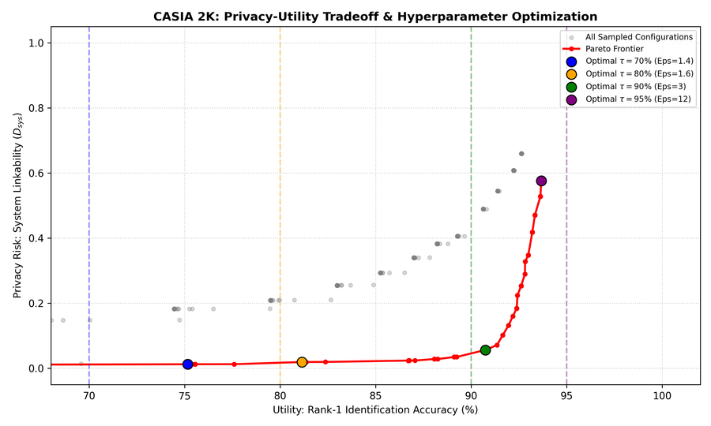
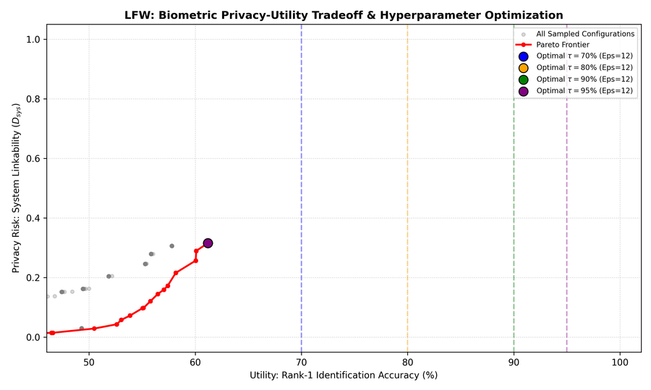
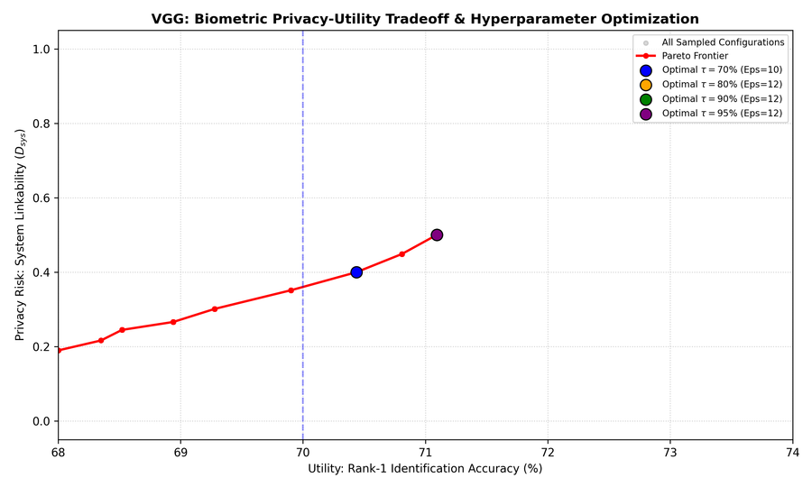
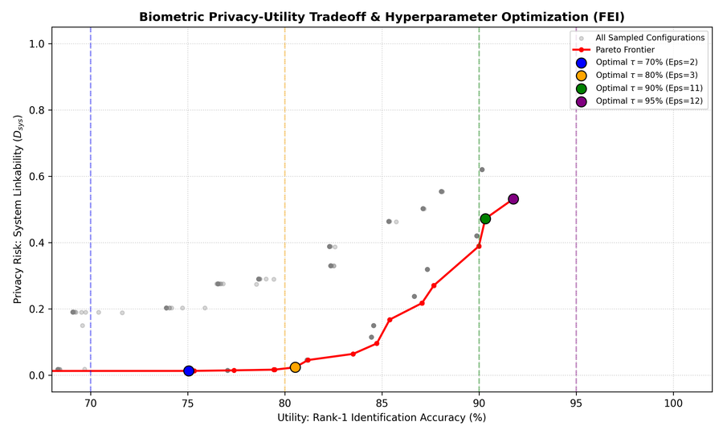
Pareto Optimization: The Privacy-Utility Trade-off :
The Objective: To visually identify the exact mathematical "sweet spot" where maximum biometric accuracy meets maximum privacy.
The Optimal Point: The curve demonstrates that at ε = 12, GeoDP achieves strong template unlinkability (D_{sys}) while successfully maintaining Rank-1 Accuracy above 93%.

Slide 14
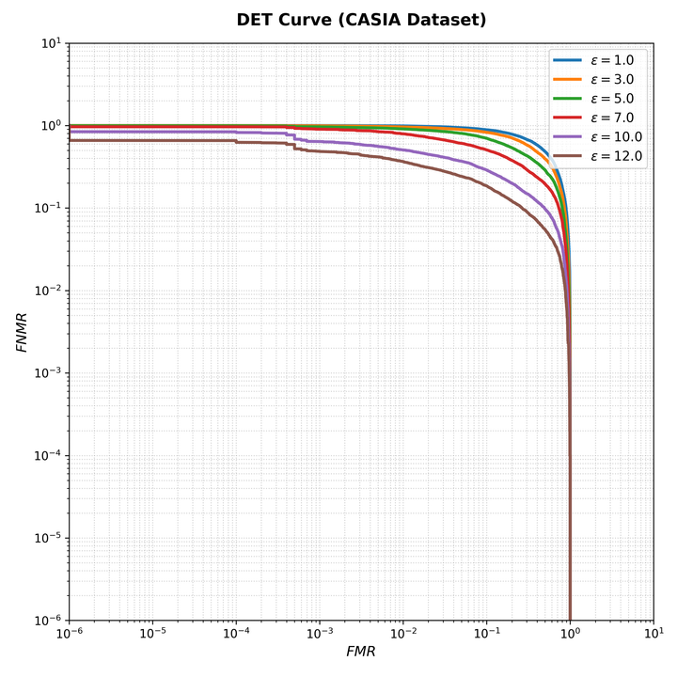
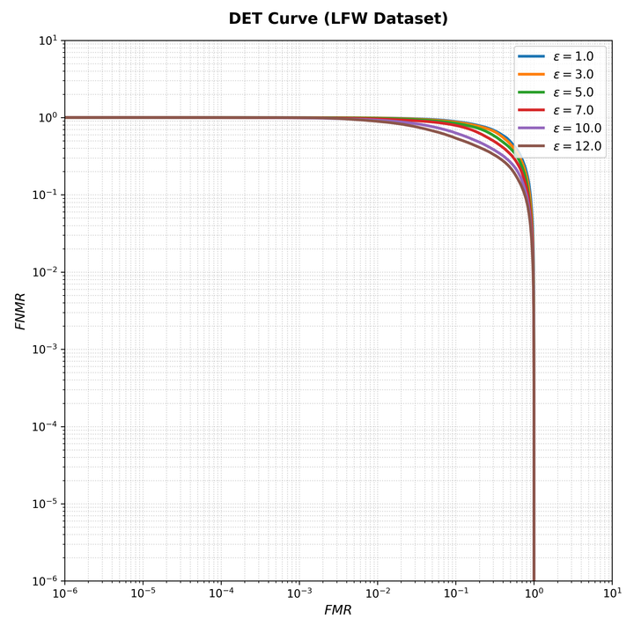
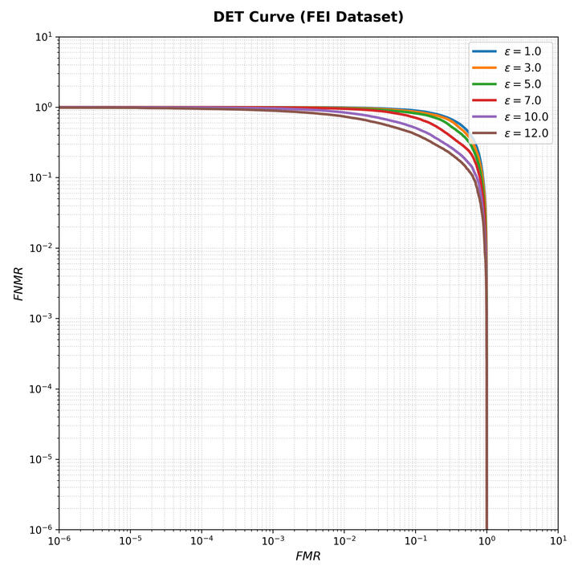
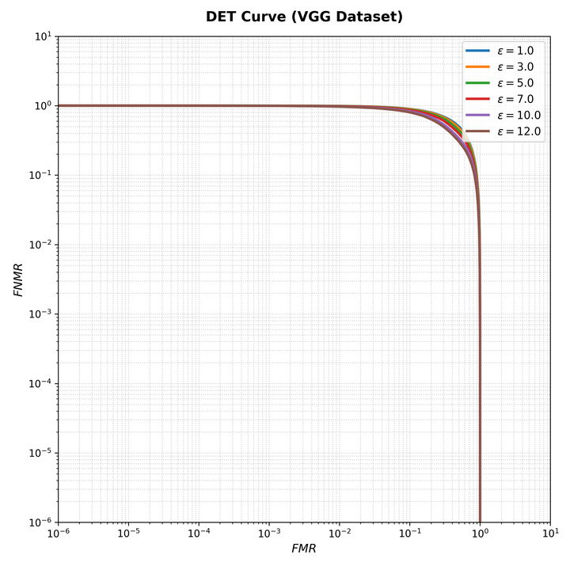
Verification Reliability: DET Curve Analysis
Measuring System Reliability: The DET curve evaluates the balance between False Rejections (locking legitimate users out) and False Acceptances (letting impostors in).
Minimal Utility Degradation: The tight curves prove that applying GeoDP's privacy noise does not destroy the underlying face verification performance.
Enterprise Viability: The framework maintains a highly competitive Equal Error Rate (EER) under protected conditions, proving it is reliable enough for real-world deployment.
Tata Consultancy Services

Slide 15
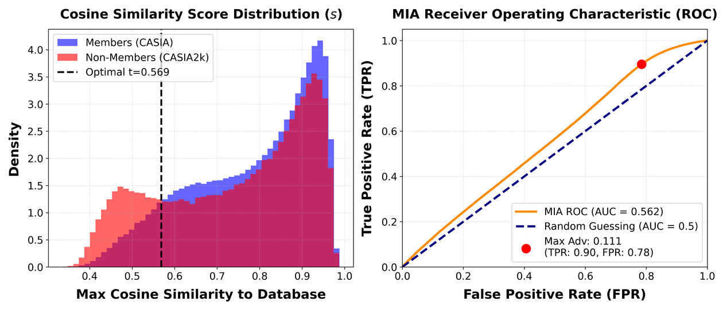

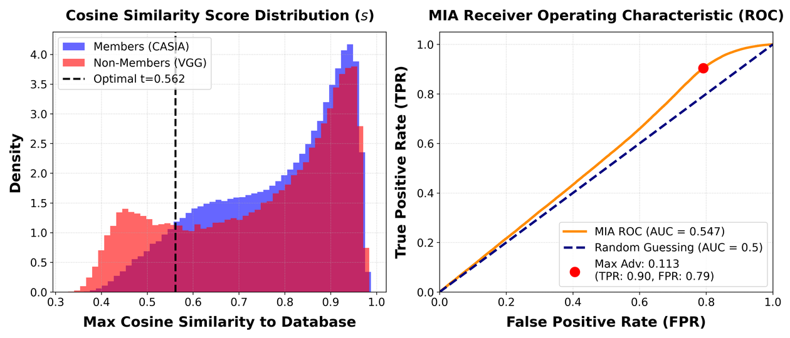
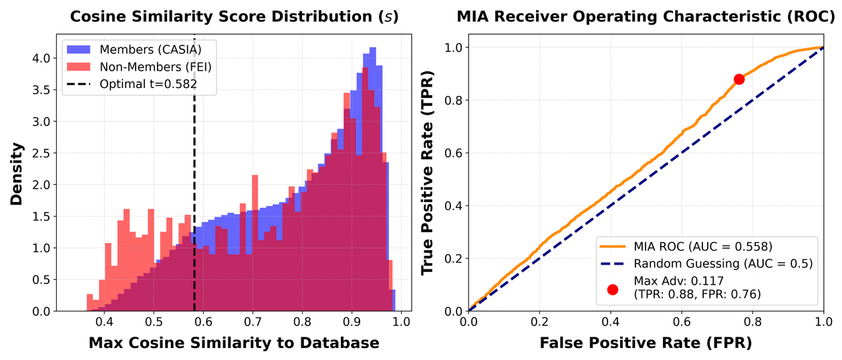
Mitigating Membership Inference
  Threat Model: The system faces a distance-based adversary who attempts to infer membership by calculating the maximum Cosine Similarity between a query face template and stored database profiles.
  Result Analysis: The GeoDP framework successfully neutralizes the threat, reducing the attacker to random guessing as evidenced by ROC-AUC scores hovering near the ideal target of 0.5 across all evaluated datasets.
Tata Consultancy Services

Slide 16
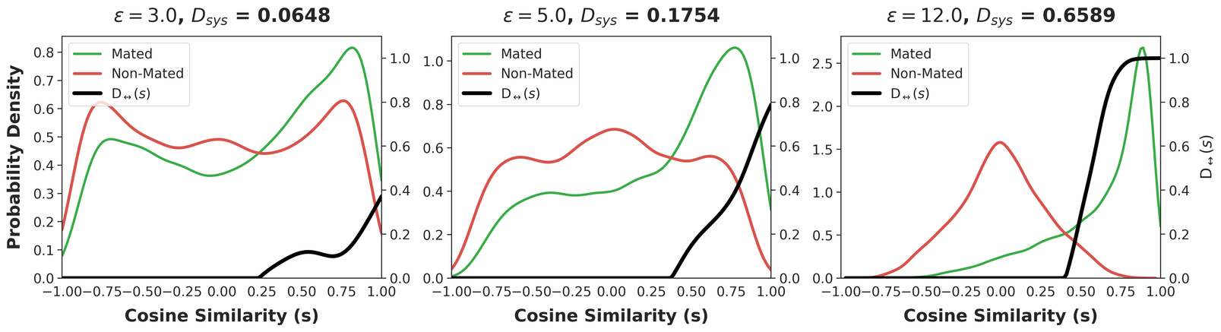
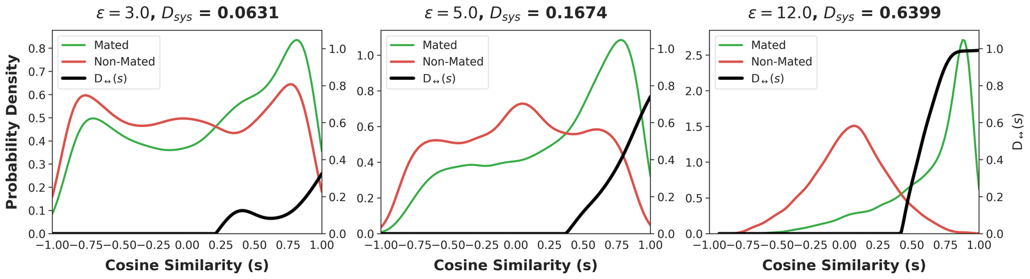
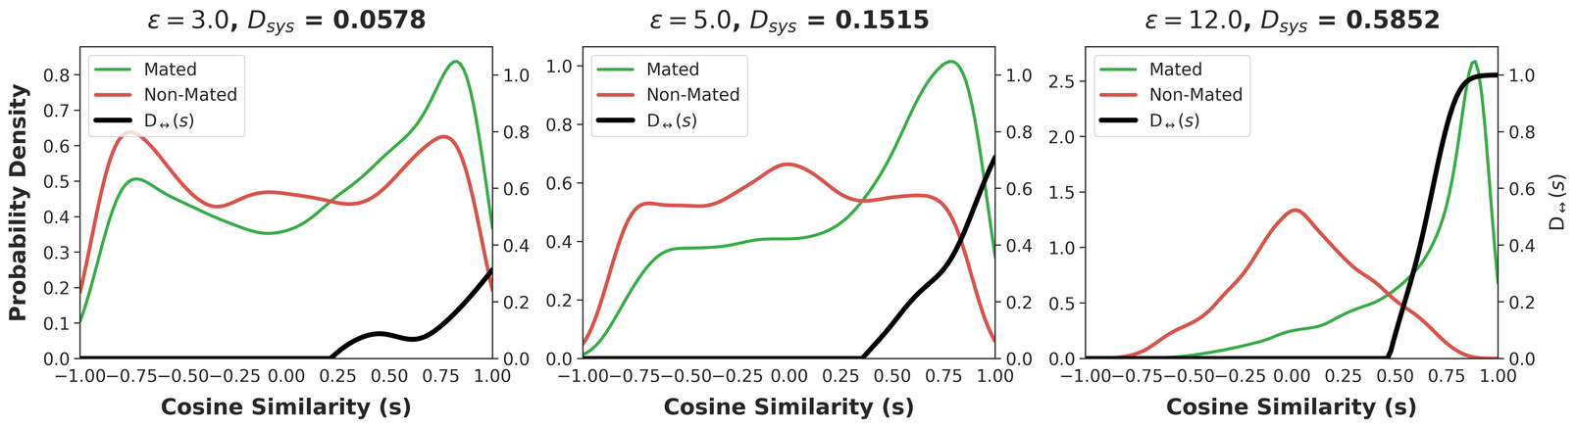
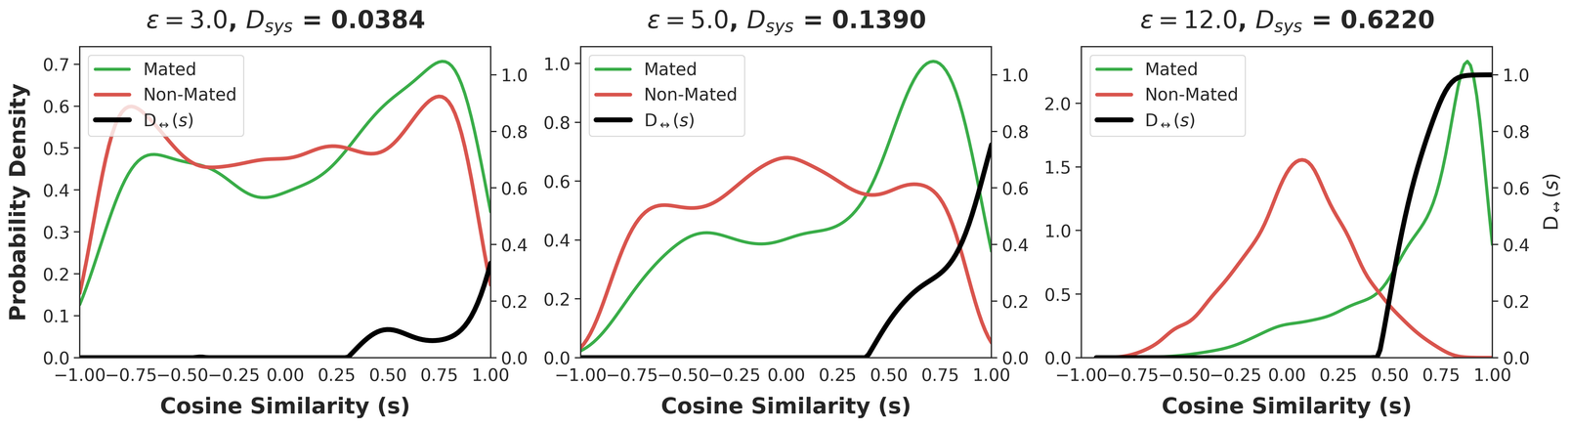
System Linkability vs. Privacy Budget (ε)
  Threat Model: An adversary attempts to track and match a user's profile across two independent databases (Database A and Database B) that are protected with distinct privacy noise seeds.
CASIA2k unseen :
LFW :
VGG :
FEI :
  Result Analysis: As the privacy budget (ε) tightens to 3.0, the mated and non-mated distributions significantly overlap, successfully driving the global system linkability down to an empirical near-zero of 0.0031.
Tata Consultancy Services

Slide 17
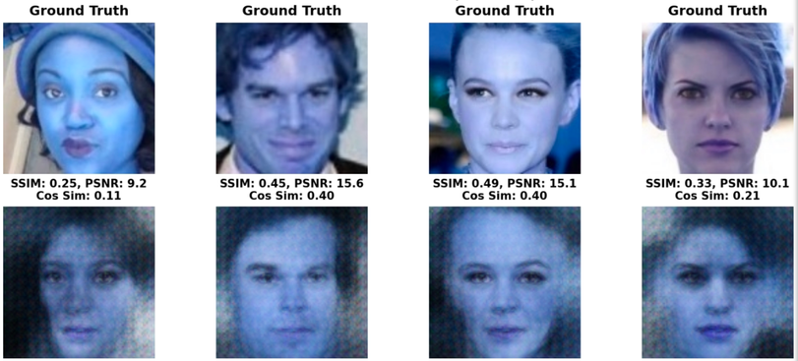
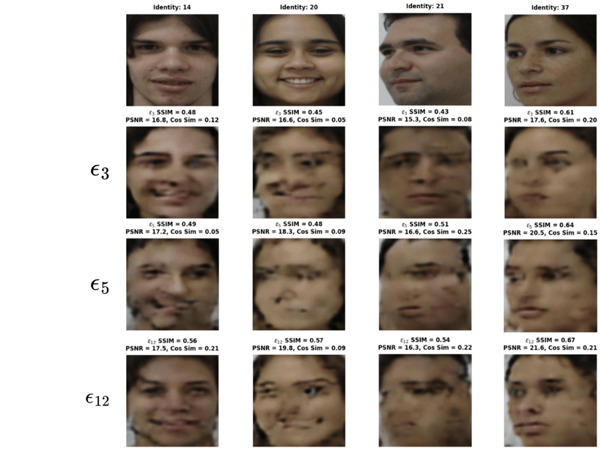
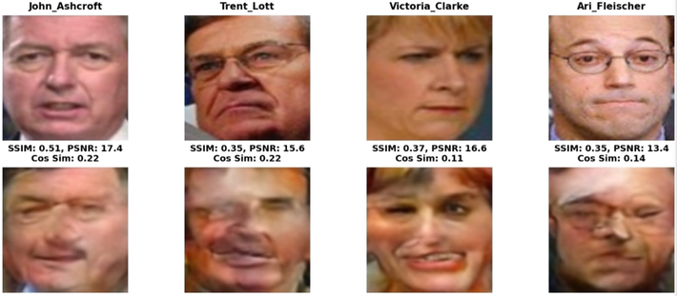
Identity Recovery Fails on Protected Templates
  Threat Model: A white-box adversary intercepts the protected 512-dimensional facial templates and attempts to invert them back into recognizable face images using a sophisticated deep inversion network (NBNet).
CASIA :
FEI :
LFW :

Slide 18
Reconstruction Attack: Analysis & Key Takeaways
Core Observations :
Security Insights :
  Strong Privacy Boundary (ε = 3 and ε = 5): Reconstructed faces are highly distorted and completely unrecognizable. Low SSIM (~0.45) and low PSNR (~16 dB) mathematically prove that the attacker's inversion network (NBNet) fails to recover visual identity.
  Mitigation of Deep Inversion: GeoDP successfully defends against white-box reconstruction attacks by adding targeted noise to the embedding space before an attacker can reverse-engineer the features.
  Privacy Leakage at High ε (ε = 12): As the privacy budget increases, structural facial features (eyes, nose shape, outlines) become clearly visible, making the identity vulnerable to recognition.
  The Optimal Sweet Spot: ε = 5 acts as the ideal security threshold—it keeps the attacker's Cosine Similarity exceptionally low (~0.20) while maintaining excellent verification utility for the actual system.
Tata Consultancy Services

Slide 19
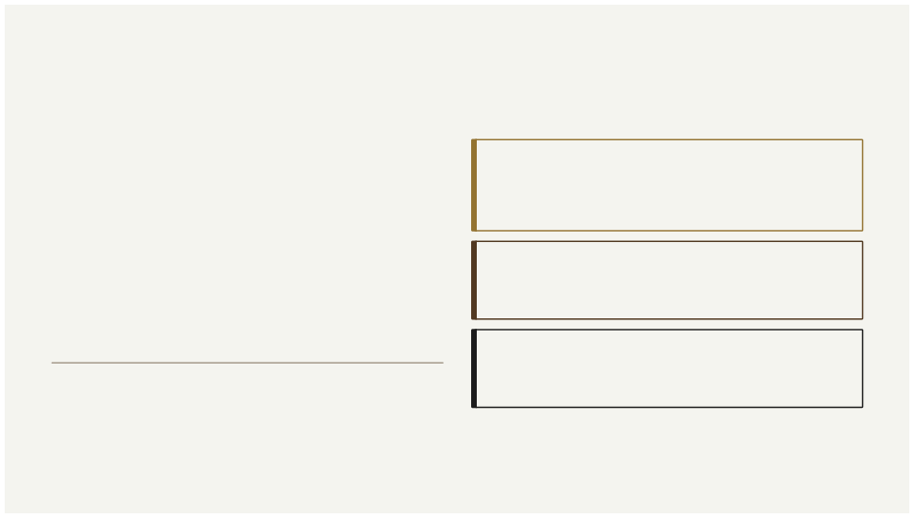
Performance, Comparative Advantage & Security
Biometric Utility — Key Results
Security&Privacy Analysis
Reconstruction Attacks
93.67%
Rank-1 Accuracy
On CASIA-WebFace at ε = 12
91.75%
Rank-1 Accuracy
On FEI Database at thePareto-optimal point
Visually and structurally restricted. Adversaries are limited to a Structural
Similarity Index (SSIM) of approximately 0.35, rendering reconstructed faces non-usable.
Membership Inference
Attack performance drops toward random guessing, confirming the
strength of the differential privacy guarantee.
Unlinkability
Comparative Advantage
GeoDP substantially outperforms both image-level and isotropic embedding- level DP baselines. Even under strong privacy constraints at ε = 3, GeoDP preserves significantly higher recognition accuracy than all baseline methods, demonstrating the power of geometry-aware noise allocation.
Successfully satisfies the strict unlinkability requirements of the ISO/IEC
24745 biometric template protection standard.
Tata Consultancy Services

Slide 20
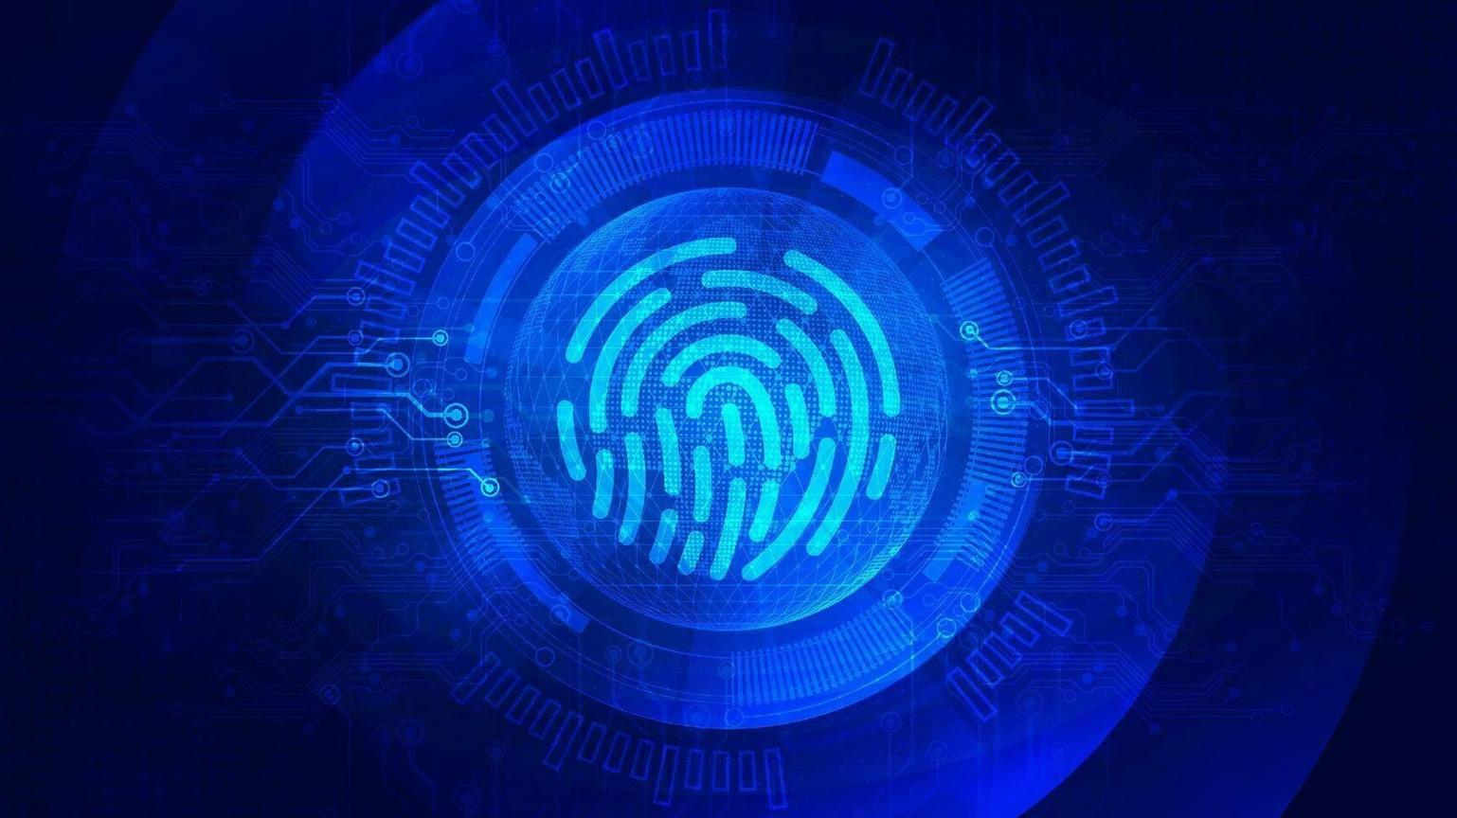
The Future of Biometric Privacy
Core Contribution
Exploiting the intrinsic statistical geometry of face embeddings fundamentally improves the differential privacy privacy-utility trade-off beyond
what image-level or isotropic
approaches can achieve.
Proven Guarantees
GeoDP delivers formal DP guarantees, strong resistance to reconstruction and membership inference attacks, and compliance with ISO/IEC 24745
unlinkability requirements.
Future Directions
Exploring joint deep representation learning co-optimized with GeoDP noise, and integration with fully homomorphic encryption for large-
scale, privacy-preserving cloud
biometric deployments.
GeoDP demonstrates that geometry awareness is not merely a refinement — it is a fundamental prerequisite for practical, privacy- preserving biometric systems.
Tata Consultancy Services

Slide 21
THANK YOU

