Slide 1
Does Attention Help Recurrent Models for Wearable Human Activity Recognition?
HAR
A subject-independent ablation with a pre-specified decision rule on three benchmarks
Himansh Munjal | Project review presentation
Notes:
Introduce the project: we set out to build a dual-attention BiGRU and ended up with a rigorous study of whether attention helps at all under subject-independent evaluation.

Slide 2
Roadmap of this review
1
Problem & literature
Why HAR, what exists, where the gap is
2
Proposed methodology
SG-DA-BiGRU, layers, spectral gate
3
Experimental design
8 models, 3 datasets, LOSO, 1,320 runs
4
Results & analysis
Does the gate help? What dominates?
5
Limitations & takeaways
Threats to validity, recommendations

Slide 3
Why HAR, and why evaluation matters
The task
The problem
Classify activity from wearable IMU windows (accelerometer, gyroscope)
Used in health monitoring, rehabilitation, sports, context-aware apps
Deep models: CNN, RNN, CNN+RNN, now attention
Papers report 96-99% accuracy for dual-attention models
Random splits leak the same person into train and test
One training run, no significance test, no cost reporting
Gains may be noise or leakage, not architecture

Slide 4
Literature review: the foundation papers
Family | Representative work | Strength | Gap
BiLSTM + attention | Residual BiLSTM-Attn (UCI-HAR, WISDM, KU-HAR) | Separates similar activities | No cross-subject study
GRU + hierarchical attention | Nurse-activity data | Handles imbalance | ~66% cross-subject; private data
Lightweight Attn-GRU | WiFi CSI: 252M to 0.058M params | ~98.9% accuracy, tiny | RF signals, not IMU
GRU + dual attention | Channel + temporal attention | Where vs. when to look | No UCI/WISDM/PAMAP2, no ablation
Transformer-only | Smartphone accel + gyro | Matches CNN+LSTM | No data-efficiency analysis
CNN + (Bi)LSTM + attention | H-Activity, MHEALTH, UCI-HAR, noisy data | Strongest baselines | 99.9% own data vs 93% UCI: overfit?
Pattern: strongest results are CNN+RNN hybrids; pure RNN+attention papers are few, single-dataset and rarely cross-dataset.

Slide 5
Closest recent work (2025-2026)
Paper | Architecture | Datasets | Result / focus
Dual-INABA (Sci. Rep. 2025) | Inception + Attn + BiGRU + Attn, wavelet | PAMAP2, UCI-HAR, WISDM | 98.15 / 98.89 / 96.78% accuracy
TGA-HAR (Sensors 2025) | TCN + BiGRU + Attention | WISDM, USC-HAD, PAMAP2 | Robust across sensor setups
MHAT-Net (2026) | Parallel BiGRU + Transformer | Smartphone inertial | Stationary activities
CNN-BiGRU-Transformer (2025) | Multi-branch CNN + BiGRU + Transformer | Wearable data | Long-term dependencies
AttnFusionGRU (2025) | Dual-branch attn + SqueezeNet + BiGRU | UCF101, Human3.6M | Vision-based, not IMU
Cross-dataset transfer (CORAL, self-supervised, data mixtures) is also mature, so naive fine-tuning is no longer novel.

Slide 6
How this work differs from existing models
Frequency prior
Existing attention uses learned time-domain statistics only. We inject a non-learned spectral gate (33 params).
CNN-free
Dual-INABA, TGA-HAR add Inception/TCN. Ours is pure BiGRU + attention, so the gate is isolated.
Rigorous protocol
Others: single split, accuracy only. Ours: 30 LOSO folds, 5 seeds, Wilcoxon + Holm, Bayesian ROPE.
Cost reporting
Others omit it. We report params, FLOPs and measured latency.
Pre-specified rule
Success criterion fixed before final runs; the outcome is reported either way.

Slide 7
Research question and contributions
Does attention, including a new frequency-informed variant, improve a BiGRU for wearable HAR on unseen subjects?
SG-DA-BiGRU: spectral-gated dual-attention BiGRU (33-parameter gate, one FFT per window)
Controlled ablation: 8 models, 1 shared pipeline, 3 benchmarks, 1,320 runs
Pre-specified decision rule and its outcome: gate gives no gain, evidence of equivalence
Analysis of evaluation itself: subject variance, fixed-split rank instability, checkpoint selection
Practical recommendations and released code/results

Slide 8
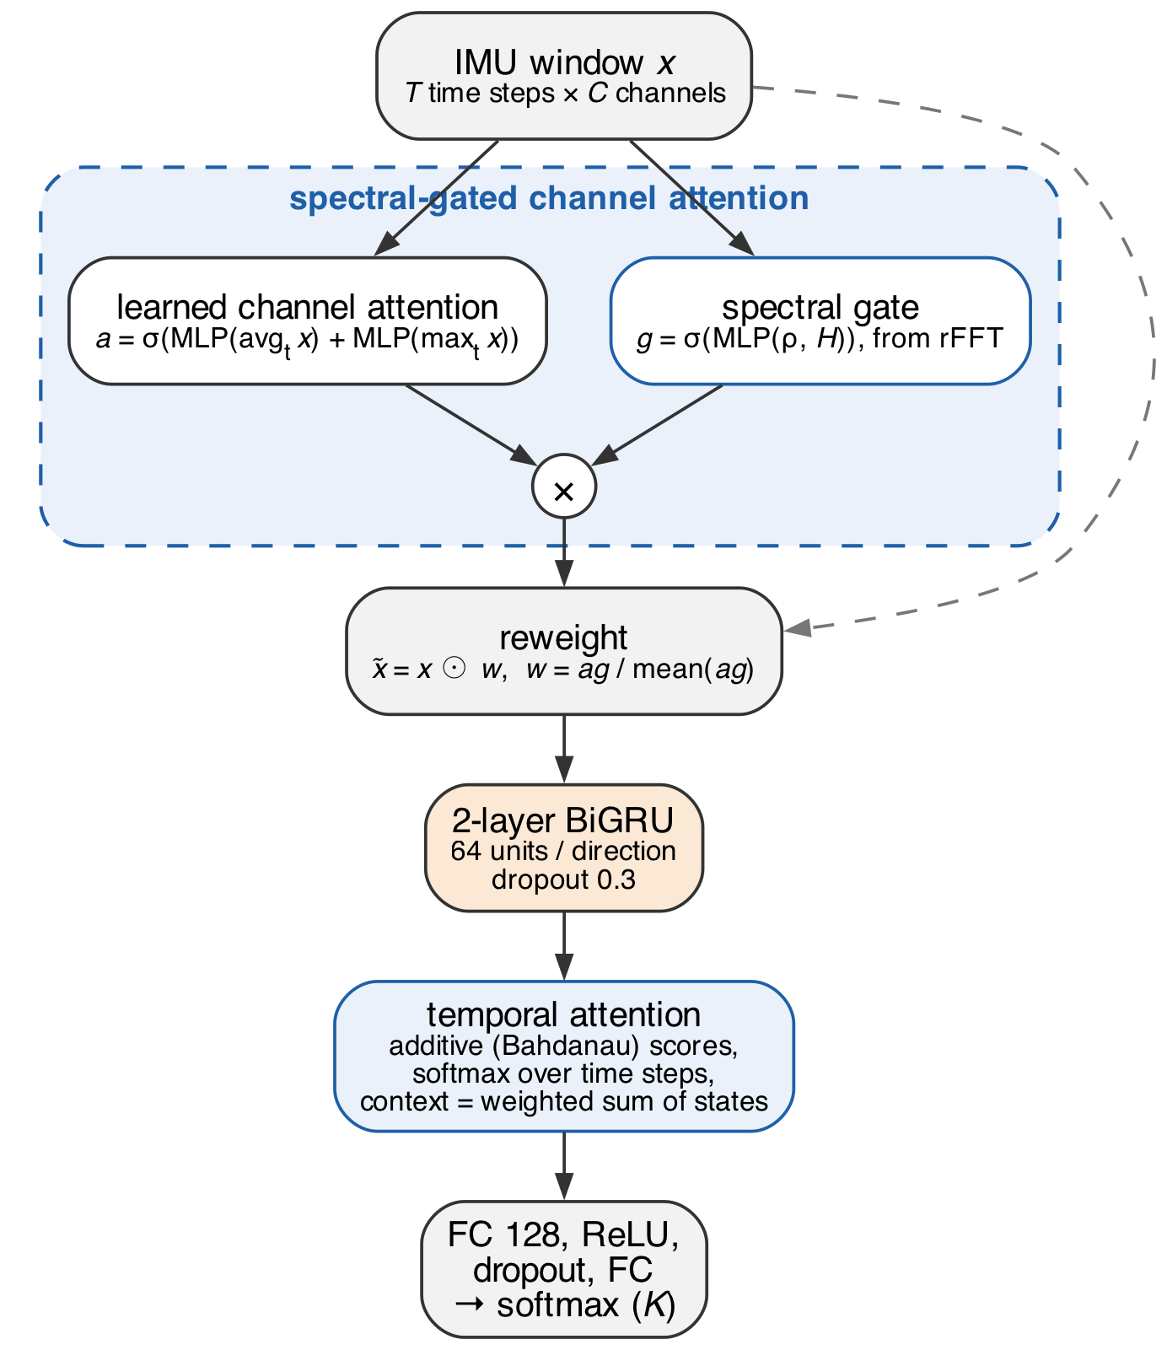
Proposed model: SG-DA-BiGRU
Input: window of T steps x C channels, z-scored with training-subject statistics
Channel attention (CBAM-style) from mean/max pooling and a shared MLP
Spectral gate from FFT descriptors multiplies the channel weights
Reweighted input goes through a 2-layer BiGRU
Additive temporal attention pools the states; FC head predicts K classes

Slide 9
Model layers, step by step
# | Layer | Configuration | Output
1 | Input window | T x C, per-channel z-score | T x C
2 | Channel attention | mean + max pool, MLP C > floor(C/4) > C, sigmoid | C gates a
3 | Spectral gate | rFFT descriptors (rho, H), MLP 2 > 8 > 1, tanh, sigmoid | C gates g
4 | Reweighting | w = a*g / mean(a*g), x~ = w * x | T x C
5 | BiGRU x 2 | 64 units per direction, dropout 0.3 | T x 128
6 | Temporal attention | additive (Bahdanau), 64-d, softmax over time | 128 context
7 | Head | FC 128, ReLU, dropout 0.3, FC K, softmax | K classes
127.8k parameters on UCI-HAR (plain BiGRU: 119.4k). Sigmoid gates, not softmax, so several channels can matter at once.

Slide 10
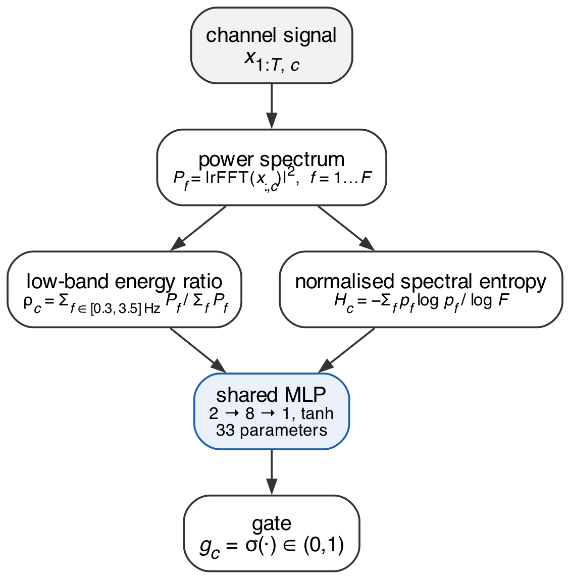
The spectral gate
Per channel c, from power spectrum P(f):
Low-band energy ratio: share of power in 0.3-3.5 Hz (gait, limb swing)
Normalised spectral entropy: low for clean periodic signals, high for noise
Tiny shared MLP (2 > 8 > 1, 33 params) maps them to a gate in (0,1)
Intended bias: a time-domain MLP cannot easily measure periodicity from one window; the FFT gives it directly.

Slide 11
Eight models, one pipeline
Model | Backbone | Channel attn | Spectral gate | Temporal attn | Front-end
SG-DA-BiGRU (proposed) | BiGRU | Y | Y | Y | none
DA-BiGRU (plain) | BiGRU | Y | - | Y | none
Channel-only | BiGRU | Y | Y | mean-pool | none
Temporal-only | BiGRU | - | - | Y | none
BiGRU | BiGRU | - | - | mean-pool | none
BiLSTM + Attn | BiLSTM | - | - | Y | none
CNN + BiGRU | BiGRU | - | - | mean-pool | 3 x Conv1D
DeepConvLSTM | LSTM | - | - | last step | 4 x Conv
Full vs. plain isolates the gate. All but DeepConvLSTM share size, depth, dropout and head; no per-model tuning.

Slide 12
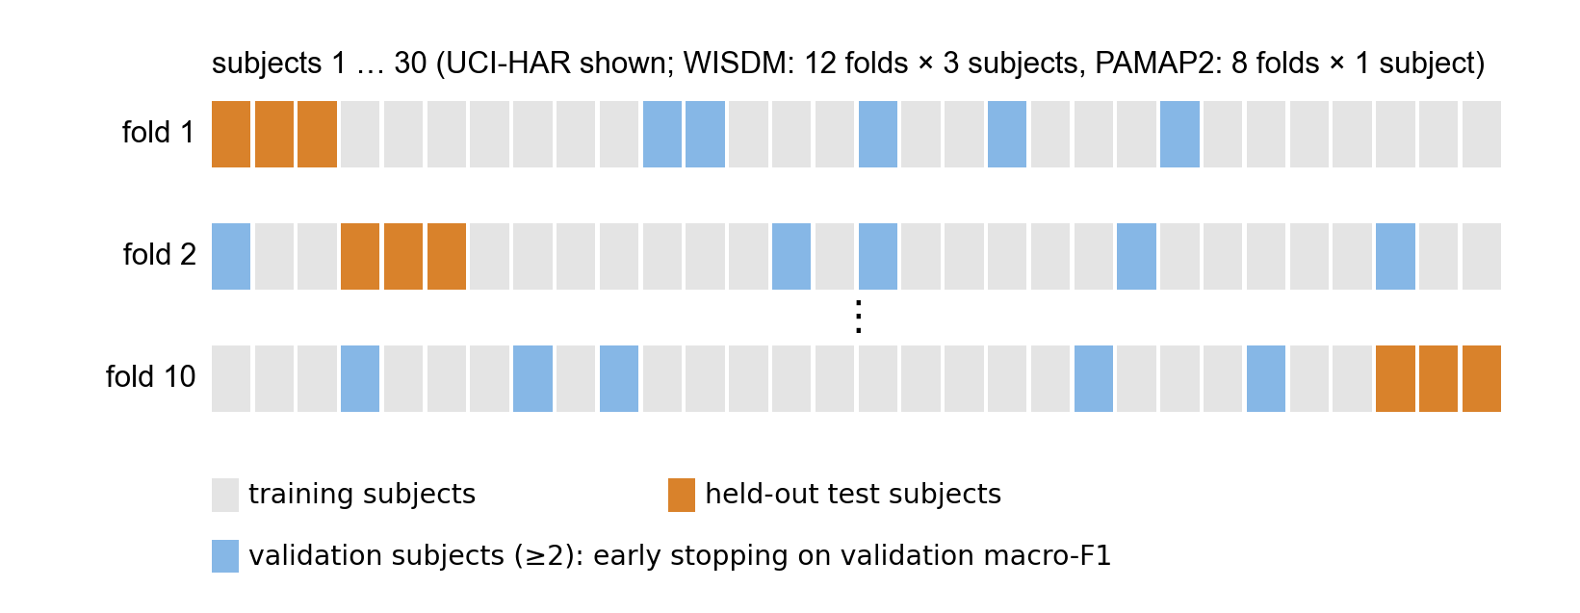
Datasets and subject-independent protocol
Dataset | Subj. | Classes | Channels | Rate | Windows | LOSO folds
UCI-HAR | 30 | 6 | 6 | 50 Hz | 10,299 | 10
WISDM | 36 | 6 | 3 | 20 Hz | 42,657 | 12
PAMAP2 | 8 | 12 | 18 | 50 Hz | 14,922 | 8
Test subjects never touch training or selection
20% of train subjects (min 2) for validation
Early stop on val macro-F1
5 seeds per fold, averaged

Slide 13
Training setup and the pre-specified rule
Training
Decision rule (fixed 2026-10-16)
Adam, lr 1e-3, batch 64, cross-entropy
Max 50 epochs, grad clip 1.0
ReduceLROnPlateau, early stop (patience 8)
Select on val macro-F1
RTX 3050 laptop GPU: 27.6 GPU-hours
Endpoint: pooled LOSO macro-F1 over 30 folds
Wilcoxon signed-rank, Holm-corrected over 7 comparisons
Method paper only if full beats plain (p Holm < 0.05) and is not significantly worse than any baseline
Otherwise: an empirical study

Slide 14
Result: LOSO macro-F1 across models
0.75-0.92
best model per dataset: PAMAP2 0.75, WISDM 0.84, UCI-HAR 0.92
0.832
CNN+BiGRU and DeepConvLSTM lead (pooled)
0.813-0.819
all attention variants and plain BiGRU

Slide 15
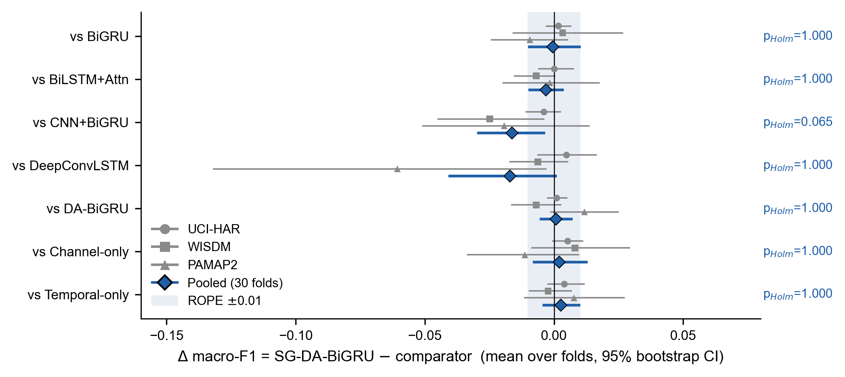
Primary endpoint: does the spectral gate help?
+0.0008
macro-F1, full vs. plain (CI -0.005 to +0.007)
p = 0.78
Wilcoxon; Holm p = 1.0; wins 17/30 folds
99.5%
Decision rule condition (i) fails: this is an empirical study, not a method paper. CNN+BiGRU beats the proposed model by 0.016 (Holm p = 0.065).
Bayesian prob. of practical equivalence (|d| < 0.01)

Slide 16
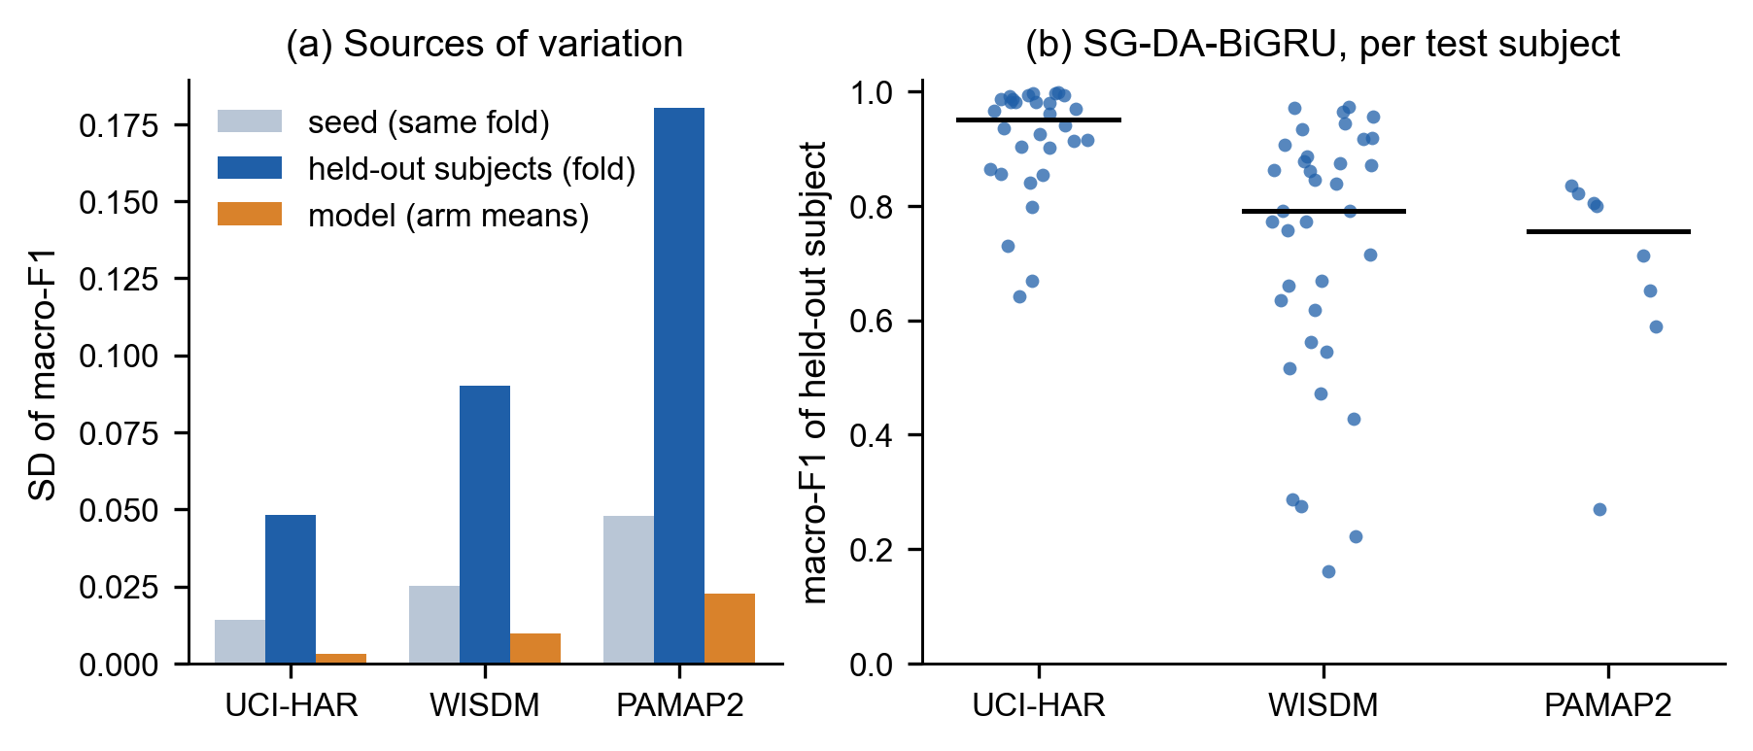
Subjects dominate, architectures barely matter
94-96%
of fold-score variance explained by which subjects are held out
0.4-1.5%
explained by the choice among 8 models
0.16-0.97
range of WISDM per-subject macro-F1 for one model
A fixed split with one seed cannot separate these models.

Slide 17
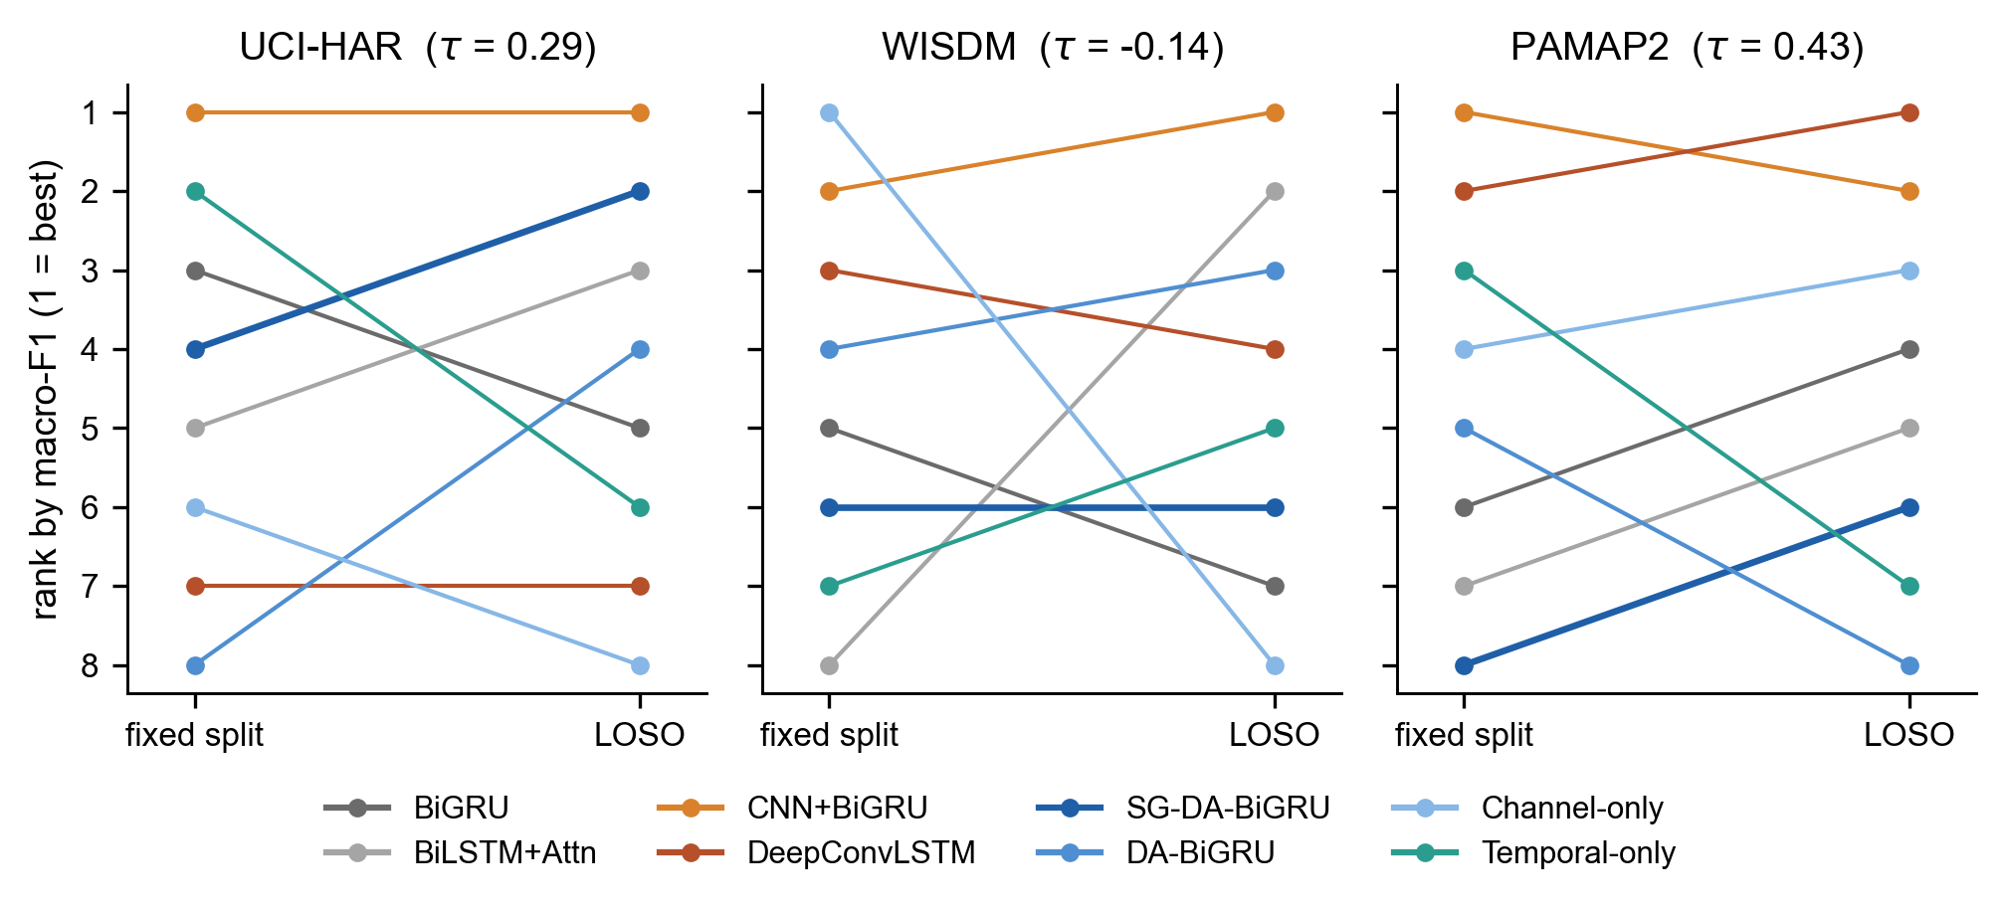
Fixed-split rankings mislead
Kendall tau between fixed-split and LOSO rankings: -0.14 to 0.43
Rankings on a single split are poor proxies for subject-independent ones
Protocol v1 selected on val loss: 43.5% of runs picked epoch <= 3
Fix: select on val macro-F1; median best epoch 4 > 9

Slide 18
Computational cost
Model | Params (k) | MFLOPs | GPU b32 (ms)
BiGRU | 119.4 | 26.6 | 1.06
BiLSTM+Attn | 161.8 | 37.5 | 1.15
CNN+BiGRU | 259.3 | 18.7 | 2.73
DeepConvLSTM | 458.1 | 175.0 | 3.58
SG-DA-BiGRU | 127.8 | 28.8 | 4.21
DA-BiGRU | 127.8 | 28.8 | 1.64
33 params
the gate adds almost nothing in size or FLOPs
2.6x slower
GPU inference with the gate (4.2 vs 1.6 ms) and no accuracy gain
UCI-HAR inputs, RTX 3050 laptop GPU. FLOPs exclude the FFT.
18.7M
CNN+BiGRU: fewest FLOPs, best accuracy

Slide 19
Why the gate fails and convolutions help
Why the gate does not help
Why CNN front-ends help
Descriptors only separate static from dynamic activities, which every model already gets right
Remaining errors (up vs. down stairs, sit vs. stand) need fine temporal structure
A BiGRU with z-scored inputs can already re-weight channels itself
Short learned temporal filters separate hard class pairs
WISDM: upstairs +5.3, downstairs +3.7 points
PAMAP2 (DeepConvLSTM): walking +10.2, ironing +7.9
Pooling shortens the sequence the BiGRU must integrate

Slide 20
Limitations and threats to validity
Hyper-parameters
Scope
One shared config; no per-model or nested tuning under LOSO
3 benchmarks, 6-18 channels, 2.56 s windows; attention may matter with more sensors or longer windows
Statistical power
Protocol revision
PAMAP2 has only 8 subjects; per-dataset tests are descriptive
Revised once before the final run, identically for all models
Metric definition
Hardware
Macro-F1 over true and predicted classes lowers PAMAP2 scores for all models
Latency on one laptop GPU and CPU; FFT cost may differ on embedded devices

Slide 21
Recommendations for HAR research
1
Evaluate on unseen subjects; select checkpoints on subject-wise validation macro-F1
2
Use enough folds; average seeds within folds; pool across datasets
3
Ablate against the identical model without the component
4
Report equivalence-aware statistics (Bayesian ROPE or CIs)
5
Fix the decision rule before the final run
6
Report measured latency, not only FLOPs

Slide 22
Conclusion
The spectral gate is practically equivalent to no gate (+0.0008 macro-F1)
No attention variant beats a plain BiGRU under subject-independent evaluation
CNN+BiGRU is the best practical choice: highest accuracy, fewest FLOPs
Subjects, not architectures, drive the variance
Future: tuning under nested LOSO, more sensors and longer windows, embedded latency
Thank you. Questions?

