Slide 1
Project Presentation of Industry Oriented Hands on Experience (22CS422)
On
FITASSIST – AI Powered Squat Counter & Fitness Tracker
Himansh Sood
2210990402
Supervised By
Mr. Ashish Kumar
Department of Computer Science and Engineering,
Chitkara University, Punjab

Slide 2
Introduction
FITASSIST is a browser-based AI fitness assistant that automatically counts squats in real time using a standard webcam.
Built as a 100% client-side React + Javascript web application - no backend required for the core fitness functionality.
Uses Google's MoveNet pose-estimation model (via TensorFlow.js with WebGL acceleration) to detect 17 body keypoints from the live video feed.
Provides instant visual feedback, rep counting, workout timing, and live calorie estimation, making home workouts measurable and motivating.

Slide 3
Problem Statement & Objectives
Problem: Most home users perform squats without any feedback on count or posture, leading to incorrect form, missed reps, and reduced training effectiveness.
Existing gym-grade solutions require expensive wearables or external sensors that are not accessible to everyday users.
Objective 1: Build an accessible web app that counts squats accurately using only a webcam.
Objective 2: Provide real-time posture feedback (e.g., 'Keep your back straight').
Objective 3: Track workout time and estimated calories burned per session.
Objective 4: Deliver a clean, dark-themed, gym-style user interface with smooth animations.

Slide 4
Technology Stack
Frontend Framework: React 18 + TypeScript + Vite 5
Styling: Tailwind CSS v3 with custom HSL design tokens (dark theme + orange accents)
UI Components: shadcn/ui + Radix primitives + lucide-react icons
Pose Detection: TensorFlow.js (@tensorflow/tfjs) with WebGL backend
Model: MoveNet SinglePose Lightning (@tensorflow-models/pose-detection)
Routing & State: React Router v6, Context API + useReducer for Auth
Camera Access: Native browser MediaDevices.getUserMedia API
HTTP Client: Axios (for optional authentication endpoints)

Slide 5
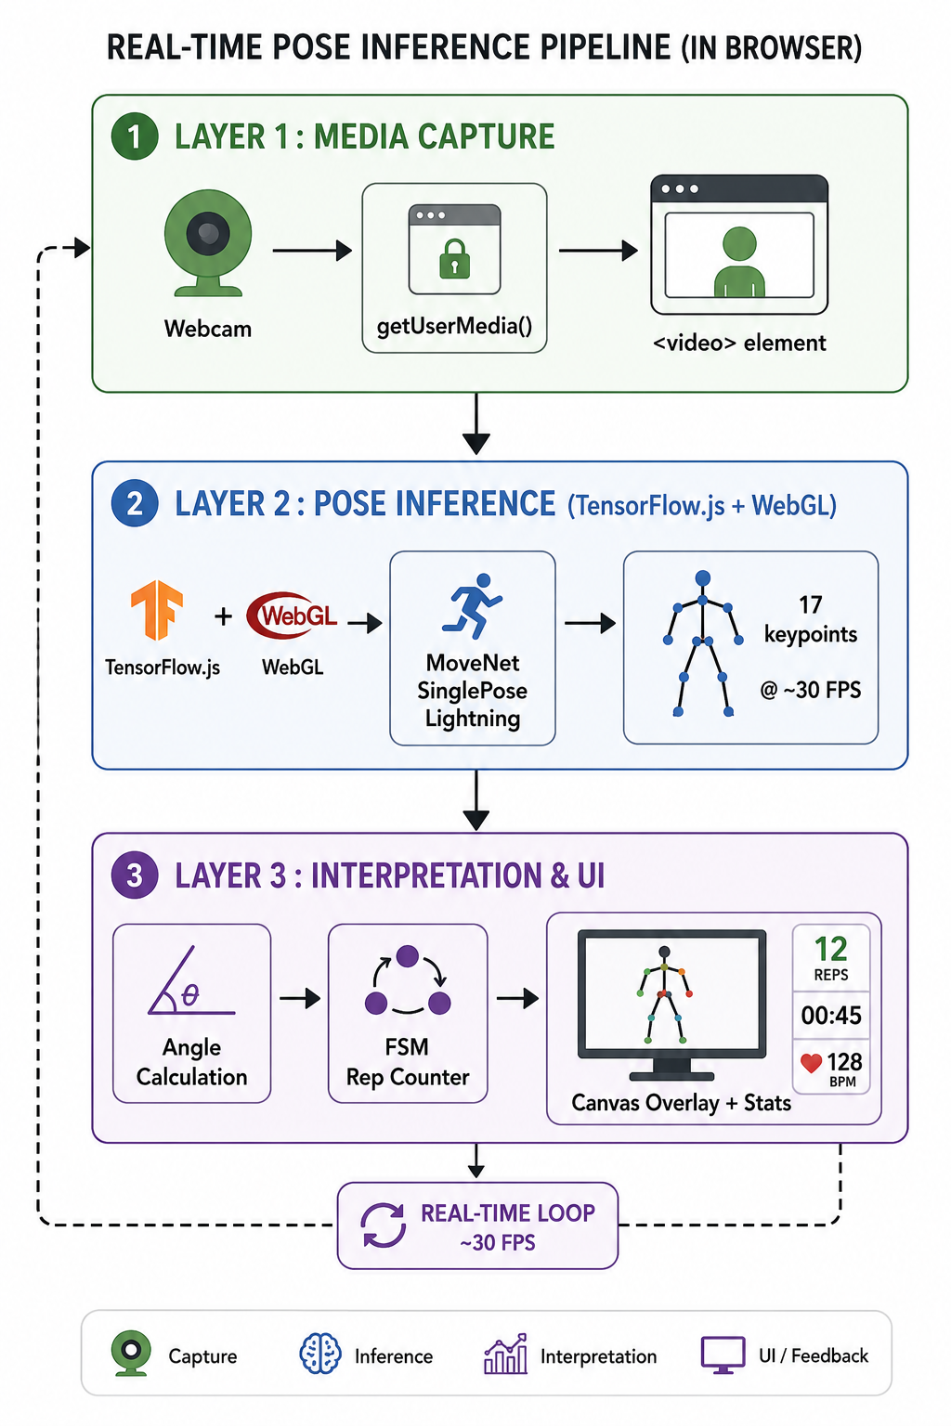
System Architecture

Slide 6
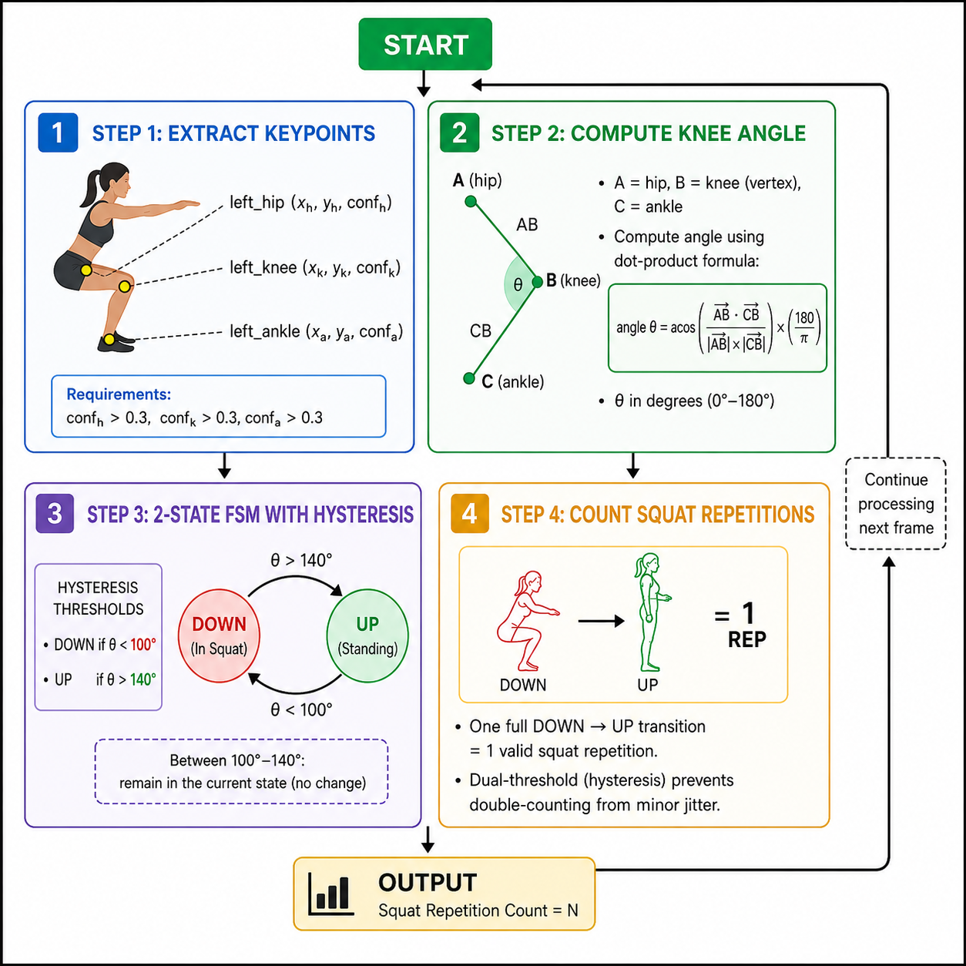
How One Rep is Counted

Slide 7
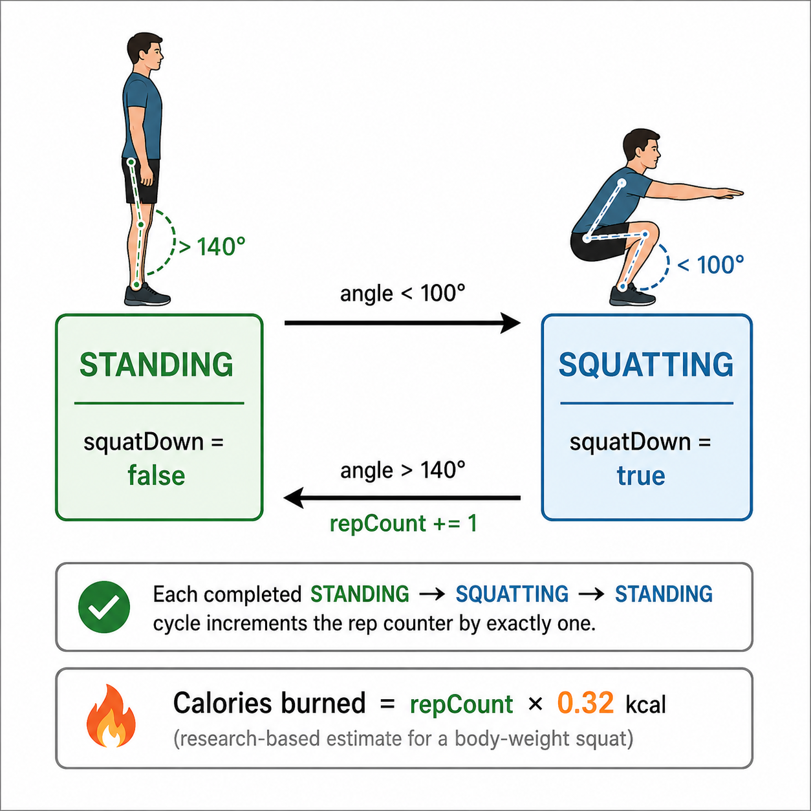
Squat State Machine – Flowchart

Slide 8
Implementation – Key Modules
src/pages/Counter.tsx — Core component: camera setup, pose detection loop (requestAnimationFrame), angle calculation, FSM, canvas skeleton overlay, stats grid.
src/pages/Home.tsx — Landing page with feature highlights and CTA to start the counter.
src/pages/Login.tsx & Register.tsx — Optional authentication screens (axios-based, ready for backend integration).
src/context/AuthContext.tsx — Centralized auth state via React useReducer (LOGIN_START / SUCCESS / FAILURE).
src/components/TopBar.tsx — Persistent navigation bar across routes.
src/index.css + tailwind.config.ts — Design system: HSL tokens, glass-morphism utilities, animations.

Slide 9
User Interface & Features
Live webcam feed with pose skeleton drawn in real time on an HTML5 Canvas overlay.
Animated stat cards displaying: Reps, Workout Time (MM:SS), Calories Burned, and Live Feedback.
Posture feedback messages: ‘✅ Great form! Keep going!’ or ‘⚠️ Keep your back straight’.
One-click Reset button to start a new session instantly.
Cinematic dark theme: black background, orange (#FF6A00) accents, glass-morphism cards, smooth fade-up animations.
Fully responsive — works on laptops and tablets with a front-facing camera.

Slide 10
Unique Features
100% Client-Side AI - Entire pose detection and rep counting runs in the browser using TensorFlow.js — no backend, no cloud API calls.
Finite State Machine for Rep Logic - Uses a proper FSM with dual-threshold hysteresis to detect squat phases (Standing → Descending → Bottom → Ascending), not just a simple angle threshold.
Live Canvas Skeleton Overlay - Draws the 17-keypoint body skeleton in real time directly over the webcam feed using HTML5 Canvas.
Zero Hardware Dependency - Requires only a standard webcam - no wearables, sensors, or special equipment needed.
Posture Feedback in Real Time - Provides live coaching messages (e.g., "Keep your back straight") while the user is exercising.

Slide 11
Key Findings
100% client-side AI pipeline — pose detection and rep counting run entirely in the browser using TensorFlow.js, with no backend or cloud dependency.
Finite State Machine (FSM) for rep logic — squat phases (Standing → Descending → Bottom → Ascending) are tracked using a structured state machine, not a simple angle cut-off.
Live skeleton overlay on HTML5 Canvas — all 17 MoveNet keypoints are drawn in real time directly over the webcam feed.
No wearables or sensors needed — works with any standard webcam, making it accessible to everyday home users.
Real-time posture feedback — live coaching messages like "Keep your back straight" are displayed while the user is actively exercising.

Slide 12
Results & Performance
Achieved real-time inference at ~25–30 FPS on a standard laptop with integrated GPU (WebGL backend).
Squat counting accuracy observed ≥ 95% under good lighting and full-body camera framing.
Total model size ~ 4 MB (MoveNet Lightning) — loads in under 3 seconds on a typical broadband connection.
Zero server costs: entire inference pipeline runs in the user's browser — fully private, no video ever leaves the device.
Calorie estimate validated against the standard reference of ~0.32 kcal per body-weight squat.

Slide 13
Challenges & Learnings
Challenge 1: Initial implementation double-counted reps due to angle noise — solved by introducing dual-threshold hysteresis (100°/140°).
Challenge 2: Keypoint jitter caused unstable skeleton — mitigated by filtering keypoints below confidence score 0.3.
Challenge 3: TensorFlow.js initialization order — resolved by awaiting tf.ready() and explicit backend selection before loading the detector.
Learning: Deep practical exposure to client-side ML, real-time computer vision, FSM design, and modern React + Tailwind architecture.

Slide 14
Future Scope
Add support for additional exercises: push-ups, lunges, planks, bicep curls — each with its own angle-based FSM.
Persist workout history per user using Lovable Cloud (Supabase) — graphs of reps/calories over time.
Voice feedback using the Web Speech API for hands-free coaching during workouts.
Mobile app version using React Native + on-device TensorFlow Lite for true portability.
Personalized AI coach that adjusts thresholds based on user height, leg length, and fitness level.

Slide 15
Conclusion
FITASSIST successfully demonstrates how modern web technologies combined with on-device AI can deliver a privacy-friendly, accessible, and accurate fitness tracking experience.
The project integrates real-time computer vision (MoveNet), clean software architecture (React + TypeScript + Context API), and thoughtful UX (Tailwind dark theme) into a single cohesive product.
It serves as a strong foundation for a broader AI-powered fitness platform and validates the feasibility of in-browser pose estimation for everyday consumer applications.

Slide 16
Thank You

