Slide 1

Sprocket Central Pty Ltd
Data analytics approach
[Approach for 1000] - [Himanshu shriwas]

Slide 2
Agenda
Introduction
Data Exploration
Model Development
Interpretation

Slide 3
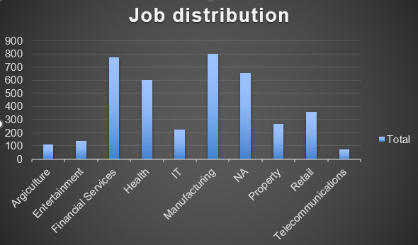
Introduction
Dataset
By Analysing the data by the customers most customer live in New south Wales, Australia
Most customers have used different products in a year according to their transition, thus many duplicate names records can exist
The average age of most customers are is between 35 to 40
Customers in manufacturing and in financial services are higher compare to other job categories
Place any supporting images, graphs, data or extra text here.

Slide 4
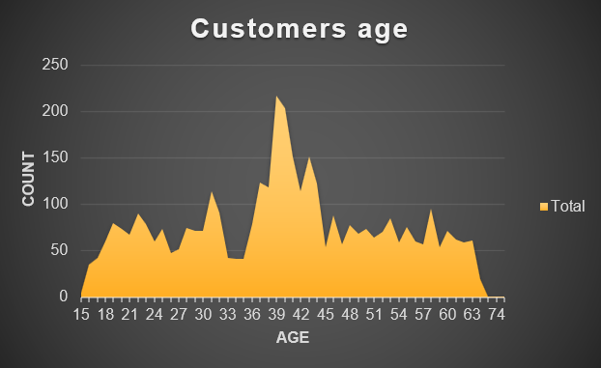
Data Exploration
Understanding the data distributions
The list price of the product should be more than 1000 as most customer prefers to purchase bike for long term
Customers who are less 50 years of age have taken into the account as many of them are working professionals and travel regularly to their destination of work
Place any supporting images, graphs, data or extra text here.

Slide 5
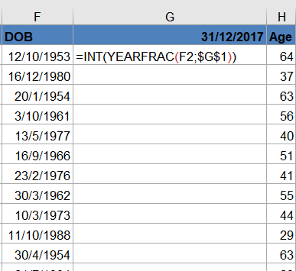
Model Development
Data transformations and modeling
The date of birth of the customers has to be changed into their age as per the transaction year.
The =INT(YEARFRAC(start,end)) function has used to change into the age.
Using Microsoft server SQL the data is analysed by the customers transaction and profit they made for on their purchase

Slide 6
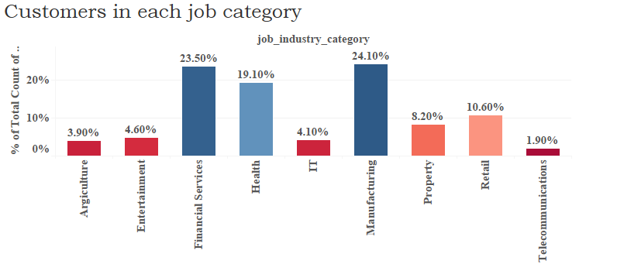
Interpretation
Results interpretation and reporting
customers who have ordered the product at least 3 times have taken into the account along with the list price greater than 1000
As most customers are in financial services and manufacturing around 23% and 24% the profit margin will be higher in this job categories
Place any supporting images, graphs, data or extra text here.

Slide 7
Conclusion
The Customers who order regularly are consider into the premium category this customers are to be targeted to drive the most value for the organisation.

