Slide 1
IBM University Engagement Project Submission
“Exploring the Power of Agentic AI with IBM Granite”

Slide 2

Project Title – AI-Powered Interview Trainer Agent
Domain of Project – Education & Career Development
NAME | Recent Passport Photo | EMAIL | PHONE NO:
HIMANSHU DAS BISWAS |  | 23052394@kiit.ac.in | 7415894382

Slide 3
Problem Statement -
Problem Statement : Interview Trainer Agent
The Challenge
An Interview Trainer Agent, powered by RAG (Retrieval-Augmented Generation), prepares users for job interviews by generating tailored question sets and preparation strategies based on their profile, experience level, and job role. It retrieves role-specific interview questions, industry expectations, and behavioral scenarios. Users can input their resume or job title, and the agent provides targeted questions, model answers, and improvement tips.
The Objective
Build an AI-powered Interview Trainer Agent that delivers personalized interview preparation for job seekers across technical and non-technical roles. The solution should:
Personalized Question Generation – Generate interview questions tailored to job role, experience level, and resume content.
RAG-Based Retrieval – Retrieve relevant, role-specific interview questions from a curated knowledge base before generation.
Model Answers & Improvement Tips – Provide concise model answers alongside specific, actionable improvement tips.
Technical & Behavioral Coverage – Support both technical assessment and soft-skill/behavioral interview prep.
Secure Session History –
User Authentication Agent (JWT-based signup/login)
History Agent (MongoDB-stored past interview sessions)
Granite Generation Agent (direct watsonx.ai Runtime API calls)
Prompt Engineering Layer (context-grounded RAG prompt construction)
Full-Stack Delivery – React frontend, Node/Express backend, deployed on Vercel and Render.

Slide 4
Proposed Solution -
Proposed Solution: AI-Powered Interview Trainer Agent
The proposed solution is a full-stack, multi-agent AI application built using the MERN stack, IBM watsonx.ai, and Granite Models to provide personalized interview simulations. The system addresses challenges in interview preparation through a tailored Retrieval-Augmented Generation (RAG) pipeline.
The system consists of key intelligent components:
Context Generation Agent: Retrieves and structures the candidate’s target job title, experience level, and resume snippets.
Assessment Mix Agent: Formulates a balanced set of technical and behavioral questions utilizing the IBM Granite foundation model.
Benchmarking & Grading Agent: Delivers instant, high-quality model answers and actionable coaching feedback for each generated question.
The solution includes a premium, user-friendly React dashboard that allows users to securely log in, configure their interview criteria, and instantly visualize their personalized questions and feedback.

Slide 5
Technology Used
IBM Granite Model (e.g. Granite-4.0-8B-Instruct) for natural language understanding, technical reasoning, and personalized question generation
Langflow platform - For designing and orchestrating multi-agent prompt workflows
IBM Cloud – Provides a reliable, secure, and scalable environment for deploying AI endpoints.
RAG – Retrieval-Augmented Generation To fetch domain-specific reference interview patterns to make the agent trustworthy and effective.
IBM Watsonx.ai - For robust model deployment and AI governance
Vector Database / MongoDB – For secure user authentication and data state management

Slide 6
Key Components Used -
1) Auth Middleware – JWT-based signup/login; protects all interview-generation routes.
2) watsonx.ai Service - Handles IAM token exchange and calls the Granite text-generation endpoint.
3) Name of IBM Granite model - ibm/granite-3-8b-instruct → Fast, efficient for real-time interview Q&A generation
4) Prompt Builder -Constructs structured prompts from job title, experience level, resume snippet, and RAG context.
5) RAG Retrieval Layer - Fetches relevant interview questions from a curated dataset before generation.
6) MongoDB Models (User, InterviewSession) store users and generated Q&A history.

Slide 7
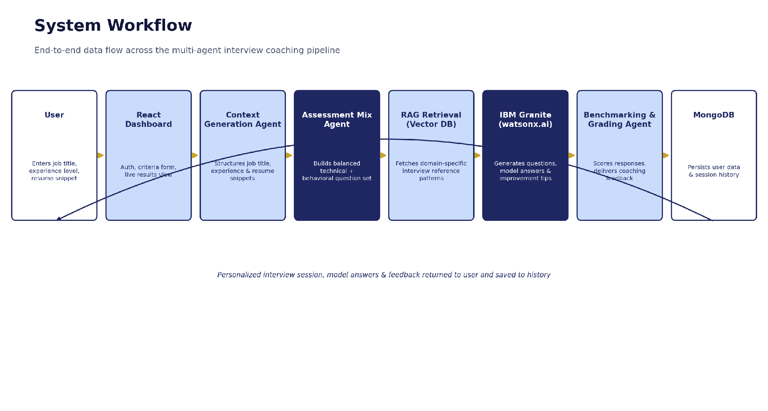
System Workflow -

Slide 8
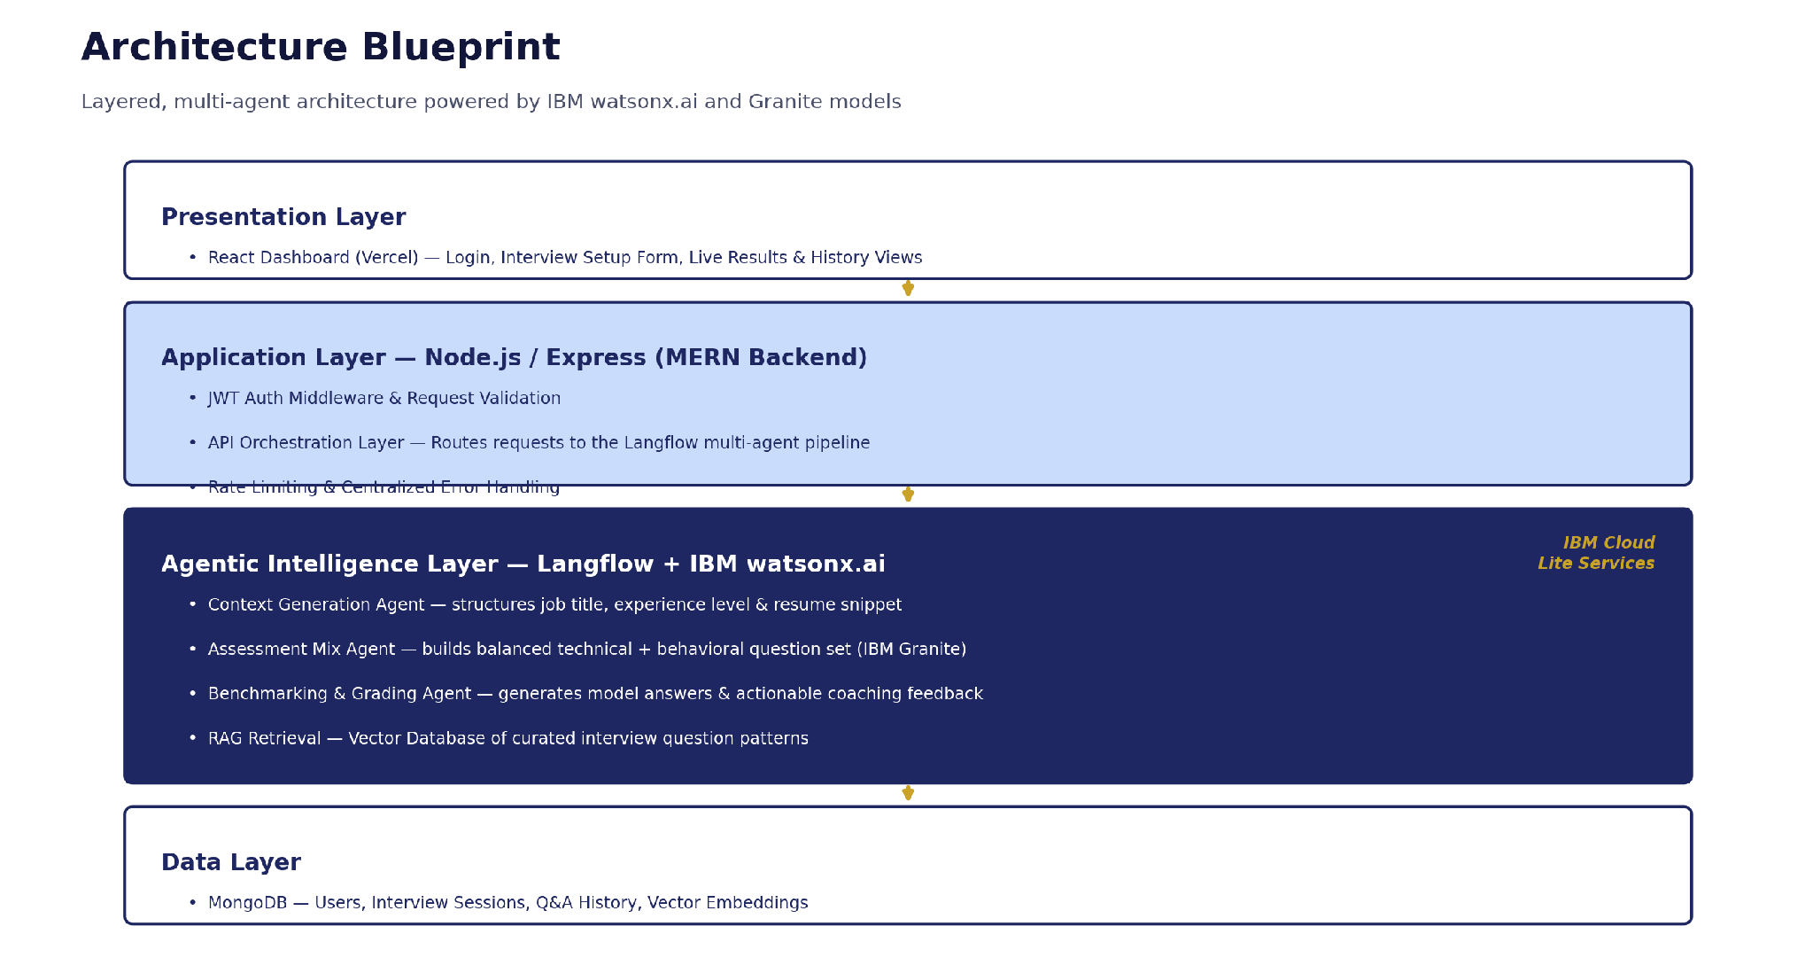
Architecture blueprint

Slide 9

Role of Agentic AI in the solution
Role of Agentic AI in the Interview Trainer Agent
Agentic AI enables the Interview Trainer Agent to function as an autonomous coaching system rather than a static Q&A lookup. Using IBM watsonx.ai and IBM Granite models, it independently retrieves relevant context and generates structured, role-specific interview material.
The agent performs multiple reasoning steps per request — interpreting job role and experience level, retrieving matching reference questions via RAG, then generating questions, model answers, and improvement tips — in a single autonomous pipeline. This retrieval-then-generation approach ensures grounded, trustworthy output rather than free-form hallucination.
The agent also brings context awareness, understanding the candidate's resume snippet, job title, and experience level to generate tailored recommendations. It supports persistent memory, storing every generated session so a candidate can track and revisit past preparation.
Authentication and history layers work alongside the generation agent, enabling a secure, continuous coaching experience across sessions.
Overall, Agentic AI makes the system proactive, personalized, and goal-driven, acting like a smart digital interview coach that helps candidates prepare with confidence.

Slide 10
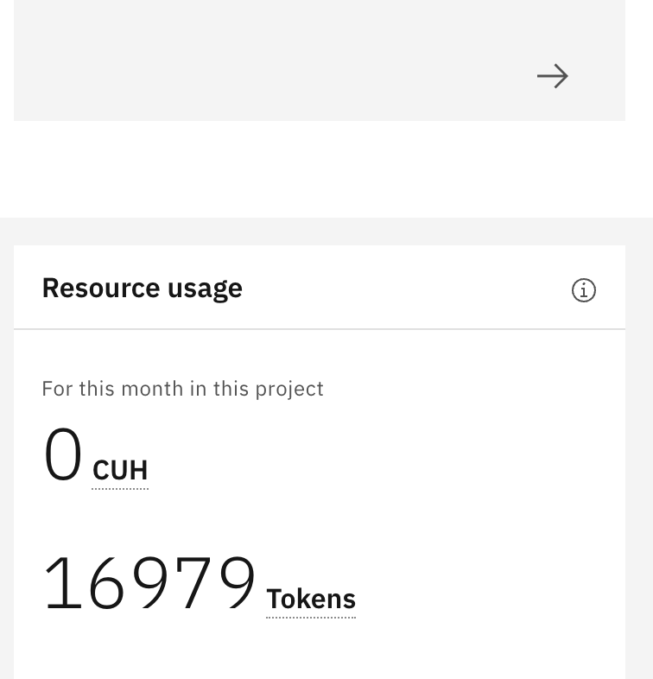
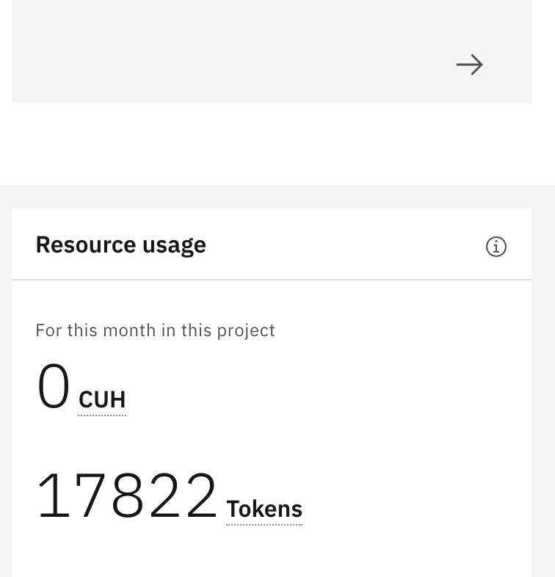
Token Usage
843 tokens used by the interview-coach prompt (16,979 → 17,822)
Before Prompt
After the Prompt
·
·
·

Slide 11
Novelty and Uniqueness
The proposed Interview Trainer Agent stands out by combining Agentic AI, RAG, and full-stack engineering into a single production-ready system.
RAG-Grounded Accuracy – Retrieves real, curated interview questions before generation, reducing generic or hallucinated output.
True IBM Granite Integration – Calls watsonx.ai's raw REST API directly with IAM authentication, not just a no-code builder.
Hyper-Personalization – Tailors questions, answers, and tips based on job role, experience level, and resume content.
Persistent Learning History – Every session is saved to MongoDB, letting candidates track preparation over time.
Secure, Real Auth System – JWT-based signup/login protects every interview-generation request.
Practical, Self-Tested Use Case – Built and validated against real placement-drive prep (TCS NQT, service-based company interviews).
Industry-Ready Architecture – Built on IBM watsonx.ai with IBM Granite models, layered Express architecture, and MongoDB Atlas, ready for real deployment.
This makes the solution a genuine engineering deliverable, not just a wrapper around a chatbot.

Slide 12
GitHub Link
Public repository created with README enabled, containing the full project source code.
GitHub URL – https://github.com/himanshu-db787/interview-trainer-agent
Repository includes: 1) Full source code (MERN stack + Langflow agents) 2) Problem Statement PDF 3) This project presentation (.pptx) 4) README with setup instructions. Live Application URL – https://interview-trainer-agent-one.vercel.app
·
·
·

Slide 13
Future Scope
1. Voice-Based Mock Interview Simulation –
Extend the agent with a voice interface so candidates can practice answering aloud, with feedback on clarity, pacing, and confidence — simulating a real interview panel experience.
2. Expanded RAG Knowledge Base & Multilingual Support –
Grow the curated question dataset to cover more companies and roles, and add regional language support so candidates from diverse linguistic backgrounds can prepare in their preferred language.
·
·
·

Slide 14
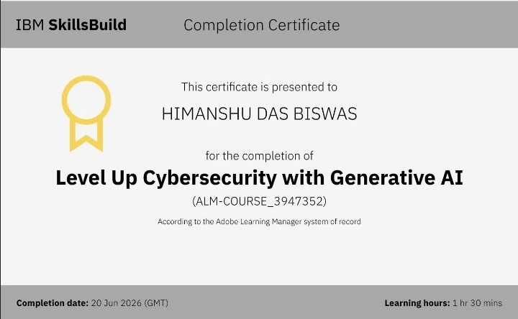
Certificates Earned:
IBM SkillsBuild Certificate – Level Up Cybersecurity with Generative AI

Slide 15
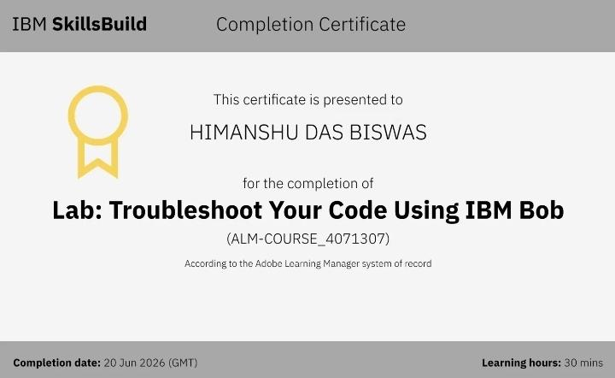
Certificates Earned:​
IBM SkillsBuild Certificate – Lab: Troubleshoot Your Code Using IBM Bob (Final)

Slide 16


