Slide 1
DAIMLER INDIA COMMERCIAL VEHICLES · FLEET RELIABILITY
Starter Motor Failure
Prediction Program
Executive Business Review · Predictive Intelligence for the BharatBenz Fleet · Version 1.1
34
106M+
13 of 14
168 days
vehicles analysed
telemetry records
failures identified in advance
median early warning
July 2026 · Confidential — prepared for DICV leadership, service engineering, warranty and fleet operations

Slide 2
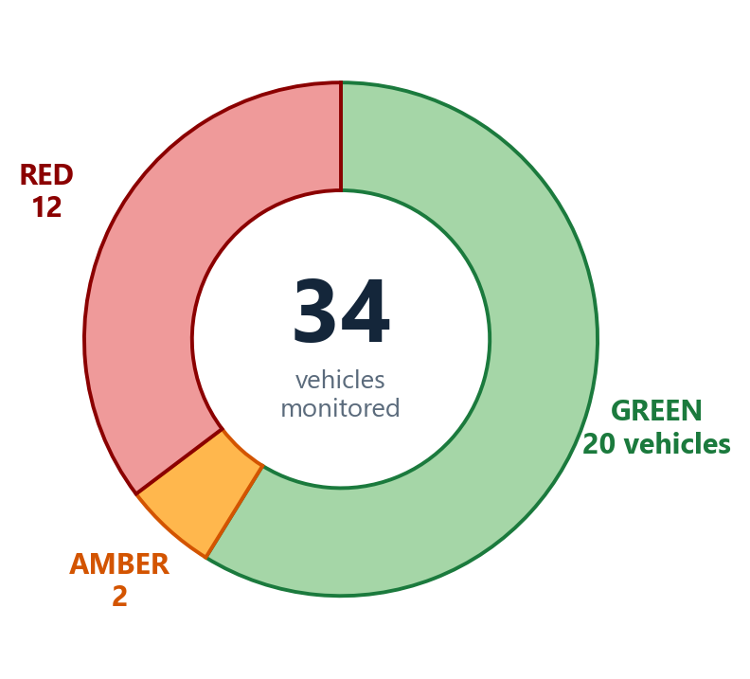
EXECUTIVE SUMMARY
02 / 09
Validated early warning for starter motor failures — months before they happen
13 of 14
168 days
93%
FLEET HEALTH AT A GLANCE
Failures identified in advance
Median early-warning lead time
Risk-ranking strength
Across 14 real starter motor failures, 13 vehicles raised a validated early warning before the failure date.
First warning arrived a median 168 days before failure (range 77–424 days) — ample time to plan.
AUROC 0.93 (95% CI 0.81–0.99): independently validated ability to rank failing vehicles above healthy ones.
10 weeks
0
106M
Every vehicle, every week: one clear health status and one clear action.
12 RED — 10 later failed; 2 flagged for inspection.
2 AMBER — bundled into next service visit.
20 GREEN — 16 healthy on routine ops; 4 subtle failures, 3 of them still caught by the alert layer (slide 8).
Validated action window
Battery-cascade false alarms
Telemetry records analysed
A flagged vehicle is typically within ~10 weeks of failure — the confirmed window for maintenance action.
The highest-precision alert fired on 4 failing vehicles and on none of the 20 healthy vehicles.
34 vehicles · 2,636 vehicle-weeks · 20,471 engine-start events — evidence base for every claim in this review.
KEY TAKEAWAY
RECOMMENDED ACTION
V1.1 reliably separates degrading starter motors from healthy ones, with months of advance notice on real DICV fleet data.
Endorse pilot deployment to convert validated warnings into avoided breakdowns.
Daimler India Commercial Vehicles · Starter Motor Failure Prediction Program V1.1 · Confidential — for internal DICV use

Slide 3
HOW IT WORKS — BUSINESS VIEW
03 / 09
From vehicle operating data to maintenance decisions, every week
1
Vehicle Operational Data
2
Continuous Health Assessment
3
Early Risk Identification
4
Vehicle Risk Classification
Standard on-board electrical and usage signals — no new sensors required
Predictive Intelligence Engine evaluates each vehicle's electrical behaviour weekly
Departures from the vehicle's own healthy pattern are detected months ahead
Each vehicle is classified GREEN / AMBER / RED with a validated risk score
5
Future Failure Outlook
6
Maintenance Prioritisation
7
Operational Decision Support
Flagged vehicles are typically within ~10 weeks of failure — a confirmed planning window
Workshops see a ranked list: which vehicles, how urgent, what to check first
Clear actions: inspect in 2–4 weeks, bundle at next service, or continue routine ops
WHAT THIS MEANS OPERATIONALLY
The engine turns raw operating behaviour into a weekly fleet health report. Maintenance teams no longer wait for a breakdown call: degrading vehicles surface on a ranked watch-list months earlier, spare parts and workshop slots are arranged in advance, and healthy vehicles stay on the road undisturbed. The underlying analytics remain fully managed within the platform — DICV teams interact only with clear statuses and actions.
KEY TAKEAWAY
RECOMMENDED ACTION
A weekly, fully automated pipeline turns existing vehicle data into ranked, actionable maintenance intelligence.
Integrate the weekly health report into existing workshop planning as the single fleet watch-list.
Daimler India Commercial Vehicles · Starter Motor Failure Prediction Program V1.1 · Confidential — for internal DICV use

Slide 4
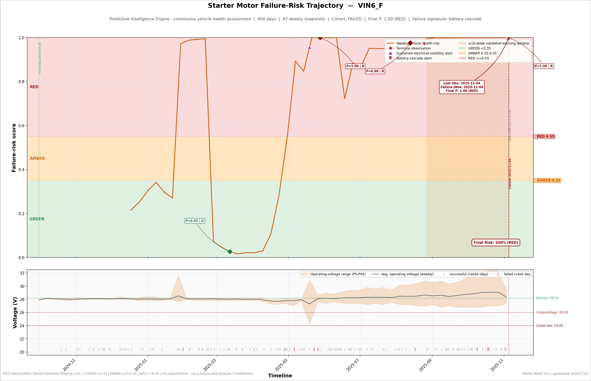
VEHICLE CASE STUDY — FAILURE PREDICTED
04 / 09
VIN6: a starter motor failure signalled 168 days in advance
ANATOMY OF A PREDICTED FAILURE
19 May 2025
Early warning: sustained electrical volatility alert — vehicle enters the watch-list
25 May 2025
Risk score leaves the healthy band — monitoring intensified
25 Aug 2025
Battery-cascade alert confirms the pathway — 70 days before failure
31 Aug — 19 Oct
Risk climbs steadily into RED: inspection and parts planning window
04 Nov 2025
Failure occurs — after a 168-day warning runway
With V1.1 live, this vehicle books a workshop slot in September — not a roadside recovery in November.
KEY TAKEAWAY
RECOMMENDED ACTION
Progressive degradation was visible, staged and confirmed by two independent alerts long before failure.
Use this case as the pilot's operating template: alert → inspect → planned replacement.
Daimler India Commercial Vehicles · Starter Motor Failure Prediction Program V1.1 · Confidential — for internal DICV use

Slide 5
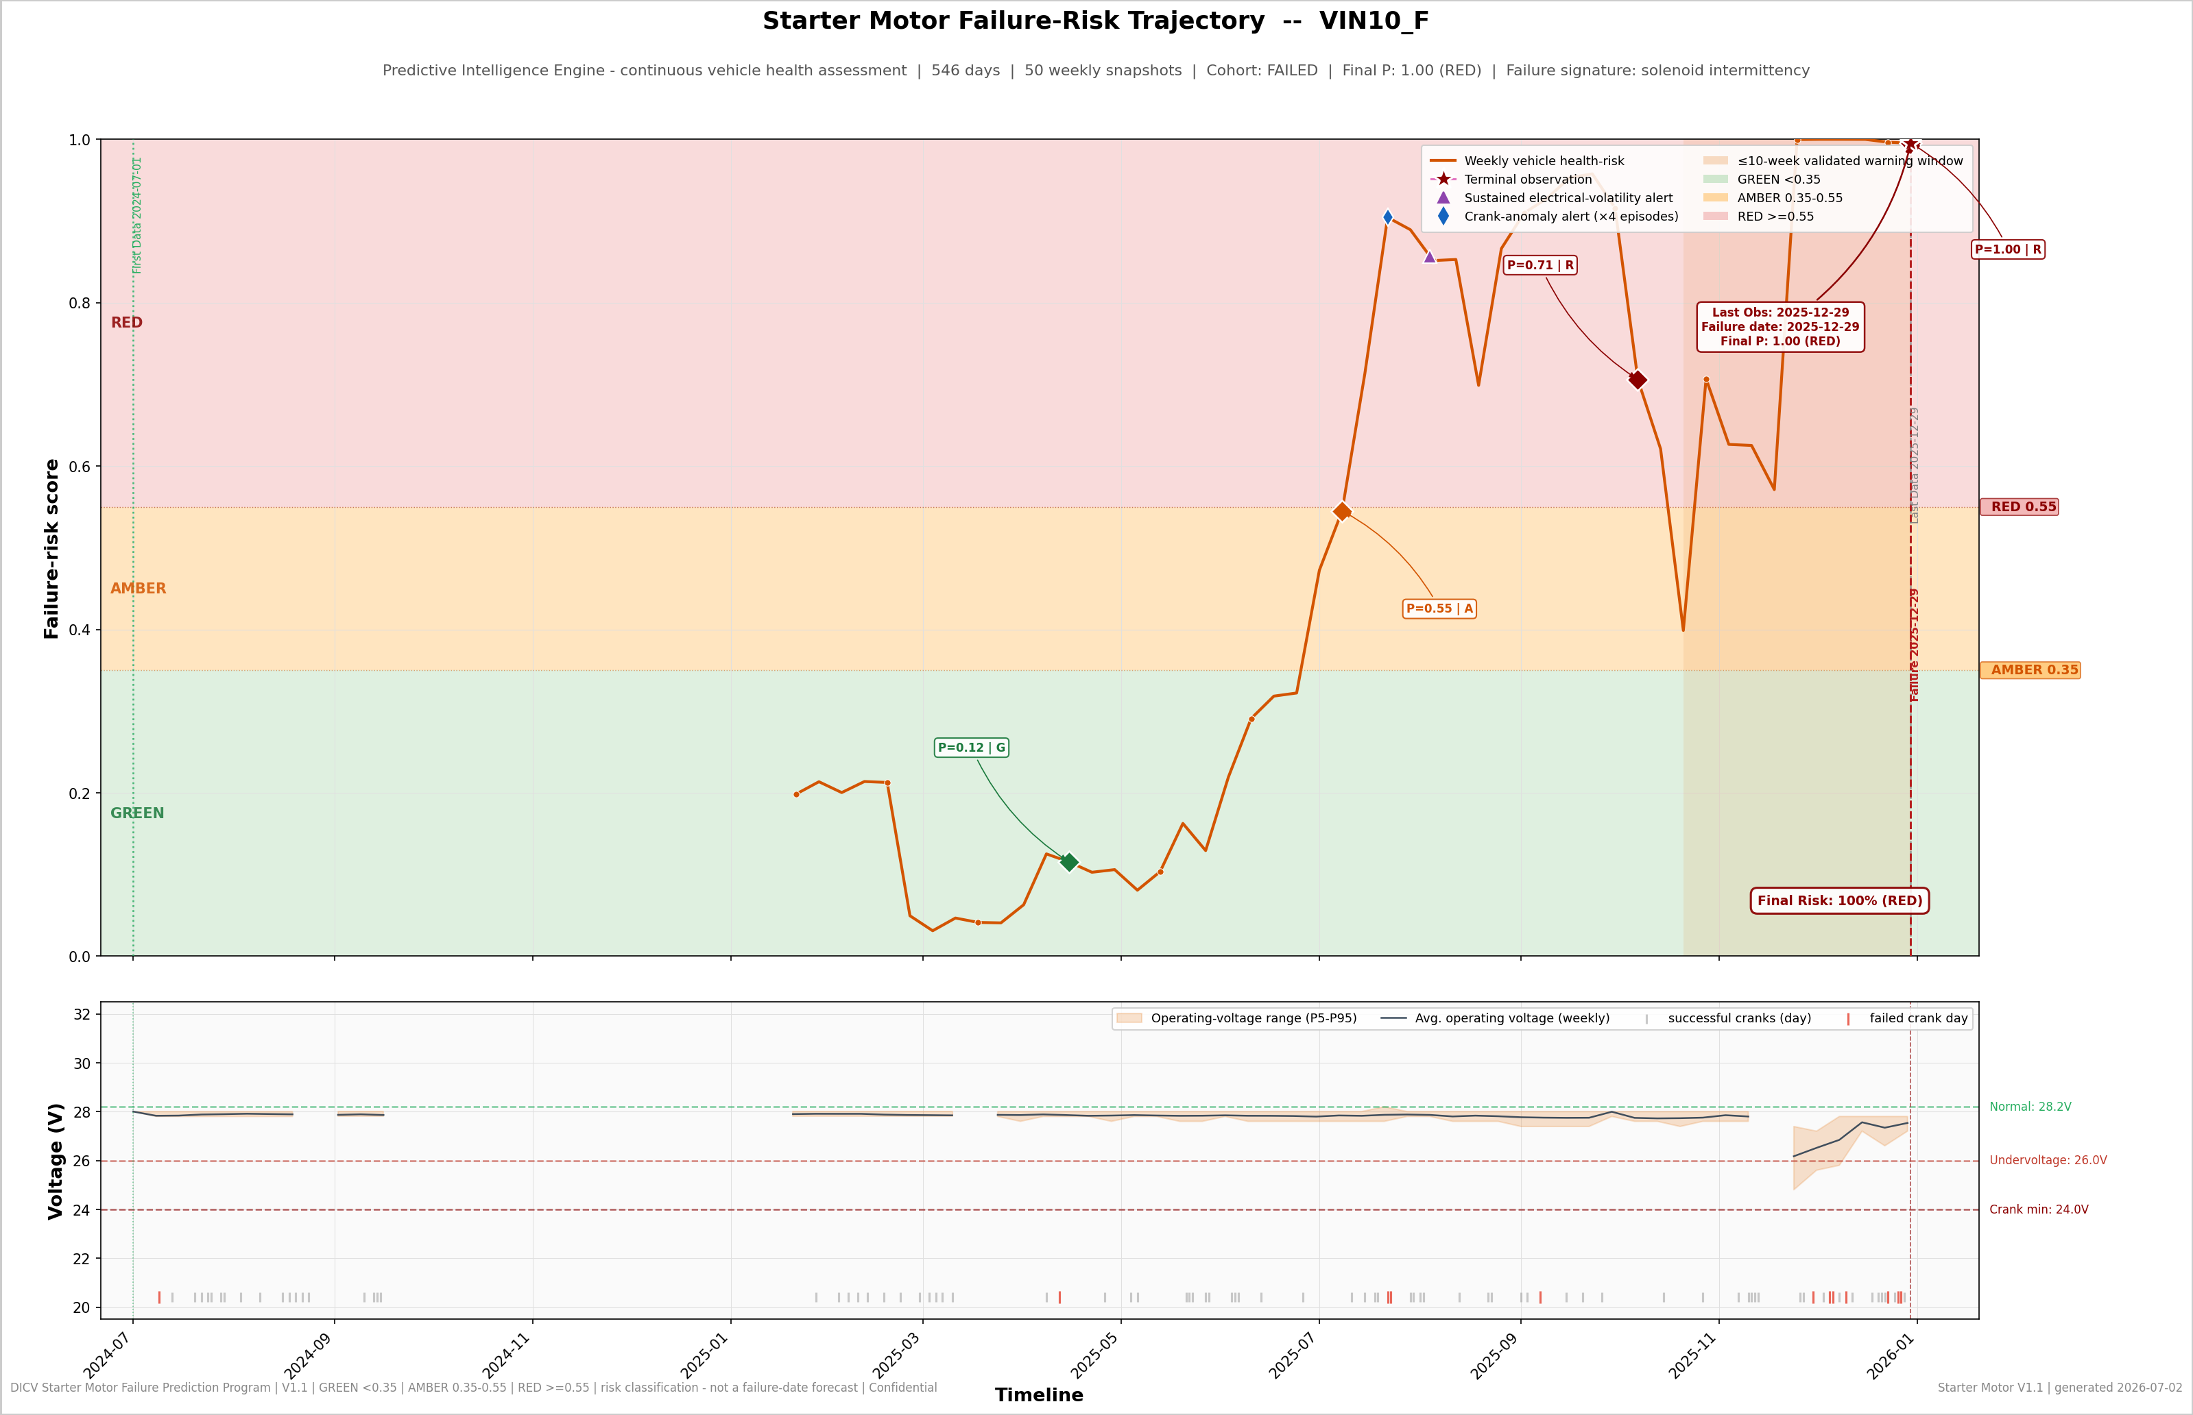
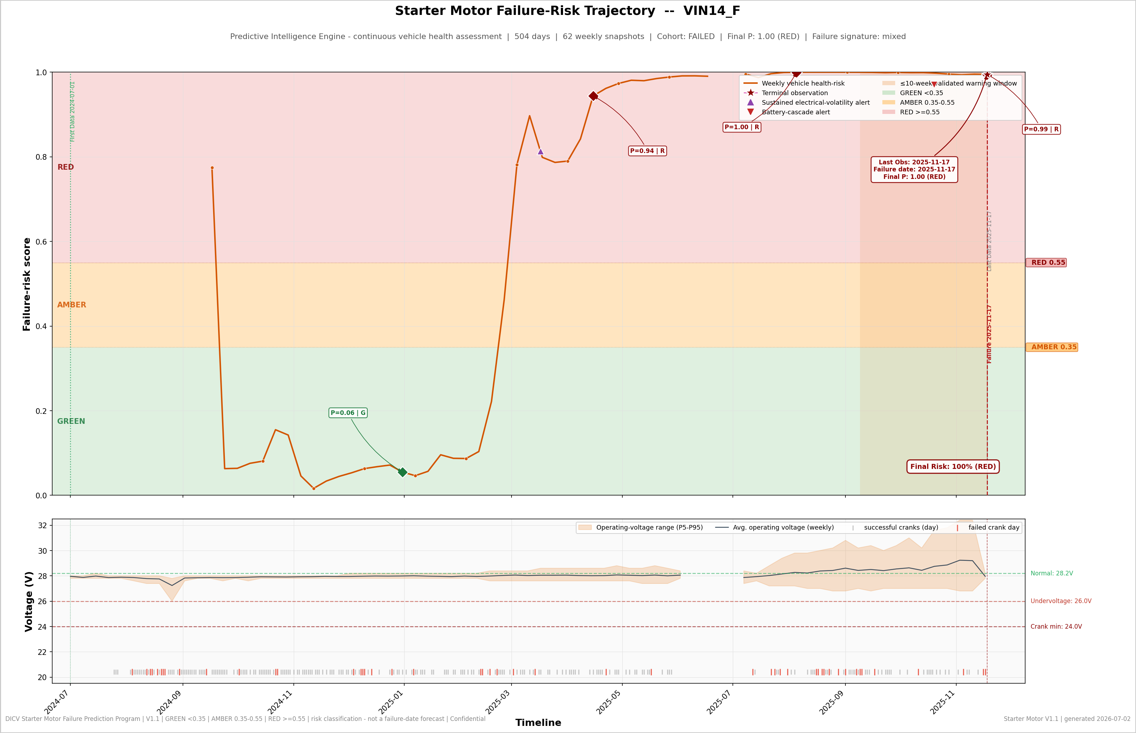
VEHICLE CASE STUDIES — FAILURE PREDICTED
05 / 09
Different failure signatures, same result: months of advance notice
VIN10 — starter-mechanism wear signature. Crank-anomaly alert fired 160 days before failure; risk climbed GREEN → RED five months ahead. Final risk 100%.
VIN14 — mixed electrical signature. First warning 245 days ahead; battery-cascade confirmation 28 days before failure. Joint-highest risk score in the fleet (1.00).
KEY TAKEAWAY
RECOMMENDED ACTION
The engine catches distinct degradation pathways — battery-driven, starter-mechanism and electrical-noise signatures alike.
Route each alert type to its matching inspection checklist (battery circuit vs. starter system).
Daimler India Commercial Vehicles · Starter Motor Failure Prediction Program V1.1 · Confidential — for internal DICV use

Slide 6
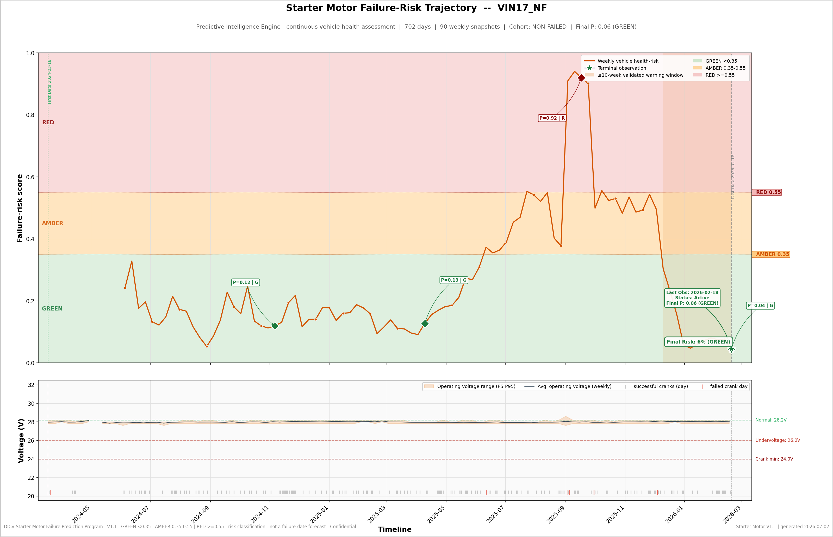
VEHICLE CASE STUDY — HEALTHY FLEET
06 / 09
What healthy looks like: stable scores, self-resolving deviations, zero alerts
THE HEALTHY-VEHICLE PATTERN
6%
final risk score after 702 days of monitoring — firmly GREEN
0
alerts raised across the full observation period
10 of 20
healthy vehicles never triggered any alert channel
16 of 20
healthy vehicles finished in GREEN; 2 AMBER, 2 RED flagged for precautionary inspection
Reading the contrast: short-lived score elevations on healthy vehicles settle back to GREEN on their own. Failing vehicles climb and stay high. That difference — sustained versus transient — is what the engine measures every week.
KEY TAKEAWAY
RECOMMENDED ACTION
Healthy vehicles stay green and quiet — the system earns trust by leaving well-running trucks alone.
Track alert-free healthy-fleet share as a standing KPI during the pilot (baseline: 50% fully quiet, 80% green).
Daimler India Commercial Vehicles · Starter Motor Failure Prediction Program V1.1 · Confidential — for internal DICV use

Slide 7
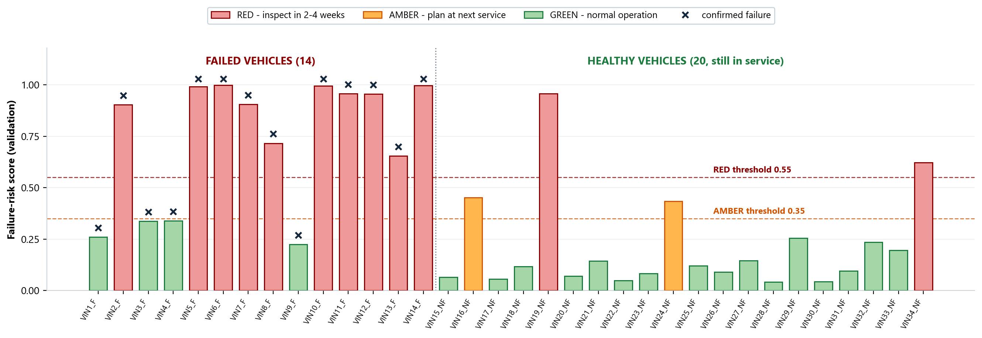
VEHICLE-LEVEL INTELLIGENCE
07 / 09
One ranked view of all 34 vehicles — maintenance effort flows where risk is
VIN6_F · RED · risk 100%
VIN19_NF · RED · risk 96%
VIN16_NF · AMBER · risk 45%
VIN17_NF · GREEN · risk 6%
Failed as predicted — 168-day warning validated
In service — priority inspection within 2–4 weeks
In service — bundle checks into next scheduled service
In service — routine operation, no action required
KEY TAKEAWAY
RECOMMENDED ACTION
Every vehicle carries a current status, a validated risk score and a clear next action — updated weekly.
Adopt the tier rule in workshop planning: RED inspect in 2–4 weeks; AMBER at next service; GREEN routine.
Daimler India Commercial Vehicles · Starter Motor Failure Prediction Program V1.1 · Confidential — for internal DICV use

Slide 8
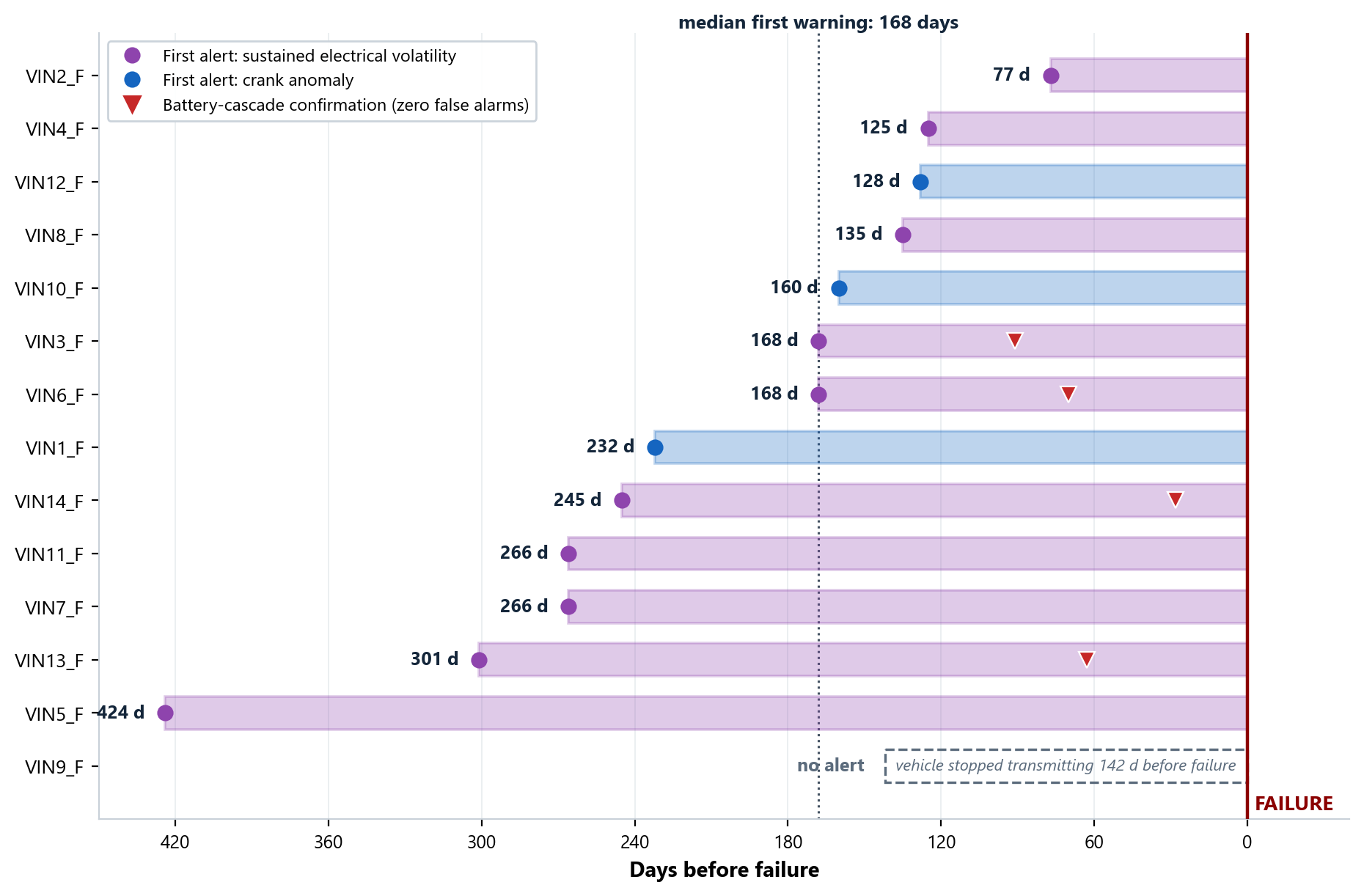
FLEET RISK OUTLOOK
08 / 09
The early-warning runway: how much time maintenance teams actually get
FROM RISK STAGE TO OPERATIONAL RESPONSE
GREEN — Normal operation
Weekly monitoring continues in the background; no workshop action.
AMBER — Early degradation
Plan ahead: reserve a service slot, stage spares, add checks to the next visit.
RED — High risk
Inspect starter and battery circuit within 2–4 weeks; vehicle typically within ~10 weeks of failure.
CRITICAL — Battery-cascade alert active
Immediate intervention — this alert produced zero false alarms in validation.
KEY TAKEAWAY
RECOMMENDED ACTION
12 of 13 detected failures gave more than 3 months of notice — enough to plan parts, slots and vehicle rotation.
Build pilot SOPs around the runway: alert → diagnose → schedule → replace before failure.
Daimler India Commercial Vehicles · Starter Motor Failure Prediction Program V1.1 · Confidential — for internal DICV use

Slide 9
BUSINESS OUTCOMES & STRATEGIC RECOMMENDATIONS
09 / 09
Deploy what is validated; grow what the data supports
PREDICTION EFFECTIVENESS — VALIDATED
OPERATIONAL BENEFITS
STRATEGIC ROADMAP
Coverage-first mode: 13 of 14 failures caught; 5 of 20 healthy flagged for inspection
Fewer roadside failures — degrading vehicles reach the workshop first
NOW — Pilot
Deploy on the active fleet; validate alerts against workshop findings; adopt tier-based SOPs
Precision-first mode: 10 of 14 failures caught; only 2 of 20 healthy flagged
Better workshop scheduling — median 5+ months of planning runway
Smarter spares — battery vs. starter signature guides what to stock
NEXT — Integrate
Risk-ranking strength: AUROC 0.93 (95% CI 0.81–0.99), independently validated
Service-centre integration, fleet dashboards, automated scheduling hooks
Higher fleet availability — planned repairs beat breakdown recovery
Early warning: Median 168 days; battery-cascade confirmation median ~9 weeks, zero false alarms
Focused effort — 80% of the healthy fleet stays untouched
THEN — Scale
Enterprise rollout across the BharatBenz fleet; richer vehicle data feeds — identified during validation — to push detection coverage and precision further
Known limit: 1 of 14 failures gave no signal — the vehicle stopped transmitting 142 days before failing
Warranty insight — degradation evidence per vehicle, per week
EXECUTIVE CLOSING MESSAGE
V1.1 demonstrates that predictive vehicle intelligence moves DICV from reactive repair to proactive, data-informed fleet reliability management — improving operational continuity, maintenance planning and customer satisfaction, while the underlying predictive technology remains fully protected.
KEY TAKEAWAY
RECOMMENDED ACTION
The capability is validated, the operating model is defined, and the scaling path is clear.
Approve the pilot and nominate the first operating fleet and service centres.
Daimler India Commercial Vehicles · Starter Motor Failure Prediction Program V1.1 · Confidential — for internal DICV use

