Slide 1
INTERNAL — SENIOR ENGINEERING REVIEW FOR WORK APPROVAL
Starter Motor Failure Prediction V1.1
Technical Deep-Dive: Data, Methods, Validation, Results
Nested leave-one-vehicle-out RidgeClassifier pipeline · 34-truck fleet · 106.4M telemetry rows · frozen 4-feature model
0.9321
p = 0.005
13 / 14
k* = 10 wk
nested-LOVO AUROC [0.811, 0.986]
full-pipeline permutation test
recall @ per-fold Youden
validated prequential horizon
July 2026 · V1.1 frozen 2026-06-10 · artifacts: STARTER MOTOR/V1.1/{results, reports, audit, discovery, graphs}

Slide 2
INTERNAL · TECHNICAL REVIEW — SCOPE
02 / 25
What V1.1 delivers, and what we are asking you to approve
SCOPE OF THE V1.1 ITERATION
APPROVAL ASKS (THIS REVIEW)
Objective: weekly per-vehicle starter-motor failure-risk classification on the 34-truck SM fleet (14 failed / 20 non-failed).
Method: nested leave-one-vehicle-out (LOVO) RidgeClassifier(alpha=1.0), fold-internal imputation/scaling/selection, per-fold Platt recalibration, pre-registered thresholds.
Deliverables: recalibrated probabilities + GREEN/AMBER/RED tiers, 3-channel alert layer, 10-week validity horizon, 34 per-VIN dashboards, full audit trail.
Explicit non-deliverable: day-level RUL / failure-date forecasts (all survival variants lose to a constant — evidence on slide 17).
1
Freeze the modal 4-feature nested model as the V1.1 production scorer (spec: V1_1_SM_model_spec.json).
2
Ship recalibrated probabilities + tier rule (GREEN < 0.35, AMBER 0.35-0.55, RED >= 0.55) — calibration gate passed (slope 0.86).
3
Adopt the 3-channel alert policy: A2 battery-cascade as pager, persistence as terminal condition flag, A1 as corroborator.
WHY V1.1 EXISTS (V1 POST-MORTEM)
V1 reported 0.9214 without nested selection; honest restatement is 0.8929 (selection optimism +0.0285).
V1's vsi_dominant_freq was exposed as a 1/n_weeks observation-length artifact (fake TP on VIN2_F) - banned in V1.1.
V1 missed VIN8_F (P 0.303). V1.1 recovers it (P 0.716, RED) via the battery-step-aware rest-VSI baseline.
4
Approve weekly scoring cadence (monthly gives only 2 reads inside the 10-week horizon).
5
Endorse instrumentation requests: >=1 Hz crank logging, cranking current / battery SoC, maintenance records, more failure cases.
ENGINEERING TAKEAWAY
REVIEW / DECISION POINT
V1.1 is a frozen, fully audited iteration; every claim in this deck is reproducible from committed artifacts.
Confirm the five asks or flag which require deeper review.
Starter Motor Failure Prediction V1.1 · Internal engineering review — full technical disclosure · Not for external distribution

Slide 3
INTERNAL · TECHNICAL REVIEW — DATA
03 / 25
Data foundation — and the data reality the design had to survive
CORPUS
SIGNAL DICTIONARY (AS USED)
34 trucks (14 F / 20 NF), _SM suffix — fully independent of the ALT fleet (no cross-VIN identity).
106,445,161 raw 5-second rows after null-timestamp drop; 17,522 active vin-days.
Reduced to 2,636 truck-weeks (weekly cache) + 20,471 crank events (event extraction, artifact-filtered).
Signals: VSI, SMA, RPM, CSP, ANR, GED. No current, no temperature, no battery SoC. VSI quantized at 0.2 V.
Power-supply voltage (V)
VSI
0-36 valid; sentinels 0/255; x0.2 scaling; drive vs rest split
SMA
Starter Motor Active {0,1}
crank-event extraction basis; dead on 7 trucks
RPM
Engine speed (rev/min)
sentinel 65535; crank success criterion rpm_max_15s >= 550
DATA REALITY (DESIGN CONSTRAINTS)
Vehicle speed (km/h)
SMA-dead cohort (7 trucks): VIN8/9_F + 5 NF have <1% SMA coverage - all crank features NaN, fold-internal median-imputed.
Terminal silent gaps (5 failed): VIN1 72d, VIN4 97d, VIN5 32d, VIN8 37d, VIN9 142d - no telemetry before failure.
Leakage ceilings: observation length ALONE classifies at AUROC 0.952 (n_weeks) / 0.893 (t_start). Every feature must beat the L40 fixed-window control to prove it is not a length proxy.
CSP
sentinel 65535; drive-state gating
ANR
Engine torque (Nm)
sentinels 65535 / -5000; load context
GED
Alternator excitation state {0..3}
no GED=2 events in failed SM fleet (unlike ALT)
ENGINEERING TAKEAWAY
REVIEW / DECISION POINT
The pipeline is designed around missingness and length-leakage — not around an idealized dataset.
Confirm the SMA-dead imputation and L40 anti-leak strategy are acceptable engineering practice.
Starter Motor Failure Prediction V1.1 · Internal engineering review — full technical disclosure · Not for external distribution

Slide 4
INTERNAL · TECHNICAL REVIEW — ARCHITECTURE
04 / 25
End-to-end pipeline: raw telemetry to audited risk artifacts
1 · RAW TELEMETRY
2 · CLEANING
3 · WEEKLY CACHE
4 · CRANK EVENTS
5 · FEATURE MATRIX
2 SM-fleet CSVs, 106.4M rows @5 s VSI SMA RPM CSP ANR GED
sentinel handling (65535 / -5000 / 0 / 255) VSI x0.2 scaling, null-ts drop
2,636 truck-weeks V1_SM_weekly_*.parquet
20,471 events, artifact-filtered V1_SM_crank_events.parquet
34 x 10 candidates, L40-anchored + admissibility audit (reject rule)
continues at stage 6 ↓
6 · NESTED LOVO MODEL
7 · RECALIBRATION
8 · OOF RISK + TIERS
9 · ALERT LAYER
10 · HORIZON + OUTPUTS
RidgeClassifier(alpha=1.0) 34 outer folds, inner select k=3-6
per-fold Platt on inner-OOF per-fold Youden threshold
prob_recal per VIN GREEN <0.35 | AMBER | RED >=0.55
persistence / A1 burst / A2 cascade alert_validation + policy CSVs
prequential k*=10 wk 34 dashboards, reports, gates.json
AUDIT SPINE (RUNS ACROSS EVERY STAGE)
A · Data-quality audit
B · Feature audit
C · Model audit
D-G · Physics & discovery
Gates G1-G6
labels, null structure, sampling gaps, VSI sensor probes (probe1-7)
candidate screening, incremental LOVO, truncation control, model variants
nested folds, jackknife, permutation, C1_audit_results.json
failure-physics brief (D); clustering/archetypes, survival & fleet-clock, sequence probes (E-G)
L40 control, proxy audit, calibration, stability, jackknife, token scan
audit/A_data_quality_audit.md
audit/B_feature_audit.md
audit/C_model_audit.md
audit/D + discovery/E,F,G
results/V1_1_SM_gates.json
ENGINEERING TAKEAWAY
REVIEW / DECISION POINT
Ten pipeline stages, five audit workstreams — every artifact named, versioned and re-runnable with py -3.
Architecture sign-off: any stage requiring design changes before pilot integration?
Starter Motor Failure Prediction V1.1 · Internal engineering review — full technical disclosure · Not for external distribution

Slide 5
INTERNAL · TECHNICAL REVIEW — FEATURES
05 / 25
Candidate pool: 10 admissible features, 3 physics families, 1 hard reject rule
VOLTAGE-VOLATILITY FAMILY (4)
CRANK-EVENT FAMILY (4) — NaN on SMA-dead cohort
BATTERY-STATE FAMILY (2)
vsi_std_ratio_30d_L40
failed_crank_rate_last90
rest_vsi_p05_delta90
between-week drive-VSI volatility, last 4 wks vs fixed L40 window
share of failed cranks among success-known events, last 90 d
rest-VSI p05 shift vs baseline, RE-BASELINED after detected battery-replacement step (>= +0.5 V, SNR >= 2) [WINNER]
vsi_withinwk_std_ratio_30d_w
retry_burst_rate_last90
dip_depth_last90_delta
within-week drive-VSI noise ratio, 30 d vs L40 baseline [WINNER]
burst episodes (>=2 events/10 min, no intervening success) per active day
crank dip-depth deepening, last 90 d vs L40 baseline [WINNER]
vsi_range_trend
extended_crank_tail_rate_last90
Theil-Sen slope of weekly p95-p05 envelope, last 12 masked wks [WINNER]
P(n_rows>=2) last 90 d minus L40 baseline share
vsi_trend_persistence
first_crank_fail_rate_last90
|mean sign| of rolling 4-wk OLS slopes of vsi_drive_mean, last 12 wks
first-crank-after-6h-rest failure share, last 90 d
ADMISSIBILITY RULE + THE BANNED ARTIFACT
REJECT iff max |Spearman r| vs {n_weeks, t_start, span} > 0.5 AND L40 fixed-window AUROC drop > 0.05. Cautionary tale: V1's vsi_dominant_freq = 1/n_weeks in disguise (AUROC 0.748 raw -> 0.525 under L40) — banned from the V1.1 pool.
ENGINEERING TAKEAWAY
REVIEW / DECISION POINT
All 10 candidates are window-anchored by construction; the L40 control is the anti-leak backbone.
Approve the admissibility rule as the standing bar for all future feature proposals.
Starter Motor Failure Prediction V1.1 · Internal engineering review — full technical disclosure · Not for external distribution

Slide 6
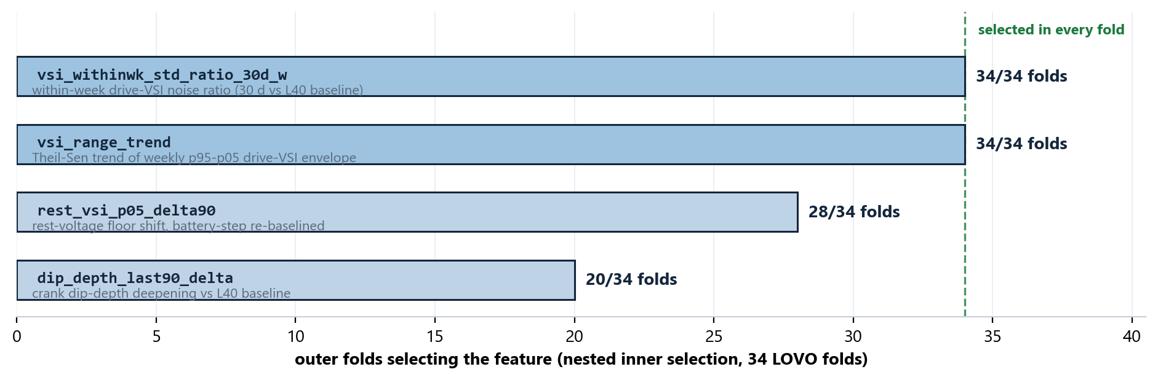
INTERNAL · TECHNICAL REVIEW — MODEL INPUTS
06 / 25
The frozen 4-feature subset: selection stability and one disclosed suppressor
PHYSICS READING & THE SUPPRESSOR
withinwk_std_ratio - the workhorse: sustained electrical noise rises before failure.
rest_vsi_p05_delta90 - battery floor sag; re-baselining after replacement steps is what recovered VIN8_F.
dip_depth_last90_delta - crank load signature deepening (battery-cascade component).
vsi_range_trend - SUPPRESSOR: physics-positive (widening envelope = risk) but enters with a NEGATIVE multivariate weight, driven by r = +0.82 collinearity with the noise ratio. Per-VIN explanation cards state the physical direction and the model usage separately - do not read its coefficient as physics.
G4 WINNER-STABILITY GATE — STRICT FAIL, DISCLOSED
Only 3 distinct subsets ever chosen across 34 folds: the modal 4-feature set (14), its 3-feature sibling without dip_depth (14), and a 3-feature sibling without rest_p05 (6).
Strict criterion needs the modal subset in >=17/34 folds; 14/34 fails it. Substantive stability is strong (core pair in 34/34), but the gate is reported as FAIL — not smoothed over.
ENGINEERING TAKEAWAY
REVIEW / DECISION POINT
Two features carry every fold; the suppressor is a documented modeling artifact, not a physics claim.
Accept G4 strict-fail with substantive-stability evidence, or request a fixed-subset re-run.
Starter Motor Failure Prediction V1.1 · Internal engineering review — full technical disclosure · Not for external distribution

Slide 7
INTERNAL · TECHNICAL REVIEW — VALIDATION
07 / 25
Nested LOVO: selection, threshold and calibration all inside the fold
OUTER LOOP (x34)
INNER SCREENING (33 trucks)
INNER SUBSET SEARCH
REFIT + SCORE
hold out truck i entirely (features, selection, scaling, imputation never see it)
Mann-Whitney p < 0.1 · AUROC >= 0.6 Spearman dedup |rho| <= 0.85 stability >= 0.8 · pool cap 10
exhaustive k = 3..6 subsets inner-LOVO AUROC picks winner (modal 4 in 14/34 folds; 3 subsets ever)
RidgeClassifier(alpha=1.0) closed-form replica (<1e-9 vs sklearn) score held-out truck i
PER-FOLD POST-PROCESSING
AGGREGATE OOF
INFERENCE
threshold = inner-OOF Youden (pre-registered rule) recalibration = Platt on inner-OOF decision values
34 out-of-fold recalibrated probabilities nested AUROC = 0.9321 (optimism vs non-nested: +0.0036)
bootstrap N=200 (seed 42): CI [0.8107, 0.9861] full-pipeline permutation N=200 (seed 43): p = 0.005
WHY THIS PROTOCOL (WHAT IT CLOSES OFF)
Selection leakage: feature screening and subset choice re-run inside every fold — the held-out truck never influences its own scorer (this alone is worth -0.0285 on V1's reported number).
Threshold leakage: Youden point comes from inner-OOF only; no post-hoc threshold tuning on test outcomes.
Calibration leakage: Platt fitted per fold on inner-OOF decision values; recalibrated probabilities are honestly out-of-fold.
ENGINEERING TAKEAWAY
REVIEW / DECISION POINT
Everything that could overfit is re-derived 34 times inside the folds; the permutation test validates the WHOLE pipeline.
Protocol sign-off: is nested-LOVO accepted as the standing evaluation bar for SM iterations?
Starter Motor Failure Prediction V1.1 · Internal engineering review — full technical disclosure · Not for external distribution

Slide 8
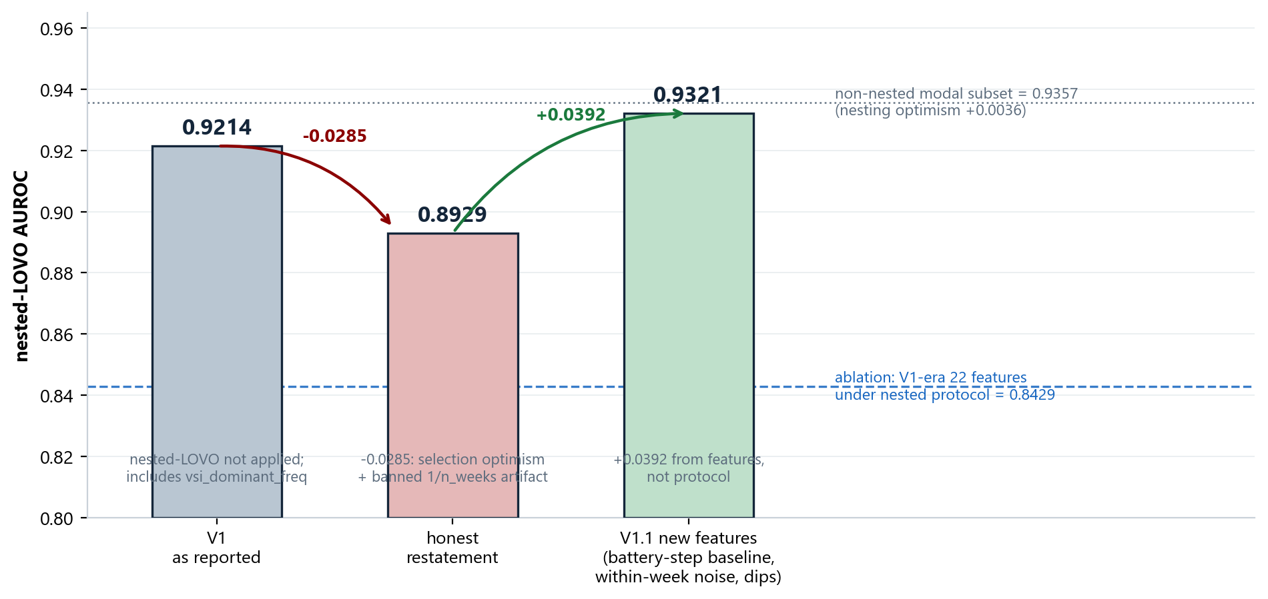
INTERNAL · TECHNICAL REVIEW — RESULTS
08 / 25
Headline: nested AUROC 0.9321 — and where the gain actually comes from
HEADLINE NUMBERS
0.9321
nested-LOVO AUROC, 34 OOF probabilities
[0.811, 0.986]
bootstrap 95% CI (N=200, seed 42) - small-n width, read honestly
p = 0.005
permutation test: 0/200 full-pipeline label shuffles reach 0.9321 (N=200 floor)
+0.0036
nesting optimism vs non-nested modal 0.9357 - selection bias is tiny in V1.1
+0.089
V1.1 features vs V1-era 22 features under the SAME nested protocol (0.9321 vs 0.8429): the gain is features, not protocol
ENGINEERING TAKEAWAY
REVIEW / DECISION POINT
V1.1 beats the honestly-restated V1 by +0.039 AUROC and includes VIN8_F, V1's worst miss.
Accept 0.9321 [0.811, 0.986] as the frozen reference number for all downstream claims.
Starter Motor Failure Prediction V1.1 · Internal engineering review — full technical disclosure · Not for external distribution

Slide 9
INTERNAL · TECHNICAL REVIEW — OPERATING POINTS
09 / 25
Two pre-registered operating points — choose per maintenance economics
A · Per-fold Youden (coverage-first)
B · RED tier >= 0.55 (precision-first)
NON-DOMINANCE
Flagged
Clear
Flagged
Clear
No point beats V1-restated (12/14 @ 18/20) on every cell:
Youden: +1 recall, -3 specificity
RED tier: -2 recall, equal specificity (18/20)
Both are honest, pre-registered; the choice is an economics decision, not a statistics one.
13
1
10
4
Failed (14)
Failed (14)
caught
missed
caught
missed
5
15
2
18
Healthy (20)
Healthy (20)
false alarm
correct clear
false alarm
correct clear
recall 0.929 · specificity 0.75 · F1 0.8125 · MCC 0.6691. Threshold from inner-OOF Youden, per fold (pre-registered).
recall 0.714 · specificity 0.90. RED false alarms: VIN19_NF (P 0.96), VIN34_NF (P 0.62) - plausibly right-censored degraders.
THE ONE MISS AT YOUDEN
VIN9_F: raw score 0.401 vs fold threshold 0.406 — loses by 0.005 (recalibrated P 0.224, the GREEN bar on the fleet chart). SMA-dead (0.4% coverage), 142-day terminal silent gap, mid-fleet on every live feature. This truck is structurally unobservable in the current telemetry; no admissible model sees it (full anatomy on slide 16).
ENGINEERING TAKEAWAY
REVIEW / DECISION POINT
13/14 @ 5/20 or 10/14 @ 2/20 — both validated; the trade is explicit and priced.
Pick the default operating point for the pilot (recommend: RED tier pager + Youden watch-list).
Starter Motor Failure Prediction V1.1 · Internal engineering review — full technical disclosure · Not for external distribution

Slide 10
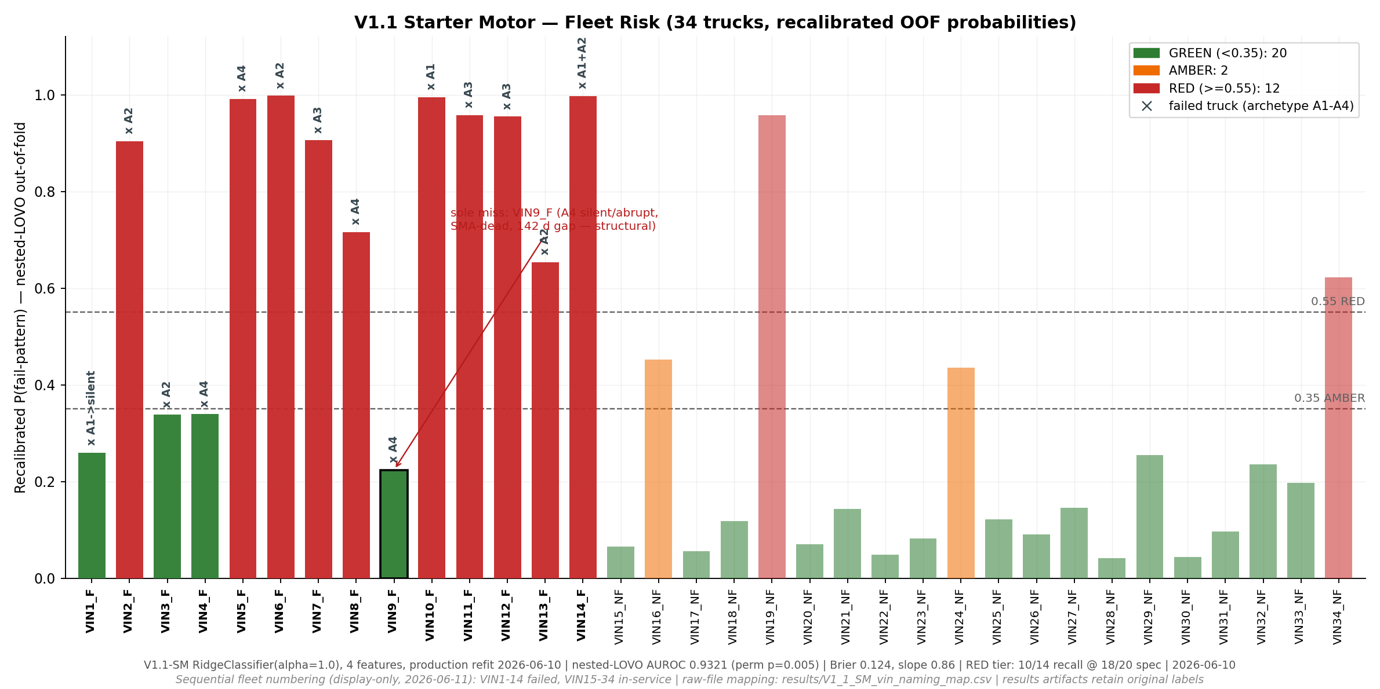
INTERNAL · TECHNICAL REVIEW — RESULTS
10 / 25
Per-VIN out-of-fold risk: the full 34-truck picture
READING NOTES
Tiers at end of history: RED 12 (10 F + 2 NF), AMBER 2 (NF), GREEN 20 (4 F + 16 NF).
4 failed in GREEN: VIN1/3/4_F caught at Youden or by alert channels; VIN9_F is the structural miss.
2 NF in RED: VIN19_NF (0.96) and VIN34_NF (0.62) fire multiple channels - plausibly genuinely degrading (right-censored).
Display note: graphs renumber NF VINs +14 (VIN1_NF -> VIN15_NF); results CSVs keep original labels.
ENGINEERING TAKEAWAY
REVIEW / DECISION POINT
The ranking is clean: 10 of the top 12 scores are true failures; the borderline zone is where alerts take over.
Confirm the two RED healthy trucks are queued for physical inspection feedback.
Starter Motor Failure Prediction V1.1 · Internal engineering review — full technical disclosure · Not for external distribution

Slide 11
INTERNAL · TECHNICAL REVIEW — AUDIT GATES
11 / 25
Six gates, reported as measured — including the one that fails
Fixed L40-window control
recompute every feature with data clipped to last 40 masked weeks; AUROC drop = 0.0000
G1
PASS
OOF-vs-proxy audit
Spearman: n_weeks -0.640 · t_start +0.507 · span -0.653 (all >|0.5| tripwire). Defense: label-mediated - G1 drop 0.0000 + prequential collapse at k=11 prove failure-locking, not length-locking
G2
REPORT
Calibration
Platt slope 0.86 (in [0.5, 2]) · Brier 0.124 vs constant 0.242 · CITL -0.062 -> probabilities shippable
G3
REPORT
Winner stability (strict)
modal subset 14/34 < 17 required; 3 distinct subsets; core pair 34/34 - substantive stability strong
G4
FAIL
Jackknife (drop-1-truck)
AUROC range 0.9269-0.9511, std 0.007 - no single truck carries the result
G5
REPORT
Banned-token scan
0 hits for banned leakage tokens (vsi_dominant_freq family, epoch fields) in the frozen pipeline
G6
PASS
ENGINEERING TAKEAWAY
REVIEW / DECISION POINT
The audit is adversarial by design: G2's correlations and G4's strict fail are printed, defended, and left visible.
Countersign the gate table (results/V1_1_SM_gates.json) as the audit record for V1.1.
Starter Motor Failure Prediction V1.1 · Internal engineering review — full technical disclosure · Not for external distribution

Slide 12
INTERNAL · TECHNICAL REVIEW — CALIBRATION
12 / 25
Recalibrated probabilities are shippable — and drive a three-tier action rule
G3 CALIBRATION EVIDENCE (PER-FOLD PLATT)
GREEN
routine operation; weekly re-score only
slope 0.86
recalibration slope inside the [0.5, 2] ship-range defined in the V1.1 spec; V1 had slope 4.72 = rank-only
P < 0.35
20 trucks (4 F + 16 NF)
Brier 0.124
vs constant-predictor reference 0.242 - probabilities carry real information
CITL -0.062
calibration-in-the-large logit gap ~ 0 - no systematic over/under-confidence
AMBER
bundle inspection into next scheduled service
0.35 <= P < 0.55
2 trucks (both NF)
WEEKLY OPERATING CADENCE
Score every truck weekly from fresh 30-90 d feature windows. Monthly cadence gives only ~2 reads inside the 10-week validity horizon - too coarse to act on.
Tier is re-evaluated each week; alerts (slide 13) run alongside as independent channels.
RED
inspect starter + battery circuit within 2-4 weeks
P >= 0.55
12 trucks (10 F + 2 NF)
ENGINEERING TAKEAWAY
REVIEW / DECISION POINT
Slope 0.86 means a shown 70% is a real ~70% — tiers are probability statements, not just ranks.
Approve shipping recalibrated probabilities (not tier-only) to the pilot dashboards.
Starter Motor Failure Prediction V1.1 · Internal engineering review — full technical disclosure · Not for external distribution

Slide 13
INTERNAL · TECHNICAL REVIEW — ALERT LAYER
13 / 25
Three channels, three verdicts: pager, condition flag, corroborator
A2 · BATTERY-CASCADE TRIPLE
PERSISTENCE · VOLATILITY FLAG
A1 · CRANK-BURST
Rule (all three, causal at scoring week):
rest-VSI step <= -0.5 V (SNR >= 2) + drive-VSI step >= +0.3 V within +/-8 wk + dip-depth widening > +1 V (>= 10 events)
Validation: 4/5 battery-archetype failures caught (miss: VIN2_F, no qualifying drive-step); 0/20 NF false alarms; median lead 66.5 d (28-91).
Battery-replacement separation: 5 NF trucks with rest-VSI steps UP do NOT fire.
Rule:
trailing-4-wk within-week VSI-std ratio above training-fold NF p90 envelope in >= 4 of last 12 wks
Validation: fires on 13/14 failed (median terminal lead 168 d). BUT: all 20/20 NF enter fire-state at least once (avg 31.4% of weeks in-fire) - walking-alarm pathology.
Never a standalone first-crossing pager; gate behind AMBER/RED tier.
Rule:
daily failed-cranks + retries within 120 s; 7-day rolling sum S7 > own-first-half mean + 3 SD (floor S7 >= 3) for >= 2 consecutive days; SMA-dead excluded
Validation: 4/12 applicable failed fire (leads 128-179 d vs last telemetry; VIN1_F 232 d vs recorded failure date); 8/15 applicable NF fire = 1.52 episodes/truck-year - too noisy alone.
Value: recovered VIN1_F, a GREEN-tier miss - 232 d before recorded failure.
SHIP AS PAGER
TERMINAL CONDITION FLAG ONLY
AMBER/RED CORROBORATOR
Combined policy: 13/14 failed trucks fire >= 1 channel (median first-fire lead 168 d - a distinct metric, equal to the persistence terminal median by coincidence); 10/20 NF completely clean; VIN16/19_NF fire all three - candidates for physical inspection.
ENGINEERING TAKEAWAY
REVIEW / DECISION POINT
Only A2 is precise enough to page on its own; the other channels add recall and corroboration behind the tier gate.
Approve the channel verdicts (pager / condition flag / corroborator) as the pilot alert policy.
Starter Motor Failure Prediction V1.1 · Internal engineering review — full technical disclosure · Not for external distribution

Slide 14
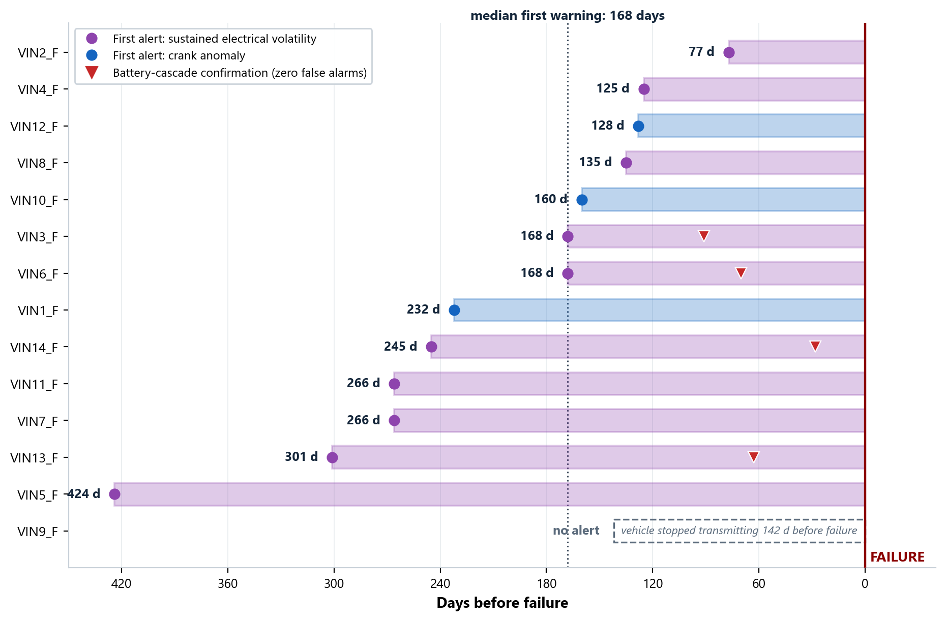
INTERNAL · TECHNICAL REVIEW — ALERT OUTCOMES
14 / 25
Validated per-VIN alert leads: the runway the policy actually delivers
POLICY OUTCOMES (VALIDATED)
Failed fleet: 13/14 fire >= 1 channel; median first lead 168 d (range 77-424 vs recorded failure date); persistence first x10, A1 first x3.
A2 confirmations: VIN3 (91 d), VIN6 (70 d), VIN13 (63 d), VIN14 (28 d) - short-fuse, zero-false-alarm escalation on top of early channels.
Healthy fleet burden: 10/20 zero channels; 6 show one; 2 show two; VIN16/19_NF show all three (treat as inspection candidates, possibly true degraders).
The gap case: VIN9_F fires nothing - silent 142 d before failure. Telemetry continuity itself must become a monitored health signal.
ENGINEERING TAKEAWAY
REVIEW / DECISION POINT
The alert layer converts a ranking model into an operating procedure with measured leads and measured burden.
Confirm inspection follow-up for VIN2_NF / VIN5_NF to close the loop on all-three-channel healthy trucks.
Starter Motor Failure Prediction V1.1 · Internal engineering review — full technical disclosure · Not for external distribution

Slide 15
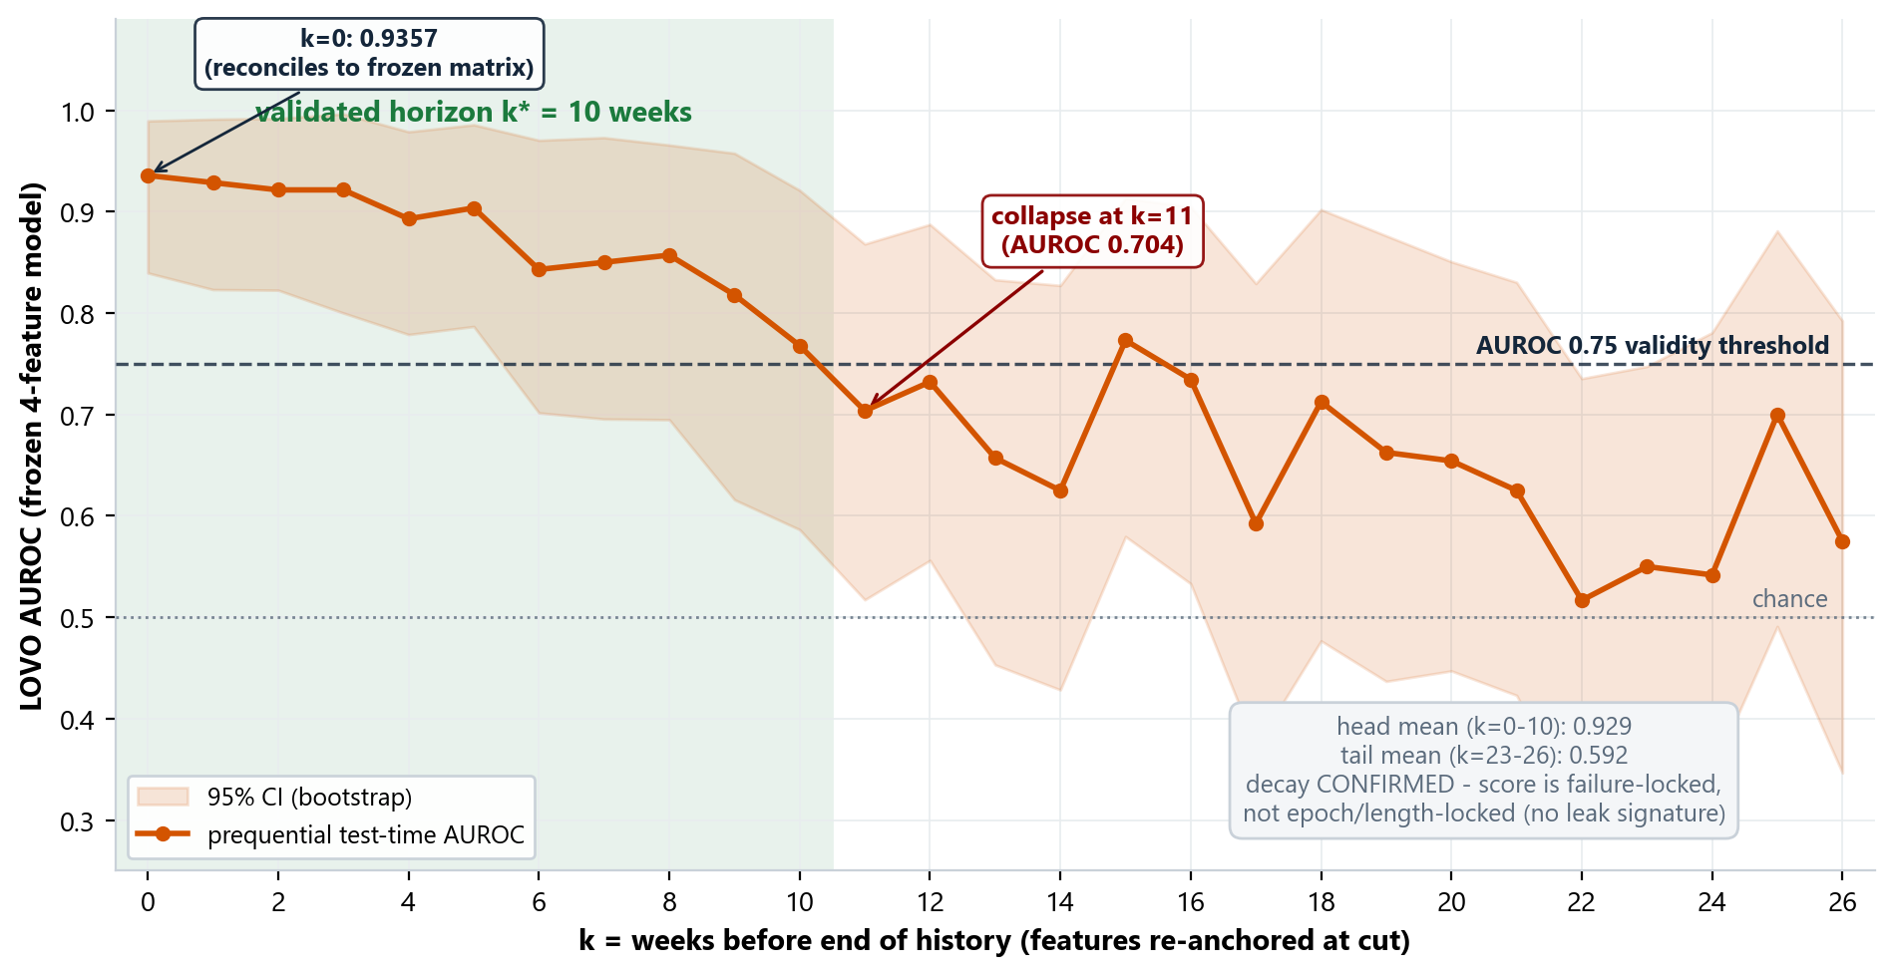
INTERNAL · TECHNICAL REVIEW — HORIZON
15 / 25
Prequential validation: the score is trustworthy for 10 weeks — and we can prove why
METHOD & READING
Method: cut each truck's history k weeks before its end, re-anchor all feature windows at the cut, re-score with the frozen 4-feature LOVO models, recompute AUROC.
k* = 10: largest k with AUROC >= 0.75 sustained from k=0 (isolated k=15 blip not counted).
Recall at 18/20 specificity decays 0.71 (k<=3) -> 0.36 (k=10): flag late, act fast.
Anti-leak dividend: an epoch/length artifact would NOT decay with distance-to-failure; the collapse at k=11 is the strongest single evidence the score is failure-locked.
ENGINEERING TAKEAWAY
REVIEW / DECISION POINT
The 10-week horizon is a measured validity window — the same curve that certifies it also certifies non-leakage.
Approve '<=10 weeks' as the only forward-looking claim allowed in external material.
Starter Motor Failure Prediction V1.1 · Internal engineering review — full technical disclosure · Not for external distribution

Slide 16
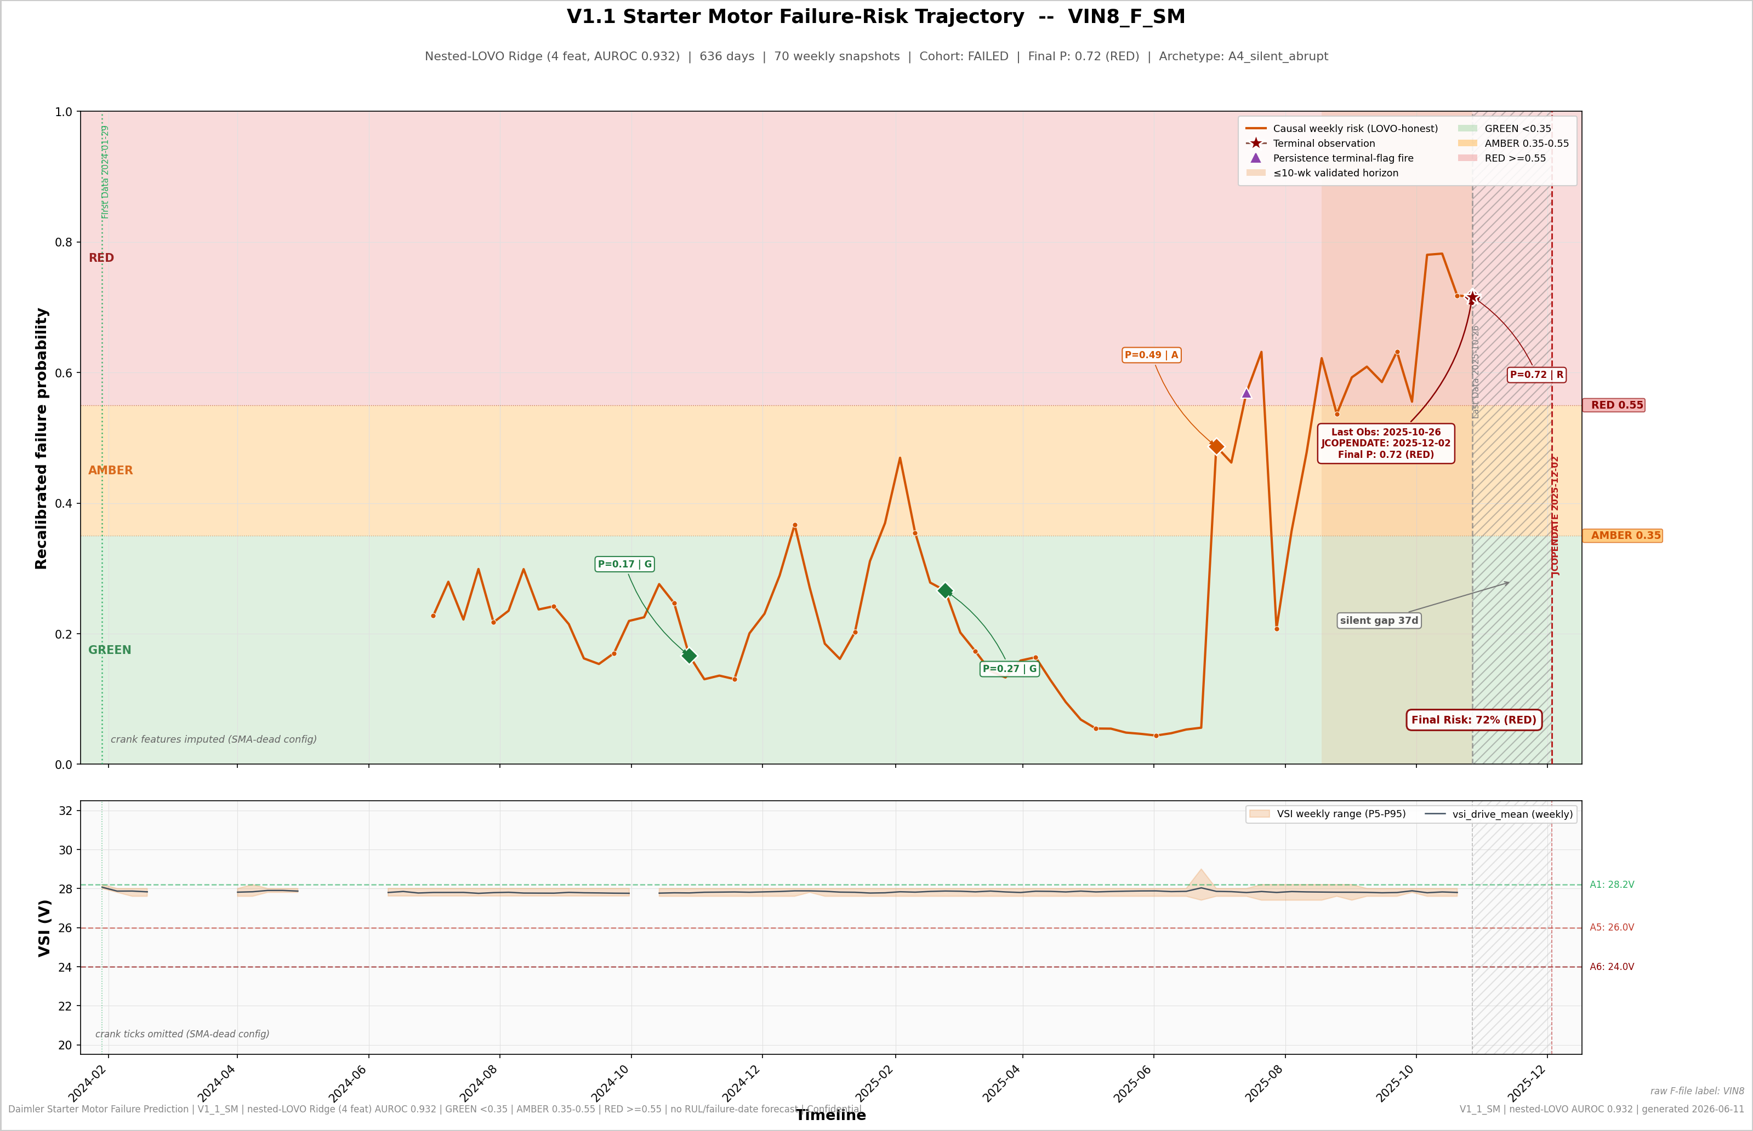
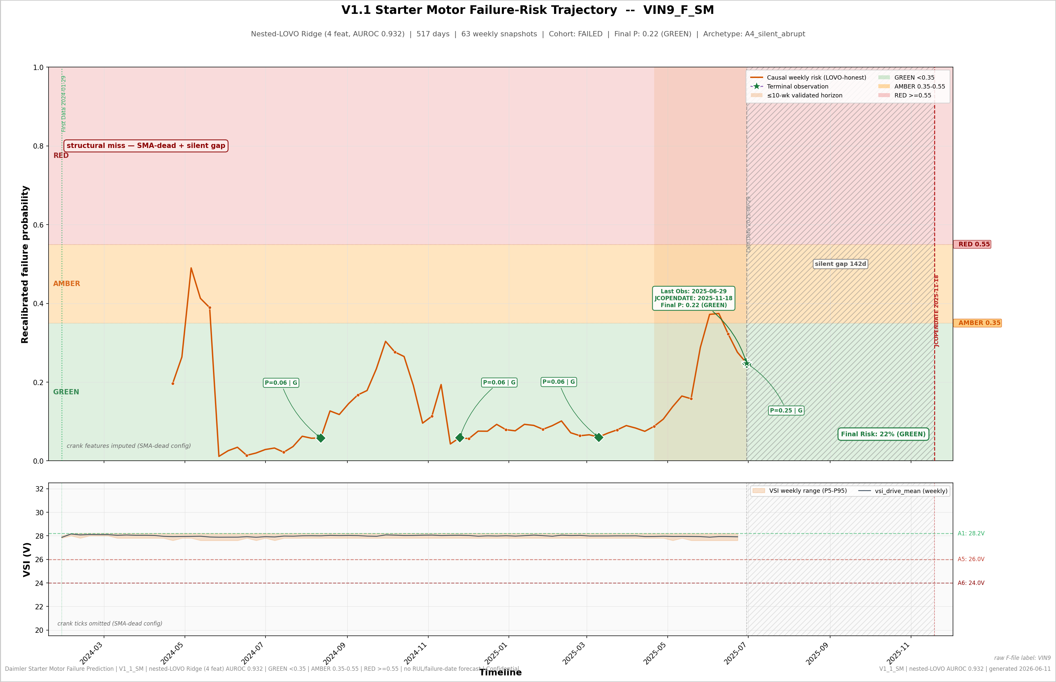
INTERNAL · TECHNICAL REVIEW — CASE ANATOMY
16 / 25
VIN8_F: the engineered catch · VIN9_F: the honest miss
VIN8_F - V1 missed it (P 0.303); V1.1 catches it (P 0.716, RED). SMA-dead + 37 d silent gap. The battery-step-aware rest-VSI re-baseline recovers the pre-silence signal; persistence lead 98-135 d.
VIN9_F - the structural miss (raw score 0.401 vs threshold 0.406; recalibrated P 0.22 shown on the dashboard). SMA-dead (0.4%), longest silent gap (142 d), mid-fleet on all live features, zero alerts. Fix is instrumentation + telemetry-continuity monitoring, not a better classifier.
ENGINEERING TAKEAWAY
REVIEW / DECISION POINT
The same physics that explains the catch explains the miss — observability, not model capacity, is the boundary.
Approve 'telemetry-continuity monitoring' as a pilot workstream (a truck going quiet is itself a trigger).
Starter Motor Failure Prediction V1.1 · Internal engineering review — full technical disclosure · Not for external distribution

Slide 17
INTERNAL · TECHNICAL REVIEW — LIMITATIONS
17 / 25
Failure archetypes, physics ceilings, and what V1.1 deliberately does not claim
A1 · solenoid intermittency x3
A2 · battery cascade x4-5
A3 · VSI volatility x3
A4 · silent / abrupt x4
failed-crank rate up to 4.3x, retries 7.5x; A1 channel territory
rest-floor sag + drive rise + dip widening; A2 detector territory
sustained electrical noise without battery/crank signature
no admissible precursor in 5 s / 0.2 V telemetry - the recall ceiling
Archetypes are in-sample descriptors (not out-of-fold validated); counts sum past 14 because VIN14_F carries a dual A1+A2 signature. Honest tier-RED recall ceiling ~= 10-11/14, set by the A1+A2+A3 count.
PHYSICS CEILINGS (WHY MORE MODELING WON'T HELP)
STATISTICAL HONESTY LEDGER
Brush wear: the real 60-120 d declining-crank-voltage precursor lives in sub-sample dip shape and sub-second duration growth - destroyed by 5 s / 0.2 V sampling.
Bearing seizure: zero electrical precursor at any sampling rate.
No RUL: discrete-time hazard, Cox, Weibull and deep-survival variants all lose to a constant predictor (MAE 576 d vs 44 d). V1.1 ships a validity window, never a date.
n = 34, 14 failures: CI floor 0.811; a handful of trucks decide every threshold - treat point estimates with CI-width humility.
OOF scores correlate with observation-length proxies (up to |0.653|) - defended as label-mediated via G1 + horizon collapse, and disclosed rather than hidden.
Suppressor coefficient (vsi_range_trend) documented; per-VIN explanations separate physics from model usage.
Permutation N=200 (runtime-bounded; target 1000) - p-value floor 0.005 stated as such.
ENGINEERING TAKEAWAY
REVIEW / DECISION POINT
V1.1's boundaries are measured, physical, and documented — the ceiling is data, not method.
Accept the limitation ledger as the agreed basis for external claims and future-iteration bars.
Starter Motor Failure Prediction V1.1 · Internal engineering review — full technical disclosure · Not for external distribution

Slide 18
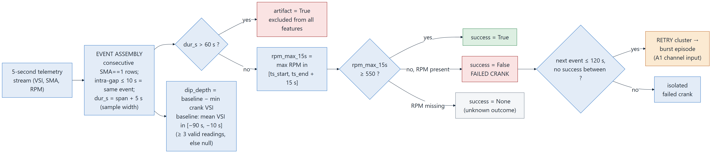
INTERNAL · TECHNICAL REVIEW — EVENT EXTRACTION
18 / 25
Crank-event state machine: 20,471 events distilled from 106M raw rows
<= 10 s
> 60 s
>= 550 RPM
[-90, -10] s
intra-event gap: consecutive SMA==1 rows merge
max plausible duration -> artifact, excluded
success criterion on rpm_max_15s (+15 s window)
dip baseline window (>= 3 valid VSI readings)
120 s
45 s
+ 5 s
1.2%
retry window: failed crank -> retry cluster / burst
recovery window for post-crank stabilisation
sample width added to event duration
reconciliation delta vs gap-naive reference (20,729)
Cohort note: the 7 SMA-dead trucks produce no usable events - their event-rate artifacts (up to 8.4/active-day) are excluded by cohort masking. The trucks themselves are still scored weekly via the voltage features (crank features imputed - see slide 19).
ENGINEERING TAKEAWAY
REVIEW / DECISION POINT
Every crank feature rests on a deterministic, artifact-filtered event definition - reproducible from raw rows.
Confirm the 10 s / 60 s / 550 RPM constants against powertrain engineering expectations.
Starter Motor Failure Prediction V1.1 · Internal engineering review — full technical disclosure · Not for external distribution

Slide 19
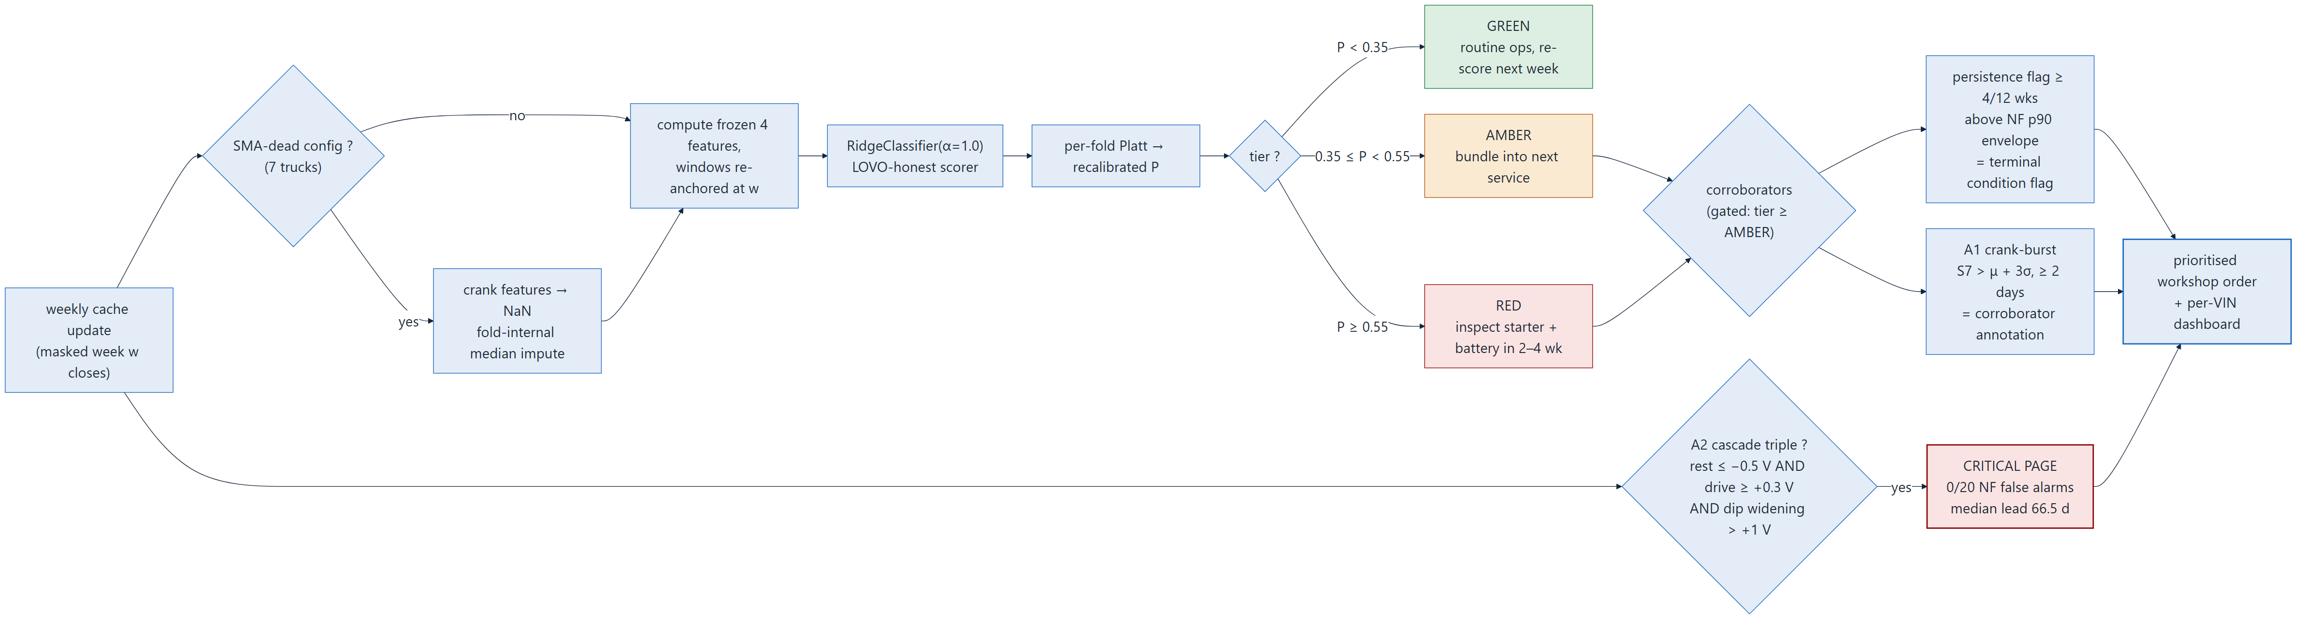
INTERNAL · TECHNICAL REVIEW — RUNTIME LOGIC
19 / 25
One week in production: scoring, tiering and alert gating as a decision flow
RUNTIME NOTES
Cadence: weekly, on masked-week close. Feature windows re-anchor at the scoring cut - the exact machinery validated by the prequential horizon test (slide 15).
Honest scoring: each truck is scored by a model trained on the other 33 (LOVO parity with validation); recalibration is per-fold Platt.
Gating: A2 battery-cascade pages independently of tier (0/20 NF false alarms earns that right); persistence and A1 annotate only at AMBER/RED - never page on their own.
ENGINEERING TAKEAWAY
REVIEW / DECISION POINT
The deployment flow is the validation flow - no new logic appears between the audit and the pilot.
Sign off the decision flow as the pilot SOP skeleton (workshop order = tier + alert annotations).
Starter Motor Failure Prediction V1.1 · Internal engineering review — full technical disclosure · Not for external distribution

Slide 20
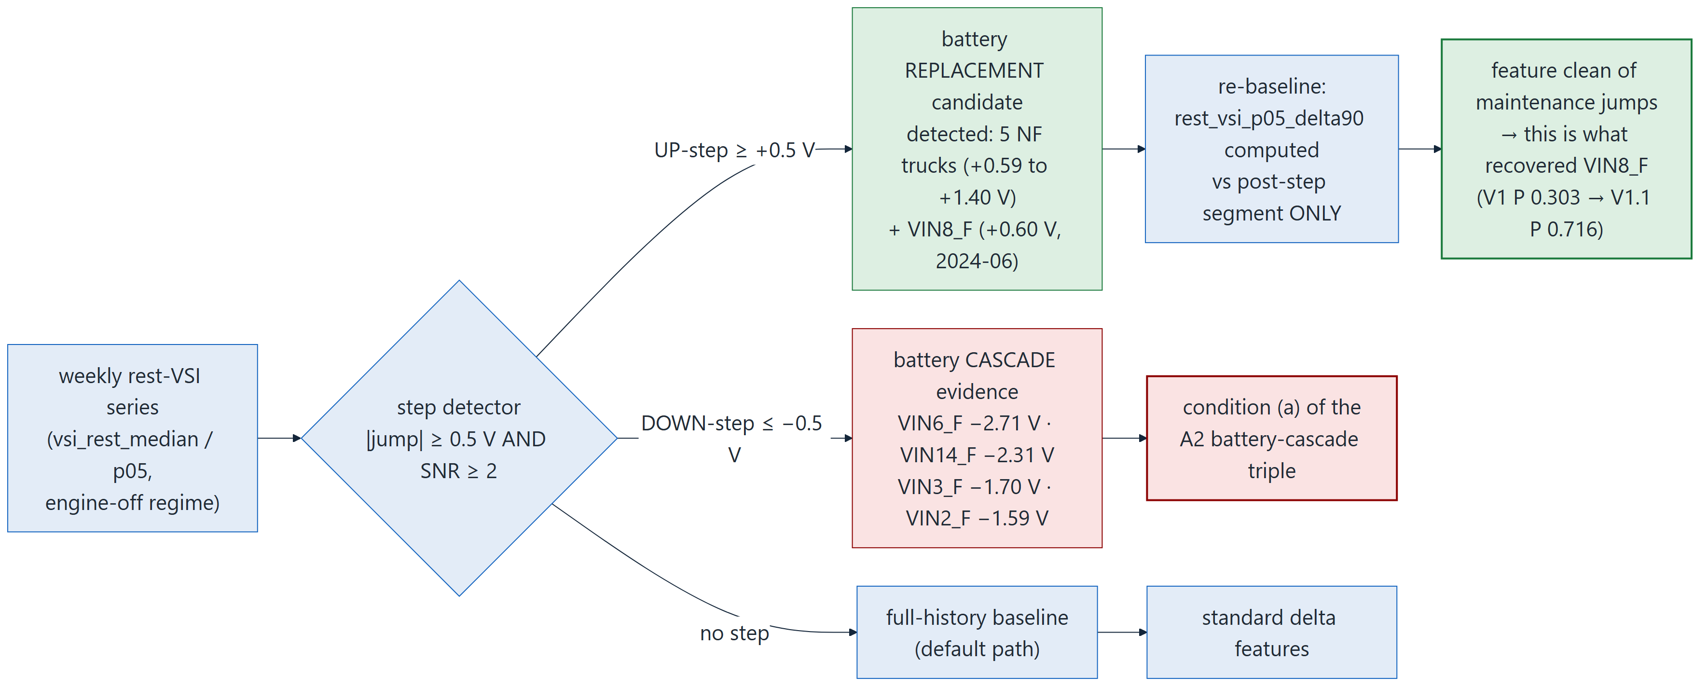
INTERNAL · TECHNICAL REVIEW — MAINTENANCE SEPARATION
20 / 25
Battery-step detection: replacements re-baseline features, cascades feed the A2 pager
DETECTED UP-STEPS (REPLACEMENT CANDIDATES, E5)
DETECTED DOWN-STEPS (CASCADE EVIDENCE)
VIN32_NF +1.40 V (2024-05) · VIN26_NF +0.70 V · VIN17_NF +0.61 V · VIN19_NF +0.61 V · VIN31_NF +0.59 V · VIN8_F +0.60 V (2024-06).
None of the 5 NF up-step trucks fires A2 - the detector separates maintenance from degradation by construction.
VIN6_F -2.71 V (2025-08) · VIN14_F -2.31 V (2025-09) · VIN3_F -1.70 V (2025-06) · VIN2_F -1.59 V (2025-09). All pass the SNR >= 2 detector gate (strongest 5.8).
The four largest rest-VSI collapses are exactly the A2 battery-cascade archetype trucks - independent corroboration of the archetype assignment.
ENGINEERING TAKEAWAY
REVIEW / DECISION POINT
One detector, two uses: up-steps clean the features (recovered VIN8_F), down-steps power the zero-false-alarm pager.
Validate the 6 replacement candidates against service records when DICV maintenance data becomes available.
Starter Motor Failure Prediction V1.1 · Internal engineering review — full technical disclosure · Not for external distribution

Slide 21
INTERNAL · TECHNICAL REVIEW — REJECTED ALTERNATIVE: RUL
21 / 25
Survival analysis was built, measured, and rejected - a constant beats every RUL model
RUL MAE - FAILED VINS, LAST 26 WEEKS
HAZARD-MODEL DIAGNOSTICS
WHAT SURVIVES FROM THE F-TRACK
44.4 d
constant '91 days' predictor (structural floor; actuals ~uniform 7-182 d)
Pooled weekly-hazard AUROC 0.747 (14 event-weeks vs 2,622 at-risk weeks).
Age-matched concordance 0.654 (332 pairs).
P(fail <= H) classification: 0.744 @30 d · 0.708 @60 d · 0.688 @90 d.
Truck-level ranking from held-out hazards: 0.586 - collapses vs the static model's 0.893.
Fleet Weibull clock: lambda 133.3 wk, rho 2.03 (wear-out), median 111.3 wk (779 d) - used ONLY as the dashboard RUL-curve illustration anchor.
Cox time-varying: vsi_std_ratio HR 1.74/unit (p=0.002), coefficient stable +0.69 +/-0.04 across folds - independent confirmation of the volatility workhorse.
Everything else is documented and retired.
461.9 d
Weibull fleet-clock conditional median (LOVO)
576.1 d
discrete-time hazard model (logistic, LOVO)
The constant wins by 10.4x and 13.0x.
RUL claims are withheld because we measured them failing - not because we did not try. Three model families, one conclusion.
ENGINEERING TAKEAWAY
REVIEW / DECISION POINT
14 events cannot parameterize a per-truck failure clock; the validated deliverable is risk + a 10-week window.
Ratify the 'risk + window, no dates' deliverable contract for the pilot and all external material.
Starter Motor Failure Prediction V1.1 · Internal engineering review — full technical disclosure · Not for external distribution

Slide 22
INTERNAL · TECHNICAL REVIEW — REJECTED ALTERNATIVE: DEEP LEARNING
22 / 25
Parameter-budget math: why 14 failures cannot feed a sequence model
MINIMAL-CONFIG PARAMETER BUDGET (EPV >= 10 -> ~1.4 PARAMS)
WHAT WAS STILL TRIED (HONEST PROBES, LOVO)
architecture (minimal config)
params
over budget
Sequence probes (G2, screening): PCA3 0.868-0.900 (PC1 leak-flagged: r +0.50 vs n_weeks); trend-coefficient Ridge 0.918-0.925; 1-NN margin 0.914. None survives the leak audit with a genuine edge.
Variant sweep (B4, non-nested V1-era screening): baseline 0.9214; drop-artifact 0.8643; +within-week noise feature 0.9679 - the screening high-water mark that motivated V1.1's winning feature.
Screening numbers are NOT comparable to the nested 0.9321 - they exist to pick candidates, and are labeled as such wherever quoted.
V1.1 Ridge (4 features)
5
4x
LSTM, 1 layer, h=8
329
235x
TCN, 2 blocks, 8 ch
489
349x
Transformer enc, d=16
2,273
1,624x
PatchTST, d=16
2,385
1,704x
Informer, d=16
3,057
2,184x
TFT, d=16
8,785
6,275x
Even LSTM h=2 (43 params, 31x over) is seed-unstable: AUROC 0.854 / 0.882 / 0.918 across three seeds.
ENGINEERING TAKEAWAY
REVIEW / DECISION POINT
At 14 failures, capacity is the enemy: anything bigger than ~5 parameters memorizes epoch, not physics.
Adopt the EPV parameter-budget rule for all proposed model work until n_failed >= 30-50.
Starter Motor Failure Prediction V1.1 · Internal engineering review — full technical disclosure · Not for external distribution

Slide 23
INTERNAL · TECHNICAL REVIEW — DATA-QUALITY AUDIT
23 / 25
Probe atlas: what the A-track found before a single feature was built
P1 · LABELS & LIFETIME
P2 · MISSINGNESS = 3 LAYERS
P3 · SAMPLING FAMILIES
Failure_type constant across all failed rows; 0 rows after JCOPENDATE; 9/14 failed VINs transmit up to the JCO day; sale-to-failure life 171-671 d.
config (SMA-dead: 99.7-99.9% null), regime (engine-off nulls 13-86% = duty cycle), cohort (VSI null 13.3% F vs 18.6% NF). Features must be regime-aware.
median dt 5 s; continuous (p99 6 s) vs rest-heartbeat (p99 ~900 s). Gap counts classify at 0.868-0.875 = volume proxies -> banned as features.
P4 · VSI SENSOR REALITY
P5 · SINGLE-SIGNAL SCREENS
P6 · LATENT DEGRADATION
0.2 V quantization (168 distinct values); per-truck setpoints 27.6-28.2 V (fleet std ~1 LSB) -> per-VIN baselining mandatory; stuck runs (<=58 h) not failure-correlated.
vsi_drive_std 0.732 · settled p05 0.734 · rest p05 0.729. Dead ends: RPM profile 0.500, crank duration 0.507, dip-depth LEVEL 0.575, success rate 0.543.
within-VIN delta(vsi_drive_std), last 8 wks vs own baseline: AUROC 0.893 (calendar-matched control 0.889); 9/14 failed respond; onset up to 294 d (VIN13_F) / 280 d (VIN6_F).
ENGINEERING TAKEAWAY
REVIEW / DECISION POINT
The audit found the signal (within-VIN volatility deltas, P6) and the traps (volume, epoch, config) before modeling began.
Carry P2-P4 forward as mandatory preprocessing requirements for the 500-truck scale-up.
Starter Motor Failure Prediction V1.1 · Internal engineering review — full technical disclosure · Not for external distribution

Slide 24
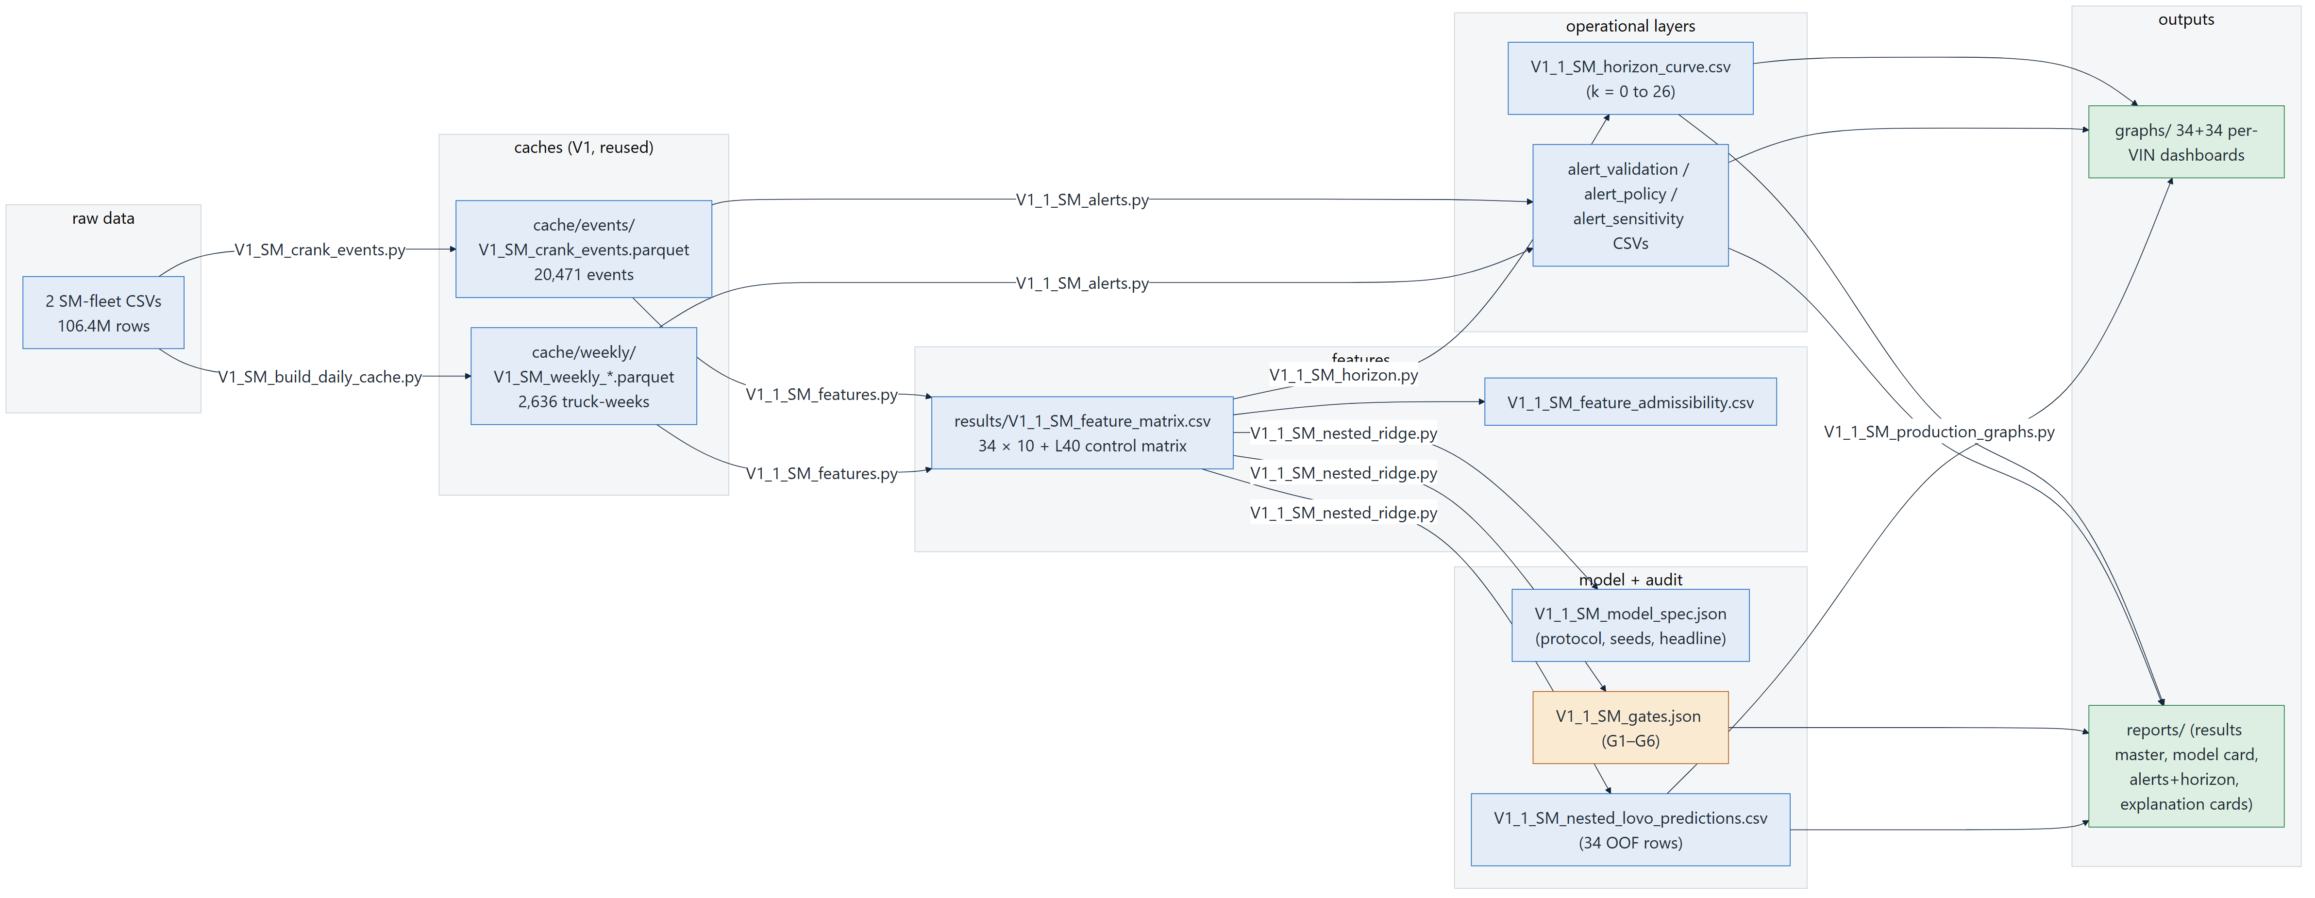
INTERNAL · TECHNICAL REVIEW — REPRODUCIBILITY
24 / 25
Artifact dependency map: review this deck by re-running it
DETERMINISM LEDGER
Seeds: bootstrap 42, permutation 43, global numpy 42.
Runtimes: nested main 132.7 s; permutation 828.5 s; dashboards ~1 min/VIN.
Parity: closed-form Ridge replica verified < 1e-9 vs sklearn.
Interpreter: py -3 (repo convention); no GPU, no cloud dependency.
Traceability: display renumbering in V1_1_SM_vin_naming_map.csv; gates.json is the machine-readable audit record.
Single-command re-runs: V1_1_SM_features.py -> V1_1_SM_nested_ridge.py -> V1_1_SM_alerts.py -> V1_1_SM_horizon.py -> V1_1_SM_production_graphs.py (each regenerates its artifacts in place).
ENGINEERING TAKEAWAY
REVIEW / DECISION POINT
Fixed seeds, committed artifacts, named scripts - every number in this deck regenerates on demand.
Archive the V1.1 artifact set as the frozen reference package for all future iteration comparisons.
Starter Motor Failure Prediction V1.1 · Internal engineering review — full technical disclosure · Not for external distribution

Slide 25
INTERNAL · TECHNICAL REVIEW — SIGN-OFF
25 / 25
Recommendations: ship the validated core, instrument for the next ceiling
SHIP NOW (VALIDATED IN V1.1)
INSTRUMENTATION ASKS (WHAT BREAKS THE CEILING)
Frozen modal-4 nested RidgeClassifier scorer + per-fold Platt probabilities (spec, seeds, artifacts committed)
>= 1 Hz crank-window logging (during SMA=1)
revives the physically real brush-wear prognosis channel - biggest unlock
GREEN/AMBER/RED tier rule on recalibrated P (0.35 / 0.55)
Cranking current or battery SoC/SoH
3-channel alert policy with the verdicts of slide 13
ends the battery-vs-starter ambiguity that caps alert precision
Maintenance / parts-replacement records
Weekly scoring cadence; <=10-week horizon as the only forward claim
turns data-derived archetypes into supervised labels
34 per-VIN dashboards + explanation cards for workshop use
More failure cases (n_failed >= 30-50)
unlocks survival modeling and representation learning credibly
PILOT WORKSTREAMS
BOTTOM LINE FOR APPROVERS
1. Alert -> workshop-finding feedback loop (labels for the next iteration).
2. Telemetry-continuity monitoring (the VIN9_F fix).
3. Physical inspection of VIN19_NF / VIN16_NF (all-channel healthy trucks).
V1.1 is the audited ceiling of the current telemetry: 0.9321 nested AUROC, calibrated probabilities, a zero-false-alarm pager and a proven 10-week window. Approving the five asks of slide 2 - model freeze, calibrated tiers, alert policy, weekly cadence, instrumentation - ships everything the data supports and funds exactly the data that lifts the ceiling.
ENGINEERING TAKEAWAY
REVIEW / DECISION POINT
Approve asks 1-5 (slide 2) to move V1.1 from frozen iteration to operating pilot.
Sign-off: model freeze · tier+alert policy · weekly cadence · instrumentation requests.
Starter Motor Failure Prediction V1.1 · Internal engineering review — full technical disclosure · Not for external distribution

