Slide 1
STARTER MOTOR PREDICTIVE MAINTENANCE
From Roadside No-Starts to a Monitored Fleet Program
BharatBenz 5528T Heavy-Duty Trucks | 34-Vehicle Study | June 2026 | V1.1_SM
FAILURES CAUGHT
EARLY-WARNING WINDOW
FALSE ALARMS (RED TIER)
FLEET VISIBILITY
13 of 14
~10 weeks
2 of 20
34 Trucks
Catch-most setting -- also flags 5 of 20 healthy trucks
Flagged trucks are typically within ~2.3 months of failure
Stricter RED-tier setting -- catches 10 of 14 failures
Every truck scored, tiered, explained
V1.1_SM | 2026-06-10 | BharatBenz 5528T Starter Motor Predictive Maintenance | BytEdge CONFIDENTIAL

Slide 2
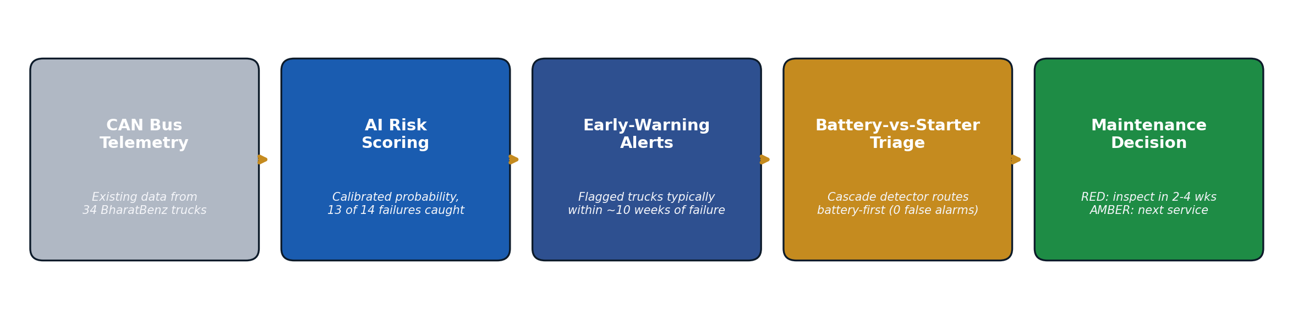
WHAT WAS BUILT
Turning existing truck telemetry into actionable starter motor maintenance intelligence
THREE PLAIN-LANGUAGE CAPABILITIES
1. RISK RANKING
2. EARLY-WARNING ALERTS
3. BATTERY-VS-STARTER TRIAGE
• Every truck gets a calibrated risk score from its own voltage patterns
• Scores map to GREEN / AMBER / RED maintenance tiers
• 13 of 14 past failures flagged before they failed (catch-most setting)
• A flagged truck is typically within ~10 weeks of failure
• Battery-cascade alert: ~9.5-week median lead, zero false alarms
• 13 of 14 failed trucks fired at least one alert channel
• Detects the battery-degradation cascade that mimics starter failure
• Routes the work order battery-first -- the cheapest correct fix
• Provably ignores battery replacements (no false trigger)
KEY TAKEAWAYS
• No new sensors needed -- the system runs on existing CAN bus data already collected from the fleet
• Every alert comes with its reasons: which signal moved, by how much, and what would clear the flag
V1.1_SM | 2026-06-10 | BharatBenz 5528T Starter Motor Predictive Maintenance | BytEdge CONFIDENTIAL

Slide 3
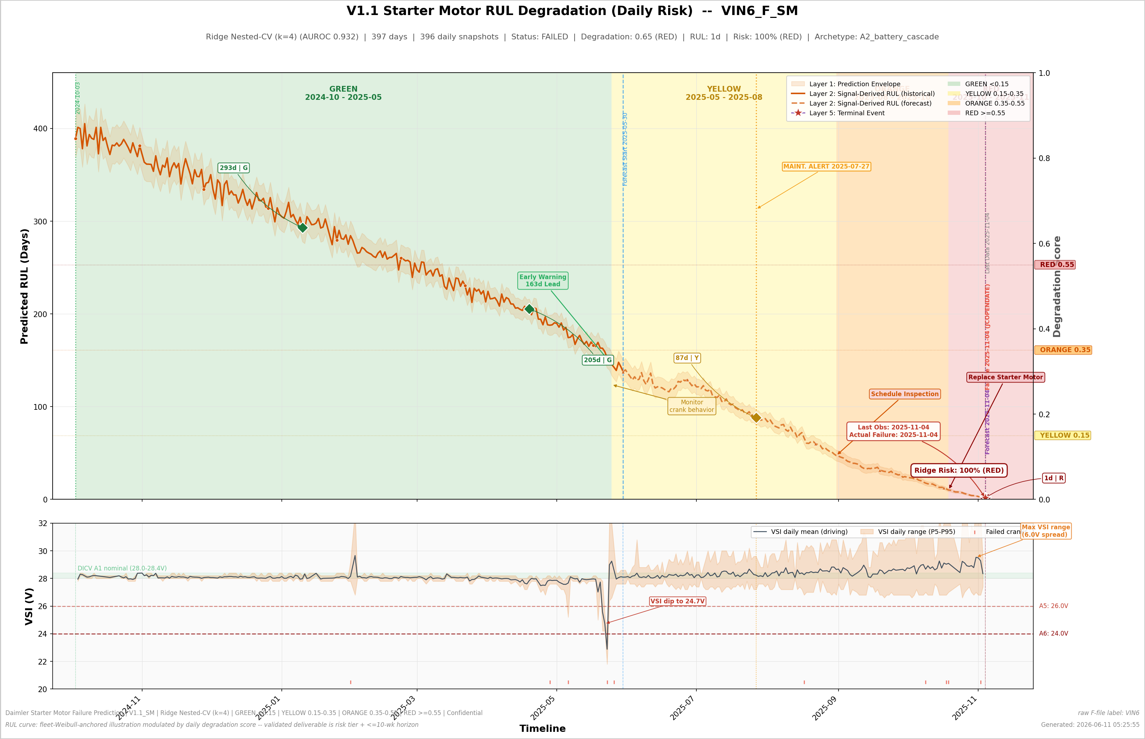
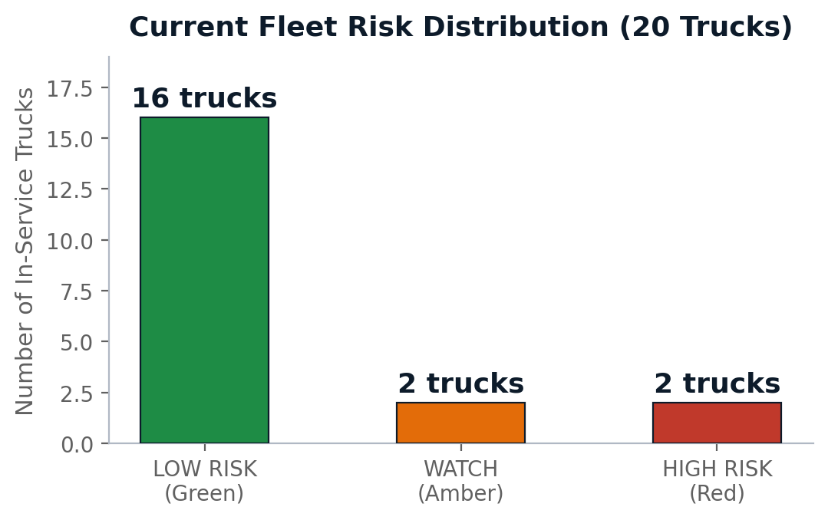
HOW WELL IT WORKS
Validated results across 34 trucks (14 known failures + 20 in-service)
DAILY DEGRADATION VIEW
• Each truck gets a daily-updated degradation view; colors = action tiers (green = healthy, red = act now).
• This failed truck (VIN6) walked the full green-to-red path before its starter failed -- the battery alert fired ~70 days early.
• The dotted tail is a fleet-average projection, not a failure date.
HEADLINE RESULTS
Sequential fleet numbering: VIN1-14 failed, VIN15-34 in-service (raw-file mapping: results/V1_1_SM_vin_naming_map.csv).
What | Result | Business Impact
Failure detection | 13 of 14 caught at the catch-most setting (5 of 20 healthy flagged) | High-risk trucks inspected before they strand
False-alarm burden | 2 of 20 healthy at RED tier -- the stricter setting, which catches 10 of 14 | Inspection effort goes where the risk is
Early warning | Flagged trucks typically within ~10 weeks; battery alerts ~9.5 weeks ahead | Time to schedule, source parts, avoid roadside events
Triage routing | Battery-cascade detector: 0 false alarms | Cheapest correct intervention happens first
Fleet status today | 16 LOW / 2 WATCH / 2 HIGH risk | Two trucks (VIN19_NF, VIN34_NF) need inspection now
KEY TAKEAWAYS
• One dial, one honest trade: the catch-most setting flags 13 of 14 failures but 5 of 20 healthy trucks; the stricter RED tier flags 10 of 14 at 2 of 20 -- operations picks the setting
• Versus the first-generation system: one more failure caught (including its worst miss), trustworthy probabilities, and an early-warning capability it did not have
V1.1_SM | 2026-06-10 | BharatBenz 5528T Starter Motor Predictive Maintenance | BytEdge CONFIDENTIAL

Slide 4
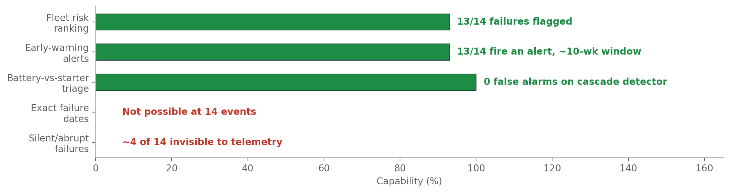
WHAT IT CANNOT DO -- AND WHY
Transparent assessment of current system boundaries
HONEST BOUNDARIES
• It does not predict failure dates
• With only 14 failure examples, a countdown clock is mathematically unsupportable -- every attempted timing model lost to a simple constant. The system says 'within ~10 weeks', never 'on June 14th'.
• ~4 of 14 failures are invisible
• Sudden internal failures (windings, seizure) and trucks whose telemetry goes silent give no electrical warning at this data resolution.
• Some alerts will be early or wrong
• A few healthy trucks get flagged: one shows genuinely stressed electrical signals; another is flagged on its risk score alone. Those inspections are cheap insurance, but they are not failures.
DATA GAPS LIMITING ACCURACY
Gap | Impact on System | How to Close
Voltage sampled only every 5 seconds | The 2-4 month brush-wear warning signal is physically unreadable | High-frequency crank logging (post-2026 vehicle architecture)
No cranking current or battery health signal | Battery vs starter cannot be proven, only inferred | Add current or battery SoC/SoH instrumentation
No maintenance/parts records in the data | Failure modes are inferred from patterns, not confirmed | Link workshop records to telemetry
Only 14 failure examples | Statistical uncertainty on every number | Keep collecting failures as the fleet ages
Some trucks transmit no crank data | 7 of 34 trucks have a config that hides starter activity | Telemetry-config audit; treat silence as a maintenance trigger
KEY TAKEAWAYS
• These are physics and data-size constraints, not model deficiencies -- the system performs at the honest ceiling of what this data allows
• The boundaries are measured and stated, which is what makes the rest of the numbers trustworthy
V1.1_SM | 2026-06-10 | BharatBenz 5528T Starter Motor Predictive Maintenance | BytEdge CONFIDENTIAL

Slide 5
RECOMMENDED ACTIONS & NEXT STEPS
Priority actions for fleet operations and what to invest in next
IMMEDIATE ACTIONS
WHAT TO INVEST IN NEXT
# | Action | Owner | Timeline
1 | Inspect the 2 RED trucks (VIN19_NF, VIN34_NF): starter + battery circuit | Fleet Ops | 2-4 weeks
2 | Bundle the 2 AMBER trucks (VIN16_NF, VIN24_NF) into next service | Fleet Ops | Next service
3 | Stand up weekly fleet scoring with monthly tier review | Engineering | This quarter
4 | Enable battery-first routing on cascade alerts | Maintenance Planning | This quarter
Priority | Investment | Expected Impact
P0 | High-frequency crank logging (>=1 Hz) | Unlocks months-ahead brush-wear warning
P0 | Cranking current or battery health signal | Proves battery-vs-starter; sharper alerts
P1 | Link maintenance/parts records to telemetry | Confirms failure modes; better labels
P1 | Keep collecting failure examples | Narrows uncertainty on every number
P2 | Telemetry-config and transmission-health audit | Closes the silent-truck blind spot
OPERATING RHYTHM
• Weekly
• Re-score every truck; new RED or battery-cascade alert triggers a work order
• Monthly
• Tier review with fleet ops; track the watch-list trucks for drift or recovery
• On each confirmed failure or repair
• Feed the outcome back; retrain only under the audited validation protocol
• Rule of communication
• Quote risk tiers and the ~10-week window -- never a failure date
KEY TAKEAWAYS
• The system delivers value today: two RED trucks to inspect, a weekly scoring rhythm, and battery-first triage on alerts
• Highest-leverage investments are new signals (crank logging, battery health), not more modeling on the same data
V1.1_SM | 2026-06-10 | BharatBenz 5528T Starter Motor Predictive Maintenance | BytEdge CONFIDENTIAL

