Slide 1
DAIMLER STARTER MOTOR PREDICTIVE MAINTENANCE
Calibrated Fleet Risk Tiers, Validated Early-Warning Alerts & a Measured Detection Horizon
BharatBenz 5528T | Fleet of 34 VINs (14F + 20NF) | V1.1_SM
June 2026 | Version: V1.1_SM
Prepared by Data Science & Engineering Team
BytEdge CONFIDENTIAL

Slide 2
EXECUTIVE SUMMARY
Starter motor failure prediction across 34 BharatBenz 5528T trucks
Nested-LOVO AUROC
Recall (Youden)
RED-Tier Recall
Calibration Slope
Detection Horizon
93.2%
13/14
10/14
0.86
10 weeks
PASS (>89.3% V1)
SPEC 15/20
SPEC 18/20
PASS [0.5, 2]
DECAY VERIFIED
Failed Trucks
In-Service Trucks
Features (Ridge)
A2 Cascade Alert
Permutation p
14
20
4
4/5 F
0.005
POST-HOC
16 GRN / 2 AMB / 2 RED
ADMISSIBILITY-AUDITED
0/20 NF, ~9.5 wk LEAD
PASS (N=200 floor)
• Objective: Predict starter motor failure risk and provide validated early warning from CAN bus voltage and crank telemetry.
• Ridge classifier achieves nested-LOVO AUROC 0.9321 (95% CI [0.811, 0.986], permutation p=0.005) with 4 audited features. Recall 13/14 at the Youden point; RED tier gives 10/14 at 18/20 specificity.
• Honest-validation differentiator: V1's reported 0.9214 was restated to 0.8929 under the fully nested protocol before being beaten. V1.1's selection optimism is +0.0036 (vs V1's hidden +0.0285). Probabilities are calibrated (slope 0.86, Brier 0.124) and shippable.
• Three validated alert channels (A2 battery-cascade ~9.5-week (66.5 d) lead with 0/20 NF false alarms; tier-gated persistence flag; A1 crank-burst corroborator) cover 13/14 failed trucks. Detection horizon: k* = 10 weeks, decay-to-chance verified. ~4/14 silent/abrupt failures remain structurally invisible.
KEY TAKEAWAYS
• Nested AUROC 0.9321 beats the honestly-restated V1 baseline (0.8929) under a strictly harder protocol
• V1's worst miss (VIN8_F_SM, P=0.303) is now caught at recalibrated 0.716, RED tier
• New capability: validated early warning with a measured 10-week horizon -- V1 had none (its trend battery fired on 90% of healthy trucks)
• 2/20 in-service trucks are RED (VIN19_NF, VIN34_NF) and should be prioritized for starter + battery circuit inspection
V1.1_SM | 2026-06-10 | BharatBenz 5528T Starter Motor Predictive Maintenance | BytEdge CONFIDENTIAL

Slide 3
BUSINESS CONTEXT
Why starter motor predictive maintenance matters for heavy-duty fleets
THE CHALLENGE
OBJECTIVES
• A failed starter motor strands the truck wherever it last parked -- no crank, no trip
• No advance warning in the current time/km-based maintenance regime
• Starter failures are entangled with battery health -- the wrong part gets replaced
• Fleet telemetry (CAN bus) streams voltage and crank activity -- untapped
• 14 of 34 study trucks failed within the observation window
• Classify fleet into risk tiers (GREEN / AMBER / RED) with calibrated probabilities
• Ship only leakage-audited features under a fully nested validation protocol
• Provide validated early-warning alerts with measured lead times and FP burden
• Route battery-vs-starter triage so the cheapest correct intervention happens first
• Quantify what is achievable (and what is not) with 5-second telemetry
FOUR-LAYER APPROACH (methodology inherited from the Alternator V10.6.2 program)
• Layer 1 -- Fleet Risk Model: 4-feature nested-LOVO Ridge, calibrated probability + GREEN/AMBER/RED tier (AUROC 0.9321)
• Layer 2 -- Early-Warning Alerts: A2 battery-cascade detector (~9.5-wk lead, 0/20 NF), tier-gated persistence flag, A1 crank-burst corroborator
• Layer 3 -- Honest RUL: validity-horizon statement (flagged truck typically within ~10 weeks of failure) instead of unsupportable day-precision dates
• Layer 4 -- Explainability: exact per-truck linear attributions, archetype assignment, raw-unit counterfactual with every alert
KEY TAKEAWAYS
• Starter failure is a no-start stranding event; battery-vs-starter misdiagnosis is the single largest avoidable-cost lever (DICV A6)
• Four-layer architecture: calibrated risk tier, validated alerts, horizon statement, and an explanation card per truck
• Honest framing: ~4/14 failures are silent/abrupt and invisible to any voltage-based method at 5 s sampling
V1.1_SM | 2026-06-10 | BharatBenz 5528T Starter Motor Predictive Maintenance | BytEdge CONFIDENTIAL

Slide 4
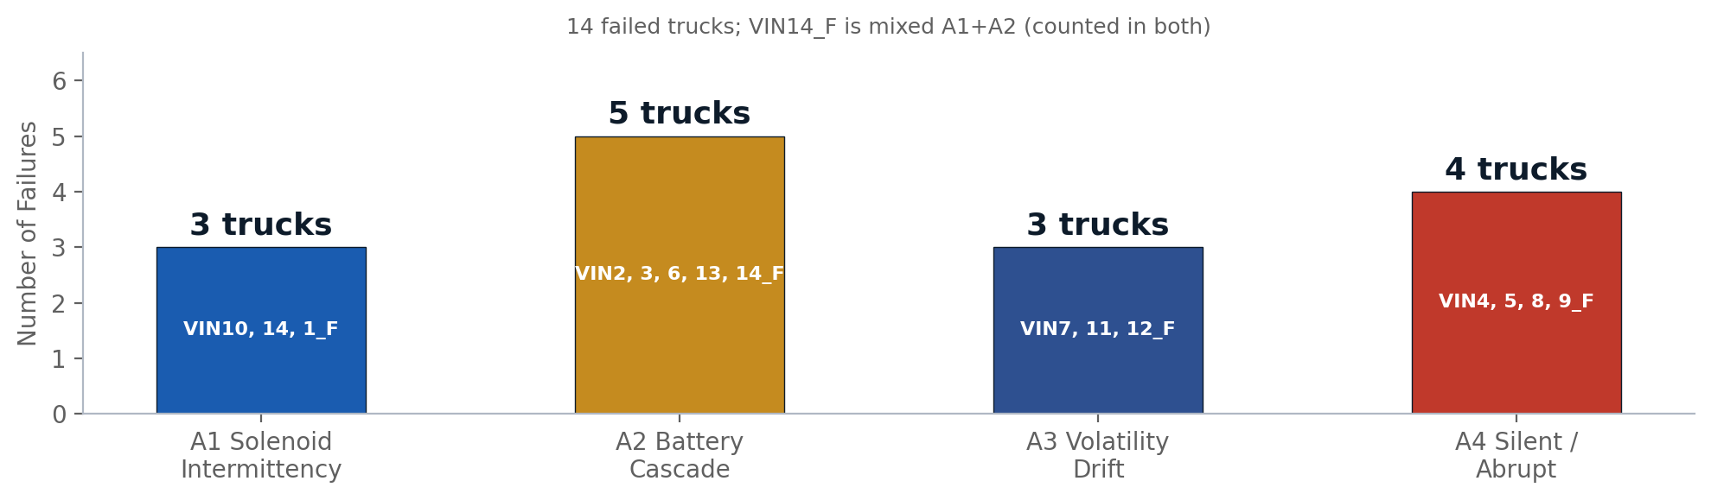
PROBLEM STATEMENT
Characterizing the starter motor failure landscape
Key Question: Can we predict starter motor failure risk and warn early from CAN bus telemetry?
FAILURE ARCHETYPES (DATA-DERIVED)
WHAT EACH ARCHETYPE MEANS
Archetype | Mechanism | Observable?
A1 Solenoid | Intermittent engagement, crank retry bursts | Yes -- days-to-weeks
A2 Battery | Rest-floor sag + deepening dips (cascade) | Yes -- best channel (~9 wk)
A3 Volatility | Within-week voltage noise drifting up | Yes -- weeks
A4 Silent/Abrupt | Windings, seizure, control loss, telemetry death | NO -- detection ceiling
• 5/14 failed trucks go silent 32-142 days before the recorded failure date
• 7/34 trucks have an SMA-dead telematics config -- crank features unobservable
• A4 (4/14) sets the honest recall ceiling at ~10-11/14 for lead-time alerting
KEY TAKEAWAYS
• Three of four archetypes (A1/A2/A3, ~10-11 trucks) are observable in voltage/crank telemetry -- A4 is not
• A2 battery cascade is the best-observed pathway and the prime confound: weak battery accelerates solenoid wear and vice versa
• Silent gaps and SMA-dead configs are telemetry-architecture problems, not modeling problems
• The physics audit predicted the recall ceiling (~10-11/14) before modeling -- the model lands exactly there at the RED tier
V1.1_SM | 2026-06-10 | BharatBenz 5528T Starter Motor Predictive Maintenance | BytEdge CONFIDENTIAL

Slide 5
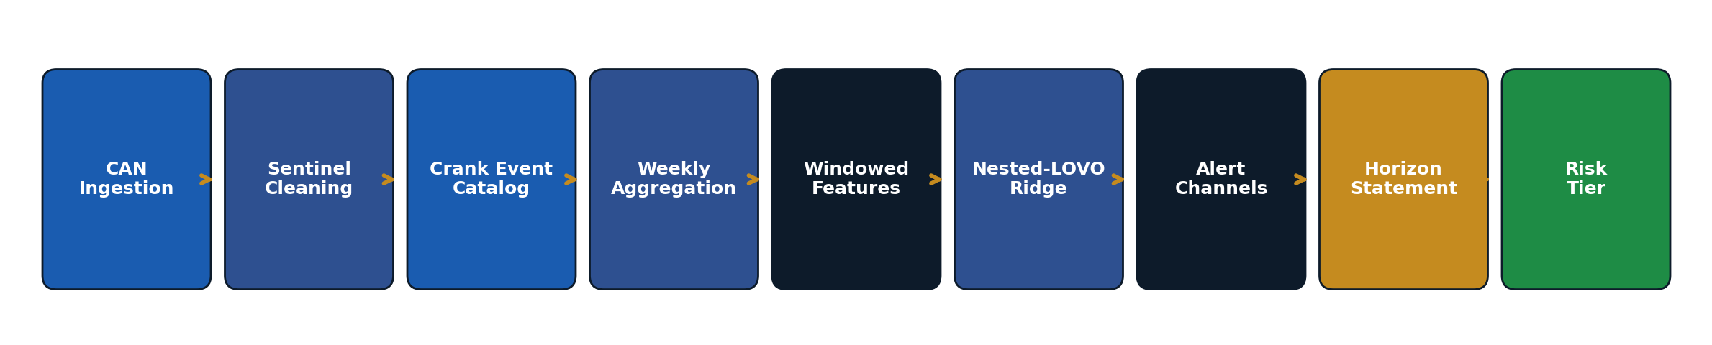
DATA LANDSCAPE
CAN bus telemetry streams and fleet composition
CAN SIGNAL INVENTORY
FLEET COMPOSITION
Signal | Meaning | Range | Role
VSI | Power Supply Voltage | 0-36V | Electrical health (primary)
SMA | Starter Motor Active | {0,1} | Crank-event catalog
RPM | Engine Speed | 0-3500 rev/min | Crank success / rest detection
CSP | Vehicle Speed | 0-100 km/h | Drive vs rest separation
ANR | Engine Torque | -400-1300 Nm | Load context
GED | Alternator Excitation State | {0,1,2,3} | Data-quality covariate only
Category | Count | Suffix | Status
Failed | 14 | _F_SM | Post-hoc analysis
In-Service | 20 | _NF_SM | Active monitoring
Total | 34 | -- | ~106M CAN rows
• 106,445,161 raw 5-second rows -> 2,636 truck-weeks + 20,471 gap-aware crank events
• 5 s sampling / ~0.2 V resolution; no cranking current, temperature, or battery SoC signal
• Sequential fleet numbering: VIN1-14 failed, VIN15-34 in-service (raw-file mapping: results/V1_1_SM_vin_naming_map.csv).
KEY TAKEAWAYS
• VSI (power supply voltage) is again the winning signal family -- 3 of 4 model features derive from it; 1 from crank physics
• SM has no GED=2 channel: zero GED2 in all 14 failed trucks -- the ALT emergency layer does not transfer
• KT crank claims reconciled: durations only +3% (not +48%); whole-life >5% failed-crank threshold refuted -- only the last-90-day change discriminates (AUROC 0.74)
V1.1_SM | 2026-06-10 | BharatBenz 5528T Starter Motor Predictive Maintenance | BytEdge CONFIDENTIAL

Slide 6
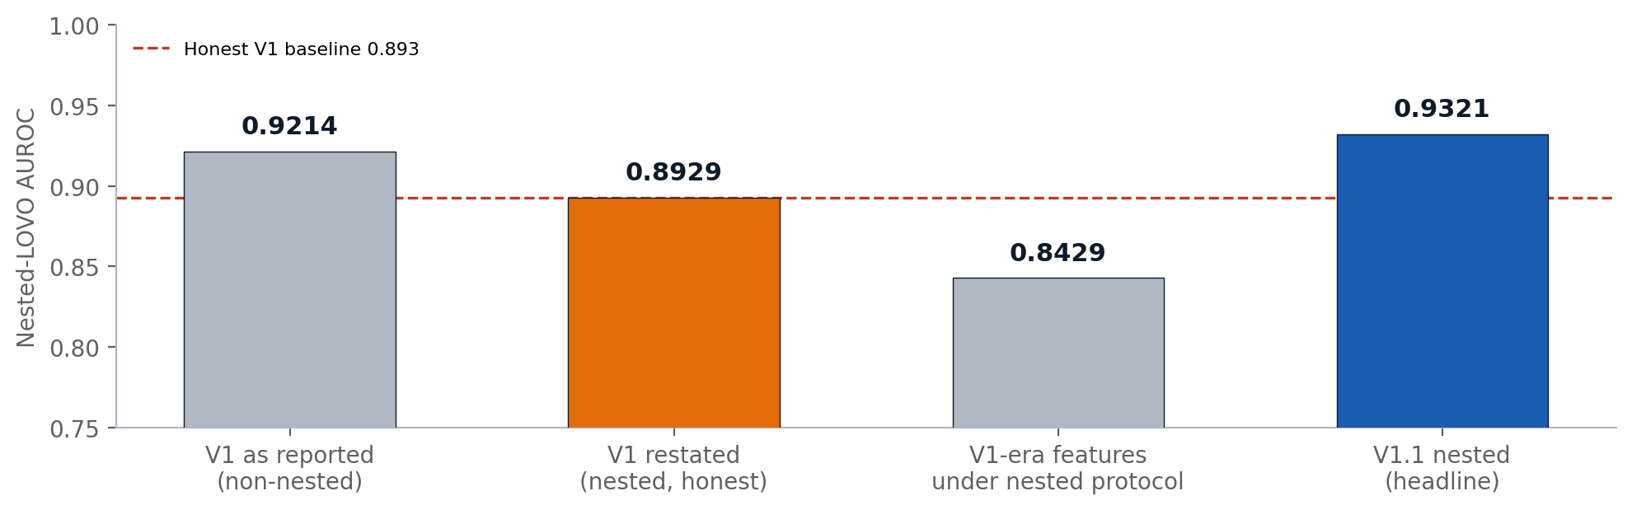
HONEST VALIDATION & LEAKAGE AUDIT
V1's headline was restated before being beaten -- the differentiator of this program
WHY THE RESTATEMENT
• V1 reported 0.9214 -- but feature screening + subset selection sat outside the LOVO loop (+0.0285 optimism), and one recall point came from a post-hoc pooled threshold.
• Nested restatement: V1's true out-of-sample AUROC is 0.8929 (recall 12/14).
• V1's top-2 feature (vsi_dominant_freq) was a 1/n_weeks artifact -- it collapses 0.748 to 0.525 under a fixed-window control. Banned.
• V1.1 redoes screening, subset search, threshold, and Platt recalibration inside every fold: optimism +0.0036.
• Ablation: the nested protocol on V1-era features scores 0.8429 -- the V1.1 gain (+0.089) is feature engineering, not protocol arithmetic.
LEAKAGE GATES (ALL ENFORCED PER REFIT)
Gate | Hazard it controls | Result
Leak ceilings measured | n_weeks alone classifies at AUROC 0.952; t_start at 0.893 (failed trucks stop transmitting because they failed) | All such features banned
G1 fixed-L40 window control | Observation-length artifacts laundered through denominators | Drop 0.0000 -- matrices bit-identical
G3 prequential time-locking | Epoch/length leak vs true failure signal | Screening-feature curve: holds to k=10 wks, chance at k=11 (0.536) -- failure-locked. NB: the frozen final-model curve (slide 16) decays slower: 0.704 at k=11
G4 winner-subset stability | Fold-to-fold feature-selection instability | Strict modal criterion FAIL (14/34 < 17/34; a k=3/k=4 tie). Substantively stable: core pair vsi_withinwk + range_trend in 34/34 folds; only 3 distinct subsets total
G6 banned-token scan | vsi_dominant_freq, calendar features, cumulative counts | 0 banned tokens in selected features
Permutation test (full pipeline) | Selection noise masquerading as signal | p = 0.005 (0/200 shuffles reach 0.9321)
KEY TAKEAWAYS
• V1 0.9214 (reported) -> 0.8929 (restated, nested) -> 0.9321 (V1.1 nested) -- measured under a strictly harder protocol; vs V1-as-reported the recall swap is VIN8_F gained, VIN9_F (nominally caught by V1 at P=0.4825) lost
• The leak ceilings in this data (AUROC 0.95 from data volume alone) exceed any honest model -- which is why the gates exist and are binding; G4 is the one strict FAIL, disclosed above
V1.1_SM | 2026-06-10 | BharatBenz 5528T Starter Motor Predictive Maintenance | BytEdge CONFIDENTIAL

Slide 7
04 MODELING APPROACH
Four-layer architecture: Risk Tiers -> Alerts -> Horizon -> Explanations
V1.1_SM | 2026-06-10 | BharatBenz 5528T Starter Motor Predictive Maintenance | BytEdge CONFIDENTIAL

Slide 8
MODELING APPROACH
Nested-LOVO Ridge + validated alert channels + horizon statement + explanations
LAYER 1: RISK MODEL
LAYER 2: ALERTS
LAYER 3: HONEST RUL
LAYER 4: EXPLAINABILITY
• RidgeClassifier(alpha=1.0)
• 4 audited features
• Fully nested 34-fold LOVO: AUROC 0.9321
• 95% CI [0.811, 0.986], p=0.005
• Per-fold Platt recalibration (slope 0.86)
• Tiers: GREEN <0.35 <= AMBER <0.55 <= RED
• Score weekly, review monthly
• A2 battery-cascade: 4/5 archetype, 0/20 NF, median lead 66.5d
• Persistence flag: 13/14, 4/20 NF -- tier-gated condition flag only
• A1 crank-burst: corroborator only (1.52 FP eps/truck-yr standalone)
• Combined: 13/14 failed fire >=1 channel; 10/20 NF fully clean
• No day-precision RUL, no survival layer
• Validity-horizon statement: flagged truck typically within ~10 weeks
• Tier -> maintenance window: RED 2-4 wks; AMBER next service
• Proof of ceiling: hazard RUL MAE 576d vs 44d for a constant
• Exact linear attribution (coef x z = SHAP for a linear model)
• 34 per-VIN explanation cards
• Archetype assignment per truck
• Raw-unit counterfactual per flagged truck
• Governance-grade model card
DECISION ENGINE: HOW THE LAYERS COMBINE
Condition | Action | Timing | Confidence
A2 battery-cascade fires | BATTERY-FIRST INSPECTION (DICV A6 routing) | Weeks (~9.5 wk lead) | High (0/20 NF false alarms)
Tier RED | STARTER + BATTERY CIRCUIT INSPECTION | 2-4 weeks | High (18/20 specificity)
Tier AMBER + persistence flag active | BUNDLE INTO NEXT SCHEDULED SERVICE | Months | Medium (tier-gated flag)
A1 crank burst on AMBER/RED truck | CORROBORATE -- ADVANCE THE INSPECTION | Days-weeks | Medium (rescued VIN1_F)
Tier GREEN, no channel | NORMAL OPERATION | Score valid ~2.3 months (70 d) | High (10/20 NF fully clean)
KEY TAKEAWAYS
• Four layers, each shipping only LOVO/physics-validated numbers -- alert channels are gated behind tiers, never standalone pagers
• A2 battery-cascade is the only short-fuse (~1-3 month) signal and the highest-confidence channel (0/20 NF false alarms)
• Alert channels recover 3 of the 4 Layer-1 GREEN-tier misses (VIN1/3/4_F) -- redundant coverage by design
V1.1_SM | 2026-06-10 | BharatBenz 5528T Starter Motor Predictive Maintenance | BytEdge CONFIDENTIAL

Slide 9
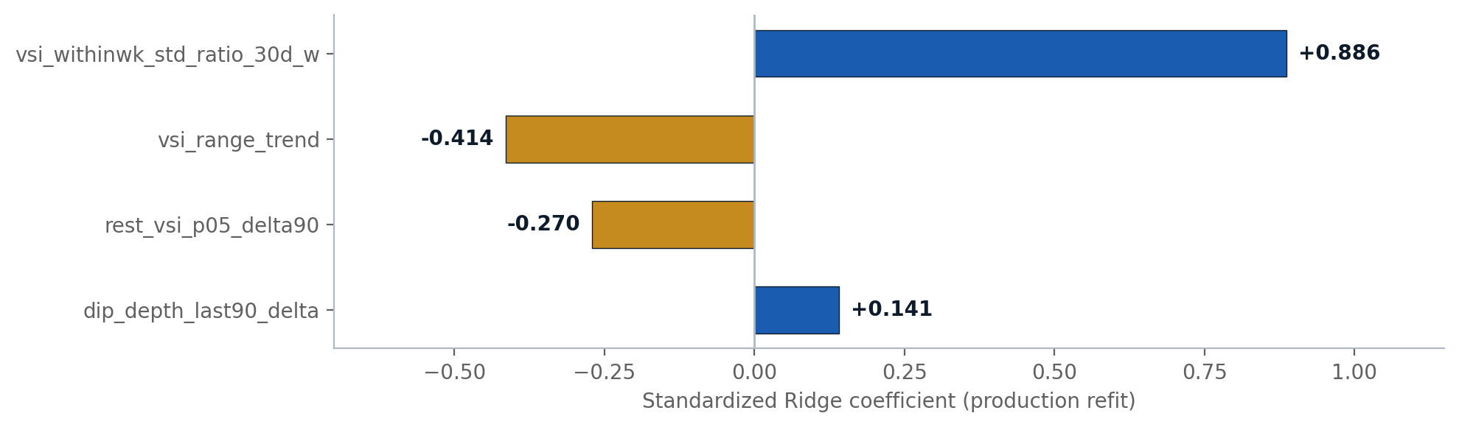
FEATURE ENGINEERING
4 winners from a 10-candidate audited pool, selected inside every fold
FEATURE DESCRIPTIONS & PHYSICS
Feature | Physics | Coef
vsi_withinwk_std_ratio_30d_w | Within-week voltage noise vs own baseline -- volatility drift (univariate AUROC 0.921) | +0.886
rest_vsi_p05_delta90 | Engine-off rest-voltage floor sag -- battery cascade (step-aware re-baseline) | -0.270
vsi_range_trend | Weekly voltage-range slope -- suppressor (physics says widening = risk; flipped by r=+0.82 collinearity) | -0.414
dip_depth_last90_delta | Crank dip widening vs own baseline -- heavier cranking load | +0.141
• Selection: V1-faithful screening + exhaustive k=3-6 subset search redone inside each of 34 folds. Core pair selected 34/34 folds; only 3 distinct subsets ever chosen -- though gate G4's strict modal criterion FAILS (14/34 < 17/34, a k=3/k=4 tie; disclosed on the gates slide).
• All features window-anchored (last 40 masked weeks / last-90-day events) and per-VIN baselined -- the L40 control matrix is bit-identical to production (zero-drop by construction).
• Two physics candidates (retry-burst, extended-crank-tail) were admissible but fleet-weak -- rejected by in-fold screening 34/34; they live on inside the A1 alert channel instead.
KEY TAKEAWAYS
• The workhorse is the within-week voltage noise ratio (coef +0.886, univariate AUROC 0.921) -- volatility drift against the truck's own baseline
• vsi_range_trend is honestly flagged as a statistical suppressor: its negative weight is a collinearity correction, not physics
• Battery-step awareness matters: rest-VSI baselines re-anchored after detected battery replacements (VIN8_F + 5 NF trucks)
V1.1_SM | 2026-06-10 | BharatBenz 5528T Starter Motor Predictive Maintenance | BytEdge CONFIDENTIAL

Slide 10
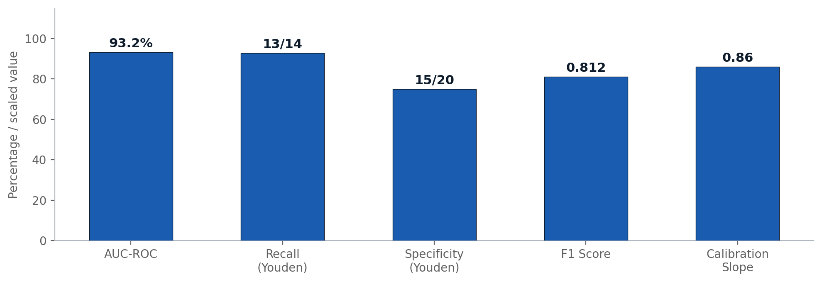
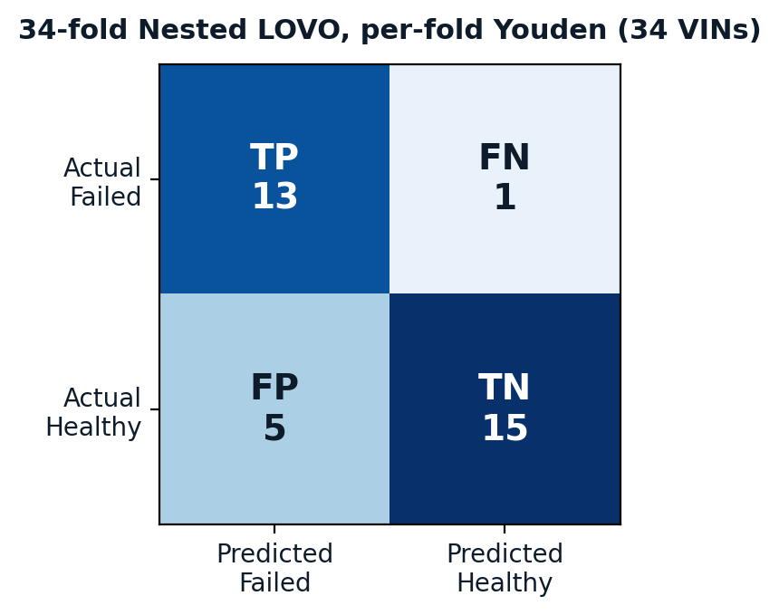
RESULTS OVERVIEW
Nested 34-fold LOVO performance, operating points and calibration
PERFORMANCE SCORECARD (ALL NESTED-LOVO OUT-OF-FOLD)
Metric | Value | Context
AUROC | 0.9321 | Bootstrap 95% CI [0.811, 0.986]; permutation p = 0.005 (N=200 floor)
Recall @ per-fold Youden | 13/14 | TP 13, FP 5, FN 1, TN 15 -- recall-greedy operating point
RED-tier operating point | 10/14 @ 18/20 | Matched-specificity alternative; choose per maintenance economics
F1 / MCC @ Youden | 0.812 / 0.669 | Recall-weighted; V1 restated was 12/14 @ 18/20
Calibration | slope 0.86, Brier 0.124 | CITL -0.062; slope in [0.5, 2] -- probabilities shippable (V1 slope was 4.72)
Selection optimism | +0.0036 | Non-nested 0.9357 vs nested 0.9321; V1 hid +0.0285
Jackknife stability | 0.927-0.951 | AUROC range 0.024, std 0.007 across leave-one-out reruns
KEY TAKEAWAYS
V1.1_SM | 2026-06-10 | BharatBenz 5528T Starter Motor Predictive Maintenance | BytEdge CONFIDENTIAL
• Two pre-registered operating points: Youden (13/14 recall @ 15/20) and RED tier (10/14 @ 18/20) -- both honest, neither dominates V1 on every cell
• The single miss (VIN9_F_SM, prob 0.401 vs threshold 0.406) is the structurally invisible A4 + SMA-dead + 142-day-silent-gap truck
• Calibrated probabilities are a new deliverable: V1 scores were rank-only (slope 4.72); V1.1 ships slope 0.86

Slide 11
07 DETAILED VIN ANALYSIS
Failed trucks, in-service fleet, alert channels and case studies
V1.1_SM | 2026-06-10 | BharatBenz 5528T Starter Motor Predictive Maintenance | BytEdge CONFIDENTIAL

Slide 12
FAILED TRUCK ANALYSIS -- 14 VINs
Out-of-fold probability, tier, archetype and first-firing alert channel
VIN | OOF P | Recal P | Tier | Archetype | First Channel | Lead (d)
VIN1_F | 0.406 | 0.260 | GREEN | A1 solenoid | A1 crank burst | 160
VIN2_F | 0.598 | 0.904 | RED | A2 battery | persistence | 77
VIN3_F | 0.438 | 0.338 | GREEN | A2 battery | persistence | 168
VIN4_F | 0.429 | 0.339 | GREEN | A4 silent/abrupt | persistence | 28
VIN5_F | 0.756 | 0.992 | RED | A4 silent/abrupt | persistence | 392
VIN6_F | 0.825 | 0.998 | RED | A2 battery | persistence | 168
VIN7_F | 0.612 | 0.906 | RED | A3 volatility | persistence | 266
VIN8_F | 0.521 | 0.716 | RED | A4 silent/abrupt | persistence | 98
VIN9_F | 0.401 | 0.224 | GREEN | A4 silent/abrupt | NONE | --
VIN10_F | 0.782 | 0.995 | RED | A1 solenoid | A1 crank burst | 160
VIN11_F | 0.651 | 0.958 | RED | A3 volatility | persistence | 266
VIN12_F | 0.658 | 0.955 | RED | A3 volatility | A1 crank burst | 128
VIN13_F | 0.496 | 0.654 | RED | A2 battery | persistence | 301
VIN14_F | 0.798 | 0.998 | RED | A1+A2 mixed | persistence | 245
KEY TAKEAWAYS
• 10/14 failed trucks score RED on recalibrated probability; 13/14 are caught at the per-fold Youden point
• VIN8_F -- V1's worst miss (P=0.303) -- is now RED at 0.716 via the within-week volatility and battery-floor features
V1.1_SM | 2026-06-10 | BharatBenz 5528T Starter Motor Predictive Maintenance | BytEdge CONFIDENTIAL
• VIN9_F is the only full miss on every layer: A4 silent + SMA-dead + 142-day silent gap -- the irreducible blind spot of this dataset
• Three GREEN-tier failures (VIN1/3/4_F) are recovered by the alert channels -- the layers are redundant by design

Slide 13
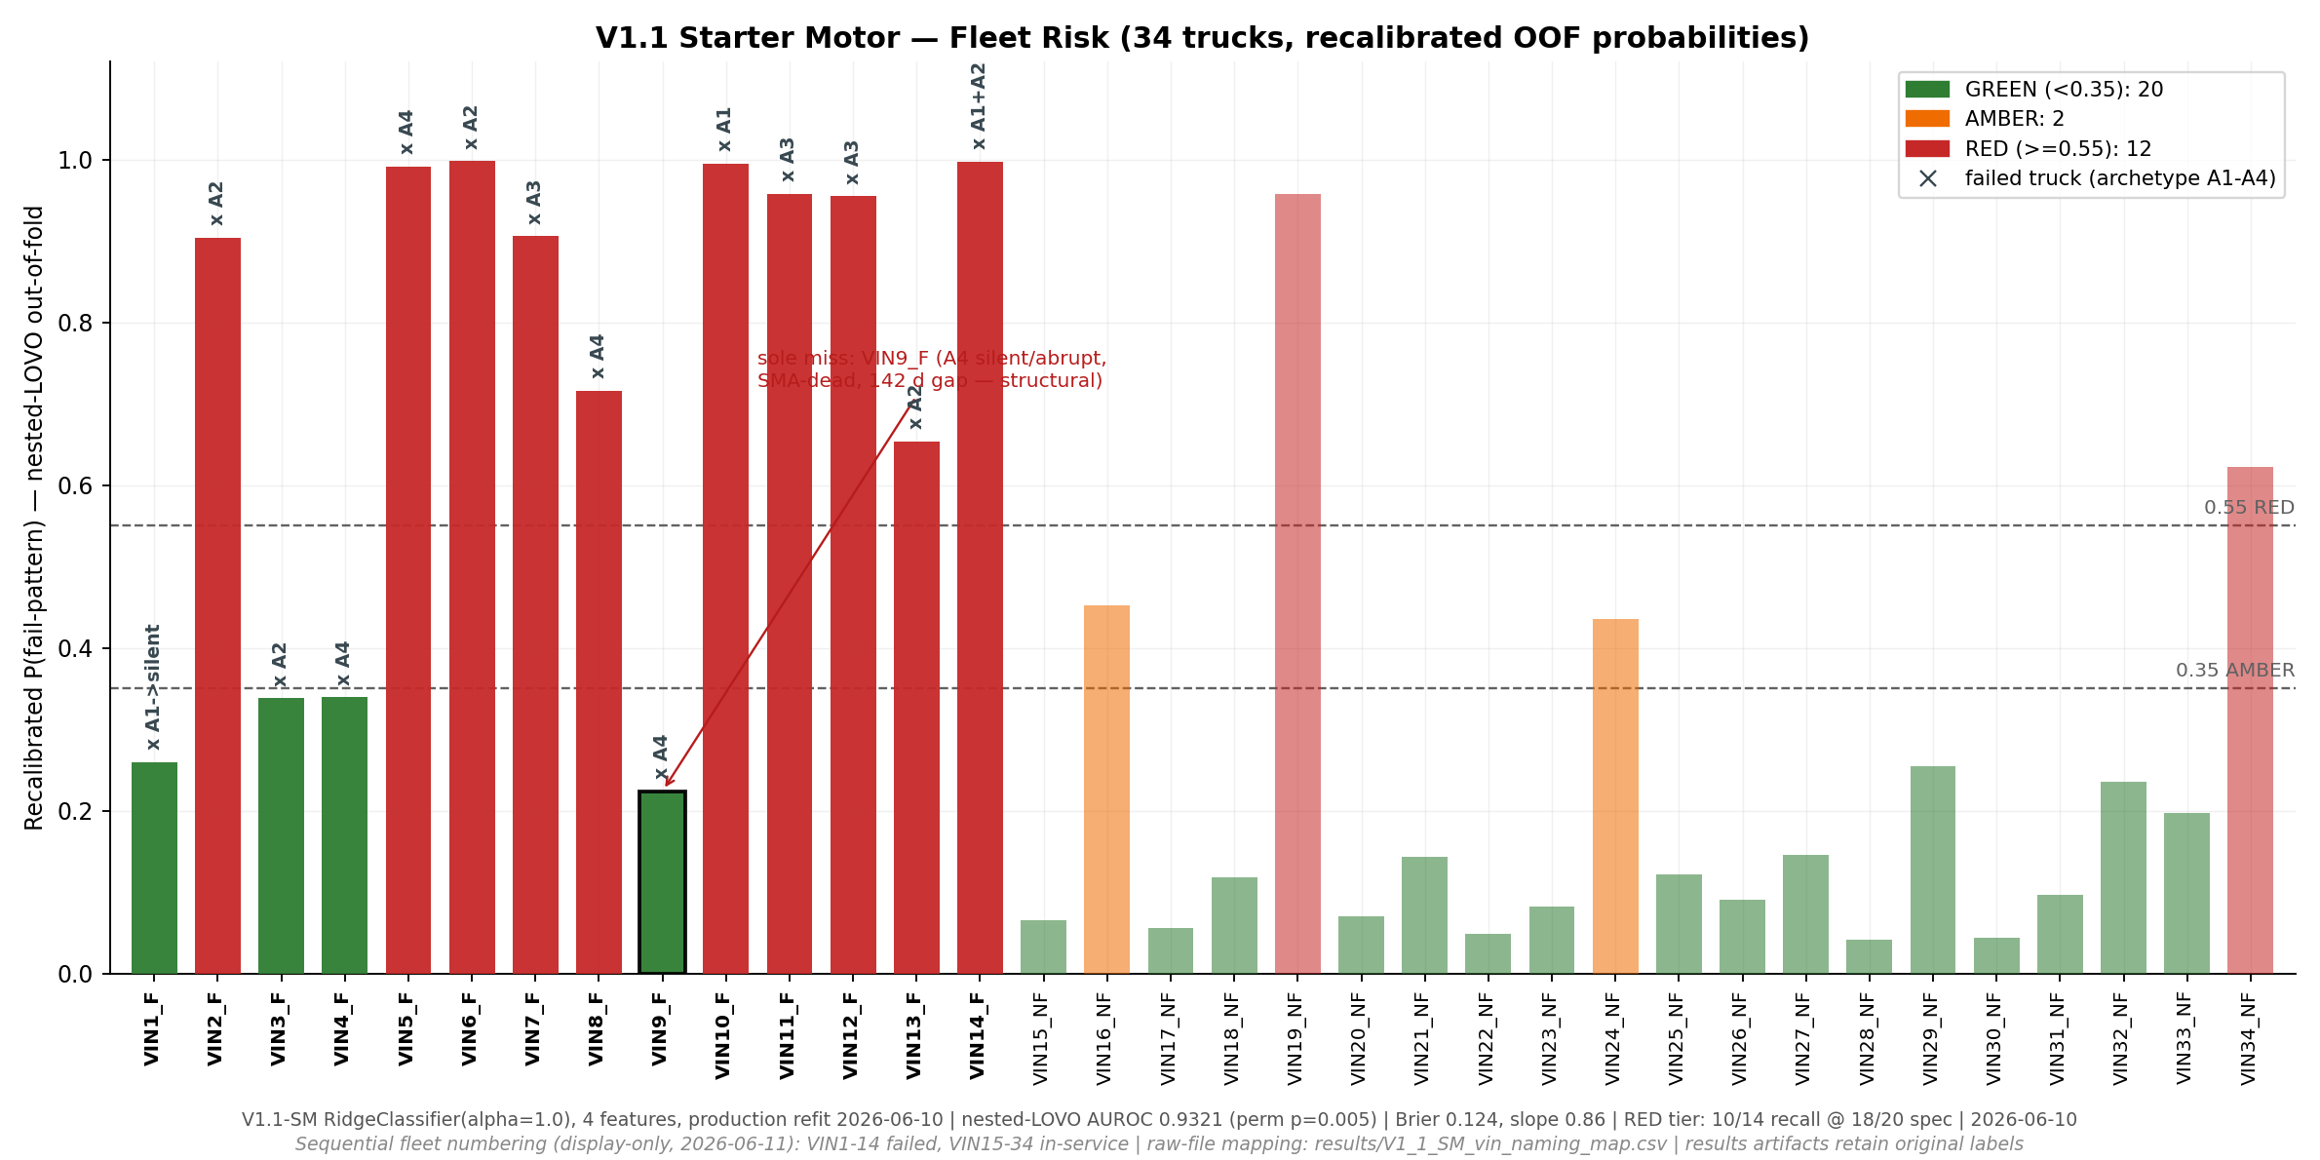
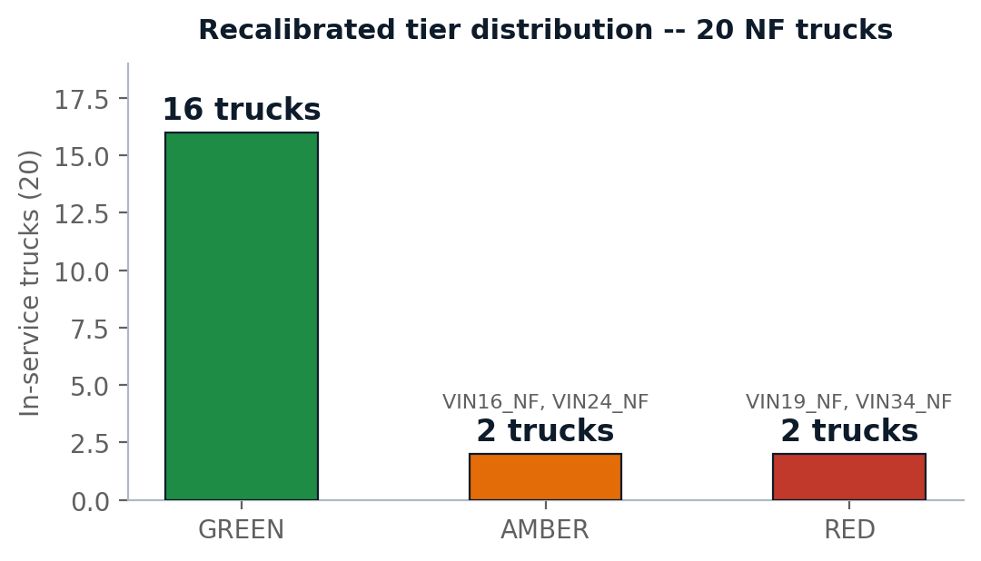
IN-SERVICE FLEET STATUS -- 20 VINs
Recalibrated out-of-fold risk across the full fleet
• RED: VIN19_NF (0.96), VIN34_NF (0.62) -- inspect starter + battery circuit within 2-4 weeks
• AMBER: VIN16_NF (0.45), VIN24_NF (0.43) -- bundle into next scheduled service
• Persistence-flag NF trucks (VIN16/19/22/29_NF) are tracked: future failures or first evidence of rule drift -- either is informative
KEY TAKEAWAYS
• 16/20 in-service trucks are GREEN; 2 AMBER and 2 RED warrant action now
• NF false alarms may be right-censored degraders: VIN19_NF shows genuinely elevated electrical noise; VIN34_NF is tier-only evidence (SMA-dead truck, no alert channel fired)
• Re-score weekly (the 10-week horizon gives only ~2 reads per month otherwise); review tiers monthly
V1.1_SM | 2026-06-10 | BharatBenz 5528T Starter Motor Predictive Maintenance | BytEdge CONFIDENTIAL

Slide 14
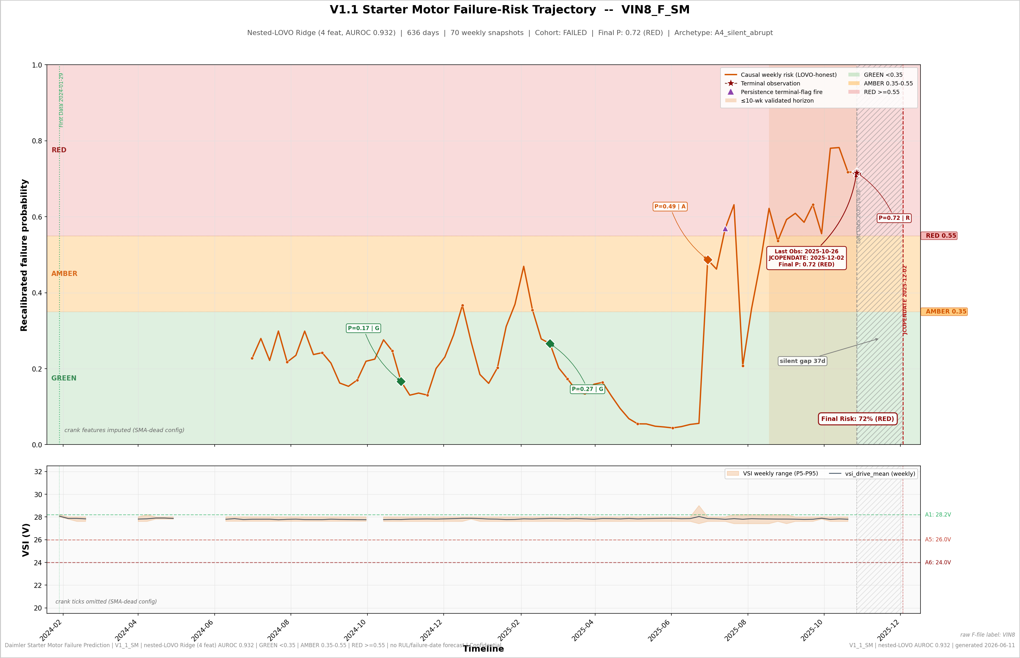
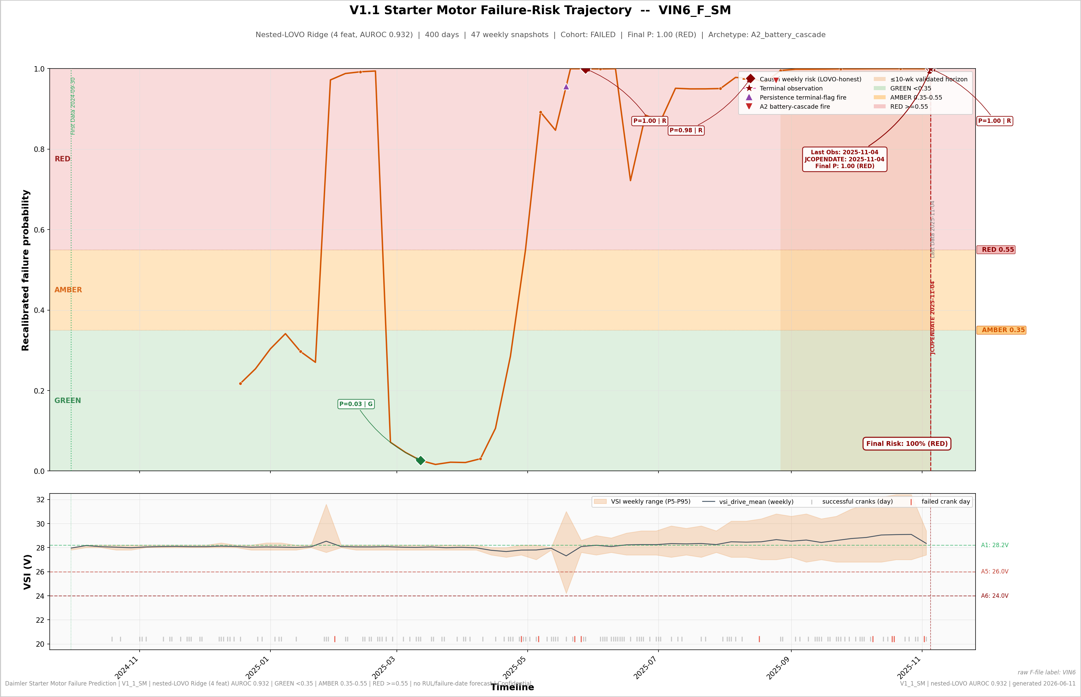
VIN CASE STUDIES
The recovered miss and the textbook battery cascade
VIN8_F -- V1's MISS, NOW CAUGHT (RED 0.716)
VIN6_F -- A2 BATTERY CASCADE (RED 0.998)
• VIN8_F: V1 scored it 0.303 (missed). V1.1's within-week volatility ratio plus the battery-step-aware rest-VSI delta lift it to OOF 0.521 (recal 0.716, RED) -- and the persistence flag fired 98 days before end of telemetry. SMA-dead config and a 37-day silent gap are honestly flagged on its card.
• VIN6_F: the textbook A2 battery cascade -- rest floor sagging -3.15 V, crank dips +4.12 V deeper, within-week noise 2.07x baseline. RED at 0.998; the A2 triple detector fired 70 days before failure and routes the work order battery-first.
• Two visual views ship per truck: the weekly risk-probability trajectory (shown here) and a daily RUL-style degradation view (see the Daily-Risk RUL Views slides that follow the Detection Horizon).
KEY TAKEAWAYS
• VIN8_F shows the V1.1 gain concretely: new physics features recover a previously-missed failure vs the restated baseline (transparency: vs V1-as-reported, V1.1 trades VIN9_F -- nominally caught at 0.4825 -- for VIN8_F)
• VIN6_F shows the triage value: battery-first routing on a cascade signature is the cheapest correct intervention
V1.1_SM | 2026-06-10 | BharatBenz 5528T Starter Motor Predictive Maintenance | BytEdge CONFIDENTIAL

Slide 15
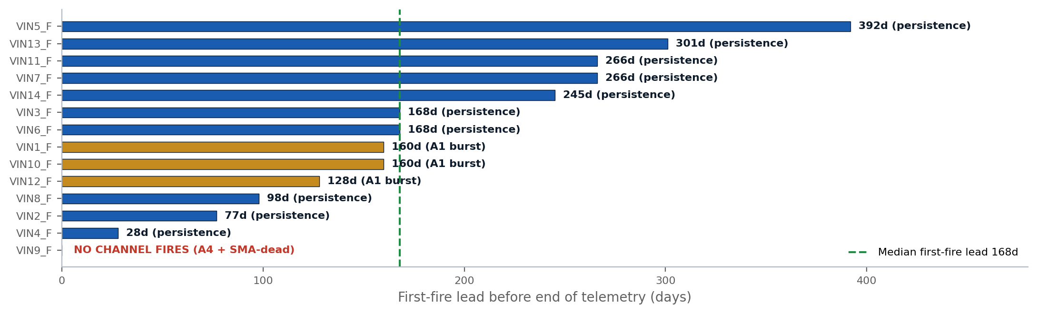
ALERT CHANNELS & VALIDATED LEADS
Three LOVO/physics-validated channels -- V1 had zero
SHIP / DON'T-SHIP VERDICTS
• A2 battery cascade -- SHIP: 4/5 battery archetype, 0/20 NF, median lead 66.5d; battery replacements provably don't fire
• Persistence flag -- SHIP tier-gated only: 13/14 recall, 4/20 NF at end-state; as a raw walking alarm it visits all 20 NF trucks (31% of weeks) -- never a first-crossing pager
• A1 crank burst -- corroborator only: 4/12 applicable failed fire, but 1.52 FP episodes/truck-year standalone; rescued GREEN-tier VIN1_F
COMBINED POLICY (TIER + PERSISTENCE + A1 + A2)
Quantity | Value | Honest note
Failed trucks firing >=1 channel | 13/14 | Persistence first on 10, A1 first on 3; A2 corroborates 4 and is the only ~1-3-month-fuse signal
Median first-fire lead | 168 d | Long leads = condition flag, not failure-imminent timer (min 28 d, VIN4_F)
NF trucks fully clean | 10/20 | 6 NF show 1 channel, 2 show 2, 2 show 3 -- repeat offenders may be right-censored degraders
GREEN-tier failures recovered | 3 of 4 | VIN1_F (A1 burst), VIN3_F and VIN4_F (persistence); only VIN9_F fires nothing
KEY TAKEAWAYS
• A2 is the deployment star: zero NF false alarms, ~9.5-week (66.5 d) median lead, and a built-in battery-vs-starter triage decision
• The persistence rule is honest about its weakness: recall holds out-of-fold (13/14) but NF FP doubled to 4/20 -- shipped tier-gated only
V1.1_SM | 2026-06-10 | BharatBenz 5528T Starter Motor Predictive Maintenance | BytEdge CONFIDENTIAL

Slide 16
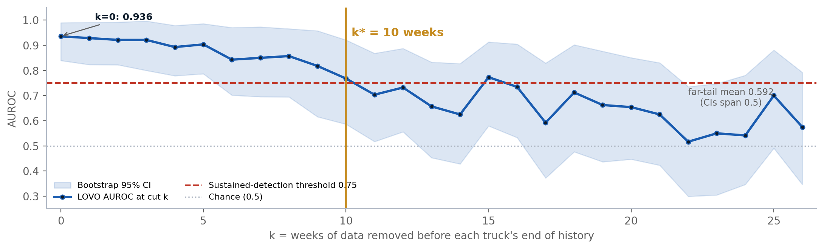
DETECTION HORIZON -- 10 WEEKS
Prequential walk-back of the frozen 4-feature model (X4)
• Method: per VIN, truncate all data k weeks before its own end of history, recompute the 4 frozen features causally, re-run LOVO -- no re-screening. k=0 reconciles exactly to the X2 figure (0.9357).
• Result: AUROC 0.9357 at k=0 decays to 0.768 at k=10 and 0.704 at k=11; far-tail (k=23-26) mean 0.592 with every CI spanning 0.5.
• Why this matters twice: (1) operations gets a validity statement -- a flagged truck is typically within ~10 weeks of failure, a clean score is good for ~2.3 months (70 d); (2) the decay-to-chance is the leak disambiguation -- an observation-length artifact would NOT decay with distance to failure.
• Curve identity: this is the FROZEN FINAL-MODEL curve (0.704 at k=11, chance past ~k=20). The G3 gate's 'chance at k=11' (slide 6) is the discovery-phase screening-feature curve (0.536 at k=11) -- two different objects, not a contradiction.
KEY TAKEAWAYS
• k* = 10 weeks: claim 'risk score valid ~2.3 months (70 d) out', never quote failure dates
• Decay is gradual (slow-burn degradation signal), reaching chance past ~k=20 -- honest about the k=13-16 hover at 0.62-0.77
• This curve is the single strongest evidence that the model reads failure physics, not telemetry bookkeeping
V1.1_SM | 2026-06-10 | BharatBenz 5528T Starter Motor Predictive Maintenance | BytEdge CONFIDENTIAL

Slide 17
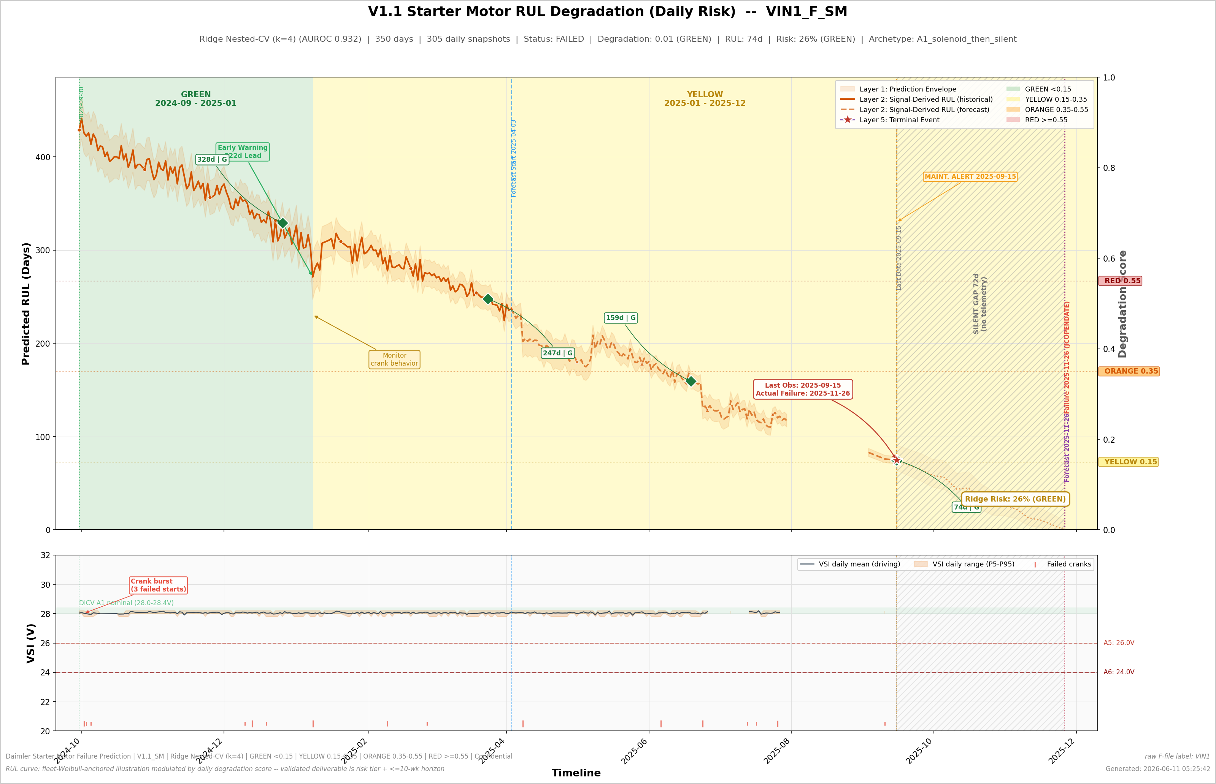
DAILY-RISK RUL VIEWS -- HOW TO READ (VIN1_F)
A1 solenoid archetype -- early warning, a real telemetry gap, and a terminal silent gap on one canvas
HOW TO READ THE DAILY VIEW
• Curve breaks = no telemetry received. VIN1_F has a real 34-day mid-history gap (2025-07-31 -> 2025-09-02): the line is masked, never interpolated.
• Hatched band = terminal silent gap: 72 days with no data before the recorded failure (2025-11-26). Going quiet is itself information.
• Dotted segment = fleet-Weibull-anchored projection beyond the last received data -- an illustration layer, not a measurement.
• Early-warning annotation marks the A1 crank-burst corroboration; background colors are the action tiers (GREEN -> RED).
• Bottom strip: daily VSI mean/range against the truck's own setpoint -- the raw physics behind the score.
Honest note: the daily RUL curve is a fleet-Weibull-anchored illustration -- the validated deliverable is the calibrated risk tier + <=10-week horizon statement, never a failure date.
V1.1_SM | 2026-06-10 | BharatBenz 5528T Starter Motor Predictive Maintenance | BytEdge CONFIDENTIAL

Slide 18
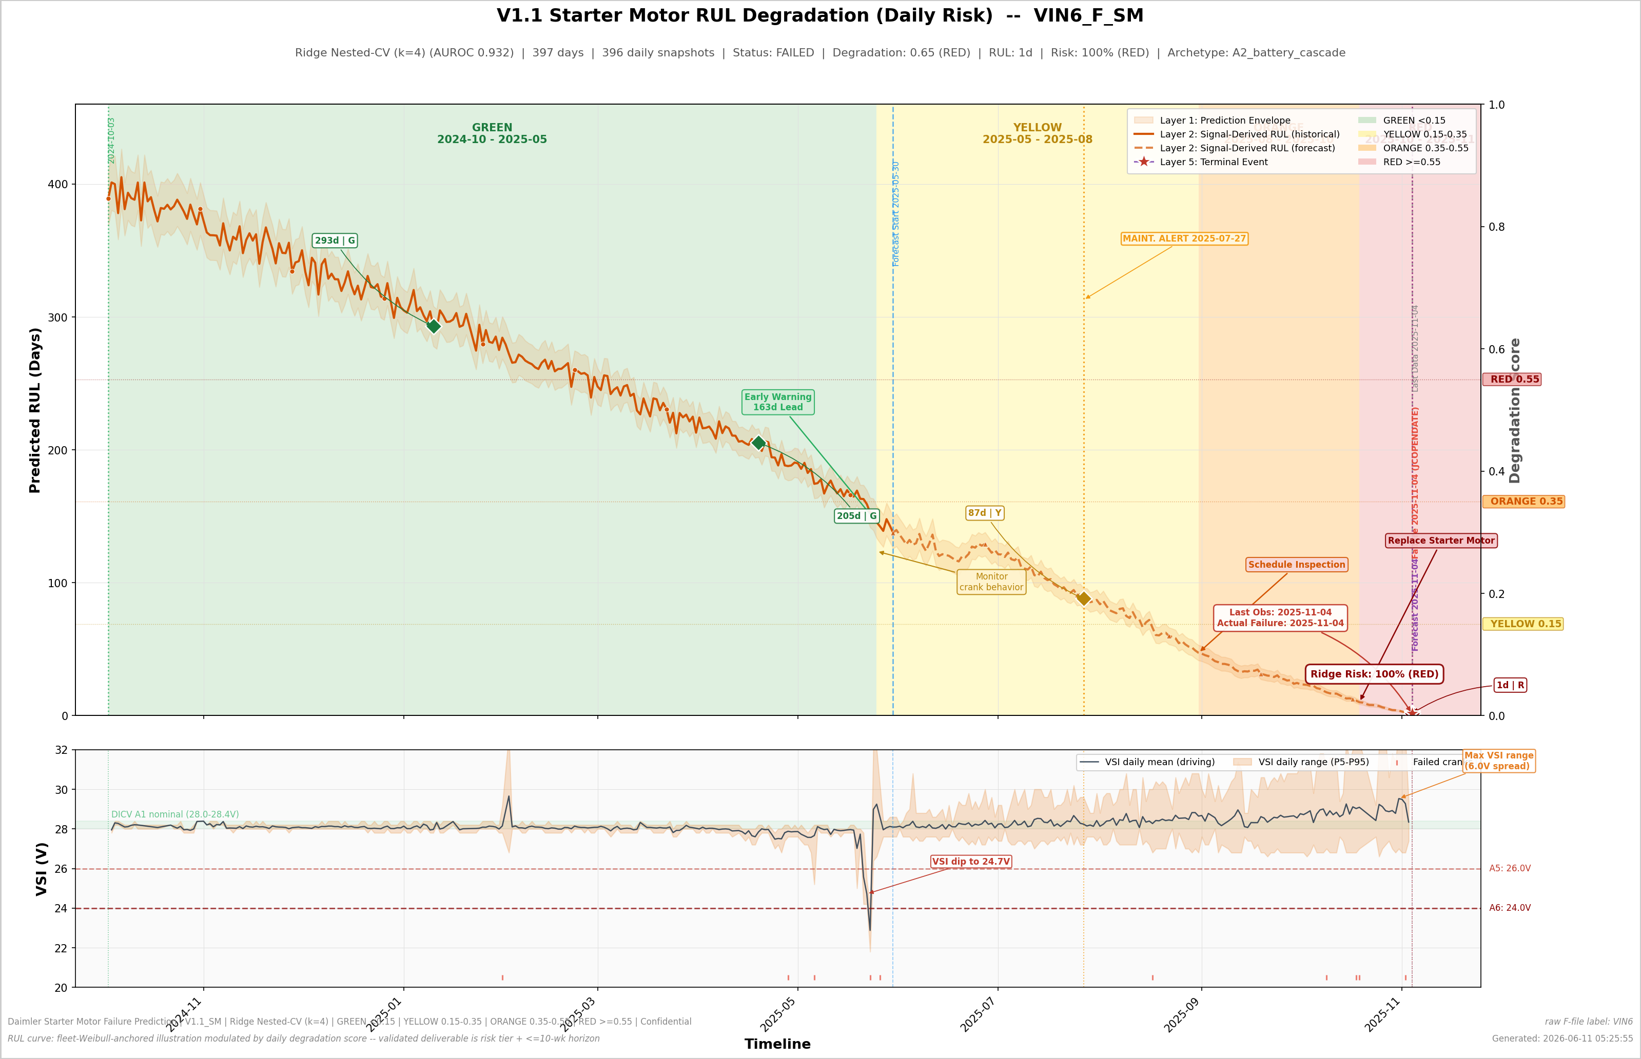
DAILY-RISK RUL VIEW -- VIN6_F (A2 BATTERY CASCADE)
The textbook battery cascade: full GREEN -> RED zone progression before failure
TAKEAWAYS
• Full tier progression GREEN -> AMBER -> RED across the history; recalibrated Ridge risk reaches 0.998 (RED) at end of telemetry.
• Cascade physics visible in the VSI strip: rest-voltage floor sagging -3.15 V, crank dips +4.12 V deeper, within-week noise 2.07x baseline.
• The A2 battery-cascade alert fired 70 days before failure -- it routes the work order battery-first (DICV A6), the cheapest correct intervention.
• This is the trajectory shape the daily view is designed to surface: monotone degradation a weekly tier review can act on early.
Honest note: the daily RUL curve is a fleet-Weibull-anchored illustration -- the validated deliverable is the calibrated risk tier + <=10-week horizon statement, never a failure date.
V1.1_SM | 2026-06-10 | BharatBenz 5528T Starter Motor Predictive Maintenance | BytEdge CONFIDENTIAL

Slide 19
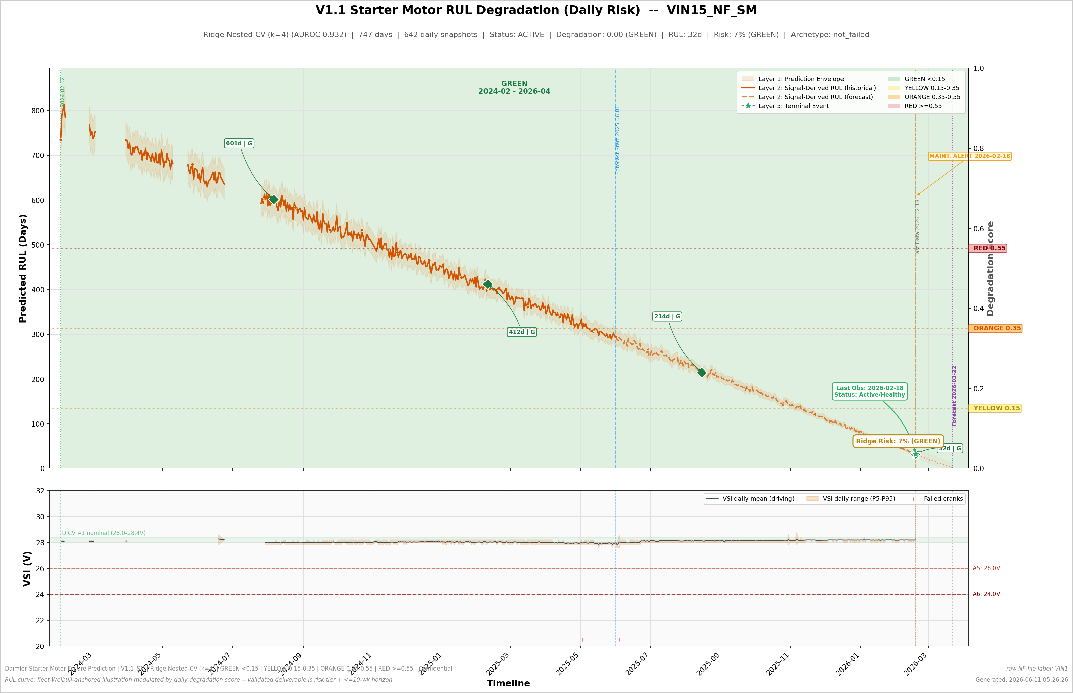
DAILY-RISK RUL VIEW -- VIN15_NF (HEALTHY IN-SERVICE)
The healthy contrast: what a GREEN truck's daily view looks like
TAKEAWAYS
• Healthy contrast: the truck stays GREEN across its entire history; recalibrated risk 0.07 at last score, status ACTIVE.
• The dotted forecast segment is the same fleet-Weibull-anchored projection drawn on every truck -- on a healthy truck it is a planning aid, not a failure prediction.
• Flat VSI strip with no rest-floor sag or dip widening -- the physics agrees with the score.
• Operating rule: a clean GREEN score is valid ~2.3 months (70 d); re-score weekly, review tiers monthly.
Honest note: the daily RUL curve is a fleet-Weibull-anchored illustration -- the validated deliverable is the calibrated risk tier + <=10-week horizon statement, never a failure date.
V1.1_SM | 2026-06-10 | BharatBenz 5528T Starter Motor Predictive Maintenance | BytEdge CONFIDENTIAL

Slide 20
08 OPERATIONAL ASSESSMENT
Explainability, closed dead ends, limitations and the path forward
V1.1_SM | 2026-06-10 | BharatBenz 5528T Starter Motor Predictive Maintenance | BytEdge CONFIDENTIAL

Slide 21
EXPLAINABILITY
Exact attributions, archetypes and counterfactuals -- one card per truck
HOW IT WORKS
EXAMPLE CARD -- VIN6_F (RED, P 0.998, A2 BATTERY CASCADE)
• Linear model -> exact decomposition: contribution = coefficient x z-scored feature (equals SHAP for a linear model; no approximation, no library)
• 34 per-VIN explanation cards: ranked drivers in physical language, archetype assignment, data-quality caveats (SMA-dead, silent gaps, battery steps)
• Raw-unit counterfactual per flagged truck -- a ceteris paribus statement, not a repair prescription
• The suppressor (vsi_range_trend) is flagged on every card: physical value and model use stated separately
• Drivers (exact linear attribution):
• Within-week noise 2.07x own baseline -> +1.202 (toward failure)
• Rest-voltage floor -3.15 V vs baseline -> +0.957 (battery floor sagging)
• Crank dips +4.12 V deeper (last 90 d) -> +0.579 (cascade signature)
• Range trend +0.200 V/wk -> -1.084 (suppressor term, flagged)
• Counterfactual: drops RED -> AMBER if within-week noise ratio falls from 2.07x to 1.01x, all else equal.
• Routing: A2 cascade -> battery-first inspection (DICV A6).
KEY TAKEAWAYS
• Every alert ships with its reasons: a depot engineer sees which physical channel moved and by how much in volts
• Counterfactuals make tiers actionable: 'returns to GREEN if the rest floor recovers 0.4 V' is a checkable statement
• Governance: model card with banned-feature registry, gate results, horizon curve and known-miss class (A4)
V1.1_SM | 2026-06-10 | BharatBenz 5528T Starter Motor Predictive Maintenance | BytEdge CONFIDENTIAL

Slide 22
CLOSED DEAD ENDS -- WITH NUMBERS
Every shelved method now has evidence attached, not vibes
Method family | What was tried | Result | Verdict
Survival / hazard RUL | Discrete-time hazard, Cox, Weibull AFT | Truck ranking 0.586 vs 0.893 (classifier); RUL MAE 576 d vs 44 d for a constant | CLOSED -- a constant beats every survival formulation at 14 events
Day-precision RUL | All of the above + calibration analysis | Calibrated weekly hazard (~0.005/wk) and day-precision are mathematically incompatible at 14 events | CLOSED -- ship the 10-week horizon statement instead
Deep sequence models | LSTM/BiLSTM/TCN/Transformer/TFT/Informer/PatchTST/TimeXer, DeepSurv/DeepHit/DSM, VAE/contrastive/Siamese (sized) | 235x-6,275x over the parameter budget at 14 events; a 43-parameter LSTM's seed variance exceeds any signal difference | CLOSED until n_failed >= 30-50
Honest simple probes | PCA, trend coefficients, distance methods | All saturate at the same ~0.89-0.93 single degree of freedom the engineered features already capture | CLOSED -- no untapped signal in the weekly aggregates
GED emergency channel (ALT transfer) | GED=2 storm detection on SM fleet | Zero GED2 events in all 14 failed SM trucks | CLOSED -- does not transfer; GED is a data-quality covariate only
KEY TAKEAWAYS
• Survival modeling made things measurably worse: RUL MAE 576 d vs 44 d for a constant -- the proof that 'no RUL' is the honest deliverable
• Deep learning is closed by arithmetic, not opinion: every requested architecture is hundreds-to-thousands of times over the events-per-parameter budget
• One shelved future path: self-supervised crank-encoder pretraining on the 106M raw rows, defensible at n_failed >= 30-50
V1.1_SM | 2026-06-10 | BharatBenz 5528T Starter Motor Predictive Maintenance | BytEdge CONFIDENTIAL

Slide 23
CURRENT LIMITATIONS
Honest assessment of what the data and models cannot do
Limitation | Impact | Root Cause | Mitigation
A4 silent/abrupt failures are invisible | ~4/14 failures (29%) fire nothing on any layer | Windings, seizure, control loss, telemetry death -- no electrical precursor at 5 s | Transmission-health monitoring: a truck going quiet is itself a maintenance trigger
No operating point dominates V1 everywhere | Youden: 13/14 @ 15/20; RED tier: 10/14 @ 18/20 | Recall-specificity trade at n=34 | Two pre-registered points; operations choose per maintenance economics
5 s / 0.2 V sampling destroys brush-wear channel | The one genuine 60-120 d precursor is unreadable | Sub-sample dip shape and sub-second duration growth | High-frequency crank logging (>=1 Hz during SMA=1) -- the single biggest unlock
n=34 trucks, 14 events | Wide CI [0.811, 0.986]; thresholds decided by a handful of trucks | Real-world failure-data scarcity | Keep collecting failures; archetypes stay suggestive, not inferential
OOF scores correlate with leak axes | Spearman -0.64 (n_weeks), +0.51 (t_start) -- above tripwire | Label-mediated: failed trucks transmit less because they failed | Zero-drop L40 control + decay-to-chance curve; a larger fleet is the only definitive cure
Persistence-flag NF false positives | 4/20 NF trucks flagged at end of history | Right-censored degraders -- or rule drift | Track VIN16/19/22/29_NF; either outcome is informative
Battery-vs-starter ambiguity caps precision | A2 routes battery-first but cannot prove the component | No cranking current or battery SoC/SoH signal | Instrument current or SoC -- ends the ambiguity
KEY TAKEAWAYS
• These are physics and data-size constraints, stated with numbers -- the honesty is itself a deliverable
• The 10-week horizon is the ceiling of this telemetry; reliable improvement requires new signals, not new models
V1.1_SM | 2026-06-10 | BharatBenz 5528T Starter Motor Predictive Maintenance | BytEdge CONFIDENTIAL

Slide 24
DEPLOYMENT, GOVERNANCE & ROADMAP
Operating cadence, refit rules, and ranked data asks
DEPLOYMENT & GOVERNANCE
RANKED DATA ASKS (VALUE PER RUPEE)
• Score the fleet weekly (features need 30-90-day windows; the 10-week horizon is built on weekly scoring); review tiers monthly
• RED -> starter + battery circuit inspection within 2-4 weeks; AMBER -> bundle into next scheduled service; GREEN -> normal operation
• Refit only when new failure labels arrive, always under the full nested protocol with all gates re-run and the permutation test
• Banned-feature registry is binding (vsi_dominant_freq, calendar features, observation-length features)
• If calibration slope leaves [0.5, 2] on a refit: ship tiers only, not probabilities
• Alert channels remain tier-gated -- no standalone pagers
# | Ask | What it unlocks
1 | High-frequency crank logging (>=1 Hz during SMA=1) | Revives the 60-120 d brush-wear channel and true dip physics
2 | Cranking current or battery SoC/SoH signal | Ends battery-vs-starter ambiguity; sharpens alert precision
3 | Maintenance / parts-replacement records | Turns data-derived archetypes into supervised labels
4 | Keep collecting failures (target n_failed >= 30-50) | Unlocks SSL crank-encoder pretraining and meaningful survival modeling
5 | Ambient temperature | Cold-start conditioning of crank features
KEY TAKEAWAYS
• V1.1 is the honest ceiling of this dataset -- improvement beyond it requires new signals, not new models
• Stop doing: chasing longer lead times in this data; evaluating deep/sequence/survival models below n_failed = 30
• VIN9_F-class failures need transmission-health monitoring, not a better classifier
V1.1_SM | 2026-06-10 | BharatBenz 5528T Starter Motor Predictive Maintenance | BytEdge CONFIDENTIAL

Slide 25
CONCLUSIONS & RECOMMENDATIONS
Summary of findings and priority actions
SUMMARY OF FINDINGS
• Nested-LOVO Ridge (AUROC 0.9321, CI [0.811, 0.986], p=0.005) beats the honestly-restated V1 baseline (0.8929) under a strictly harder protocol
• Calibrated probabilities ship for the first time (slope 0.86, Brier 0.124); recall 13/14 including V1's worst miss (VIN8_F)
• Three validated alert channels give 13/14 early-warning coverage with a measured 10-week horizon -- V1 had none
• A2 battery-cascade detector (0/20 NF false alarms, ~9.5-week lead) builds battery-vs-starter triage into the work order
• Day-precision RUL is closed with proof (hazard MAE 576 d vs 44 d for a constant); the deliverable is the validity-horizon statement
• ~4/14 silent/abrupt failures are structurally invisible -- the honest recall ceiling for tier alerting is ~10-11/14
PRIORITY RECOMMENDATIONS
# | Recommendation | Rationale
1 | Inspect VIN19_NF_SM and VIN34_NF_SM (RED tier) | Recalibrated risk 0.96 / 0.62; starter + battery circuit within 2-4 weeks
2 | Stand up weekly fleet scoring with tier review monthly | The 10-week horizon requires weekly reads to be actionable
3 | Enable A2 battery-cascade alert with battery-first routing | 0/20 NF false alarms; the single largest avoidable-cost lever (DICV A6)
4 | Track persistence-flag NF trucks (VIN16/19/22/29_NF) | Future failures or first evidence of rule drift -- either is informative
5 | Procure high-frequency crank logging + battery SoC/current | The two ranked data asks that raise the ceiling
6 | Keep the banned-feature registry and nested protocol binding | Leak ceilings (AUROC 0.95 from data volume alone) exceed any honest model
7 | Communicate the honest picture to stakeholders | Tiers + horizon + triage, not failure dates; A4 blind spot stated in every deployment doc
V1.1_SM | 2026-06-10 | BharatBenz 5528T Starter Motor Predictive Maintenance | BytEdge CONFIDENTIAL

Slide 26
APPENDIX & TECHNICAL REFERENCE
Key terms, data sources, and pipeline specifications
Term | Definition
AUROC | Area Under ROC Curve -- measures classifier discrimination (1.0 = perfect)
Nested LOVO | Leave-One-Vehicle-Out CV with feature screening, subset selection, threshold and recalibration redone inside every fold
Ridge Classifier | L2-regularized linear classifier for binary failure-pattern prediction
Platt Recalibration | Logistic mapping of decision values to calibrated probabilities, fitted per fold on inner out-of-fold values
Youden’s J | Threshold maximizing Sensitivity + Specificity - 1, chosen per fold on inner-OOF predictions (pre-registered)
VSI | Power Supply Voltage (CAN signal): 24V system; per-truck regulation setpoints span 27.6-28.2 V
SMA | Starter Motor Active (CAN signal): 0=Not operated, 1=Operated -- basis of the crank-event catalog
Archetype (A1-A4) | Data-derived failure pathway: A1 solenoid intermittency, A2 battery cascade, A3 volatility drift, A4 silent/abrupt
Persistence flag | Causal within-week VSI-std ratio above training-fold NF p90 envelope in >=4 of last 12 weeks
A2 triple detector | Rest-VSI step down + drive-VSI step up + crank-dip widening, all causal -- battery-cascade signature
Detection horizon k* | Largest k (weeks of data removed before end of history) with sustained AUROC >= 0.75
L40 control | Full rerun with every VIN clipped to its last 40 masked weeks -- zero drop proves no length artifact
SMA-dead cohort | Telematics config with <1% SMA coverage (7 trucks) -- crank features NaN + fold-internal median impute
• Data sources: STARTER MOTOR/V1.1/results/ (model spec, gates, nested predictions, horizon curve, alert validation), V1.1/reports/ (model card, comparison, alerts+horizon, experiment results), STARTER MOTOR/reports/V1_SM_final_report.md
• All metrics are nested-LOVO out-of-fold unless stated. See docs/column_dictionary.md for signal definitions. SM VINs are independent of ALT VINs (different physical trucks).
V1.1_SM | 2026-06-10 | BharatBenz 5528T Starter Motor Predictive Maintenance | BytEdge CONFIDENTIAL

