Slide 1

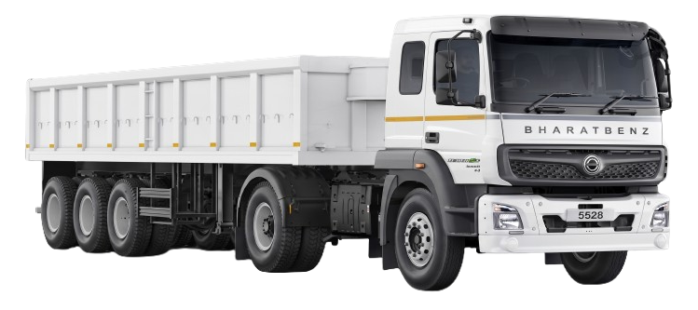

PREDICTIVE MAINTENANCE · FLEET RESULTS & PHASE-2 READINESS
Starter-Motor Failure Prediction
for the BharatBenz 5528T Fleet
From roadside no-starts to a monitored, scored fleet program
93.2% ranking accuracy · 13 of 14 failures caught · median ~6 months' warning · zero battery-alert false alarms
9 of 11 predicted service windows contained the actual failure — and both misses were on the safe side (the truck failed after the window closed).
Prepared for Fleet Operations, Maintenance & Engineering | July 2026 | Version V1.1_SM
TRUCKS IN STUDY
RANKING ACCURACY
FAILURES CAUGHT
MEDIAN WARNING LEAD
BATTERY-ALERT FALSE ALARMS
34
93.2%
13 / 14
168 d
0 / 20
14 failed · 20 in-service
failing vs. healthy (AUROC)
catch-most setting
≈ 5.5 months (77–424 d)
cascade detector, healthy trucks
Confidential — internal distribution only
BharatBenz 5528T Predictive Maintenance · Frozen V1.1_SM model

Slide 2
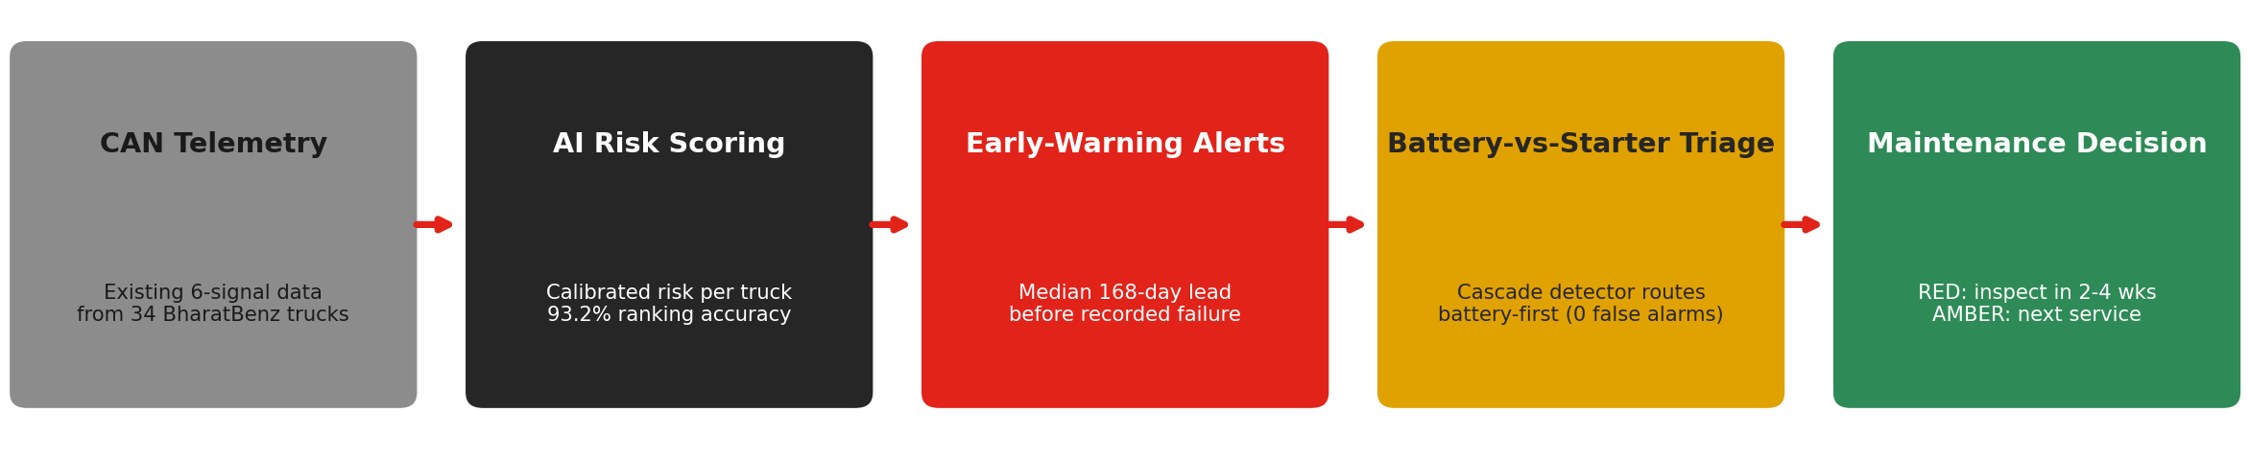
01 · WHAT WAS BUILT
Turning existing truck telemetry into actionable maintenance intelligence
THREE PLAIN-LANGUAGE CAPABILITIES
1 · Risk ranking
2 · Early-warning alerts
3 · Battery-vs-starter triage
‣ Every truck gets a calibrated risk score from its own voltage patterns
‣ Scores map to GREEN / AMBER / RED maintenance tiers
‣ 13 of 14 past failures ranked as high-risk (AUROC 0.93)
‣ Median 168-day lead from the first validated alert to failure (77–424 days)
‣ Two validated service windows — battery ~1–3 months, persistence ~4–9 months
‣ Battery-cascade alert: ~9.5-week median lead, zero false alarms
‣ Detects the battery-degradation cascade that mimics starter failure
‣ Screen-grade — tells the depot where to look first (battery-first)
‣ Agreed with failure type on 9 of 11 · 0 of 20 false attributions
RECOMMENDED ACTION: Deploy the risk ranking, tier flags and alert channels on existing CAN-bus data now — no new sensors are required to start getting value.
DICV · Starter-Motor Predictive Maintenance · V1.1_SM — Confidential
Figures audited to V1.1_SM source files
1

Slide 3
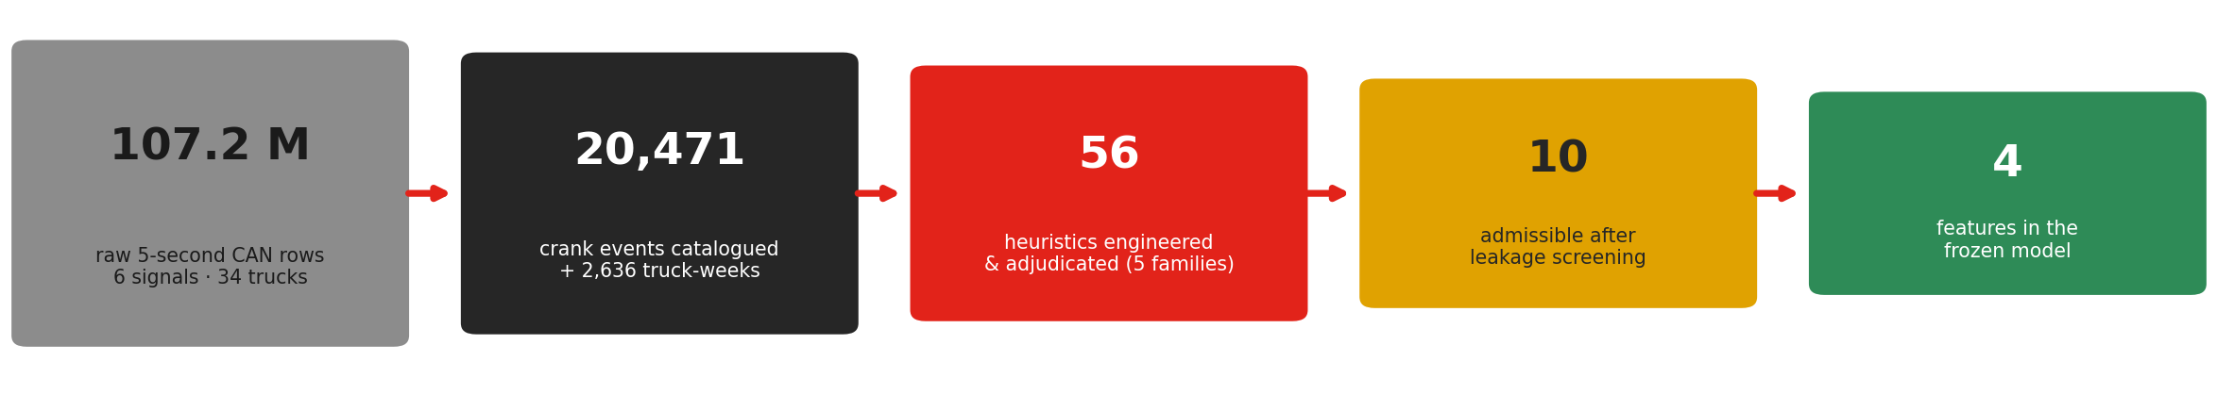
02 · HOW IT WAS BUILT
From 107 million rows of raw telemetry to four trusted signals
THE 56 HEURISTICS SPAN FIVE ENGINEERING FAMILIES
HOW THE FUNNEL WAS POLICED
Family | What it probes | In the model
A · Crank duration & effort | Brush / commutator / bearing wear via crank waveform | Crank-dip signal
B · Start failure & retry | Solenoid / pinion engagement + hard-start | Admissible (not selected)
C · Voltage & battery ★ | Supply-voltage stability & resting floor | 3 of 4 model features
D · Usage & duty cycle | Cycle-dose exposure and wear | Screened out
E · Environment & season | Thermal stress (needs new sensors) | Infeasible today
‣ Every feature is anchored to each truck's own healthy baseline (change-based, not level-based) — it flags real degradation, not truck-to-truck differences.
‣ A dominant-frequency candidate was exposed as a history-length artifact by the fixed-window control — caught, banned and locked out by a feature registry.
‣ 7 SMA-dead trucks (a telemetry config) are cohort-masked, so missing crank data is never read as a fault.
THE DESIGN CHOICE: Small on purpose — at 14 failure events, a four-signal model that generalises beats a forty-signal model that memorises.
DICV · Starter-Motor Predictive Maintenance · V1.1_SM — Confidential
Figures audited to V1.1_SM source files
2

Slide 4
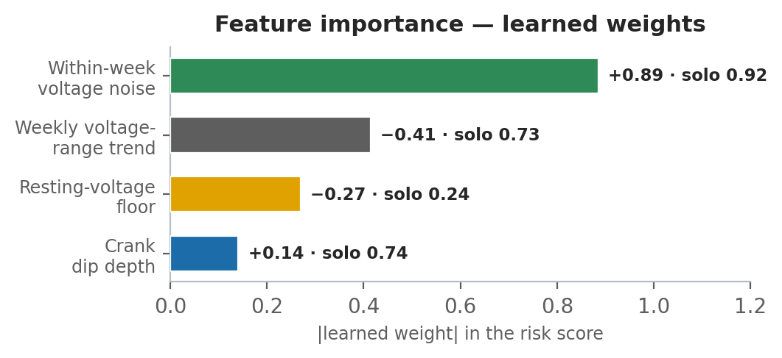
03 · THE FOUR SIGNALS IT WATCHES
Physically meaningful, always read together — no black box
Signal | What it measures (one line) | Role in the model
Within-week voltage noise vsi_withinwk_std_ratio_30d_w | Voltage jitter within a week vs the truck's own healthy baseline | The workhorse — carries most of the score
Weekly voltage-range trend vsi_range_trend | Whether the weekly voltage swing is widening or narrowing (robust 12-wk slope) | Suppressor — sharpens the ranking
Resting-voltage floor rest_vsi_p05_delta90 | How far the engine-off battery floor has sagged vs own baseline (swap-aware) | The battery-cascade signature
Crank dip depth dip_depth_last90_delta | How much deeper voltage dips during cranking, last 90 d vs own baseline | The crank-circuit load signature
Weights are learned (Ridge, standardised) — not hand-set. The two voltage signals are a core pair selected in 34 of 34 CV folds.
ON TOP OF THE SCORE: THREE ALERT HEURISTICS
Persistence flag
A1 · Crank-burst
A2 · Battery-cascade
‣ Risk stays elevated for consecutive weeks
‣ The primary early-warning channel — schedules service
‣ A burst of failed or retried cranks appears
‣ Corroborates the risk score near failure
‣ Rest-floor sag + deeper dips + rising crank failures together
‣ 0 of 20 false alarms · ~9.5-wk lead · routes battery-first
THE KEY POINT: No single signal decides anything — the model reads all four together, which is why weak individual cues combine into a 93.2% ranking.
DICV · Starter-Motor Predictive Maintenance · V1.1_SM — Confidential
Figures audited to V1.1_SM source files
3

Slide 5
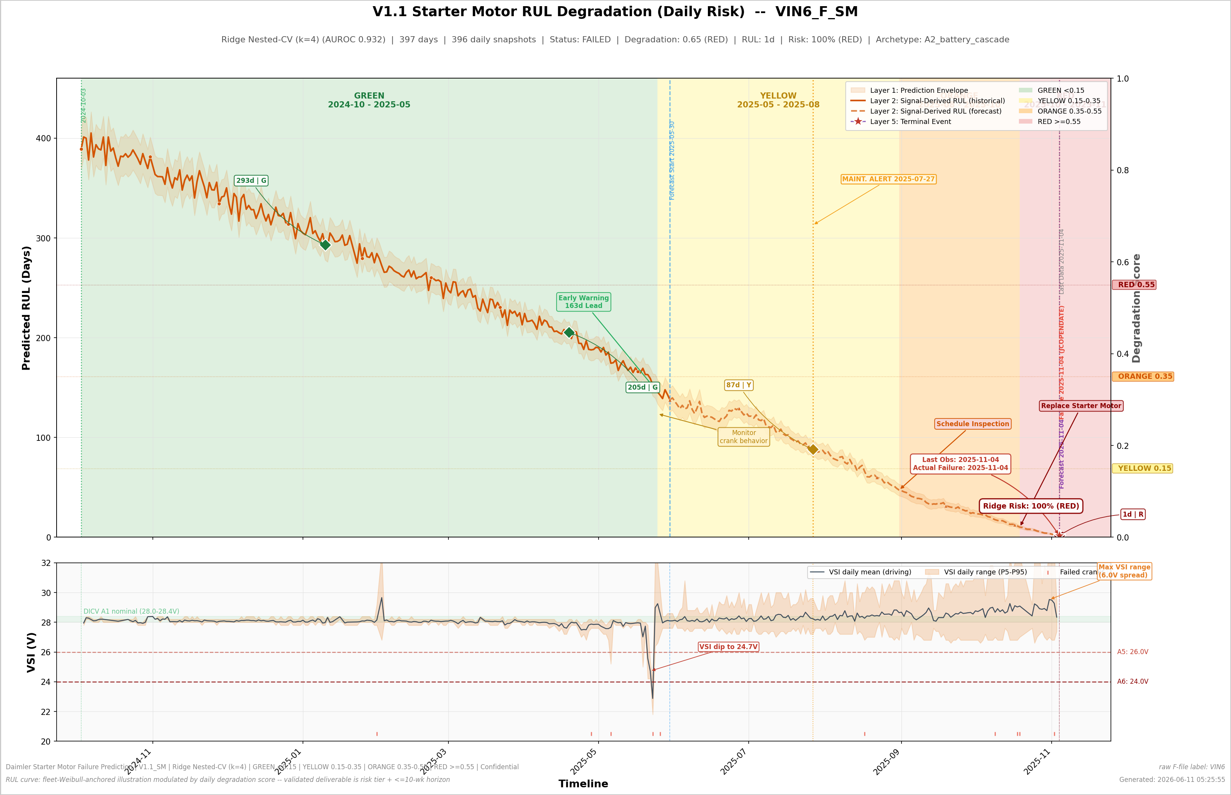
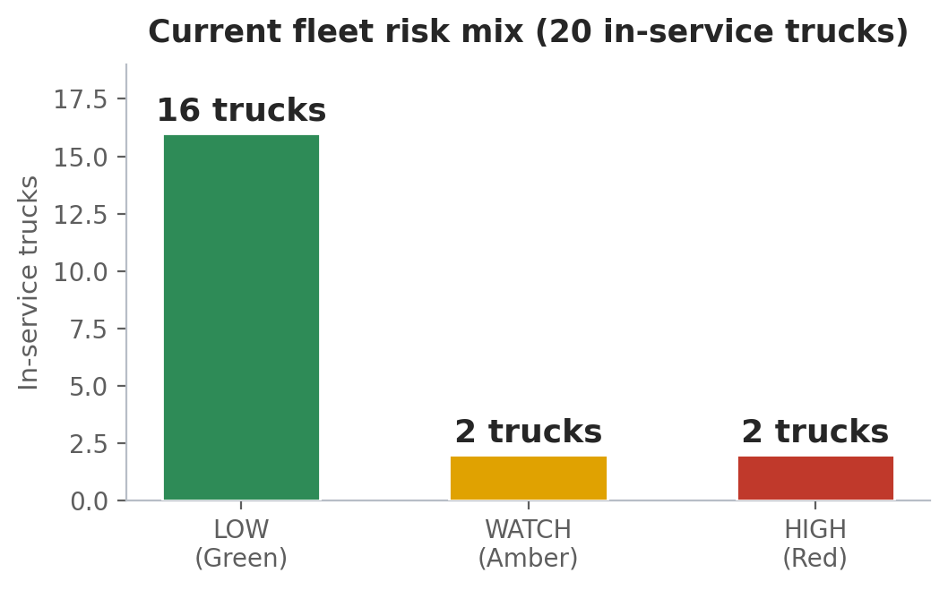
04 · HOW WELL IT WORKS
Validated across 34 trucks — 14 known failures + 20 in-service
DAILY DEGRADATION VIEW
‣ Each truck gets a daily-updated degradation view; colours are action tiers (green = healthy, red = act now).
‣ This failed truck (VIN6) walked the full green-to-red path; the battery-cascade alert fired ~70 days early.
‣ The dotted tail is a fleet-average projection, not a failure date.
HEADLINE RESULTS
Display numbering: VIN1-14 failed, VIN15-34 in-service (raw-file map: results/V1_1_SM_vin_naming_map.csv).
What | Result | Business impact
Failure detection | 13 of 14 caught at the catch-most setting (5 of 20 healthy flagged) | High-risk trucks inspected before they strand
Early warning | Median 168-day first-fire lead (77–424); battery alerts ~9.5 wks ahead | Time to schedule, source parts, avoid roadside events
Service windows | 9 of 11 windowed failures fell inside; both misses on the safe side | Failures pre-empted by a scheduled service
False-alarm burden | 2 of 20 healthy at the stricter RED tier; 0 of 20 on the battery alert | Inspection effort goes where the risk is
vs. first-generation | +1 failure caught (incl. its worst miss); honest probabilities + alerts | The upgrade is measured, not asserted
Fleet status today | 16 LOW / 2 WATCH / 2 HIGH (VIN19_NF & VIN34_NF are HIGH) | Two trucks need inspection now
RECOMMENDED ACTION: One dial, one honest trade — catch-most flags 13/14 (5/20 healthy); the stricter RED tier flags 10/14 (2/20). Operations picks the setting per cost.
DICV · Starter-Motor Predictive Maintenance · V1.1_SM — Confidential
Figures audited to V1.1_SM source files
4

Slide 6
05 · WHY THE NUMBERS ARE TRUSTWORTHY
A strong score on only 14 events invites one question — is it real?
# | Validation layer | What it showed
1 | Nested leave-one-truck-out | Every truck scored blind across 34 folds — a deployment-grade number, not an in-sample flatterer
2 | Selection optimism measured | In-sample 262 vs honest 261 of 280 pairs — a one-pair gap (a memoriser shows a large gap)
3 | Label-shuffle test | 0 of 200 shuffled-label runs beat the real score (p = 0.005)
4 | Fixed-window control | Every feature recomputed on equal windows — score reproduced bit-for-bit (0.0 borrowed from history length)
5 | Leak-ceiling audit | Observation-length proxies scored as upper bounds; one artifact feature banned by a binding registry
6 | Predecessor restated honestly | The first-generation 0.921 was revised down to 0.893 under these stricter rules — disclosed, not hidden
7 | Reproduced & attacked | Benchmark reproduced exactly 4× (V2–V3.1); 17 pre-registered challenger features all rejected
WHAT THIS BUYS YOU
When this system says 93.2% ranking accuracy, that is what you will see on unseen trucks. The score has survived a shuffle test, a fixed-window control, a leak audit, four independent reproductions and seventeen attempts to beat it. The ceiling here is the data, not the method — so every number sharpens as the fleet grows, using this same validated pipeline.
IN OPERATION: The same rigour ships with the deployment — retrain only under the audited protocol, never by hand-tuning a threshold.
DICV · Starter-Motor Predictive Maintenance · V1.1_SM — Confidential
Figures audited to V1.1_SM source files
5

Slide 7
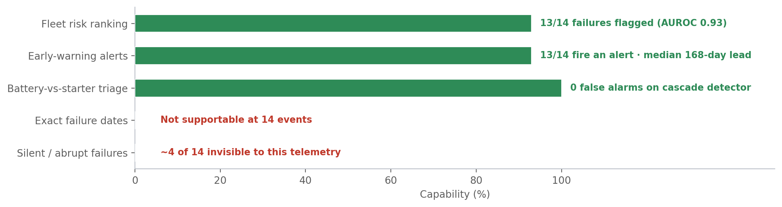
06 · HONEST BOUNDARIES — AND WHAT UNLOCKS EACH
Every limit below is a data limit, not a method limit
HONEST BOUNDARIES
‣ It does not predict failure dates.
‣ With 14 examples a countdown clock is unsupportable — every timing model lost to a simple fleet-average (576 d vs 44 d error). We say ‘within ~10 weeks’, never ‘on 14 June’.
‣ ~4 of 14 failures are electrically invisible.
‣ Sudden internal failures (windings, seizure) and telemetry-silent trucks give no electrical warning at this data resolution.
‣ Some alerts are early or precautionary.
‣ A few healthy trucks are flagged: cheap insurance inspections, but not failures.
DATA GAPS — AND THE UNLOCK
Gap | Impact on the system | The unlock
Voltage sampled only every 5 seconds | The 2–4 month brush-wear warning is physically unreadable | High-frequency crank logging (≥1 Hz)
No cranking-current or battery-health signal | Battery vs. starter can only be inferred, not proven | Add current or battery SoC/SoH sensing
No maintenance / parts records in the data | Failure modes are inferred from patterns, not confirmed | Link workshop records to telemetry
Only 14 failure examples | Wide statistical band on every number (CI 0.81–0.99) | Scale to 500 trucks (~30–50+ failures)
7 of 34 trucks transmit no crank data | An SMA-dead config hides starter activity | Telemetry-config audit; treat silence as a trigger
THE KEY POINT: Each boundary lifts at 500-truck scale using this same validated method — and only new sensing (≥1 Hz crank logging, battery health) breaks the silent-failure floor.
DICV · Starter-Motor Predictive Maintenance · V1.1_SM — Confidential
Figures audited to V1.1_SM source files
6

Slide 8
07 · RECOMMENDED ACTIONS & NEXT STEPS
Priority actions for fleet operations, and what to invest in next
IMMEDIATE ACTIONS
WHAT TO INVEST IN NEXT
# | Action | Owner | Timeline
1 | Inspect the 2 HIGH trucks (VIN19_NF, VIN34_NF): starter + battery circuit | Fleet Ops | 2–4 weeks
2 | Bundle the 2 WATCH trucks (VIN16_NF, VIN24_NF) into next service | Fleet Ops | Next service
3 | Stand up weekly fleet scoring with monthly tier review | Engineering | This quarter
4 | Enable battery-first routing on cascade alerts | Maint. Planning | This quarter
Priority | Investment | Expected impact
P0 | High-frequency crank logging (≥1 Hz) | Unlocks months-ahead brush-wear warning
P0 | Cranking-current or battery-health signal | Proves battery-vs-starter; sharper alerts
P1 | Link maintenance / parts records to telemetry | Confirms failure modes; better labels
P1 | Keep collecting failure examples | Narrows uncertainty on every number
P2 | Scale to 500 trucks (Phase 2) | ~30–50+ failures → per-truck timing
OPERATING RHYTHM
‣ Weekly —
‣ Re-score every truck; a new RED or battery-cascade alert triggers a work order.
‣ Monthly —
‣ Tier review with fleet ops; track watch-list trucks for drift or recovery.
‣ On each confirmed failure or repair —
‣ Feed the outcome back; retrain only under the audited validation protocol.
‣ Rule of communication —
‣ Quote risk tiers and the ~10-week horizon — never a single failure date.
THE BOTTOM LINE: Value today: two HIGH trucks to inspect, a weekly scoring rhythm and battery-first triage — a modeled ~43% saving vs run-to-failure. The biggest next unlock is new signals + Phase-2 scale, not more modelling on the same data.
DICV · Starter-Motor Predictive Maintenance · V1.1_SM — Confidential
Figures audited to V1.1_SM source files
7

