Slide 1
Alternator Predictive Maintenance — V11.1 Business Summary
We tested whether the new electrical signals can predict each truck's failure date — they cannot; the fleet schedule + alarms remain the deliverable.
Fleet: 25 trucks (10 failed + 15 in-service) | Classifier AUROC 0.927 (unchanged) | Verdict: NO_IMPROVEMENT_HONEST

Slide 2
How we tested it
• V11 engineered 12 new electrical signals from the existing 6 CAN sensors (no new hardware) and improved failure detection from 2/10 to 6/10 trucks.
• V11.1 asked: can those signals, combined into a statistical survival model, predict each individual truck's remaining life more accurately than the fleet average?
• We encoded two covariate signals (lifetime electrical stress history + recent compound alarm activity) into an Accelerated Failure Time model.
• The model was validated out-of-sample on all 10 failed trucks (leave-one-out per fold, parameters re-estimated from scratch each time).
• The test was repeated three ways: no covariates (M0), one covariate (M1), two covariates (M2). Result: M0 wins — covariates make things worse.

Slide 3
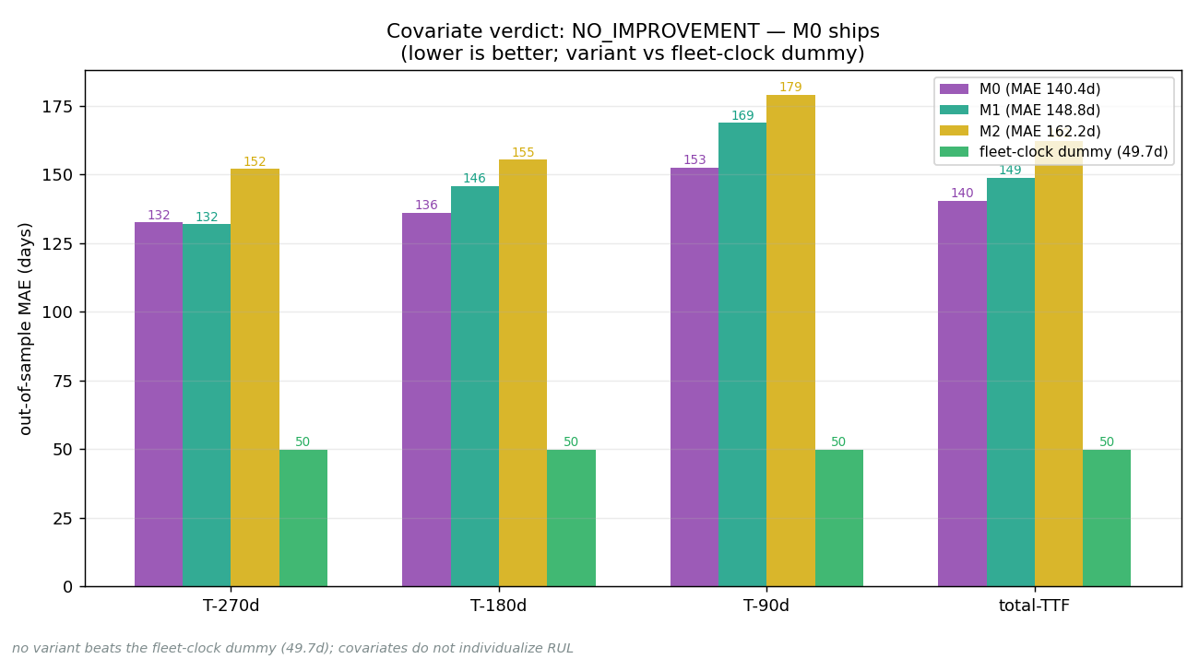
Result: no variant beats the fleet-clock dummy (error 140d vs 50d)
M0 (no covariates): 140.4d error. Fleet-clock dummy (assume every truck fails at the fleet median): 49.7d error. The dummy wins by a factor of ~3 — this is a structural data limit, not a modelling choice.

Slide 4
Limitations & why the limit is structural
• Only 10 failure events in the dataset — far too few to calibrate per-truck timing with any covariate model.
• The new electrical stress signal (x1) turns out to track truck age, not failure risk independently of age — an exposure confound.
• 4 of 10 failures had no measurable electrical precursor (abrupt / silent failure mode); those trucks are undetectable from this data.
• The fleet is aged: all 15 in-service trucks are already past or near the empirical failure median — per-truck remaining-life estimates overlap heavily.
• No per-truck calendar dates are available; timing is in operational days.

Slide 5
What ships + next steps
• WHICH trucks: frozen Ridge classifier AUROC 0.927 — risk ranks the 15 in-service trucks reliably.
• WHEN (fleet): schedule inspection at 601 days (≈ 120440 km) — the empirical fleet-failure median.
• WHEN (alerts): GED storm fires for 2/10 failed trucks, 0/15 non-failed (0 false alarms). Early-watch fires for 3/10 active-failure trucks, 0/15 non-failed (0 false alarms).
• Next: validate on the larger starter-motor fleet (n=34 trucks, more events). The timing question can be re-opened when ≥ 30 failure events are available.
• All claims are audited to source cache files (see AUDIT_REPORT.md).

