Slide 1
Alternator RUL Covariates — V11.1
Verdict: NO_IMPROVEMENT_HONEST | Chosen variant: M0 | Fleet: 25 trucks (10F + 15NF)

Slide 2
The question V11.1 asked
• V10.6.2 confirmed per-truck RUL cannot beat a fleet-clock dummy (MAE 140d vs 49.7d).
• V11 engineered 12 heuristic channels from 6 CAN channels — recall rose to 6/10 failed.
• V11.1 asks: can those heuristic signals, encoded as AFT covariates, allow per-truck RUL estimates to finally beat the fleet clock?
• Two covariate candidates were tested: x1 (lifetime exceedance count) and x2 (trailing compound-vote indicator, last 90 days).

Slide 3
Method — AFT with leakage-safe truncated covariates
• Accelerated Failure Time (Weibull AFT) fitted on all 25 trucks via LOVO (Leave-One-VIN-Out) rewound backtest — same protocol as V10.6.2.
• x1: log(1 + count of days in [start, t_rewind) where GED=2 OR compound vote ≥ 2).
• x2: binary indicator — was compound vote ≥ 2 in any of the 90 days before t_rewind?
• Leakage doctrine enforced: covariates truncated strictly at the rewind date (G-LEAK gate).
• Three variants: M0 (baseline, no covariates), M1 (x1 only), M2 (x1 + x2).
• Model selection rule: minimum MAE among variants with PI coverage ≥ 0.80.

Slide 4
Covariate construction — x1 and x2
• x1 encodes cumulative electrical stress: how many operational days did the truck show either GED=2 storm activity or a compound vote ≥ 2?
• x1 is log-transformed (log1p) to reduce influence of trucks with very long histories.
• x2 is a short-memory flag: was the compound alarm active in the last 90 days? Intended to capture current-state health vs historical load.
• Both covariates evaluated at the rewind date — never using post-event data.
• Covariate range: x1 in [0, 4.0] (log-scale); x2 in {0, 1}.
• Grid: β1 ∈ [-0.20, 1.00] (25 steps); β2 ∈ [-0.20, 1.50] (18 steps); shape/scale from posterior grid (80×80 per fold, 2000 draws).

Slide 5
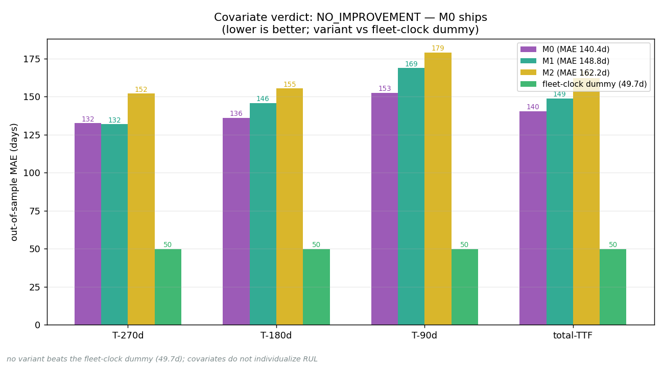
Verdict — backtest accuracy: all variants fail to beat dummy

Slide 6
Why x1 failed — the exposure confound
• Non-failed trucks have systematically higher x1 than failed trucks (e.g. NF VIN8_ALT x1=4.01 vs typical failed x1~1.5).
• Reason: NF trucks simply live longer — they accumulate more operational days and therefore more exceedance events over their lifetime.
• x1 is a proxy for truck age, not electrical pathology independent of age.
• Any positive AFT beta coefficient for x1 absorbs timing information already encoded in the Weibull scale — it cannot provide independent signal.
• A rate-based covariate (exceedances per 100 operational days) could break the confound but requires n ≫ 10 events to estimate reliably.

Slide 7
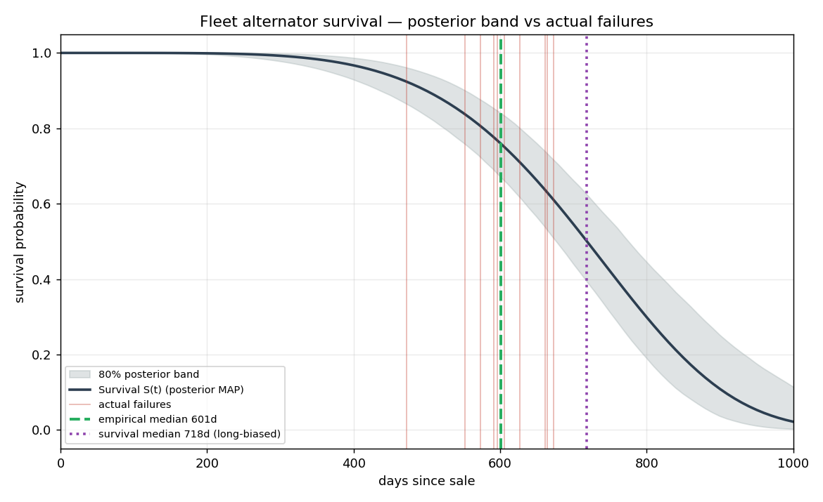
What ships — M0 ≡ V10.6.2 fleet curve (Weibull shape 5.17, scale 771d)

Slide 8
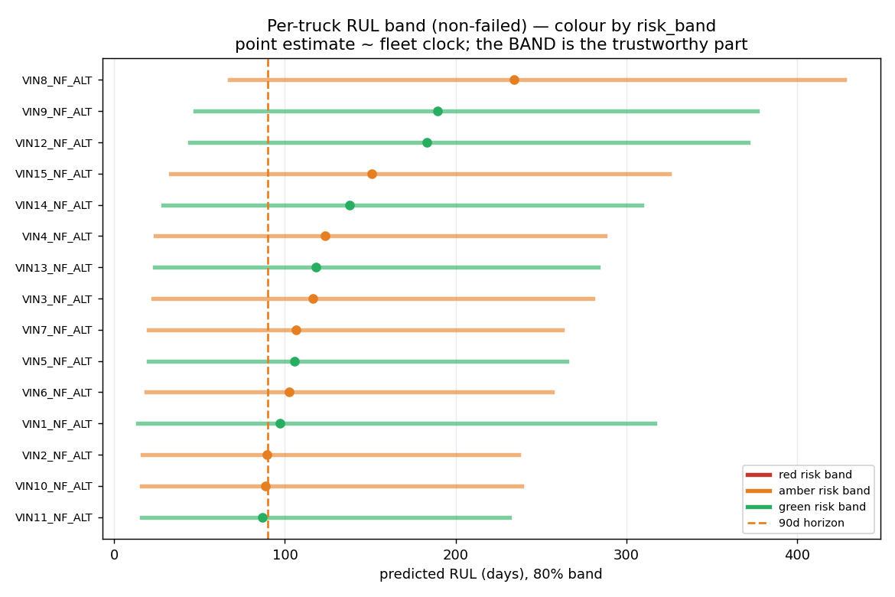
RUL band waterfall — all 15 NF trucks (time_dim SHORT for all)

Slide 9
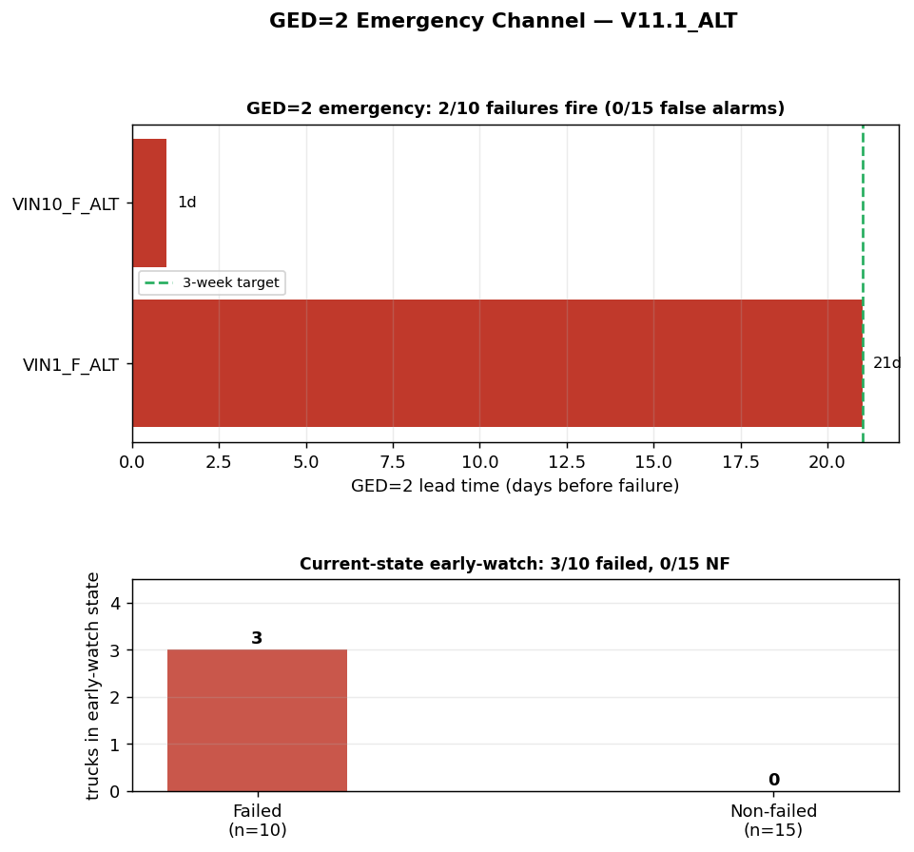
Emergency channels — GED 2/10 F, 0/15 NF | early-watch 3/10 F, 0/15 NF

Slide 10
Decision matrix — three deliverable dimensions
• WHICH (classifier): frozen Ridge, AUROC 0.927. High risk: ridge_prob ≥ threshold. NF trucks: 1 above-thr (amber), 14 below (green/amber).
• WHEN fleet (window): empirical median 601d (p25–p75 578–652d). Weibull median 718d (context only, right-censoring inflated).
• WHEN individual (emergency): GED channel 2/10 F, 0/15 NF. Early-watch current-state 3/10 F, 0/15 NF.
• RUL band (M0): available for all trucks; point estimate unreliable — use interval for planning horizon only.
• Covariates verdict (V11.1): M0 chosen; x1/x2 add no value. This is the third structural confirmation of the timing limit.

Slide 11
Five verification gates — all PASS (PASS)
• G-LEAK: Leakage audit — 60 covariate rows checked, 0 violations.
• G-BETA: Variant selection — chosen M0; verdict NO_IMPROVEMENT_HONEST.
• G-W6: Classifier code isolation — 0 classifier symbols in AFT code.
• G-EMERG: Emergency channel — GED 2/10 F / 0/15 NF; early-watch 3/10 F / 0/15 NF.
• G-COVER: PI coverage 0.867 ≥ 0.80 (M0).

Slide 12
Three-way comparison — V10.6.2 → V11 → V11.1
• V10.6.2 (honest baseline):
• Classifier AUROC 0.927
• Precursor recall: 2/10 (GED only)
• RUL MAE: 140d vs dummy 49.7d
• Verdict: NO_IMPROVEMENT
•
• V11 (lead-time heuristics):
• Classifier AUROC 0.927 (frozen)
• Precursor recall: 6/10 (compound + crank)
• 0/15 NF false alarms
• No RUL component
• V11.1 (covariate AFT):
• Classifier AUROC 0.927 (frozen)
• M0 MAE 140.4d / M1 148.8d / M2 162.2d
• Dummy MAE 49.7d (still wins)
• Verdict: NO_IMPROVEMENT_HONEST
•
• Cumulative finding:
• Timing limit is structural (n=10).
• Classifier + fleet window + emergency
• channels are the complete deliverable.

Slide 13
Limitations
• n = 10 failure events: Weibull shape and AFT beta coefficients are under-identified.
• Exposure confound (x1): lifetime exceedance count tracks age, not pathology. Rate-based time-varying covariates require n ≫ 10.
• Aged fleet — all 15 NF trucks have time_dim = SHORT: the time dimension is currently non-discriminating and RUL bands overlap heavily.
• No per-truck failure dates: TTF is in operational days; km/engine-hours are speed-integrated estimates.
• Multiple comparisons: 12+ heuristics tested against 10 events inflates spurious hits. Current-state early-watch is the conservative validated subset.
• 4/10 failures remain undetectable (abrupt / silent modes) from these 6 channels.

Slide 14
Recommendation
• Deploy the three-channel emergency system: GED storm (channel 1) + current-state early-watch (channel 2). Current-state: 3/10 F, 0/15 NF.
• Schedule fleet-wide inspection at the empirical window median (601d / ≈120440 km).
• Prioritise inspection order using the frozen Ridge classifier (AUROC 0.927).
• Do NOT rely on per-truck RUL dates for individual scheduling decisions — the timing limit is structural and confirmed across three independent iterations.
• Next: validate on the starter-motor fleet (n=34, more events) and track new failures as they accrue to re-evaluate the timing question.

Slide 15
Appendix — data sources
• All live numbers loaded from V11.1_ALT/cache/ at build time.
• backtest_results.json: MAEs for M0/M1/M2; dummy MAE; chosen variant.
• fleet_weibull_params.json: shape 5.17, scale 771d, median 718d.
• V10.6.2_ALT/cache/rul/fleet_window.json: empirical window (read-only).
• emergency_per_vin.csv: GED/early-watch per-truck status.
• V11.1_ALT_verification.json: five gate statuses.
• Graphs: visualizations/rul_core/ (backtest_accuracy.png, fleet_survival_curve.png, rul_band_waterfall.png, ged_emergency.png).
• Classifier (V10.5.3): frozen Ridge coefficients — NOT touched by V11.1 pipeline.

