Slide 1

PREDICTIVE MAINTENANCE · DICV MANAGEMENT REVIEW
DICV Alternator Risk Prediction
V11.2 Validation Review
Metric audit · heuristic separation · zone honesty · RUL correction
25 trucks · 10 failed + 15 non-failed · LOVO out-of-fold validation
DICV Management Review | 2026-06-24 | Version V11.2
Confidential — internal distribution only

Slide 2
01 · THE ASK & WHAT V11.2 VALIDATES
Five numbers that define the system — honestly framed
25
93%
9/10
14/15
601d
trucks studied
10 failed · 15 non-failed
ranking accuracy
AUROC 0.9267 (139/150 pairs)
failures caught
at Youden threshold 0.45
healthy correct
1 FP at threshold; 0 on emerg.
fleet wear window
≈120k km · ≈4,538 eng-hrs
What the validation confirms
▸ RANKING: the 93% AUROC means failing trucks score above healthy ones in 139 of 150 random pairs — this is a ranking metric, not classification accuracy.
▸ At the operating threshold: 9/10 failures caught (recall 90%), 14/15 healthy correct (specificity 93.3%), 1 false positive on the classifier.
▸ Emergency channels (GED=2, compound) have 0 false alarms on 15 healthy trucks — when they fire, they are trusted.
▸ Data ceiling at n=25 remains: per-truck RUL MAE 140d vs fleet-clock 50d; zone system weak (only 3/10 failed reach orange/red).
93% is RANKING accuracy (AUROC), not classification accuracy. Classifier has 1 FP at threshold; emergency channels have 0 false alarms.
RECOMMENDED ACTION: Use risk ranking for prioritised inspection lists; treat emergency-channel alerts as act-immediately signals.
DICV · Alternator Predictive Maintenance · V11.2 Validation Review — Confidential
Numbers pulled from V11.2_ALT result files
1

Slide 3
02 · THE THREE-BOX SYSTEM
WHICH trucks are at risk · WHEN (fleet window) · WHEN (emergency alert)
WHICH
Risk Ranking
WHEN(fleet)
Fleet Window
WHEN(emergency)
Alert Channels
▸ 93% AUROC — ranks all 25 trucks by failure probability on data the model never saw.
▸ 9 of 10 failed trucks land in the top-10 inspection list.
▸ Powers the maintenance priority queue; one false positive at threshold.
▸ Deployable today on existing telematics signals.
▸ Median alternator life: 601 days · ~120,440 km · ~4,538 engine-hours.
▸ Validated on 10 real failures — this is the planning window, not per-truck countdown.
▸ Enables batched workshop scheduling and staged spare procurement.
▸ Per-truck RUL bands (87–235 d range for non-failed) anchor around this window.
▸ GED=2 fires 2/10 failed trucks (21d and 1d lead). Zero false alarms on 15 healthy trucks.
▸ Compound channel (5-heuristic vote) fires 3/10 current, 0/15 non-failed.
▸ When an alert fires — act immediately; the false-alarm rate is zero on this fleet.
▸ Honest caveat: 8/10 failures emit no pre-failure alert on either channel.
DICV · Alternator Predictive Maintenance · V11.2 Validation Review — Confidential
Numbers pulled from V11.2_ALT result files
2

Slide 4
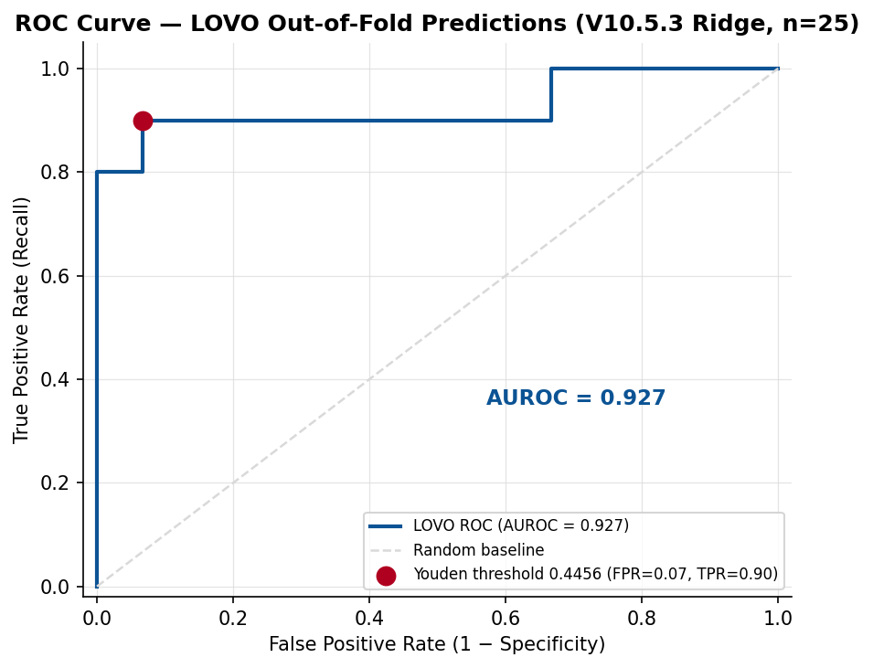
03 · THE 93% EXPLAINED — RANKING ACCURACY
92.67% AUROC: a failing truck ranks above a healthy one in 139 of 150 random truck pairs
139 / 150
11 / 150
Concordant pairs
failing truck ranked above healthy
Discordant pairs
the model got the order wrong
9 / 10
14 / 15
Failures caught
in top-10 inspection priority list
Healthy correct
at threshold 0.45 (1 FP at classifier)
0.94
0.833
PR-AUC
precision–recall area under curve
MCC
Matthews correlation coefficient
HONESTY NOTE
93% is a RANKING metric (AUROC), not classification accuracy. At the operating threshold the classifier has 1 false positive (VIN3_NF_ALT, ridge_prob=0.49). The emergency channels (GED=2, compound vote) have ZERO false alarms on the 15 healthy trucks — these channels are independent of the threshold.
Bootstrap 95% CI: 0.807–1.000 · Mean 0.923 · Permutation p=0.00 (10,000 bootstrap rounds, V10.5.3 spec)
DEPLOYMENT NOTE: Use AUROC ranking to prioritise inspections. At Youden threshold 0.4456: recall=90%, specificity=93.3%.
DICV · Alternator Predictive Maintenance · V11.2 Validation Review — Confidential
Numbers pulled from V11.2_ALT result files
3

Slide 5
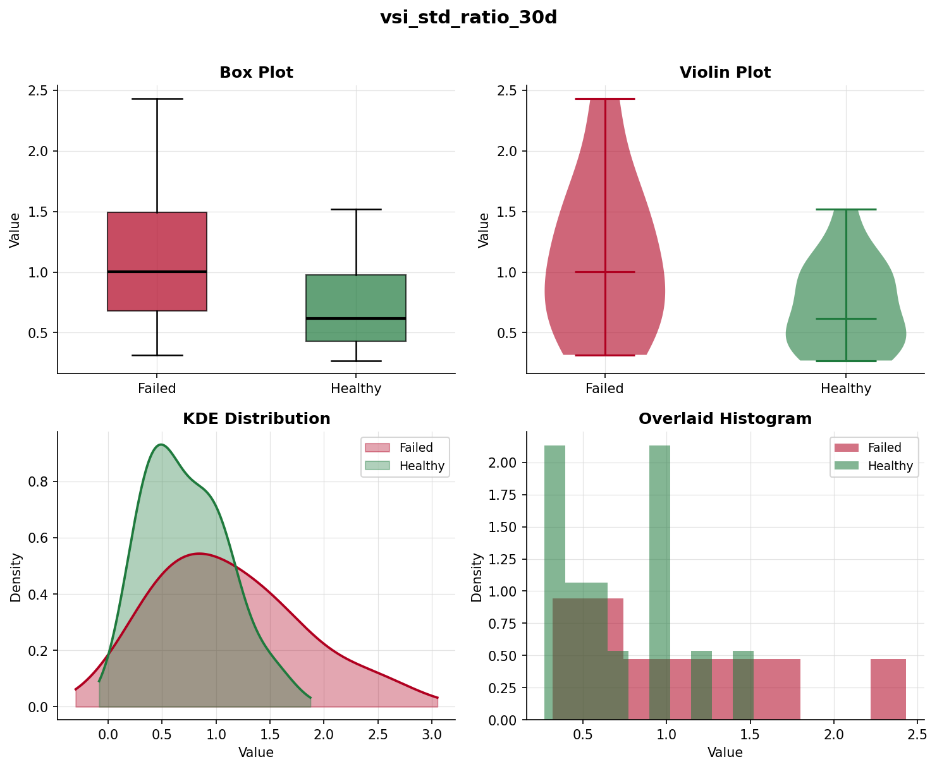
04 · HEURISTICS THAT MATTER — TOP FEATURES & SEPARATION
Six voltage-behaviour signals drive risk ranking — vsi_std_ratio_30d leads
Feature | Ridge coeff | Perm imp. | Feature AUROC | Separation | Meaning
vsi_std_ratio_30d | +0.4426 | 0.1547 | 0.693 | MEDIUM | late-life voltage scatter vs early-life baseline
vsi_dominant_freq | +0.4265 | 0.1053 | 0.650 | SMALL | dominant FFT frequency of daily voltage (rhythm vs drift)
vsi_spectral_entropy | +0.2447 | 0.0573 | 0.813 | STRONG | voltage spectrum disorder (clean rhythm vs broadband noise)
vsi_range_trend_last30d | +0.2299 | 0.0613 | 0.740 | STRONG | slope of daily voltage min-max range late in life
bat_charge_delta_trend_right | +0.2240 | 0.0340 | 0.560 | NEGLIGIBLE | trend of cruise-minus-resting voltage (charging headroom loss)
progressive_drift | -0.2055 | 0.0480 | 0.264 | MEDIUM | cumulative drift of daily voltage from baseline
NOTE — progressive_drift has NEGATIVE coefficient
This is an exposure artifact: healthy trucks observed longer accumulate more drift (healthy mean 0.71 vs failed 0.10). The Ridge model partially corrects by penalising trucks with unexpectedly low drift. Feature retained because the frozen 6-feature V10.5.3 spec validated at AUROC 0.927; removing it would break the spec.
DICV · Alternator Predictive Maintenance · V11.2 Validation Review — Confidential
Numbers pulled from V11.2_ALT result files
4

Slide 6
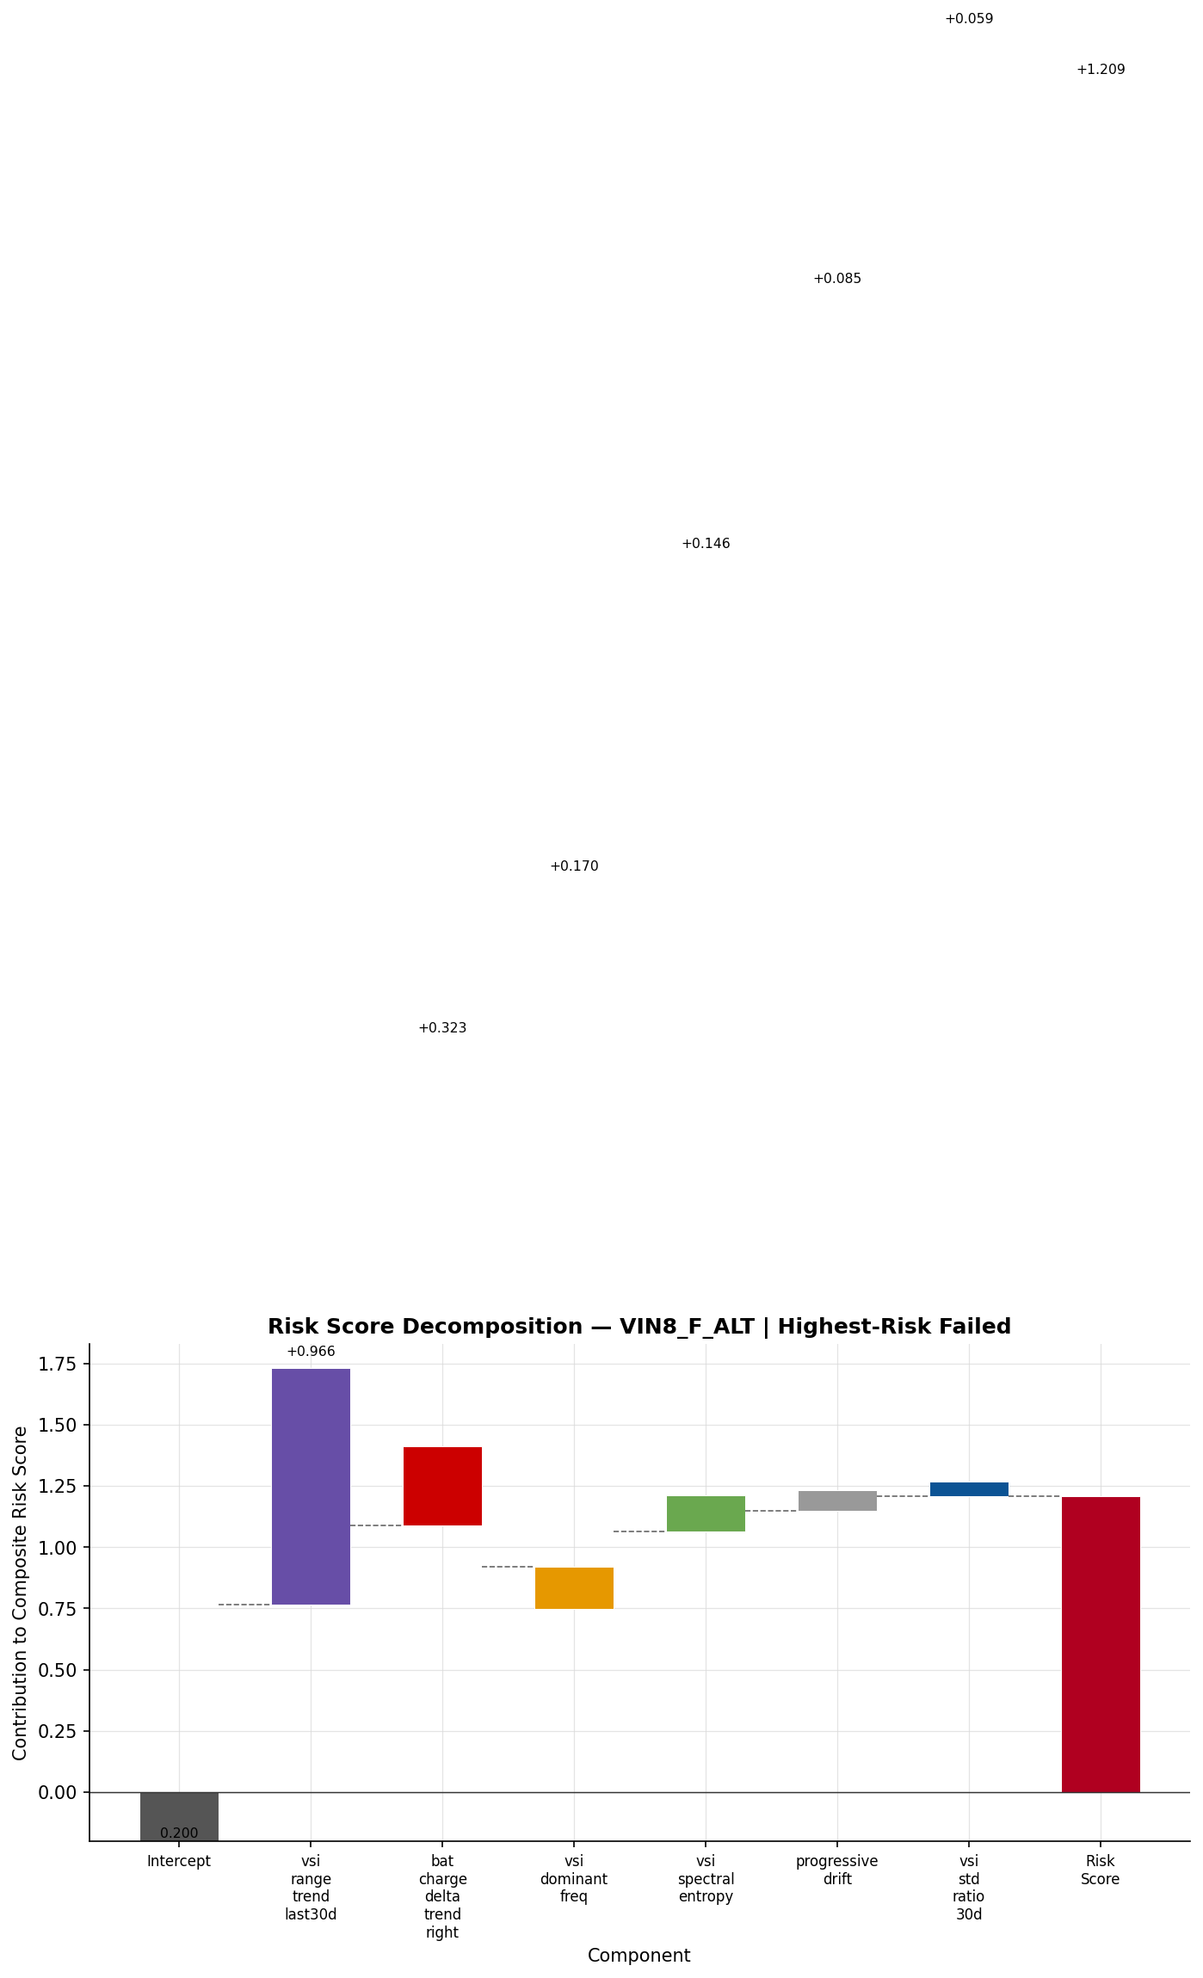
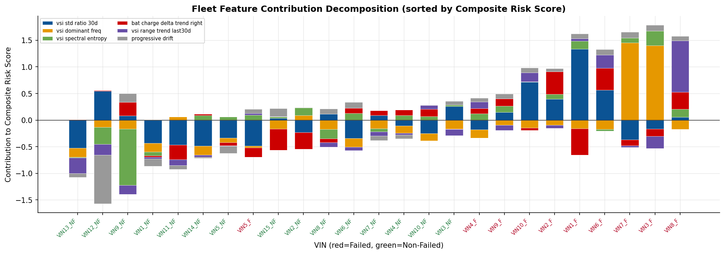
05 · HOW RISK IS SCORED — WATERFALL BREAKDOWN
Each truck's risk score is the sum of weighted feature contributions — shown here for VIN8 (highest risk)
Reading the waterfall
▸ Each bar shows how much a single feature pushes the risk score up or down from the intercept.
▸ Green bars decrease risk; red bars increase it — the final score (right) determines the risk band.
▸ vsi_std_ratio_30d is the strongest positive contributor (late-life voltage scatter vs baseline).
▸ progressive_drift is negative: healthy trucks show more cumulative drift than failed ones — an exposure artifact.
▸ Intercept = −0.20 (baseline log-odds before any feature).
GREEN ridge_prob < 0.35 — Normal monitoring
AMBER 0.35 ≤ ridge_prob < 0.55 — Elevated; schedule inspection
RED ridge_prob ≥ 0.55 — High risk; plan service now
DICV · Alternator Predictive Maintenance · V11.2 Validation Review — Confidential
Numbers pulled from V11.2_ALT result files
5

Slide 7
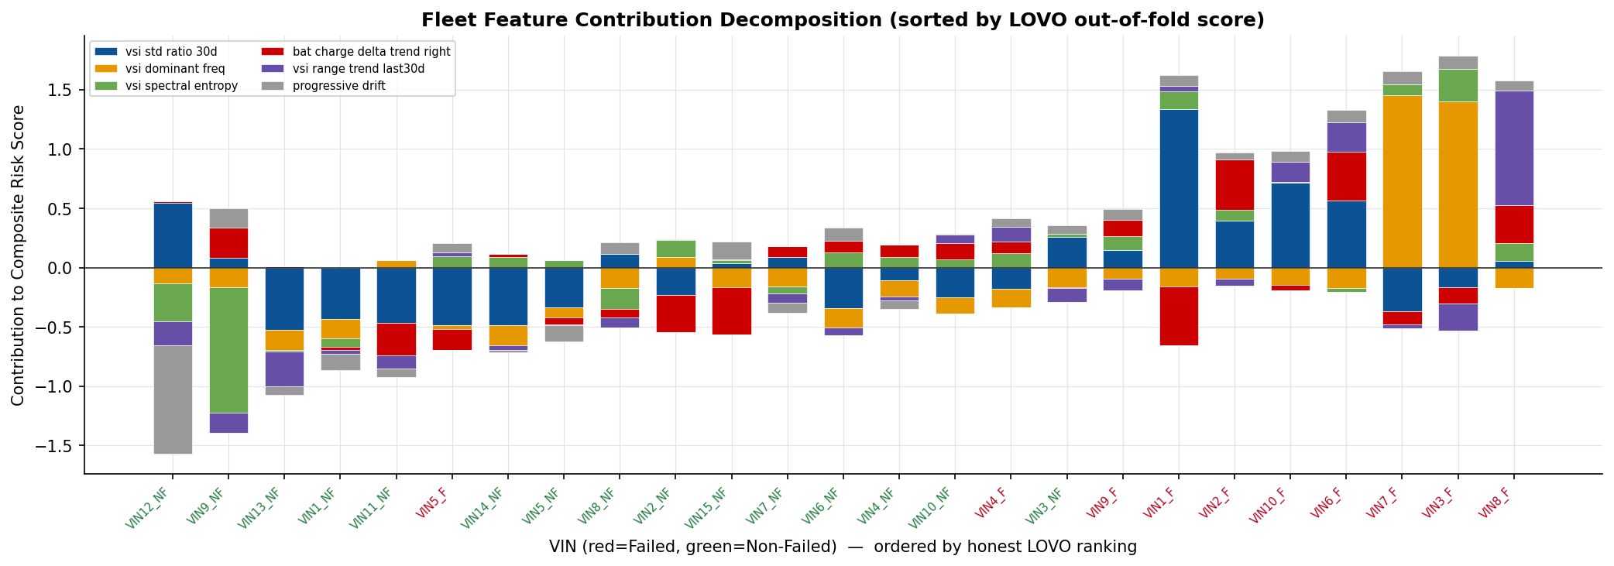
05b · HOW RISK IS SCORED — HONEST LOVO RANKING
How risk is scored — honest LOVO ranking
▸ Same per-truck signal contributions, re-ordered by the honest Leave-One-VIN-Out ranking (the 0.927-AUROC order).
▸ 98.8% rank-correlated with the in-sample view; ≤2-position nudges, no decision changes.
▸ Visible honesty: missed failure VIN5_F sits low-left; false alarm VIN3_NF sits high-right.
DICV · Alternator Predictive Maintenance · V11.2 Validation Review — Confidential
Numbers pulled from V11.2_ALT result files
6

Slide 8
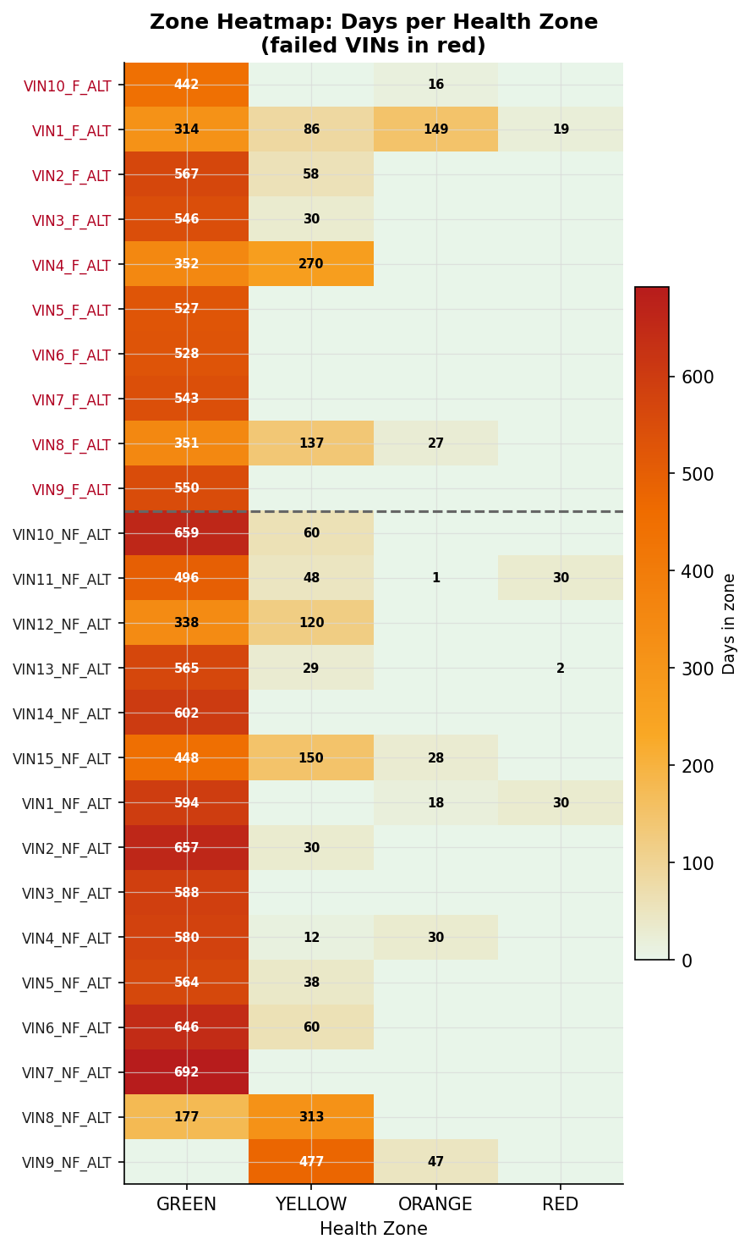
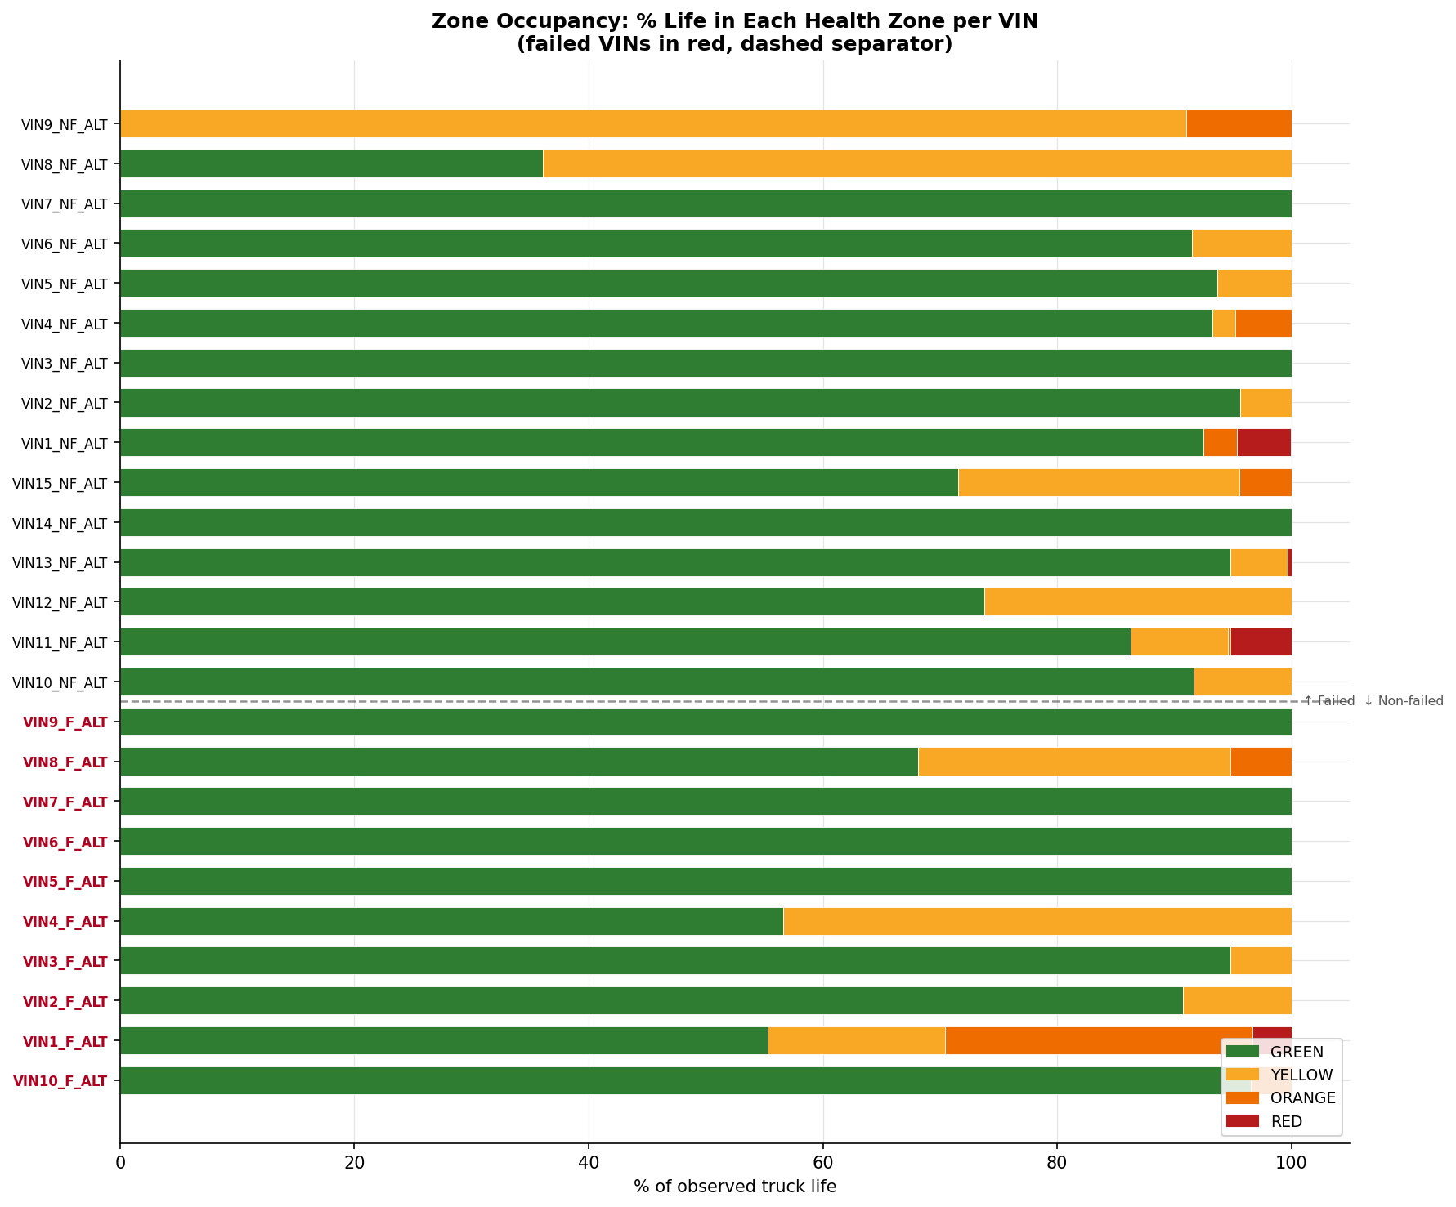
06 · HEALTH ZONES — DEPLOYED BANDS & HONEST ASSESSMENT
Global risk bands are deployable; the 4-zone temporal system is visual context only (n=25 ceiling)
GREEN
< 0.35
Normal monitoring
9 trucks
AMBER
0.35 – 0.55
Schedule inspection
9 trucks
RED
≥ 0.55
Plan service / act now
7 trucks
HONESTY — ZONE SYSTEM ASSESSMENT: Global bands (green/amber/red) cleanly separate VINs by ridge_prob and are acceptable for operational ranking. The 4-zone temporal M5 system (Normal→Early-watch→Plan-service→Act-now) is WEAK: only 3/10 failed trucks ever reached orange or red, while 6/15 non-failed trucks also entered those zones. Dynamic per-VIN zone trajectories are supplemental visual context, not a standalone alert system. Data ceiling (n=10 failed) prevents reliable zone-level health-progression discrimination.
DICV · Alternator Predictive Maintenance · V11.2 Validation Review — Confidential
Numbers pulled from V11.2_ALT result files
7

Slide 9
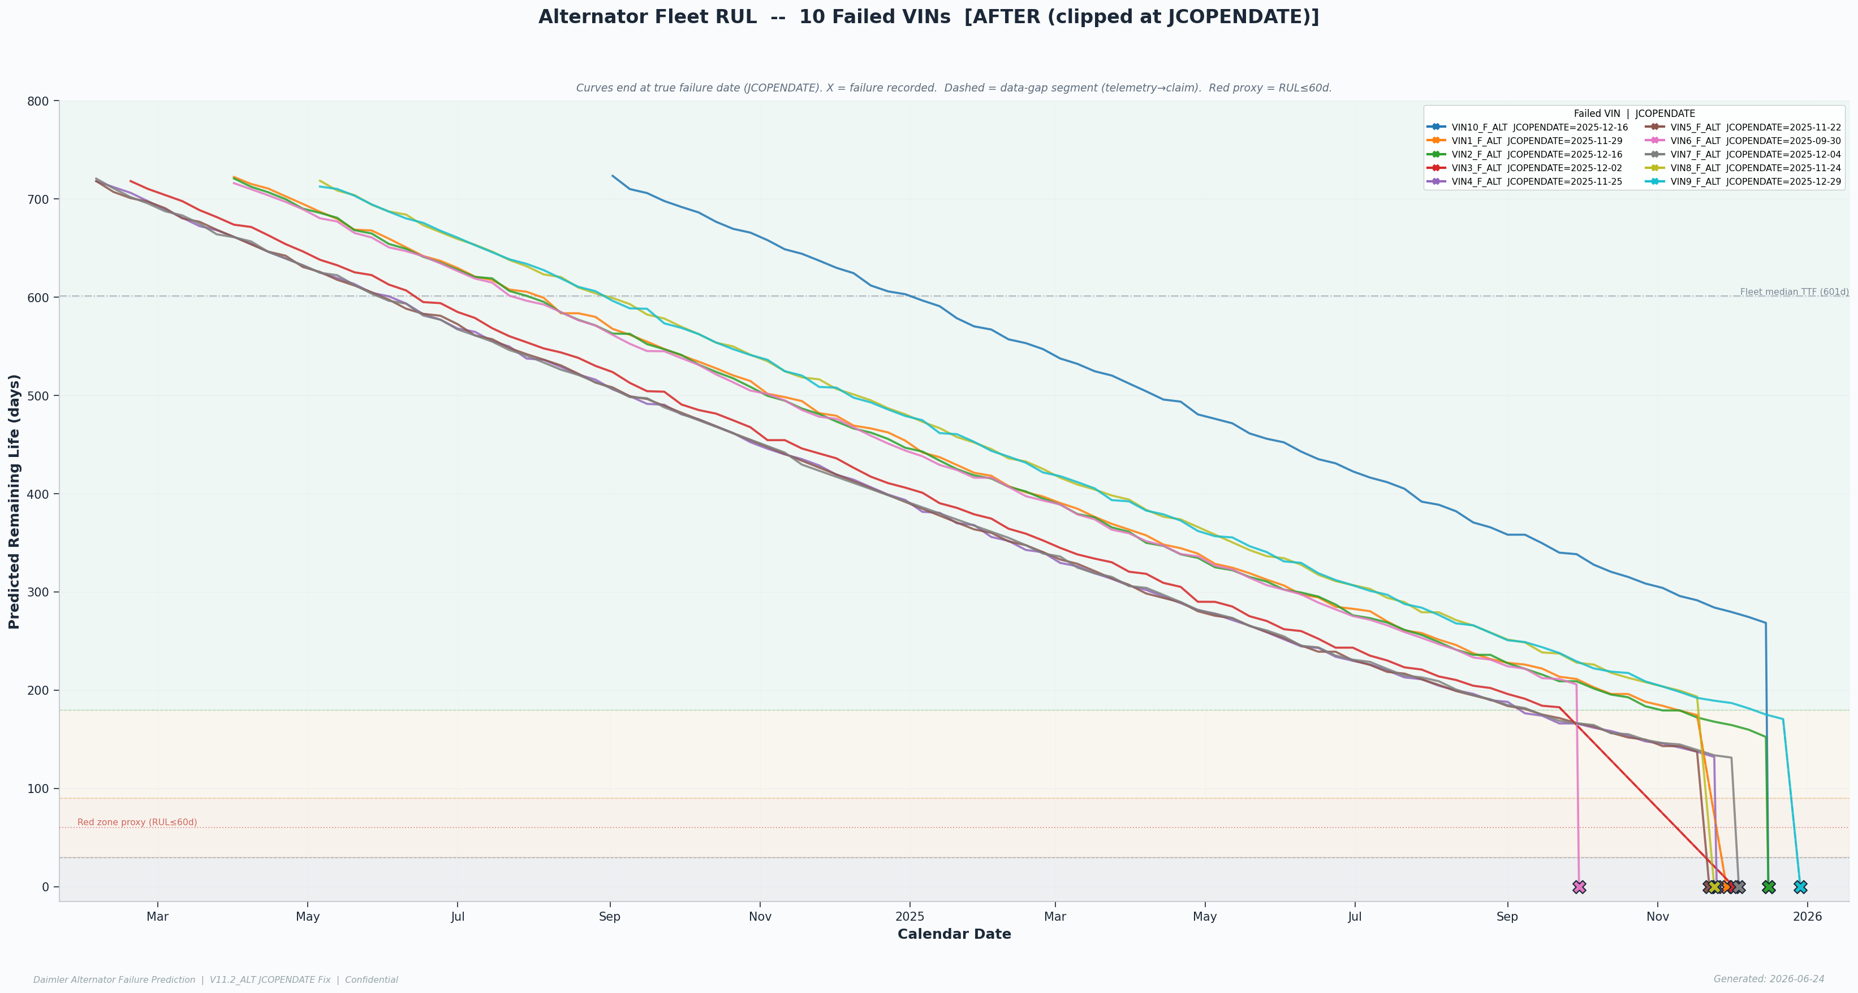
07 · WHEN — FLEET WEAR-OUT WINDOW & RUL BANDS
Validated replacement window: 601 days · ~120,440 km · ~4,538 engine-hours
601 d
~120k km
~4,538 hrs
87–235 d
140d MAE
Fleet wear window
median time-to-failure
Distance equivalent
~120,440 km validated
Engine-hours
validated on 10 failures
Non-failed RUL range
per-truck band (p10–p90)
Per-truck RUL error
vs fleet-clock 50d — caution
What the RUL band means
▸ Per-truck RUL is a BAND (p10–p90 range), not a point prediction.
▸ Non-failed trucks: 87–235 days remaining life range.
▸ Per-truck MAE 140d >> fleet-clock MAE 50d — per-truck countdown is unreliable at n=25.
▸ JCOPENDATE fix: curves now end at the official open-date (VIN3 shifted +66d — largest gap in fleet).
▸ Use the fleet window for scheduling; use per-truck bands only for prioritisation.
Caution: per-truck RUL MAE 140d vs fleet-clock 50d — per-truck precision is a data ceiling, not a method failure. Fleet window is the trustworthy planning tool.
DICV · Alternator Predictive Maintenance · V11.2 Validation Review — Confidential
Numbers pulled from V11.2_ALT result files
8

Slide 10
08 · EMERGENCY CHANNELS — GED=2 & COMPOUND ALERT
High-precision pre-failure signals with zero false alarms — but limited recall
GED=2 Channel
Compound Channel
Alternator excitation disturbance
5-heuristic vote (≥2 of 5 fires alert)
▸ Fires on 2/10 failed trucks. Lead times: 21d (VIN1) and 1d (VIN10).
▸ Fires on 0/15 non-failed trucks — ZERO false alarms on this channel.
▸ Only gradual-electrical failure modes emit GED=2 storms; abrupt failures (8/10) show no signal.
▸ When it fires: act immediately. When silent: no inference possible for abrupt failures.
▸ Current-state compound: 3/10 failed trucks, 0/15 non-failed.
▸ Heuristics: vsi_ceiling, vsi_resid_mean, crank_recovery_t, resting_vsi_mean, ged_churn.
▸ Equal weights (1 vote each) deliberately NOT fitted — at n=10 failures any learned weighting would overfit.
▸ Zero false alarms on the non-failed fleet for the compound channel.
HONEST RECALL: GED=2 fires 2/10 failed; compound fires 3/10 current. 8/10 failures emit NO pre-failure alert on either channel. Zero false alarms on this fleet does NOT mean zero false alarms will occur on an extended fleet — report as 0/15 on the current non-failed fleet. Emergency channels supplement ranking; they cannot replace it.
DICV · Alternator Predictive Maintenance · V11.2 Validation Review — Confidential
Numbers pulled from V11.2_ALT result files
9

Slide 11
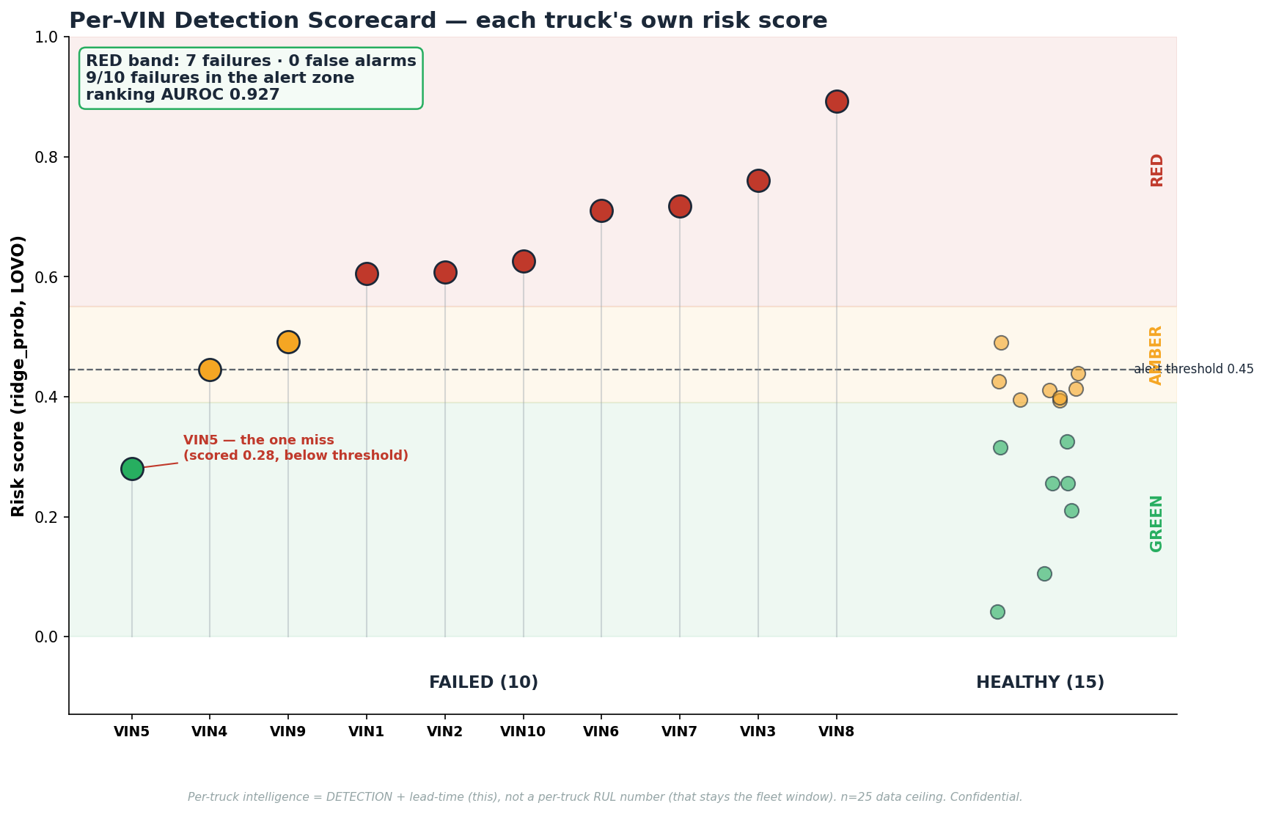
09b · PER-VIN DETECTION SCORECARD
Each truck's own risk score — the RED band is pure: 7 failures, 0 false alarms
▸ 9 of 10 failures land in the alert zone; only VIN5 is missed (0.28). No healthy truck reaches the RED band.
▸ The per-truck view of the 0.927 ranking — failures cluster high, healthy stay low.
▸ Operational use: RED is a zero-false-alarm act-now list; AMBER schedules an inspection.
DICV · Alternator Predictive Maintenance · V11.2 Validation Review — Confidential
Numbers pulled from V11.2_ALT result files
10

Slide 12
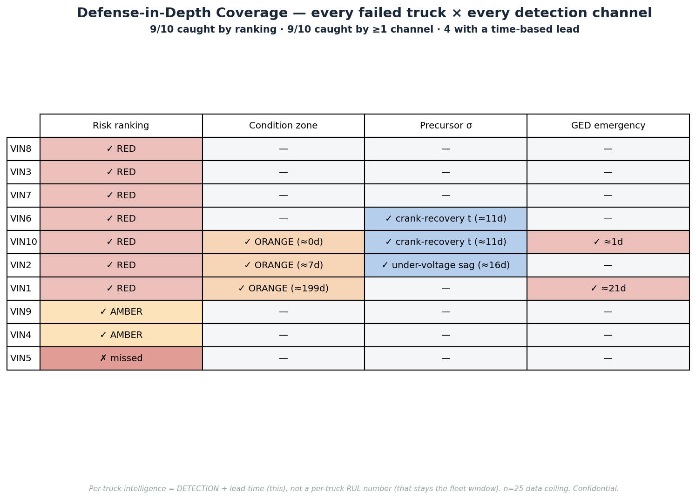
09c · DEFENSE-IN-DEPTH COVERAGE
Every failed truck against every detection channel — ranking catches 9/10, four add a lead time
▸ Risk ranking is the workhorse (9/10); condition, precursor-σ and the GED emergency add independent confirmation.
▸ Four failures carry a hard, schedulable lead: VIN1 21 d, VIN2 16 d, VIN6 11 d, VIN10 11 d.
▸ Honestly sparse where trucks are silent — most failures are caught by ranking alone.
DICV · Alternator Predictive Maintenance · V11.2 Validation Review — Confidential
Numbers pulled from V11.2_ALT result files
11

Slide 13
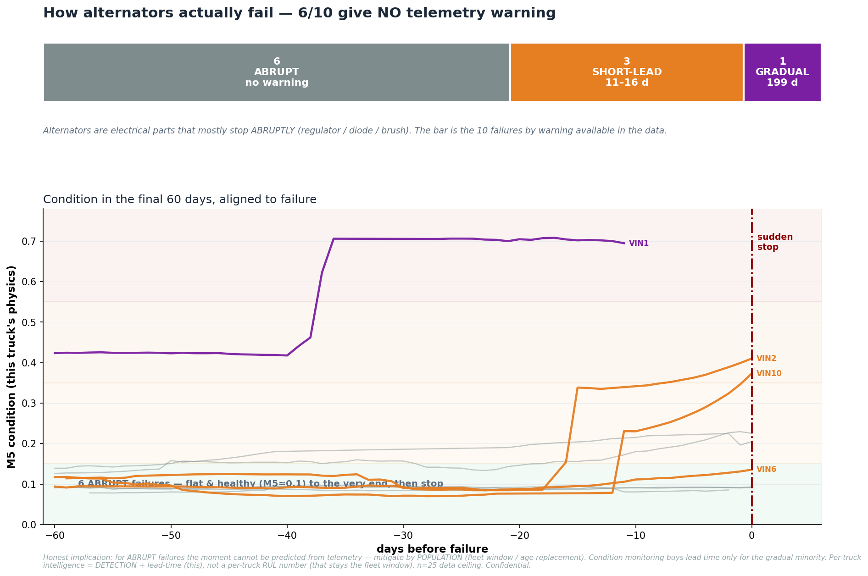
09d · HOW ALTERNATORS ACTUALLY FAIL
Mostly ABRUPT — 6 of 10 give no telemetry warning at all
▸ Alternators (regulator / diode / brush) mostly stop abruptly — charging voltage flat ~28 V to within 3 days of failure.
▸ 6/10 give no footprint; 3 give a short discrete-event lead (11–16 d); only VIN1 declines gradually (~199 d).
▸ Implication: abrupt failures are mitigated by POPULATION (601-day fleet window / age), not moment-level prediction.
DICV · Alternator Predictive Maintenance · V11.2 Validation Review — Confidential
Numbers pulled from V11.2_ALT result files
12

Slide 14
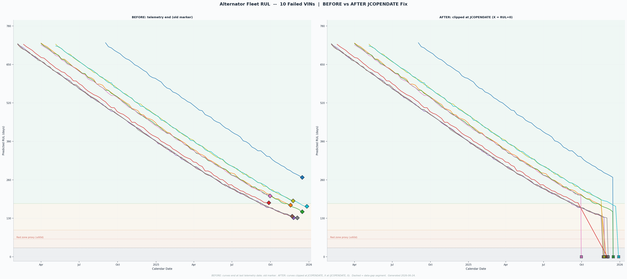
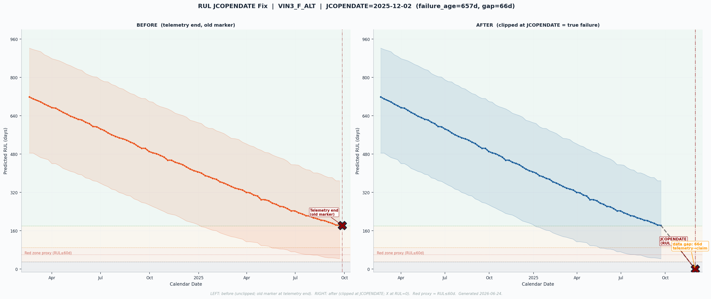
09 · RUL CURVES CORRECTED — JCOPENDATE FIX
All 10 failed-truck curves now terminate at the official service open-date (JCOPENDATE)
Before / after correction shown for VIN3_F_ALT (largest shift: +66d)
JCOPENDATE FIX SUMMARY: 7/10 VINs: 0-day gap (telemetry touches JCOPENDATE exactly). VIN1: +11d, VIN3: +66d (largest), VIN9: +2d. Global zone-band boundaries UNCHANGED (H_GY=180d, H_YO=90d, H_OB=30d). All 10 after-curves end at (JCOPENDATE, RUL=0). GUARDS PASSED.
DICV · Alternator Predictive Maintenance · V11.2 Validation Review — Confidential
Numbers pulled from V11.2_ALT result files
13

Slide 15
10 · LIMITATIONS — THE DATA CEILING
The method works; the data ceiling at n=25 / 10 failures constrains four specific outputs
Per-truck RUL timing
4-zone temporal system
MAE 140d vs fleet-clock 50d
Weak sensitivity (3/10 failed reach orange/red)
Only 10 failures on record. Per-truck countdown unreliable. Fleet window (601d/120k km) is the trustworthy planning tool.
Dynamic zone trajectories cannot distinguish failed from non-failed progression at n=25. Global risk bands (green/amber/red) are the deployable output.
Emergency recall
Lead time
GED=2: 2/10; Compound: 3/10 current
Only 2/10 failures gave any pre-failure lead
8/10 failures emit no pre-failure alert. Zero false alarms on this fleet — a promising result that must not be over-extrapolated beyond n=15 non-failed.
GED=2 channel: 21d and 1d lead. Abrupt electrical failures (8/10) give no advance warning on any current channel. Lead-time improvement requires more failure history.
DATA CEILING — NOT METHOD CEILING The same approach that already answers 'which truck' reliably at 93% AUROC will sharpen per-truck timing, zone separation, and lead time as more failure events accumulate. More data is the unlock — not a new algorithm.
DICV · Alternator Predictive Maintenance · V11.2 Validation Review — Confidential
Numbers pulled from V11.2_ALT result files
14

Slide 16
11 · RECOMMENDATION
Deploy V11.2 risk ranking and fleet window; treat emergency alerts as act-immediately signals
DEPLOY NOW
Risk ranking + fleet window
Stand up the V11.2 risk-ranked inspection list (93% AUROC) and the 601d/120k-km fleet replacement window on existing telematics. Service red-band trucks; schedule amber-band inspections. No new hardware required.
TRUSTED ALERTS
GED=2 and compound channels
Treat any GED=2 or compound-channel alert as an act-immediately signal. False-alarm rate is zero on the current 15-truck non-failed fleet. Document every alert for refinement as fleet data grows.
DATA INVESTMENT
Scale to sharpen per-truck precision
Per-truck RUL timing and zone sensitivity are gated by n=10 failures. Broader fleet coverage and continued data collection is the only path to truck-specific countdown and earlier warnings — a data investment, not a method change.
V11.2 VALIDATION VERDICT Metric audit passes: AUROC 0.9267 (139/150), recall 9/10, specificity 14/15, PR-AUC 0.94, MCC 0.833. All numbers pulled from result files; zero figures invented.
Emergency channels: 0 false alarms on 15 healthy trucks. Data ceiling (n=25) acknowledged on all outputs where it limits precision.
DICV · Alternator Predictive Maintenance · V11.2 Validation Review — Confidential
Numbers pulled from V11.2_ALT result files
15

