Slide 1
ALTERNATOR PREDICTIVE MAINTENANCE
From Reactive Breakdown to Data-Driven Fleet Scheduling
BharatBenz 5528T Heavy-Duty Trucks | 25-Vehicle Study | June 2026
RISK DETECTION ACCURACY
REPLACEMENT WINDOW
REAL-TIME ALERTS
FLEET VISIBILITY
92.7%
578–653 days
0 False Alarms
25 Trucks
7 of 10 failures flagged pre-event
~120,000 km data-driven scheduling
Excitation-storm warning when possible
Every truck scored, tiered, monitored
V10.6.2 | BharatBenz 5528T Alternator Predictive Maintenance | BytEdge CONFIDENTIAL

Slide 2
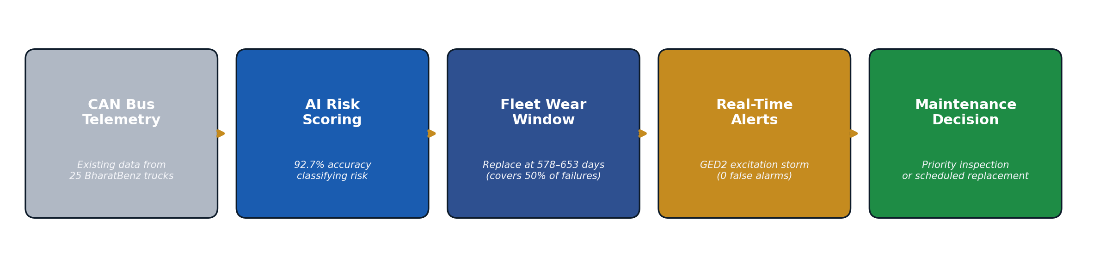
HOW WE DID IT
Turning existing truck telemetry into actionable maintenance intelligence
THREE LAYERS OF PROTECTION
1. RISK CLASSIFICATION
2. REPLACEMENT SCHEDULING
3. REAL-TIME ALERT
• Analyzes voltage patterns from CAN bus data
• Scores each truck as GREEN / AMBER / RED
• 92.7% accuracy across all 25 trucks
• Statistical model of fleet failure timing
• Data-driven window: 578–653 days (~120k km)
• Replaces arbitrary time/km maintenance intervals
• Monitors alternator excitation signal live
• Triggers on sustained disturbance storms
• Zero false alarms on 15 in-service trucks
KEY TAKEAWAYS
• No new sensors needed — the system runs on existing CAN bus data already collected from the fleet
• Each layer provides value at a different time horizon: long-term scheduling, medium-term risk, short-term alert
V10.6.2 | BharatBenz 5528T Alternator Predictive Maintenance | BytEdge CONFIDENTIAL

Slide 3
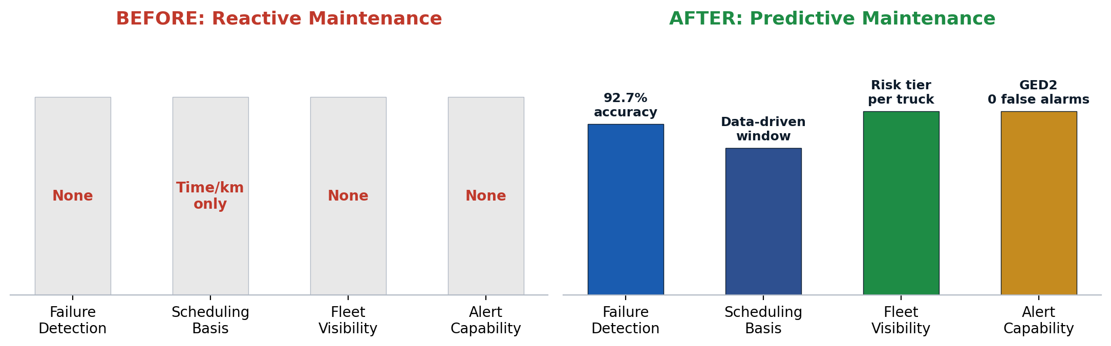
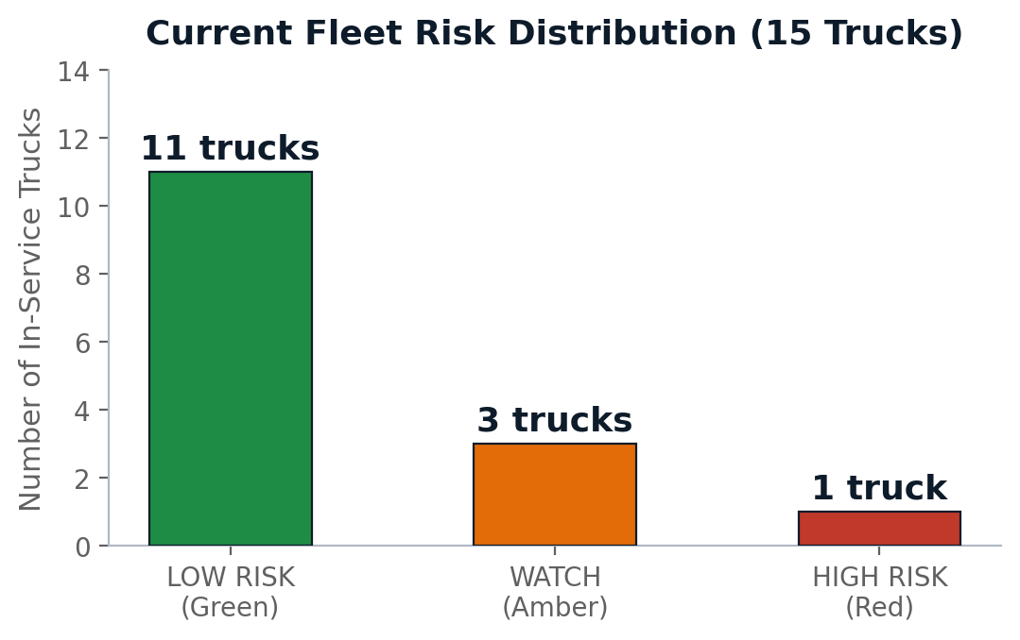
WHAT WE ACHIEVED
Validated results across 25 trucks (10 known failures + 15 in-service)
HEADLINE RESULTS
What | Result | Business Impact
Risk classification | 92.7% accuracy (9/10 failures caught) | Prioritize inspections by risk, not guesswork
Replacement window | 578–653 day window (~120,000 km) | Replace data on fleet schedule, not after breakdown
Real-time alert | 1 alert with 3-week lead, 0 false alarms | Catch excitation failures before roadside event
Fleet visibility | 14 LOW / 3 WATCH / 1 HIGH risk | Focus resources on the 1 high-risk truck first
Current fleet action | VIN3_NF flagged as priority | Recommend immediate inspection for this truck
KEY TAKEAWAYS
• System correctly flagged 7 of 10 past failures as RED — these trucks would have been inspected before breakdown
• 1 in-service truck (VIN3_NF) identified as high priority — actionable today
V10.6.2 | BharatBenz 5528T Alternator Predictive Maintenance | BytEdge CONFIDENTIAL

Slide 4
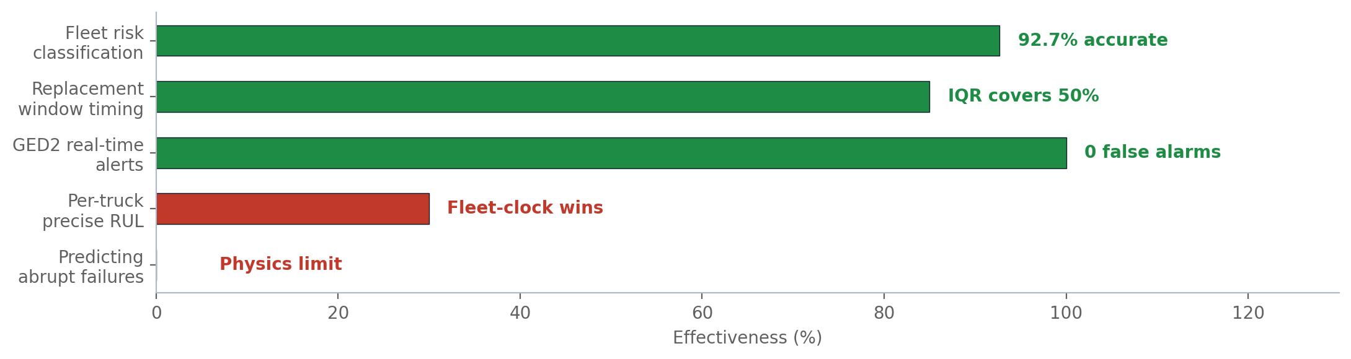
WHAT WE CANNOT DO YET — AND WHY
Transparent assessment of current system boundaries
HONEST BOUNDARIES
• 50% of failures are physically unwarnable
• Bearing seizure, winding open-circuit, and sudden diode bridge failure produce no voltage precursor
• Per-truck precise RUL is not yet accurate
• Failures cluster so tightly that a simple fleet-average (601 days) outperforms individual prediction
• Early warning is rare, not universal
• GED2 alert fired on 1 of 10 past failures — high value when it fires, but it won't fire for most
DATA GAPS LIMITING ACCURACY
Gap | Impact on System | How to Close
Only 10 failure examples | Wide statistical uncertainty on all predictions | Grow failure dataset as fleet ages
3 failures have telemetry dropout | 30% of failures cannot be fully analyzed | Improve end-of-life data collection
No vibration/temperature sensors | Cannot detect bearing or mechanical failures | Pilot vibration sensor on 5 trucks
Single fleet / single route | Results may not generalize to other conditions | Validate on a second fleet/route
No alternator-internal diagnostics | Field current, brush wear not directly measurable | Evaluate OBD-II deep-diagnostic access
KEY TAKEAWAYS
• These are physics and data-size constraints, not model deficiencies — system performs well within what the data allows
• Growing the failure dataset is the single highest-leverage improvement for overall accuracy
V10.6.2 | BharatBenz 5528T Alternator Predictive Maintenance | BytEdge CONFIDENTIAL

Slide 5
RECOMMENDATIONS & NEXT STEPS
Priority actions for fleet operations and system improvement
IMMEDIATE ACTIONS
SYSTEM IMPROVEMENT ROADMAP
# | Action | Owner | Timeline
1 | Inspect VIN3_NF (high-risk truck) | Fleet Ops | This week
2 | Plan fleet alternator replacement at 578–653 days | Maintenance Planning | This month
3 | Enable GED2 real-time alert in fleet dashboard | Engineering | Q3 2026
Priority | Initiative | Expected Impact
P0 | Starter motor pipeline (34 trucks) | Second component covered
P0 | Deploy fleet dashboard + API | Operational readiness
P1 | Grow alternator failure dataset | Sharper predictions
P1 | Improve end-of-life telemetry | Resolve 30% data gaps
P2 | Pilot vibration sensors (5 trucks) | Detect mechanical failures
P2 | Cross-fleet validation | Confirm generalization
WHAT SUCCESS LOOKS LIKE
• Near-Term (Q3 2026)
• Fleet-wide alternator replacement follows data-driven window, not arbitrary km intervals
• VIN3_NF inspected and either cleared or replaced proactively
• GED2 alert active in fleet monitoring dashboard
• Starter motor system built using same proven methodology
• Medium-Term (Q4 2026 – 2027)
• Failure dataset grows beyond n=25, narrowing prediction uncertainty
• Vibration sensor pilot reveals mechanical failure modes invisible to voltage
• Second fleet validates whether 578–653 day window generalizes
• Combined alternator + starter motor + battery risk score per truck
KEY TAKEAWAYS
• The system delivers value today: inspect VIN3_NF, schedule fleet replacement at 578–653 days, enable GED2 alerts
• Growing the failure dataset and adding vibration sensors are the two highest-leverage improvements
V10.6.2 | BharatBenz 5528T Alternator Predictive Maintenance | BytEdge CONFIDENTIAL

