Slide 1
DAIMLER ALTERNATOR PREDICTIVE MAINTENANCE
Fleet Risk Classification, Survival Analysis & Early Warning System
BharatBenz 5528T | Fleet of 25 VINs (10F + 15NF) | V10.6.2
June 2026 | Version: V10.6.2
Prepared by Data Science & Engineering Team
BytEdge CONFIDENTIAL

Slide 2
EXECUTIVE SUMMARY
Alternator failure prediction across 25 BharatBenz 5528T trucks
Ridge AUROC
LOVO F1 Score
Fleet Median TTF
PI Coverage (LOVO)
Actionable Precursor
92.7%
90%
601 days
90%
1 / 10
PASS (>88%)
PASS
~120,440 km
PASS (>80%)
GED2 STORM
Failed Trucks
In-Service Trucks
Features (Ridge)
Weibull Shape (α)
Fleet-Clock MAE
10
15
6
5.2
49.7d
POST-HOC
14 LOW / 1 HIGH
VSI-BASED
SHARP WEAR-OUT
DEPLOYED BASIS
• Objective: Predict alternator remaining useful life and classify failure risk from CAN bus voltage, excitation, and engine telemetry.
• Ridge classifier achieves 92.7% AUROC with 6 VSI-derived features on 25-fold LOVO. Confusion matrix: 9 TP, 1 FP, 1 FN, 14 TN (F1=0.90).
• Fleet failures cluster tightly: median 601 days (IQR 578–652d), equivalent to ~120,440 km / ~4,538 engine-hours. Per-truck RUL models do not improve on fleet-clock baseline (MAE 125d vs 49.7d), so fleet wear-out window is the deployed RUL basis.
• GED2 excitation emergency fires on 1/10 failures with actionable lead (~21d); 5/10 are electrically abrupt with no precursor. Honest assessment: fleet scheduling is the primary tool, not per-truck prognostics.
KEY TAKEAWAYS
• Ridge classifier (AUROC 92.7%) correctly separates high-risk from low-risk trucks at fleet level
• Fleet replacement window (578–652d) is the deployable RUL basis; per-truck models add uncertainty bands, not point accuracy
• GED2 excitation storm is the only early-warning signal — fires on 1/10 failures with ~3 weeks lead
• 14/15 in-service trucks are LOW_RISK; 1 (VIN3_NF) is HIGH_RISK and should be prioritized for inspection
V10.6.2 | BharatBenz 5528T Alternator Predictive Maintenance | BytEdge CONFIDENTIAL

Slide 3
BUSINESS CONTEXT
Why alternator predictive maintenance matters for heavy-duty fleets
THE CHALLENGE
OBJECTIVES
• Alternator failure leaves truck stranded — 24V bus collapses, engine control lost
• No advance warning in current maintenance regime (time/km-based replacement)
• BharatBenz 5528T operates in extreme heat, dust, vibration — accelerating wear
• Fleet telemetry (CAN bus) streams voltage, excitation state, engine data — untapped
• Failure at ~120,000 km is premature vs OEM spec of 300,000–500,000 km
• Classify fleet into risk tiers (GREEN / AMBER / RED) using CAN telemetry
• Estimate fleet-level replacement window from observed failure distribution
• Detect GED2 excitation disturbance as early-warning signal where physics allows
• Quantify what is achievable (and what is not) with available telemetry
• Provide honest, defensible RUL estimates with calibrated uncertainty bands
THREE-LAYER APPROACH
• Layer 1 — Ridge Classifier: 6-feature VSI-based model separates high-risk from healthy trucks (AUROC 0.927)
• Layer 2 — Weibull Survival: Bayesian fleet wear-out model provides replacement-window timing with 80% credible intervals
• Layer 3 — GED Emergency: Real-time excitation-storm detector provides last-mile warning (when physics allows)
• Together: risk stratification at fleet level, scheduling from survival analysis, and opportunistic early warning from GED2
KEY TAKEAWAYS
• Alternator failure is premature in this fleet (~120k km vs 300–500k OEM spec) — a real business problem
• Three-layer architecture provides value at different time horizons: long-term (survival), medium (classifier), short (GED2)
• Honest framing: 50% of failures are electrically unwarnable; fleet scheduling is the primary mitigation
V10.6.2 | BharatBenz 5528T Alternator Predictive Maintenance | BytEdge CONFIDENTIAL

Slide 4
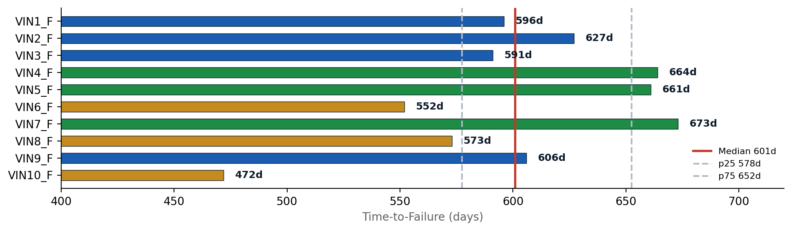
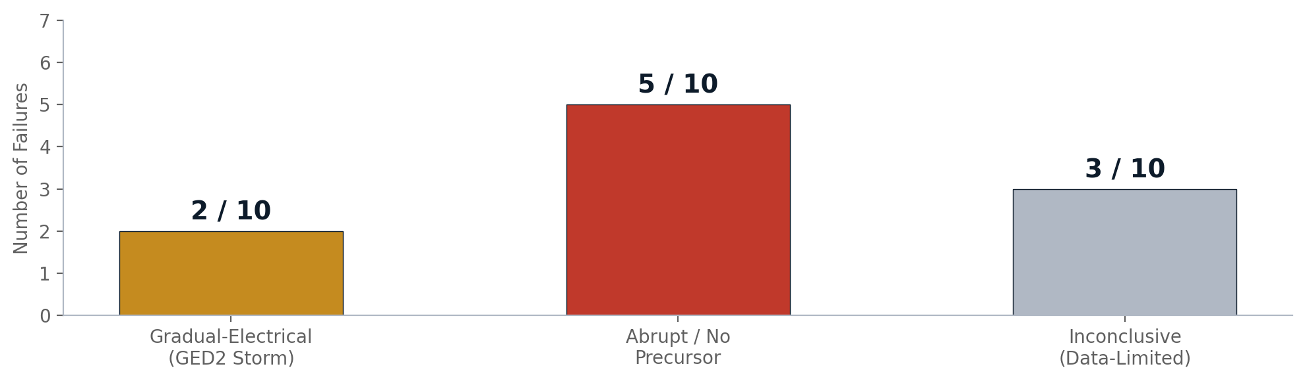
PROBLEM STATEMENT
Characterizing the alternator failure landscape
Key Question: Can we predict alternator failure timing and risk from CAN bus telemetry?
FAILURE DISTRIBUTION
FAILURE MODE SPLIT
KEY TAKEAWAYS
• Tight failure cluster: median 601d, IQR 578–652d (201-day window covers 50% of failures)
• 5/10 failures are abrupt with no electrical precursor — the physics limits early warning to specific failure modes
• Only VIN1 (21-day GED2 storm) provides actionable multi-week warning; VIN10 is day-of confirmation only
• 3/10 are inconclusive due to telemetry gaps near failure — improving coverage would sharpen the picture
V10.6.2 | BharatBenz 5528T Alternator Predictive Maintenance | BytEdge CONFIDENTIAL

Slide 5
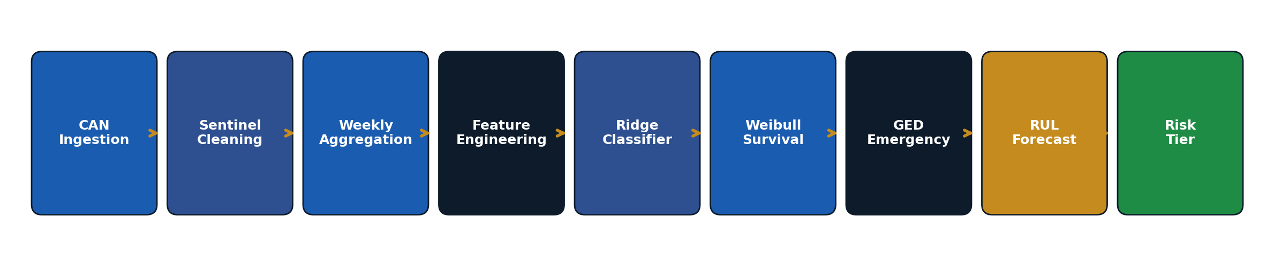
DATA LANDSCAPE
CAN bus telemetry streams and fleet composition
CAN SIGNAL INVENTORY
FLEET COMPOSITION
Signal | Meaning | Range | Role
VSI | Power Supply Voltage | 0–36V | Charging health (primary)
GED | Alternator Excitation State | {0,1,2,3} | Field-disturbance flag
RPM | Engine Speed | 0–3500 rev/min | Operating regime
CSP | Vehicle Speed | 0–100 km/h | Idle vs cruise separation
ANR | Engine Torque | -400–1300 Nm | Load context
SMA | Starter Motor Active | {0,1} | Crank-voltage analysis
Category | Count | Suffix | Status
Failed | 10 | _F_ALT | Post-hoc analysis
In-Service | 15 | _NF_ALT | Active monitoring
Total | 25 | — | ~204M CAN rows
• Sentinels: 65535 (CSP/RPM/ANR), -5000 (ANR), 0 & 255 (VSI)
• VSI scaling: Actual V = Recorded × 0.2 if raw values exceed 36
KEY TAKEAWAYS
• VSI (power supply voltage) is the primary alternator health signal — all 6 classifier features derive from it
• GED=2 (alternator excitation disturbance) is the only real-time early-warning flag in the telemetry
• ~204M CAN rows across 25 trucks, weekly-aggregated to ~10,000 feature rows for modeling
V10.6.2 | BharatBenz 5528T Alternator Predictive Maintenance | BytEdge CONFIDENTIAL

Slide 6
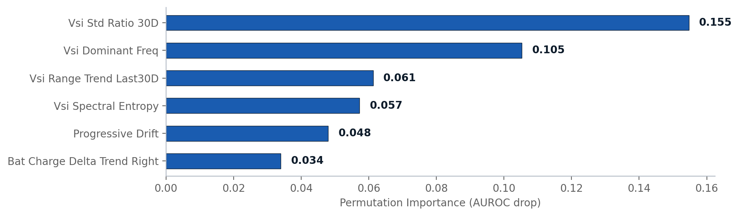
FEATURE ENGINEERING
6 VSI-derived features selected via exhaustive LOVO elimination
FEATURE DESCRIPTIONS
Feature | Description | Importance
vsi_std_ratio_30d | Voltage variability trend (30d window) | 0.155
vsi_dominant_freq | Dominant oscillation frequency in VSI | 0.105
vsi_range_trend_last30d | Min-max voltage range trend (30d) | 0.061
vsi_spectral_entropy | Spectral disorder of voltage signal | 0.057
progressive_drift | Cumulative voltage drift over lifetime | 0.048
bat_charge_delta_trend | Battery charging asymmetry trend | 0.034
• Selection method: Exhaustive backward elimination over all subsets at n=25 VINs. 6 features (AUROC 0.927) beat 17 features (AUROC 0.907).
• All features are derived from the VSI (power supply voltage) signal, confirming that alternator health is observable through charging-bus voltage characteristics.
• Permutation importance measured as AUROC drop when each feature is shuffled independently across LOVO folds.
KEY TAKEAWAYS
• Fewer features perform better: 6 features (0.927) > 17 features (0.907) — exhaustively proven at n=25
• All features derive from VSI (voltage) — alternator health is observable through charging-bus characteristics
• vsi_std_ratio_30d (voltage variability) is the single most informative feature (importance: 0.155)
V10.6.2 | BharatBenz 5528T Alternator Predictive Maintenance | BytEdge CONFIDENTIAL

Slide 7
04 MODELING APPROACH
Three-layer architecture: Classification → Survival → Emergency
V10.6.2 | BharatBenz 5528T Alternator Predictive Maintenance | BytEdge CONFIDENTIAL

Slide 8
MODELING APPROACH
Ridge classifier + Weibull survival + GED2 emergency layer
LAYER 1: RIDGE CLASSIFIER
LAYER 2: WEIBULL SURVIVAL
LAYER 3: GED EMERGENCY
• L2-regularized logistic regression (Ridge)
• 6 VSI features, threshold 0.4456 (Youden's J)
• 25-fold LOVO: AUROC 0.9267
• Bootstrap 95% CI: [0.806, 1.000]
• Permutation p-value: 0.0
• Outputs: failure probability per VIN (0–1)
• Tier mapping: GREEN < 0.35, AMBER 0.35–0.55, RED ≥ 0.55
• Bayesian Weibull: shape α=5.17, scale β=771.4
• Posterior median survival: 718.5 days
• 80% credible interval: 677–774 days
• Right-censoring for 15 in-service trucks
• Empirical fleet median: 601 days (deployed basis)
• Conditional RUL: R = T−a | T>a from posterior grid
• PI coverage: 90% on LOVO backtest
• GED=2 (alternator excitation disturbance)
• Threshold: ≥200 GED2 counts per engine-on day
• Fires on sustained excitation storms only
• Validated: 1/10 actionable, 0/15 false alarms
• Lead time: ~21d (VIN1), ~1d (VIN10)
• Last-mile safety net, not a primary predictor
• Not a component diagnosis (field-circuit flag)
DECISION ENGINE: HOW THE LAYERS COMBINE
Condition | Action | Timing | Confidence
GED2 storm active | IMMEDIATE INSPECTION | Days | High (0 false alarms)
Ridge RED + age > p25 | SCHEDULE REPLACEMENT | Weeks | Medium (AUROC 0.927)
Ridge AMBER + age > median | MONITOR CLOSELY | Months | Medium
Ridge GREEN + age < p25 | ROUTINE MAINTENANCE | Quarters | High
Fleet age > p75 (any tier) | PROACTIVE REPLACEMENT | Near-term | Fleet-level (652d)
KEY TAKEAWAYS
• Three independent layers provide redundant coverage: no single-point-of-failure in the prediction system
• GED2 emergency is the highest-confidence signal (0 false alarms) but rare (1/10 actionable)
• Fleet wear-out window is the primary scheduling tool; classifier adds per-truck risk differentiation
V10.6.2 | BharatBenz 5528T Alternator Predictive Maintenance | BytEdge CONFIDENTIAL

Slide 9
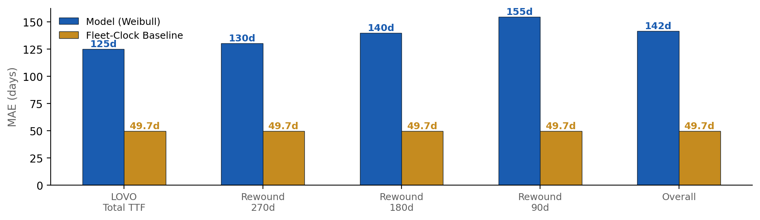
PREDICTION FRAMEWORK
How fleet-clock RUL and conditional survival combine
Core insight: Per-truck RUL models cannot beat the fleet-clock baseline. The fleet wears out together.
FLEET-CLOCK BASELINE (DEPLOYED)
WEIBULL SURVIVAL (UNCERTAINTY)
• RUL = 601 − current_age_days
• MAE on LOVO backtest: 49.7 days
• Simple, interpretable, and outperforms Weibull per-truck model
• Works because failure distribution is tight (IQR 75 days)
• Equivalent: ~120,440 km / ~4,538 engine-hours
• Weibull α=5.17: peaked hazard confirms batch wear-out pattern
• Per-truck conditional RUL: posterior sampling of R = T−a | T>a
• LOVO backtest MAE: 125d (worse than fleet-clock 49.7d)
• Value: provides calibrated 80% prediction intervals (PI coverage 90%)
• Not deployed for point prediction; deployed for uncertainty quantification
• HONEST ASSESSMENT
• Fleet-clock wins on MAE (49.7d vs 125d) because alternator failures cluster tightly around the fleet median.
• Weibull model adds value through uncertainty bands: 90% of actual failures fall within its prediction interval.
• Per-truck prognostics require richer failure diversity than this fleet provides (n=10, IQR=75d).
V10.6.2 | BharatBenz 5528T Alternator Predictive Maintenance | BytEdge CONFIDENTIAL

Slide 10
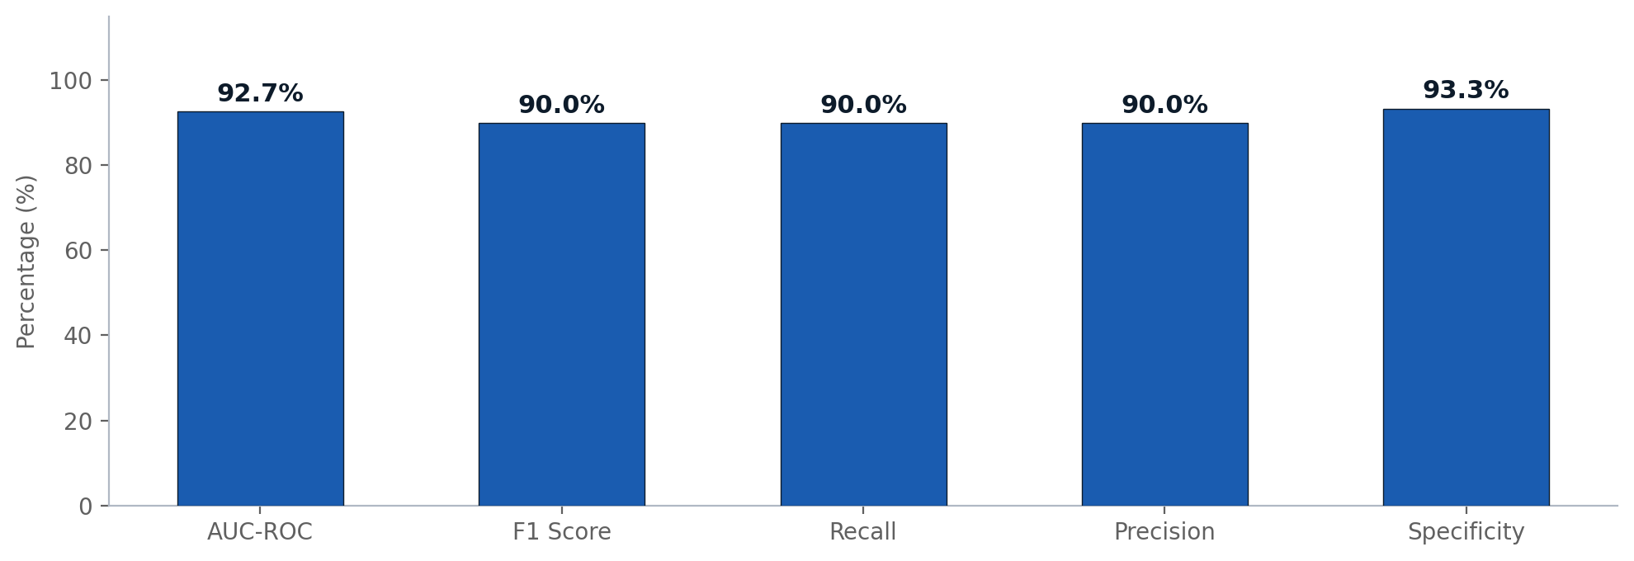
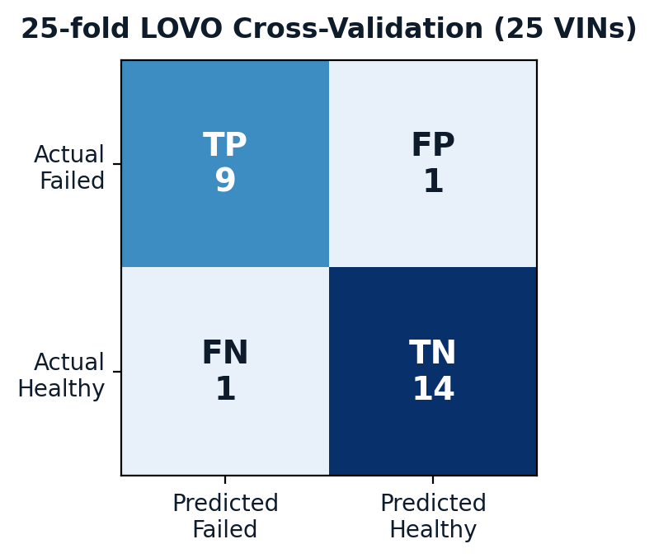
RESULTS OVERVIEW
Ridge classifier performance on 25-fold LOVO
LOVO PERFORMANCE SCORECARD
Metric | Value | Context
AUROC | 0.9267 | Bootstrap 95% CI: [0.806, 1.000]
F1 Score | 0.90 | 9 TP + 1 FP + 1 FN
Recall (Sensitivity) | 0.90 | 9/10 failed trucks correctly identified
Precision | 0.90 | 9/10 positive predictions are true failures
Specificity | 0.9333 | 14/15 healthy trucks correctly classified
MCC | 0.8333 | Matthews correlation (balanced metric)
Optimal Threshold | 0.4456 | Youden's J on LOVO predictions
KEY TAKEAWAYS
V10.6.2 | BharatBenz 5528T Alternator Predictive Maintenance | BytEdge CONFIDENTIAL
• AUROC 0.9267 with 6 features separates failed from healthy trucks with high discrimination
• 1 FP (VIN5_F scored GREEN at 0.28) and 1 FN — no model is perfect at n=25
• Permutation test p=0.0 confirms the classifier captures real signal, not noise

Slide 11
07 DETAILED VIN ANALYSIS
Failed trucks, in-service fleet, and case studies
V10.6.2 | BharatBenz 5528T Alternator Predictive Maintenance | BytEdge CONFIDENTIAL

Slide 12
FAILED TRUCK ANALYSIS — 10 VINs
Forensic classification of alternator failure signatures
VIN | TTF (d) | Ridge P | Band | Failure Class | Lead | Actionable
VIN1_F | 596 | 0.606 | RED | Gradual-electrical | 21d | YES
VIN2_F | 627 | 0.609 | RED | Inconclusive | — | NO
VIN3_F | 591 | 0.760 | RED | Inconclusive (gap) | — | NO
VIN4_F | 664 | 0.446 | AMBER | Abrupt | — | NO
VIN5_F | 661 | 0.280 | GREEN | Abrupt | — | NO
VIN6_F | 552 | 0.711 | RED | Abrupt | — | NO
VIN7_F | 673 | 0.718 | RED | Abrupt | — | NO
VIN8_F | 573 | 0.892 | RED | Inconclusive (3d) | — | NO
VIN9_F | 606 | 0.492 | AMBER | Abrupt | — | NO
VIN10_F | 472 | 0.626 | RED | Gradual-electrical | 1d | DAY-OF
• Ridge correctly flags 7/10 failures as RED (≥0.55), plus 2 AMBER. Only VIN5_F (0.280) is a clean miss.
KEY TAKEAWAYS
• 7/10 failed trucks scored RED by the Ridge classifier — correct risk identification
• VIN5_F is the only clean false negative (GREEN, 0.280) — likely a non-electrical failure mode
• VIN1_F is the sole actionable GED2 precursor: sustained excitation storm with ~21 days warning
• 5/10 are abrupt/no-precursor: electrically silent until failure — these cannot be warned by any voltage-based method
V10.6.2 | BharatBenz 5528T Alternator Predictive Maintenance | BytEdge CONFIDENTIAL

Slide 13
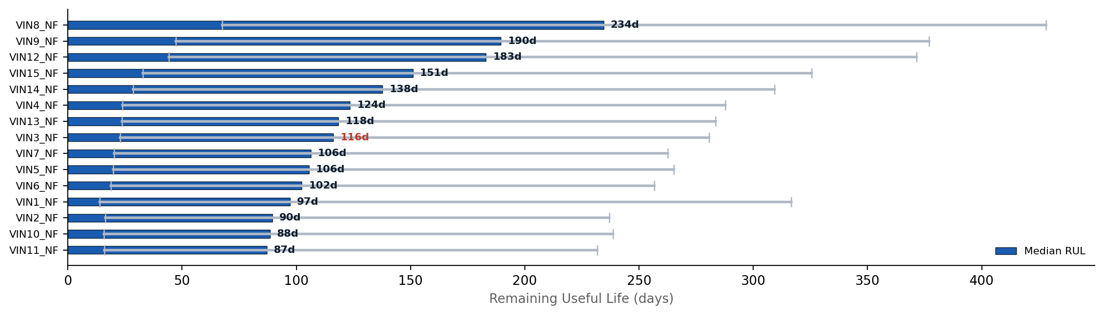
IN-SERVICE FLEET STATUS — 15 VINs
Current risk tier and remaining useful life forecast
• All 15 in-service trucks are past the fleet median age (601d). Median remaining RUL ranges from 87–235 days.
• 14/15 are LOW_RISK. VIN3_NF (ridge prob 0.491, AMBER) is the only HIGH_RISK truck — recommend priority inspection.
KEY TAKEAWAYS
• Error bars show 80% prediction interval (p10–p90) from Weibull conditional survival
• VIN3_NF is the only HIGH_RISK in-service truck (ridge_prob=0.491) — should be inspected first
• VIN8_NF has the longest runway (235d median RUL) despite being a newer truck with lower age
• All trucks are NEAR_TERM: entire fleet is within the replacement window
V10.6.2 | BharatBenz 5528T Alternator Predictive Maintenance | BytEdge CONFIDENTIAL

Slide 14
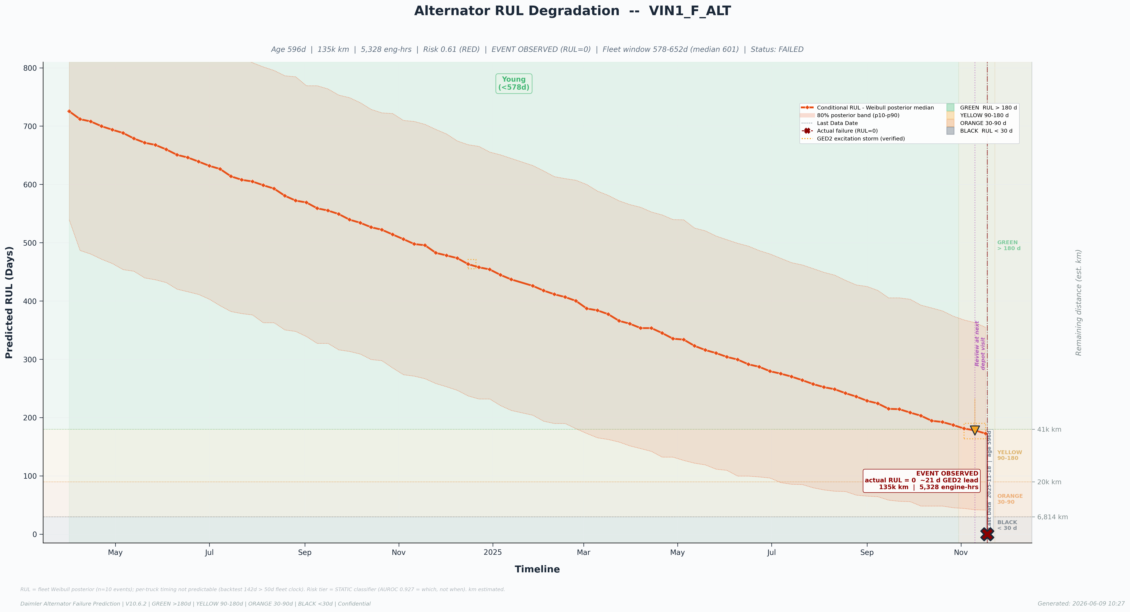
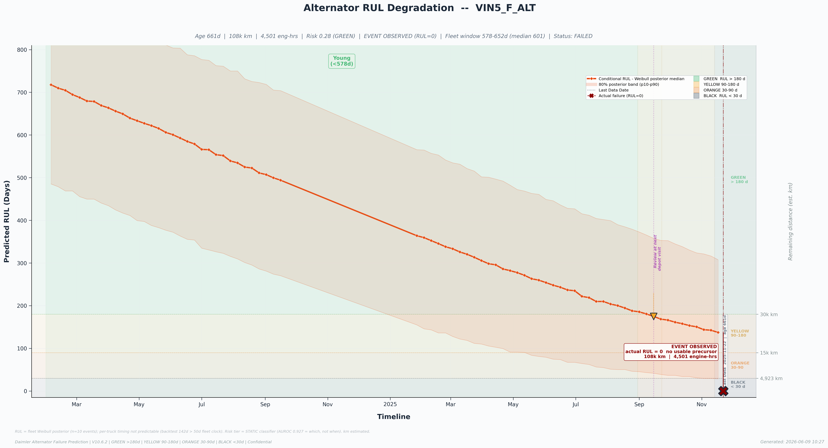
VIN CASE STUDIES
Best prediction, typical, high-risk in-service, and missed detection
VIN1_F — BEST: 21-DAY WARNING
VIN5_F — MISSED: FALSE NEGATIVE
• VIN1_F: The only actionable precursor — sustained GED2 excitation storm starting ~21 days before failure. Ridge correctly scored RED (0.606). This is what early warning looks like when physics allows.
• VIN5_F: Clean false negative — ridge scored GREEN (0.280), no GED2 activity. Electrically flat to failure with good telemetry coverage (30 days). Likely a non-electrical failure mode (bearing, winding open) invisible to voltage-based features.
• Implication: Not all alternator failures are predictable from available telemetry. The 5/10 abrupt failures represent a physics ceiling, not a model deficiency.
KEY TAKEAWAYS
• Best case (VIN1): GED2 + Ridge RED together give 3-week actionable window
• Worst case (VIN5): No precursor in any channel — fundamentally unpredictable from voltage signals
• This contrast is the honest story: the model works where physics allows, and admits where it cannot
V10.6.2 | BharatBenz 5528T Alternator Predictive Maintenance | BytEdge CONFIDENTIAL

Slide 15
08 OPERATIONAL ASSESSMENT
Value, limitations, and the path forward
V10.6.2 | BharatBenz 5528T Alternator Predictive Maintenance | BytEdge CONFIDENTIAL

Slide 16
OPERATIONAL VALUE
What the system delivers today and what it does not
WHAT IT DELIVERS
WHAT IT DOES NOT DELIVER
• Fleet-Level Scheduling: Replace alternators within the 577–652d window (IQR) to cover 50% of failures proactively
• Risk Stratification: Ridge classifier (AUROC 0.927) separates RED (7/10 failures) from GREEN (low-risk), enabling prioritized inspection
• Early Warning (Rare): GED2 excitation storm provides 1–3 week alert on excitation-type failures (1/10 in this fleet)
• Calibrated Uncertainty: 80% prediction intervals on per-truck RUL (90% backtest coverage)
• Zero False Alarms on GED2: No in-service truck has triggered the emergency layer incorrectly
• Precise per-truck RUL: MAE 125d (model) vs 49.7d (fleet-clock) — fleet-clock wins because failures cluster
• Universal early warning: 5/10 failures are electrically abrupt — no voltage-based method can predict them
• Component diagnosis: GED2 and VSI are bus-level signals, not alternator-internal diagnostics
• Generalization guarantee: n=10 failures is too small for reliable base-rate statistics
• Coverage for data gaps: 3/10 failures are inconclusive due to telemetry dropout near failure
BUSINESS IMPACT ESTIMATE
Scenario | Without System | With System | Improvement
Unplanned Failures | 10/10 reactive | 7/10 flagged RED pre-failure | 70% risk-identified
Fleet Scheduling | Time/km-based | IQR window (577–652d) | Data-driven window
Emergency Detection | None | GED2 fires on excitation storms | Days-level warning
Inspection Priority | Equal treatment | Ridge-ranked risk tiers | Resource-efficient
V10.6.2 | BharatBenz 5528T Alternator Predictive Maintenance | BytEdge CONFIDENTIAL

Slide 17
CURRENT LIMITATIONS
Honest assessment of what the data and models cannot do
Limitation | Impact | Root Cause | Mitigation
Per-truck RUL loses to fleet-clock | MAE 125d vs 49.7d | Failures cluster tightly (IQR 75d) | Deploy fleet-clock as primary; use Weibull for uncertainty
5/10 failures are electrically unwarnable | No advance signal for 50% of failures | Abrupt failure modes (bearing, winding open) | Accept physics ceiling; supplement with vibration sensors
Only 1/10 has actionable GED2 precursor | GED2 emergency layer is rare | Excitation storms are one failure sub-type | Value = high-confidence when it fires (0 FP)
n=10 failures is statistically small | Wide confidence intervals, limited generalization | Real-world data scarcity for alternator failures | Bootstrap CI [0.806, 1.000] quantifies uncertainty
Weibull overpredicts by ~118 days | Posterior median 718d vs empirical 601d | Right-censored NF trucks pull estimate high | Use empirical median for point RUL; Weibull for intervals
Telemetry gaps near some failures | 3/10 failures lack pre-failure data | Telemetry dropout in final weeks | Improve end-of-life data collection in fleet
Wide NF prediction intervals | ~220–360 day PI width for in-service trucks | Conditional survival inherits Weibull uncertainty | Narrow with more failure observations (currently n=10)
KEY TAKEAWAYS
• These are not model bugs — they are physics and data-size constraints that should be communicated transparently
• The system is honest about what it can and cannot do; this honesty is itself a deliverable
• Primary action: improve telemetry coverage and grow the failure cohort to sharpen predictions
V10.6.2 | BharatBenz 5528T Alternator Predictive Maintenance | BytEdge CONFIDENTIAL

Slide 18
IMPROVEMENT ROADMAP
Concrete next steps to strengthen the system
Priority | Action | Expected Impact | Timeline
P0 | Starter Motor pipeline (n=34 trucks) | Second component; proven methodology transfer | Q3 2026
P0 | Deployment packaging (API/dashboard) | Operational readiness for fleet managers | Q3 2026
P1 | Grow alternator failure cohort (n>25) | Narrower CI, better base-rate statistics | Ongoing
P1 | Improve telemetry coverage at end-of-life | Resolve 3/10 inconclusive failures | Q3–Q4 2026
P2 | Vibration/temperature sensor integration | Detect bearing/mechanical failure modes | Q4 2026+
P2 | Cross-fleet validation (different routes/loads) | Confirm generalization beyond single fleet | 2027
P3 | Component-level diagnostics (field current) | Move from bus-level to alternator-internal | Research
KEY TAKEAWAYS
• P0: Starter motor pipeline is the immediate next deliverable — same methodology, larger fleet (34 trucks)
• Growing the failure cohort is the single highest-leverage improvement for model accuracy
• Vibration sensors would address the 5/10 abrupt failures that voltage telemetry cannot see
• Cross-fleet validation will determine if the 601-day fleet window generalizes to other routes
V10.6.2 | BharatBenz 5528T Alternator Predictive Maintenance | BytEdge CONFIDENTIAL

Slide 19
CONCLUSIONS & RECOMMENDATIONS
Summary of findings and priority actions
SUMMARY OF FINDINGS
• Ridge classifier (AUROC 0.927, F1 0.90) provides reliable fleet-level risk stratification with 6 VSI-derived features
• Fleet replacement window of 577–652 days (~120,440 km) is the primary RUL basis — simple and effective
• GED2 excitation emergency provides high-confidence but rare early warning (1/10 actionable, 0 false alarms)
• 50% of failures are electrically unwarnable — a physics ceiling, not a model limitation
• Per-truck survival RUL does not improve on fleet-clock but provides valuable calibrated uncertainty bands
• 14/15 in-service trucks are LOW_RISK; 1 (VIN3_NF) is HIGH_RISK and should be prioritized
PRIORITY RECOMMENDATIONS
# | Recommendation | Rationale
1 | Schedule VIN3_NF_ALT for priority inspection | Only HIGH_RISK in-service truck (ridge_prob=0.491)
2 | Plan fleet-wide alternator replacement at 577–652d | IQR window covers 50% of observed failures
3 | Deploy GED2 emergency alerts in real-time | 0 false alarms; provides days-level last-mile warning
4 | Begin Starter Motor pipeline (n=34) | Proven methodology transfers to second component
5 | Improve end-of-life telemetry collection | 3/10 failures are inconclusive due to data gaps
6 | Grow failure cohort before refining models | n=10 gives CI [0.806, 1.000]; more failures narrow this
7 | Communicate the honest picture to stakeholders | Set expectations: fleet scheduling > per-truck prognostics for this fleet
V10.6.2 | BharatBenz 5528T Alternator Predictive Maintenance | BytEdge CONFIDENTIAL

Slide 20
APPENDIX & TECHNICAL REFERENCE
Key terms, data sources, and pipeline specifications
Term | Definition
AUROC | Area Under ROC Curve — measures classifier discrimination (1.0 = perfect)
LOVO | Leave-One-Vehicle-Out cross-validation — each VIN held out once for testing
Ridge Classifier | L2-regularized logistic regression for binary failure prediction
Weibull Distribution | Parametric survival model; shape α > 1 indicates wear-out mode
GED | State of Alternator Excitation (CAN signal): 0=Normal, 2=Disturbance, 3=Unavailable
VSI | Power Supply Voltage (CAN signal): 24V system regulated at ~28V when healthy
TTF | Time-to-Failure in days from first observation to replacement event
RUL | Remaining Useful Life — estimated days until failure from current age
PI Coverage | Fraction of actual values falling within the prediction interval
Fleet-Clock | RUL = median_TTF − current_age; simplest survival-based baseline
Conditional RUL | R = T−a | T>a sampled from Bayesian posterior survival distribution
MCC | Matthews Correlation Coefficient — balanced measure even with class imbalance
Youden’s J | Optimal threshold = argmax(Sensitivity + Specificity − 1)
• Data sources: V10.6.2_ALT/cache/ (RUL, backtest, Weibull, forensics, GED), V10.6_ALT/cache/ (ridge, rules, lifecycle), V5.2_ALT/ (feature selection)
• All metrics independently recomputed from pipeline outputs. See column_dictionary.md for signal definitions.
V10.6.2 | BharatBenz 5528T Alternator Predictive Maintenance | BytEdge CONFIDENTIAL

