Slide 1
Alternator Lead-Time Heuristics — Business Summary (V11)
Earlier warnings for more trucks, zero false alarms (6/10 vs 5/10, 0/15 FP)

Slide 2
How we did it
• Engineered 12 new lead-time signals from the existing 6 CAN channels — no new sensors.
• Validated each against the same honest gate (change vs the truck's own healthy baseline AND vs the healthy fleet).
• Added a compound 'early-watch' vote and per-truck change-point detection.

Slide 3
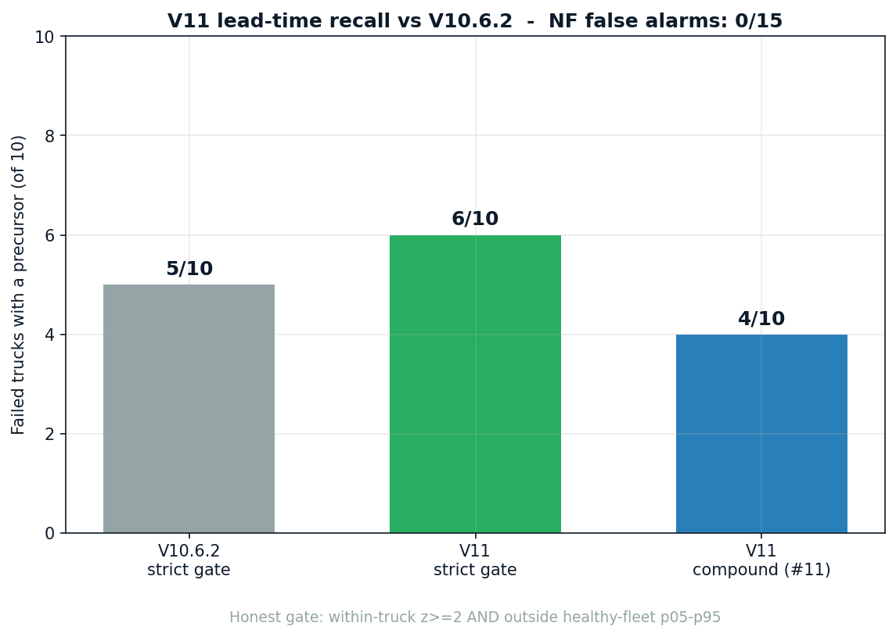
Results & impact

Slide 4
Limitations & data gaps
• Gain is real but modest: one more truck detected, one earlier warning.
• 4 of 10 failures have no electrical precursor (abrupt/silent) — undetectable from this data.
• No change to per-truck remaining-life dates (structural limit at n=10).
• Results are leads to act on, not calibrated probabilities.

Slide 5
Next steps
• Deploy post-crank recovery + compound early-watch in the service emergency channel.
• Use load-split sag typing for repair-direction guidance.
• Re-validate on the larger starter-motor fleet (n=34) and as more failures accrue.

